Slide 1
Microplastics
WHOI
Science

Slide 2
Microplastics – What does it mean to the rest of us?
Concerned
citizens
K-12 Students
WHOI Scientists
Coastal
residents
Sailors/
boaters
A lot of intersections = a lot of opportunities for ENGAGEMENT
… education, outreach, citizen science …

Slide 3
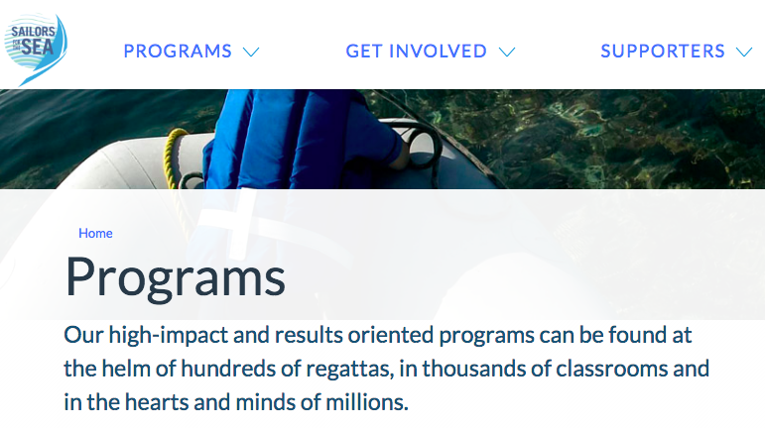
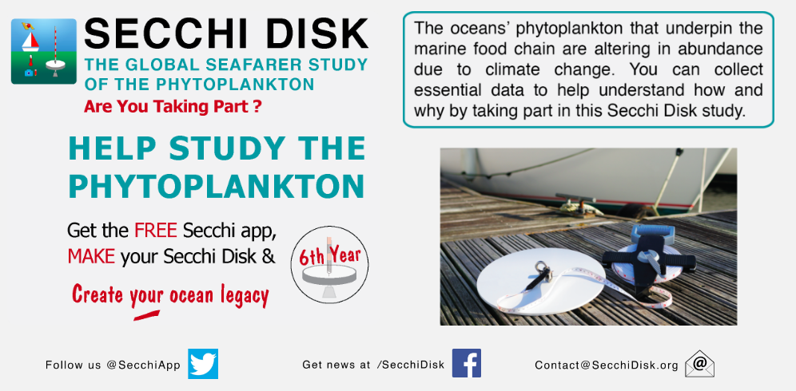
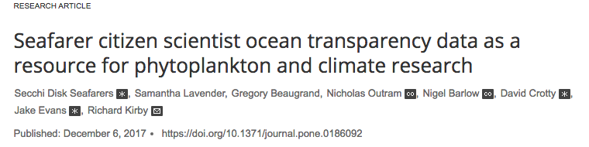
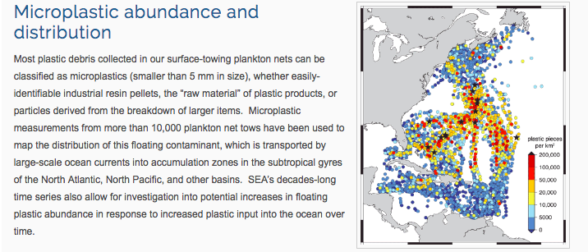
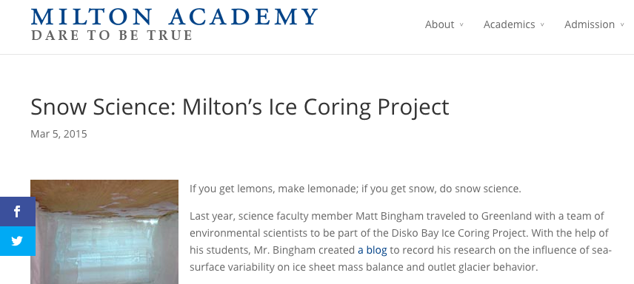
Examples
Citizen science = research?
Sailors for the Sea Boston based org
PLoS ONE
(2017)
SEA Microplastics research
Connection with school science programs
Sampling, analyses and experiments
Development of instrumentation, sampling plans and
observational survey sites/routes for recreational boaters

