Slide 1
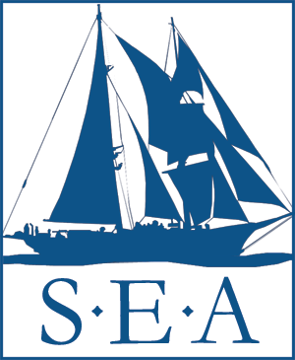
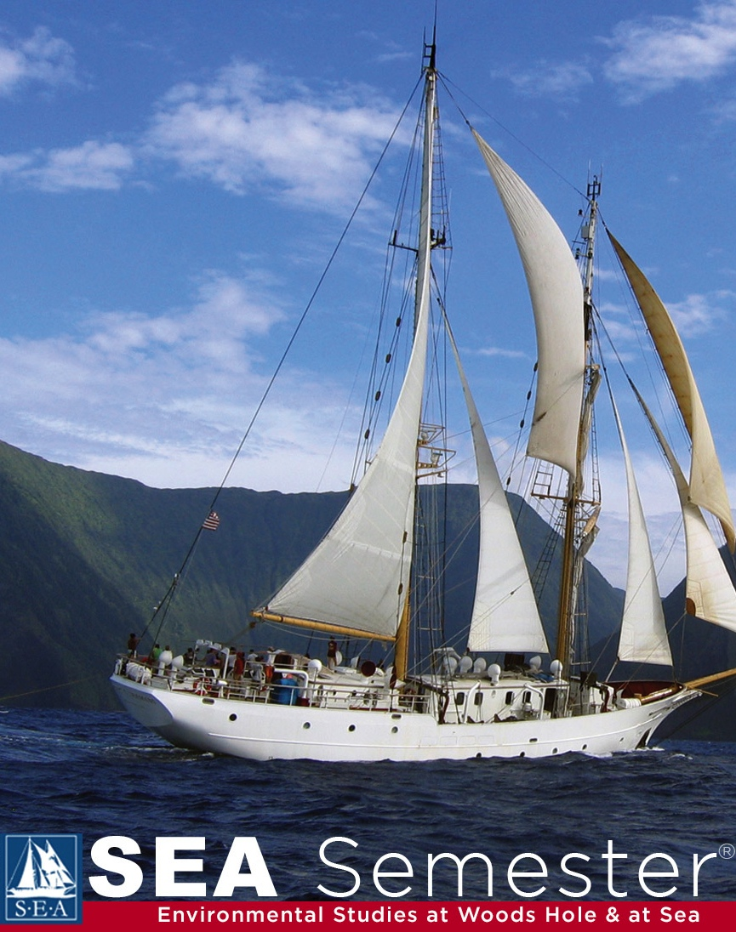
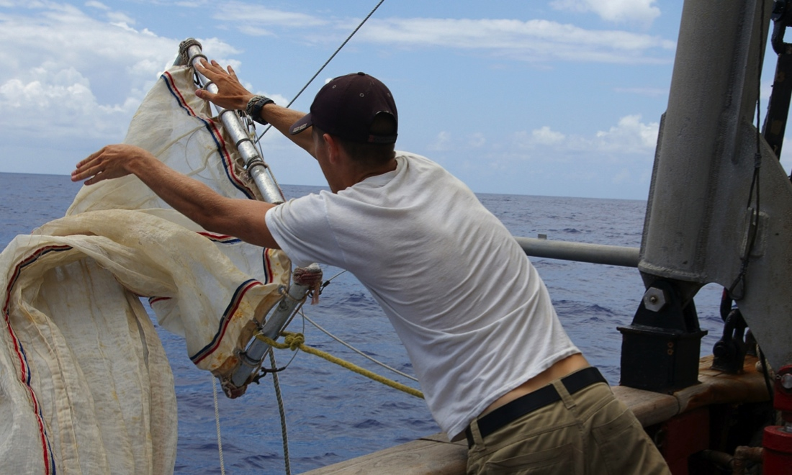
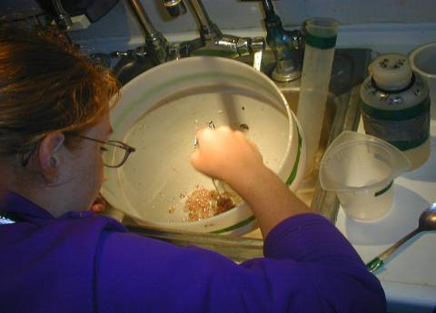
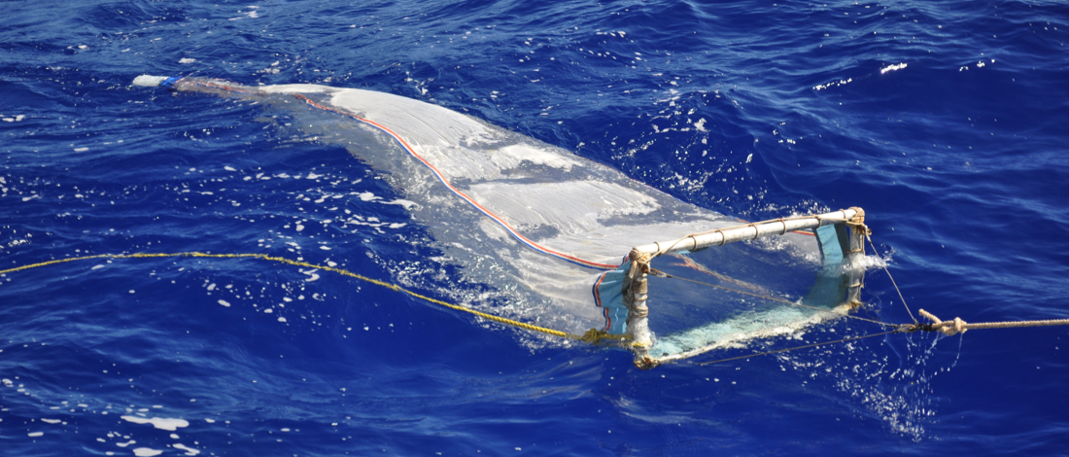
Measuring plastics at the sea surface
www.sea.edu
Notes:
As I mentioned earlier, the first scientific report of microplastics floating in the ocean was published in the early 1970s.
The longest and most extensive data set on floating plastic debris in the open ocean has been collected by students and faculty scientists at Sea Education Association (or SEA).
At SEA, we are the only organization in the U.S. that offers open-ocean sailing and marine science research experience to high school and college students aboard a tall sailing ship.
We have run the SEA Semester study abroad program for more than 45 years, serving undergrads from colleges and universities across the U.S.
- the academic programs integrate marine science; maritime literature, history and policy; and practical seamanship with deep-water oceanographic research
- students carry out academic coursework and research development on our campus in WH, then sail and conduct research on one of our sailing oceanographic research vessels
- students of all majors come to study at SEA in a variety of programs – some are science intensive programs, while others are more humanities or social science based; all involve sailing on one of our two tall ships in either the Atlantic or Pacific
We have been collecting data on plastic debris during SEA Semester cruises since the mid-1980s in the North Atlantic Ocean and Caribbean Sea, and since 2001 in the North and South Pacific Oceans.
In support of student research projects, we routinely tow a plankton net at the sea surface, shown here, to collect biological organisms and any other floating material, such as microplastic

Slide 2
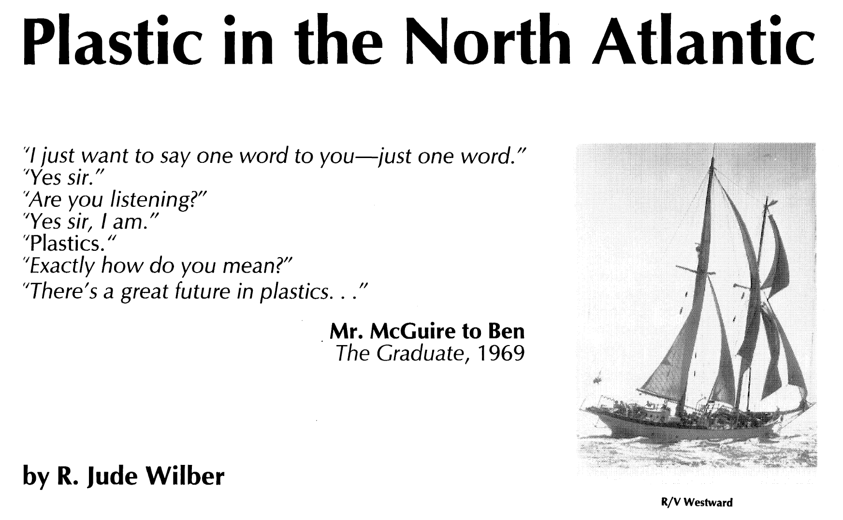
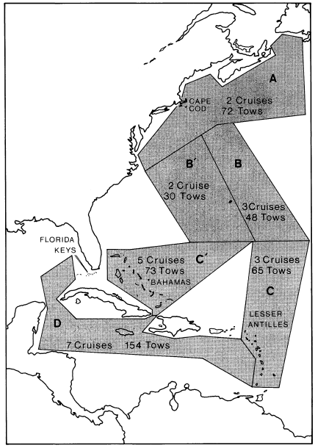
Wilber, Oceanus 1987
www.sea.edu
Notes:
In 1987 Jude Wilber’s wrote an article for Oceanus magazine, published by WHOI, describing the results of a research study he had been conducting with SEA Semester students in which they collected plastics data starting in 1984 (31 years ago)
In this study the highest accumulations of floating plastic were found in the Sargasso Sea, where surface currents of the subtropical gyre converge, trapping floating material.
In the decades since, many many SEA Semester students have done “the plastics project”, counting plastics in the neuston net and studying their distribution relative to the ocean surface currents.
In my experience this was always a simple, straightforward project, especially good for students who needed some kind of “hook” to generate interest in any kind of oceanography project
Particularly on the trip south from Woods Hole in the fall, or back north again in the spring, you knew you would find plastic, you knew where you would find it, and therefore you could all-but-guarantee a successful project.
When I started at SEA in 2003, the abundance and distribution of floating plastic debris was simply institutional knowledge. Not particularly exciting in my mind, but certainly reliable.

Slide 3
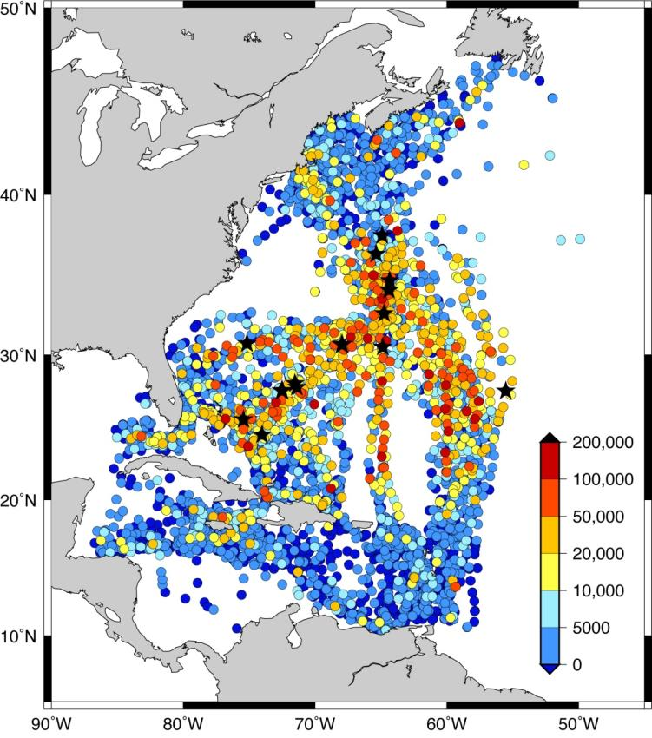
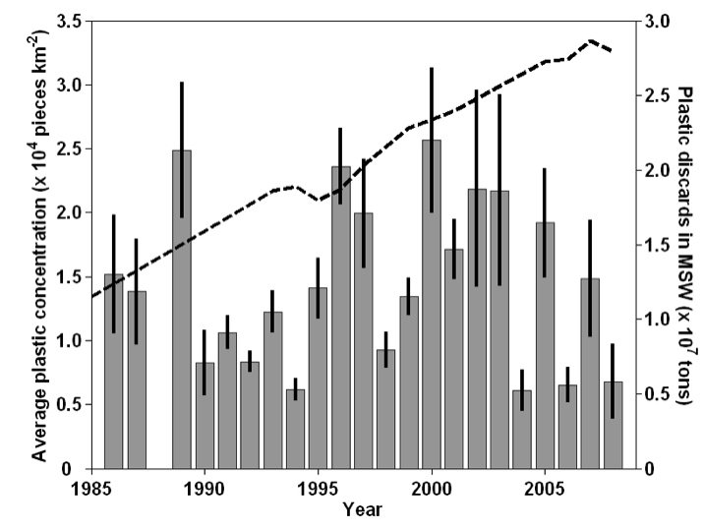

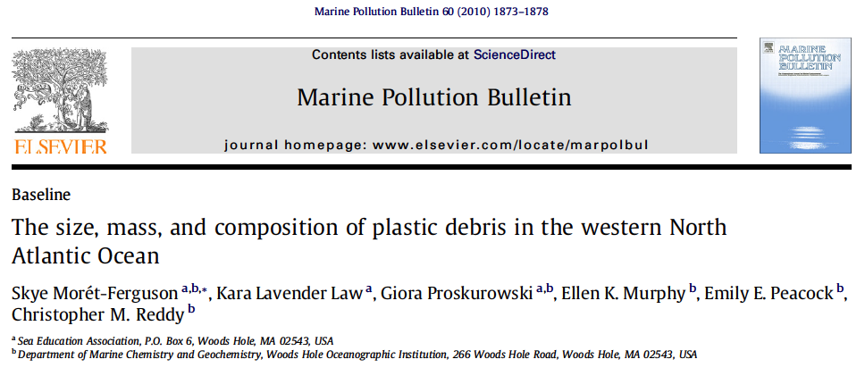

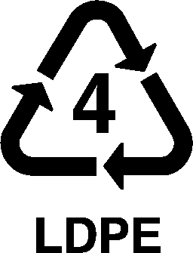

North Atlantic Data Set
6136 neuston net tows from 1986-2008
www.sea.edu
www.sea.edu
Law et al., Science 2010
Notes:
Just before S-218 sailed in summer 2008, Chris Reddy, a marine chemist at WHOI who you may know as an expert in oil spill chemistry, approached SEA after he learned about our long-term archive of plastics data in the North Atlantic.
He knew a scientific “gold mine” when he spotted one, and together we wrote a small research grant to NSF’s “SGER” program to analyze the North Atlantic data set
He knew the attention that a solid analysis of this unparalleled data set would generate, and I think it is fair to say that we likely would not be in the position we are today without Chris’s motivation, collaboration, and professional mentorship at this critical point
In Sept. 2008 we were awarded $33K grant to excavate, organize and analyze the decades-old archive of North Atlantic plastics data, and in 2010 an expansion of Jude Wilber’s original 1987 study was published in two articles, one in Science magazine and the other in MPB.
Flurry of international media attention, beginning with presentation of results at Ocean Sciences meeting (Feb. 2010, prior to publication) and again once the articles came out (Aug. 2010).
- Press release by NSF
- Falmouth Enterprise, Discovery News, Chemistry World, AP, The Independent, The Economist, New Scientist, Popular Mechanics
- I was invited for a brief interview with Ira Flatow on the radio program Science Friday
Why did this launch us into the international spotlight?
First, the timing was critical, which Chris recognized. The public’s interest and concern about plastic pollution in the ocean was rapidly growing, fueled by media reports of floating islands of garbage and marine animals becoming entangled in debris or found with bellies full of plastic.
This data set was and is, by far, the largest data set on floating plastic debris ever collected. And no one knew it existed. People wanted to know who Sea Education Assoc. was.
From these data we made the first estimate of the mass of plastic floating in the western NA – a minimum of 1100 metric tons of plastic.
Despite exponential growth in the production of plastic since the 1950s, and similar increases in plastic in the municipal waste stream, we could not find evidence of an increase in plastic in the part of the ocean where it accumulates – the reasons for which are still up for debate.
5. Not only did we report the abundance and distribution of debris in the western NA (where no one was talking about plastic debris), but we also reported on the physical characteristics of the debris itself, in which we determined that we collect particular types of plastic that float, and that those particles are tiny with an average mass of a fraction of a gram (13.6 mg)
6. Finally, the science was solid, at a time when there were not many rigorous scientific publications on plastic debris to be found. In fact, the paper led by Skye won MPB’s “Best Paper Award” for that year.

Slide 4
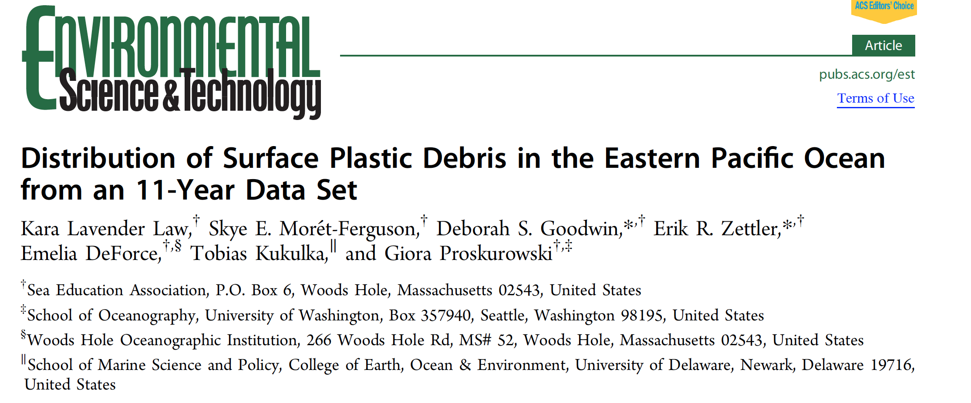
Pacific Data Set
> 2500 surface net tows from 2001–2012
www.sea.edu
Notes:
After that cruise, we were motivated to get our Pacific data set into the scientific literature and public as well

Slide 5
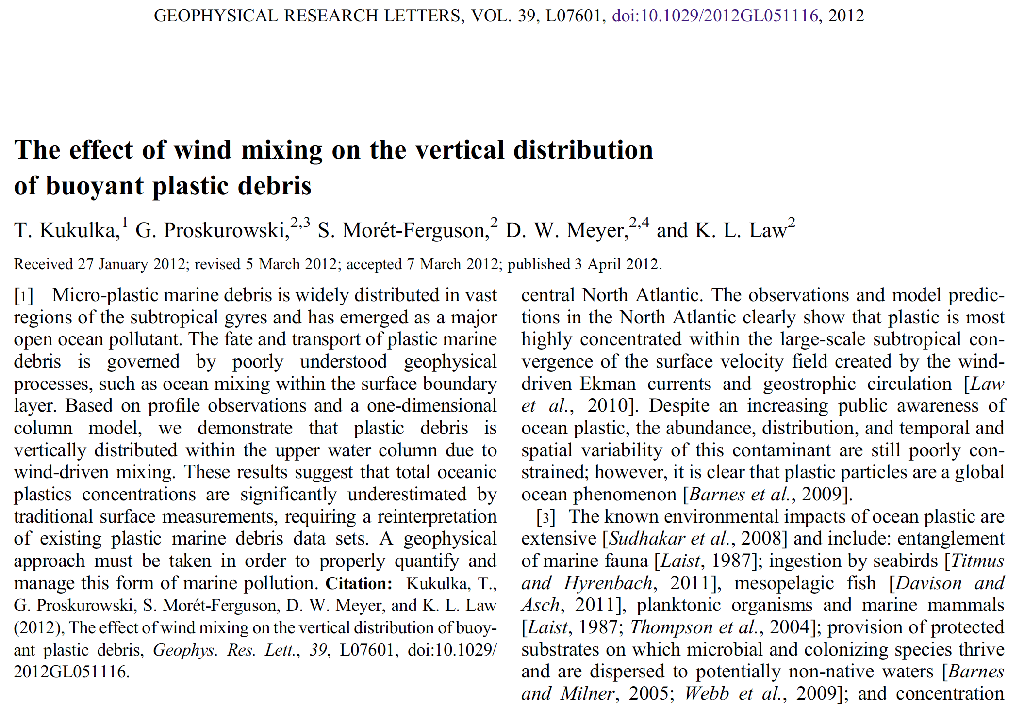
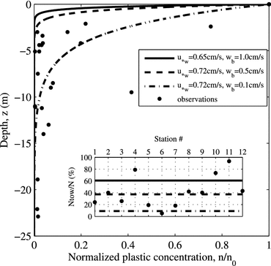
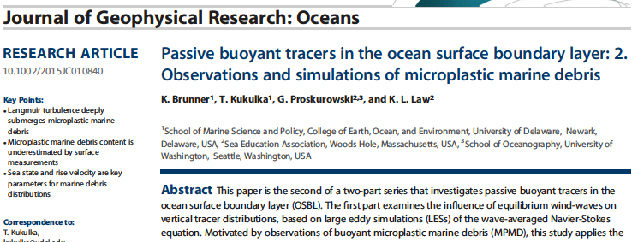
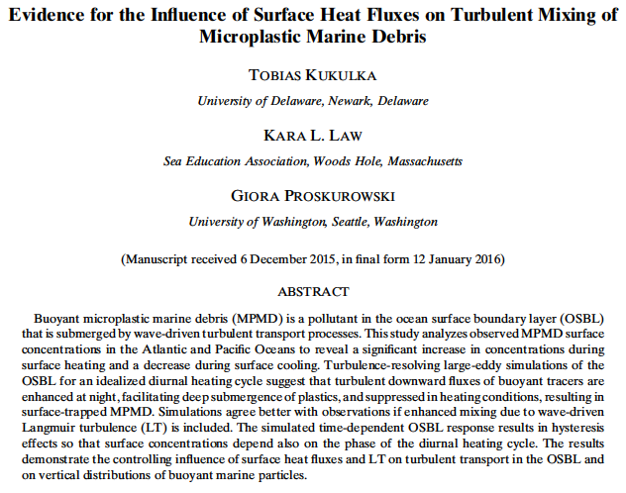
Wind-driven vertical mixing
www.sea.edu
www.sea.edu
Notes:
Observation by Giora P. from the quarterdeck of the Seamans in the NP – could see lots of plastic pieces when seas were flat calm, but as soon as the wind picked up in the slightest they seemed to disappear
Hypothesized that this was because the wind was mixing plastics below the surface, out of sight and out of reach of the neuston net
Collaborated with Tobias K., expertise in turbulence modeling, and published paper with SEA student author Dylan Meyer on this in 2012
This led to a follow-on proposal to NOAA MDP for further study, led by Giora (SEA awarded $15K of $61K)
Work resulted in Master’s thesis at UDel, Kelsey Brunner, with three additional papers (one published, one revised submission, one in prep)

Slide 6
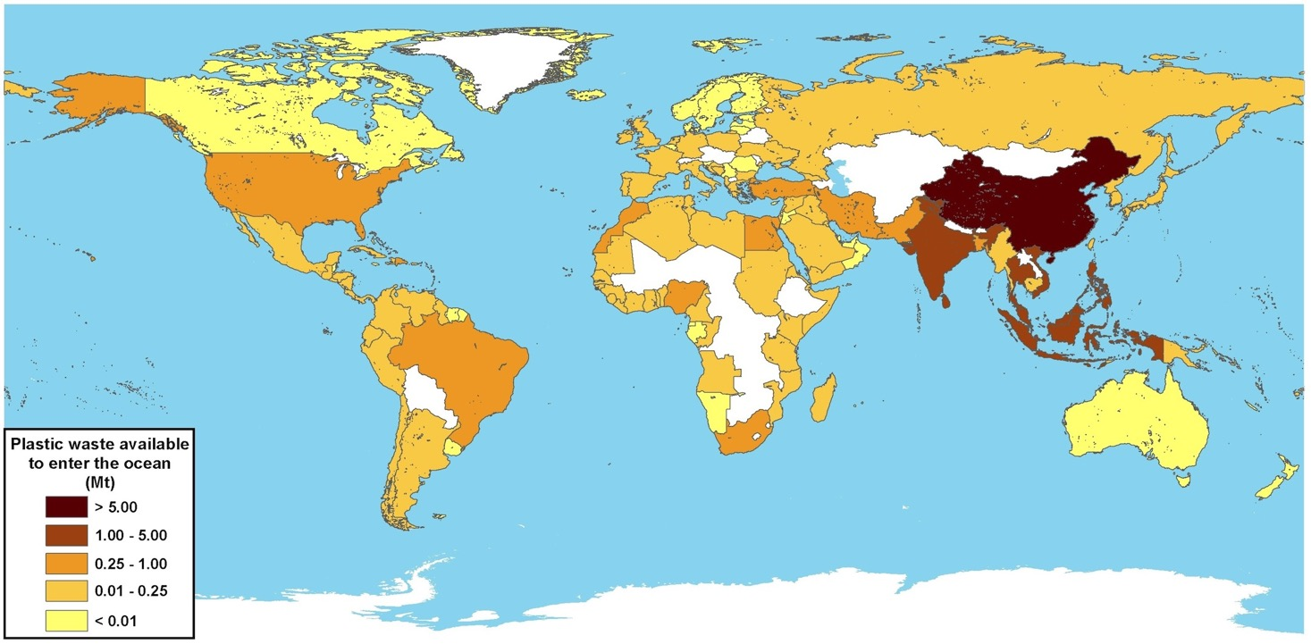
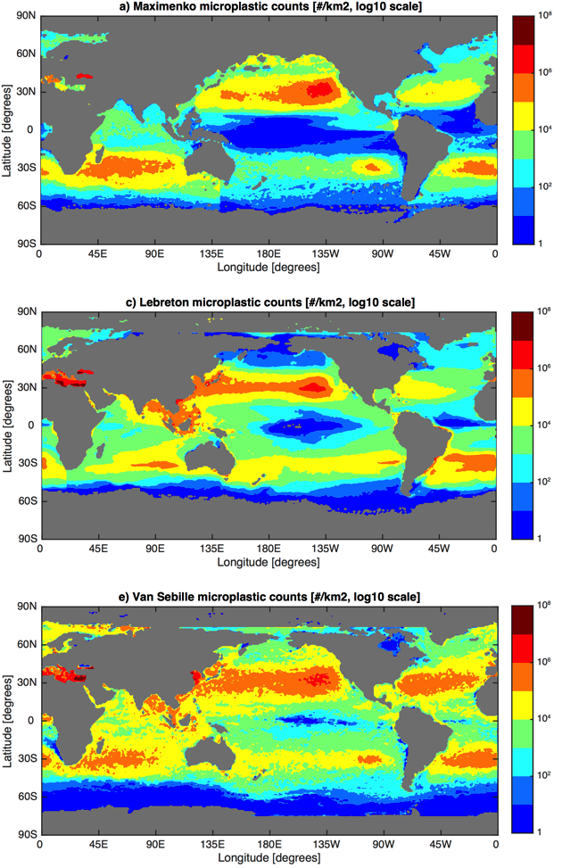
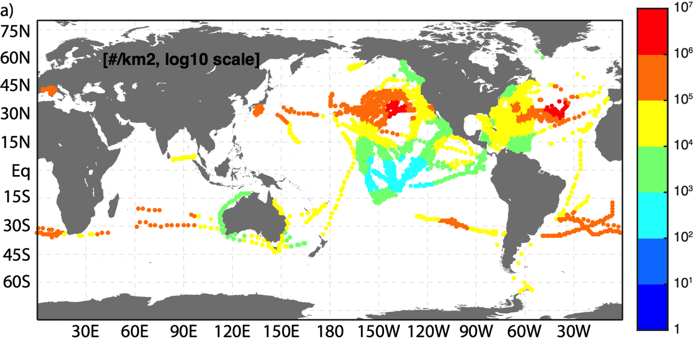
Marine Debris Working Group
Plastic waste input from land
8 million metric tons in 2010
Mass of plastics produced
8.3 billion metric tons
90% still exist
Mass of floating MPs
93-236 thousand metric tons
Jambeck et al., Science 2015
Geyer et al., Sci. Adv. 2017
Van Sebille et al., ERL 2015

Slide 7

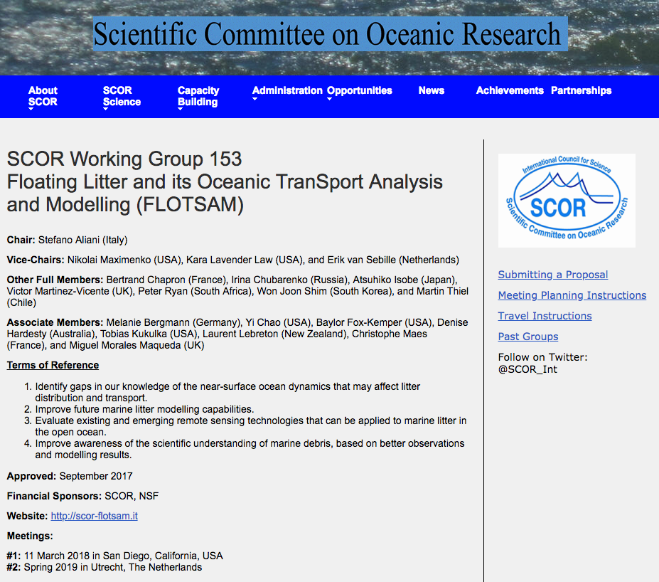
SCOR Working Group

Slide 8
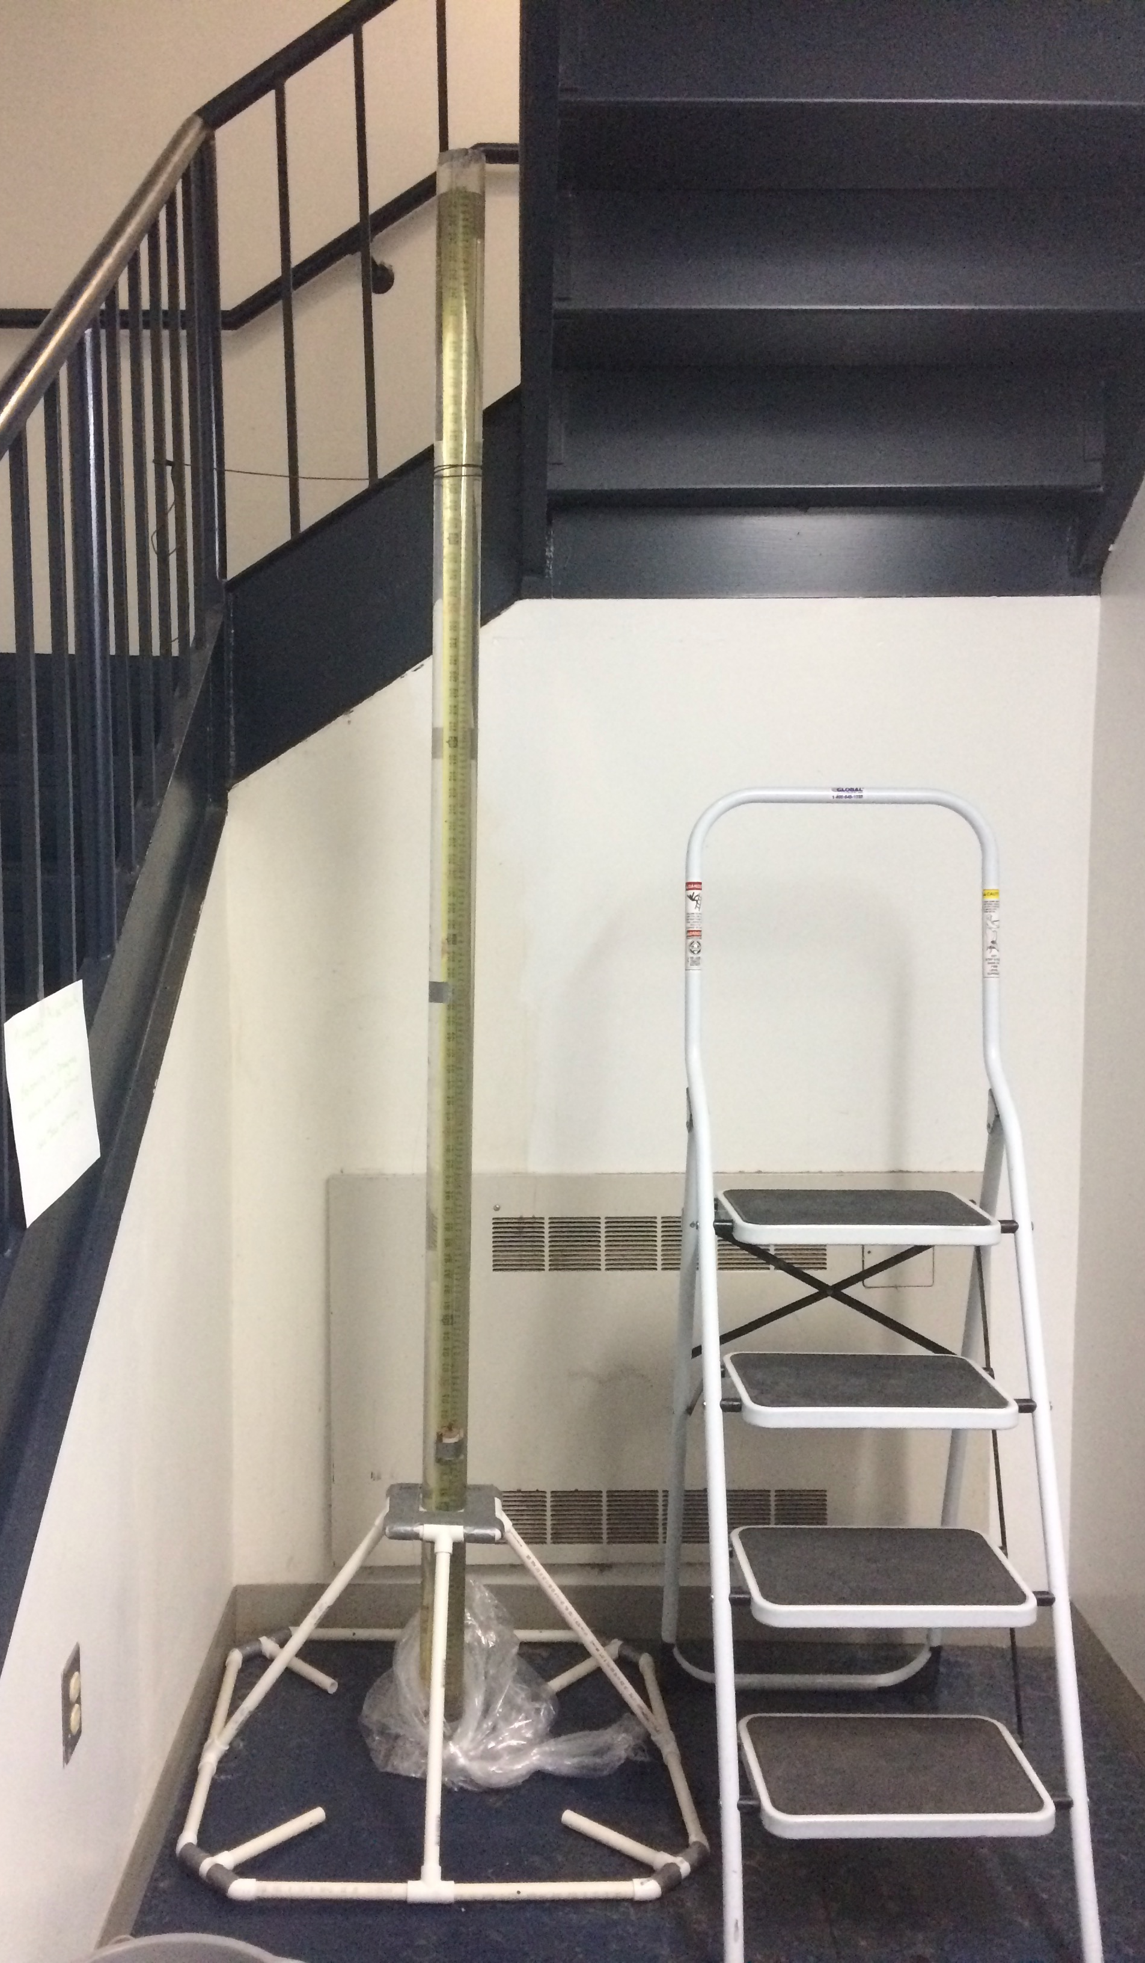



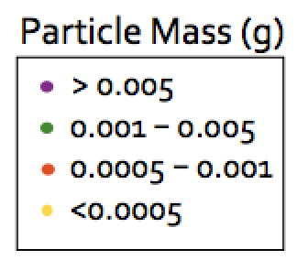
Wind-driven vertical mixing
Particle rise velocity
www.sea.edu

Slide 9
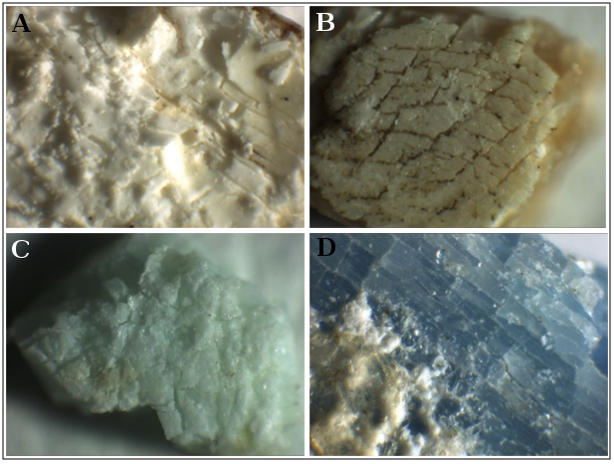
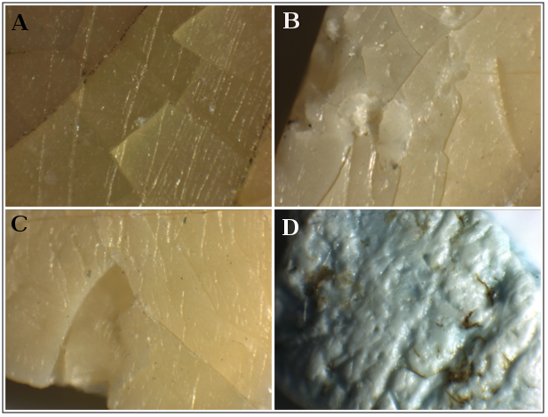
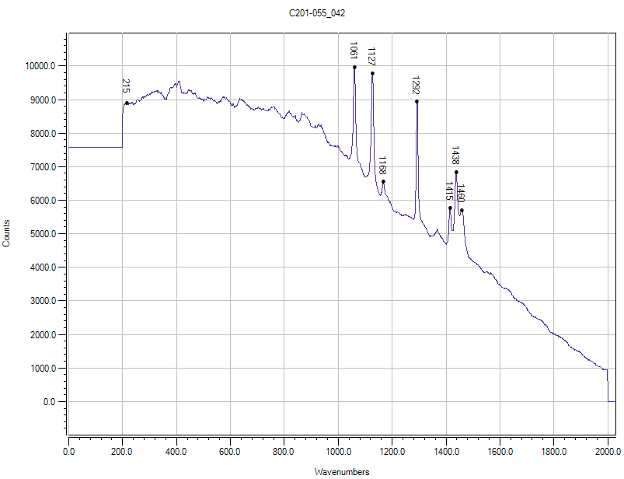
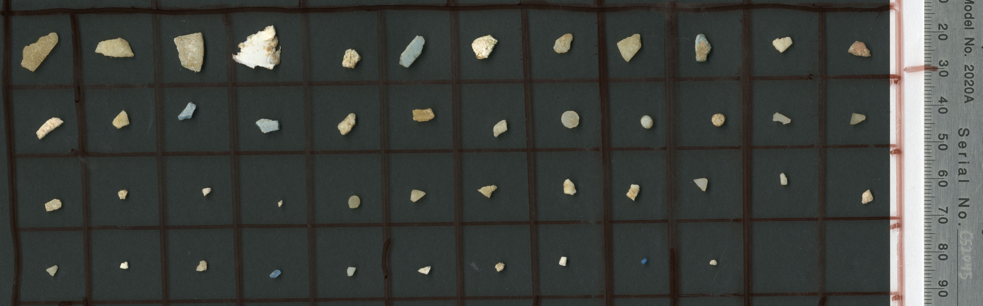
Plastics degradation in the
marine environment
www.sea.edu
2 cm

