Slide 1
Biogenic Production of Extracellular Reactive Oxygen Species (ROS): Role in Microplastic Degradation?
Colleen Hansel, MC&G, WHOI
O₂^{•-}
H₂O₂
OH•
Fe²⁺

Slide 2
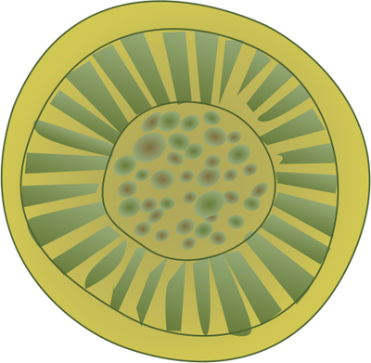



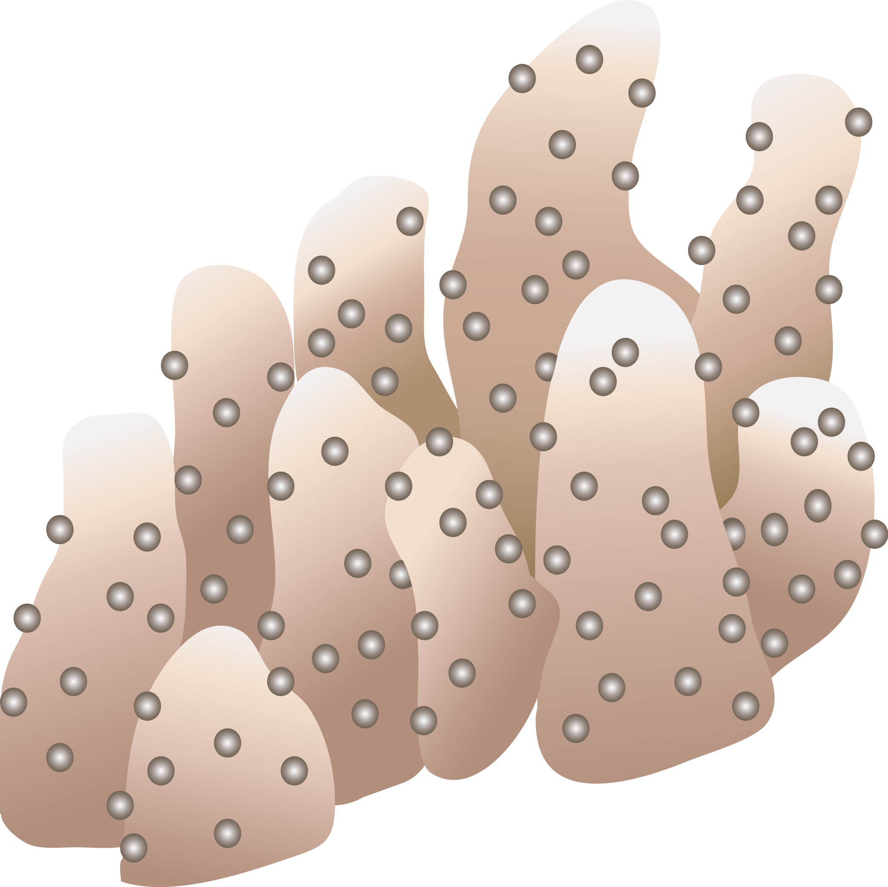
sunlight
Photic
O₂
CDOM
O₂
O₂^{•-}
O₂^{•-}
O₂
Seas of Superoxide
CDOM
O₂^{•-}
Aphotic

Slide 3
widespread biogenic extracellular superoxide
Dark production only
Exponential cells
Wide diversity
cryptophyte
diatoms
cyano-
bacteria
algae
Superoxide Production Rates
(amol cell⁻¹ hr⁻¹)
bacteria
Diaz et al., Science 2013; Hansel et al., L&O, 2016; Hansel et al., in prep; Diaz et al., in prep

