Slide 1

MIT-WHOI Joint Program
Information Session

Slide 2

Please Record!
Welcome
Ann Tarrant, WHOI Associate Dean
Mick Follows, MIT JP Director
Tricia Nesti, MIT JP Assistant Director
Keqi Ren, WHOI Grad. Admissions & Student Affairs Officer
Program
Overview of JP structure
Funding
Application materials
What makes a strong application?
Waivers
JP ASK program
Breakout room Q&A
Notes:
Say where MIT is located and where WHOI is located and two separate institutions

Slide 3
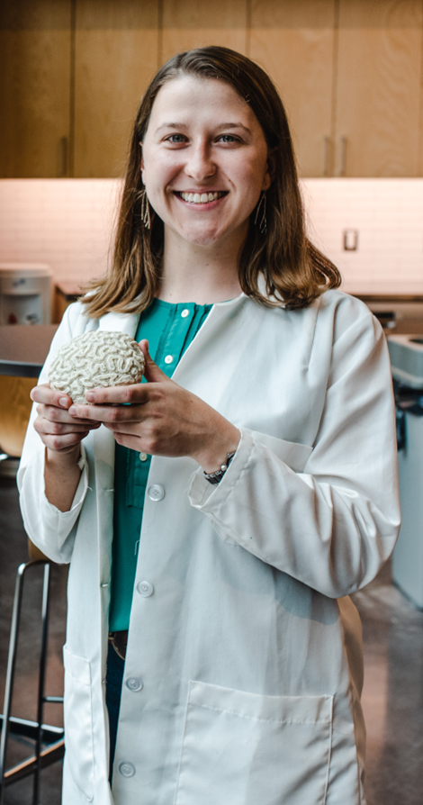
MIT-WHOI Joint Program
One doctoral degree program composed of 5 disciplines:
Applied Ocean Sciences and Engineering (AOSE)
Biological Oceanography (BO)
Chemical Oceanography (CO)
Marine Geology and Geophysics (MGG)
Physical Oceanography (PO)
Notes:
Generally, first 2 yrs spent at MIT taking classes and remainder of program conducting research where advisor resides.

Slide 4
JP Disciplines/WHOI and MIT Department Organization
JP Discipline | WHOI Department | MIT Departments
AOSE: Applied Ocean Science and Engineering | AOP&E: Applied Ocean Physics and Engineering | CEE, MechE, EECS, AeroAstro
BO: Biological Oceanography | Biology | CEE, Biology, EAPS
CO: Chemical Oceanography | MCG: Marine Chemistry and Geochemistry | CEE, EAPS
MGG: Marine Geology and Geophysics | G&G: Geology and Geophysics | CEE, EAPS
PO: Physical Oceanography | PO: Physical Oceanography | EAPS
MIT Departments Affiliated with the JP:
(1) CEE: Civil and Environmental Engineering, (2) MechE: Mechanical Engineering, (6) EECS: Electrical Engineering and Computer Science, (12) EAPS: Earth, Atmospheric and Planetary Science, (16) AeroAstro: Aeronautics and Astronautics
Notes:
Why you would choose one MIT dept/disc than another, changing MIT depts after admitted

Slide 5
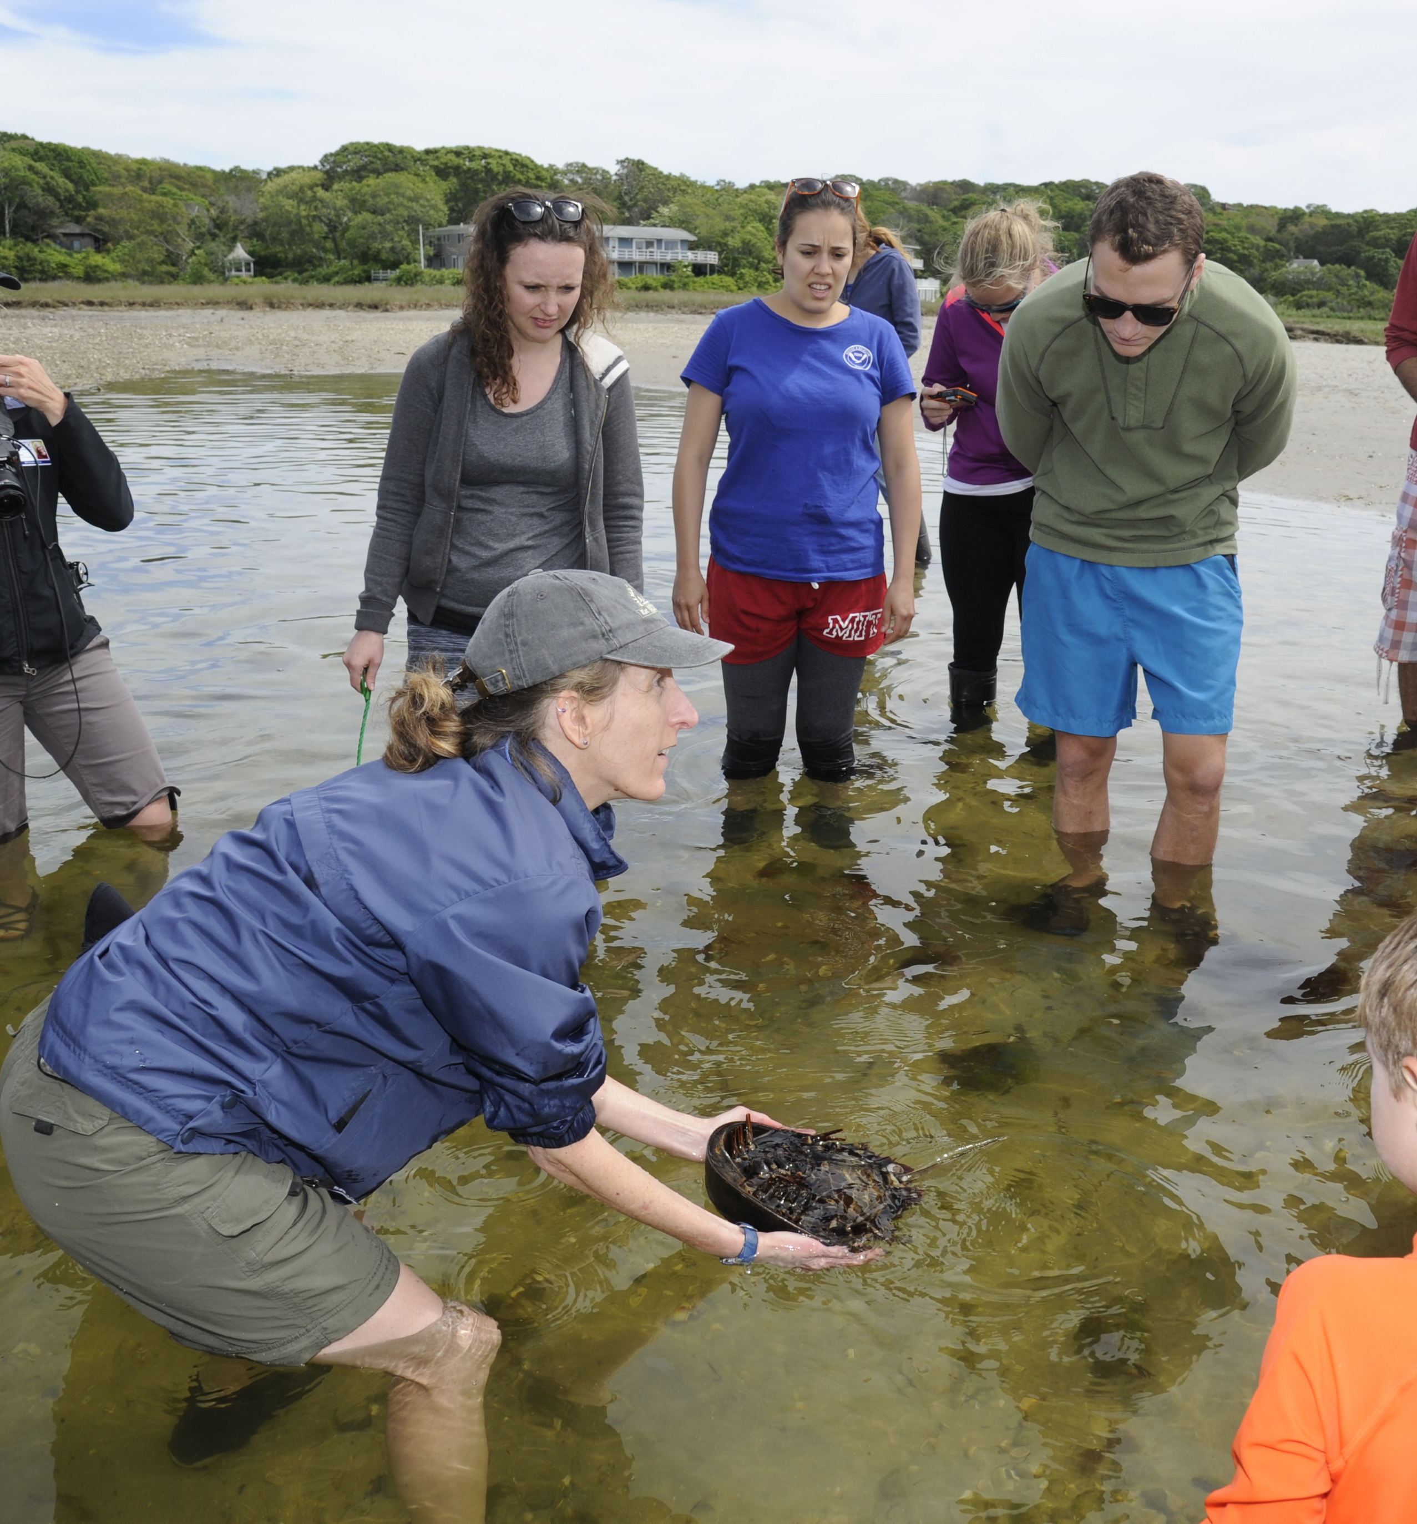
MIT-WHOI Joint Program Students
are enrolled at both institutions, and have access to courses, programs and resources at both institutions.
Leads to a doctoral degree awarded by both MIT and WHOI.
Notes:
Mention WHOI is its own independent institution and not an MIT dept

Slide 6
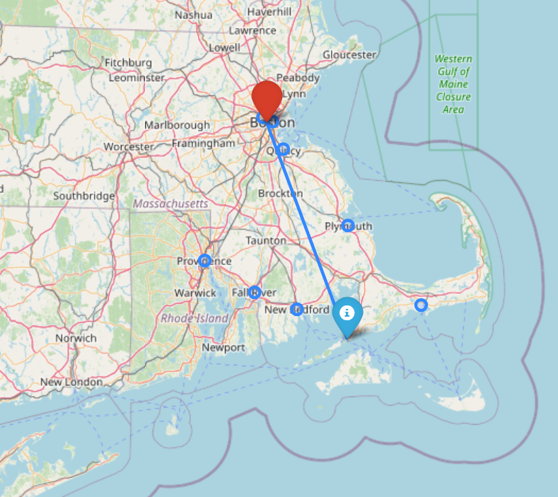
Supporting commuting logistics across two institutions
MIT and WHOI are about 75 miles apart (driving distance)
A chartered bus runs from MIT to WHOI and back twice a week during academic year
JP bus available from MIT
Other reimbursable transportation
Student apartment for short-term stays at MIT, transient housing at WHOI
MIT
WHOI

Slide 7
Funding
Commitment of financial support for 5 years of full-time study given satisfactory academic progress
Admitted with full funding
Consists of tuition, a stipend (at least $52,311/yr), and health insurance for a single person
Support may come from a Graduate Research Assistantship or fellowships
**Encouraged to apply for external fellowships.

Slide 8
For students applying to NSF GRFP
Your major field of study must align with the proposed graduate program of study. If you have questions, ASK!
https://docs.google.com/spreadsheets/d/1zR0le6-e33BOJASTxmcbWYf2VgGxuXfuFAwrAClR6Xk/edit?gid=0#gid=0
JP Discipline | MIT Department | Major Field of Study
AOSE | Civil Eng, Mech E, or Aero Astro | Engineering or Geosciences
AOSE | EECS | Engineering, Comp/IS/Eng, or Geosciences
Biol Oce, Chem Oc, MGG | Civil Eng | Geosciences or Engineering
Biol Oce, Chem Oc, MGG, PO | EAPS | Geosciences
Bio Oce | Biology | Geosciences or Life Sciences

Slide 9
Application Materials
JP students come from various STEM majors, and many are new to ocean science/engineering.
1. Undergrad degree
2. Unofficial transcript(s)
3. Describe grading system
4. English Language Proficiency exam Required for applicants for whom English is not their first language.
Minimum scores:
TOEFL 100
IELTS 7.0
Cambridge English (C1 or C2) 185
Duolingo English Test 130
5. Statement of objectives
1.5-2.5 pages single-spaced
why you are a good candidate
what you would like to study and how your previous training and experiences have prepared you for that work
specific faculty whose research most interests you
factors that may have impacted your performance or opportunities to gain experience
6. Resume
7. Three letters of recommendation
Letters should be from people who are familiar with your academic and/or research capabilities
8. Optional GRE scores (not required)
*APPLICATION CLOSES DECEMBER 1, 2025

Slide 10
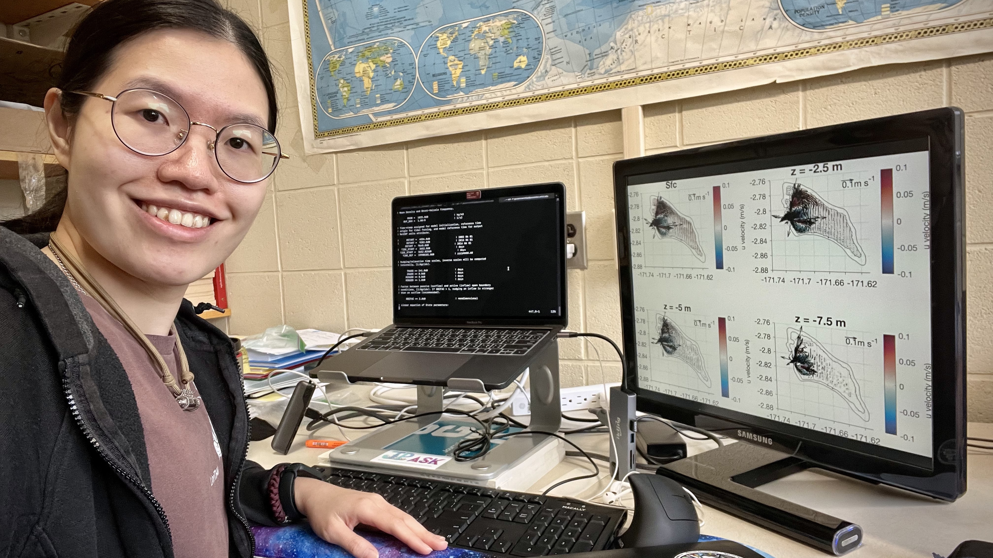
What Makes a Strong Application?
No single factor, holistic admissions process
Clear statement of the type of research the student envisions doing and how their background provides a foundation
Potential match with a research advisor
External fellowships
Highlights the applicant’s strengths and potentially describes challenges that have been overcome

Slide 11
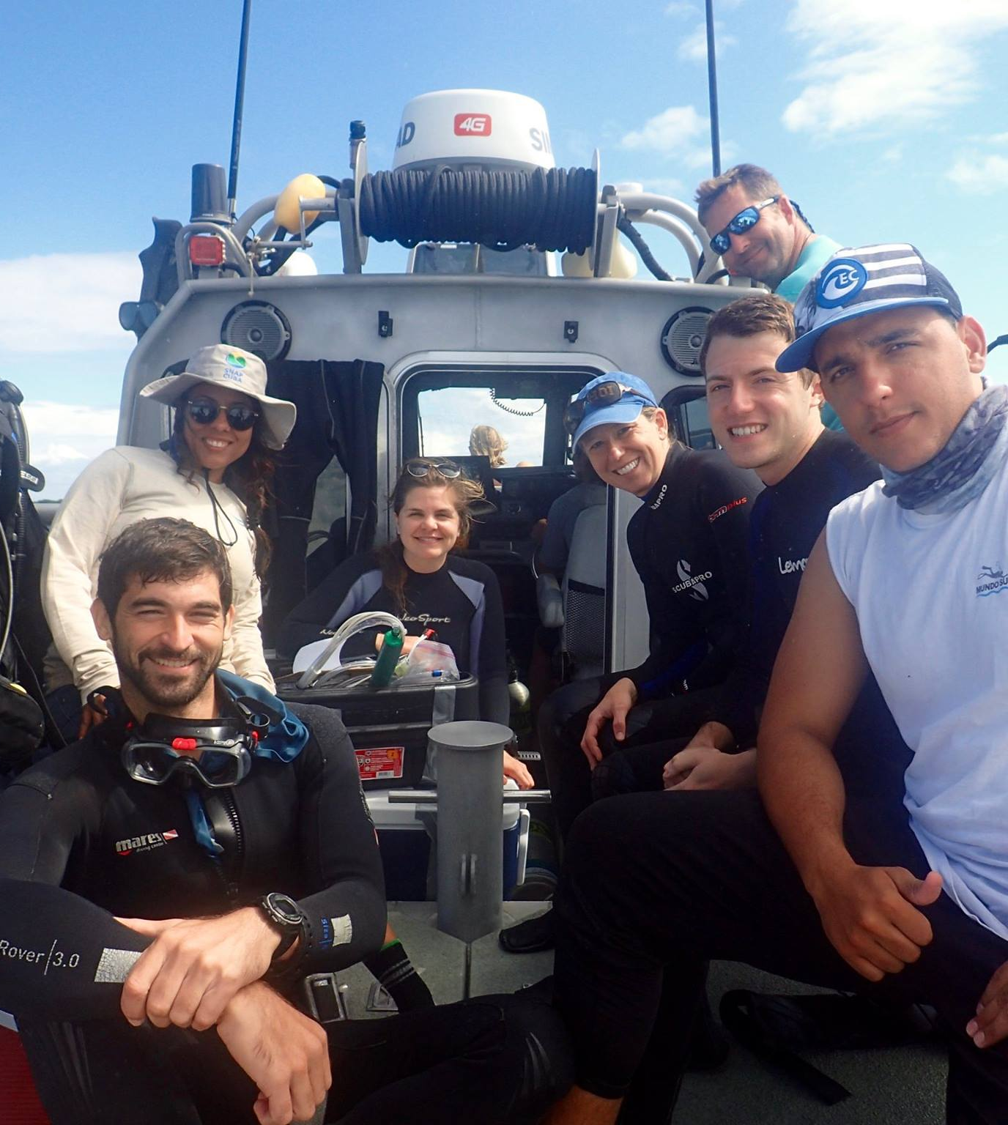
Application Fee Waivers
https://oge.mit.edu/graduate-admissions/applications/application-fee-waiver/
For U.S. Citizens and U.S. Permanent Residents
(1) who demonstrate financial hardship,
(2) are current or former members of the U.S. Armed Forces, or
(3) who have participated in special graduate research preparation programs
Eligible applicants should submit the fee waiver form
ELP Waivers
https://oge.mit.edu/graduate-admissions/admissions-policies/elp-test-requirement/department-elp-waivers/
You may be eligible if
Primary language was English during primary and secondary schooling or
You attended a 4-year English-speaking college/university in an English-speaking country and graduated with a bachelor's degree
A two-year Master's degree in a U.S. or English-speaking university is not considered sufficient to qualify for a waiver.
Submit the request through the online application system

Slide 12

Advise and support prospective students through the graduate application process by pairing prospective applicant mentees with current graduate student mentors
Program runs: September 1 to November 15
OFFICE HOurs: Oct 28, 6 pm EST
Nov 4, 6 PM EST
Website: https://mit.whoi.edu/admissions/apply/jp-applicant-service-knowledgebase-jp-ask/
Questions contact:
jp-ask@mit.edu

Slide 13

Thank you for joining us!
Questions:
Try our FAQ page:
https://mit.whoi.edu/admissions/faqs/
Or write: jp-info@mit.edu
Deadline: December 1, 2025

