Slide 1

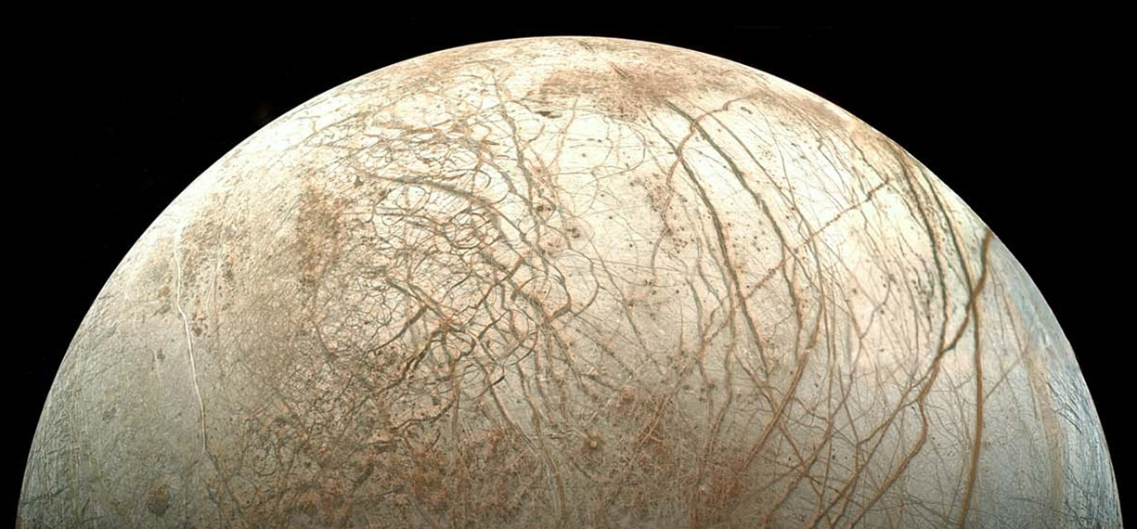
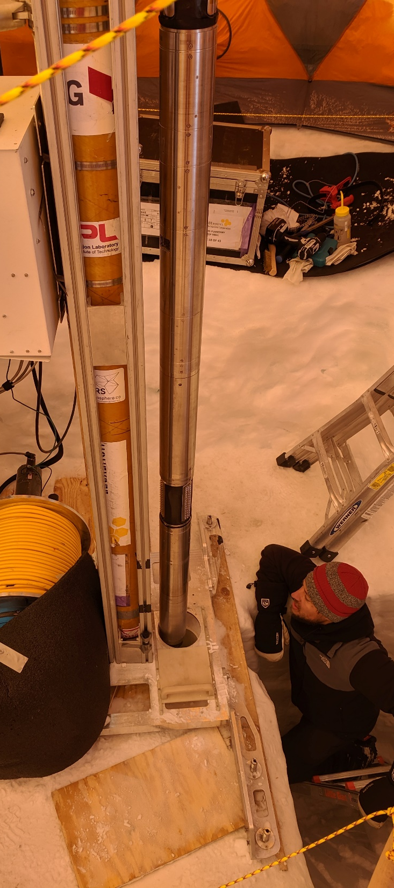
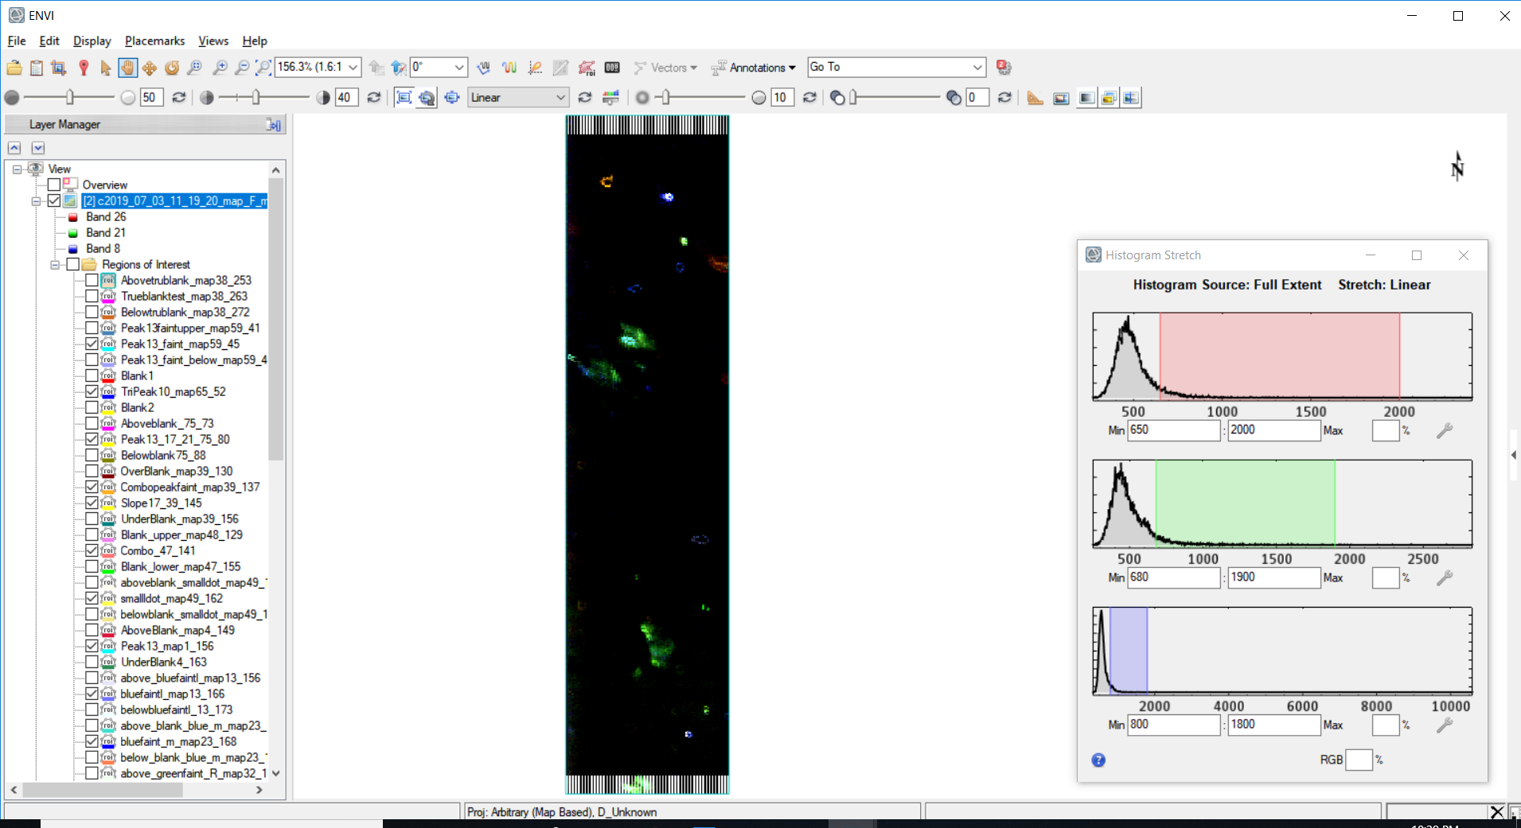
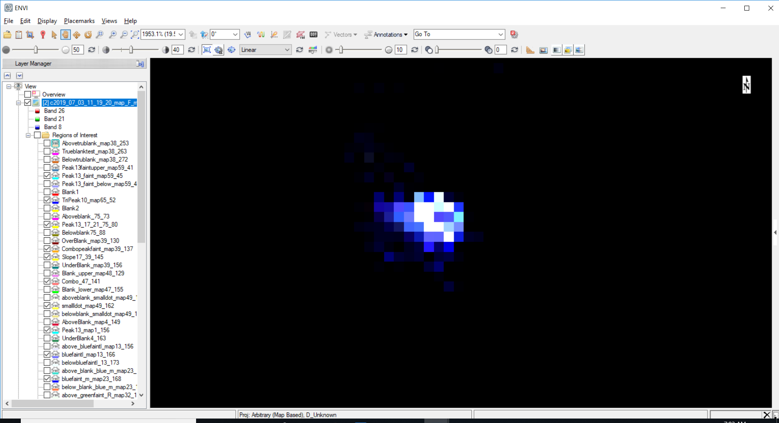
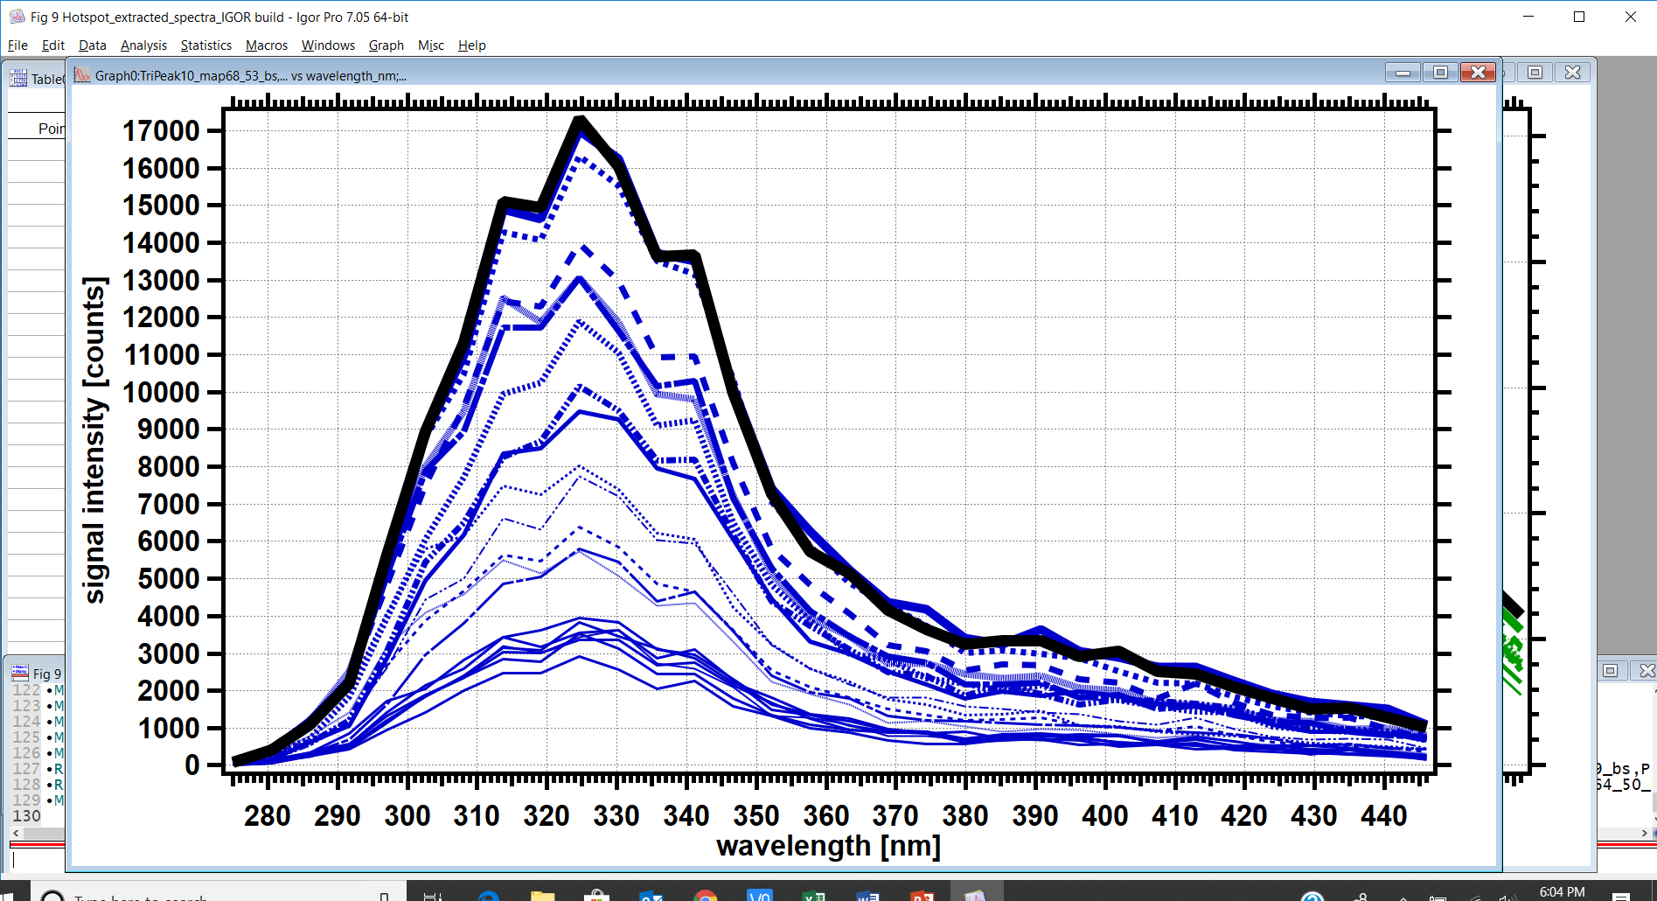
Demonstration of a down-borehole Deep UV instrument for the detection of microbes and organics in the icy crusts of the Ocean Worlds
Michael Malaska and co-authors
hotspot detail
Background: Deep Ice will be the first habitable environment encountered during deep drilling in the Ocean Worlds. We developed an Deep-UV fluorescence instrument for detecting microbes and organics in a drilled ice borehole.
Results: We drilled to 105 m deep in the Greenland ice sheet. With our instrument integrated into the drill string, we detected fluorescent organic and microbial concentrated spots in both firn and glacial ice.
Significance: This instrument can be used to detect biosignatures in the icy crusts of the Ocean Worlds as well as further exploration of Deep Ice habitats on Earth.
1 mm
intensity
Malaska, M.J., Bhartia, R., Manatt, K.S., Priscu, J.C., Abbey, W.J., Mellerowicz, B., Palmowski, J., Paulsen, G.L. Zacny, K., Eshelman, E.J., D’Andrilli, J., 2020. Subsurface in situ detection of microbes and diverse organic matter hotspots in the Greenland ice sheet. Astrobiology 20, in press. doi: 10.1089/ast.2020.2241
Link to open-access article: https://www.liebertpub.com/doi/10.1089/ast.2020.2241
5 mm
275 nm
wavelength [nm]
445 nm
Instrument-drill
in Greenland ice borehole
Fluorescence
map from
93.8 m depth
Hotspot
detail and fluorescence spectra
This work was supported by an award to R. Bhartia through the NASA PSTAR program.
© 2020 California Institute of Technology. U.S. Government sponsorship acknowledged.

