Slide 1
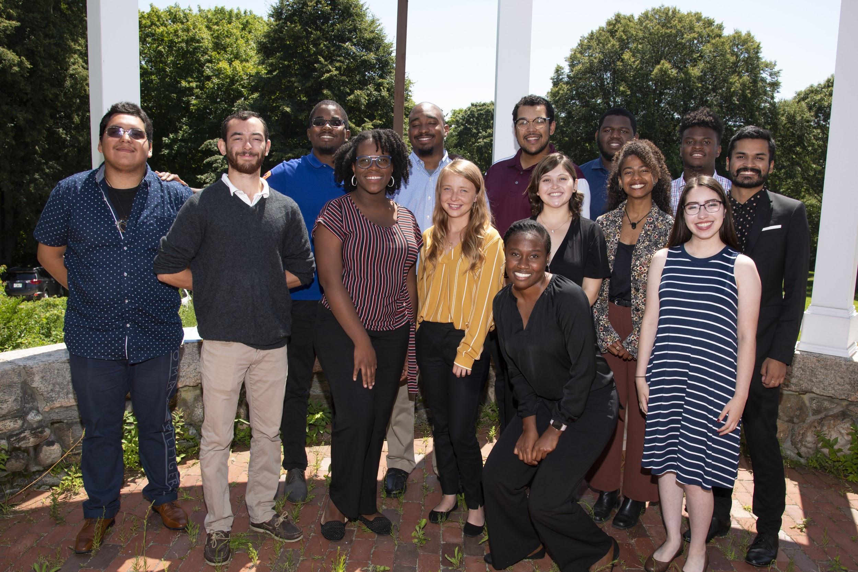
Woods Hole
Partnership Education
Program
PEP 2019 cohort
Ambrose Jearld
Senior Advisor
Sea Education Association
&
George Liles
PEP Director
NOAA Northeast Fisheries Science Center

Slide 2
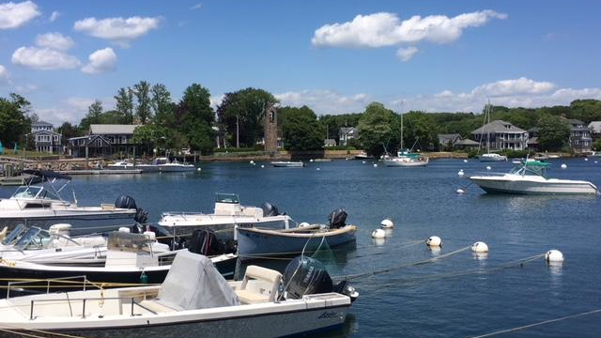
Overview
Our vision
Who we are?
What our program offers
A summer in our
internship
How to apply
Contact info
Questions

Slide 3
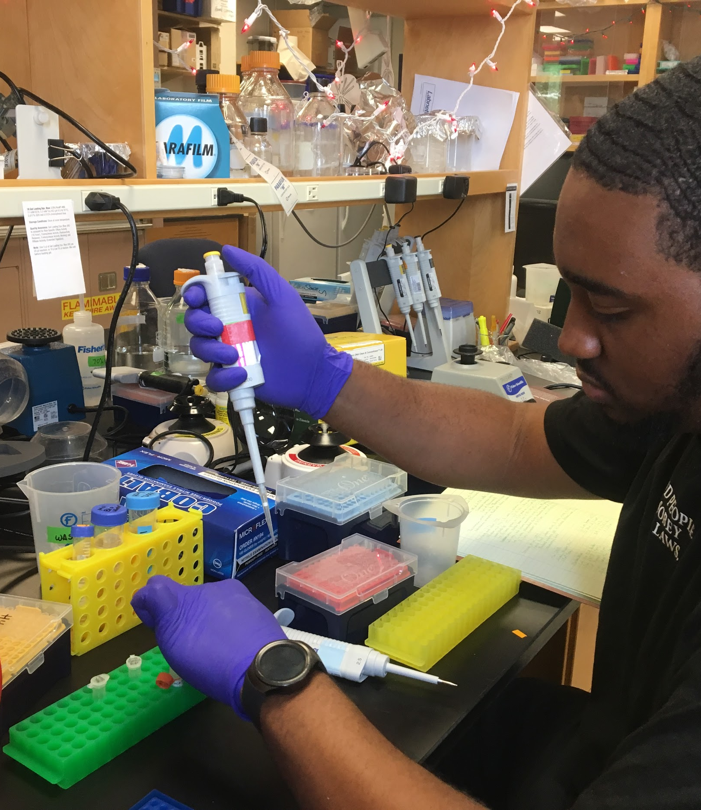
Our vision
PEP began as a vision of what could be achieved via a partnership among seven institutions to address an issue of common concern—increasing diversity in the marine and environmental sciences…

Slide 4
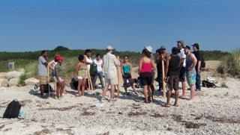
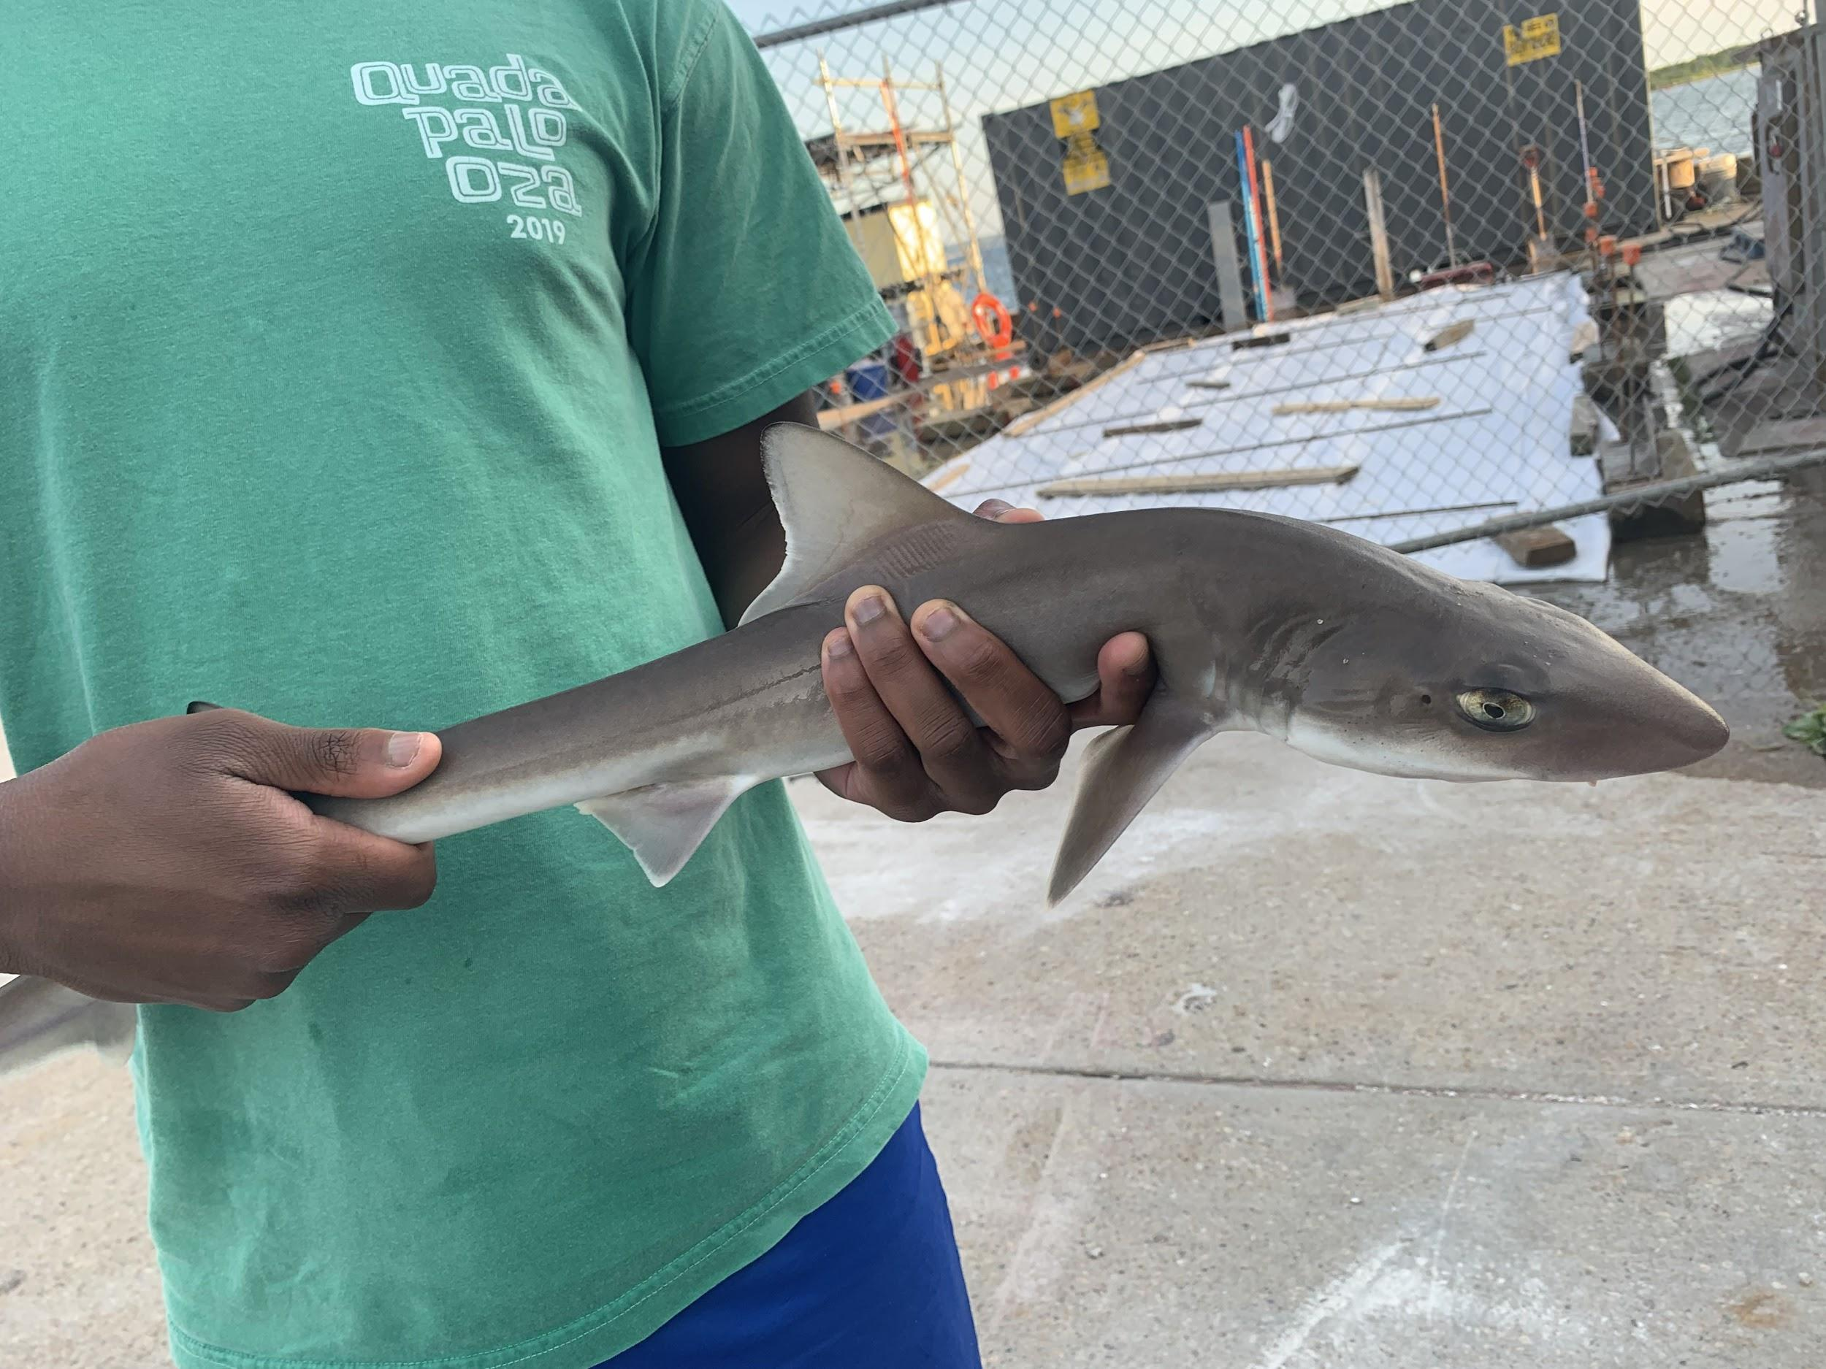
Wh0 we are?
A paid 10-week summer intern program designed primarily for college juniors and seniors
Our interns work and live in Woods Hole, MA on Cape Cod for the duration of the summer
PEP provides a first-hand introduction to real-world training in the research skills students need to advance as working scientists
We are a partnership program comprised of six scientific institutions and one academic partner

Slide 5

Our Partners

Slide 6
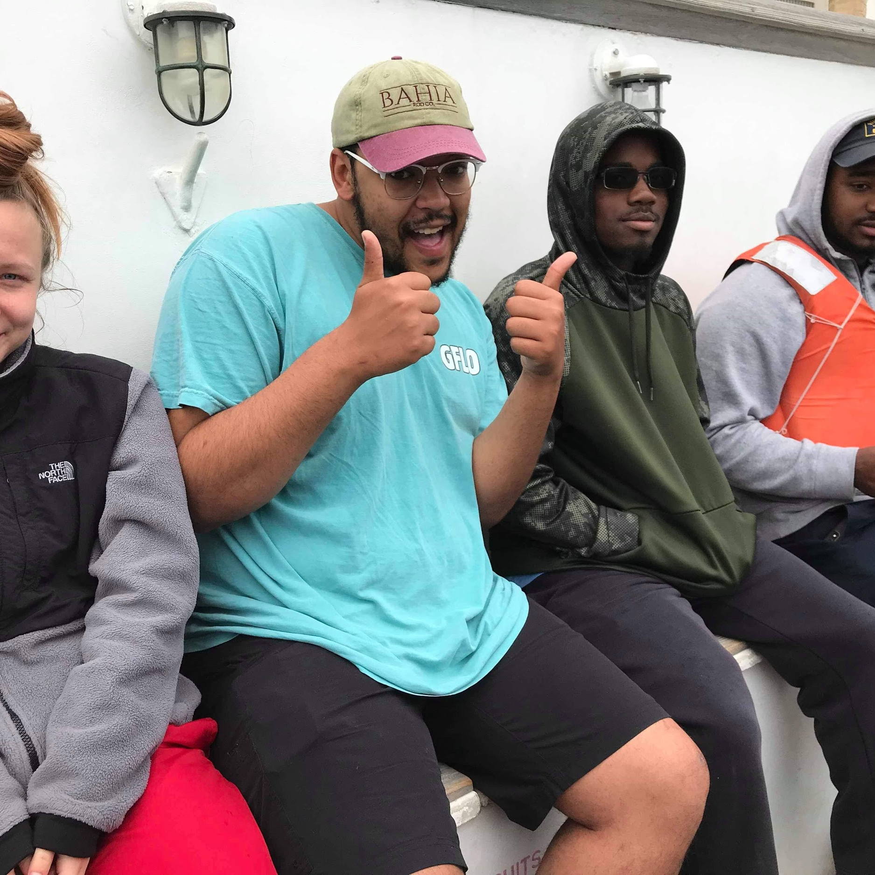
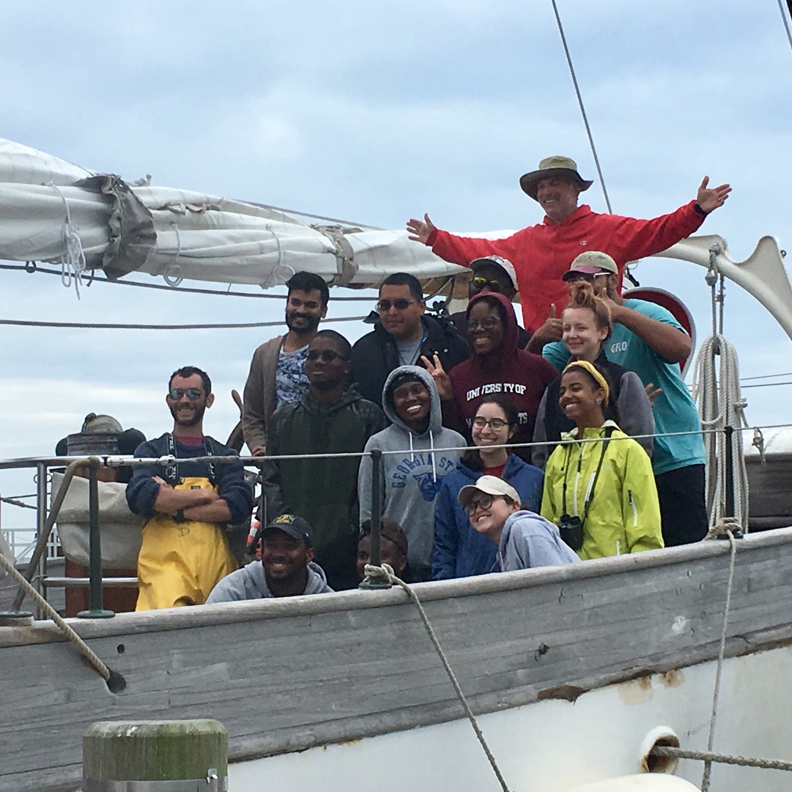
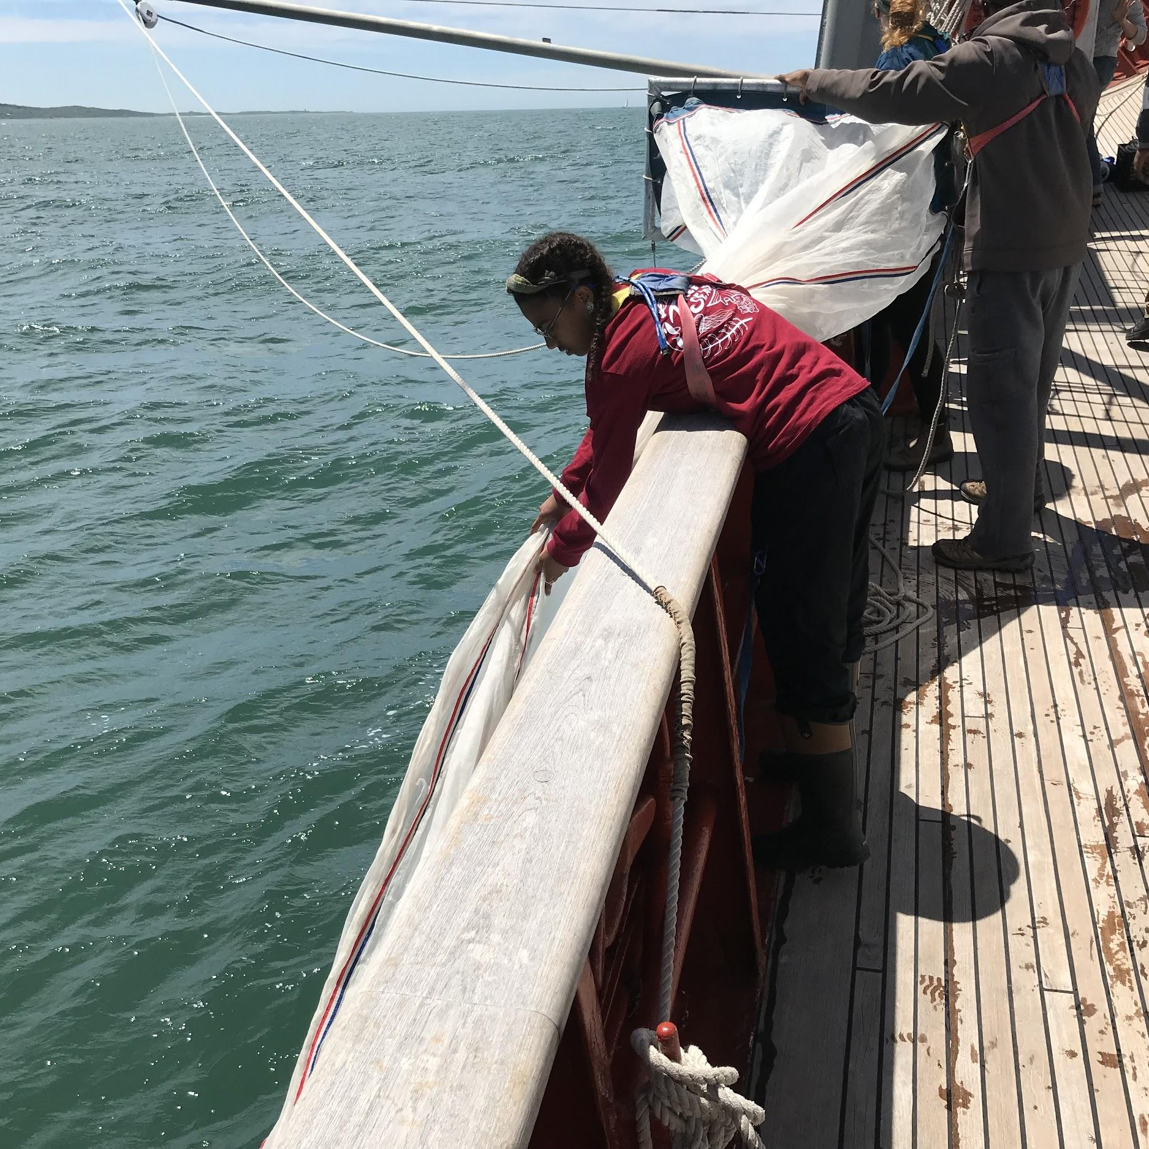
What our program Offers
Interns are offered:
Four hours of academic credit (via UMES)
Housing
Tuition covered
$4,500 stipend
Room and board
Travel expenses paid
Some main program components:
A month-long, Global Climate Change course
Placement in the laboratory/program of a senior researcher to conduct individual research projects
Career development activities
A five day research cruise aboard the SSV Corwith Cramer
Final symposium, 15-min oral presentation

Slide 7
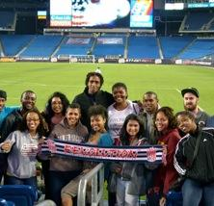
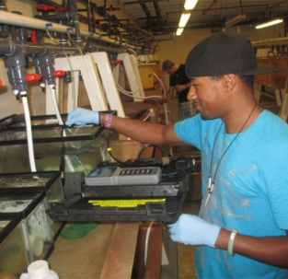
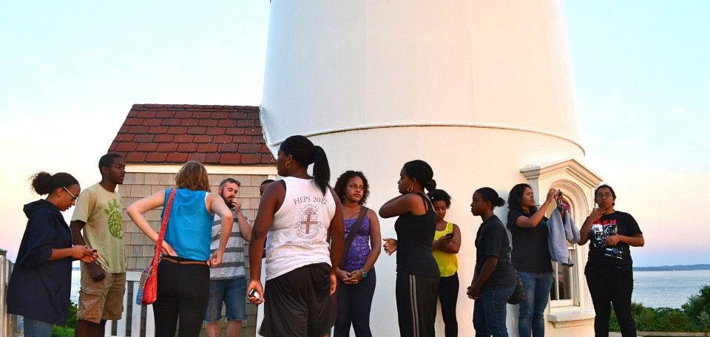
What our program Offers
PEP interns have the opportunity to network since the program allows interns to live, socialize, and participate together in group career building activities such as seminars, workshops, field trips, and at-sea experiences.

Slide 8
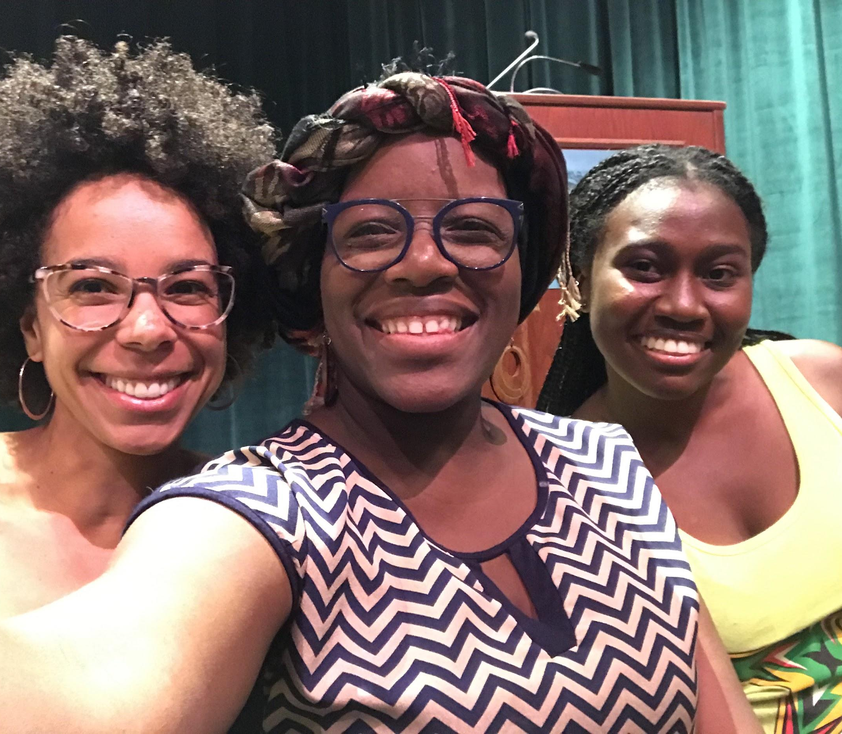
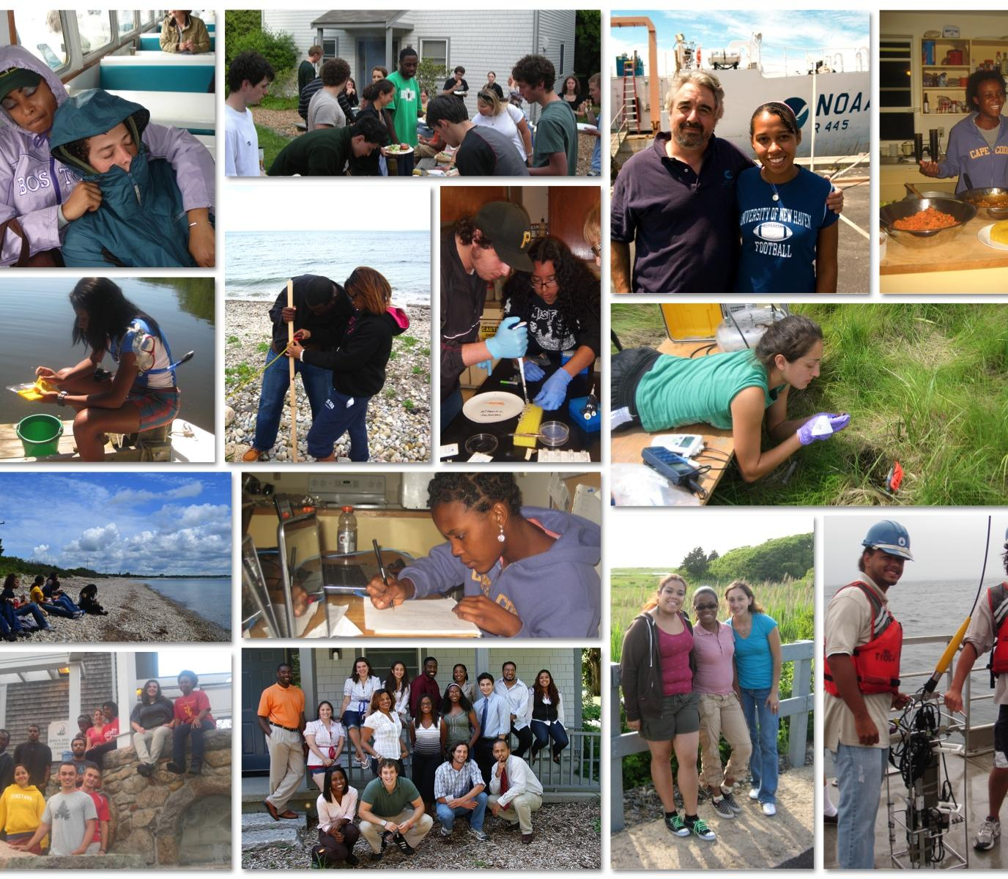
The Day in the Life
of a PEP Student

Slide 9
Application
Requirements
---
Deadline to apply is
15 February 2020
Completed application
Short-answer responses
Contact info
Research interests, etc.
3)Personal statement
500 words or less
4) Two letters of Reference
One must be from a faculty member
2)Resume or curriculum vitae
Be sure it’s updated
5)Unofficial transcript
Official transcripts required upon accepting an offer
Apply here today: https://www.surveymonkey.com/r/pep2020application

Slide 10
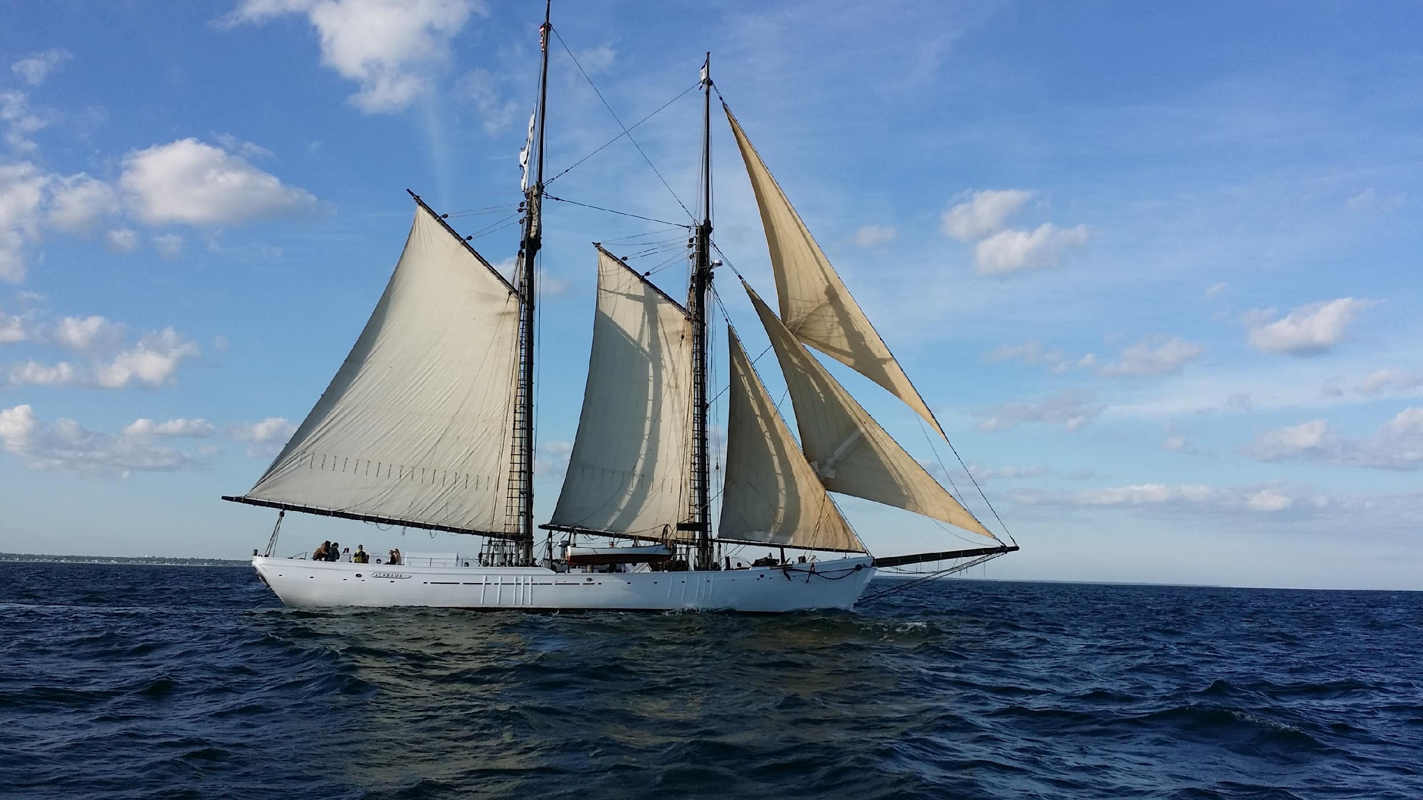
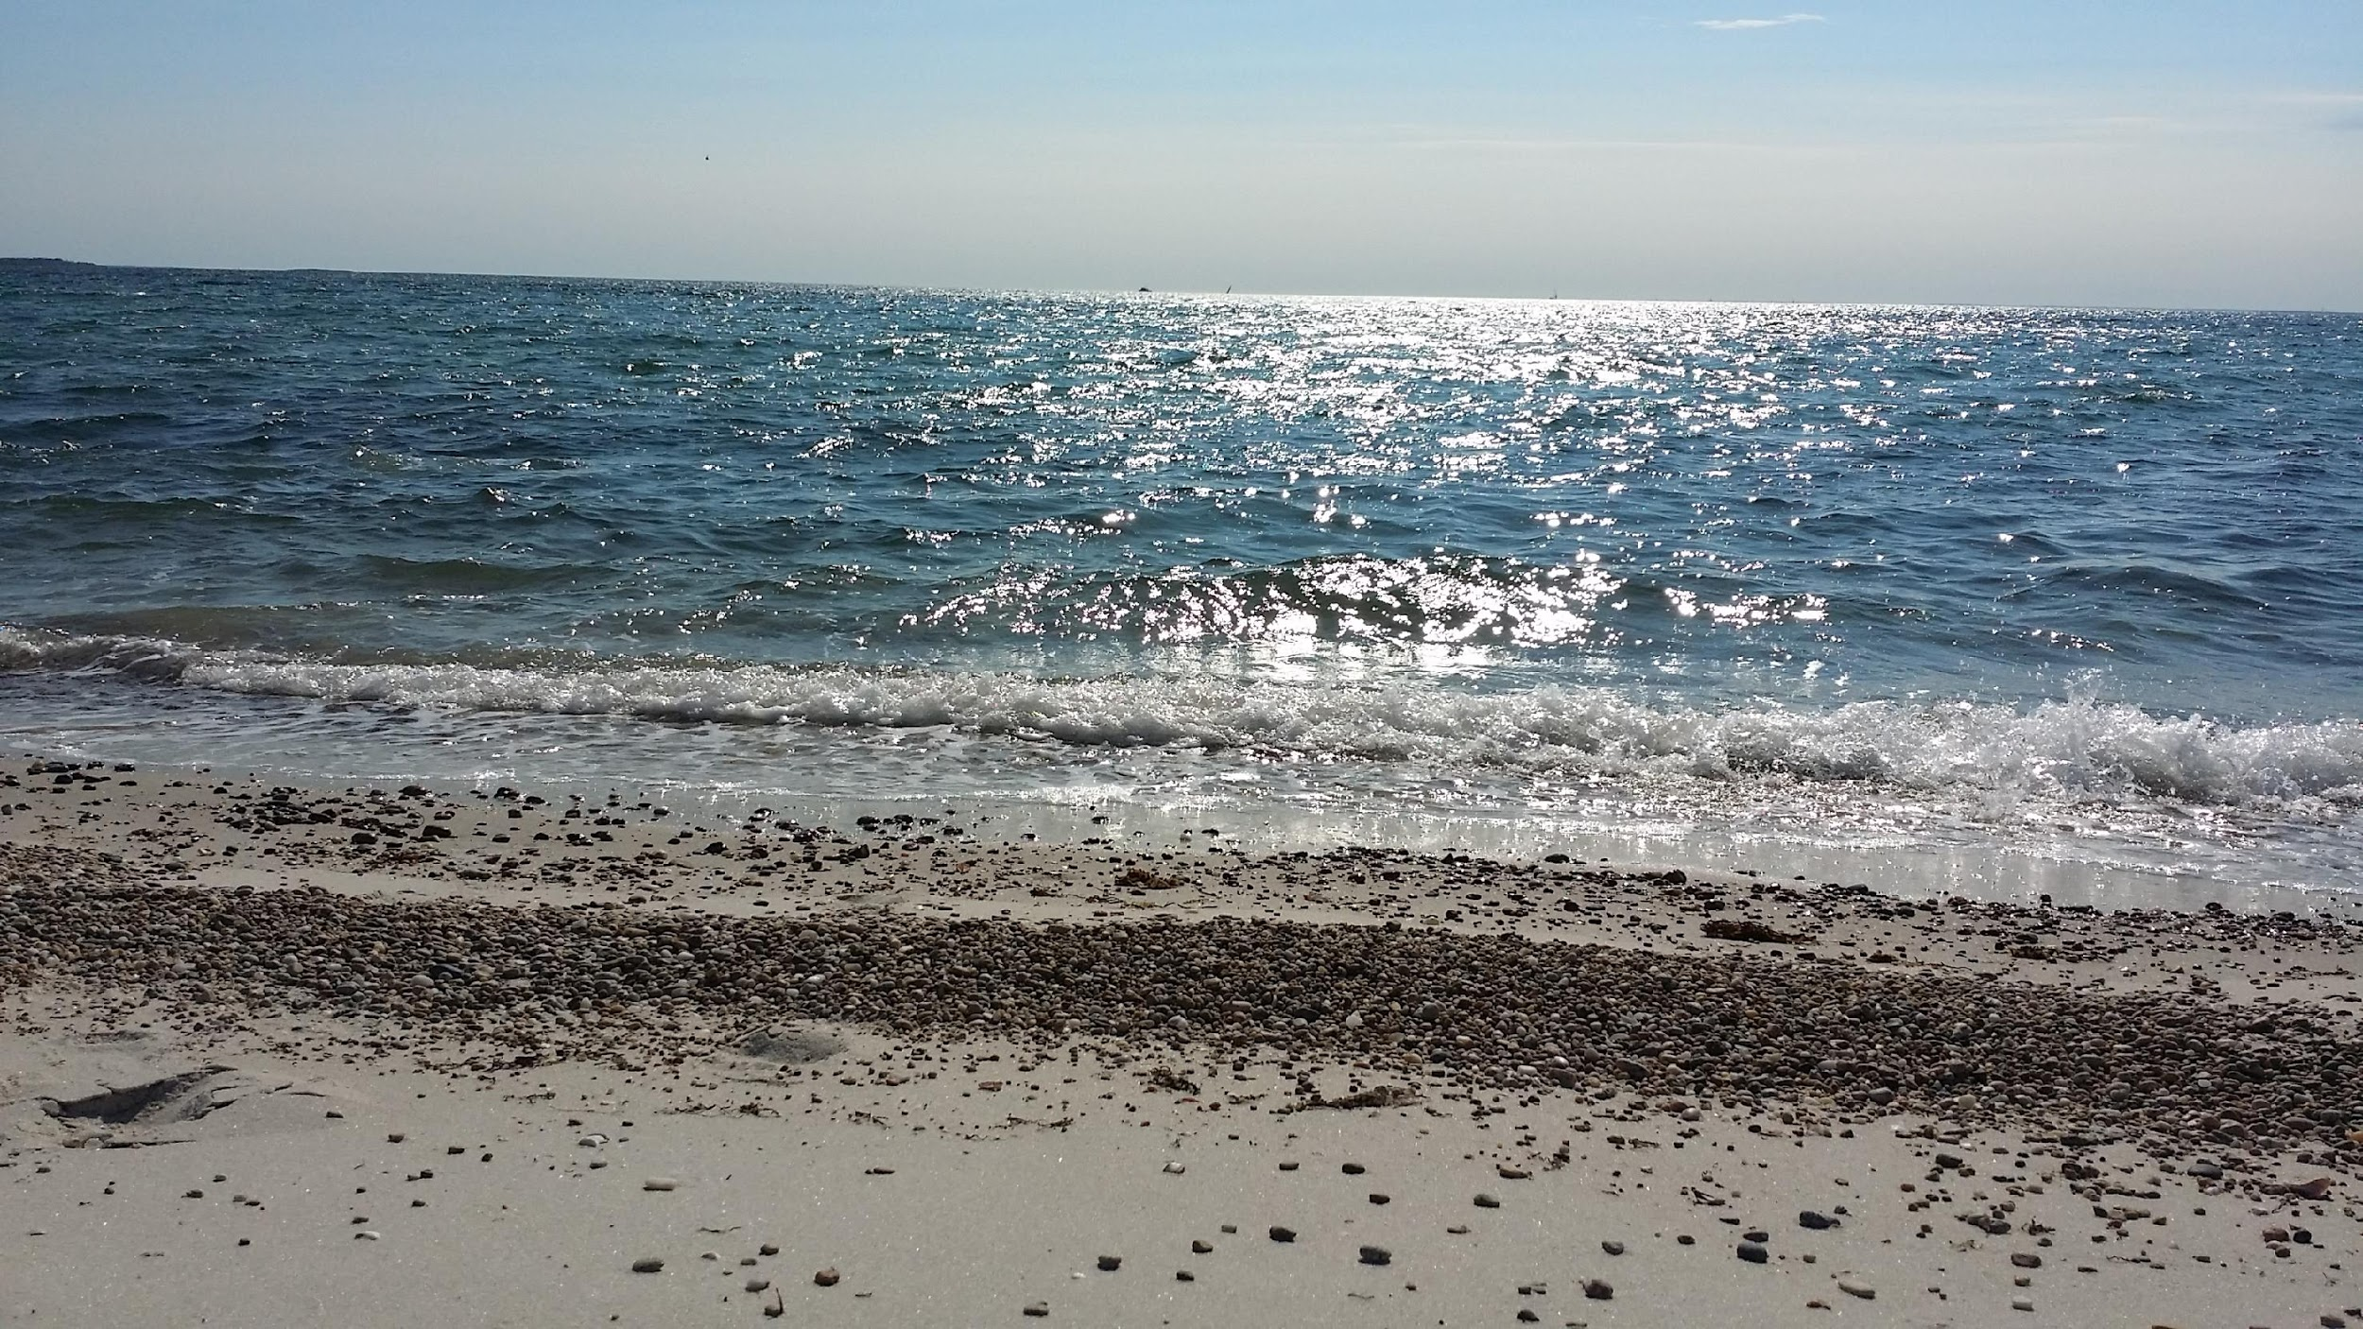
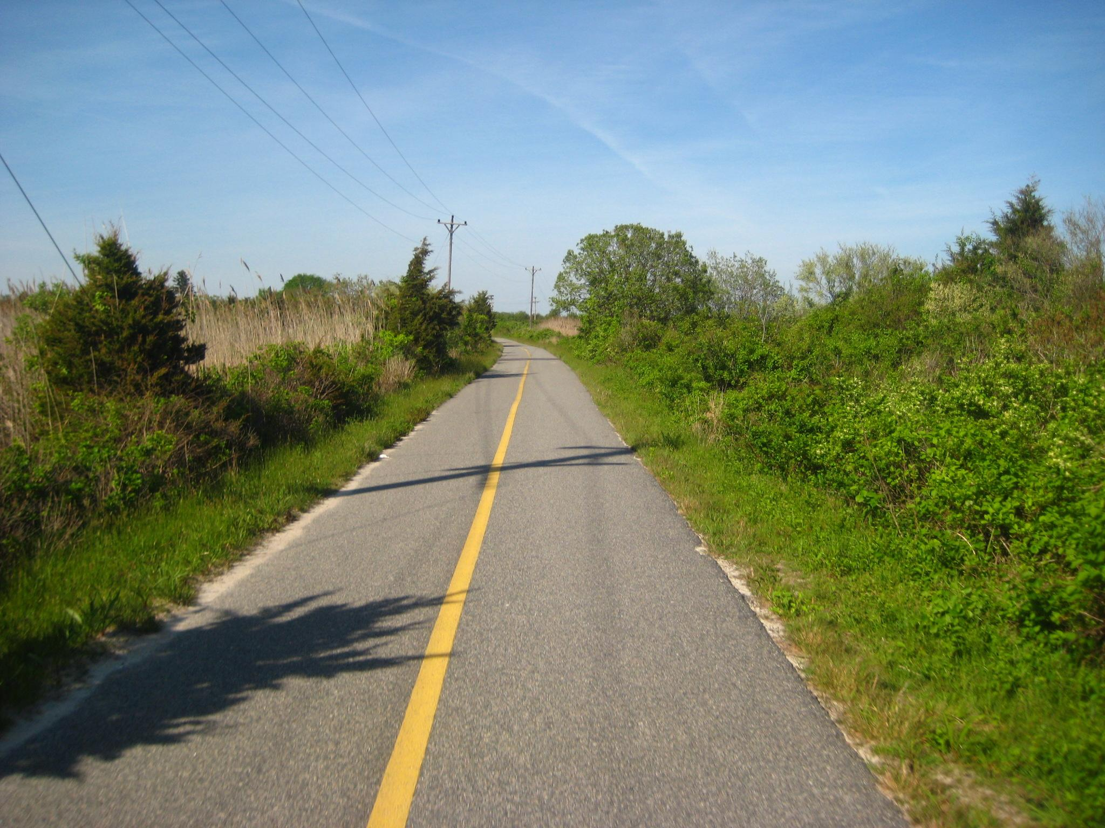
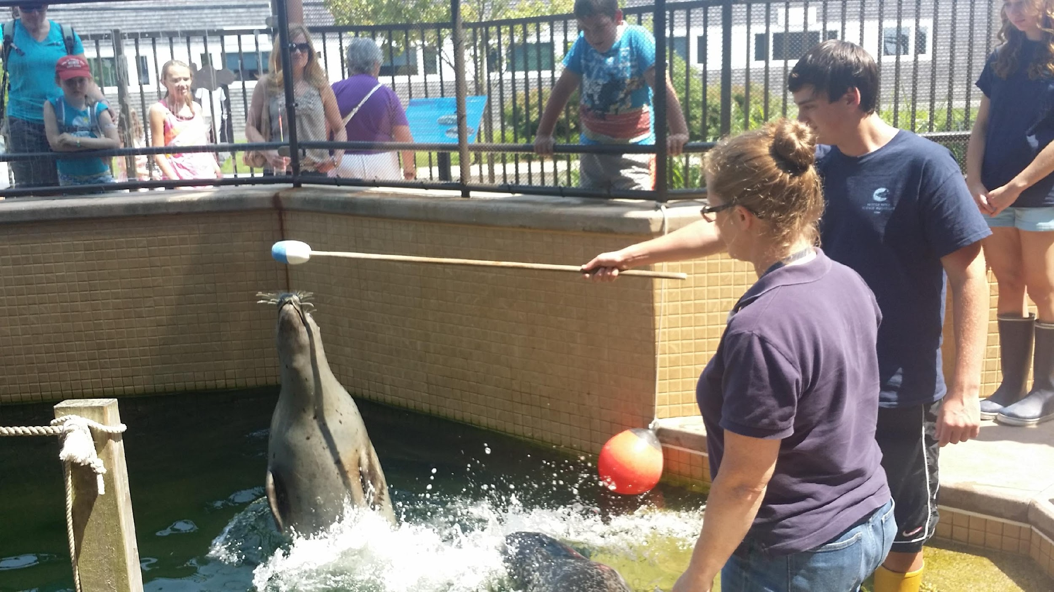
Woods Hole:
Little Village…
Notes:
What are the necessary skills for success as a Geoscientist?
Presentation skills – poster and oral: PEP students give an oral presentation about their summer research at their symposium; Here is a picture of an informal poster the students gave in one of their modules
Group work/collaboration – almost all the coursework requires group work
Required coursework – specific courses need to be completed, we aim to give students one of those academic courses covering multiple topcs
Research experience and skills
Other related skills, such as reading a map!
10

Slide 11
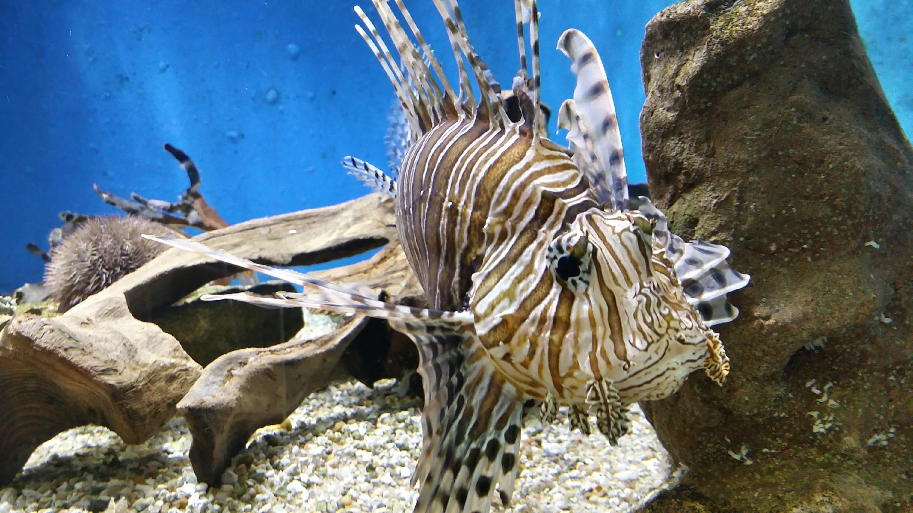
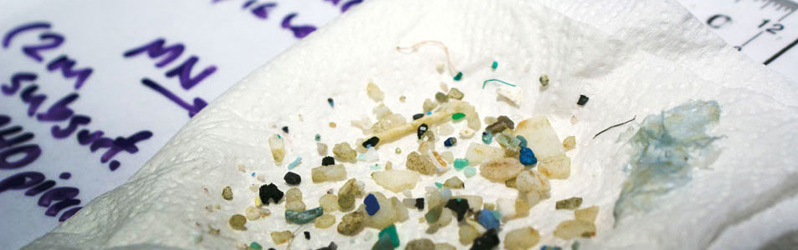
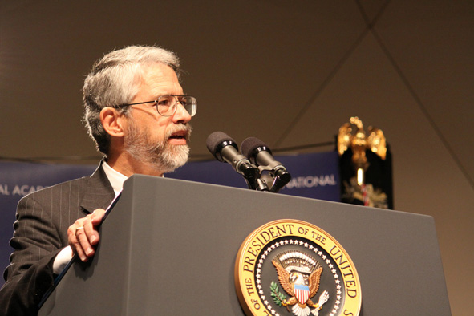
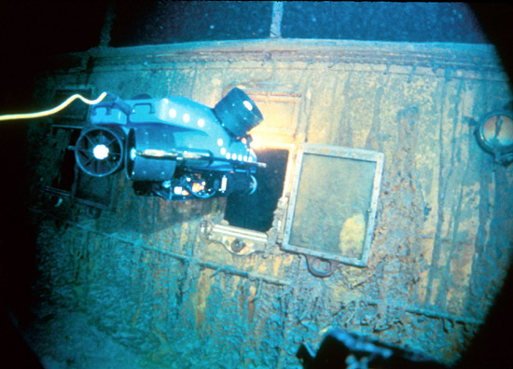
Woods Hole:
Big Science!
Sea.edu
Sciencepress.org
WHOI.edu

Slide 12
Acknowledgements
&
Contact Information
PEP Staff
Ambrose Jearld, George Liles, Benjamin Gutierrez, Benjamin Harden, Kwanza Johnson, and Onjale Scott-Price
WHDI/DAC
Peg Brandon, Jon Hare, Max Holmes, Sue Natali, Robert Thieler, David Mark Welch, and Hauke Kite Powell
Friends of PEP
Emorcia Hill and Scott Branco
PEP Alumni
153 Interns who have completed the PEP program
Ambrose Jearld
(ajearld@aol.com)
George Liles
(george.liles@noaa.gov) or 508.495.2318
Kwanza Johnson
(kwanza.johnson@noaa.gov)or
508.495.2177

Slide 13

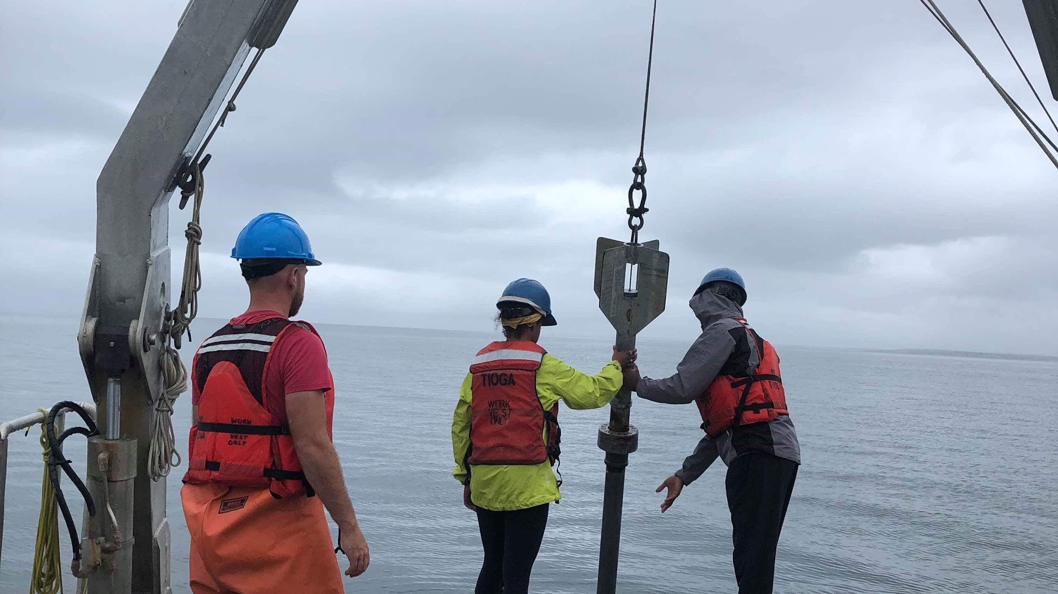
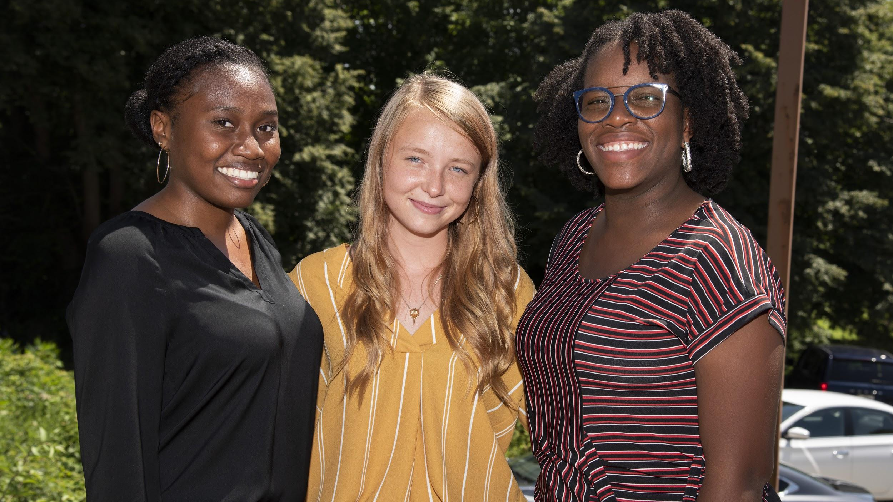
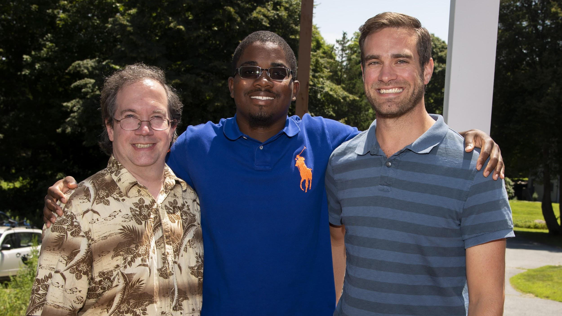

Slide 14

