Slide 1
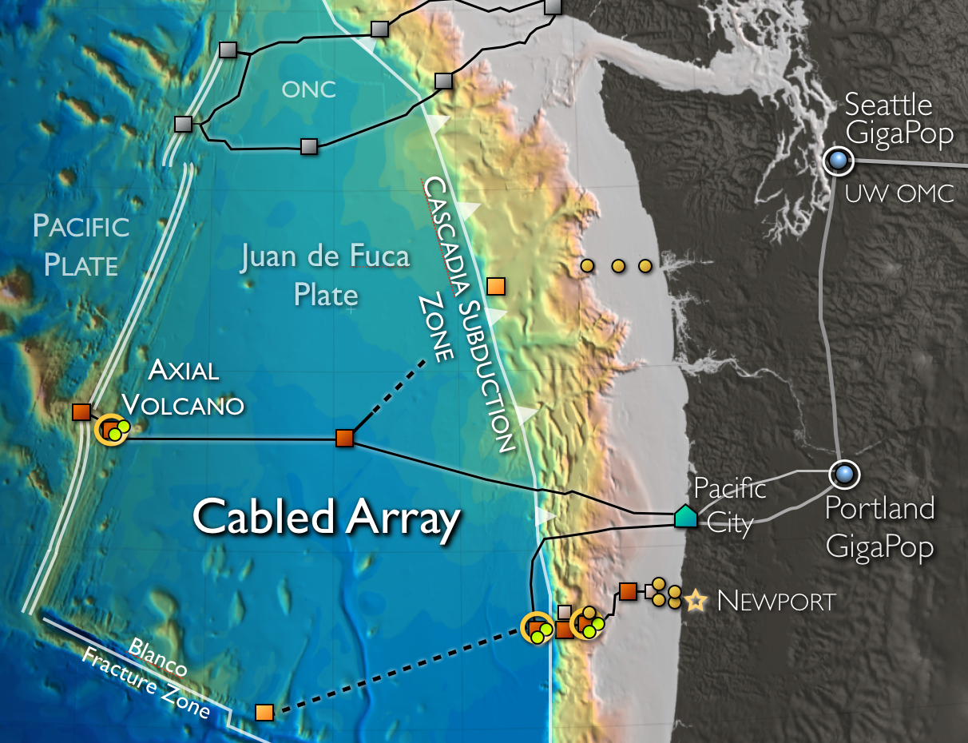
Regional Cabled Array
Primary Infrastructure
900 km of high-bandwidth (10 Gbs) and high-power (8 kW) primary cables and 7 nodes (seafloor substations), and shore station
Secondary Infrastructure
18 junction boxes (substations) provide 375V
and 1 Gb/s
6 up to 2900 m-tall moorings with instrumented wire crawlers connected to the cable
>140 instruments provide 24/7 real-time data with two-way communication – response capabilities
Highly expandable for science, education, industry
Primary Nodes
Cabled moorings

Slide 2
Cabled Axial Seamount: 2015 Eruption
Largest & most active volcano on Juan de Fuca Ridge
Eruptions in 1998, 2011, and 2015
Observations of 24 April 2015 eruption:
  >8,000 earthquakes
  Seafloor fell 2.4 m
  >30,000 explosive events associated with eruption of thick lava flow
  Billions of novel microbes ejected into overlying water column
Chadwick et al. (GRL 2016), Nooner & Chadwick (Science 2016), Wilcock et al. (Science 2016), …

Slide 3
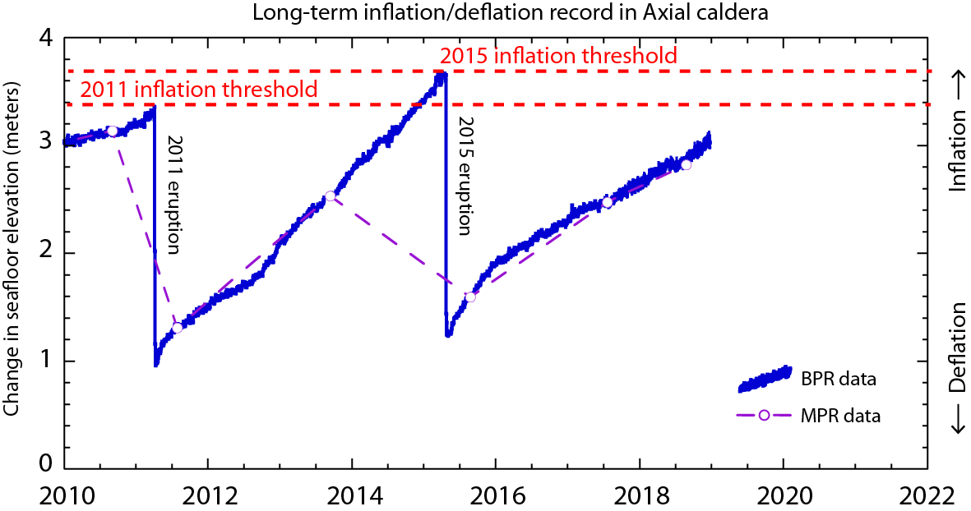
Cabled Axial Seamount: Prediction
First place in world ocean where prediction of a submarine eruption can be tested. Chadwick & Nooner (https://www.pmel.noaa.gov/eoi/axial_blog.html).

Slide 4
Opportunities
Use the data
  GUI data portal, raw data archive, M2M interface, ERDDAP
Modify the sampling
  Change glider or AUV track, change sample timing
Add instruments to a platform
  Self-powered, self-logging or connected to OOI infrastructure
Add platform to an Array
  Supplemental glider, nearby mooring
Ancillary work on OOI cruise
Potential Pioneer Array move in fall 2023

Slide 5
2019 Performance To Date
Array | Asset Type | Number of Science Sensors (AWP) | Number of Science Sensors Deployed | Expected Science Data
Total OOI: | Fixed Assets | 593 | 564 | 91%
Pioneer | Fixed Assets | 140 | 113 | 84%
Endurance | Fixed Assets | 172 | 140 | 82%
Irminger | Fixed Assets | 113 | 113 | 95%
Station Papa | Fixed Assets | 43 | 43 | 100%
55 South | Global Surface Mooring | 55 | 55 | 80%
Regional Cabled Array | Array Total | 147 | 136 | 88%

Slide 6
Core Science Instruments
Instrument | 5-Letter Code | Vendor | Model
Conductivity, Temperature, Depth (CTD) | CTDBP | SeaBird | SBE 16plusV2
 | CTDGV, CTDAV | SeaBird | SBE GP
Seafloor pressure | PRESF | SeaBird | SBE 26plus
Dissolved Oxygen | DOFST | SeaBird | SBE 43F
 | DOSTA | Aanderaa | AADI optode 4831, 4330
Acoustic Doppler Current Velocity (ADCP) | ADCPA | Teledyne RDI | Explorer 600 DVL Navigator 600
 | ADCPS, ADCPT | Teledyne RDI | WorkHorse, LongRanger
Single Point Velocity | VELPT | Nortek | Aquadopp
3-D Velocity | VEL3D | Nortek | Vector
Surface Wave Spectra | WAVSS | Axys Technologies | TRIAXYS
Direct Covariance Flux | FDCHP | WHOI | DCFS
Bulk Meteorology | METBK | Star Engineering | ASIMET

Slide 7
Core Science Instruments, cont.
Instrument | 5-Letter Code | Vendor | Model
Multi-Channel Fluorometer | FLORT | WET Labs | ECO Triplet ECO Puck BB3
Optical Attenuation and Absorption | OPTAA | WET Labs | AC-S
Photosynthetically Available Radiation (PAR) | PARAD | WET Labs | ECO PAR
 | PARAD | Biospherical | QSP
Spectral Irradiance | SPKIR | Satlantic | OCR507
Nitrate | NUTNR | Satlantic | SUNA
Partial Pressure of CO2 in Air & Water | PCO2A | Pro-Oceanus | pCO2-PRO with ATM
Partial Pressure of CO2 in Water | PCO2W | Sunburst Sensors | SAMI-CO2
pH | PHSEN | Sunburst Sensors | SAMI-pH
Bio-Acoustic Sonar | ZPLSC | ASL Environmental | AZFP
Pioneer Array: ~18 instrument types, >25 instrument models, ~150 total instruments

