Slide 1
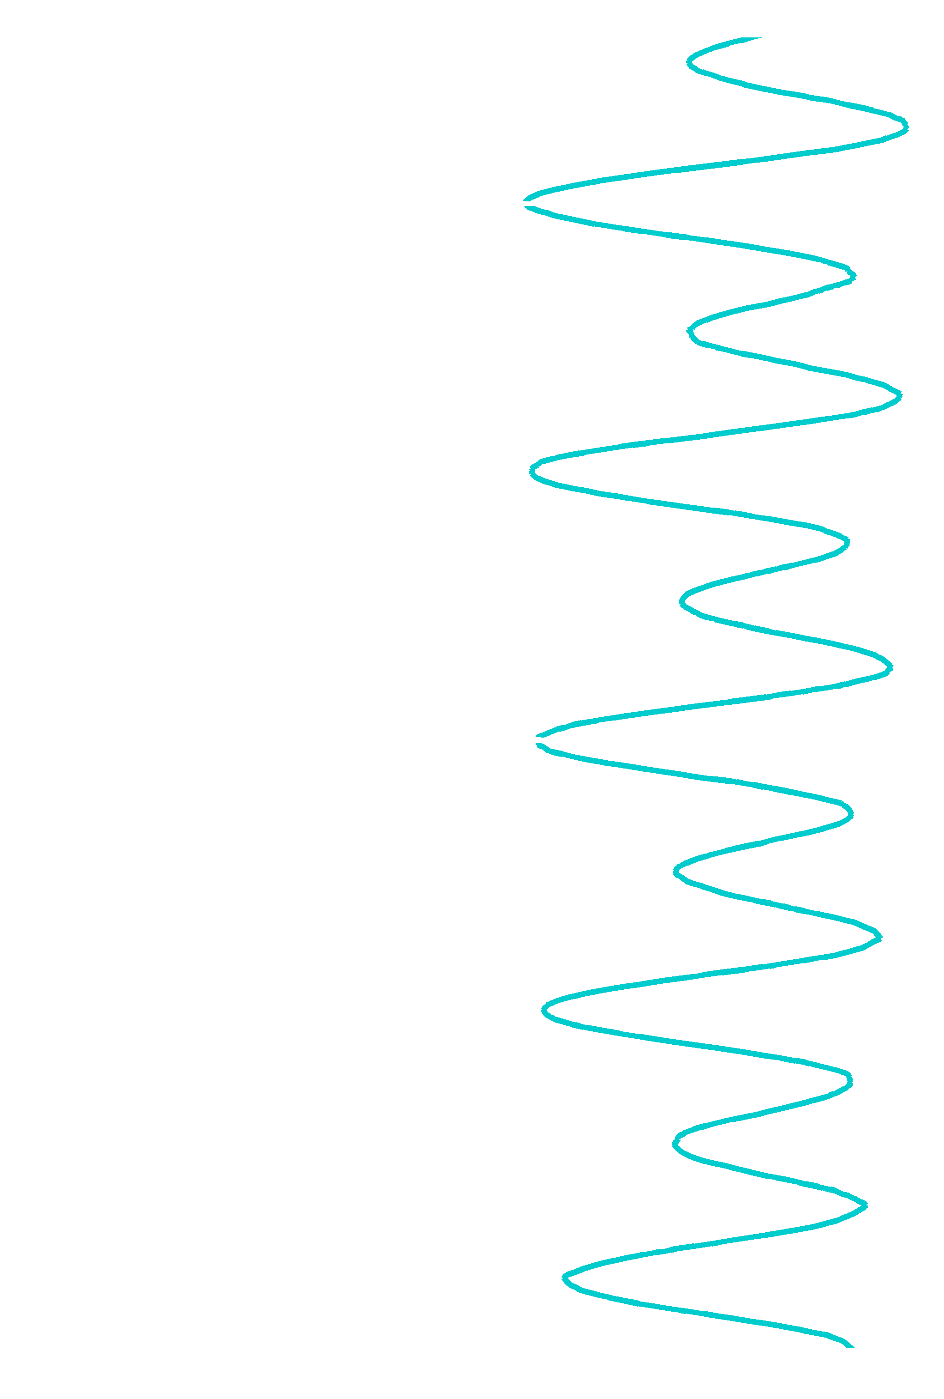
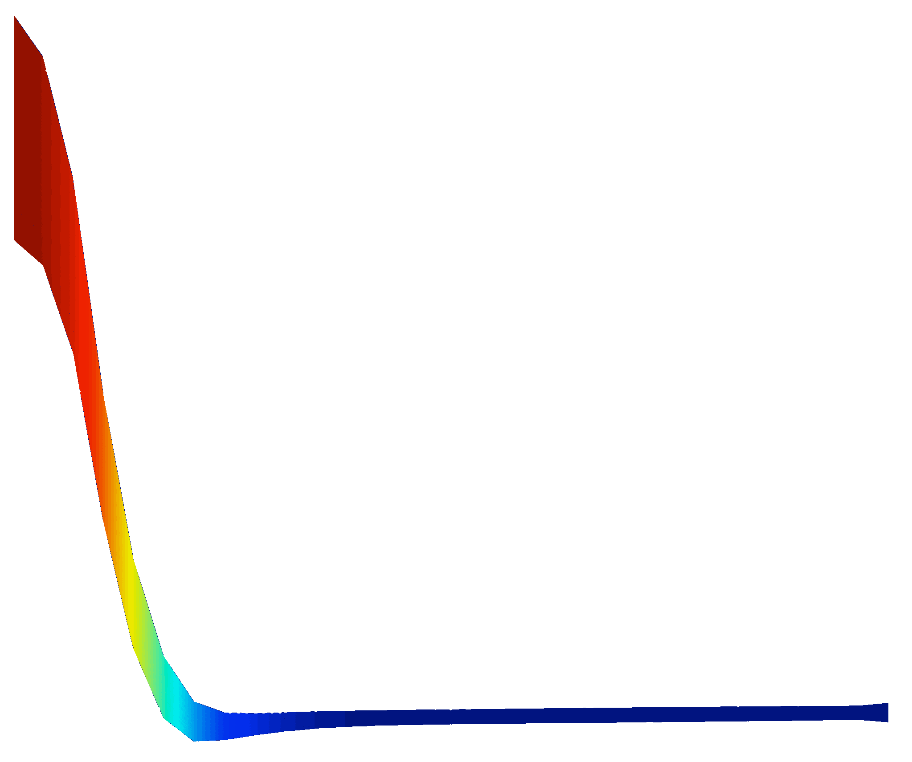

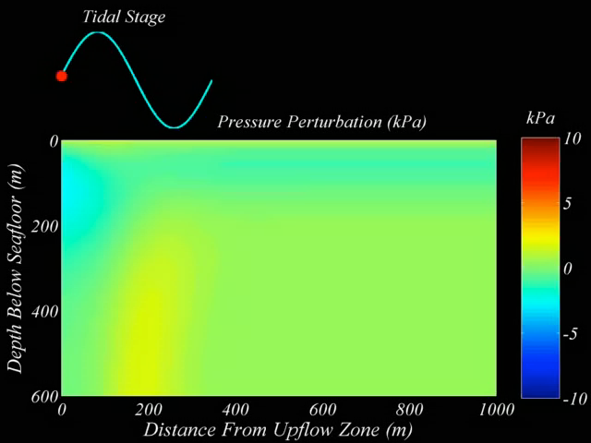

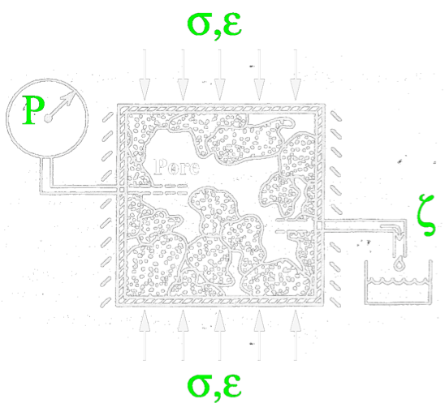
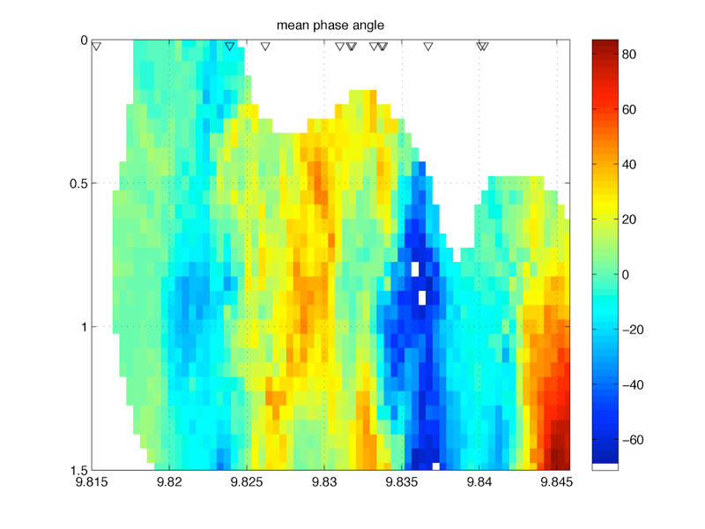
I Poroelasticity:
A Review of Poroelastic Theory and its Application to Seafloor Hydrothermal Systems
Tim Crone
5 March 2015

Slide 2
Outline
Definition of poroelasticity
Why study poroelasticity?
Why does poroelasticity seems so complicated? Some historical context.
Basic theory
One-dimensional analytical models
Two-dimensional numerical models
Real-world use cases

Slide 3
What is poroelasticity theory?
“The theory of poroelasticity addresses the time-dependent coupling between the deformation of rock and fluid flow within rock.” - Herbert Wang (2000)
Small deformations (i.e., reversible process, no faulting, linear poroelastic constants)
Short timescales (i.e., no creep, no plastic or viscoelastic deformation)

Slide 4
Why study poroelasticity?

Slide 5
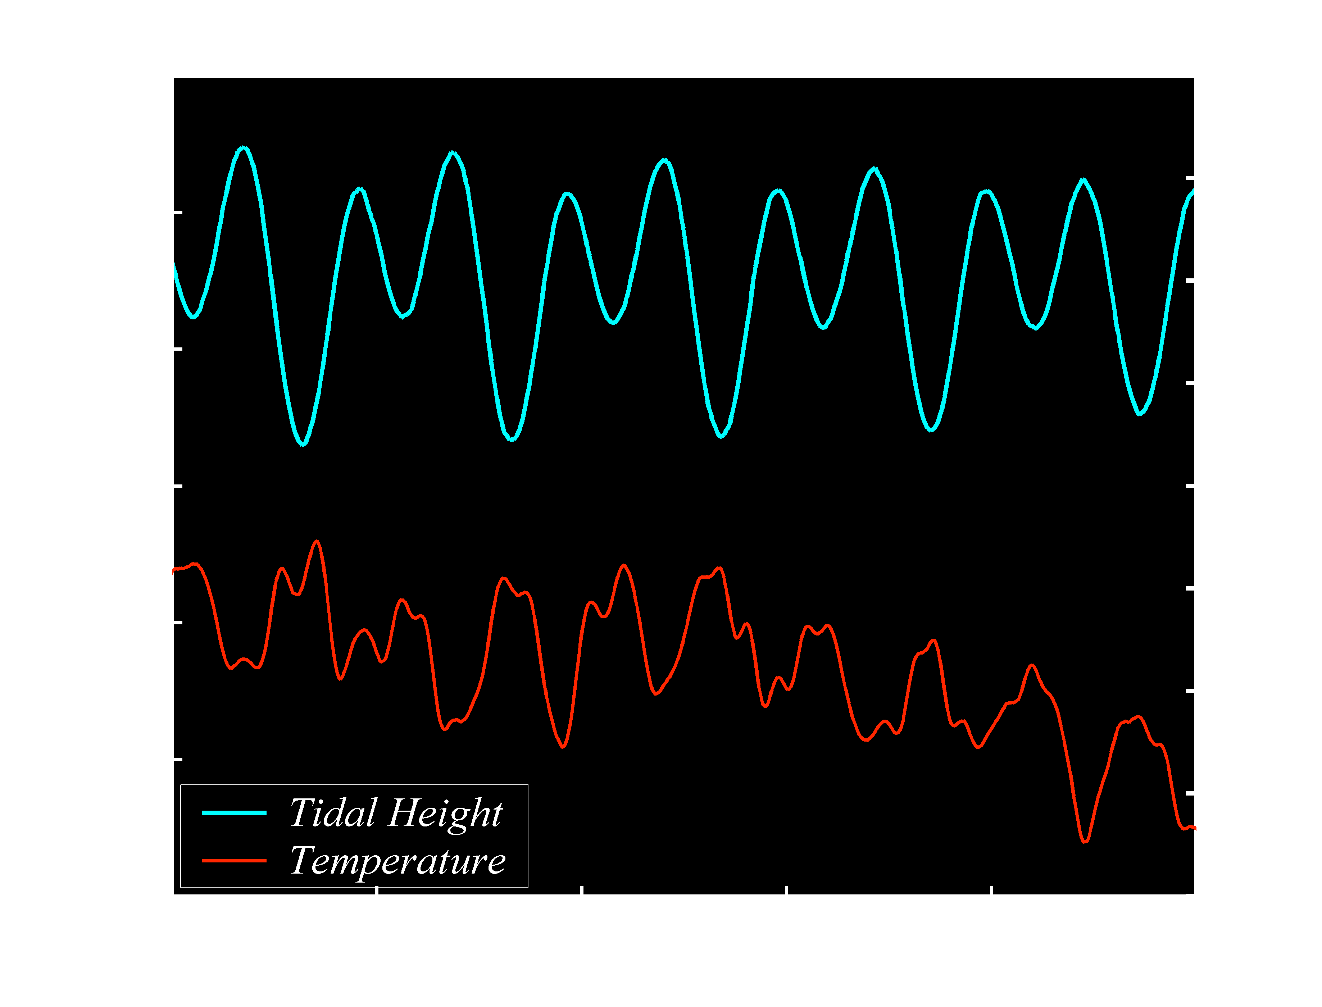
After Larson, 2007

Slide 6
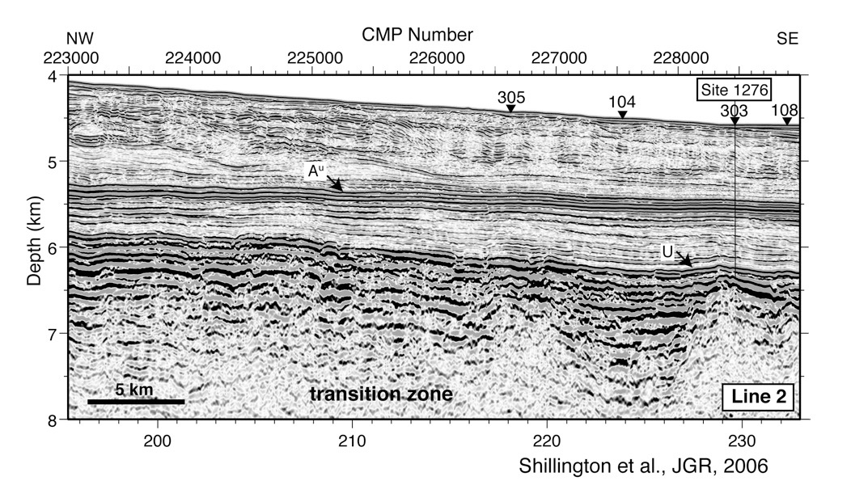

Slide 7
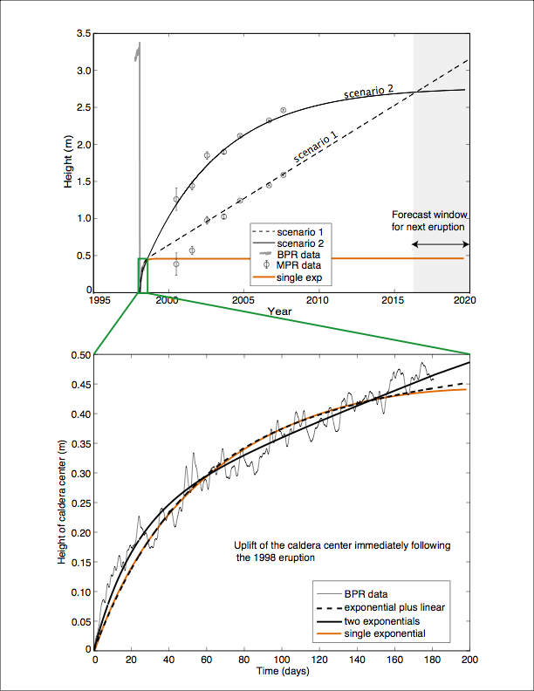
Figure provided by Scott Nooner

Slide 8
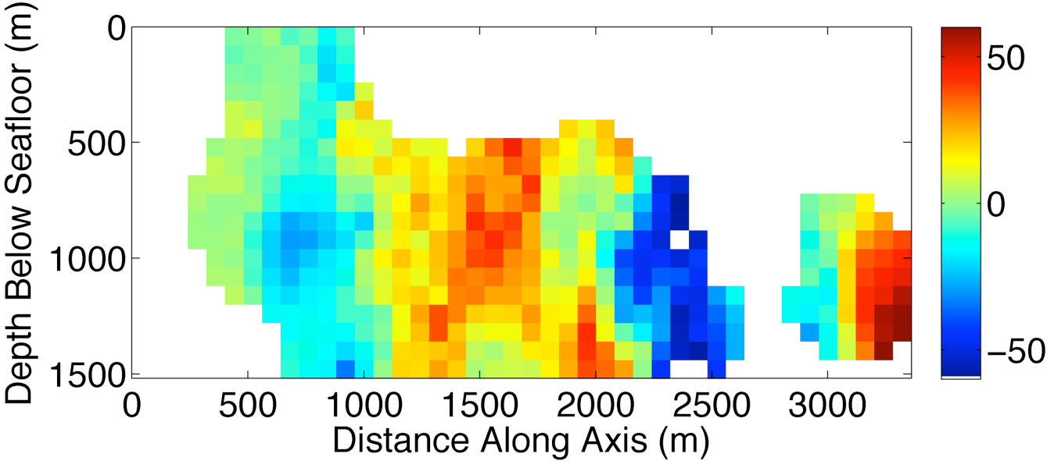
Phase Lag of Tidally Triggered Earthquakes
Data
Depth (km)

Slide 9

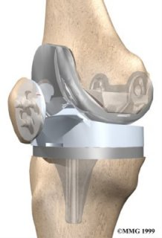
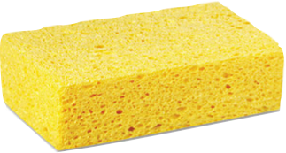

Slide 10
Why does poroelasticity seem so complicated?

Slide 11
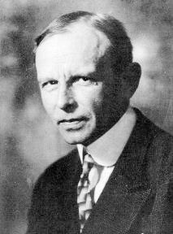
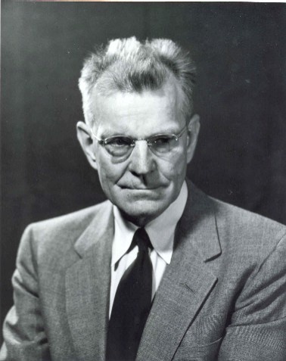

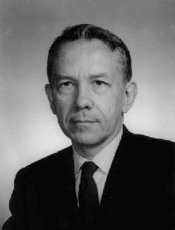
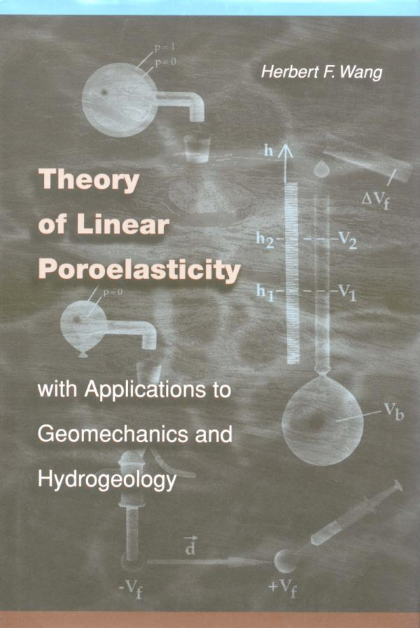
Historical Development
Karl Terzaghi
(1883 - 1963)
M. King Hubbert
(1903 - 1989)
Maurice Biot
(1905 - 1985)
Herbert Wang
“Erdbaumechanik auf bodenphysikalischer Grundlage” (1925)
“Darcy’s law and the field equations of the flow of underground fluids” Pet. Trans. (1956)
“Theory of Linear Poroelasticity” (2000)
“General theory of three-dimensional
consolidation” J. Appl. Phys. (1941)
Notes:
mechanics of earthworks based on rudiments of soil physics

Slide 12
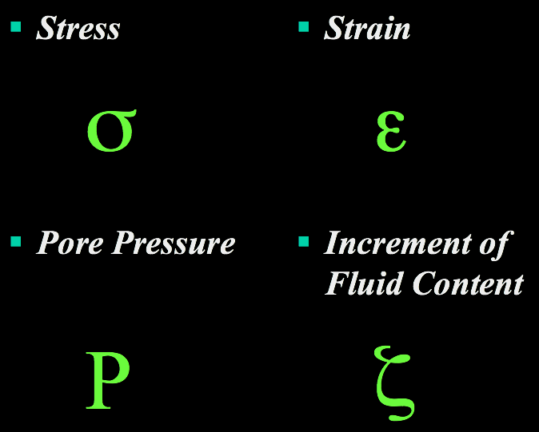
Four Primary Variables

Slide 13
After Wang, 2000

Slide 14

It still seems complicated!

Slide 15
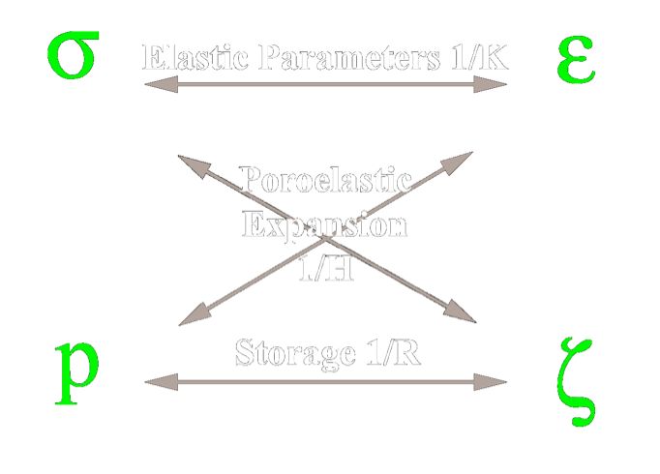

Slide 16
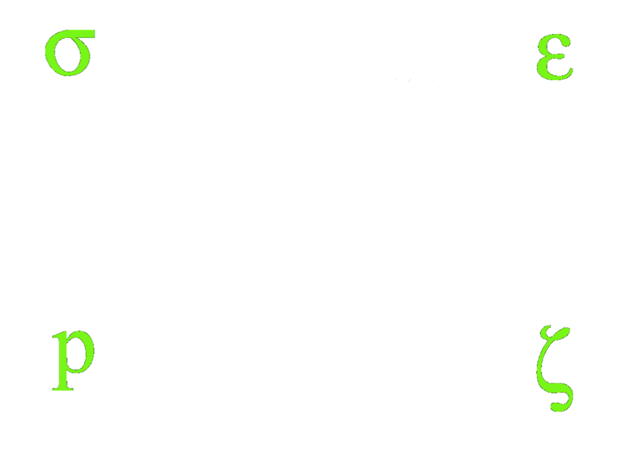

frame (matrix) bulk modulus
solid (grain) bulk modulus
fluid bulk modulus
shear modulus
fluid viscosity
permeability
porosity

Slide 17
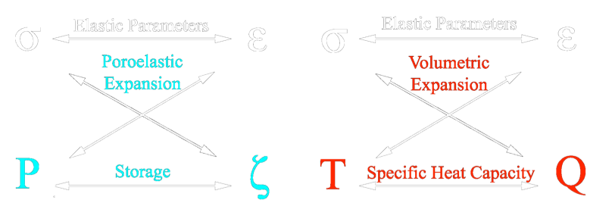
A Thermoelastic Analogy:

Slide 18

1-D Pore Pressure Equation
=
“Loading Efficiency”
=
“Hydraulic Diffusivity”

Slide 19
1-D Pore Pressure Equation

Slide 20

Poroelasticity in a Flask

Slide 21
1-D Pore Pressure Equation

Slide 22


1-D Analytical Solution

Slide 23
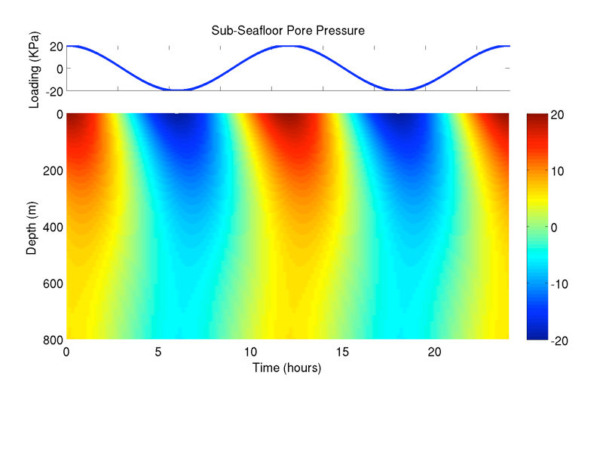
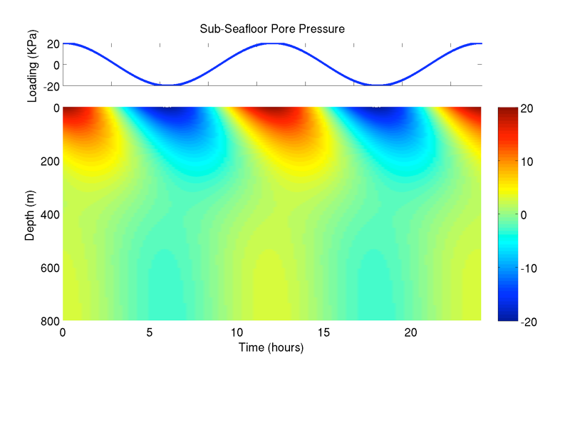
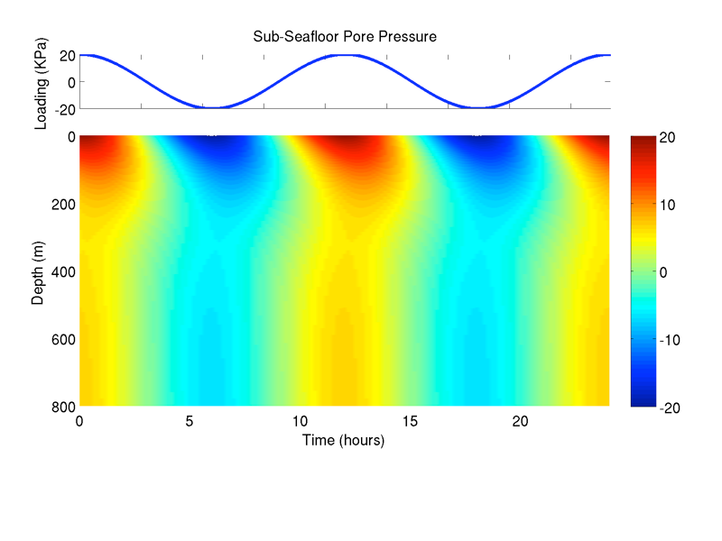
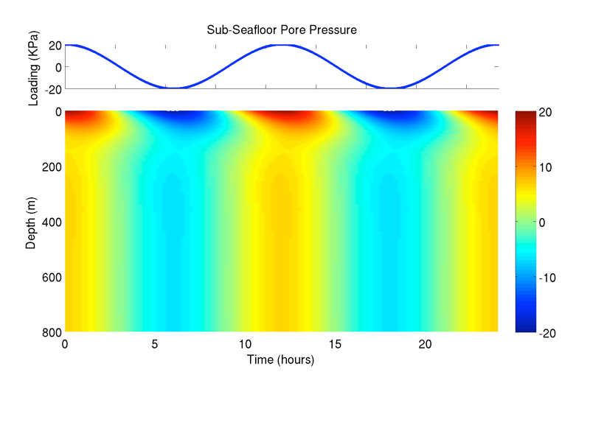
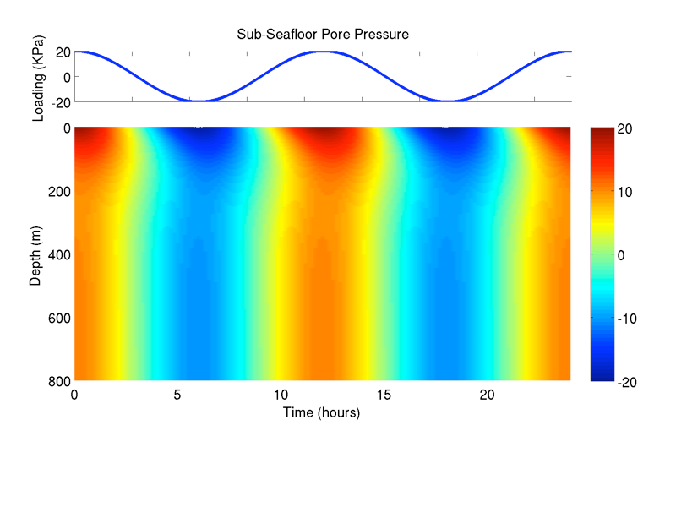
Changing
Permeability
Changing Frame
Stiffness (K)

Slide 24
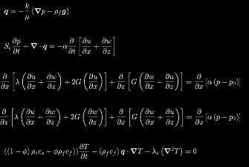
2-D Equations
Darcy’s Law
Pressure
Mechanical Equillibrium
Heat
After Wang 2000, Tucotte & Schubert, 1982

Slide 25
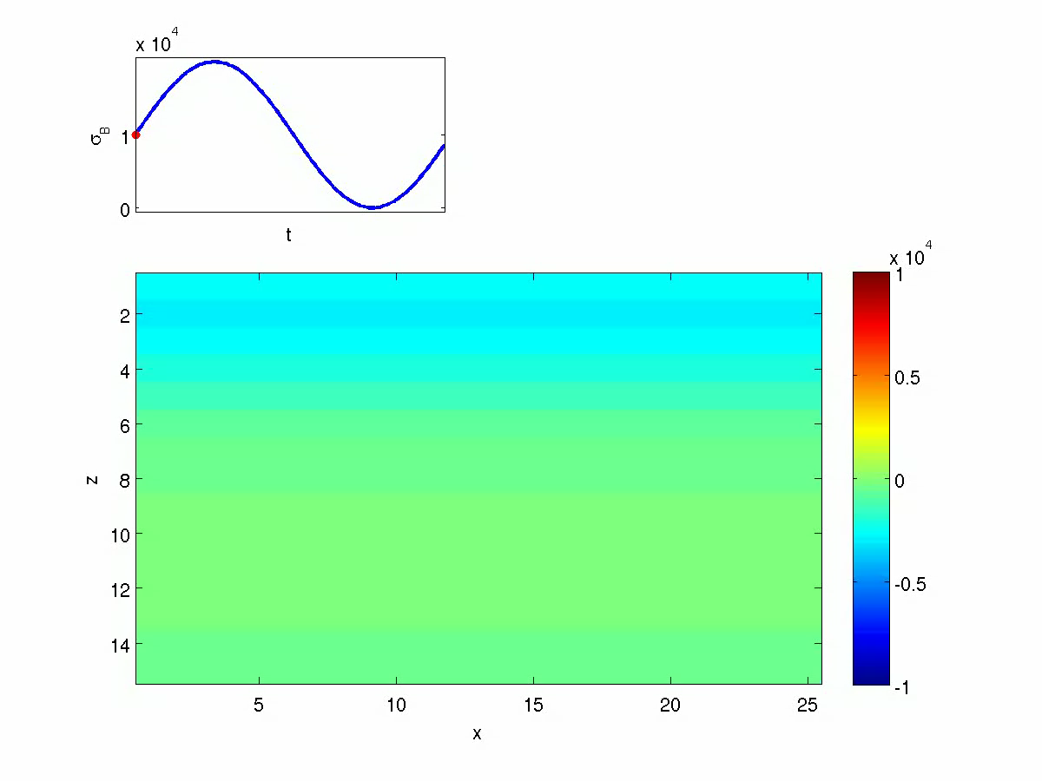
Tidal Loading

Slide 26
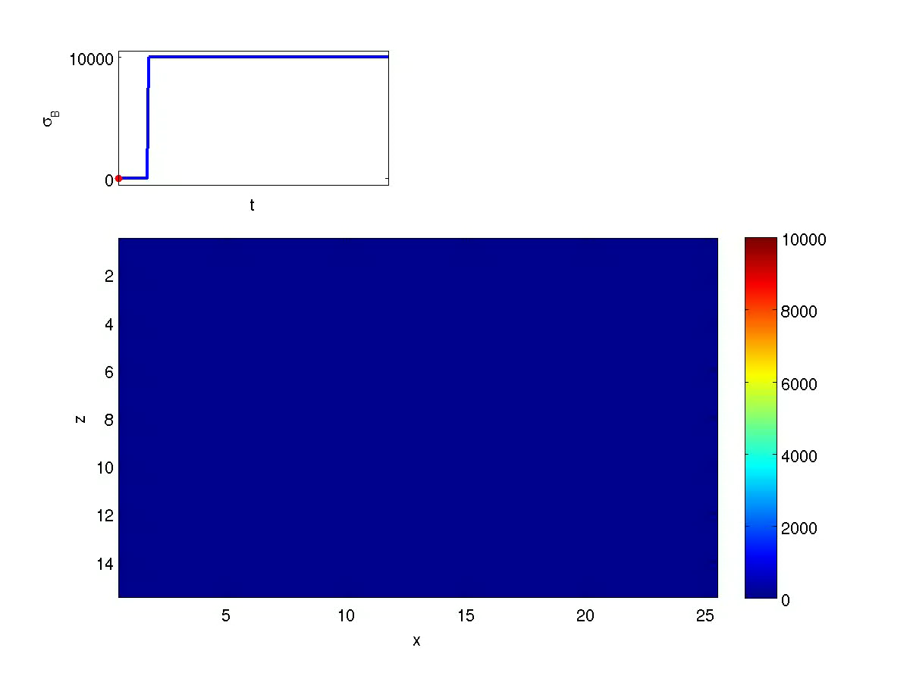
Applying a Step Load

Slide 27
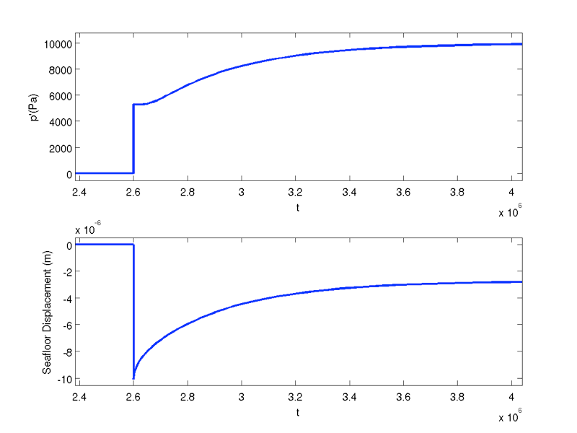

Slide 28

Horizontally Varying Permeabiltiy
Lower Permeability
Higher Permeability

Slide 29

Horizontally Varying Stiffness
Higher Stiffness (K)
Lower Stiffness (K)

Slide 30
Real-World Use Cases
Tidal loading

Slide 31
After Larson, 2007

Slide 32
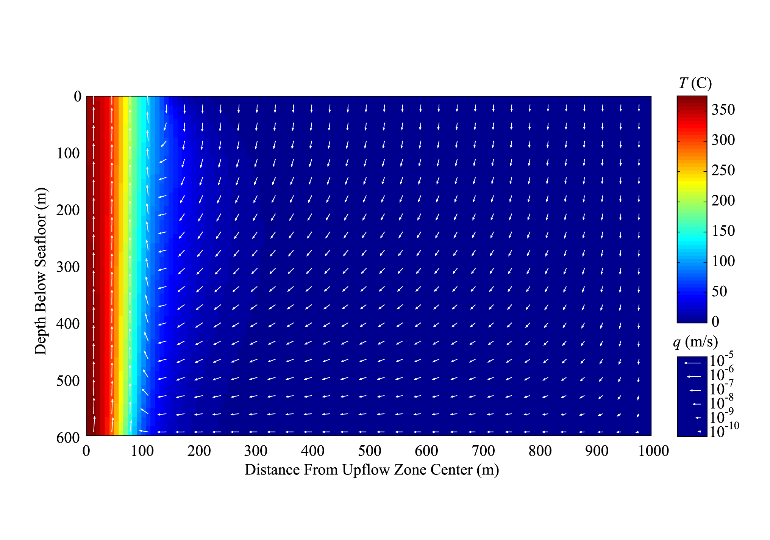
Steady-State Model Solution:

Slide 33
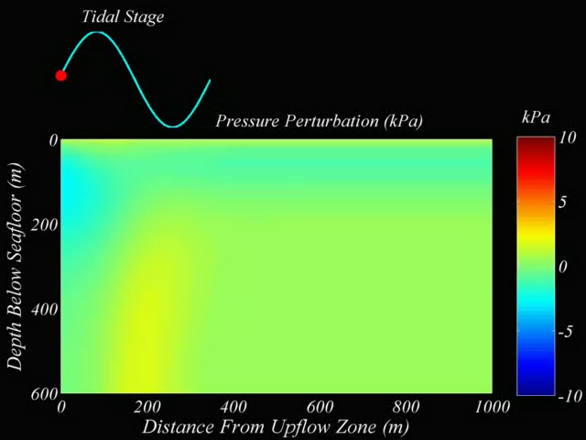

Slide 34
Tidal Earthquake Triggering

Slide 35
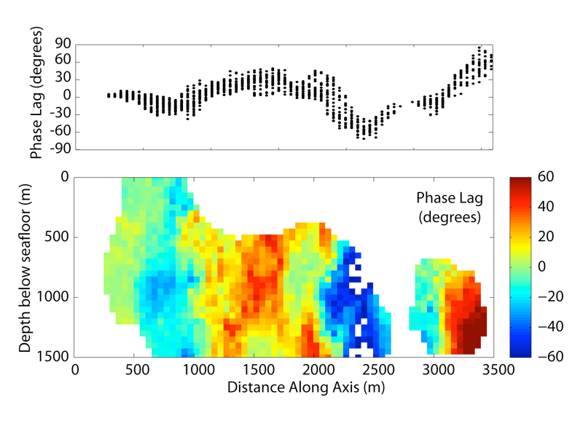


After Stroup, et al. (2009)

Slide 36
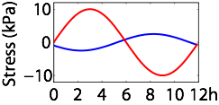
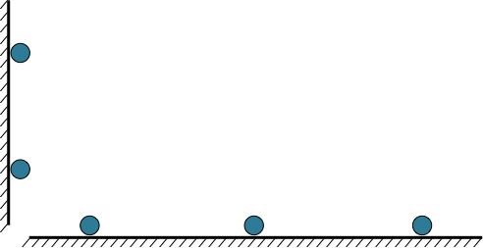
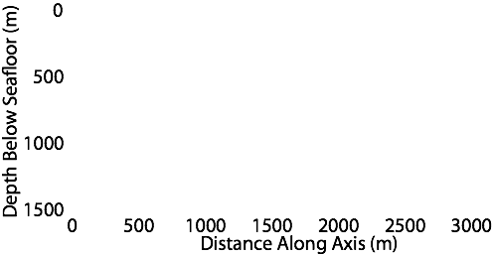
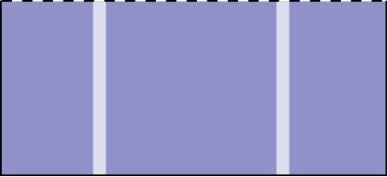
Earth Tide
Ocean Loading
Ocean Loading
Poroelastic
Medium
High Permeability Zone
High Permeability Zone
Earth
Tide

Slide 37
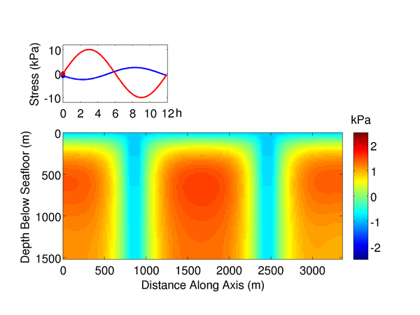
Pore Pressure Perturbation
Earth Tide
Ocean Loading
Compression

Slide 38
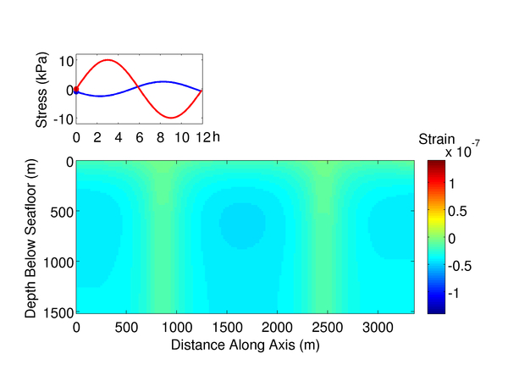
Effective Stress Perturbation
Earth Tide
Ocean Loading
kPa
4
2
0
Compression
-2
-4

Slide 39
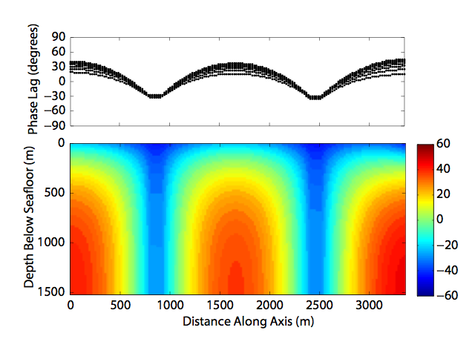
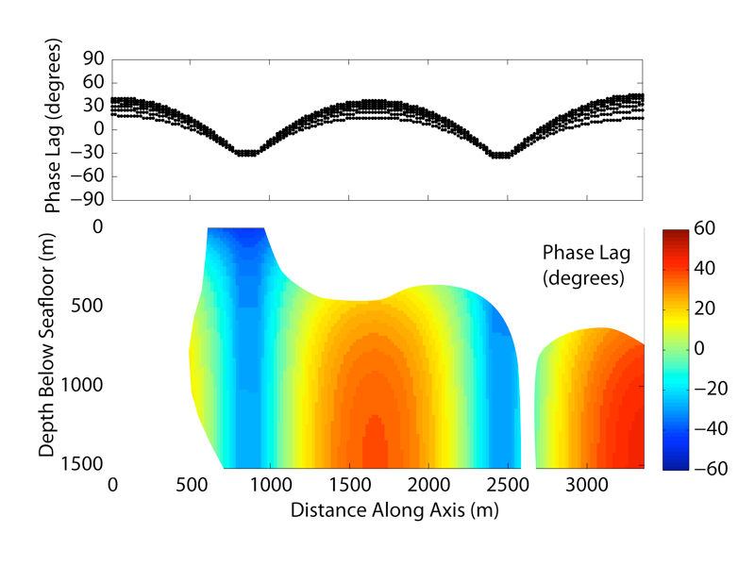
Extensional Stress Phase Lags

Slide 40
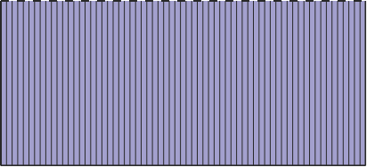
z-axesav
Earth Tide
Ocean Loading
Ocean Loading
Earth
Tide

Slide 41
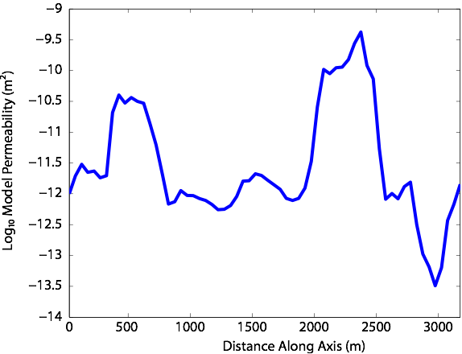
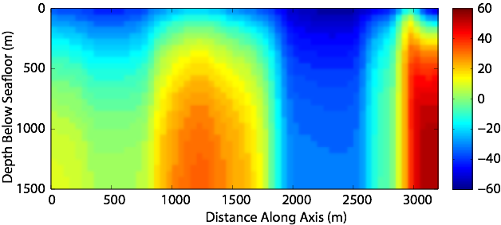
Phase Lag

Slide 42
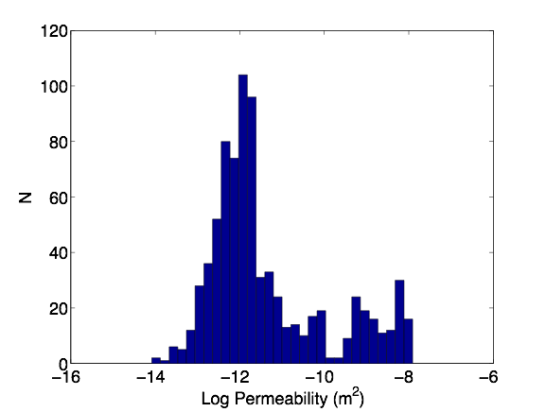
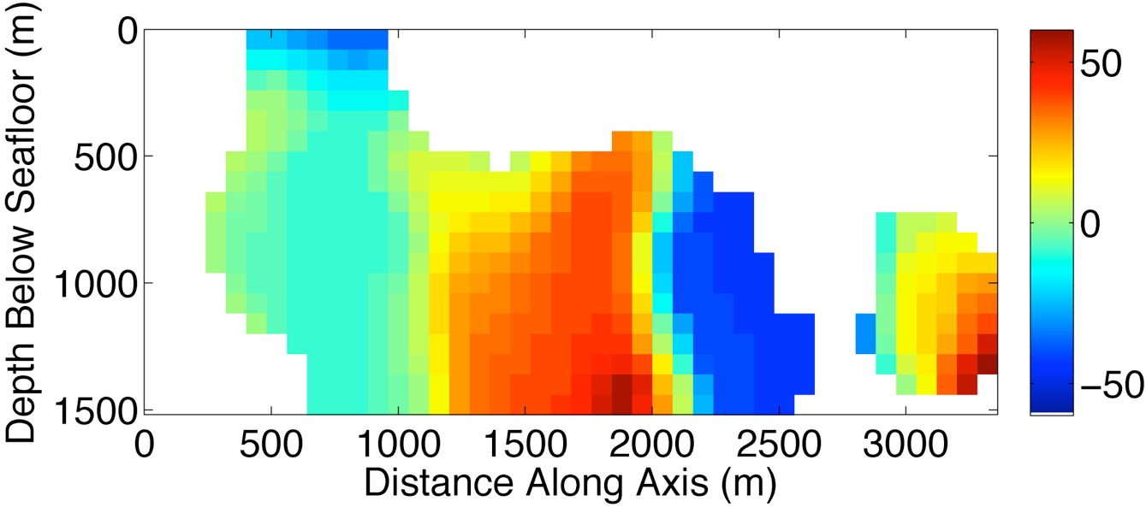
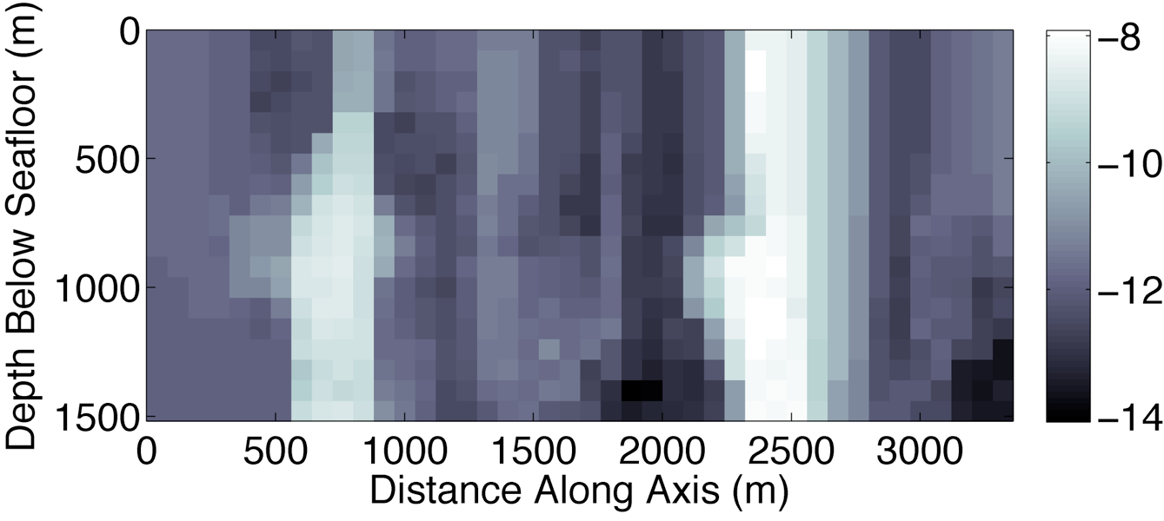
Data
Model

Slide 43
Enigmatic periodic seafloor deformation

Slide 44
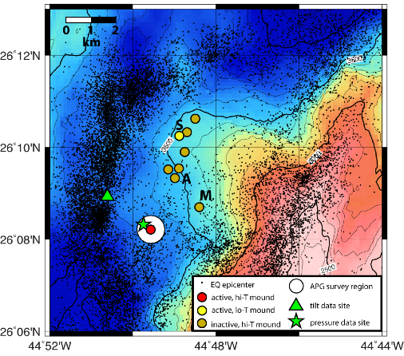

Slide 45
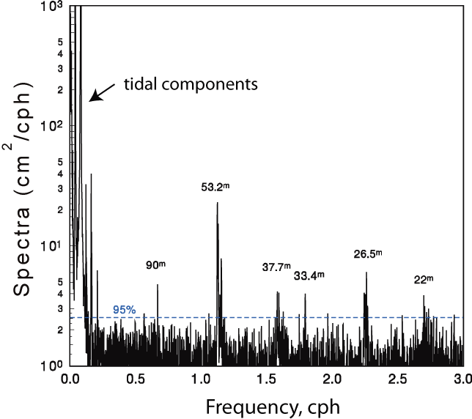

Slide 46
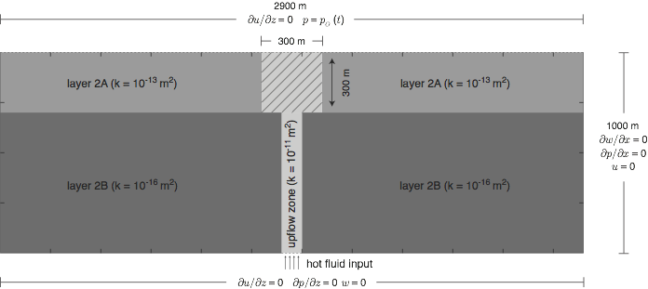

Slide 47
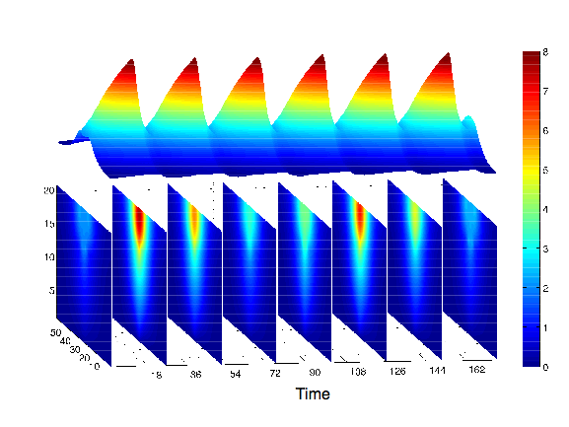

Slide 48
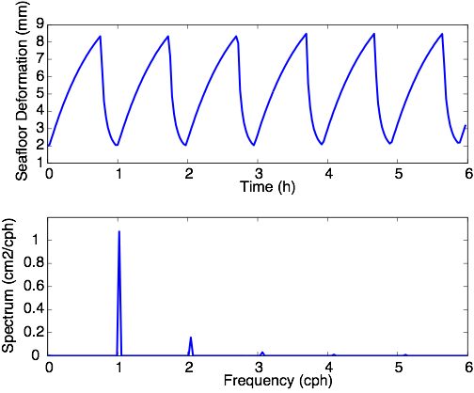

Slide 49


Slide 50
Conclusions
Poroelasticity is really cool
Poroelasticity theory isn’t as complicated as it may seem, but lots of complex behavior can be generated
Poroelasticity theory can be applied to a wide range of geophysical problems

