Slide 1
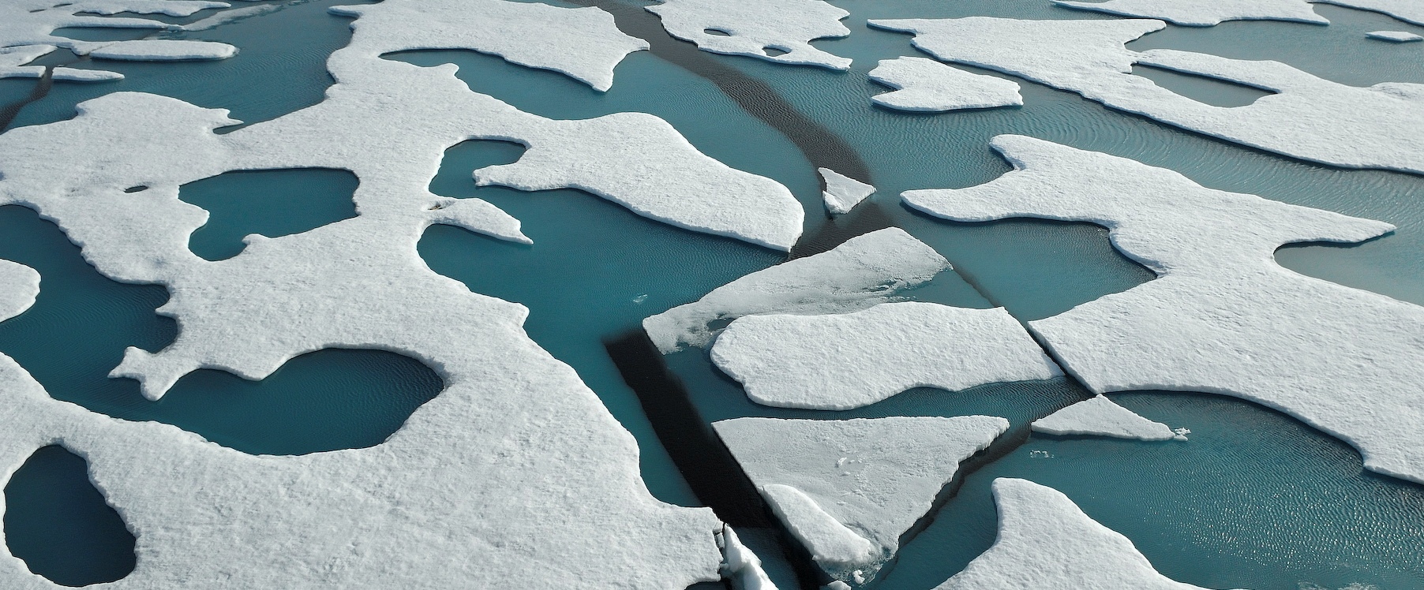
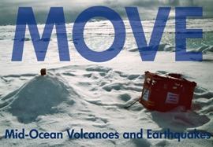

Deformation modes of magmatic and amagmatic ocean lithosphere at ultraslow spreading ridges
Vera Schlindwein
F. Schmid and
Emmy-Noether Junior Research Group MOVE
AWI Bremerhaven

Slide 2
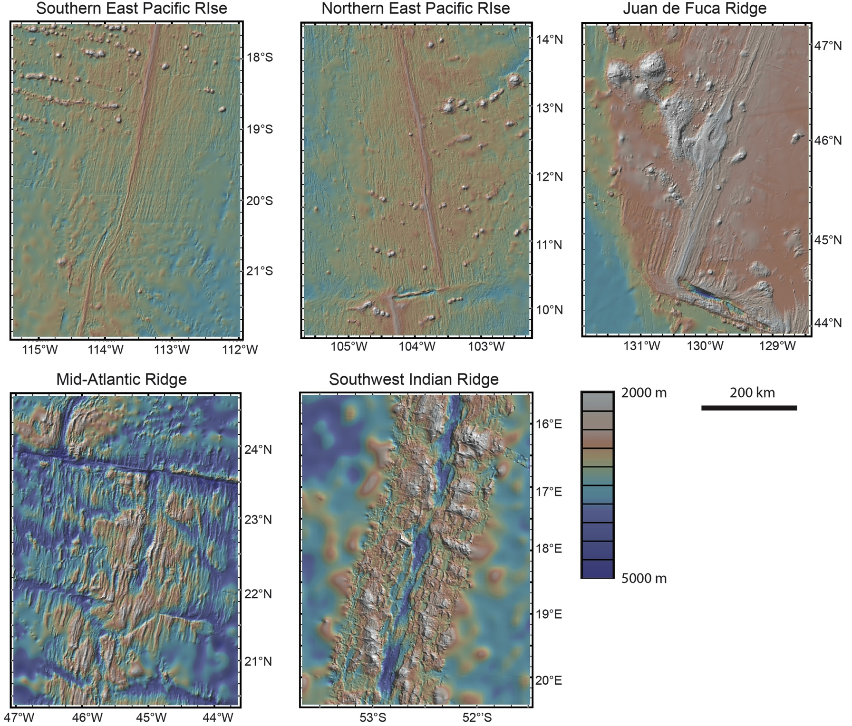
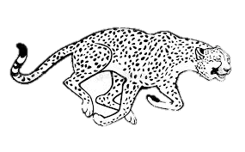

Part I: Seismicity and spreading rate
Spreading rate 
Earthquakes 
Volcanoes 
modified from Karson et al. 2015, Discovering the Deep

Slide 3
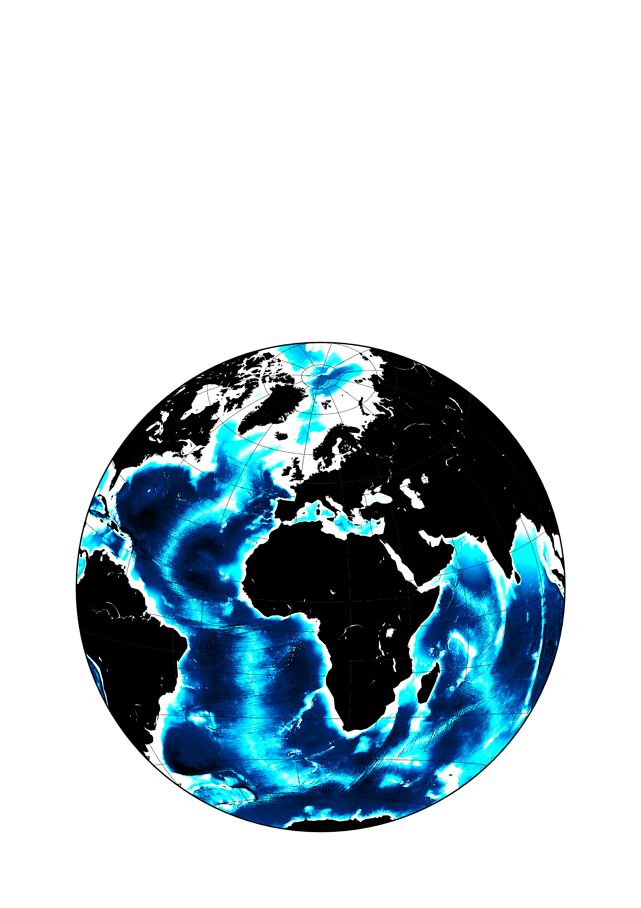
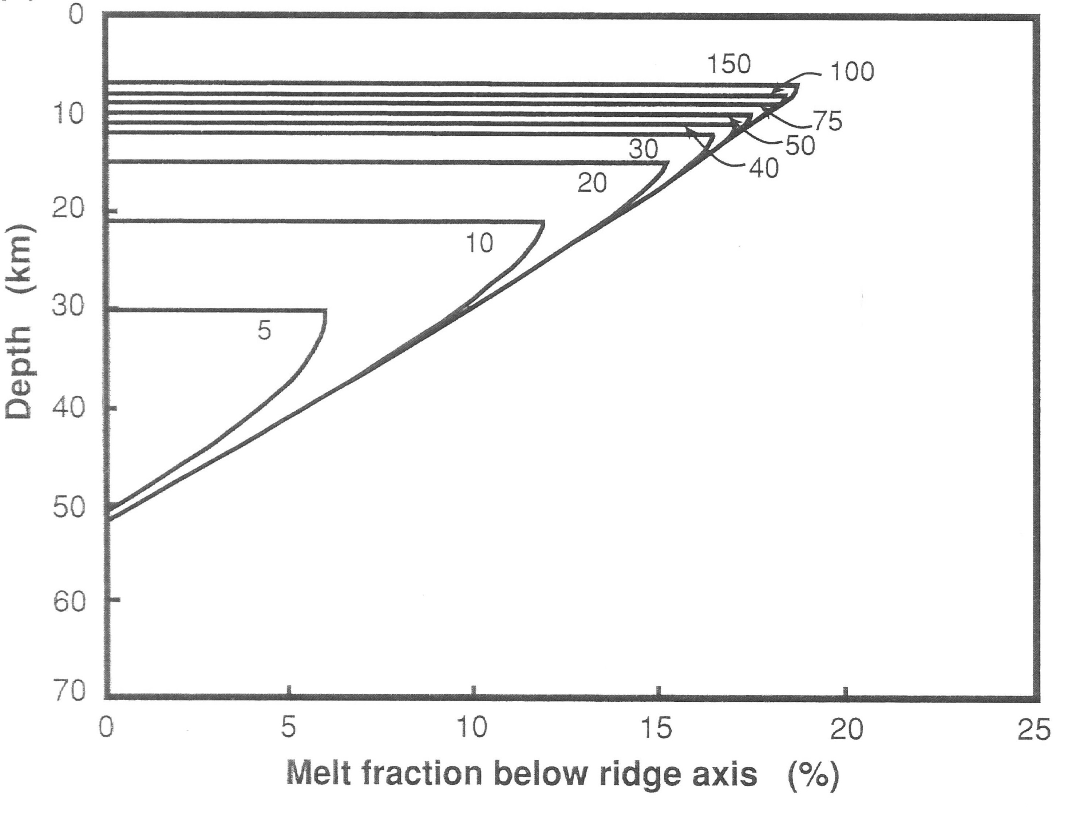
Ultraslow spreading ridges
➔ models may not apply
➔ remote survey locations
ARS
(after Bown & White 1994)
Ultraslow spreading ridges
< 20 mm/y:
Arctic Ridge System
15 mm/y - 6 mm/y
Southwest Indian Ridge
15 mm/y
SWIR

Slide 4
Gakkel Ridge segmentation: typical example of ultraslow spreading
13mm/y
Michael et al. 2003
9 mm/y

Slide 5
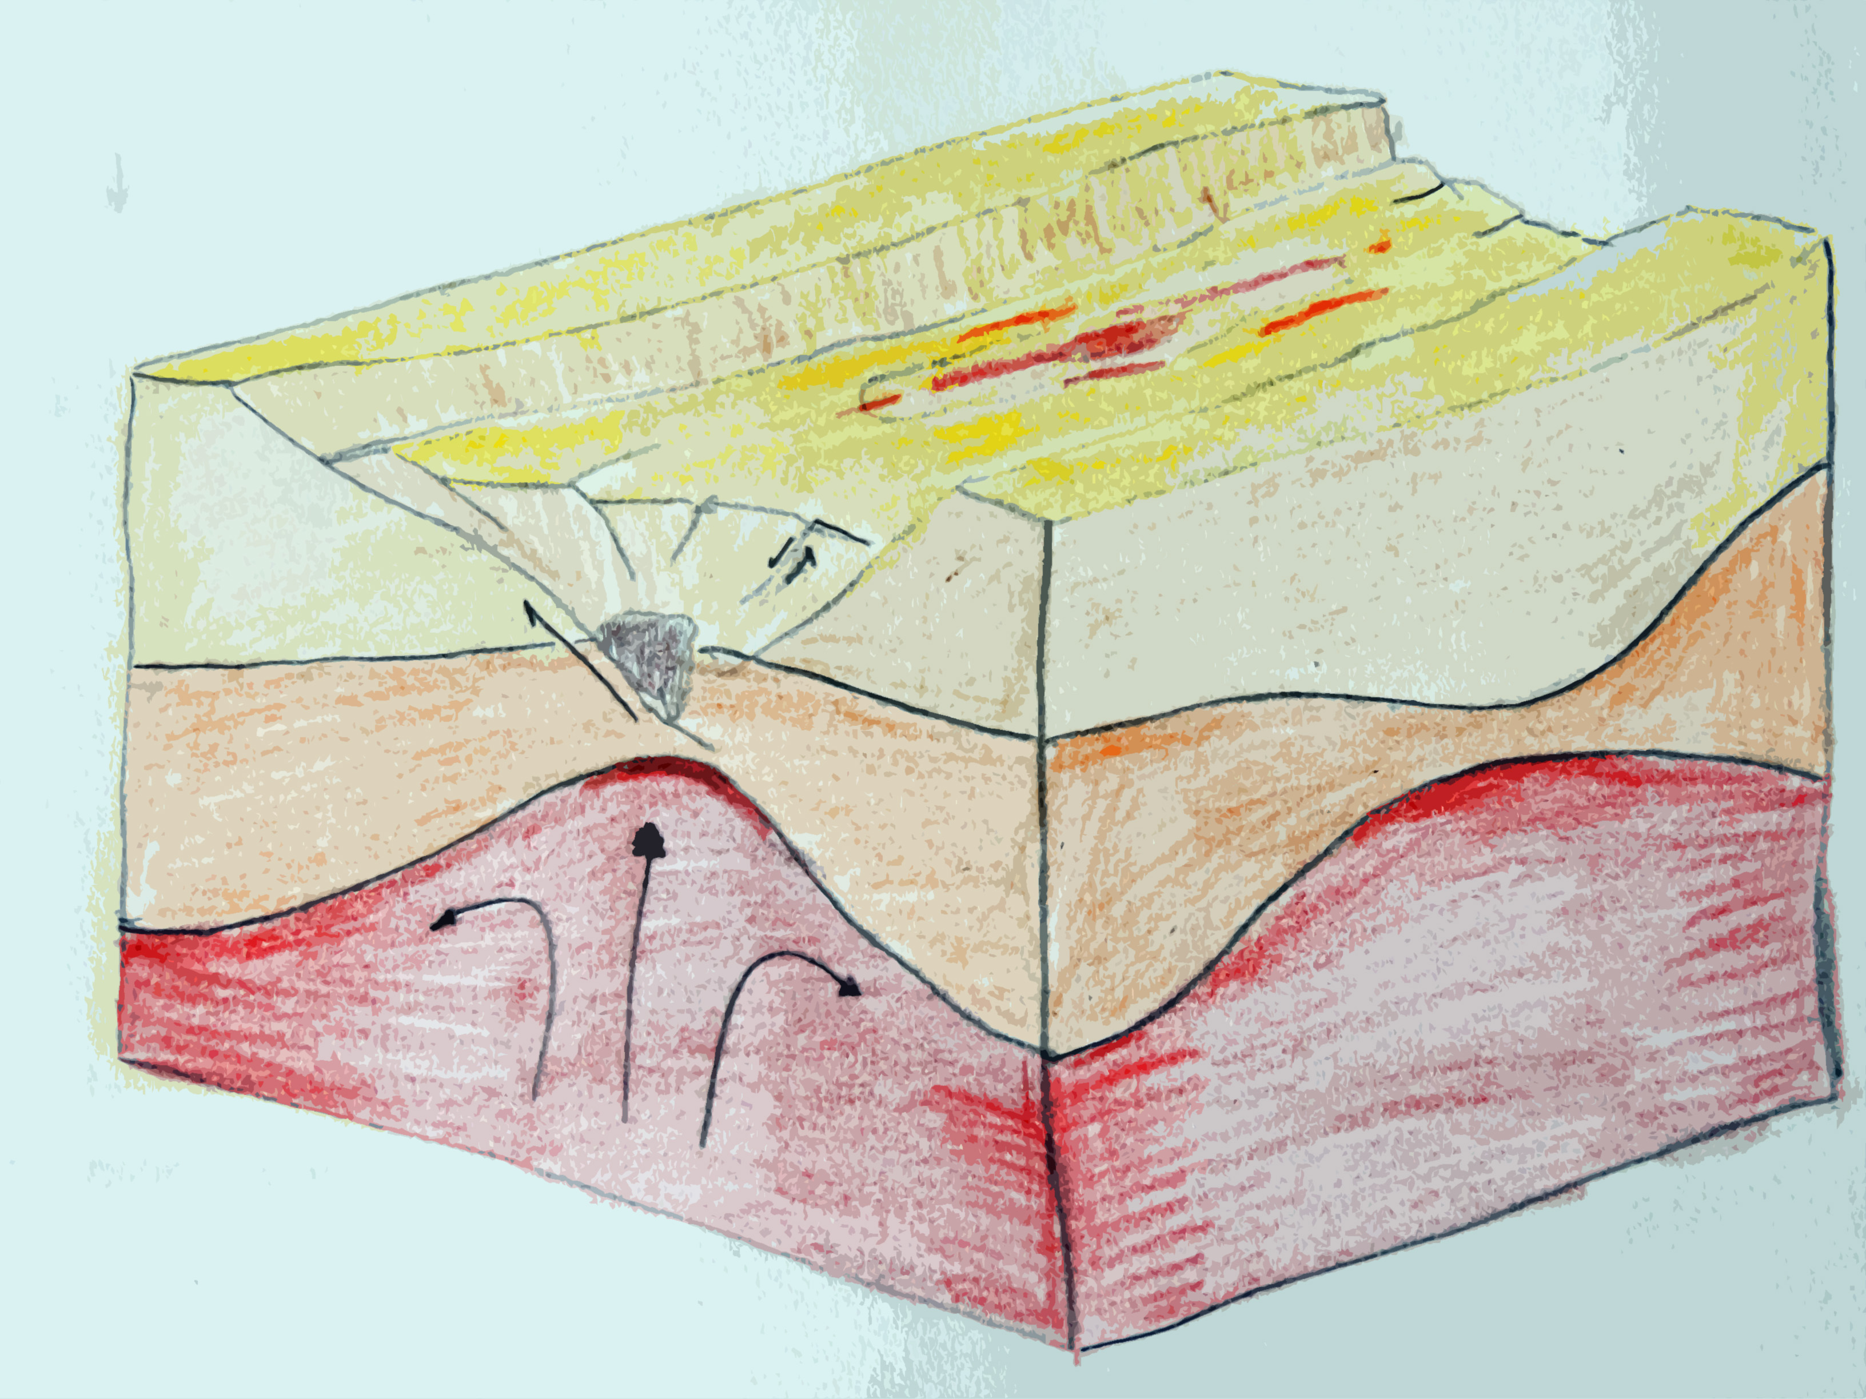
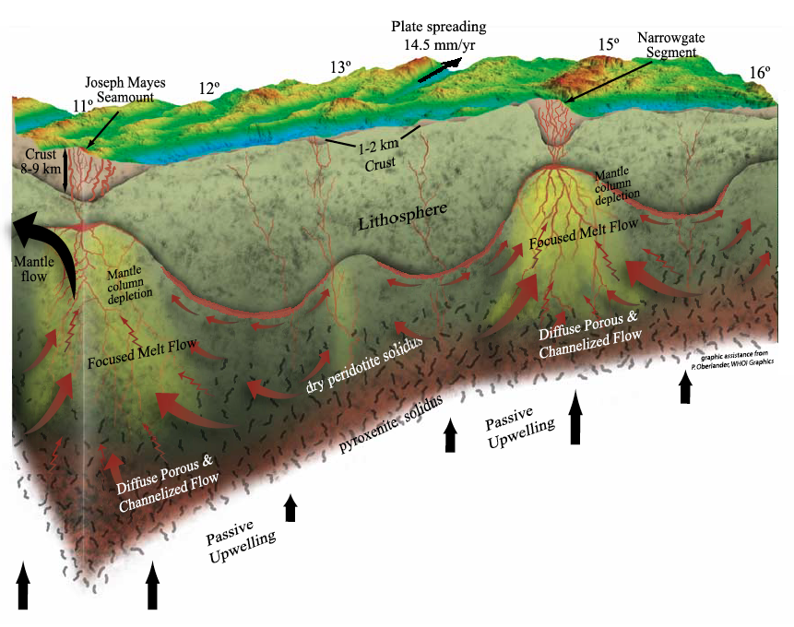
Slow ... and ... ultraslow spreading
segment end
segment centre
segment end
axial valley
axial volcanic ridge
crust
mantle
lithosphere
asthenosphere
(free after Cannat et al., 2004)
(from Standish et al., 2008)
Clear segmentation by transform
faults (~50 km segment length)
Small variation in crustal thickness
Detachment faulting
Strong variation of crustal thickness (0-9 km)
Variable seafloor lithology with mantle rock exposure
Uneven melt distribution

Slide 6
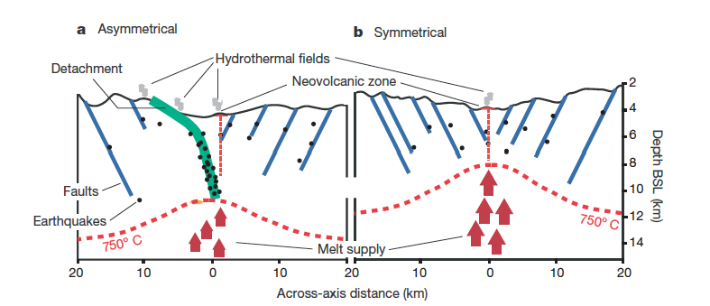
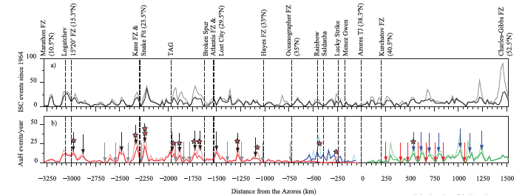
Seismicity of slow spreading ridges
(from Escartin et al., 2008)
Stripe and gap pattern
Increased seismicity at detachment faults often at segment ends
Decreased seismicity at segment centres
(from Simao et al., 2010)

Slide 7
(tele)Seismicity of ultraslow spreading ridges
ISC bulletin
35 years of data
earthquakes within 30 km of rift axis
segment-wise analysis
(from Schlindwein, 2012)

Slide 8
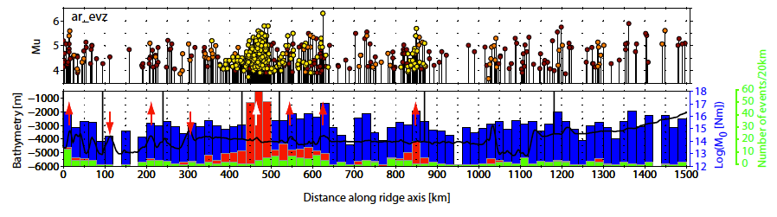
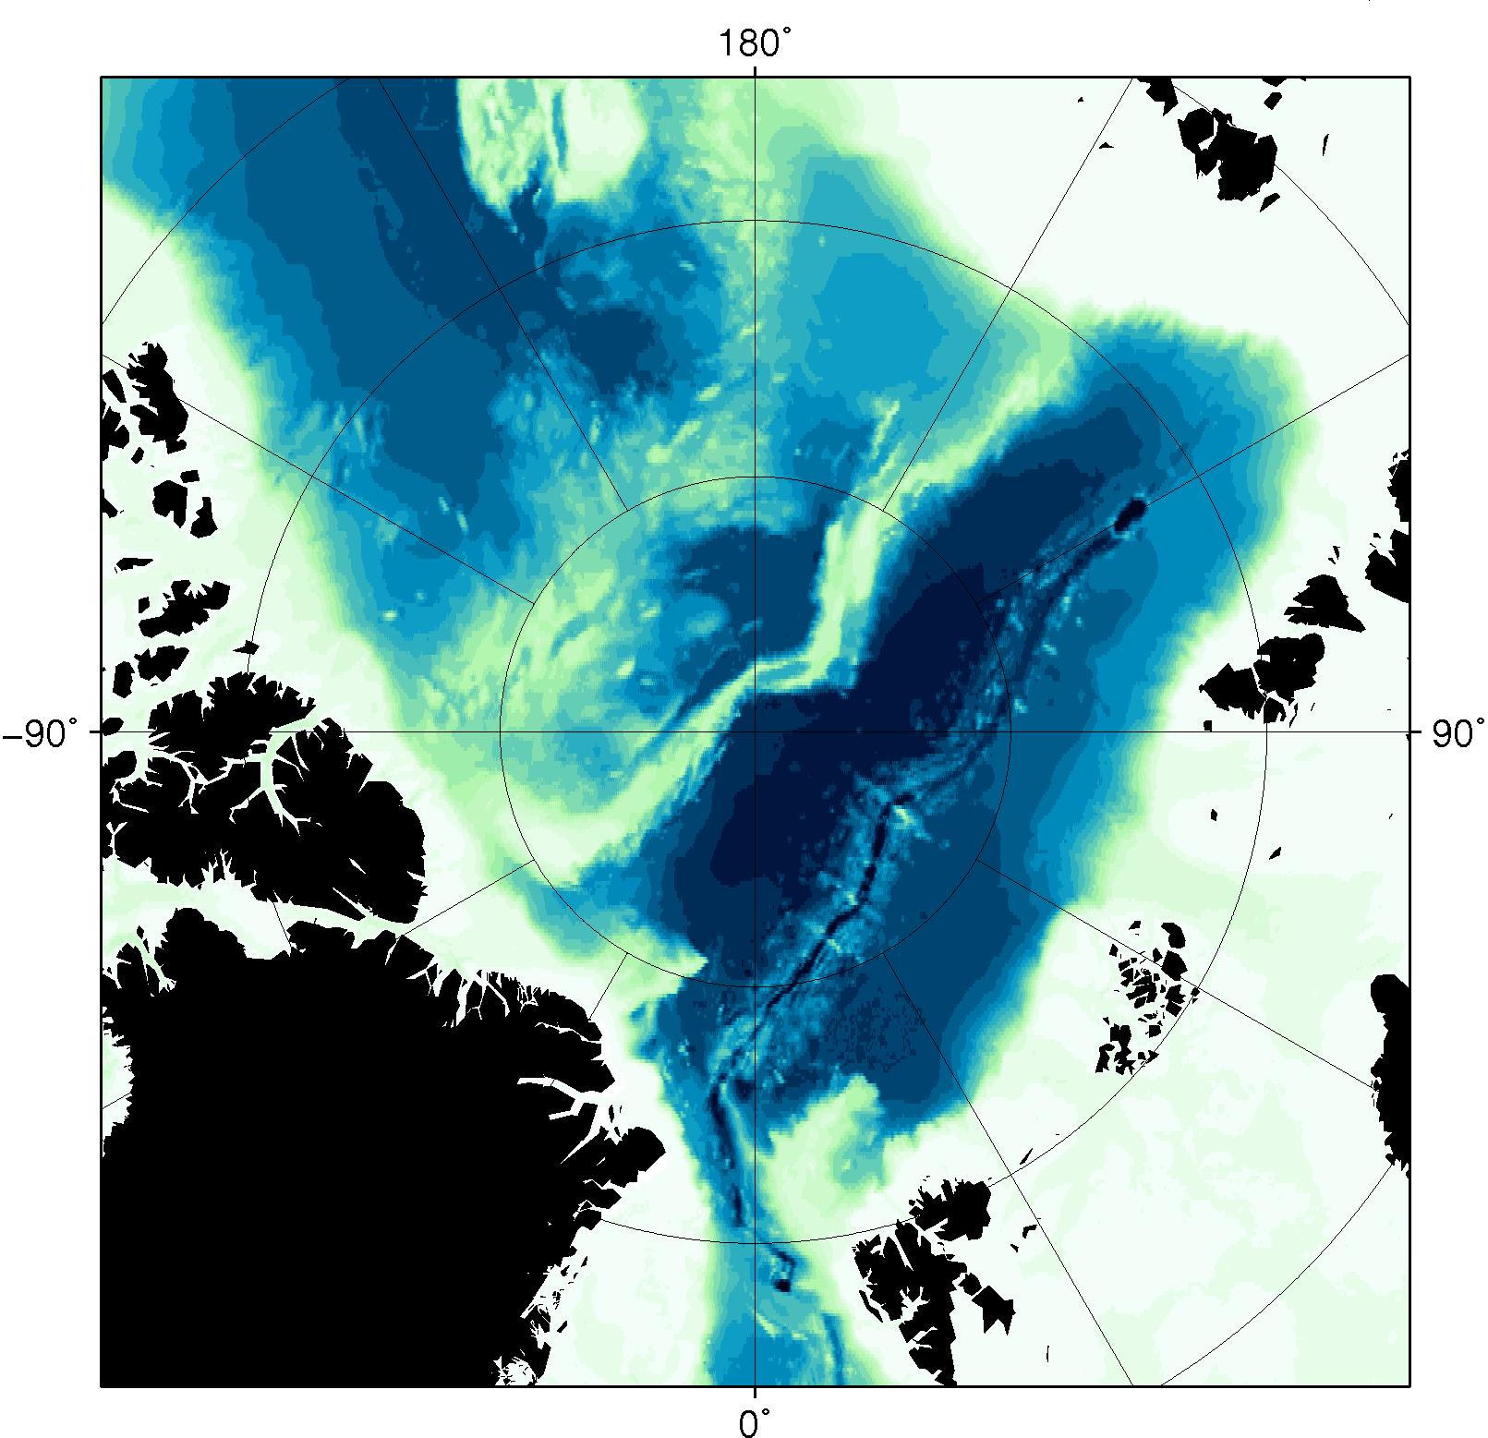
Along-axis seismicity of the EVZ
(from Schlindwein, 2012)
No stripes and gaps, but “blobs and holes”
Increased seismicity at volcanic centres
Swarm activity at volcanic centres, related to spreading episodes
Tectonomagmatic swarms, activating > 50 km of segment

Slide 9
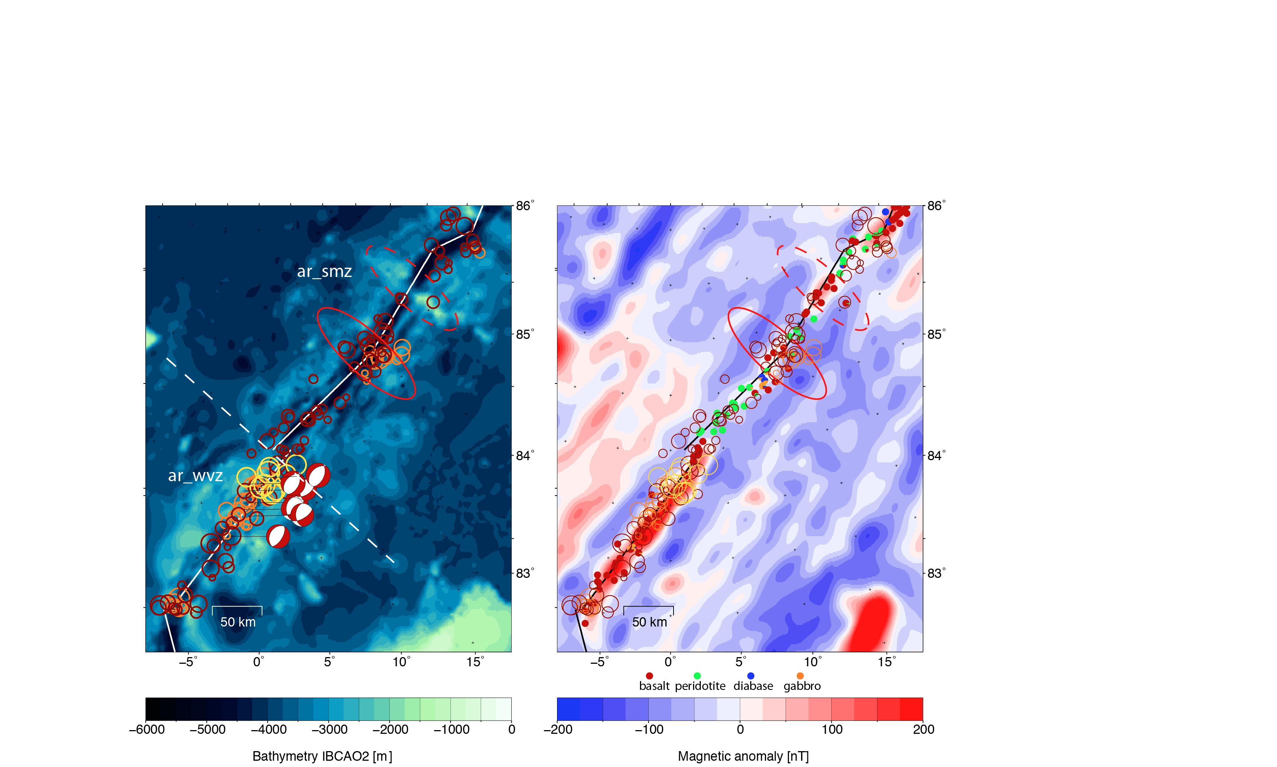
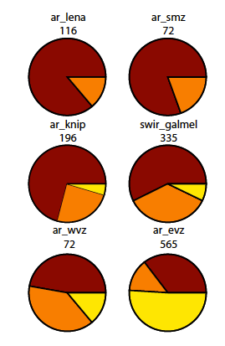
Ultraslow spreading: amagmatic vs magmatic
amagmatic
Swarms
Small clusters
Single events
magmatic
Magmatic
Many earthquakes
Often clustered
Strong CMA, AVR, basalt
Amagmatic
Few and weak earthquakes
Hardly swarms
Peridotite at seafloor, no CMA

Slide 10
Part II: Comparing seismicity of magmatic and amagmatic segments at ultraslow spreading ridges
from Standish et al. 2008

Slide 11
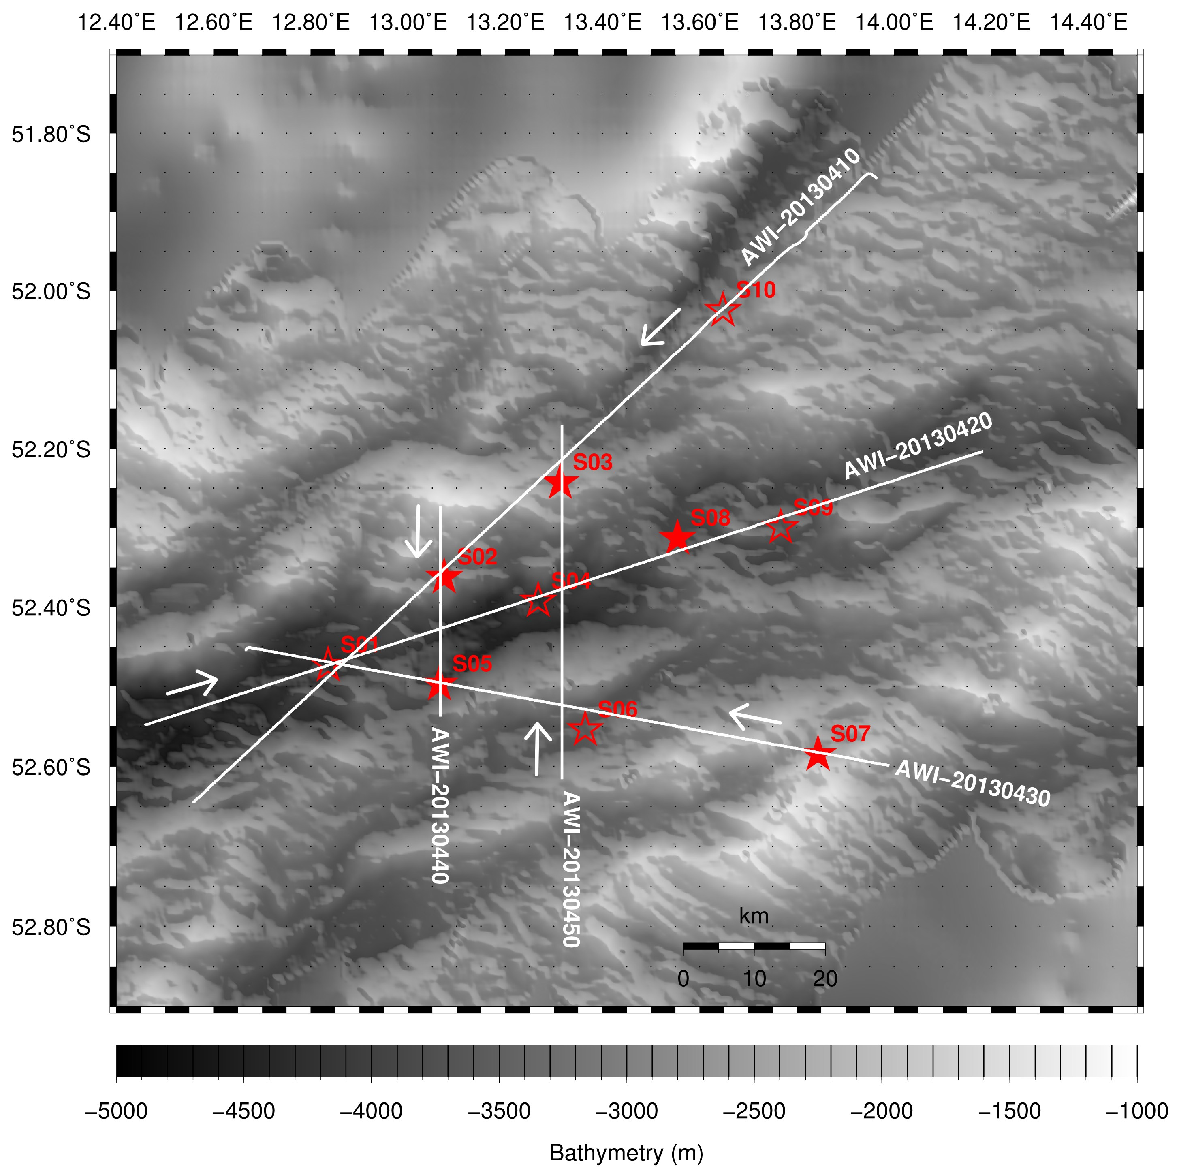
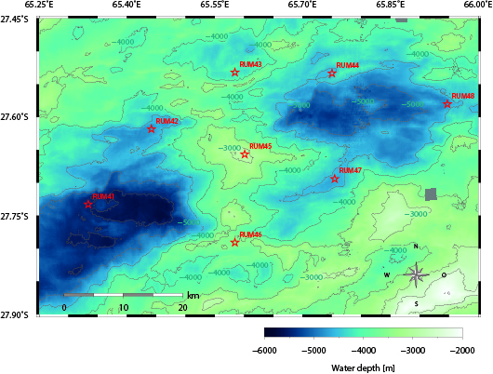
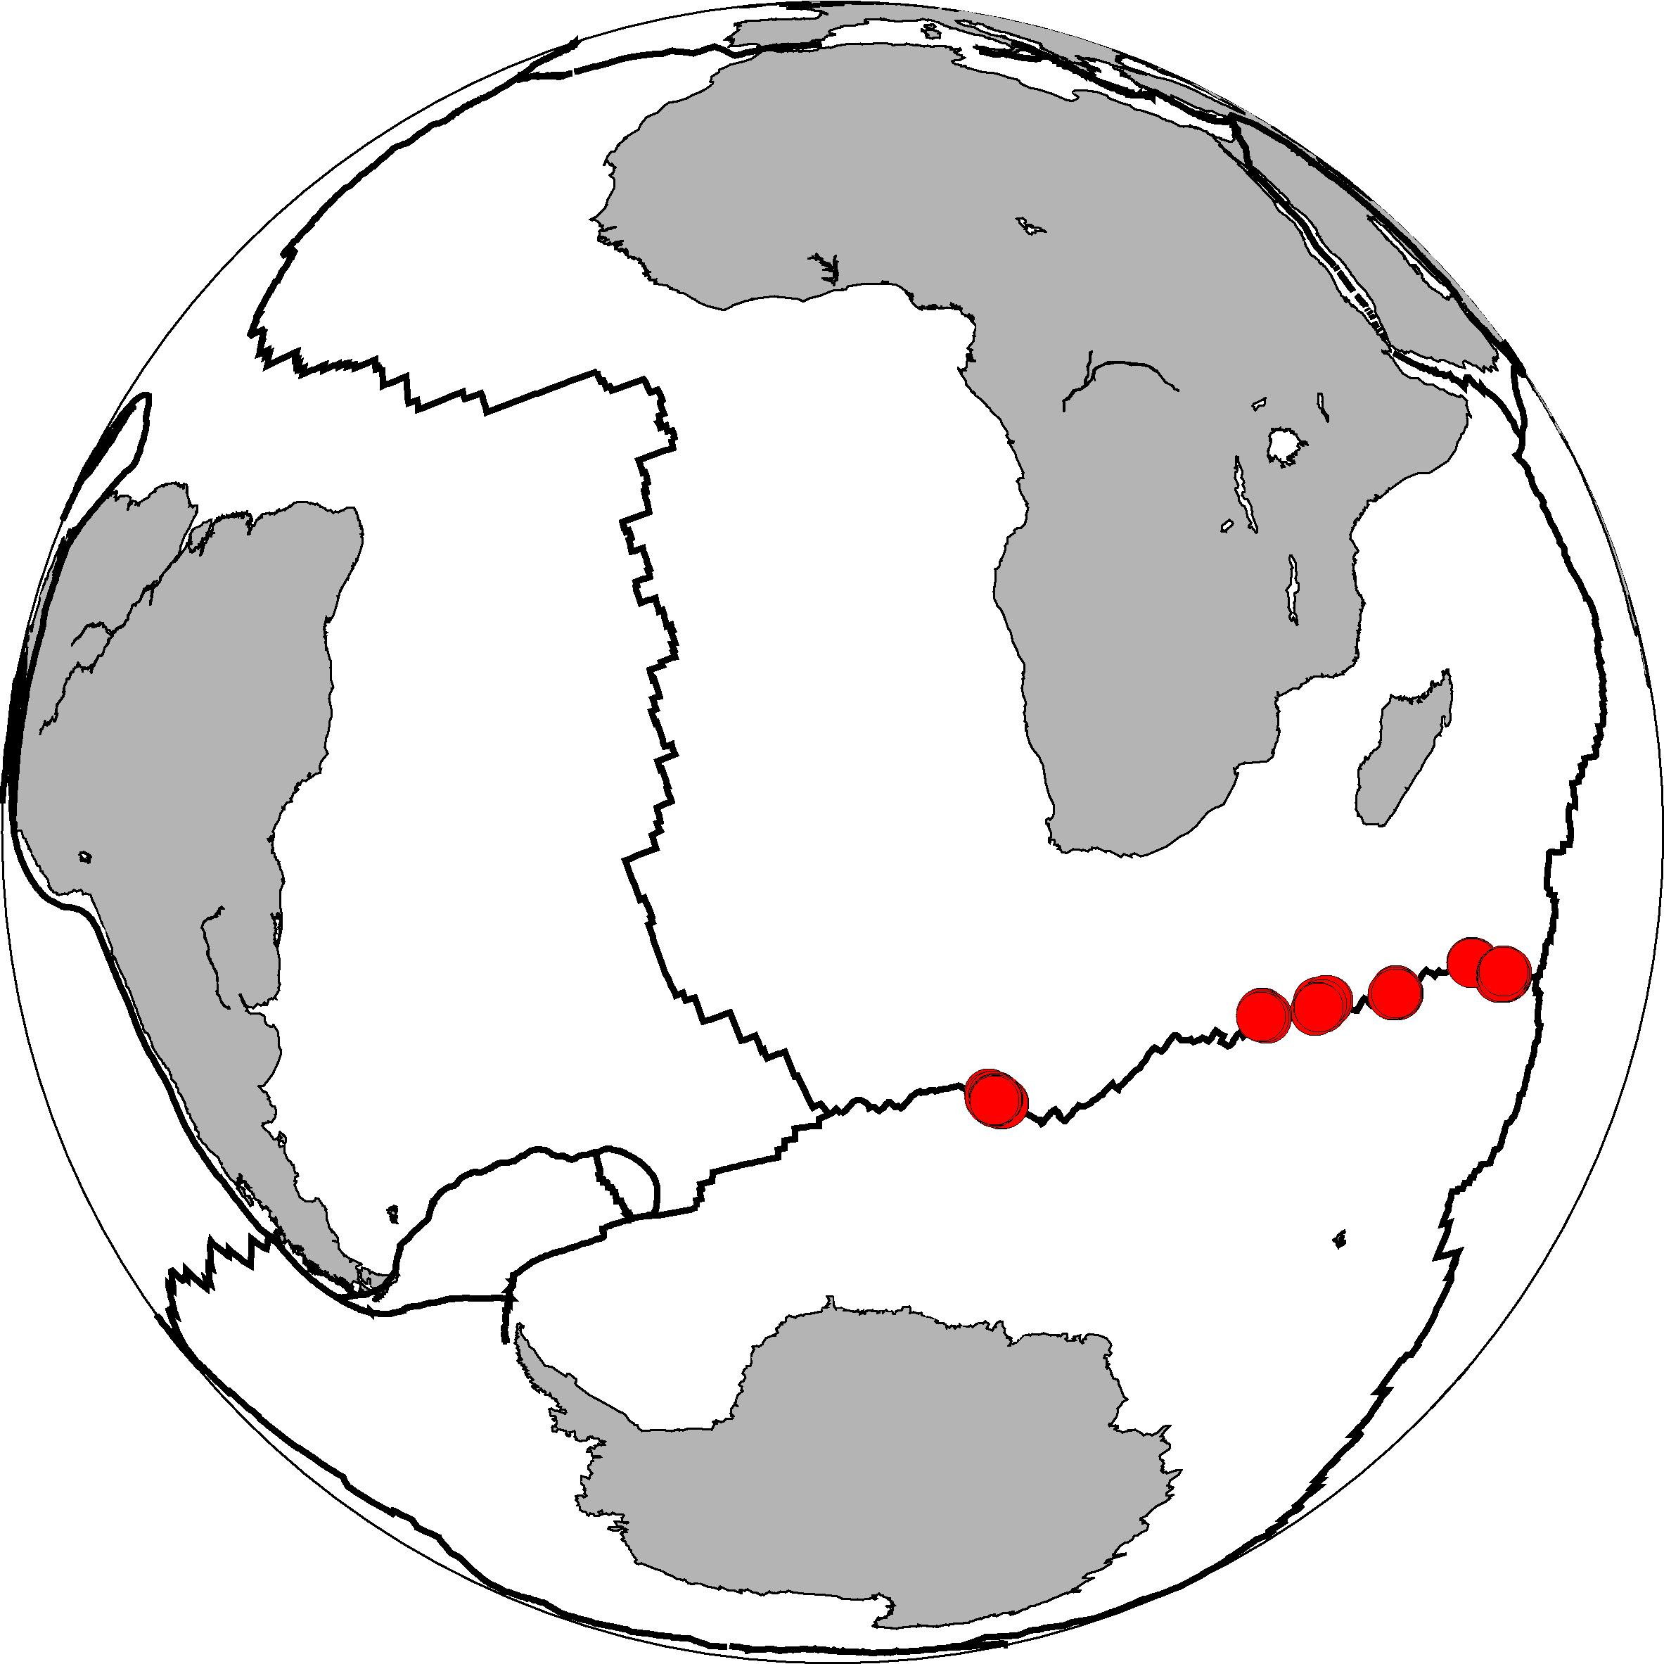
Design of comparative OBS survey
Oblique Supersegment
Segment 8
36km
60km
18 equal OBS
of German DEPAS pool
Magmatic site 66°E 27°S
RHUM-RUM, RV Marion Dufresne, RV Meteor
Amagmatic site 13°E 52°S
RV Polarstern
10 months recording period Oct/Nov 2012 – Oct/Dec 2013

Slide 12
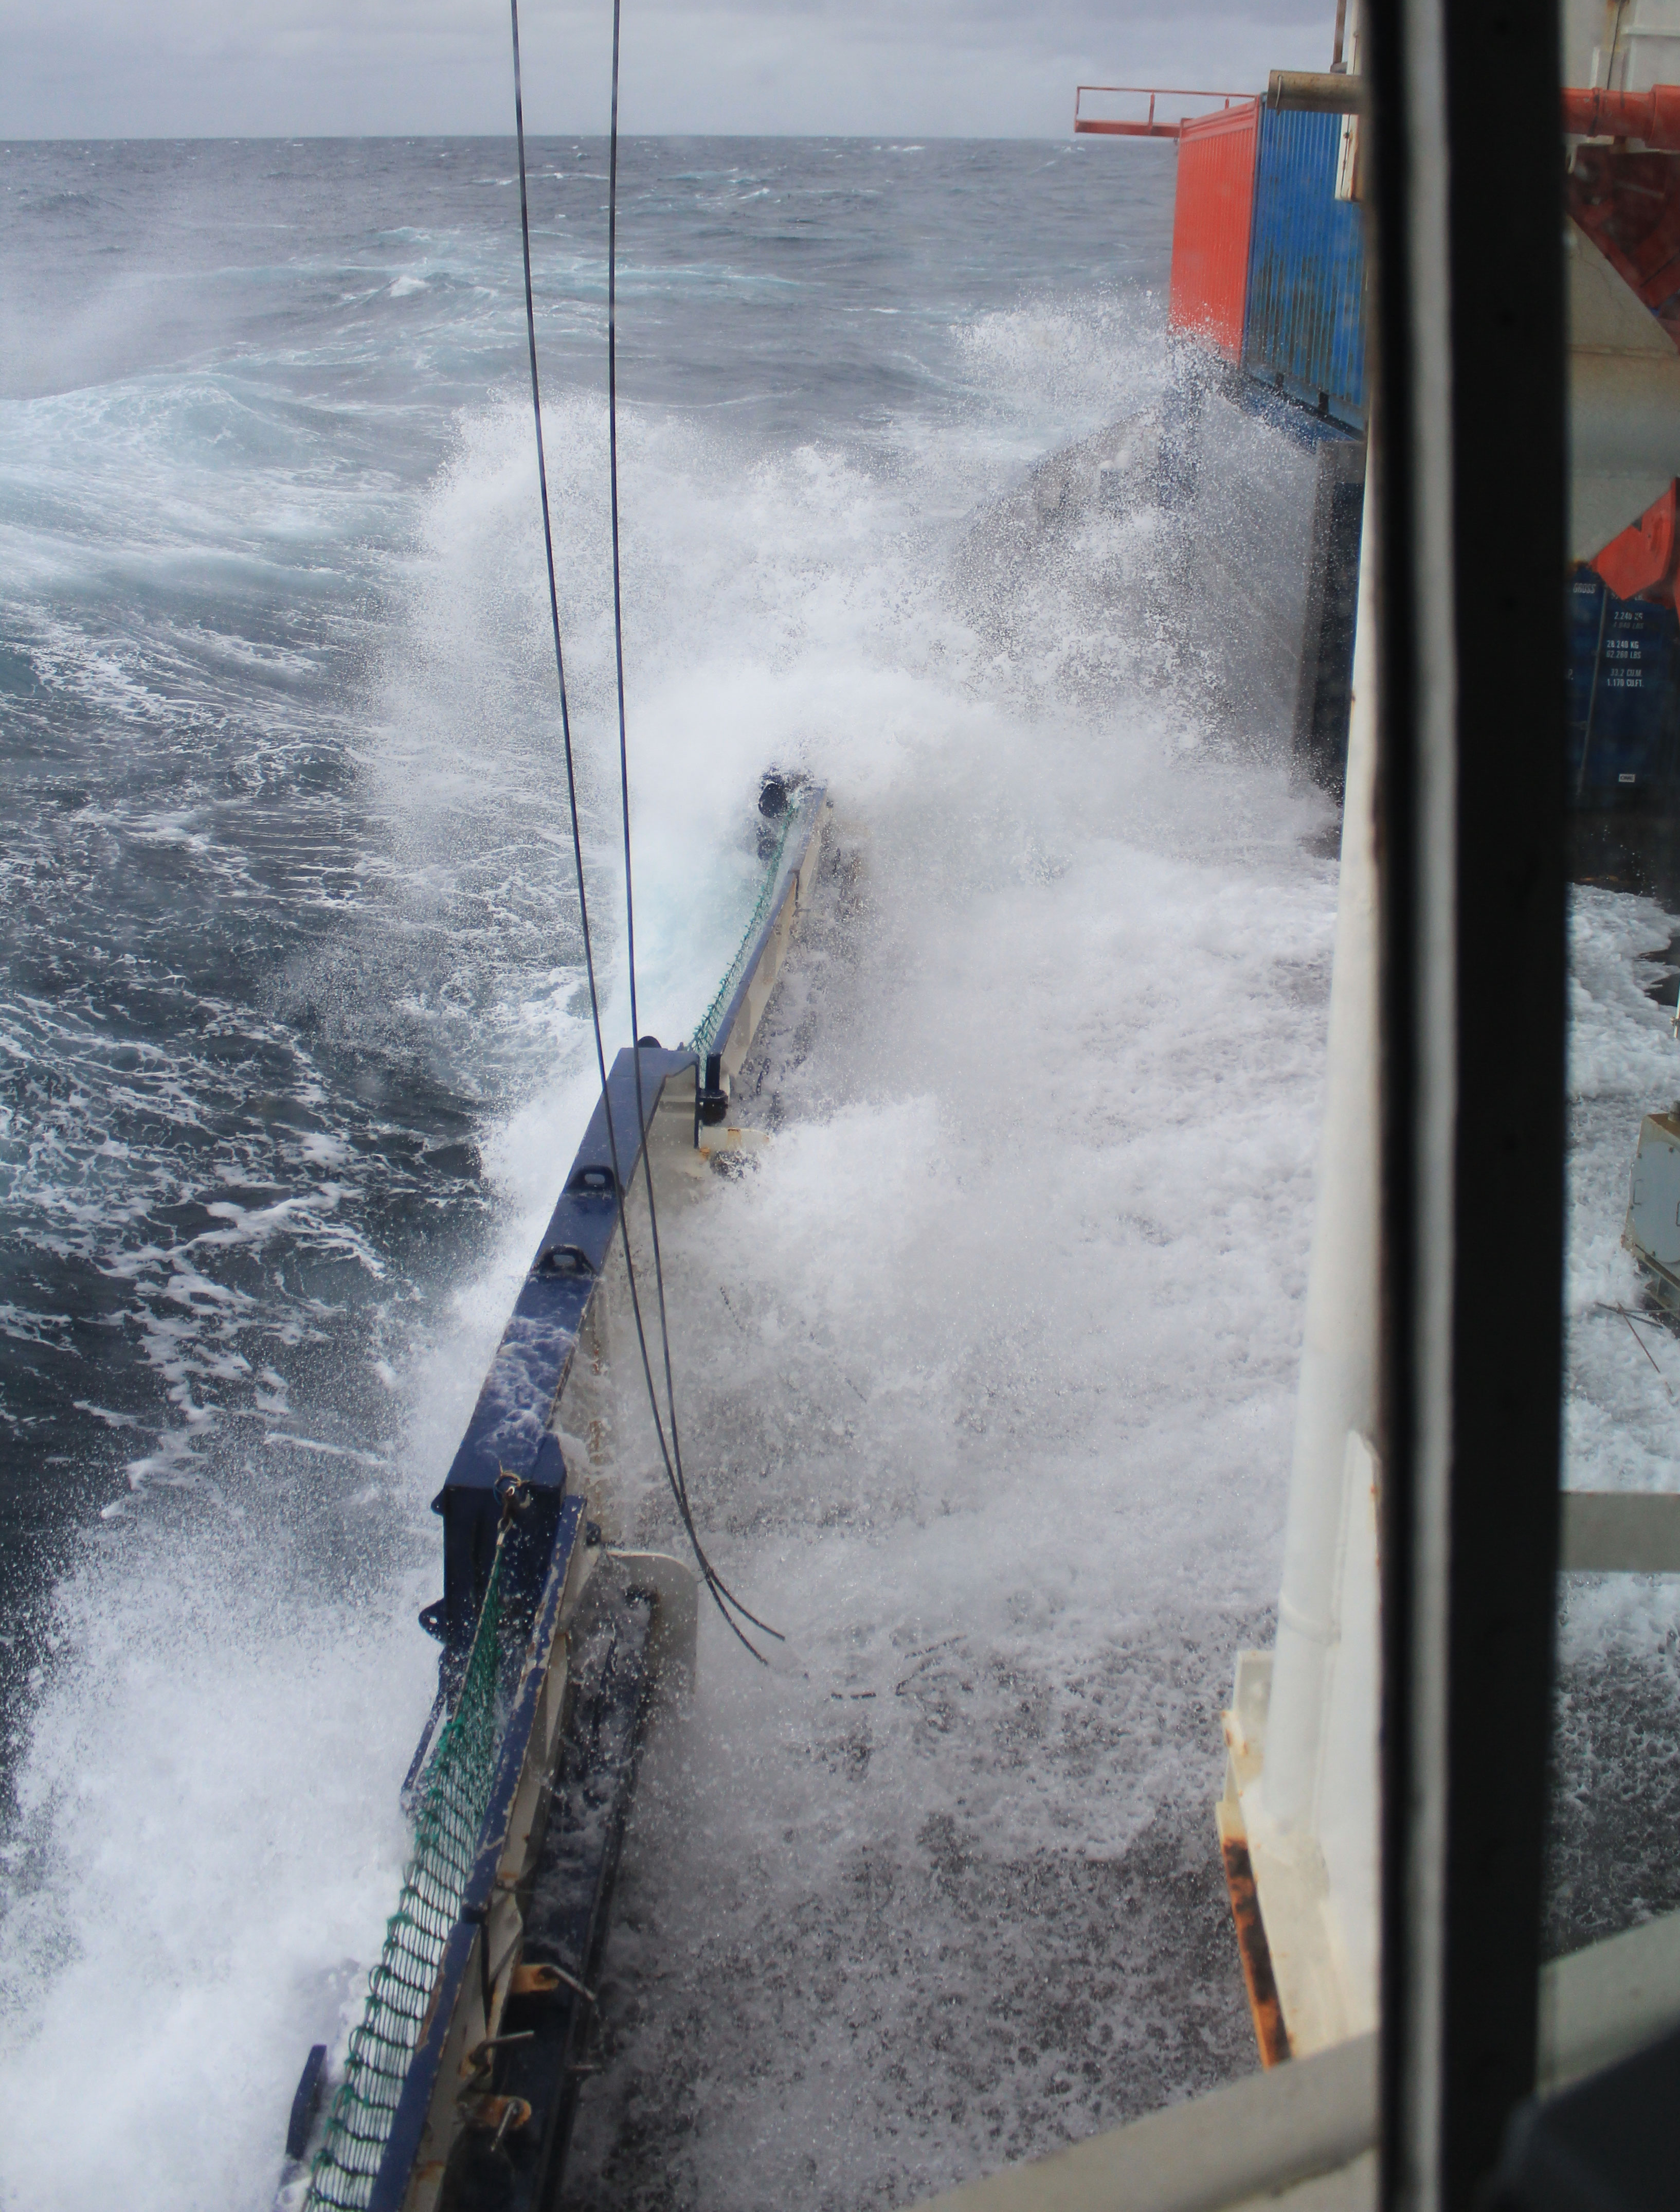
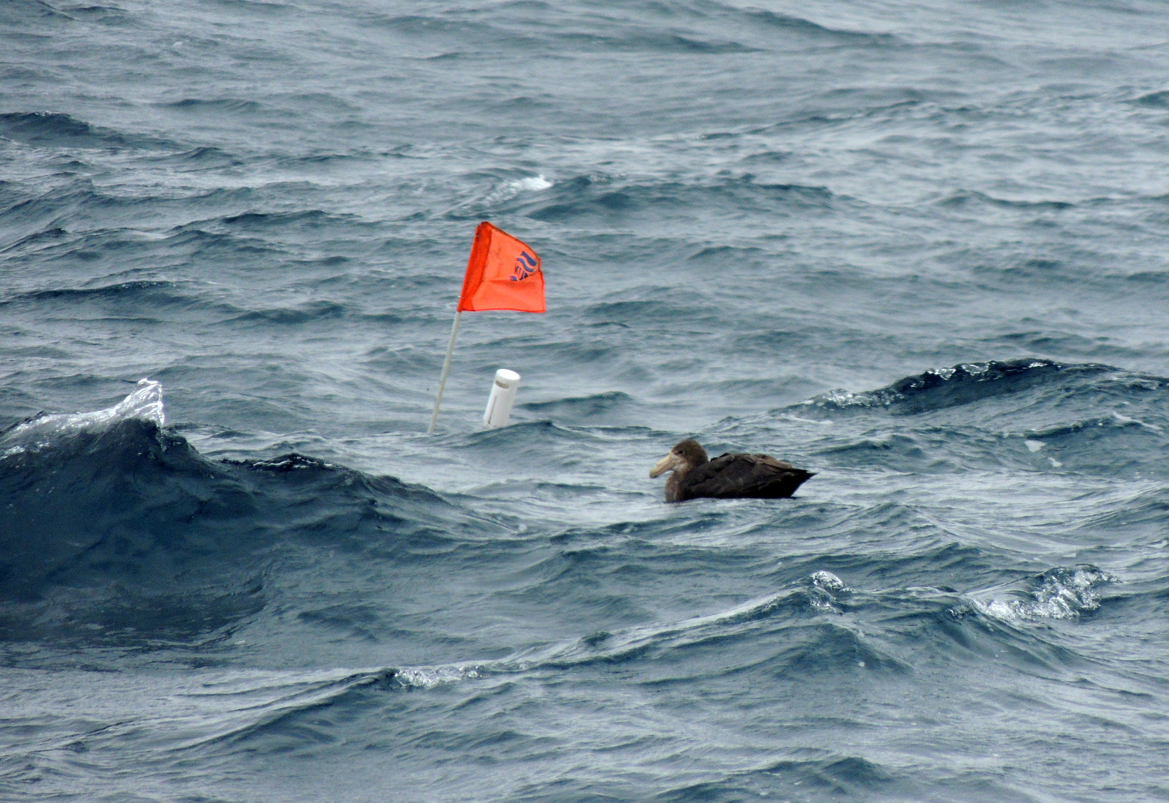
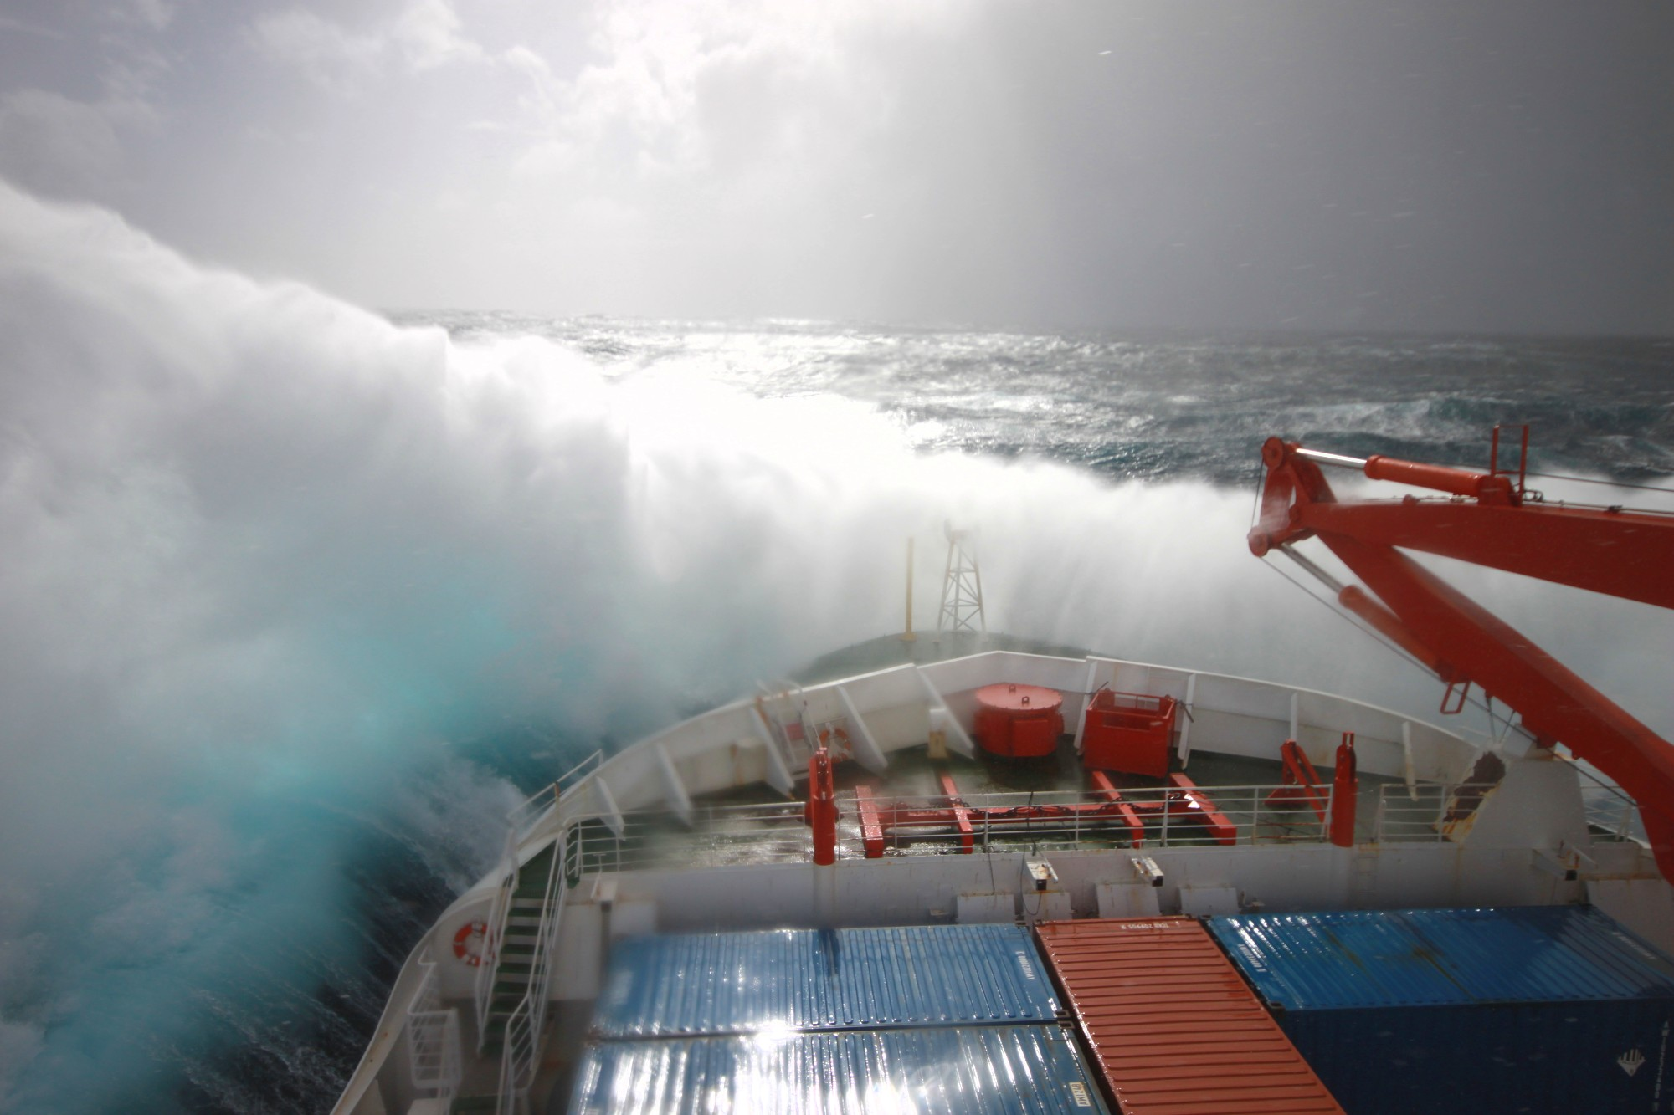
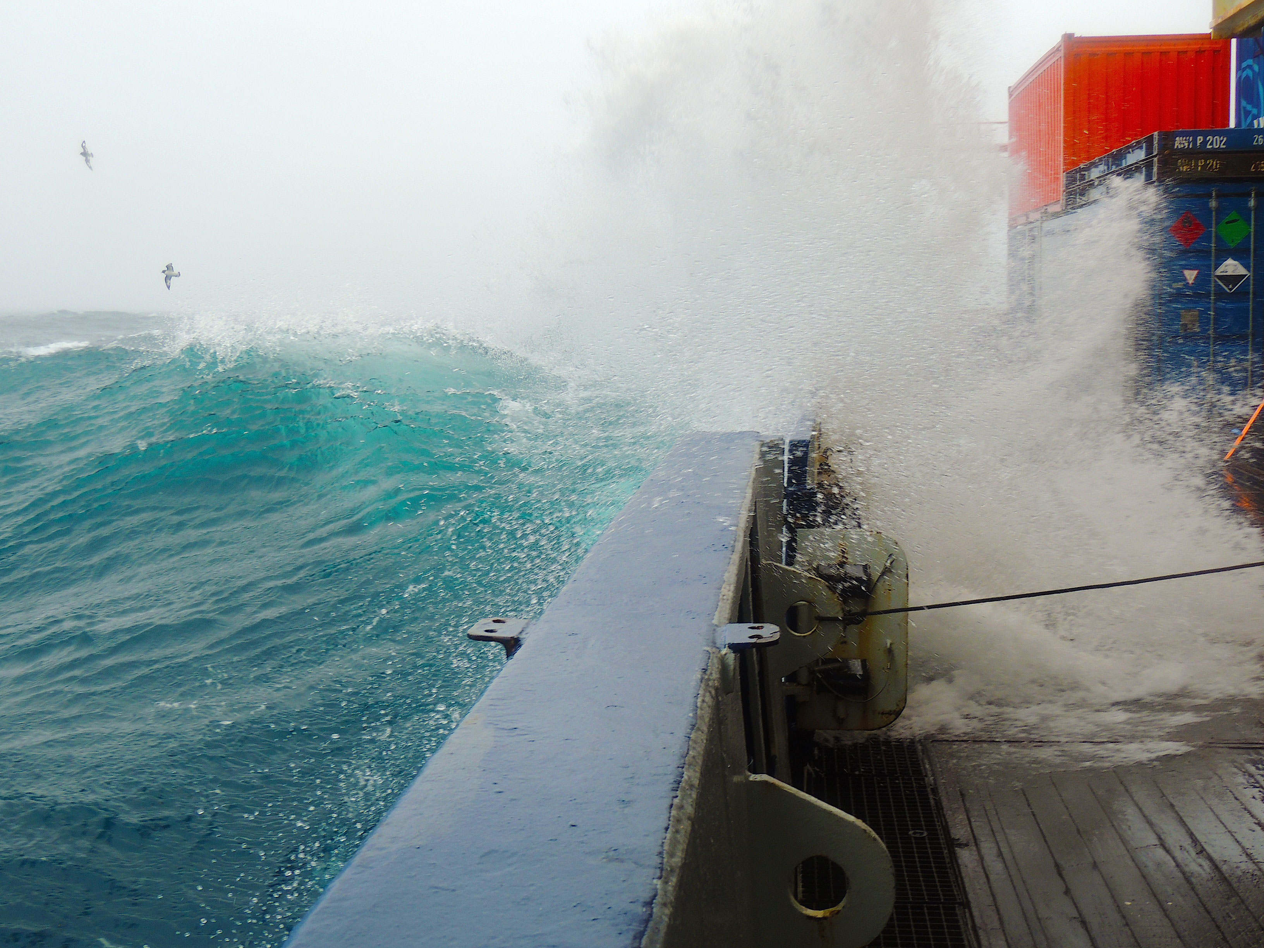
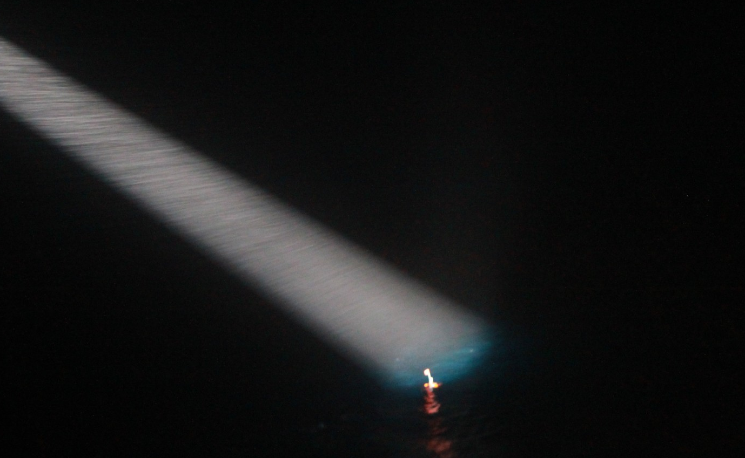
RV Polarstern – workhorse in stormy waters
© M. Lehmann
© V. Schlindwein AWI
© F. Schmid AWI
© E. Nowatzki AWI
© F. Schmid AWI
© V. Schlindwein AWI
Recovery of ocean bottom seismometers difficult
high risk of instrument and data loss

Slide 13
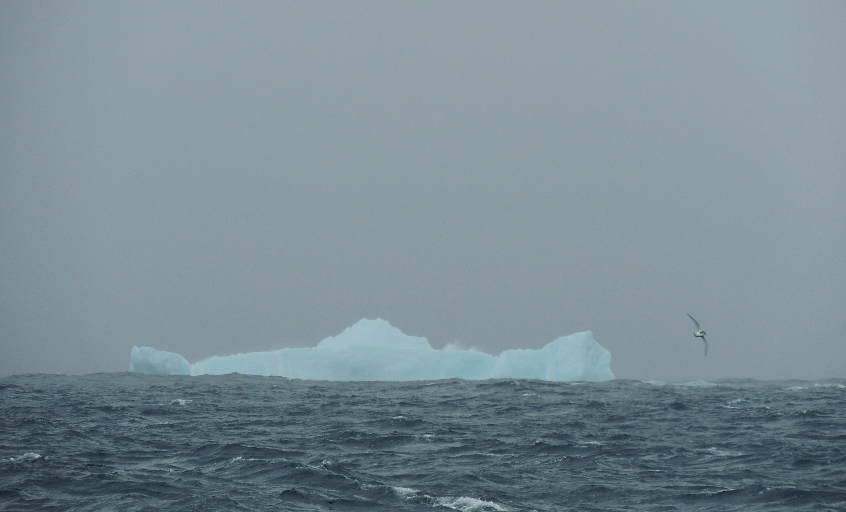
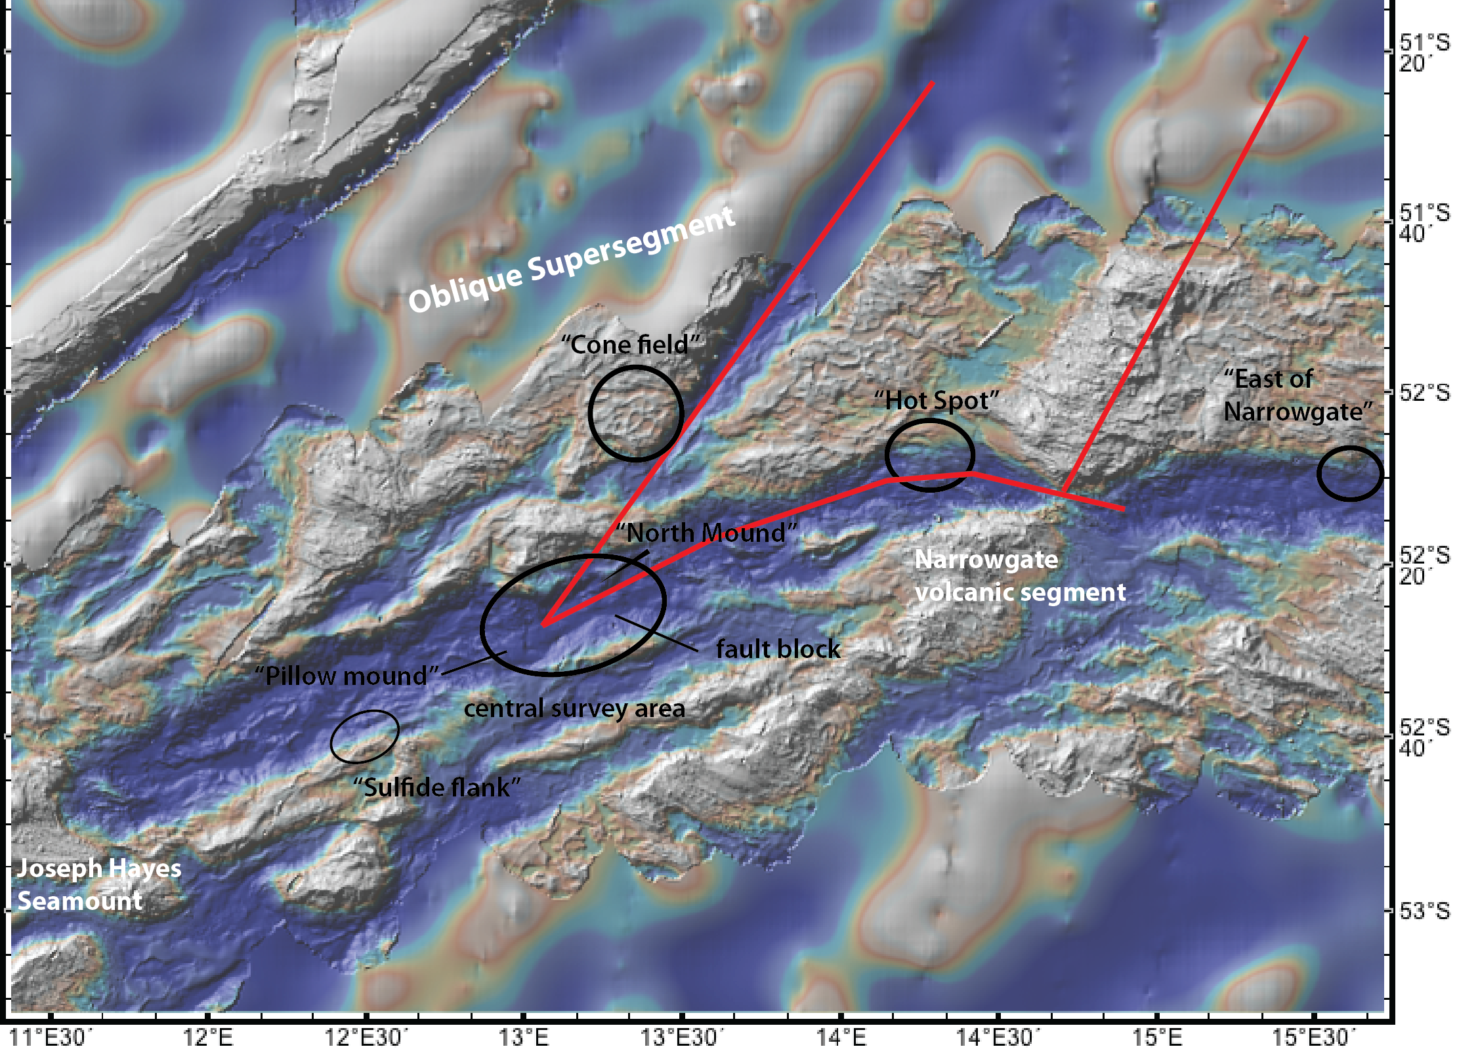

Multidisciplinary cruise SWEAP:
28 days in the Furious Fifties
Seismicity (recovery of OBS), seismic refraction
Hydrothermal plumes
Heat flow
Seafloor organisms
Seafloor geology
150 km
Heat Flow
sample sites
seismic network
Nov-Dec 2013

Slide 14
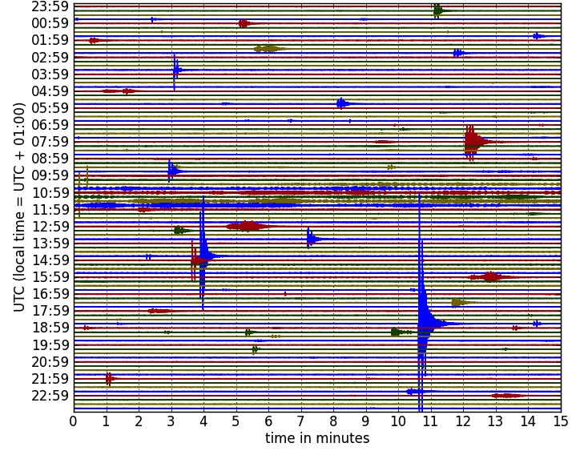
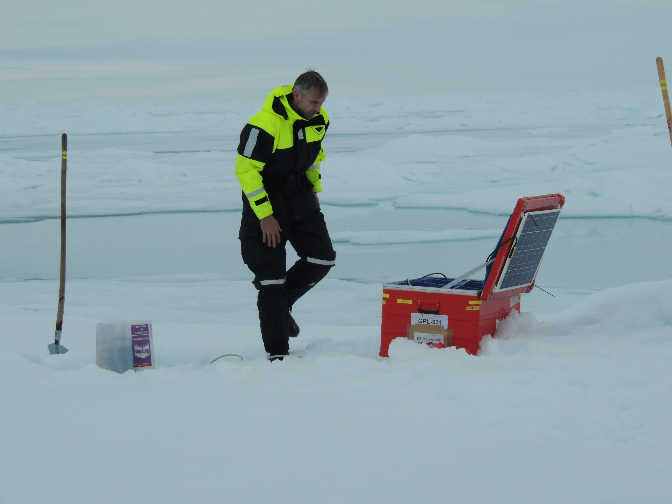
One day of seismic data on the SWIR
10 months of data:
2000-6000 earthquakes
suitable for location
automatic processing necessary
T-Phase
Whales
Local earthquake

Slide 15
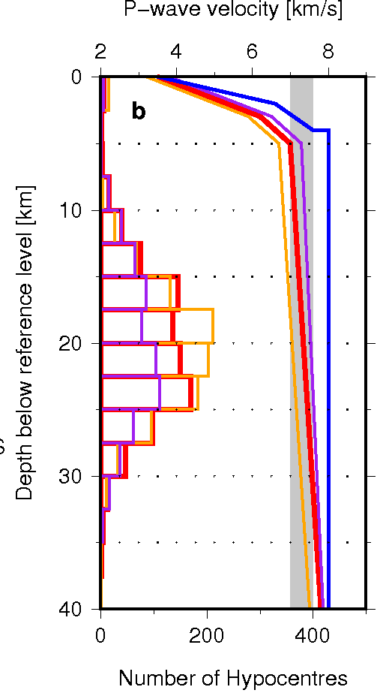
OBS experiments compared
Processing:
Basic location (hyposat) ➔ Relative location (hypoDD)➔ LETomography (LOTOS)
Oblique Supersegment
Local eq: 1528
ISC eq: 43
Segment 8 volcano
Local eq: 2820
ISC eq: 186
ISC
57
events
vp < 7.6 km/s

Slide 16
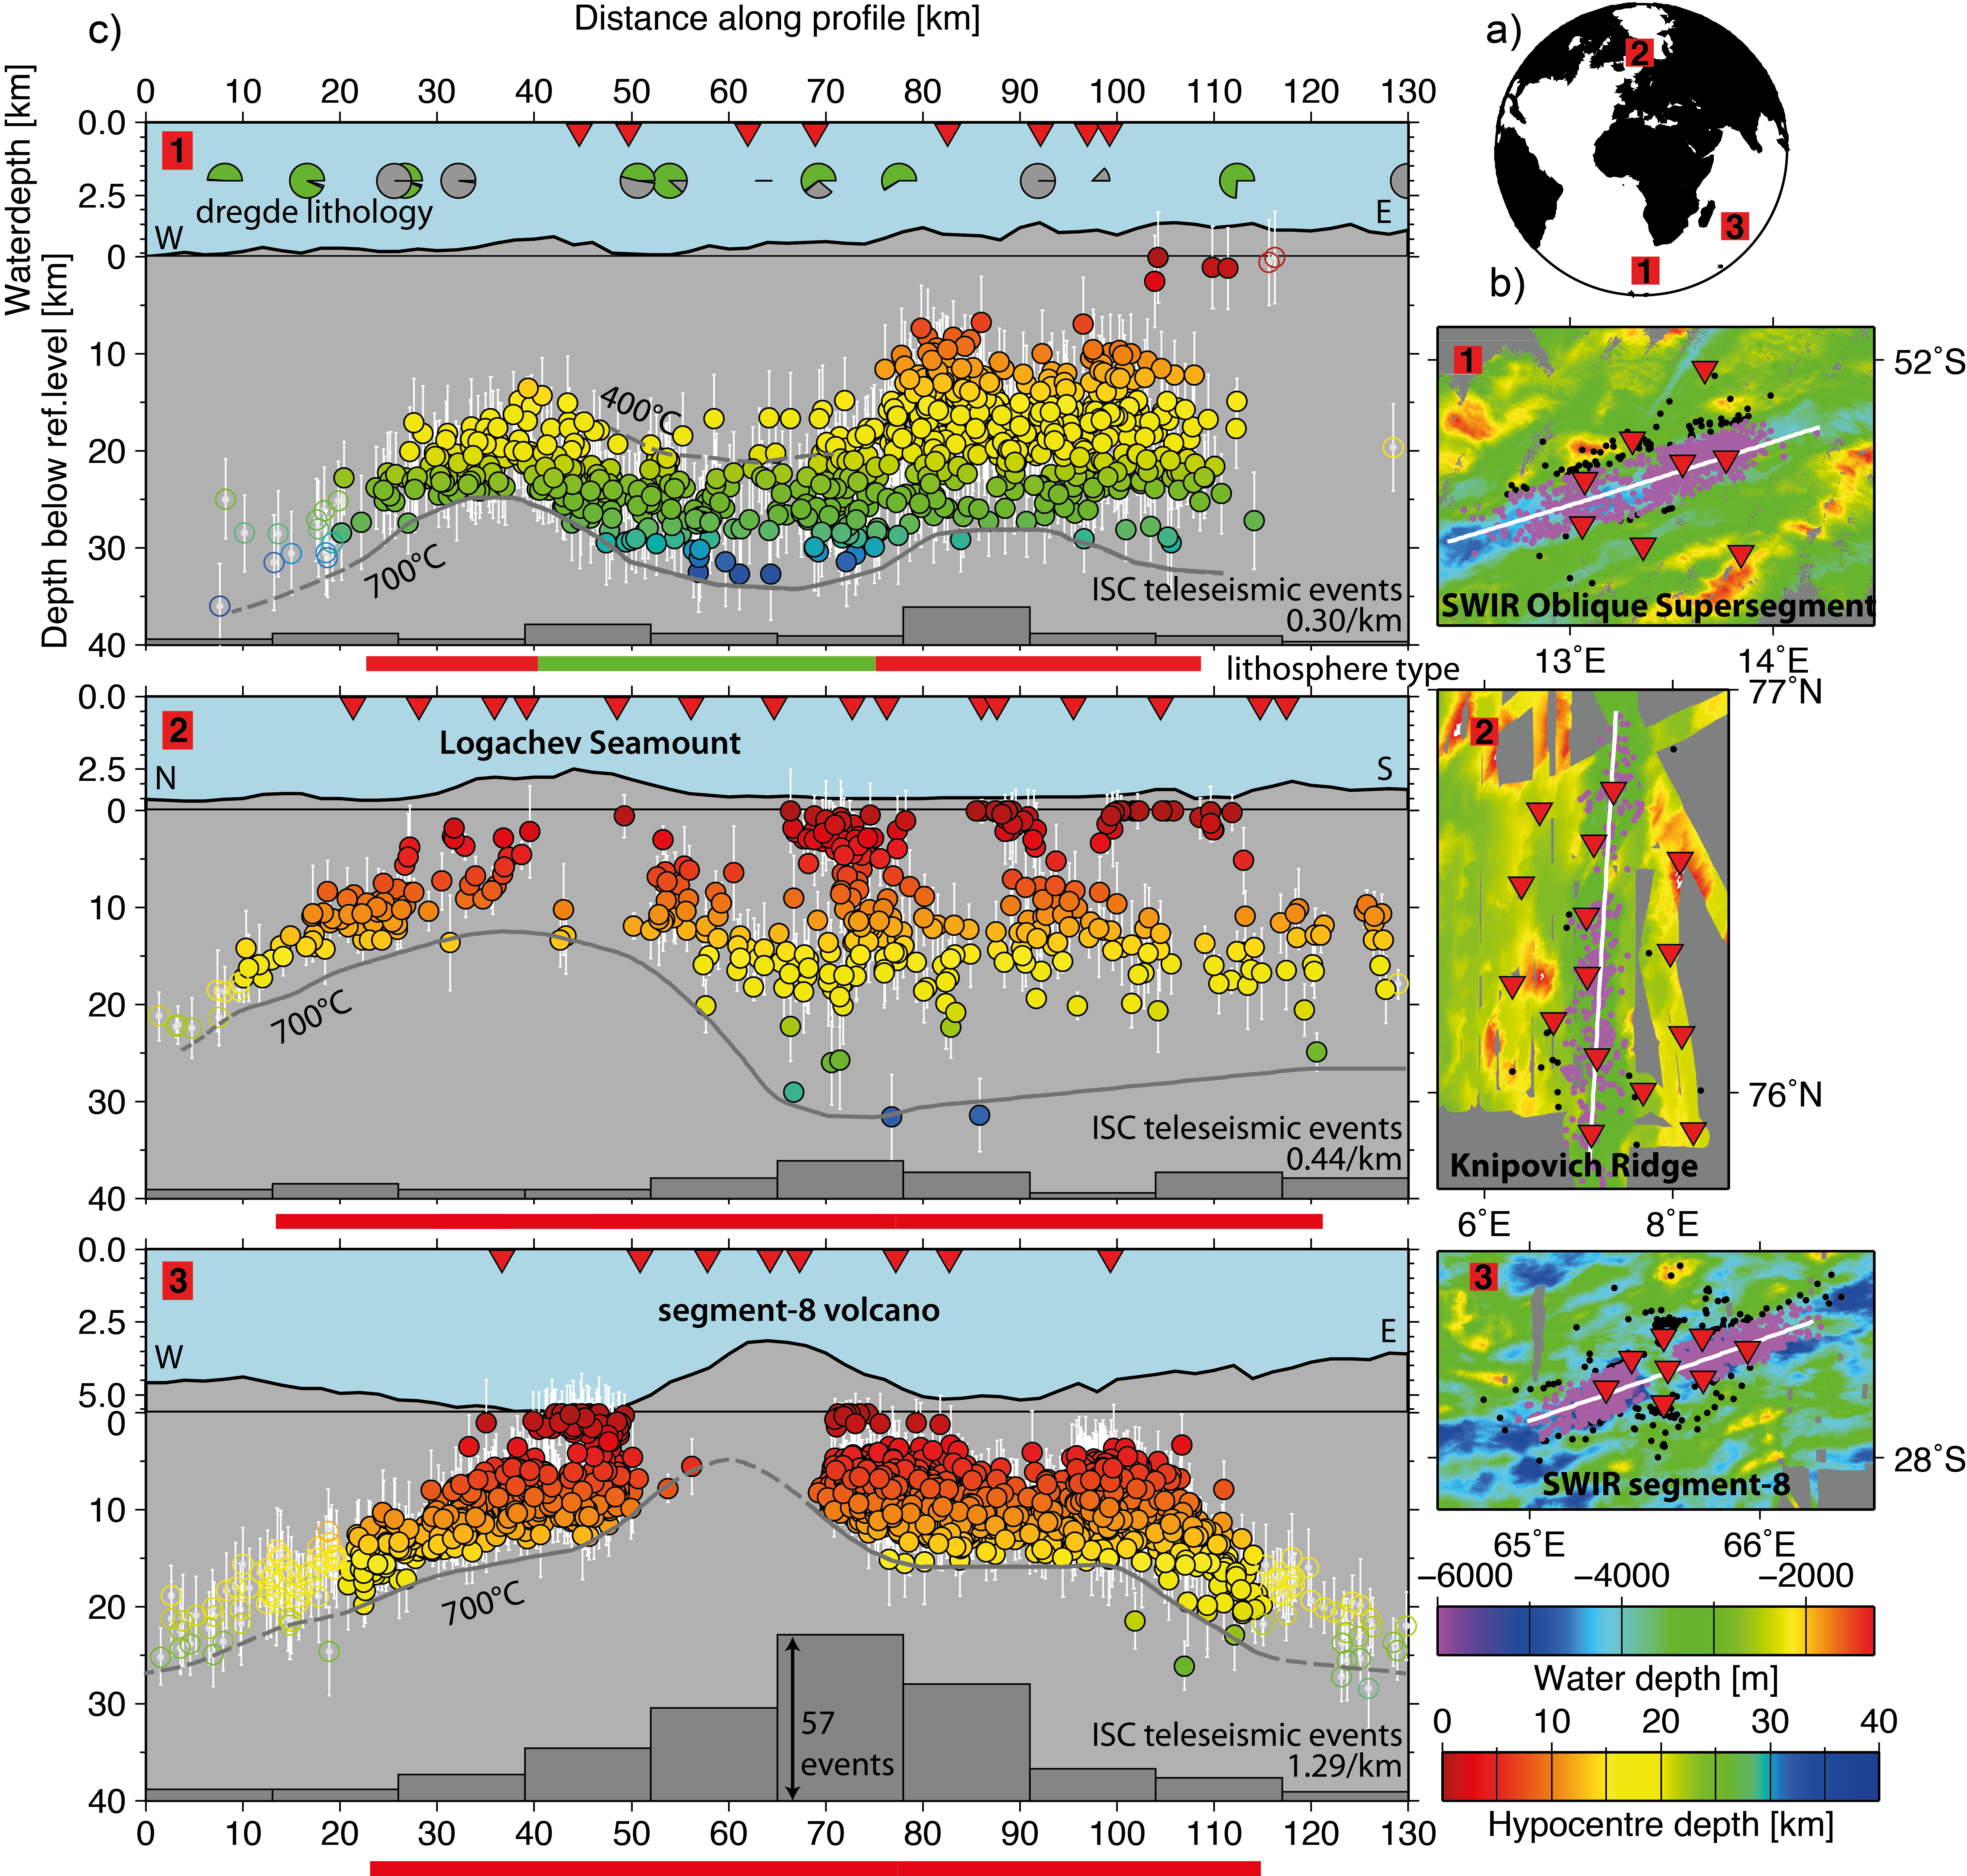
From earthquakes to spreading processes
Along-axis seismicity transects on three ridge sections (SWIR and Knipovich)
cold
Highlights:
deepest known mid-ocean ridge earthquakes (35 km instead of 15 km!!)
lithosphere thickness varies dramatically along axis
➔ shallows under volcanoes
➔ melt flow towards volcanoes along LAB
aseismic regions up to 15 km deep into mantle rock areas
warm
600°-750°C
hot
(Schlindwein & Schmid, 2016)

Slide 17
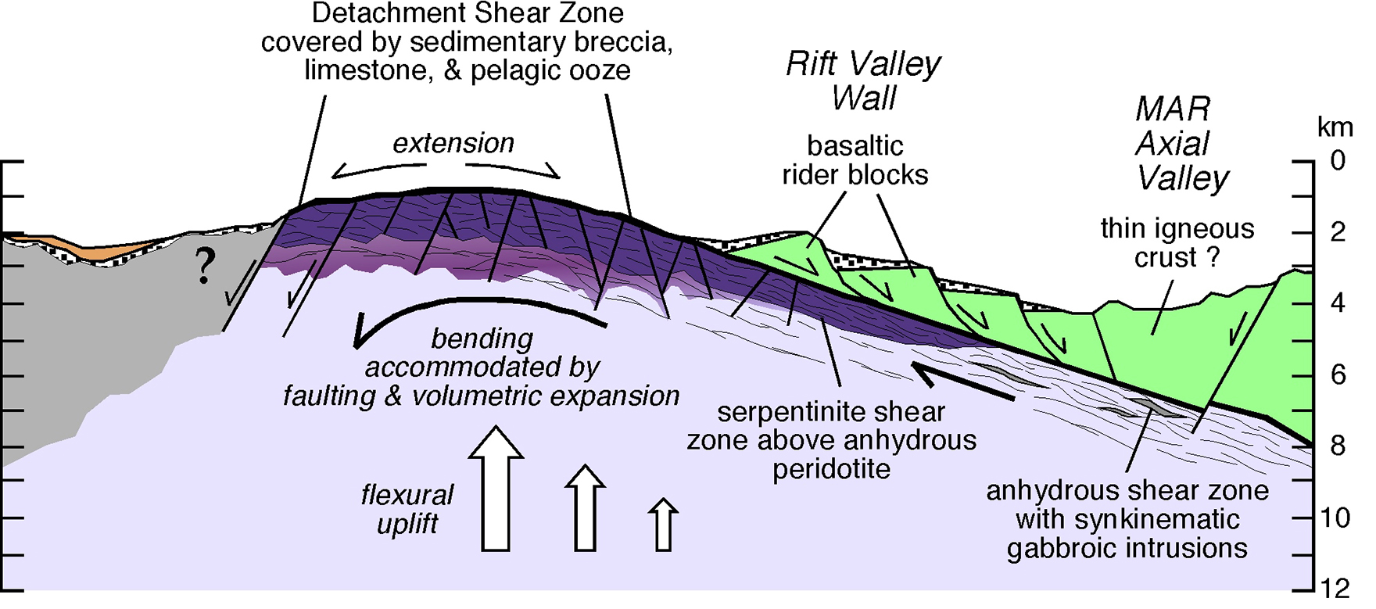
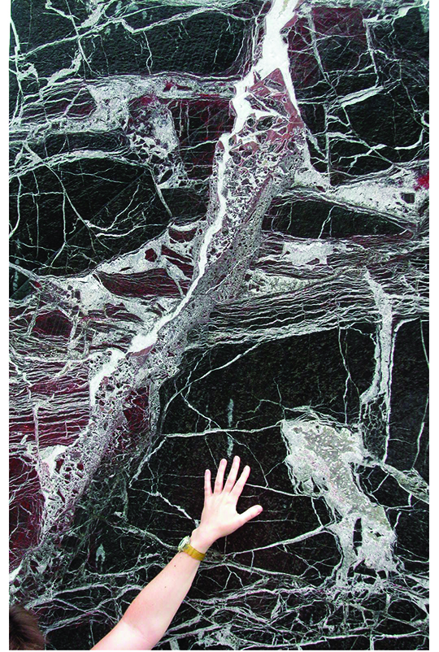
Part III: Deformation in amagmatic lithosphere
from Karson et al. 2015, Discovering the Deep

Slide 18
Aseismic deformation ➔ deep serpentinisation
Serpentinisation 75%
25%
Serpentinisation reduces rock strength
leads to strain localization
lizardite stable to about 400°C
Strength MPa
serpentinisation front 15 km deep
(after Escartin et al. 2001)
aseismic deformation
brittle deformation

Slide 19
Contrasting deformation in magmatic and amagmatic mantle domains
depth interval 8-15 km ➔ mantle rocks expected
temperature < 400°C
brittle (magmatic) versus aseismic (amagmatic) deformation
potential reasons: differences in mantle composition
          differences in fluid circulation
aseismic deformation
brittle deformation

Slide 20
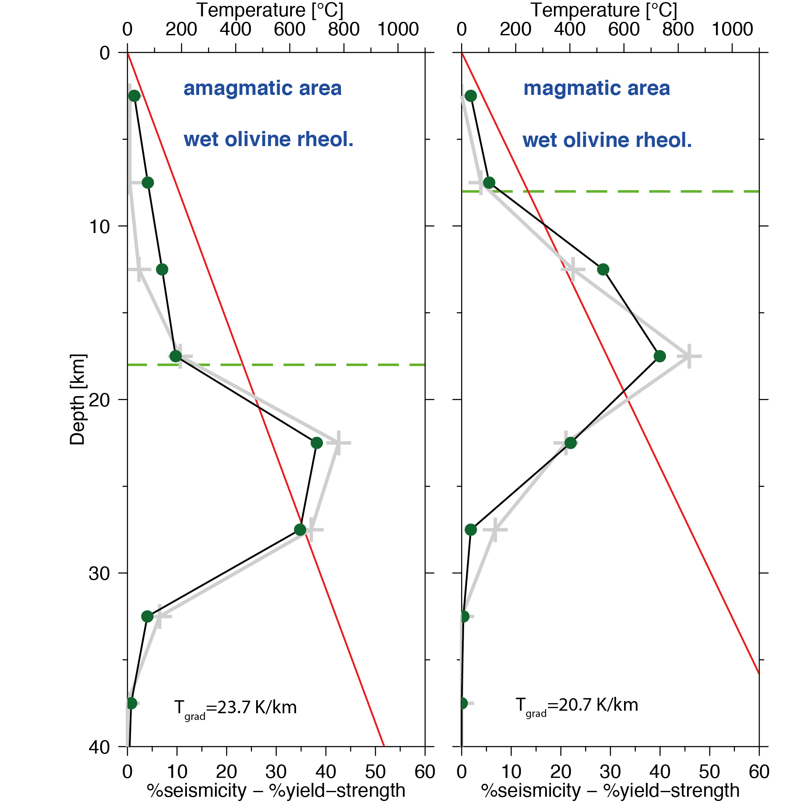
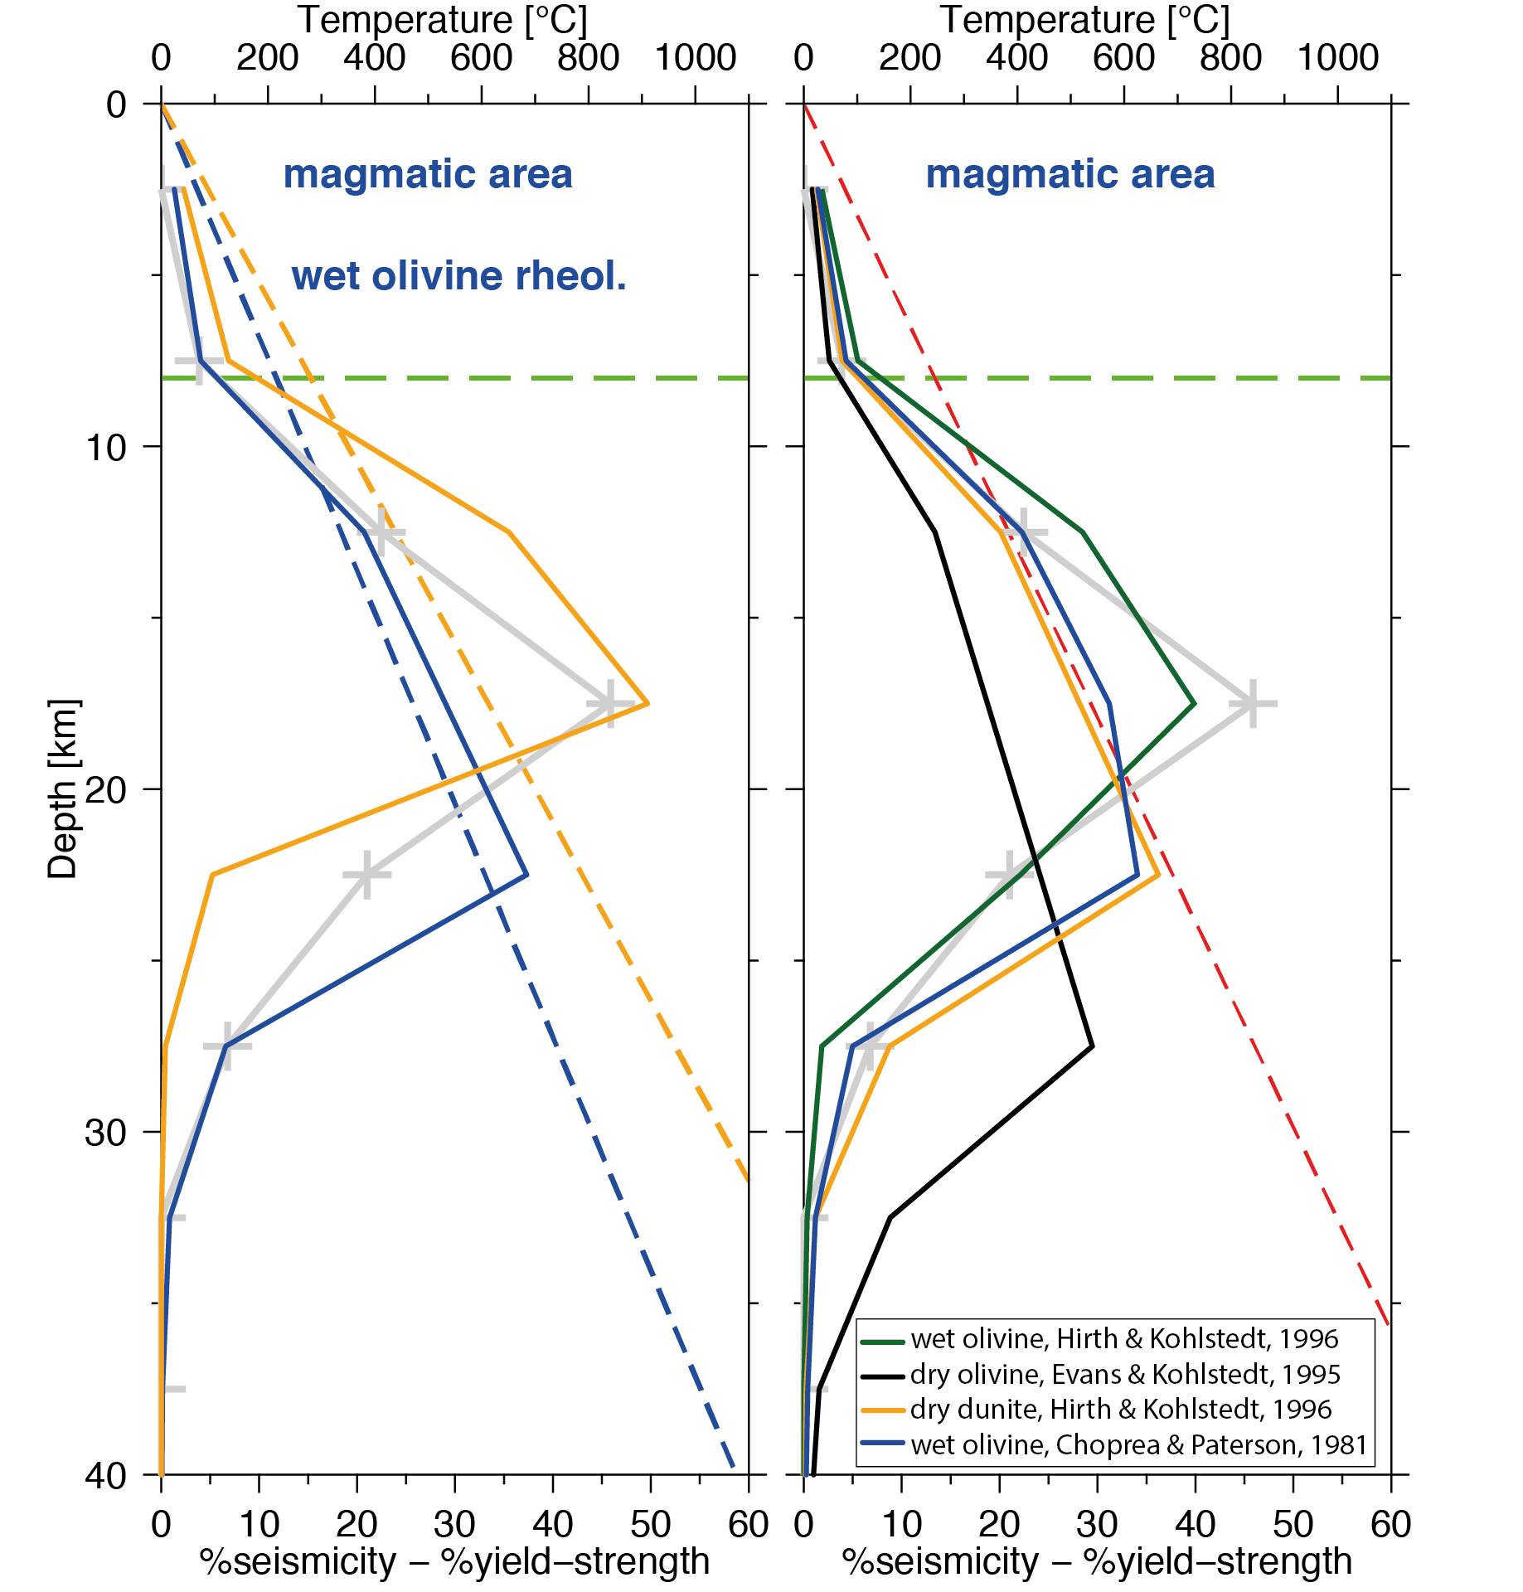
Yield strength ⬄ depth of serpentinisation
% seismicity ⬄ % yield strength
smallest strength of serpentine friction, Byerlee, creep law (T/d)
parameters: T, serpentinisation depth, rock type
T=20.7 K/km
T=23.7 K/km

Slide 21
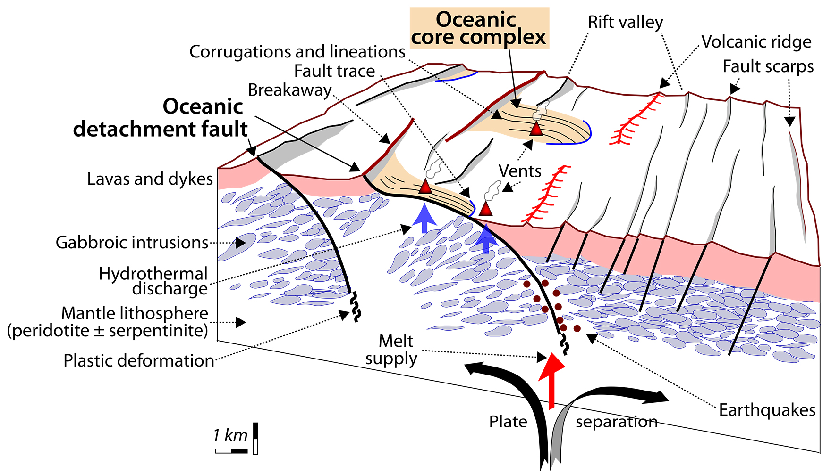
Detachment faulting at slow spreading ridges
shallow serpentinisation
(DeMartin et al. 2007)
seismicity tracing detachment
(Escartin & Canales 2010)

Slide 22
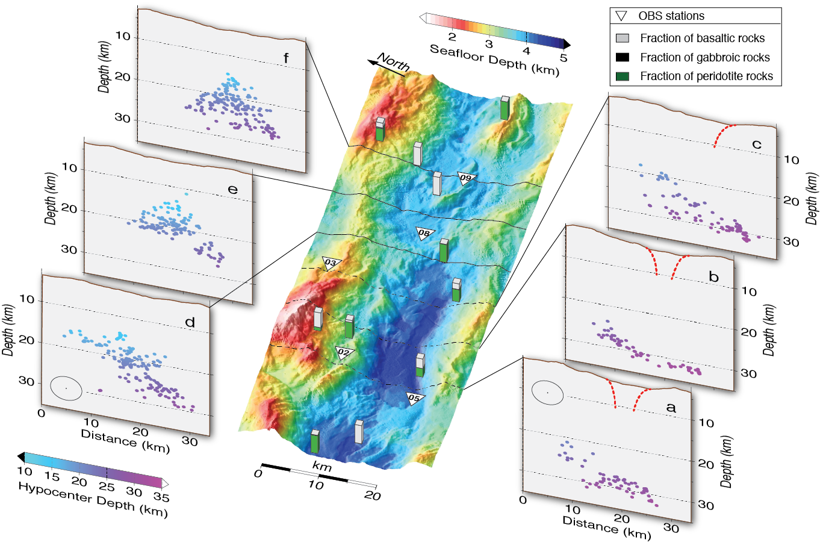
No seismically active detachments
(Schmid & Schlindwein, 2016)
HypoDD relocation

Slide 23
Diverse source mechanisms
(from Schmid & Schlindwein, 2016)
➔ complexity of local stress field

Slide 24
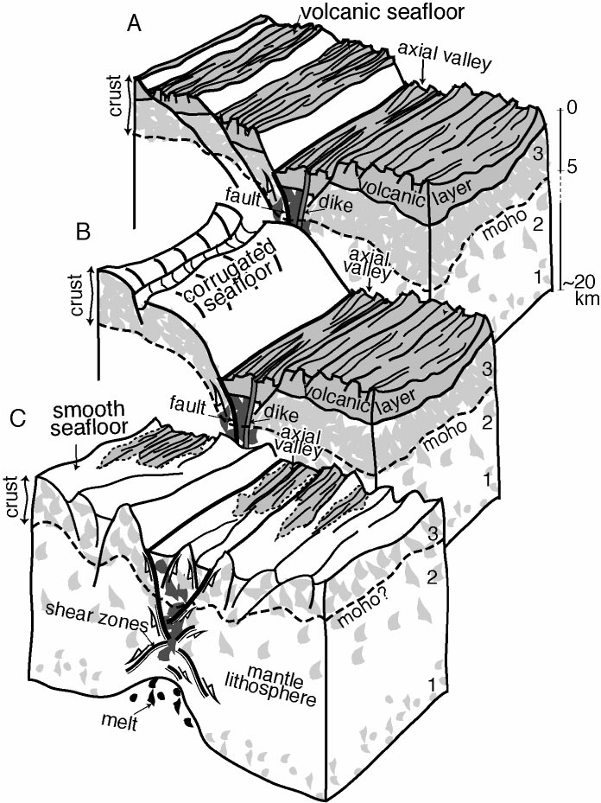
No seismically active detachments, but…
≈ 40%
< 10%
≈ 50%
??
southern rift flank decoupled
aseismic detachments/normal faults
(Cannat et al. 2006)
seafloor types at eastern SWIR

Slide 25
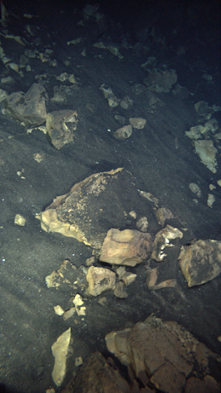
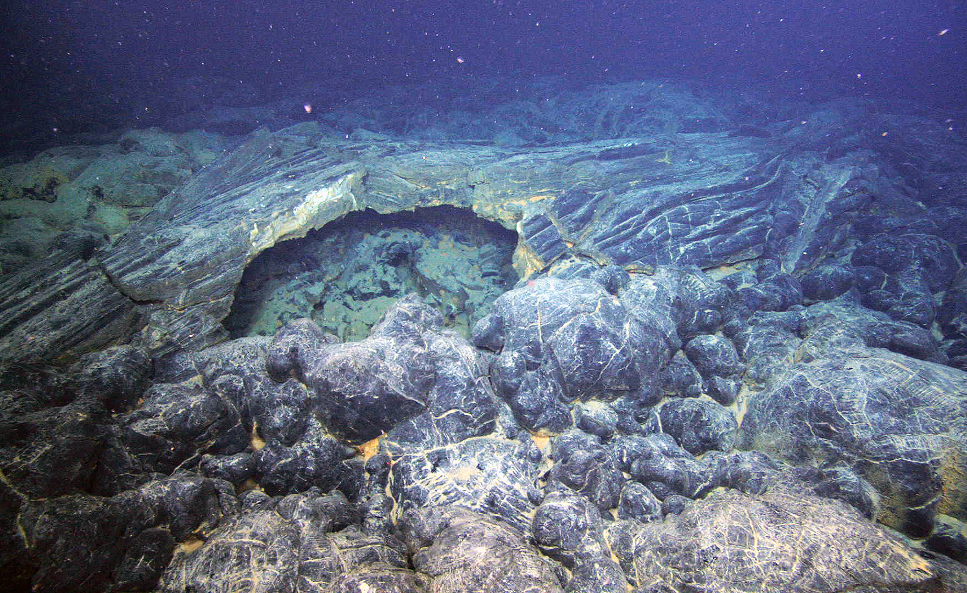
Part IV: Magmatic lithosphere and centres of magmatic activity in action
Sohn et al. 2008
Karson et al. 2015, Discovering the Deep
Sohn et al. 2008
Axial Seamount
pillows and flows
Gakkel Ridge
85°E volcanic complex
from Karson et al. 2015, Discovering the Deep

Slide 26
Types of magmatic lithosphere
➔ magmatic centres
  tiny patches in amagmatic sections to massive volcanoes
➔ robustly magmatic segments
  Western Volcanic Zone, Orthogonal Supersegment
Brittle deformation
Western Volcanic Zone Sparsely Magmatic Zone
(Schlindwein & Schmid, Nature, accepted)

Slide 27
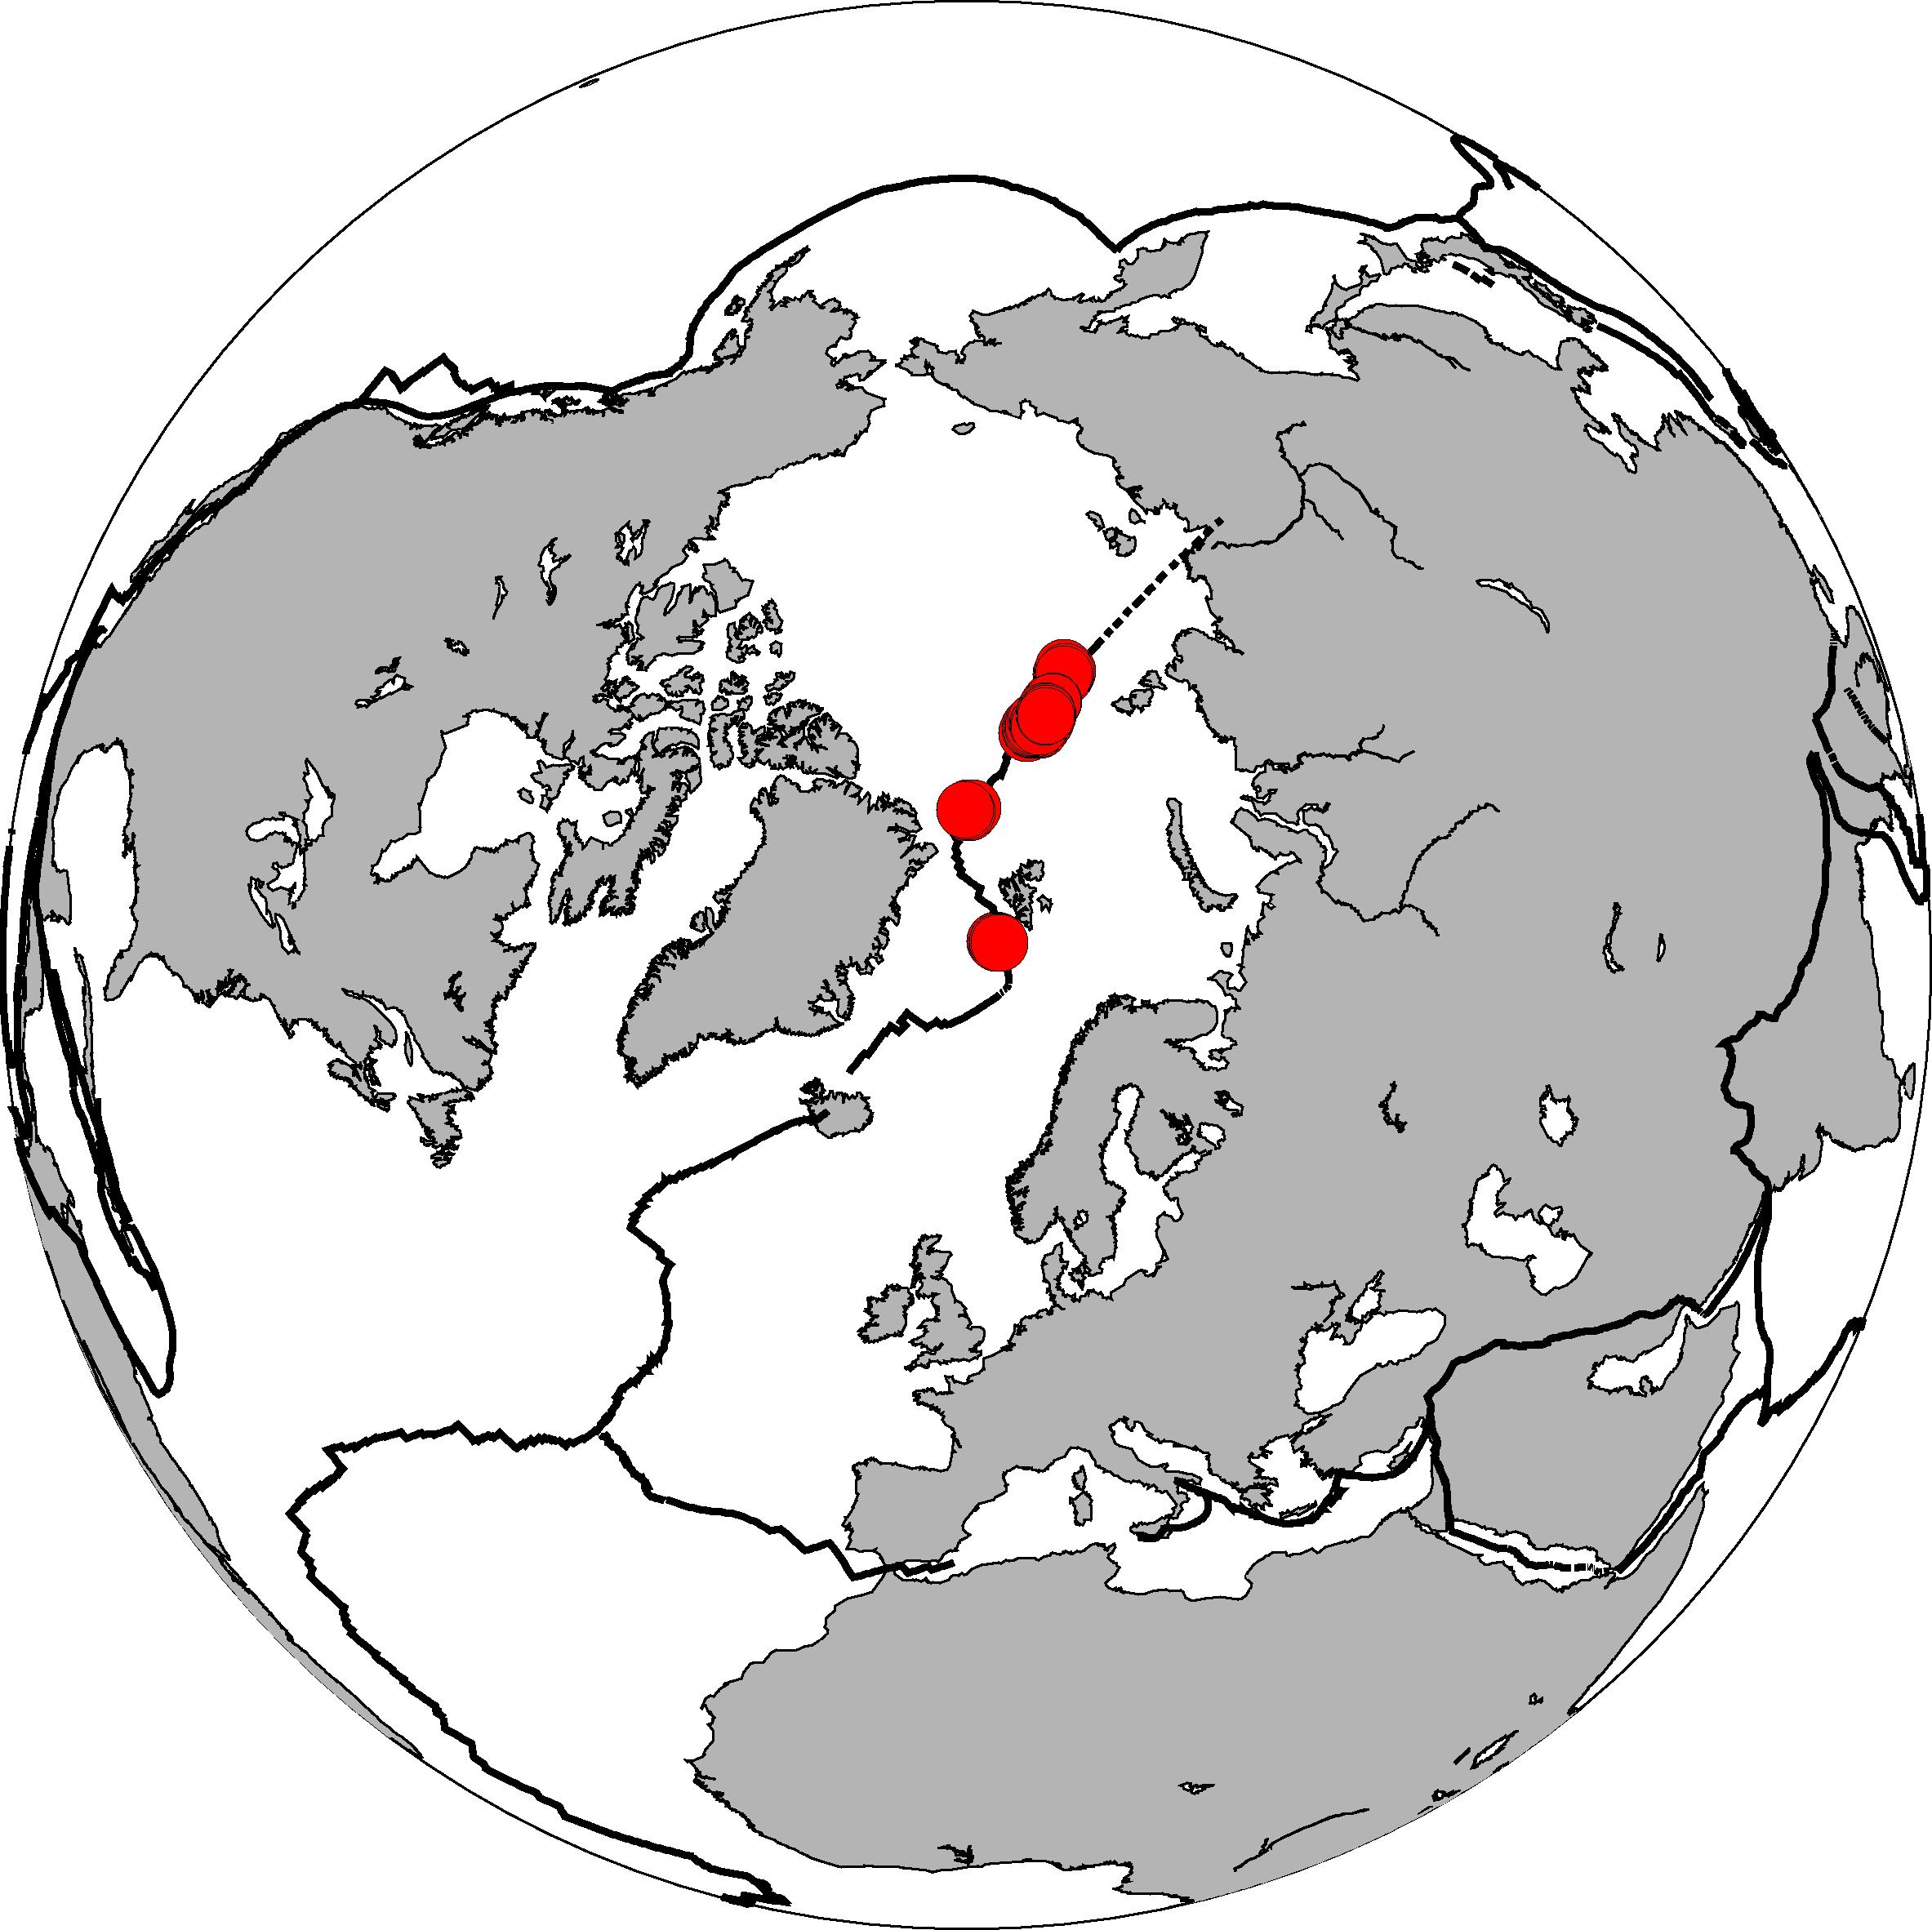
Teleseismic earthquake swarms point to active sites
(from Schlindwein, 2012)
Volcanoes are special: Large earthquakes M>5 in swarms activating entire segments
activity extended in space or time

Slide 28
Detection of submarine volcanic eruptions
(from Dziak et al., 1995)
real-time detection of submarine eruption
at CoAxial Seamount, JdFR,
with hydroacoustic data
migration of seismicity
shallowing hypocentres
M<<4

Slide 29
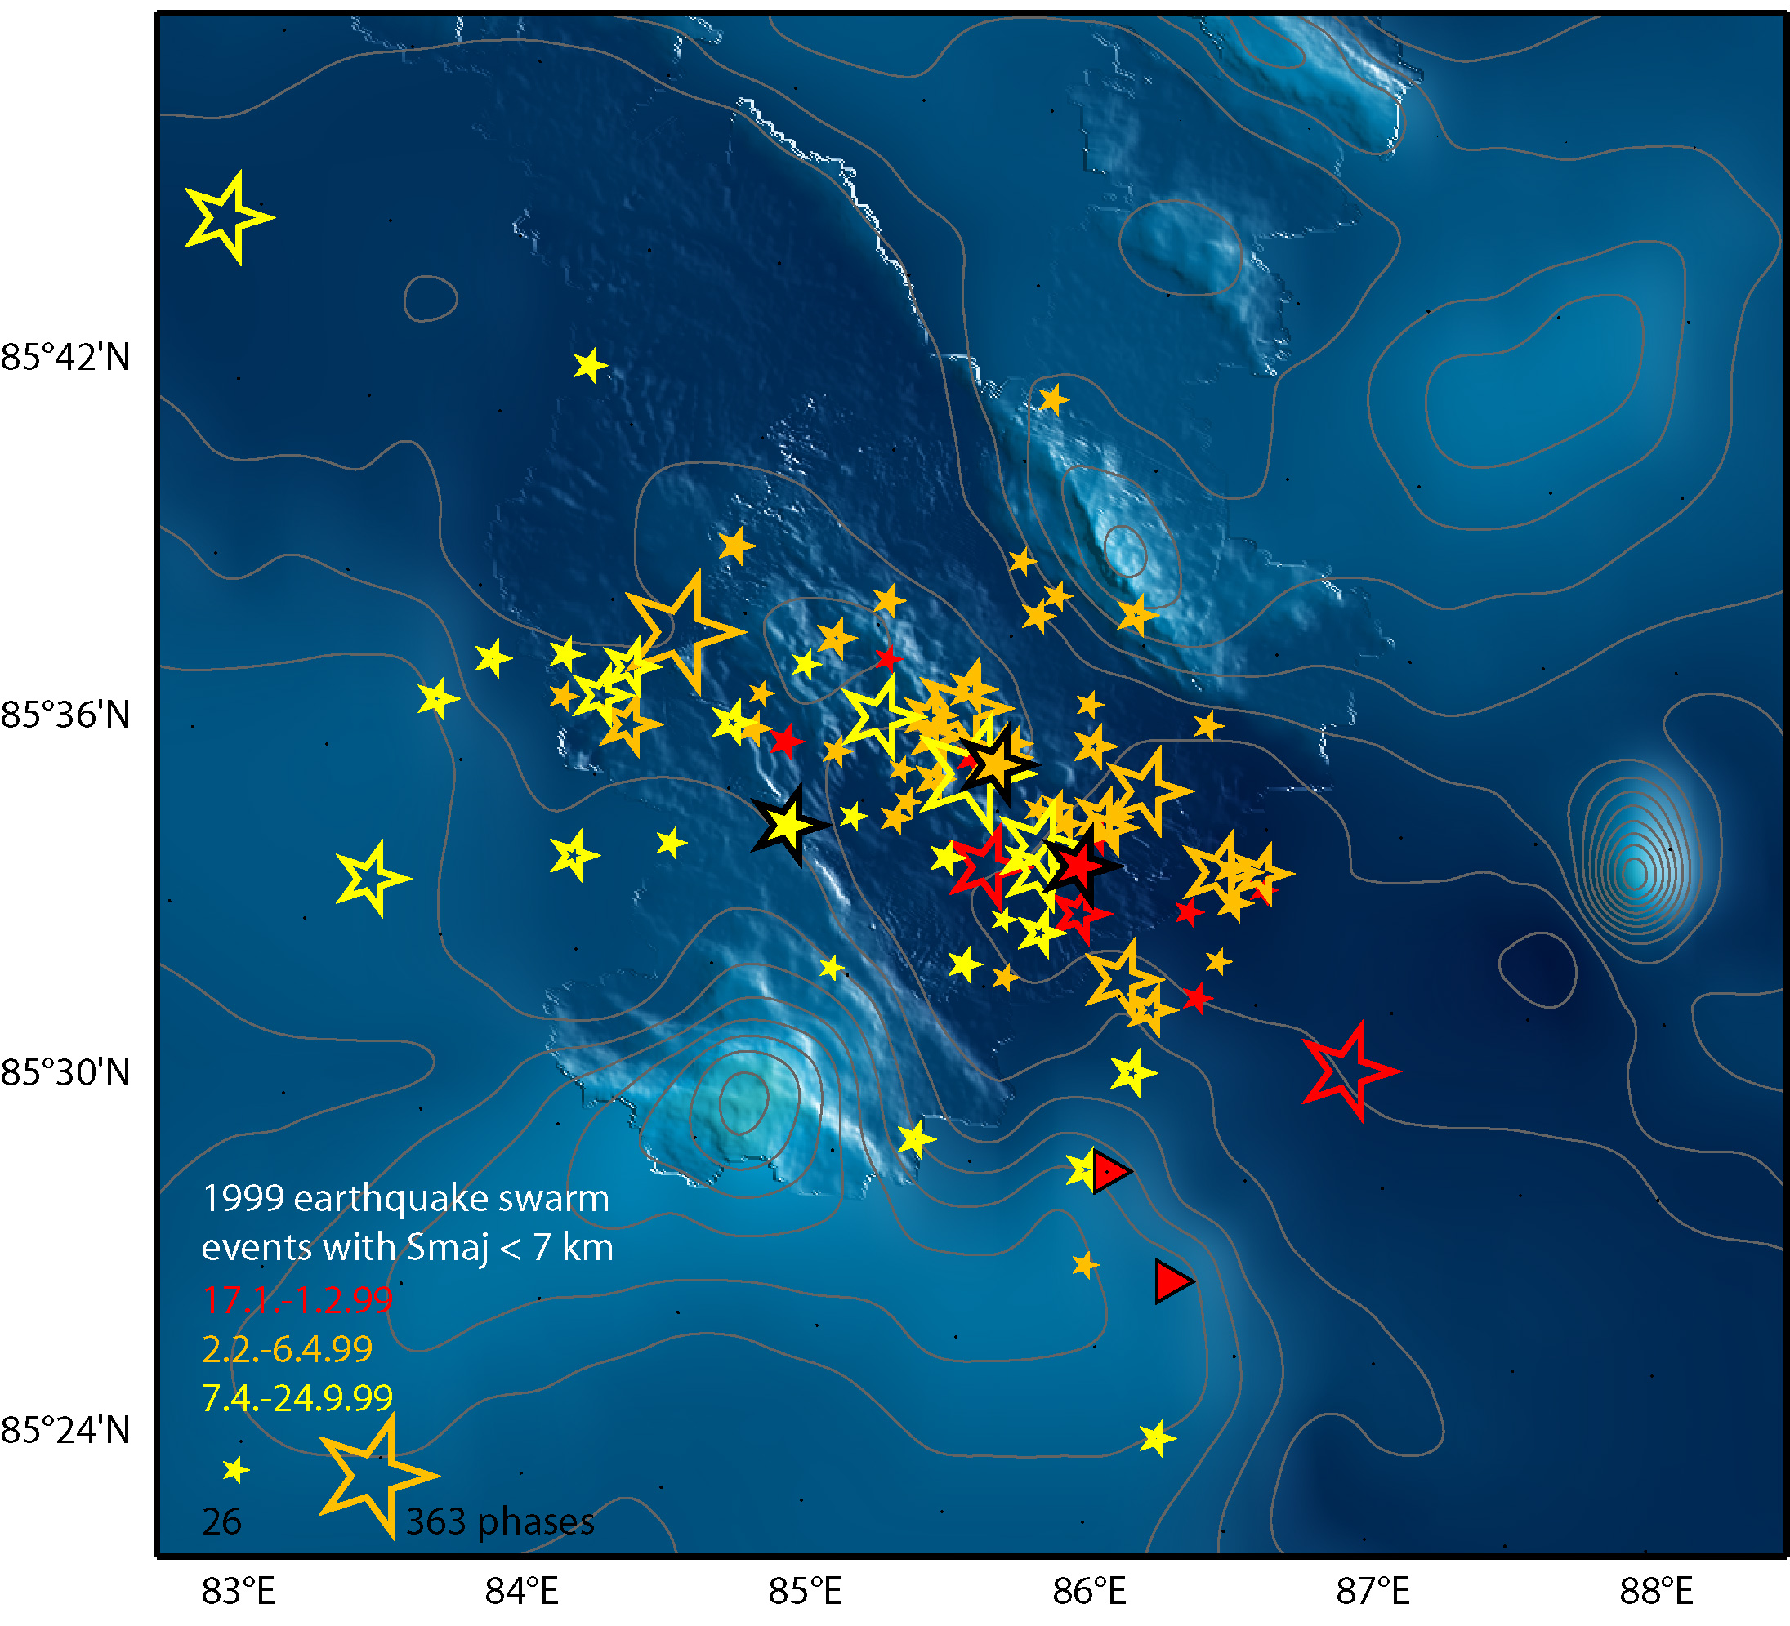
Unusual earthquake swarm at 85°E Gakkel Ridge
1999: 250 earthquakes
giant hydrothermal event plume in 2001
explosion sounds in 2001
ash of deep submarine explosive volcanism discovered
(adapted from Korger & Schlindwein 2012)
no migration of seismicity
no shallowing of hypocentres
11 events M>5
(Sohn et al. 2008)

Slide 30
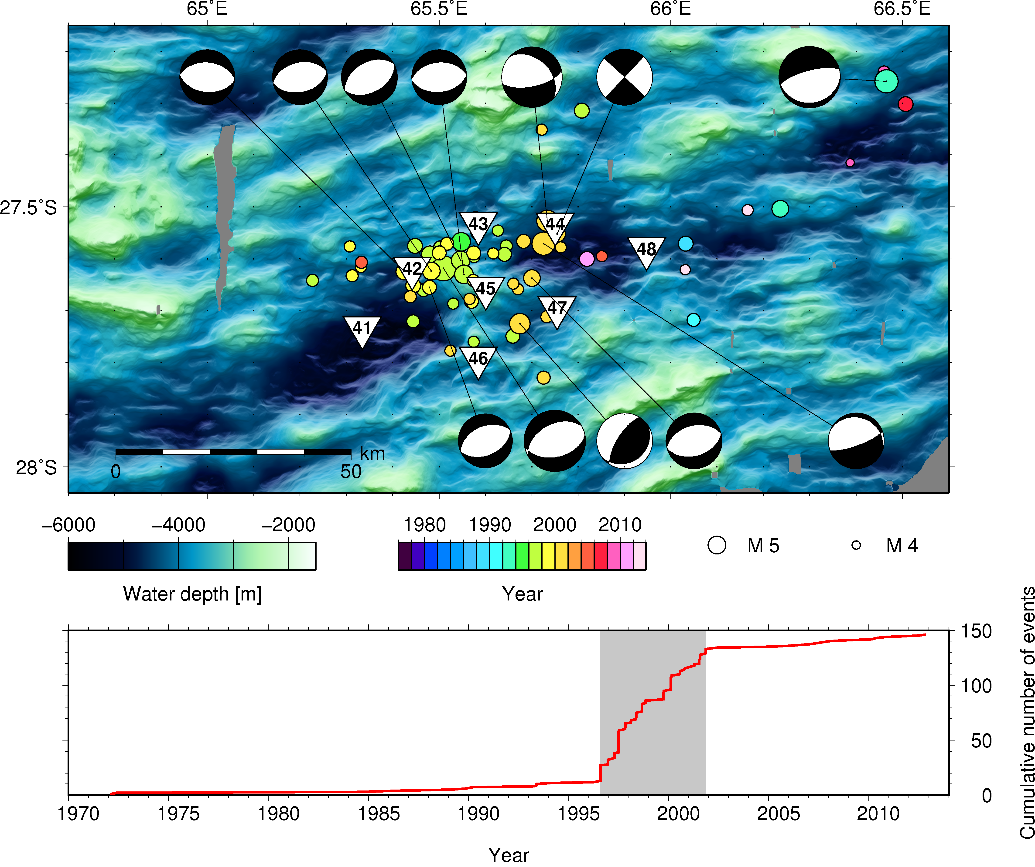
Presence of melt underneath volcano?
Segment 8 volcano
teleseismic swarms 1996-2002
8 OBS 2012-2013
(Schmid et al., Sci. Rep., 2017)

Slide 31
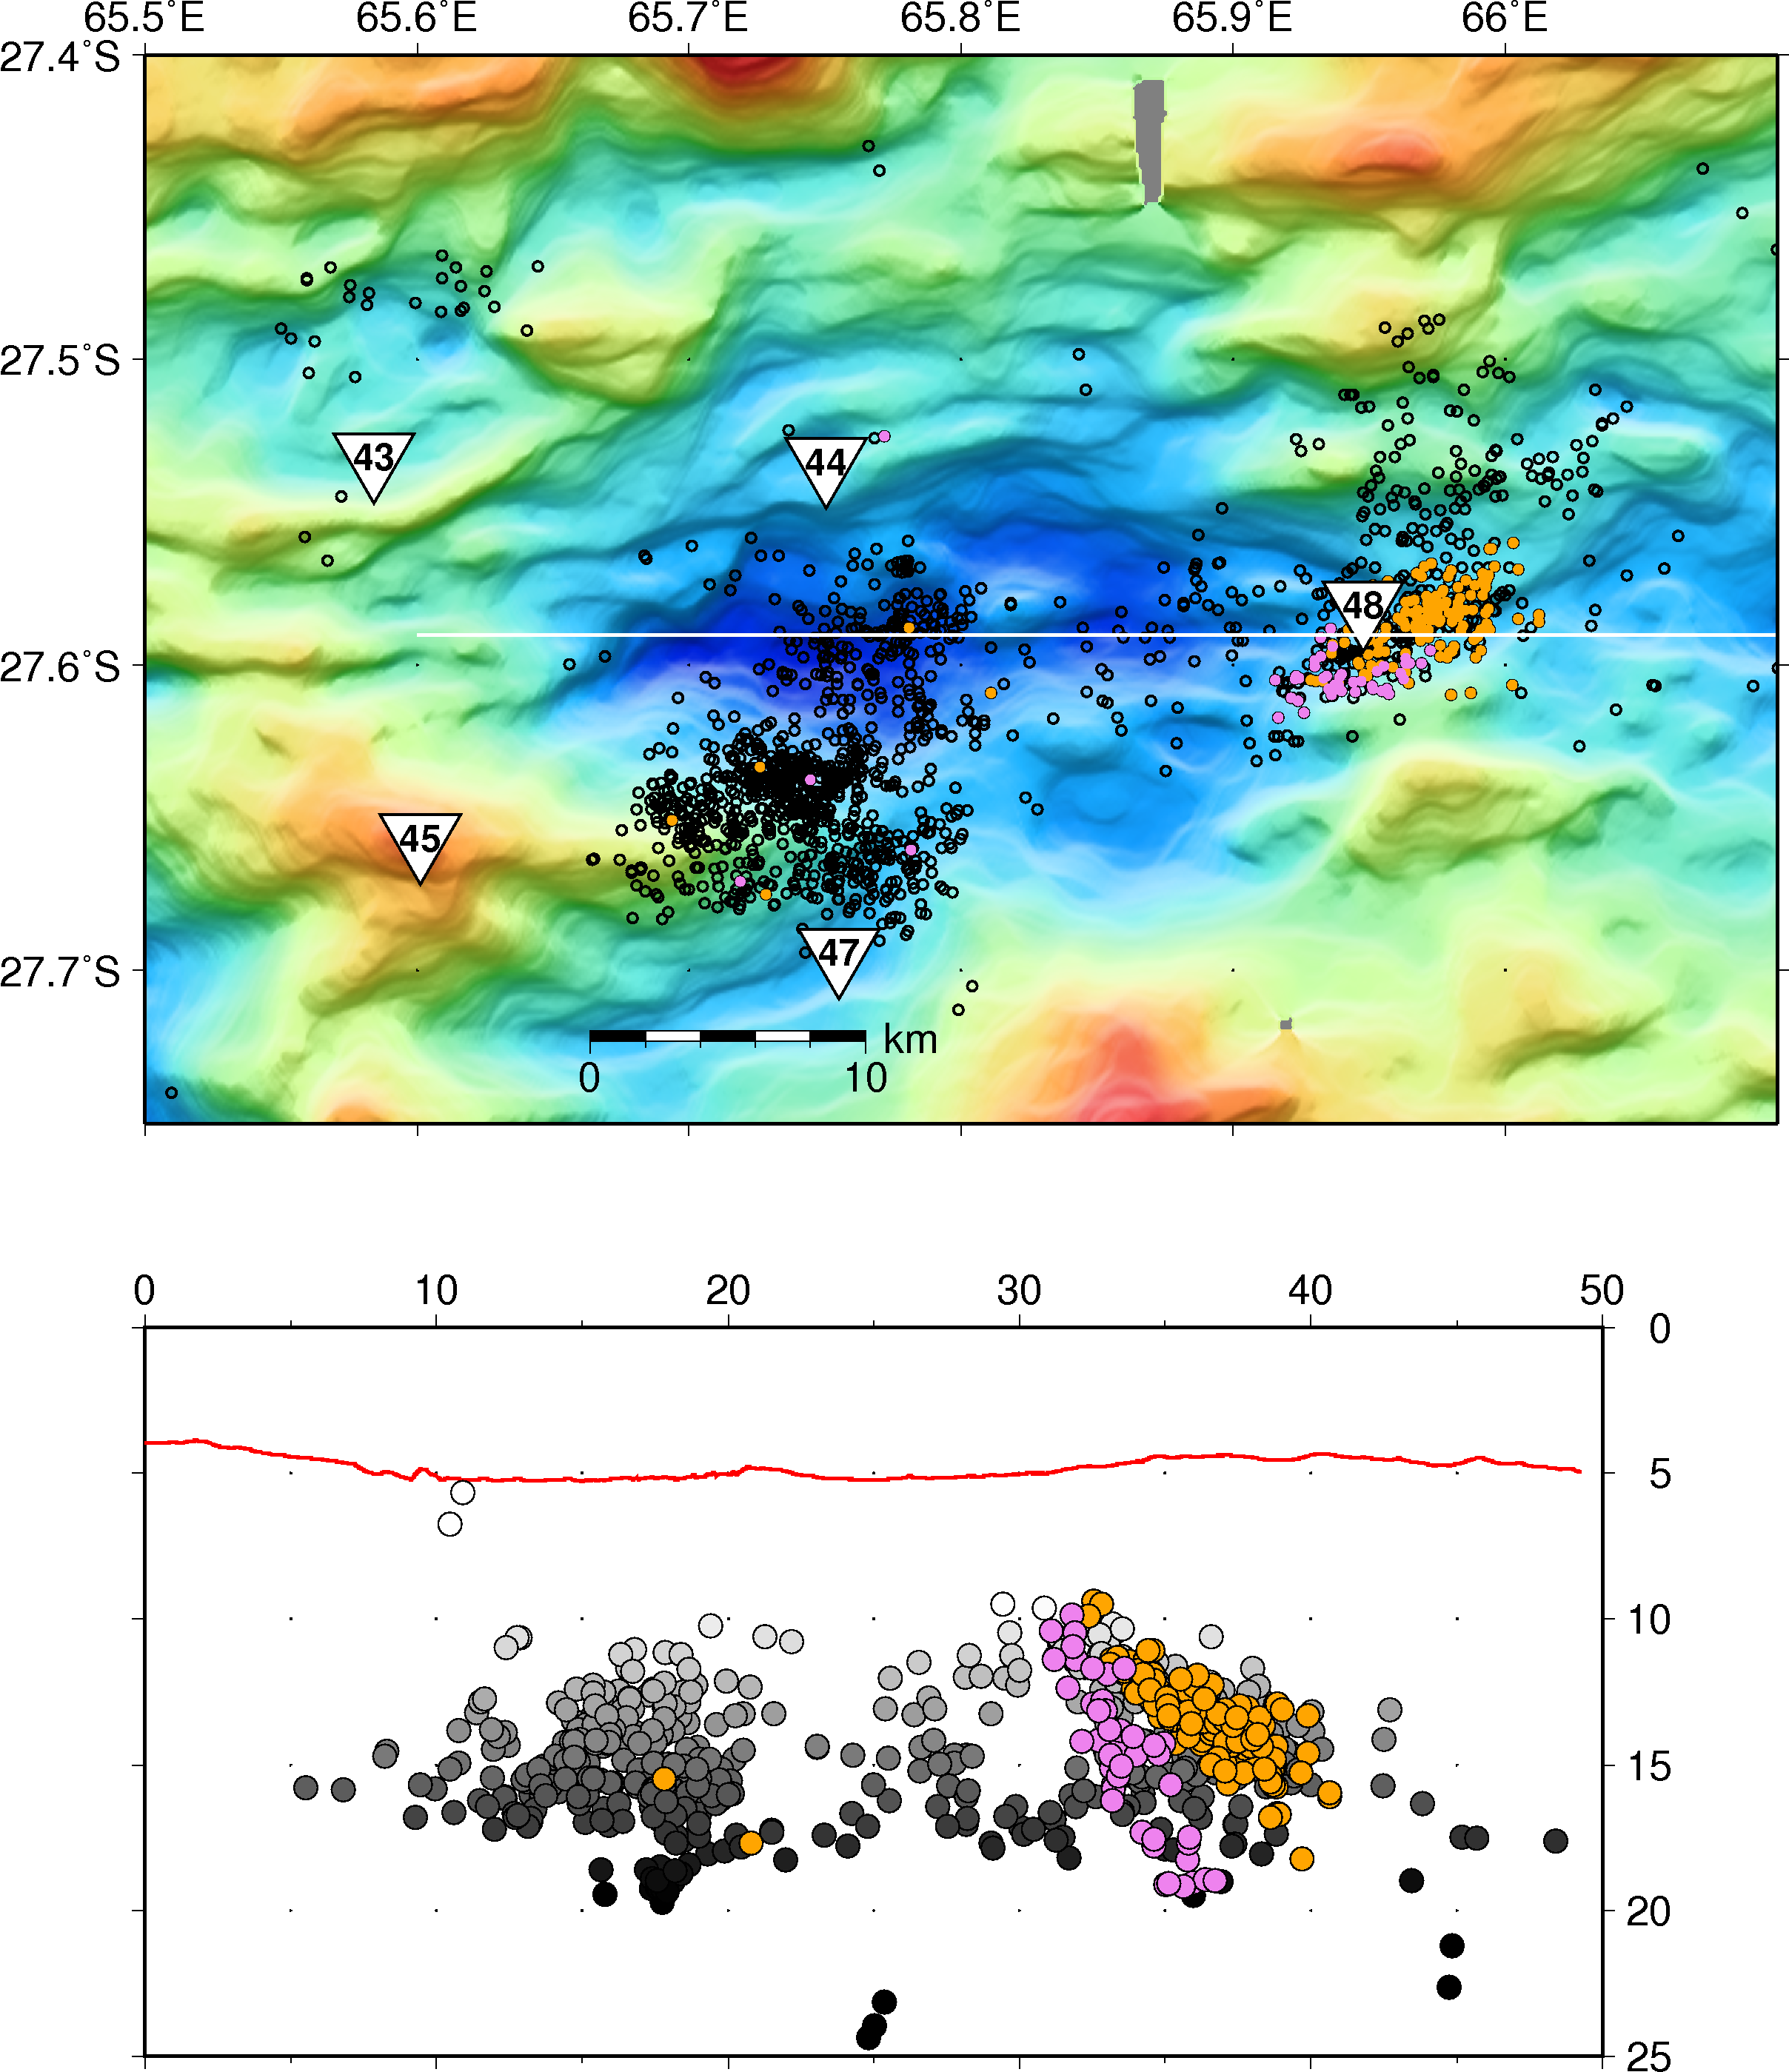
Diking – 16 years after begin of teleseismic episode
intrusion tremor
AVR
Seg7
cumulative number of eq < 10 km of R48
diking !!
Seg8
january
swarms
april
extended phases of magmatic activity
(comparable to East Africa; Krafla episodes)

Slide 32
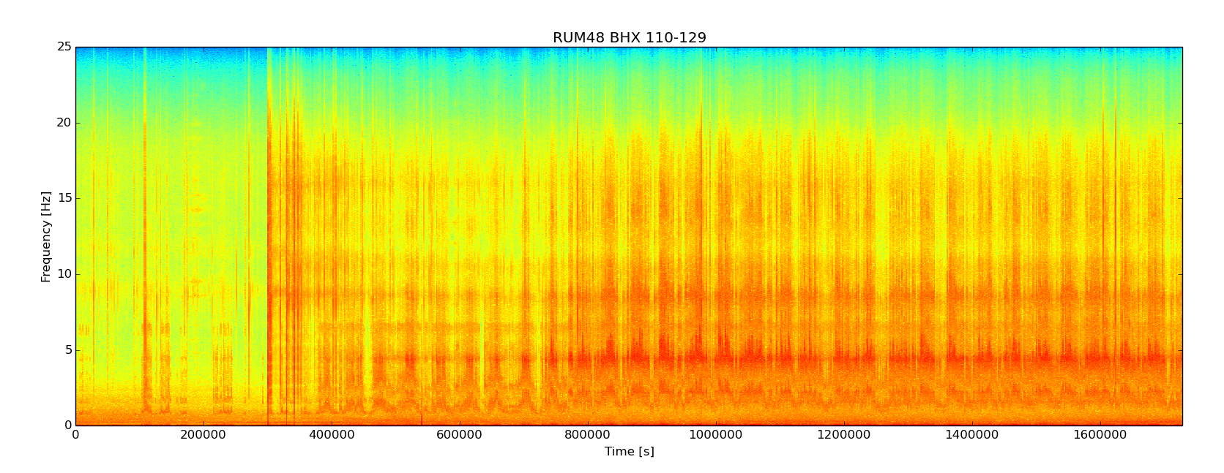
Intrusion tremor, SWIR
monochromatic
tidal modulation
of tremor
earthquake swarm
23.4. + 24.4.2013
Rare observation of submarine spreading episode
with OBS – detailed study to follow

Slide 33
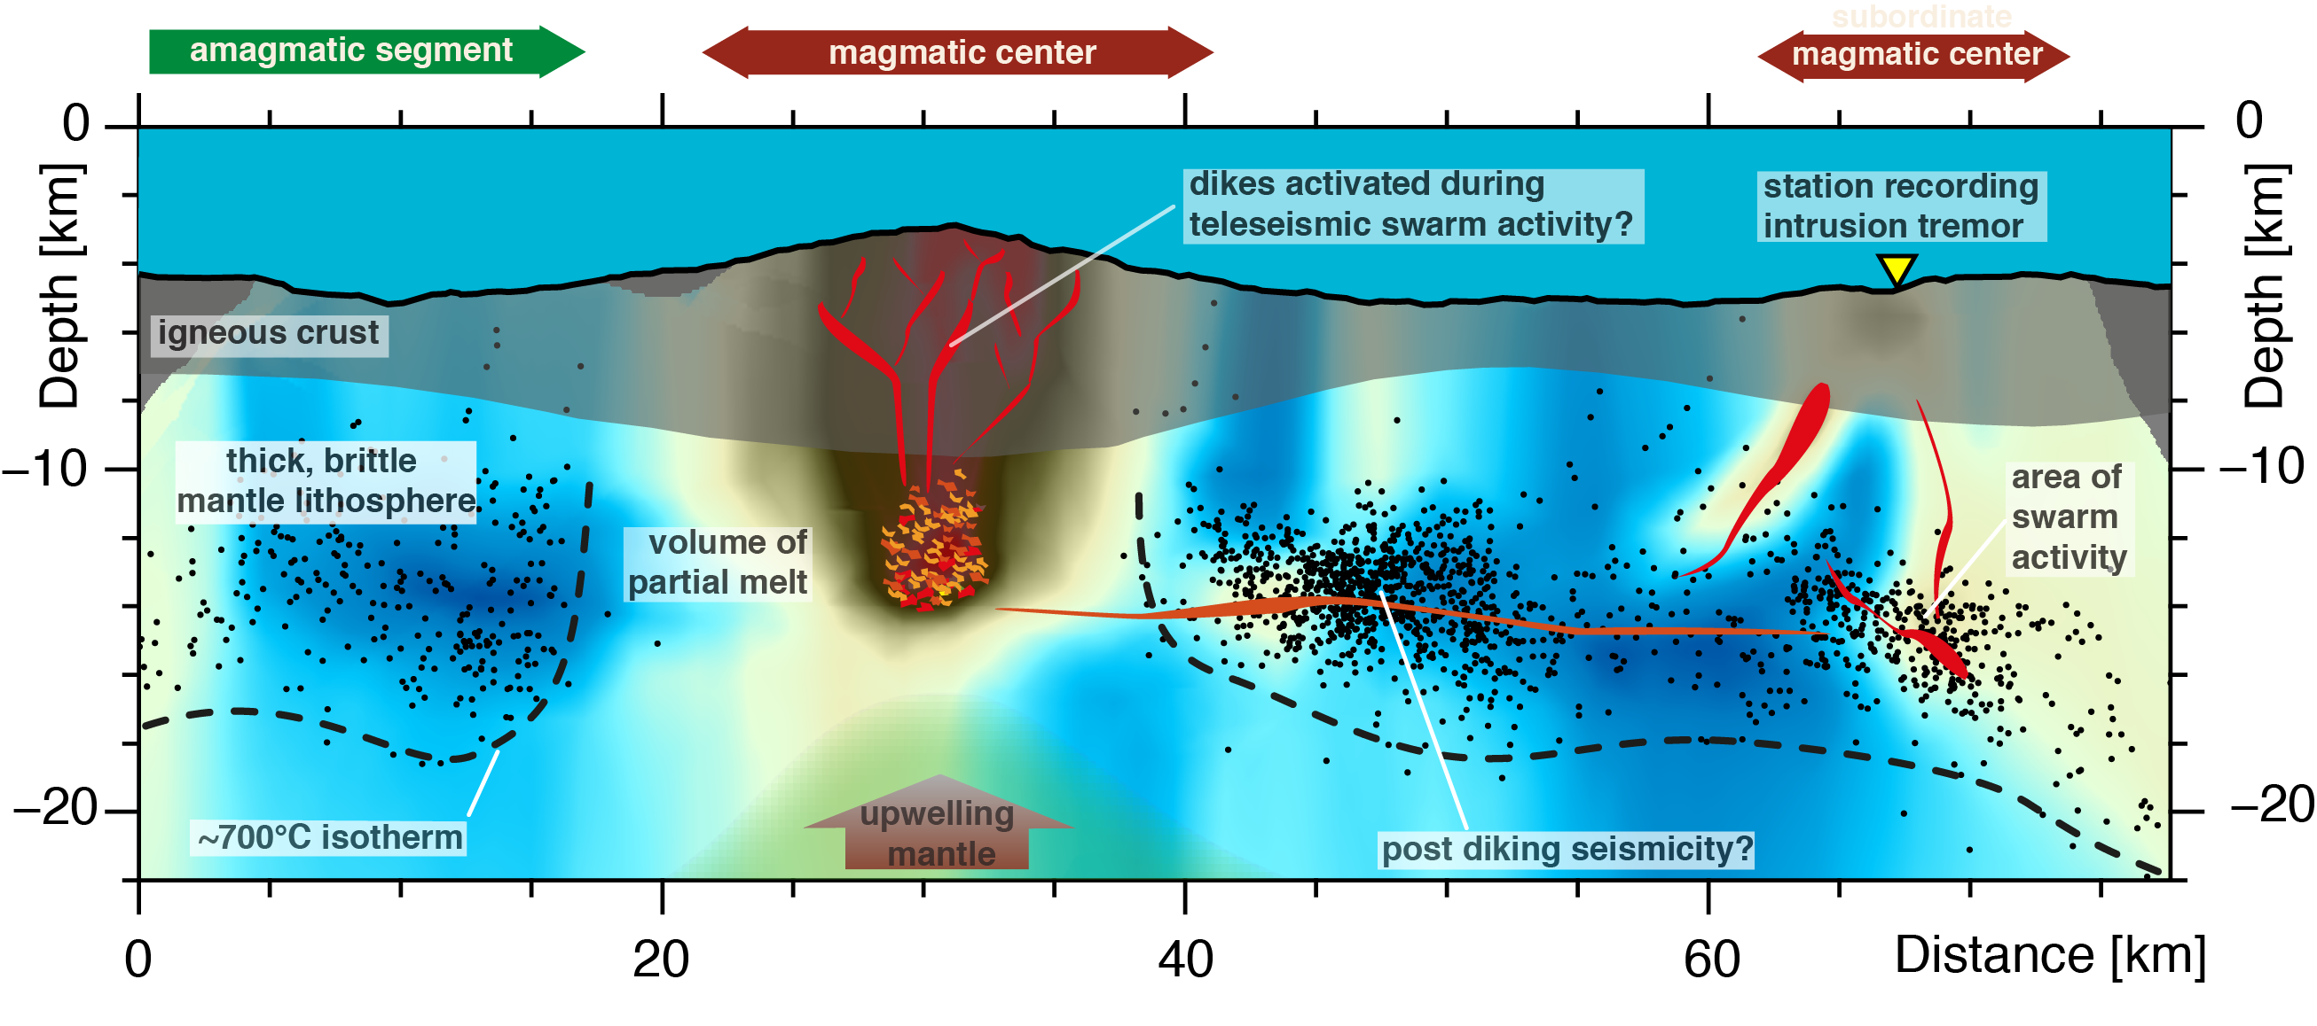
Active spreading at an ultraslow magmatic centre
(Schmid et al., Sci. Rep., 2017)
Subordinate neighbouring magmatic segments fed by the same source?

Slide 34
Spreading episodes at ultraslow ridges
Teleseismic earthquake swarms with M>5 events preceed spreading episodes
stress release in thick brittle lithosphere, triggered by magmatism
magmatic phase with weak seismicity, long-lasting, aseismic feeder zone
explosive volcanism possible

Slide 35
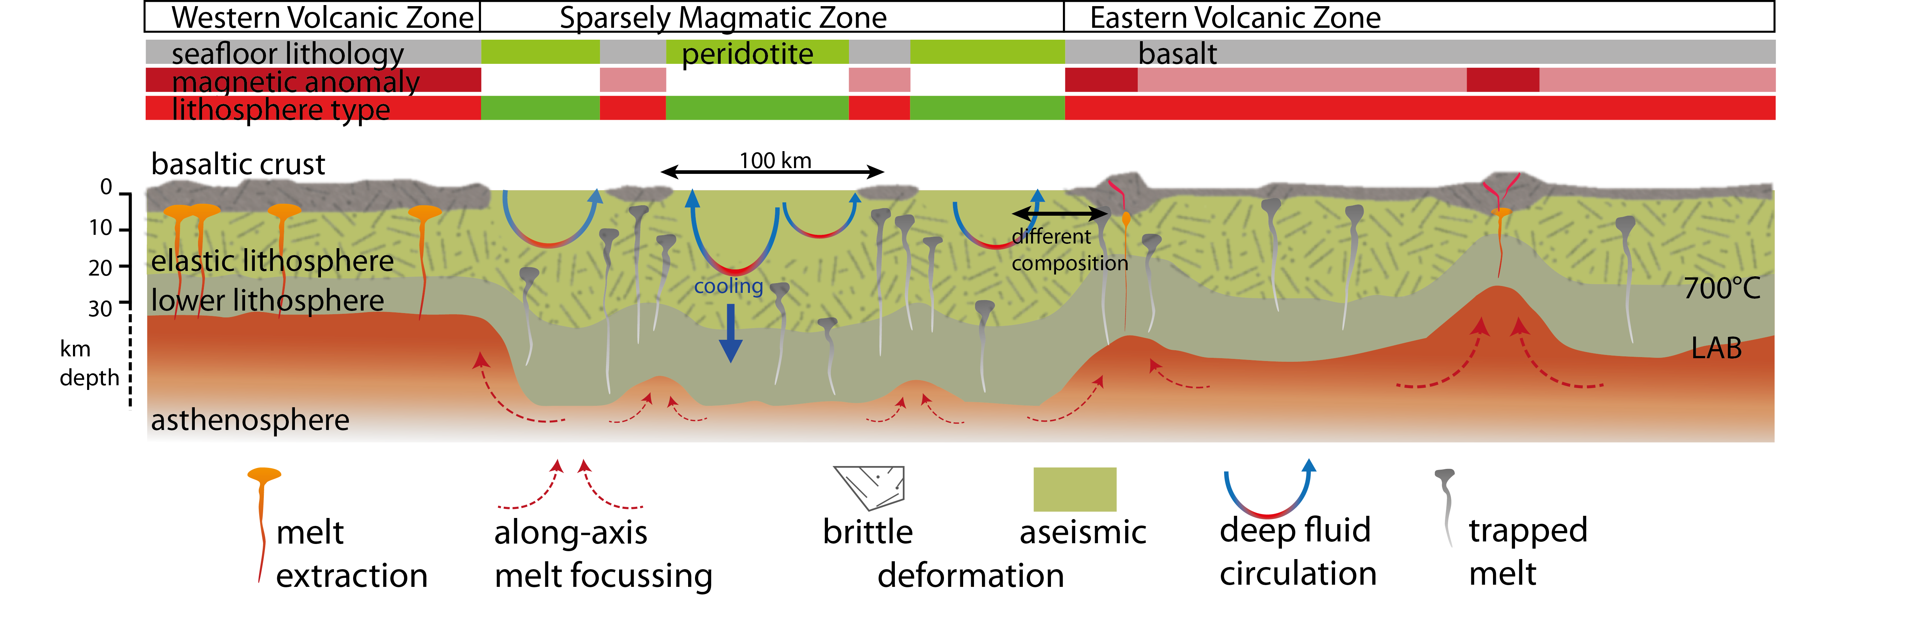
Summary
Conceptual model for ultraslow lithosphere production
(Schlindwein & Schmid, 2016)
peridotite dominated regions ➔ lack of seismicity/magnetic anomaly
deep reaching alteration cools lithosphere
basalt dominated regions ➔ brittle deformation, magnetic anomaly
thin lithosphere (many varieties/activity states)
pronounced LAB topography ➔ melt flow along ridge
stable segmentation (Gakkel Ridge)

Slide 36
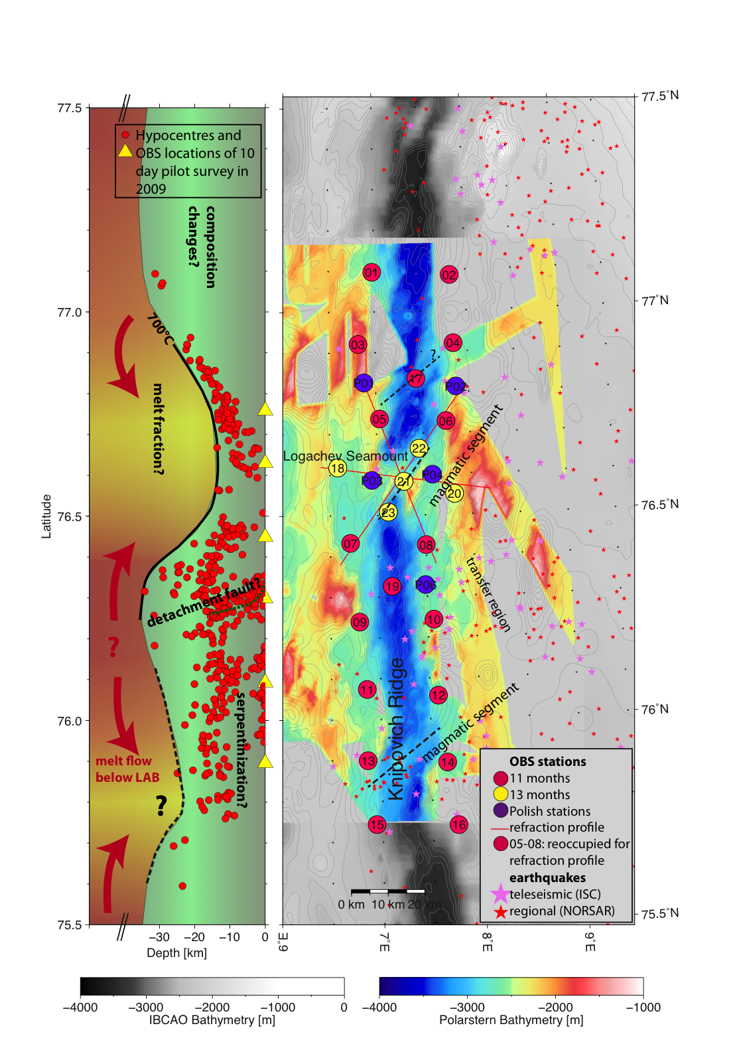
Outlook:
Ongoing experiment: KNIPAS – getting the bigger picture at segment scale
2019+:
Gakkel Ridge 3°E: Looking at magmatic and amagmatic lithosphere in contact
Ice-OBS in production

Slide 37
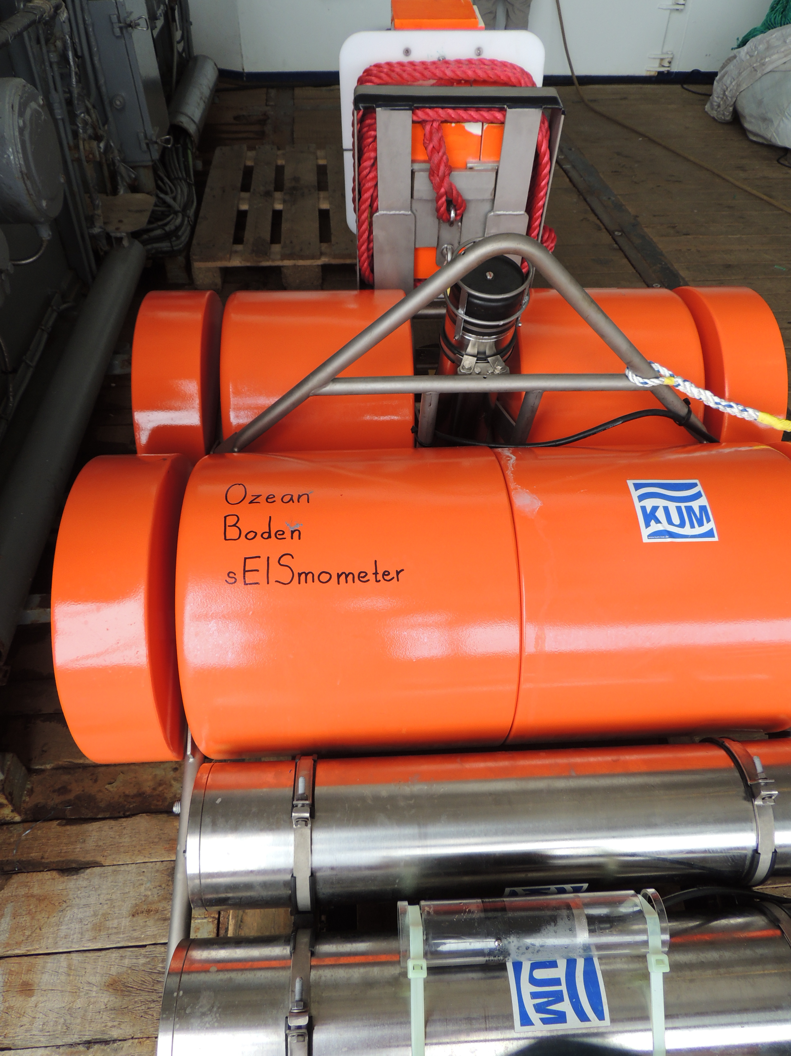
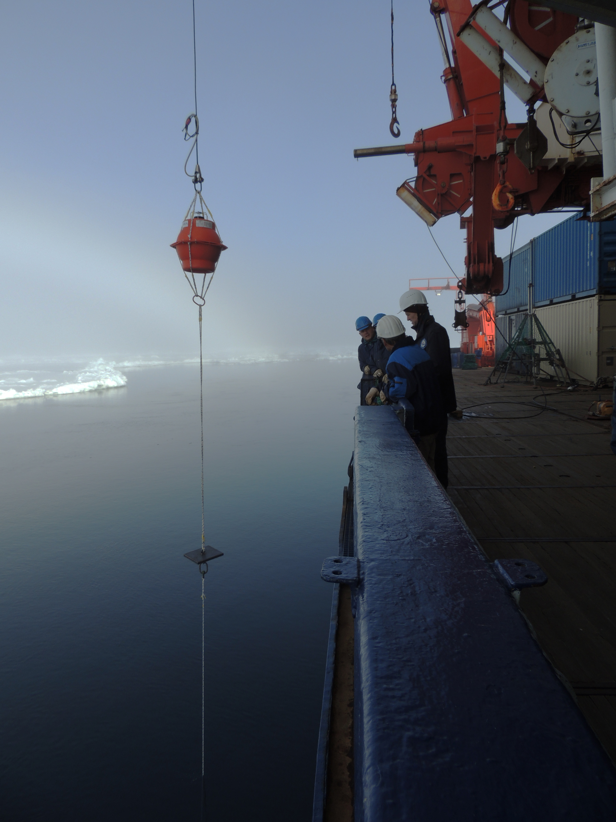
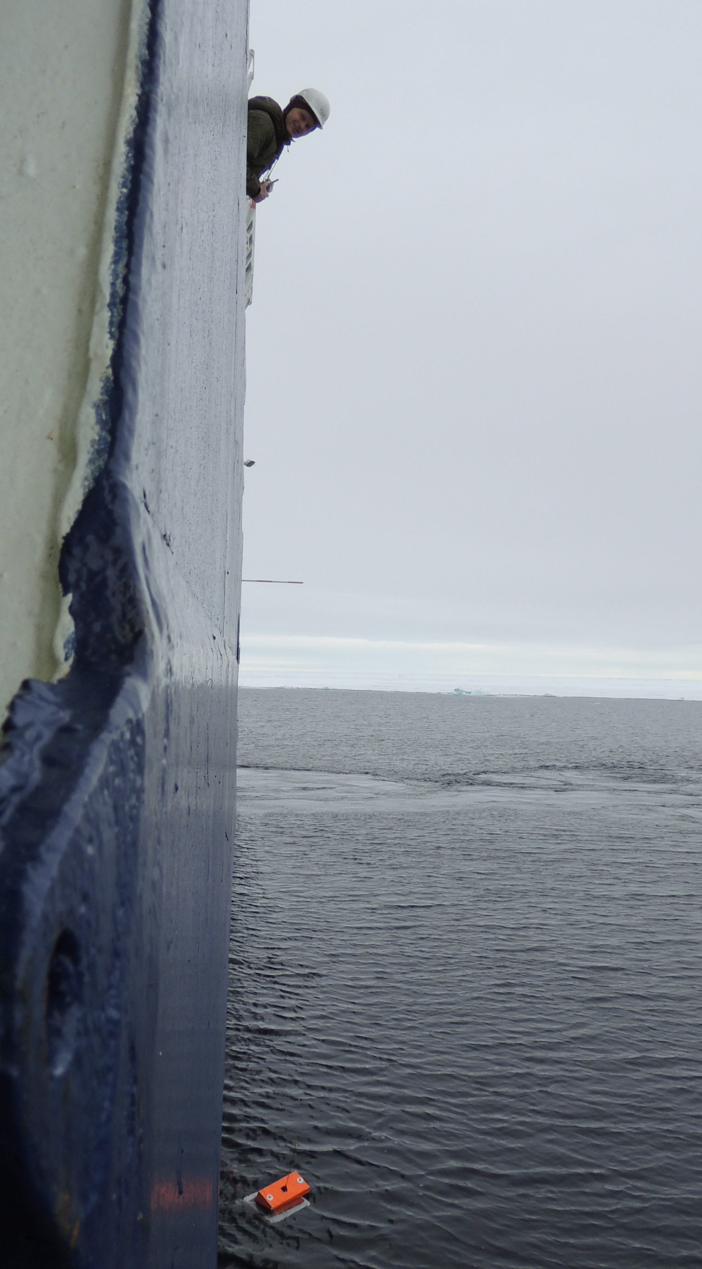
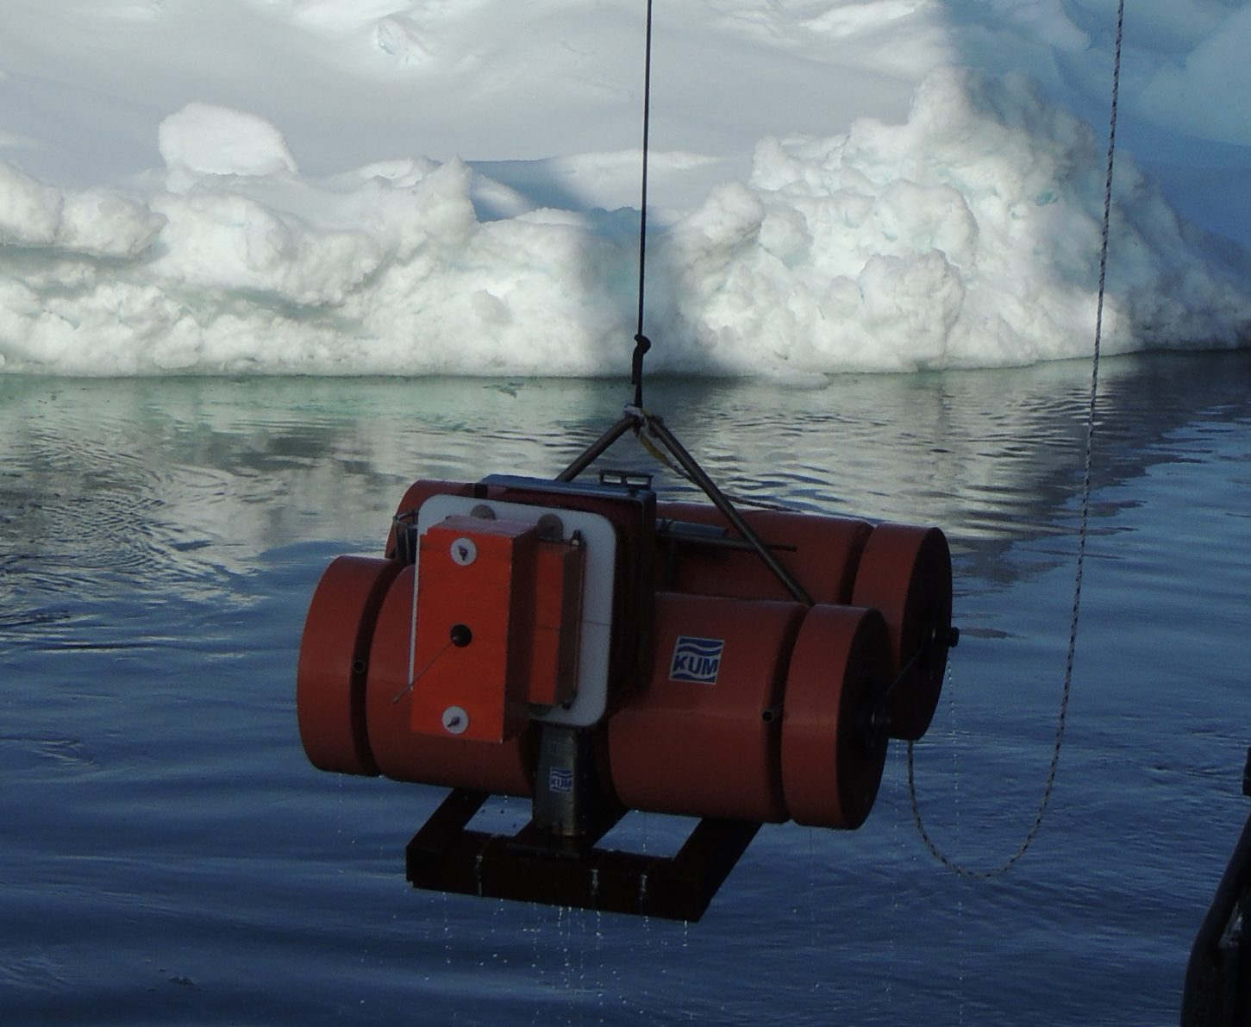
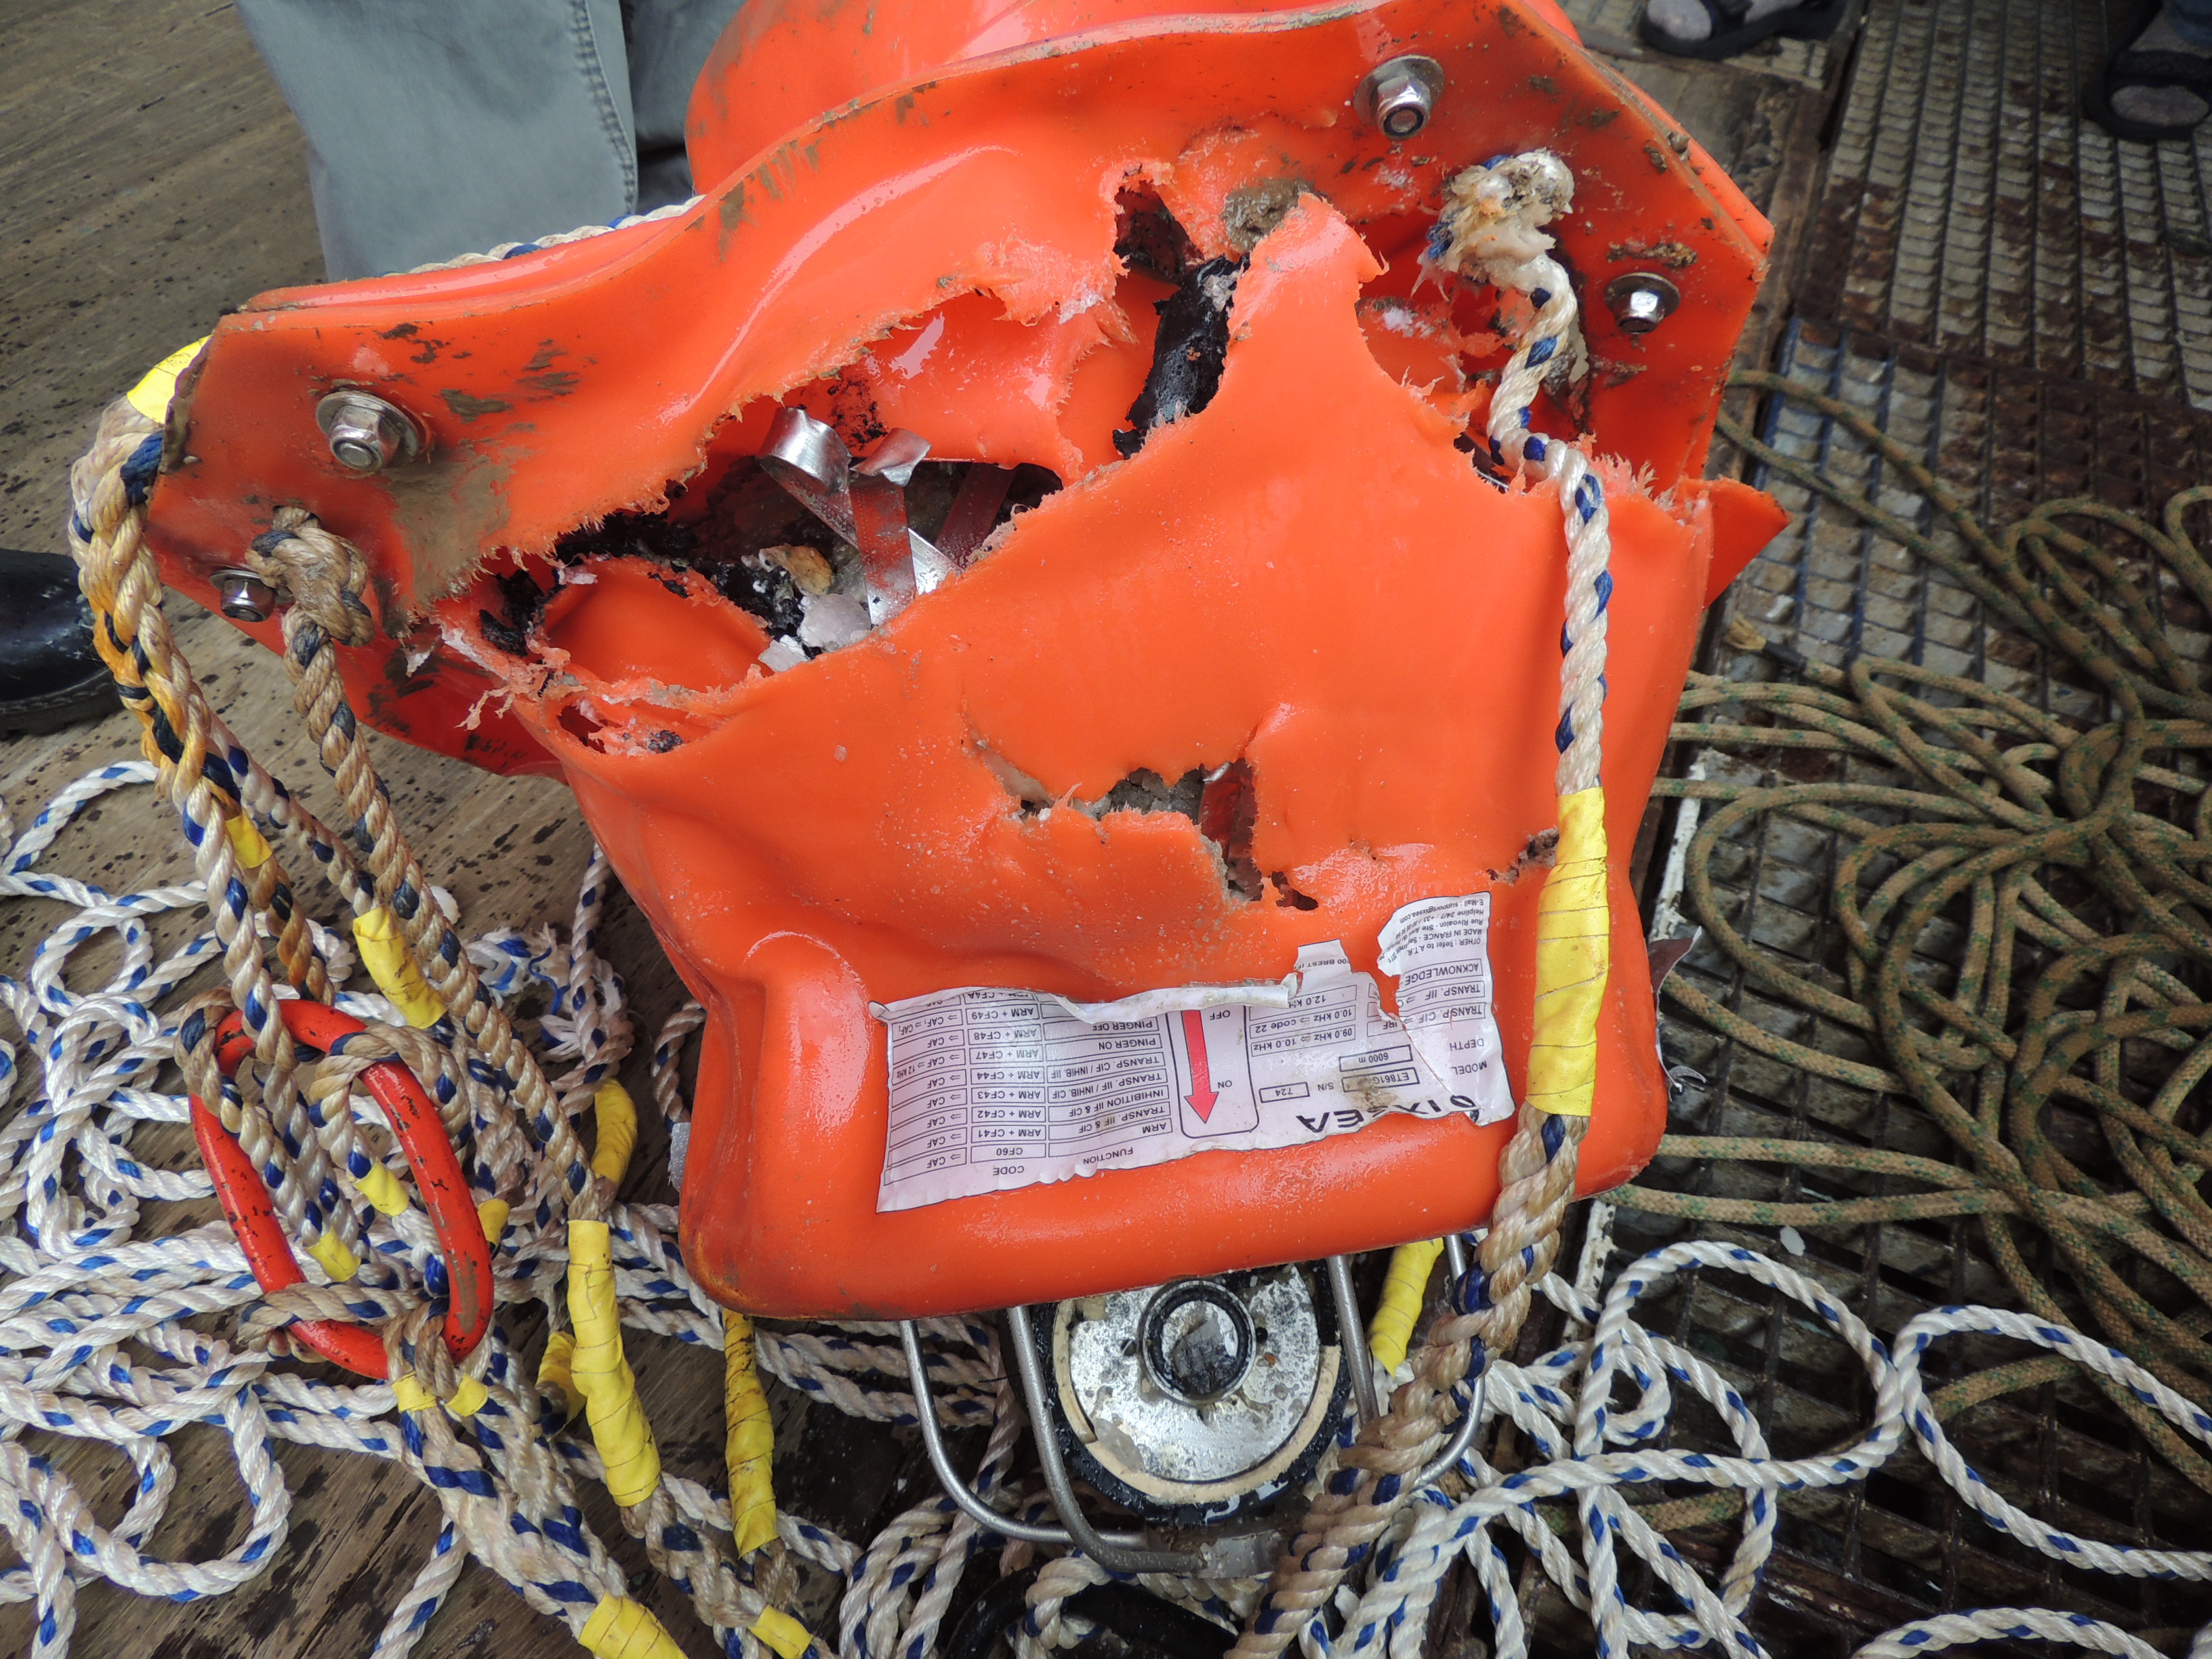
Test of ice-going OBS, July 2014, Gakkel Ridge
© V. Schlindwein AWI
© V. Schlindwein AWI
© V. Schlindwein AWI
© V. Schlindwein AWI
© V. Schlindwein AWI
© V. Schlindwein AWI
Notes:
I want to conclude with these photos of a successful recovery of an under ice OBS that yielded ten days of seismological data of excellent quality as the seismic noise in the Arctic Ocean is extremely low.

