Slide 1
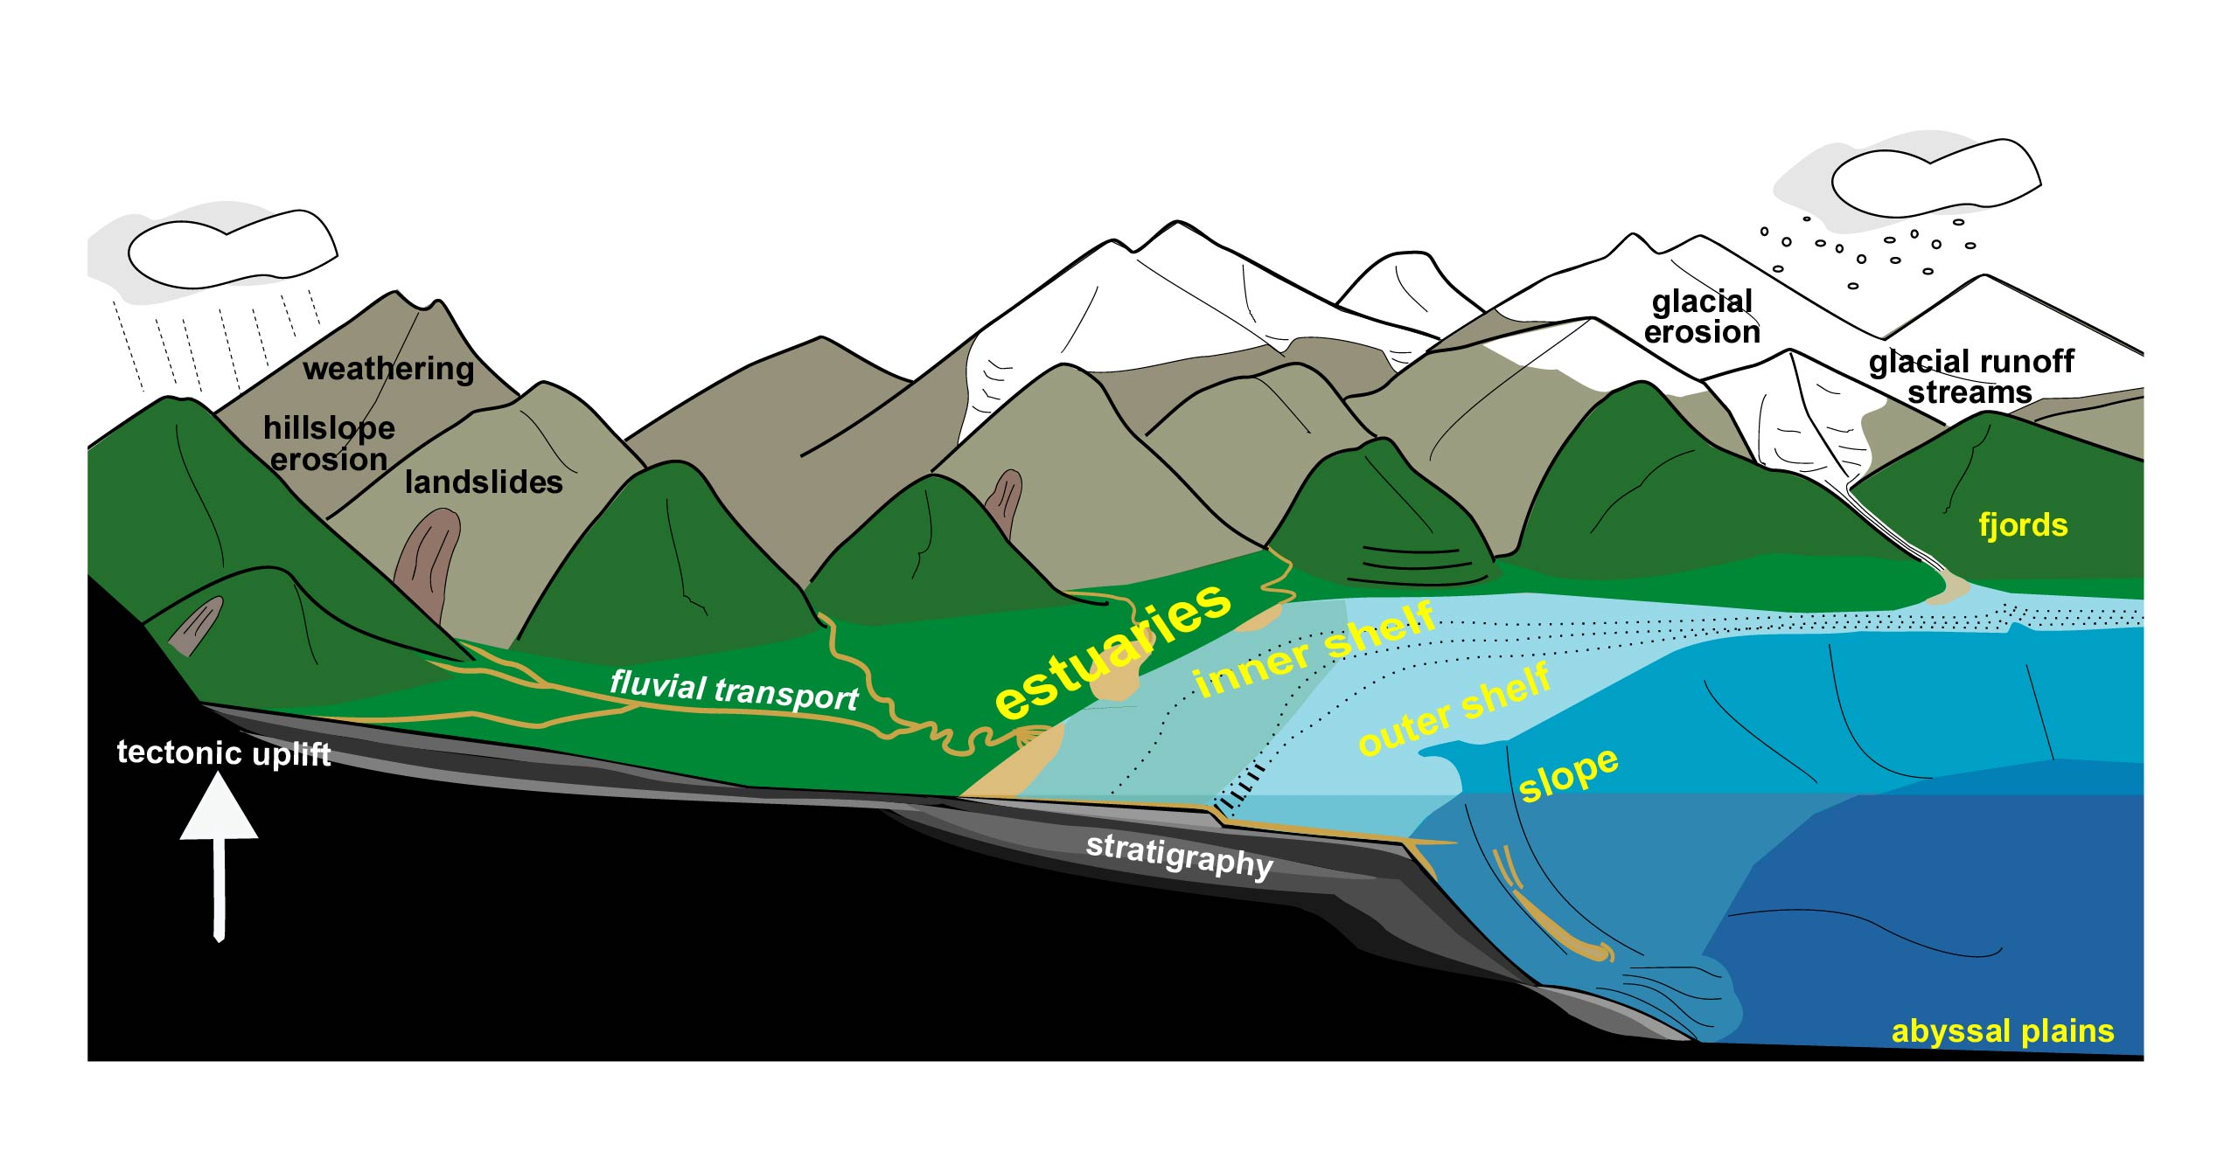
The influence of estuaries
on the transport
from rivers to the ocean
Rocky Geyer
WHOI
April 26, 2011
Reading:
Geyer, W.R., P.S. Hill and G.C. Kineke, 2004.
The transport and dispersal of sediment by
buoyant coastal flows. Continental Shelf
Research, 24, 927 – 949.
Traykovski, P., W.R. Geyer, and C. Sommerfield,
2004. Rapid sediment deposition and fine-scale
strata formation in the Hudson estuary.
J. Geophys Res, 109, doi: 10.1029/2003JF000096.
PERSONS attempting to find a motive in this lecture will be prosecuted; persons attempting to find a moral in it will be banished; persons attempting to find any relevance to societal issues will be shot.
apologies to Mark Twain

Slide 2
Backwater curve
river
Base level
?
ocean
Hydrodynamic “equilibrium”: Q_{in} = Q_{out}
Morphological “equilibrium”: (QC)_{in} = (QC)_{out}
Q is volume flux of water (e.g., m³/s)
C is concentration of sediment (e.g., kg/m³)

Slide 3
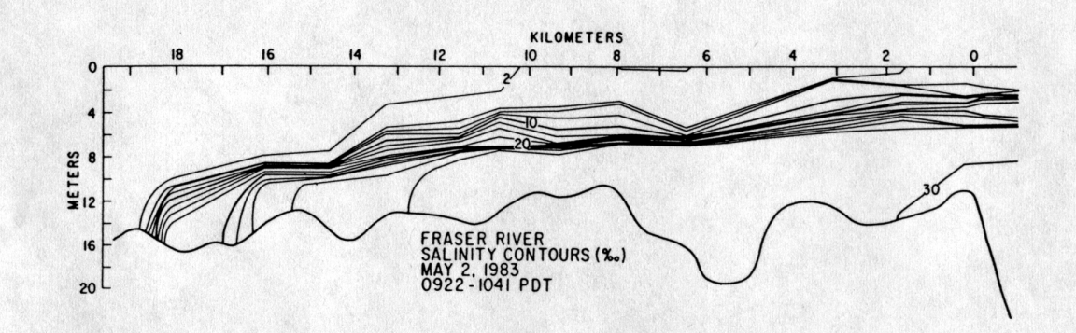
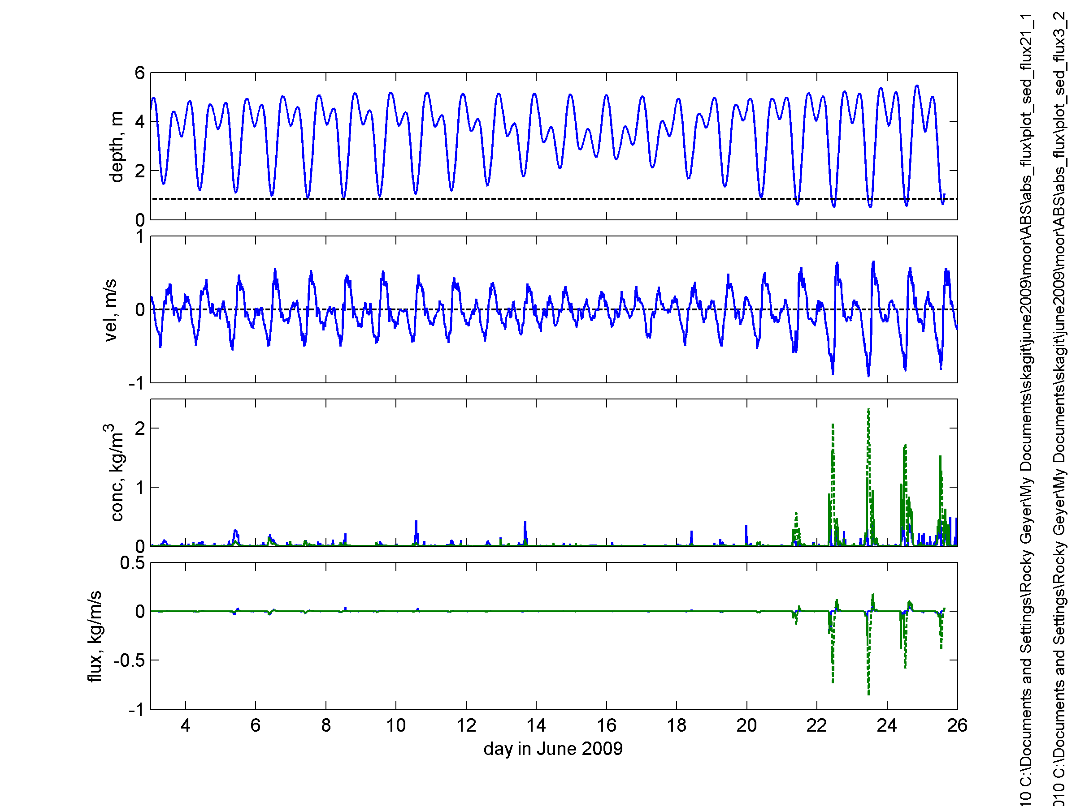

Slide 4
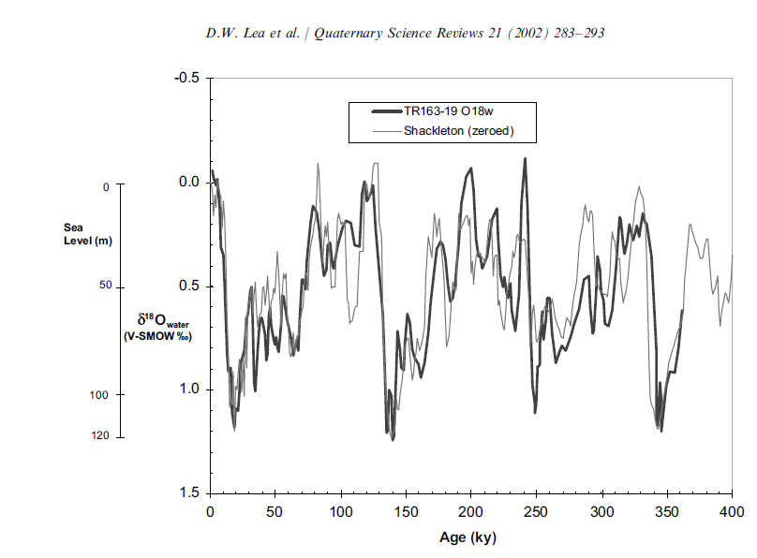
Timescales: 5,000 to 100,000 years
Max. amplitude of dh/dt: 10 mm/y (1 m/100 y)

Slide 5
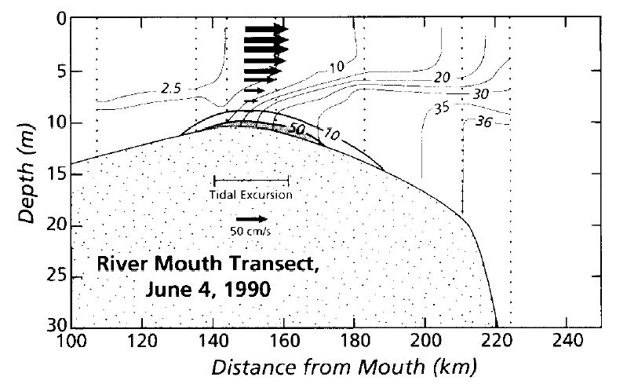
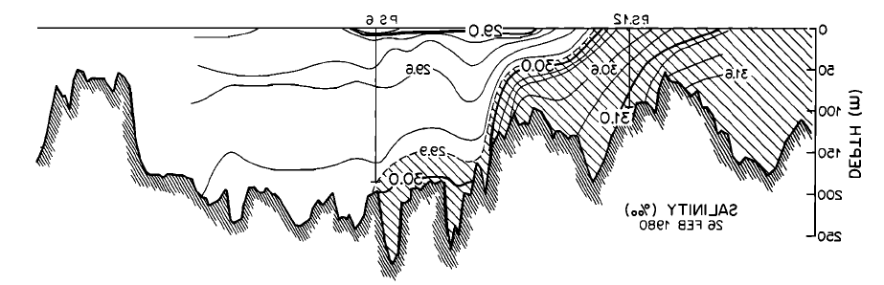
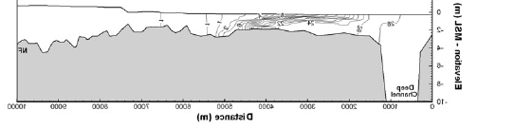
Amazon estuary
Q=80,000-250,000 m³/s
Q_{s}=10⁹ tons/y
Fill time = 20 y
Fraser estuary
Q=1,000-8,000 m³/s
Q_{s}=10⁷ tons/y
Fill time = 5 y
0
Hudson estuary
5
Q=200-2,000 m³/s
Q_{s}=10⁶ tons/y
Fill time = 300 y
Depth, m
10
15
80 60 40 20 0
Puget Sound
Q=500-4,000 m³/s
Q_{s}=4×10⁶ tons/y
Fill time = 5,000 y
Skagit River
tidal flats
Q=200-2,000 m³/s
Q_{s}=2.5×10⁶ tons/y
Fill time = 10 y

Slide 6
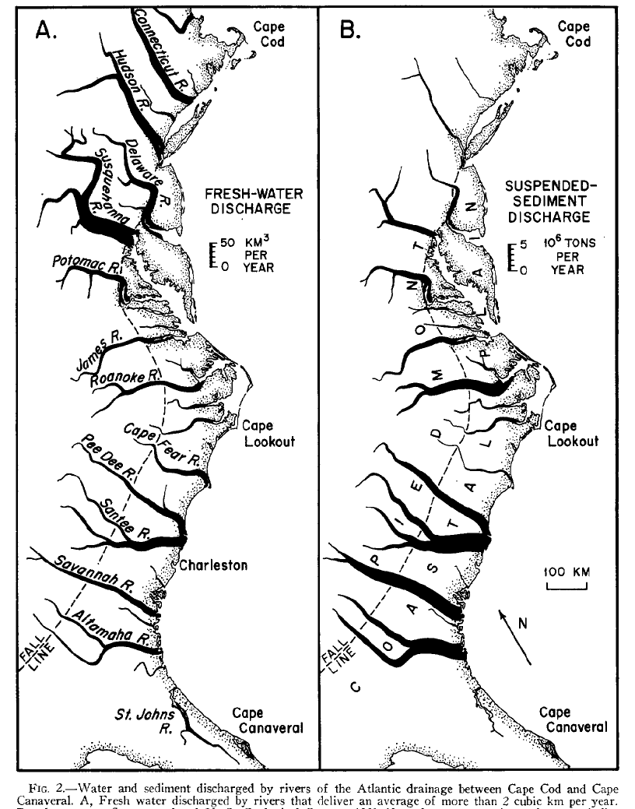
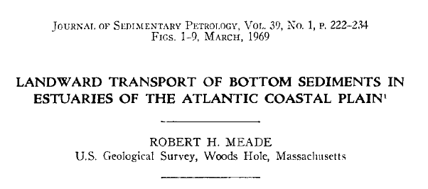

Slide 7
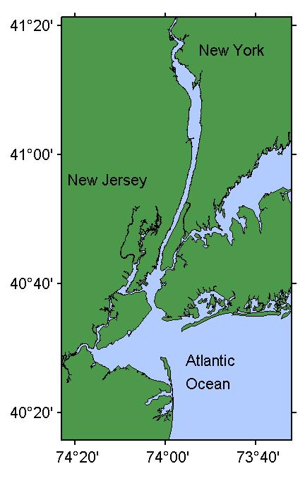
50 km

Slide 8
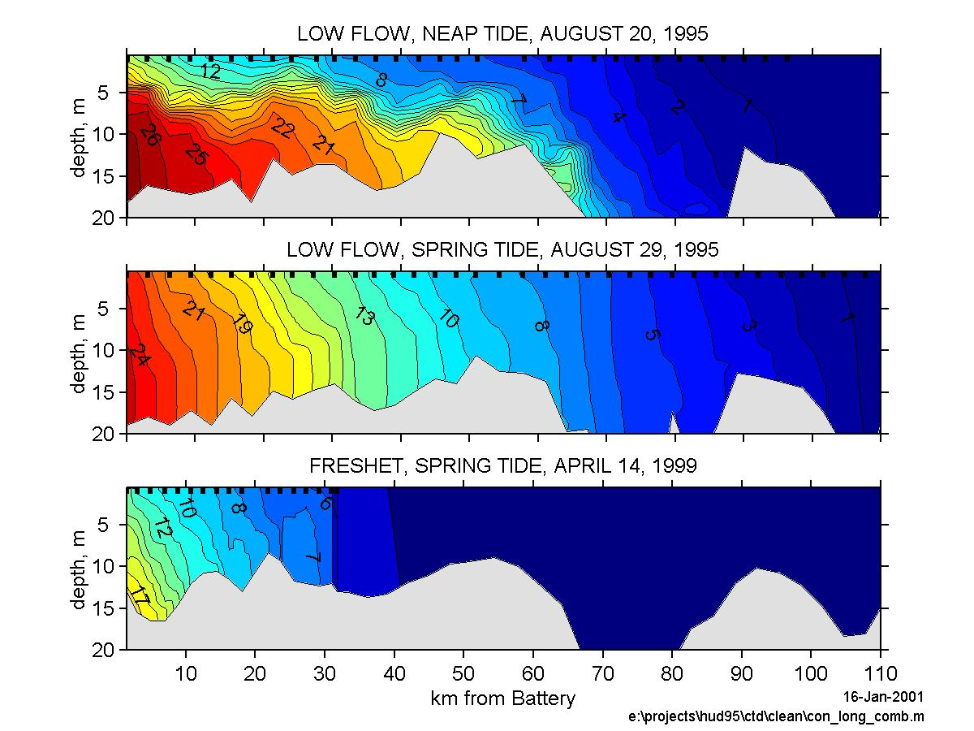

Slide 9
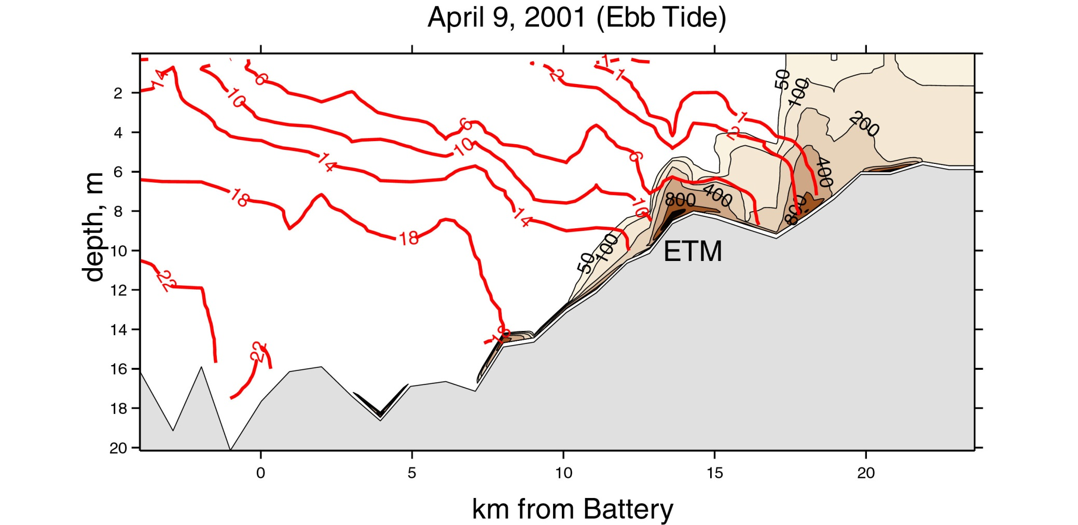
Notes:
This is a section through the hudson ETM that clearly demonstrates the trapping mechanism, in which we see sediment coming in from upstream at moderate concentrations, in a region with no stratification. When it reaches the stratified zone, the suspended concentration immediately drops in the upper water column, and we see high concentrations, in this case around1000 mg/l, in the bottom water. The only hint that things arent simple is that there seem to be multiple patches of high concentrati

Slide 10
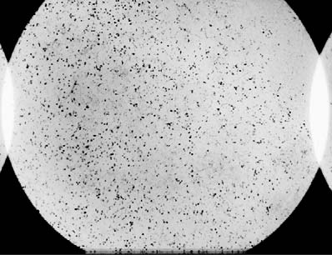
How a salinity front traps sediment
pressure
gradient
river outflow
more dense
pressure
gradient
deposition
Flocs: w_{s}~ 1 mm/s
~ 3.6 m/hour

Slide 11
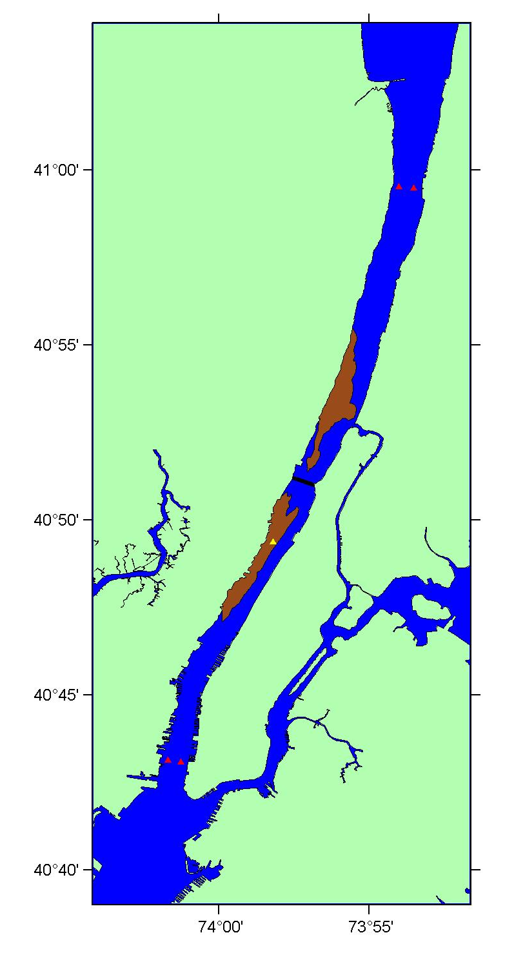
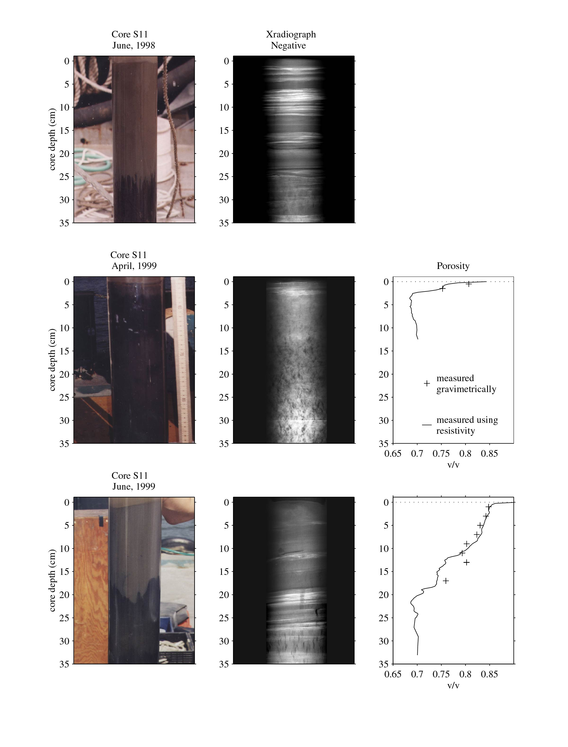
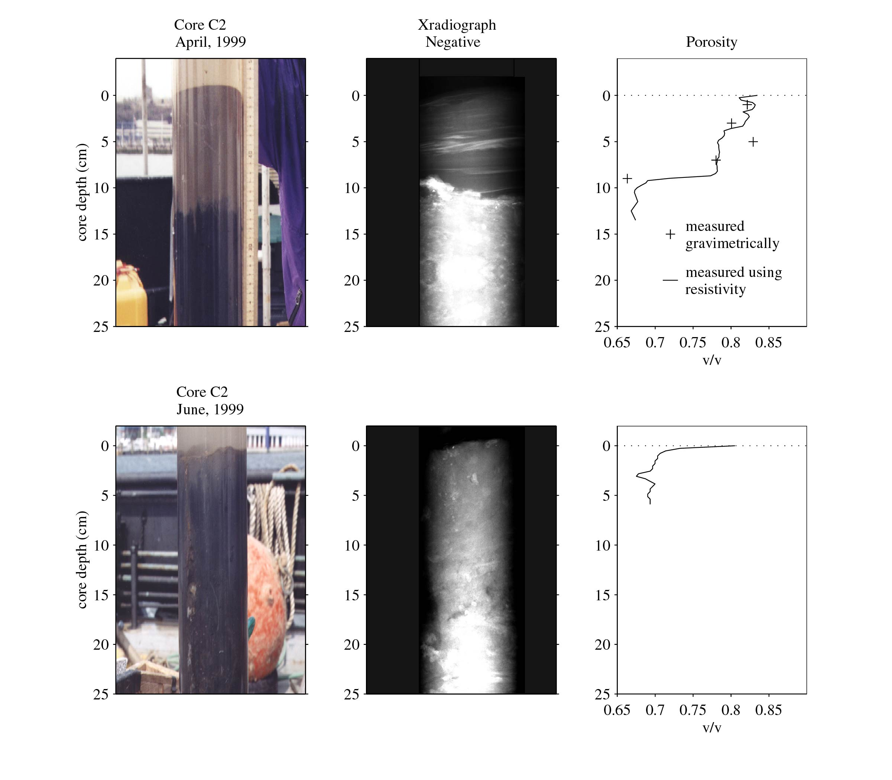
High discharge:
sediment trapped
near mouth or exported
Low discharge:
sediment trapped
in mid-estuary deposits
Core S11
Core C2

Slide 12
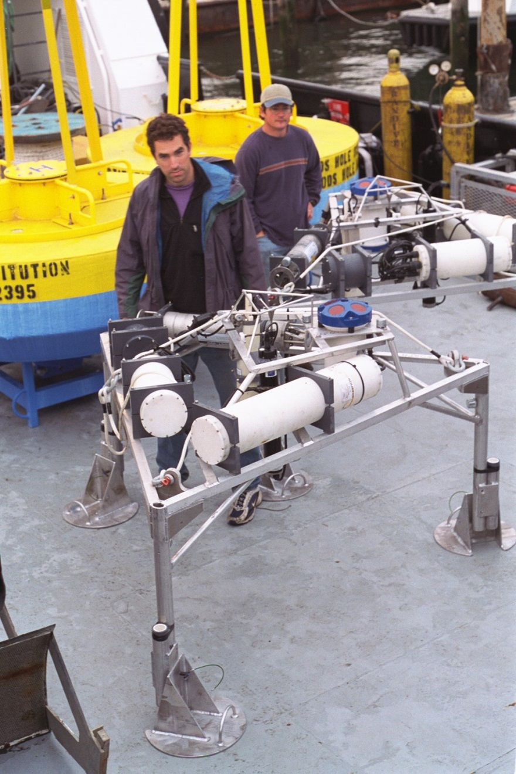
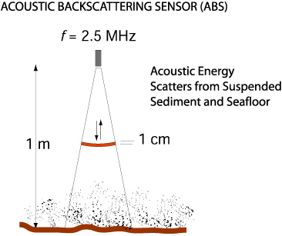

Slide 13
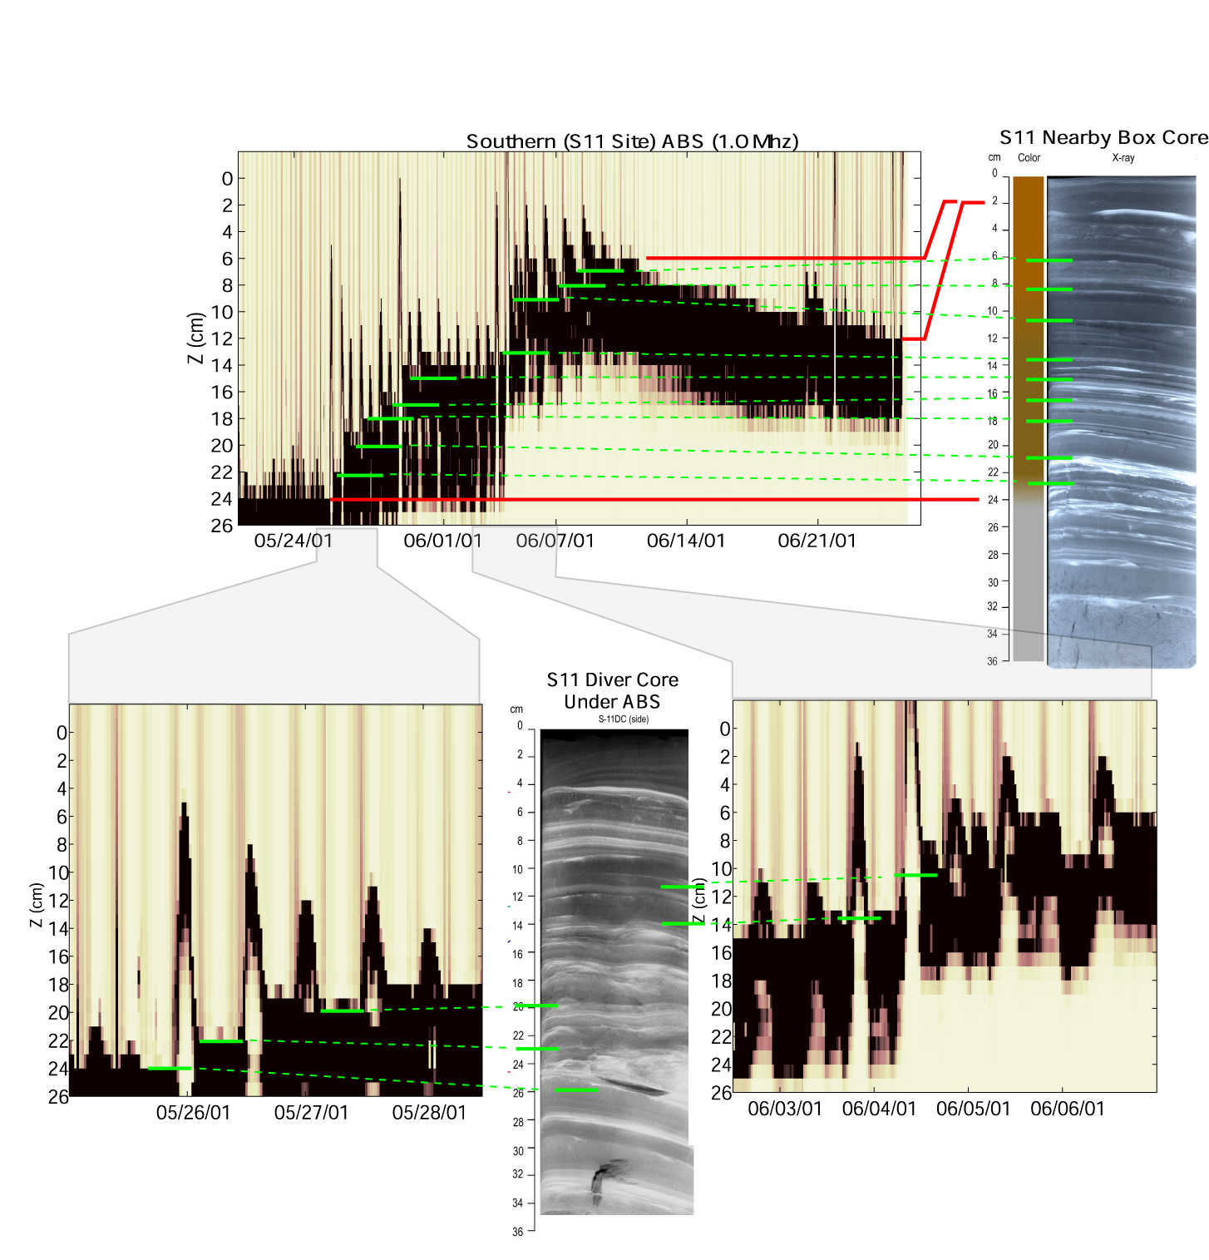
ABS Core

Slide 14
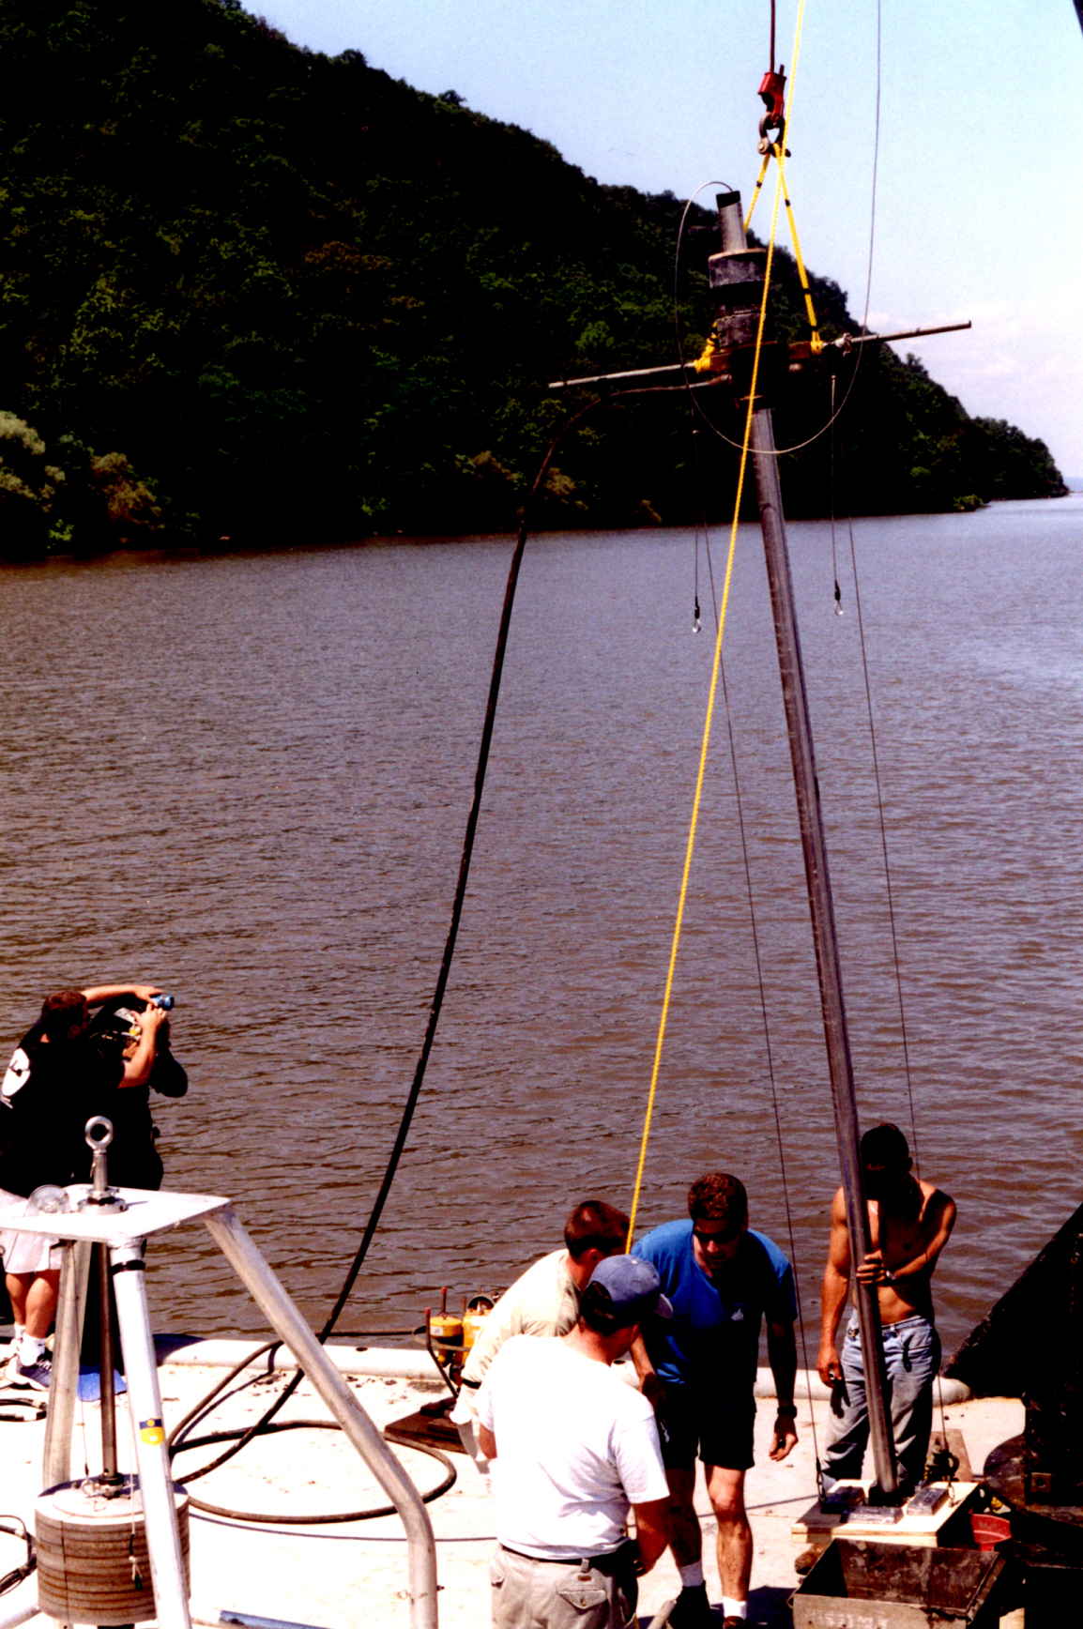

Slide 15
short cores
medium cores
Long cores
Long-term
sedimentation
rate ~ 2 mm/yr
Notes:
HRF Final Report Figure 16: Plots showing the strong negative dependency of sediment accumulation rate on the timespan of averaging

Slide 16
Big, rare discharge events cause erosion and export. Or do they?

Slide 17
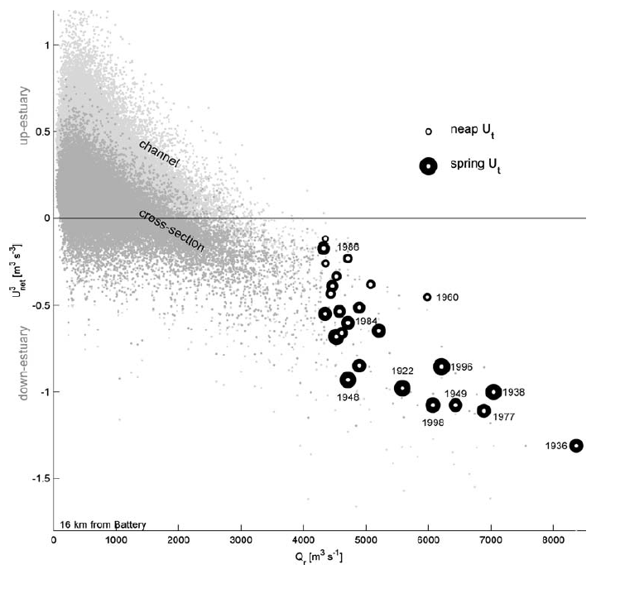
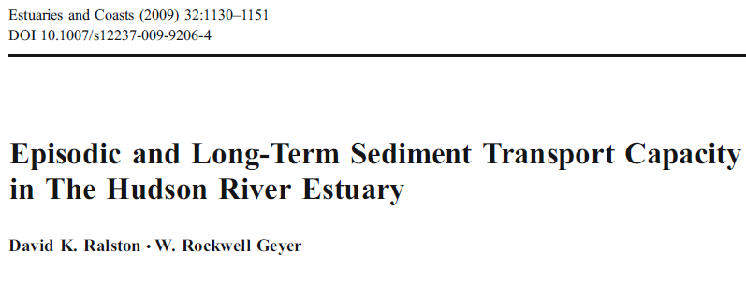
Based on Ralston’s modeling of extreme events, big outflows
cause big export.

Slide 18
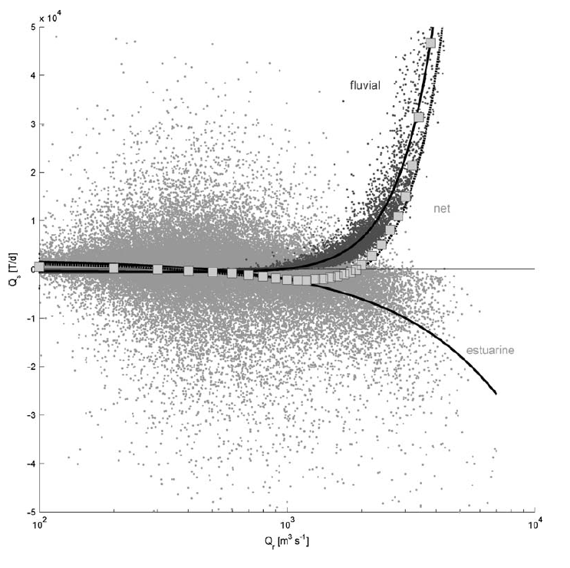
but it is not so simple. More sediment comes in
during really big events than leaves!
river input
net
estuarine transport

Slide 19
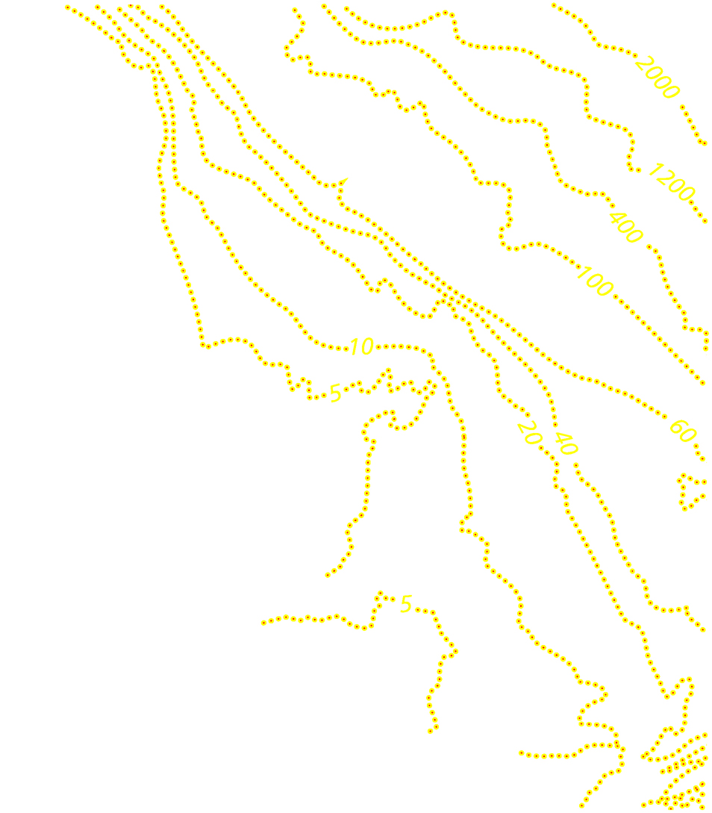
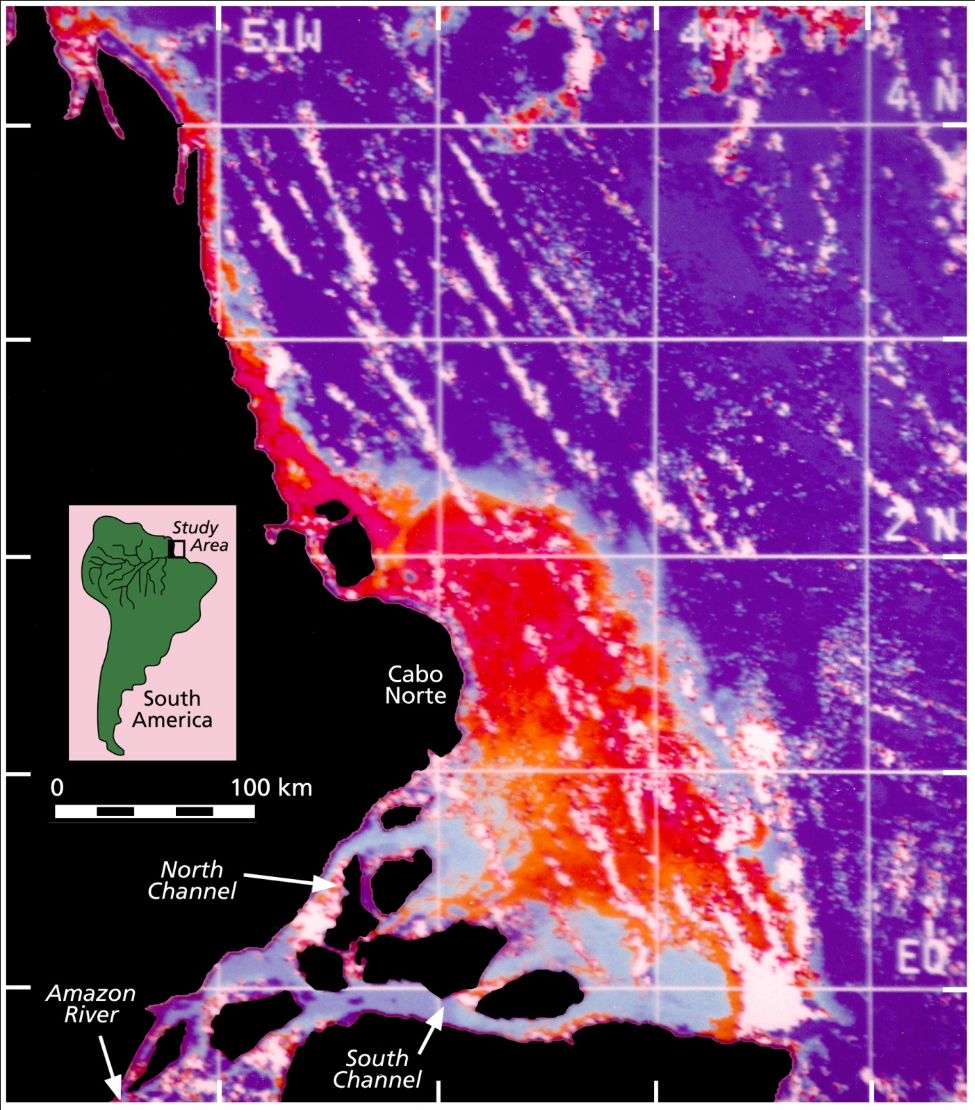
Depth, m
80 km
Notes:
This front in surface sediment concentration is associated with the bathymetry, as shown by these depth contours. The high surface concentrations only occur in waters less than 10 m deep– in fact as we move north from the river mouth region, they are confined to water depths less than about 5-m.
So the surface plume is distinctly a shallow-water phenomenon….

Slide 20
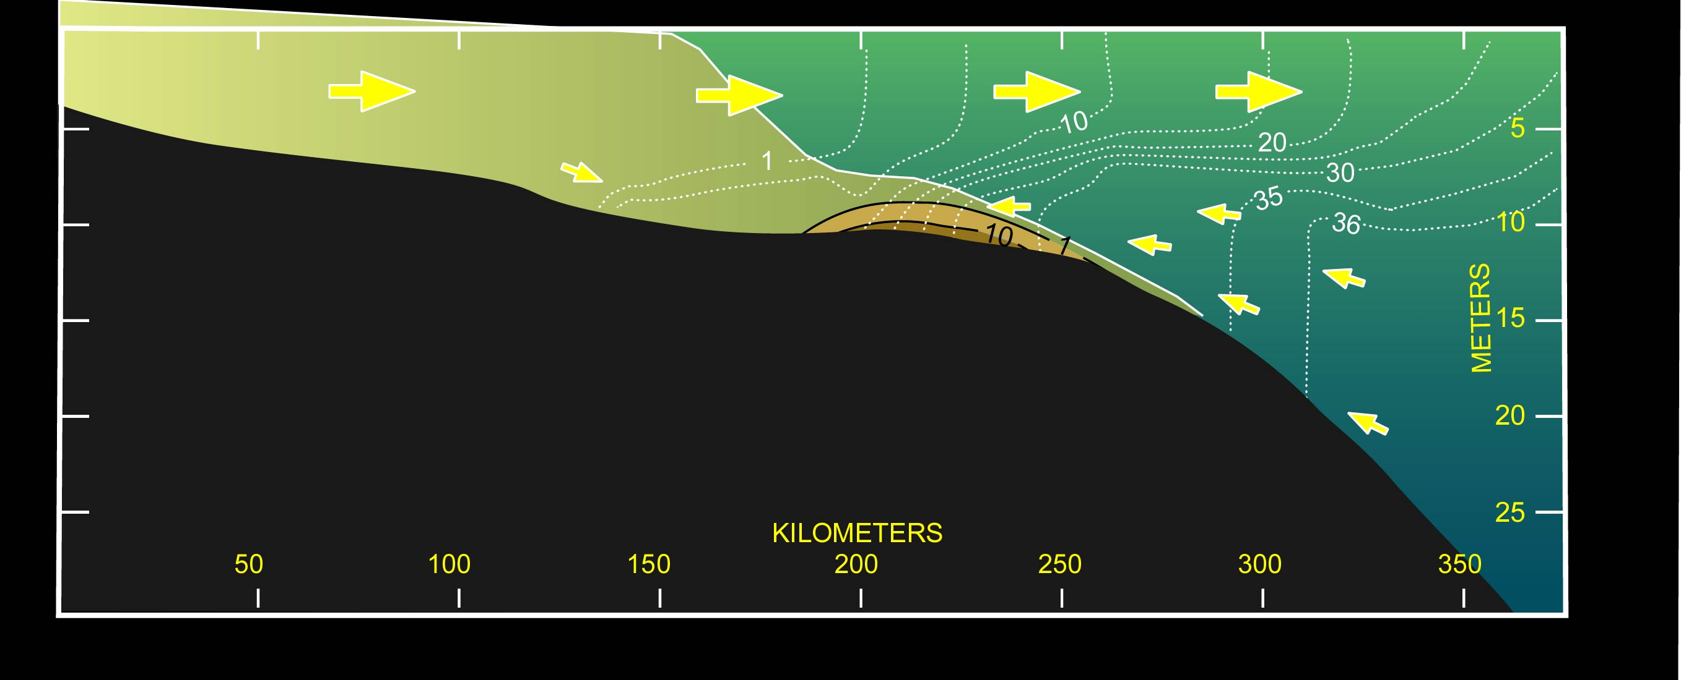
Notes:
This cross-section gives a generic picture of what happens when the sediment-laden water runs into seawater. It may be in the estuary or on the shelf– (actually this figure was roughly based on the Amazon mouth, which is really more shelf than estuary because it doesn’t have sides). The big arrows show that the fresh water flows over the salt water (the salinity contours are shown by the dotted white lines). The salinity gets higher as the water flows out due to vertical mixing, and so there has to be bottom inflow of high salinity water to balance the salt flux. This bottom inflow is driven by the density gradient of the salt water– I have talked about this many times.
So, what happens to the sediment? Before the sediment gets to the salt front, there is no stratification by salt, and so the sediment is distributed nearly homogeneously in the water column. As it encounters the salinity front, the stratification starts to suppress turbulence, which makes the sediment start falling out of the upper part of the water column. There is a near-bottom convergence of flow, which then traps the sediment in the frontal zone.

Slide 21
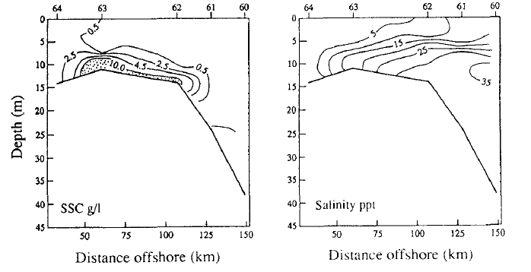
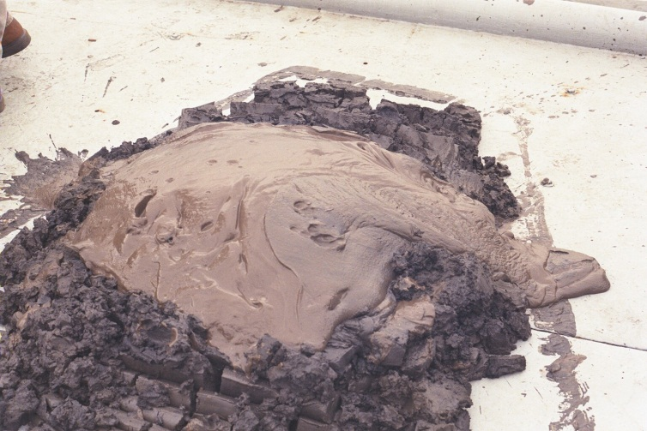
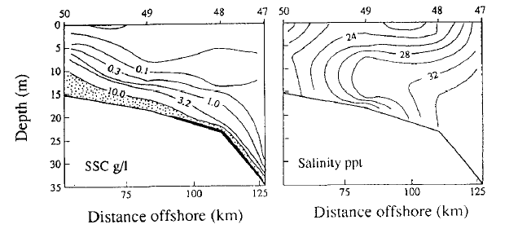
Kineke et al., 1996:
Fluid-mud processes
on the Amazon cont-
inental shelf. CSR

Slide 22
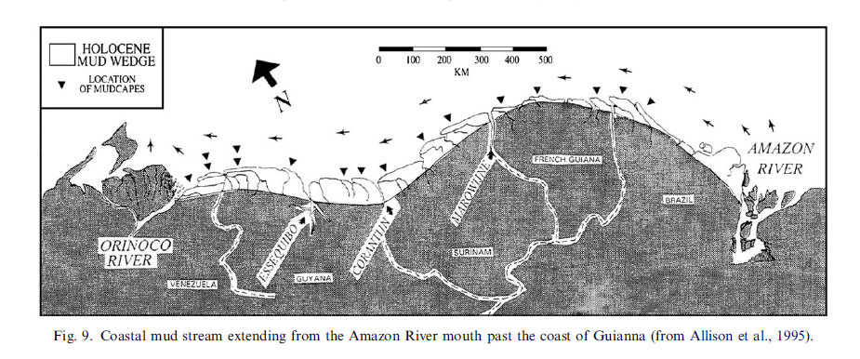

Slide 23
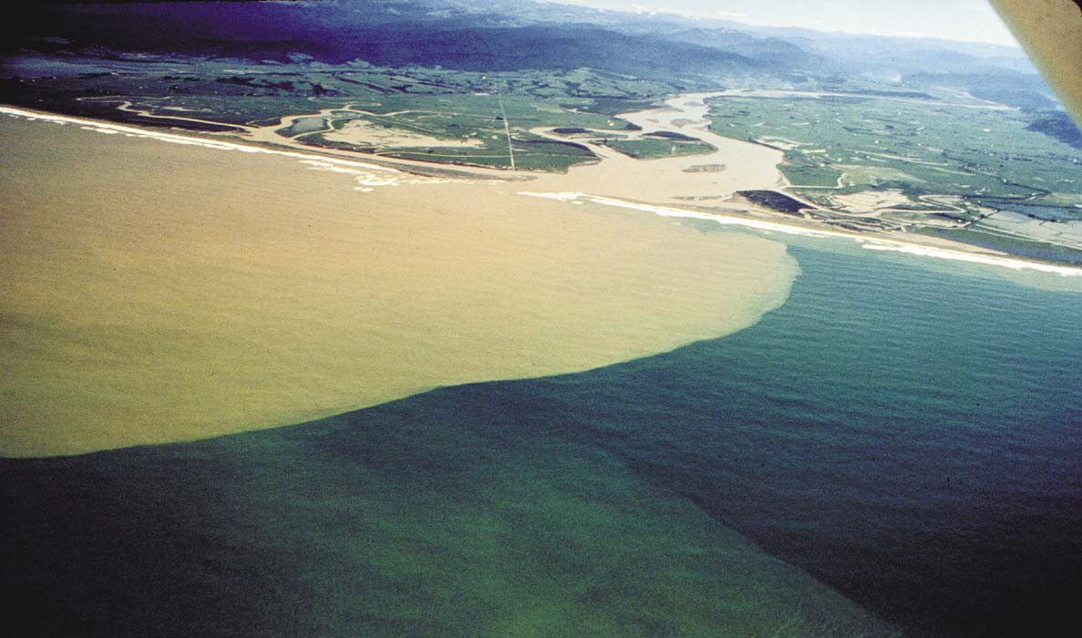
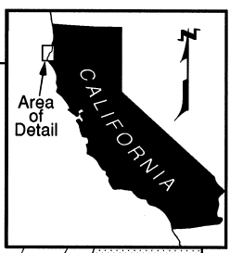
Eel River plume during flood

Slide 24
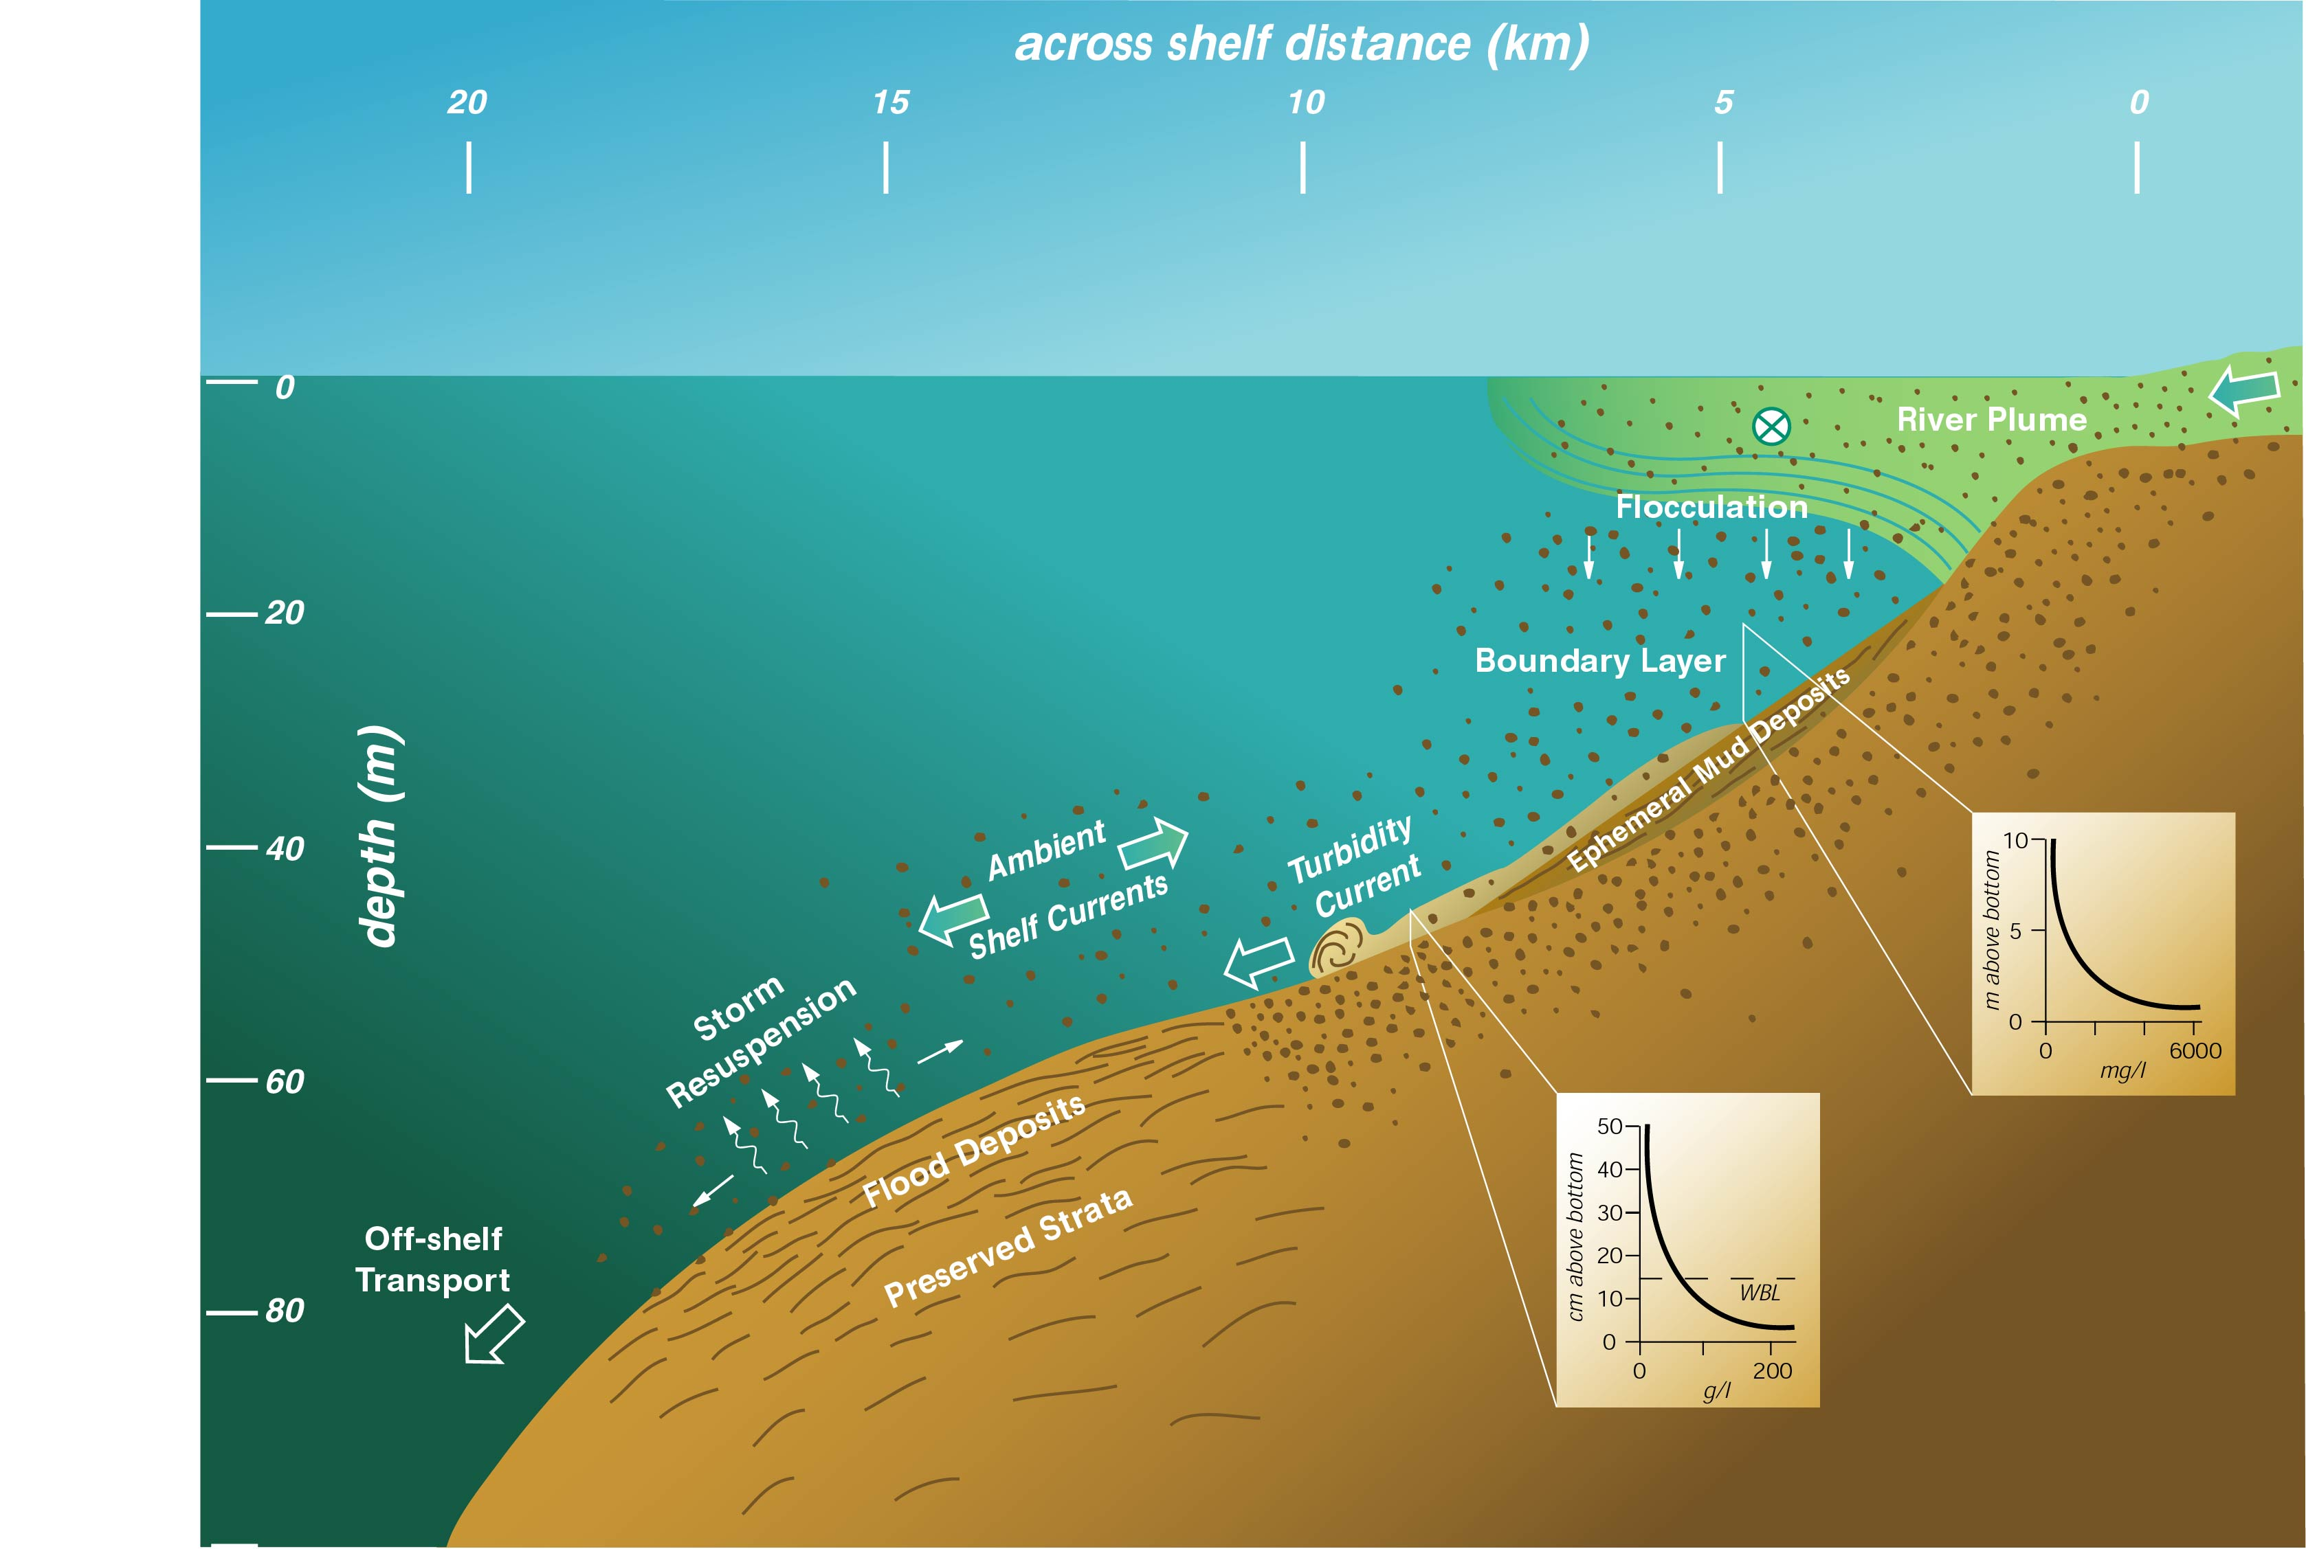
K-20
K-60
Notes:
So the way the plume story, the tripod burial, the ABS data, and the flood deposits are tied together is that very thin turbidity currents slide down the shelf, within the wave boundary layer. The intense turbulence within the wave boundary layer either stirs up recently deposited sediment or keeps the sediment from settling. This suspended sediment layer gets heavy enough after a few hours to start flowing down the shelf at about 10-20 cm/s, which gets it from K-20 to K-60 in less than a day or so.
The stratification by suspended sediment at the top of the layer is critical to keeping the turbidity current from mixing with the overlying water. And the hindered settling due to the high concentration is critical to keeping the sediment in suspension in such a thin layer.

Slide 25
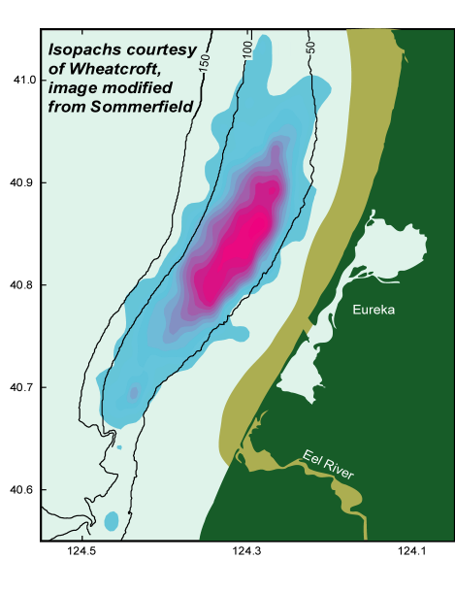
9 cm
<1 cm

Slide 26
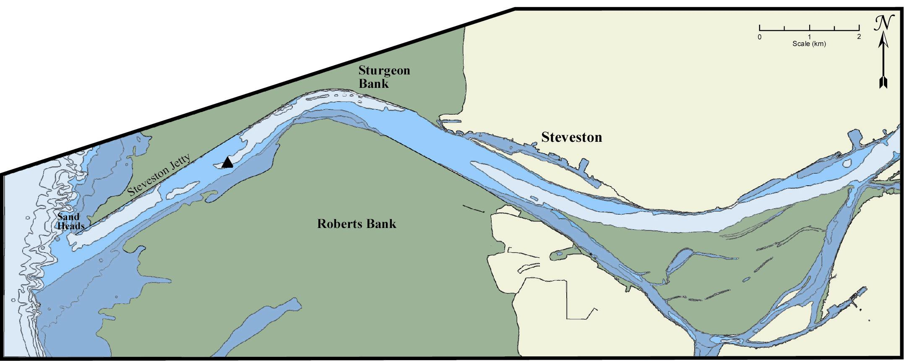
Fraser River

Slide 27
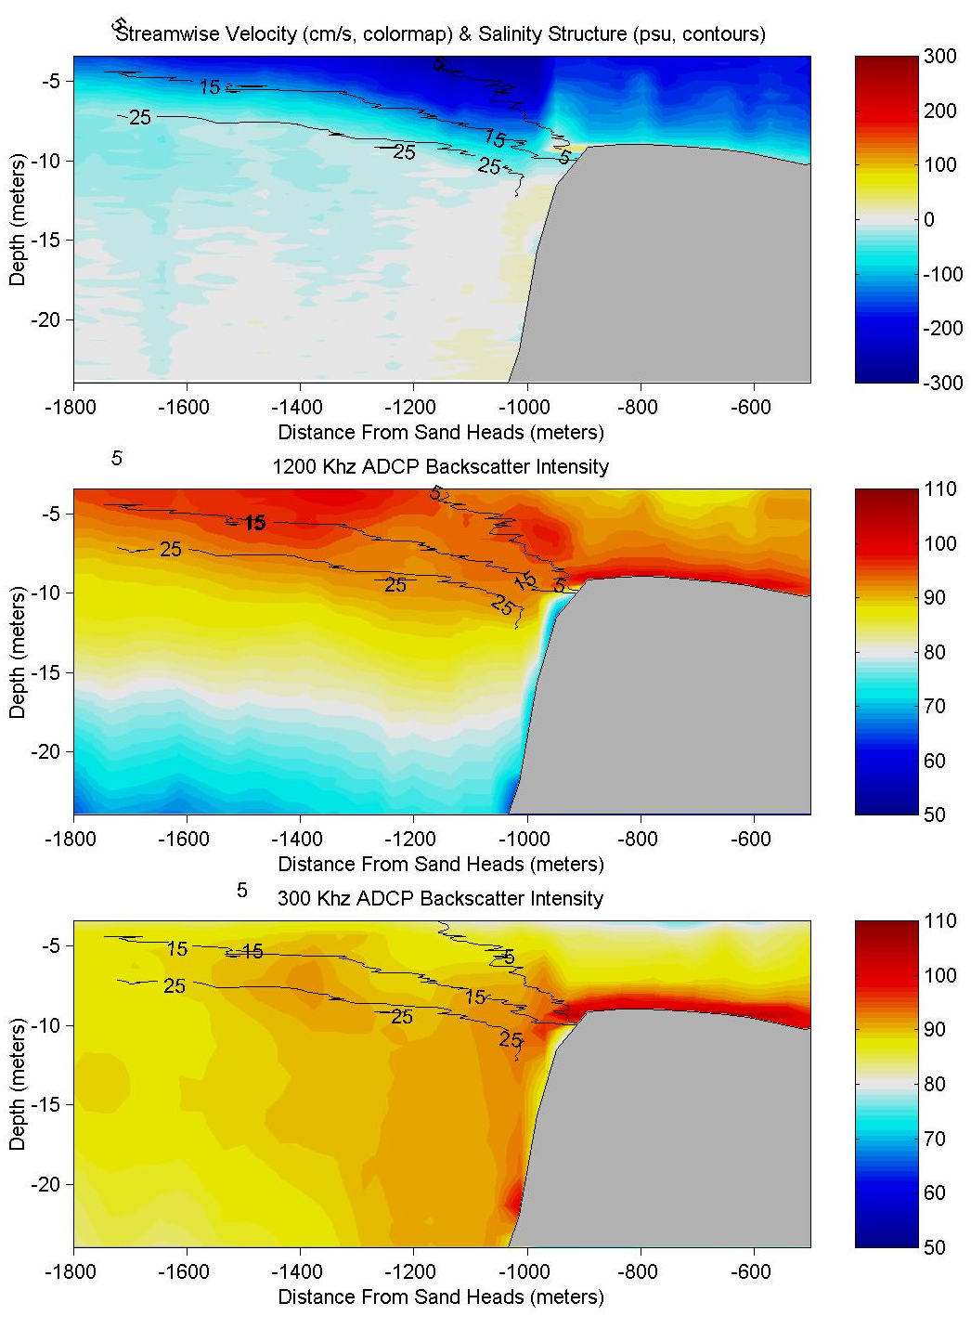
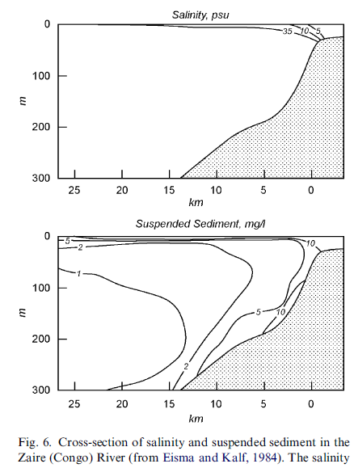
Fraser River mouth
velocity
Congo River mouth
mud
sand
growing
delta front

Slide 28
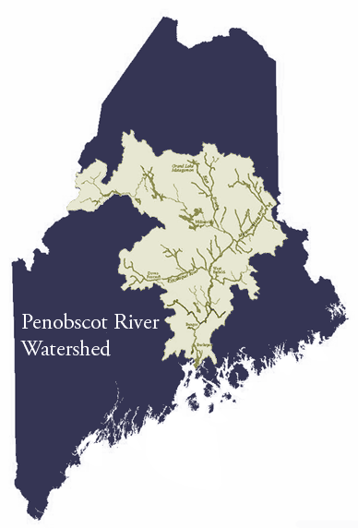
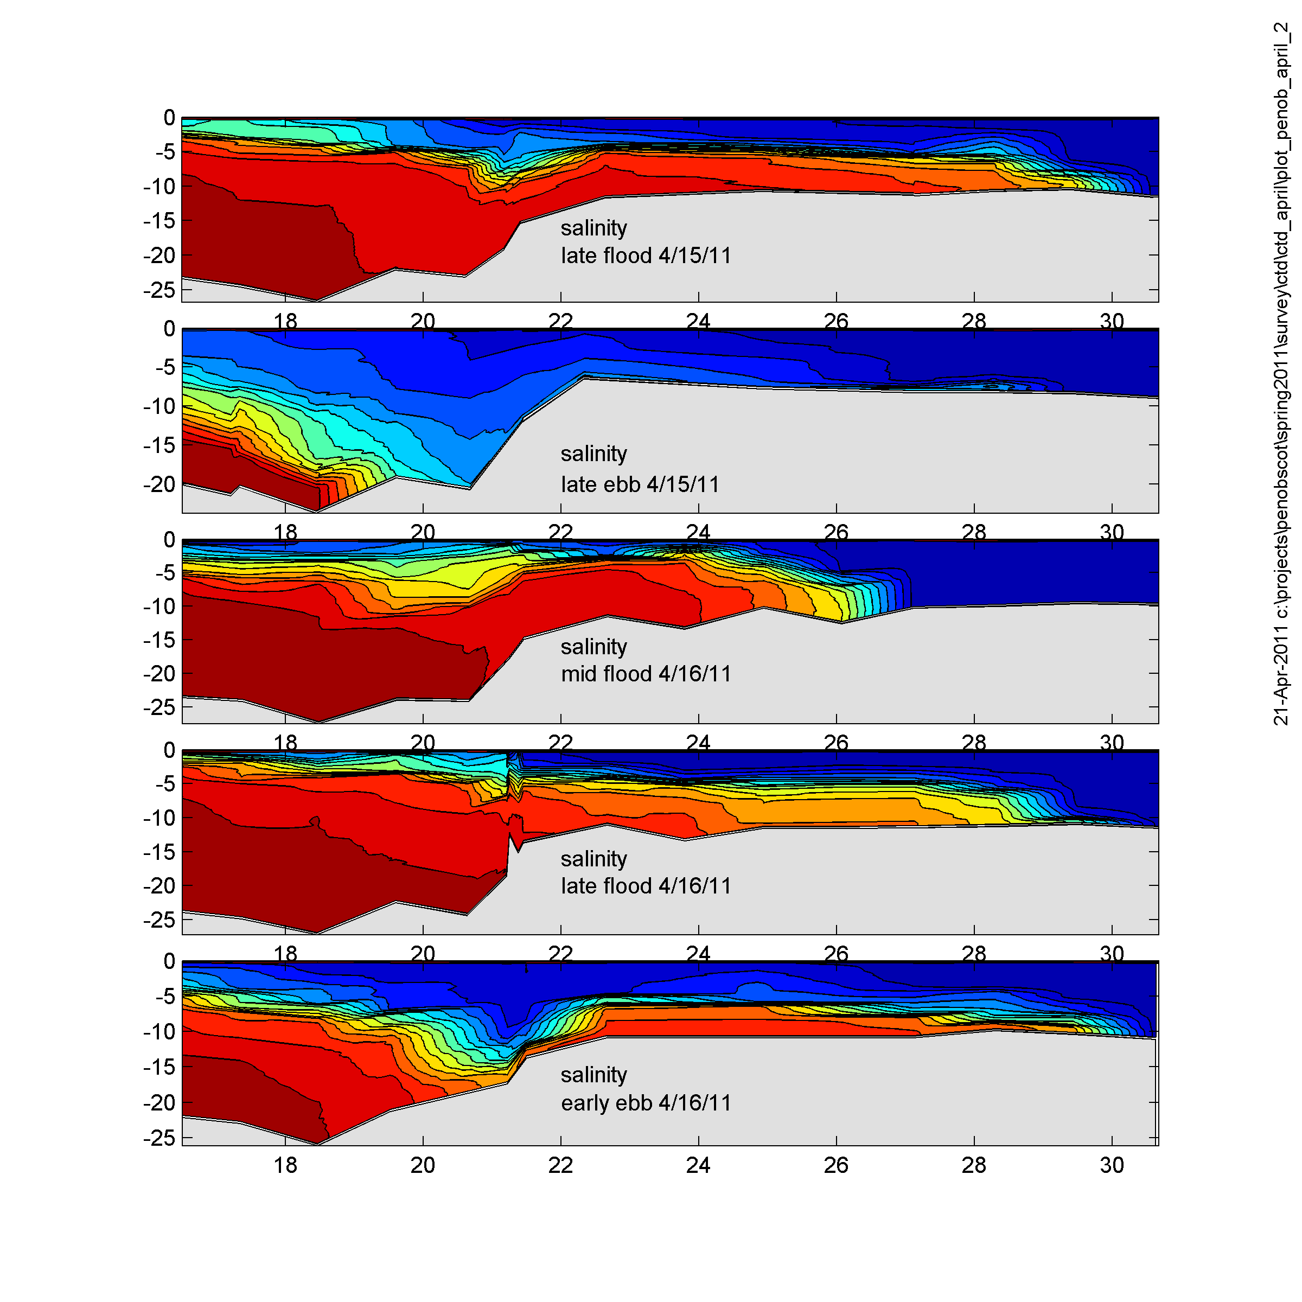
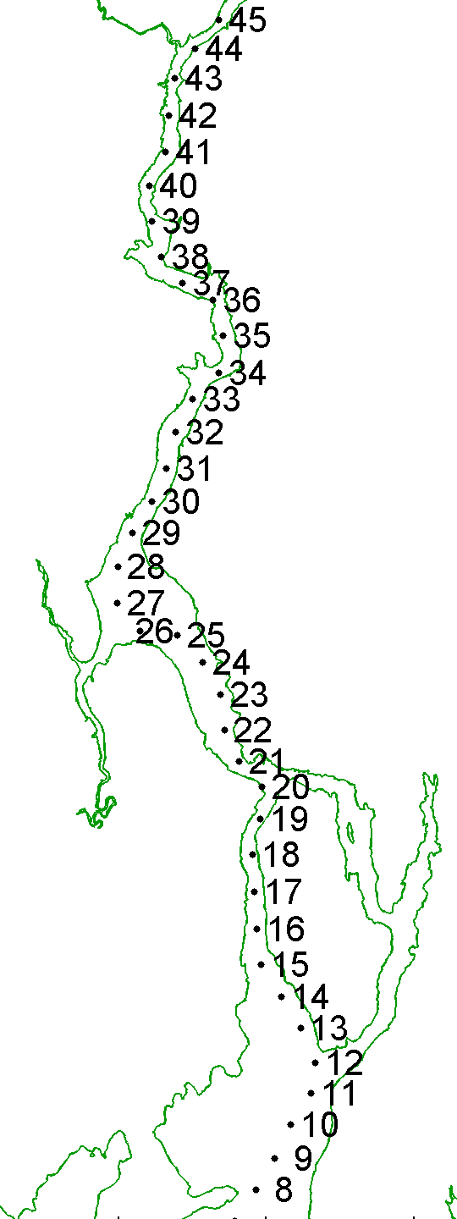
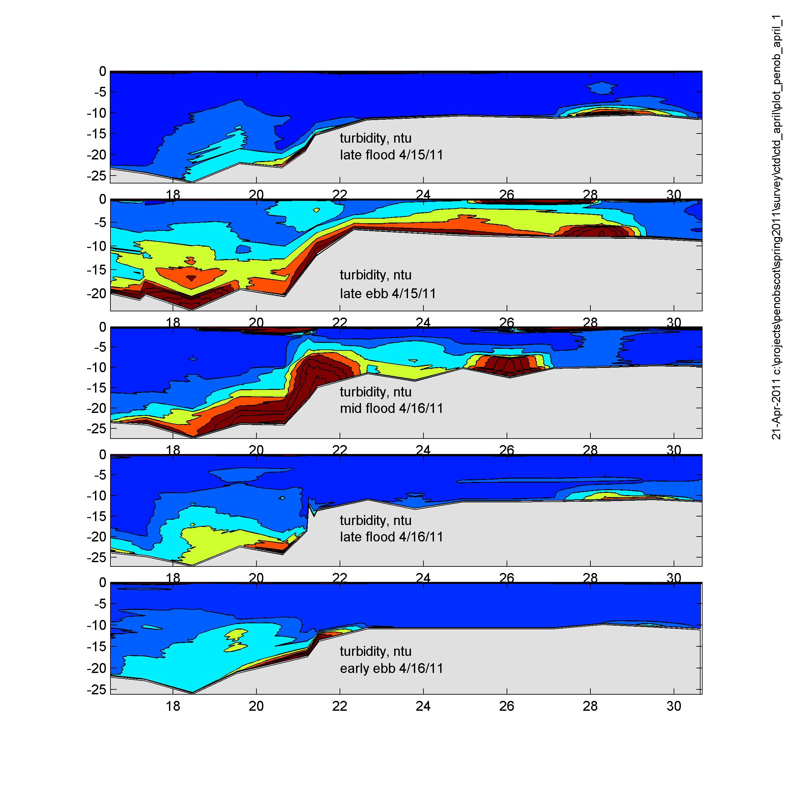
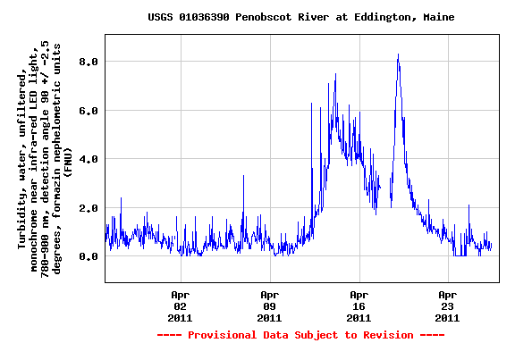
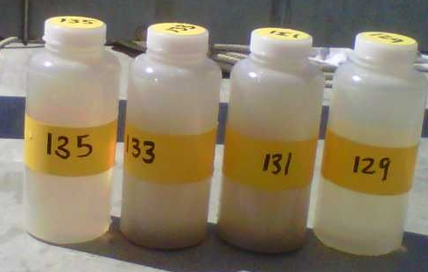

Slide 29
Key Ideas
Estuaries are the regions where freshwater river outflow runs into salt water.
Estuaries all have roughly the same dynamics and structure, but
Big rivers and flooding rivers push the estuary onto the continental shelf.
The salt front traps sediment.
The far-field transport of sediment depends on other processes, such as
- coastal currents
- wave-supported gravity currents
- turbidity currents

Slide 30
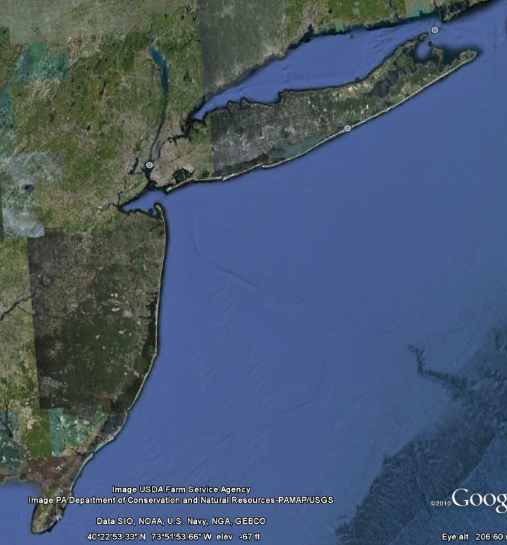
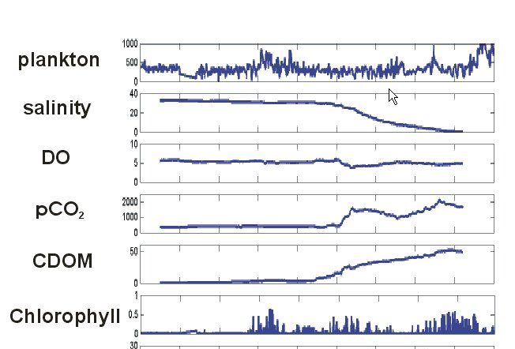
C
B
B
C
A
A

