Slide 1
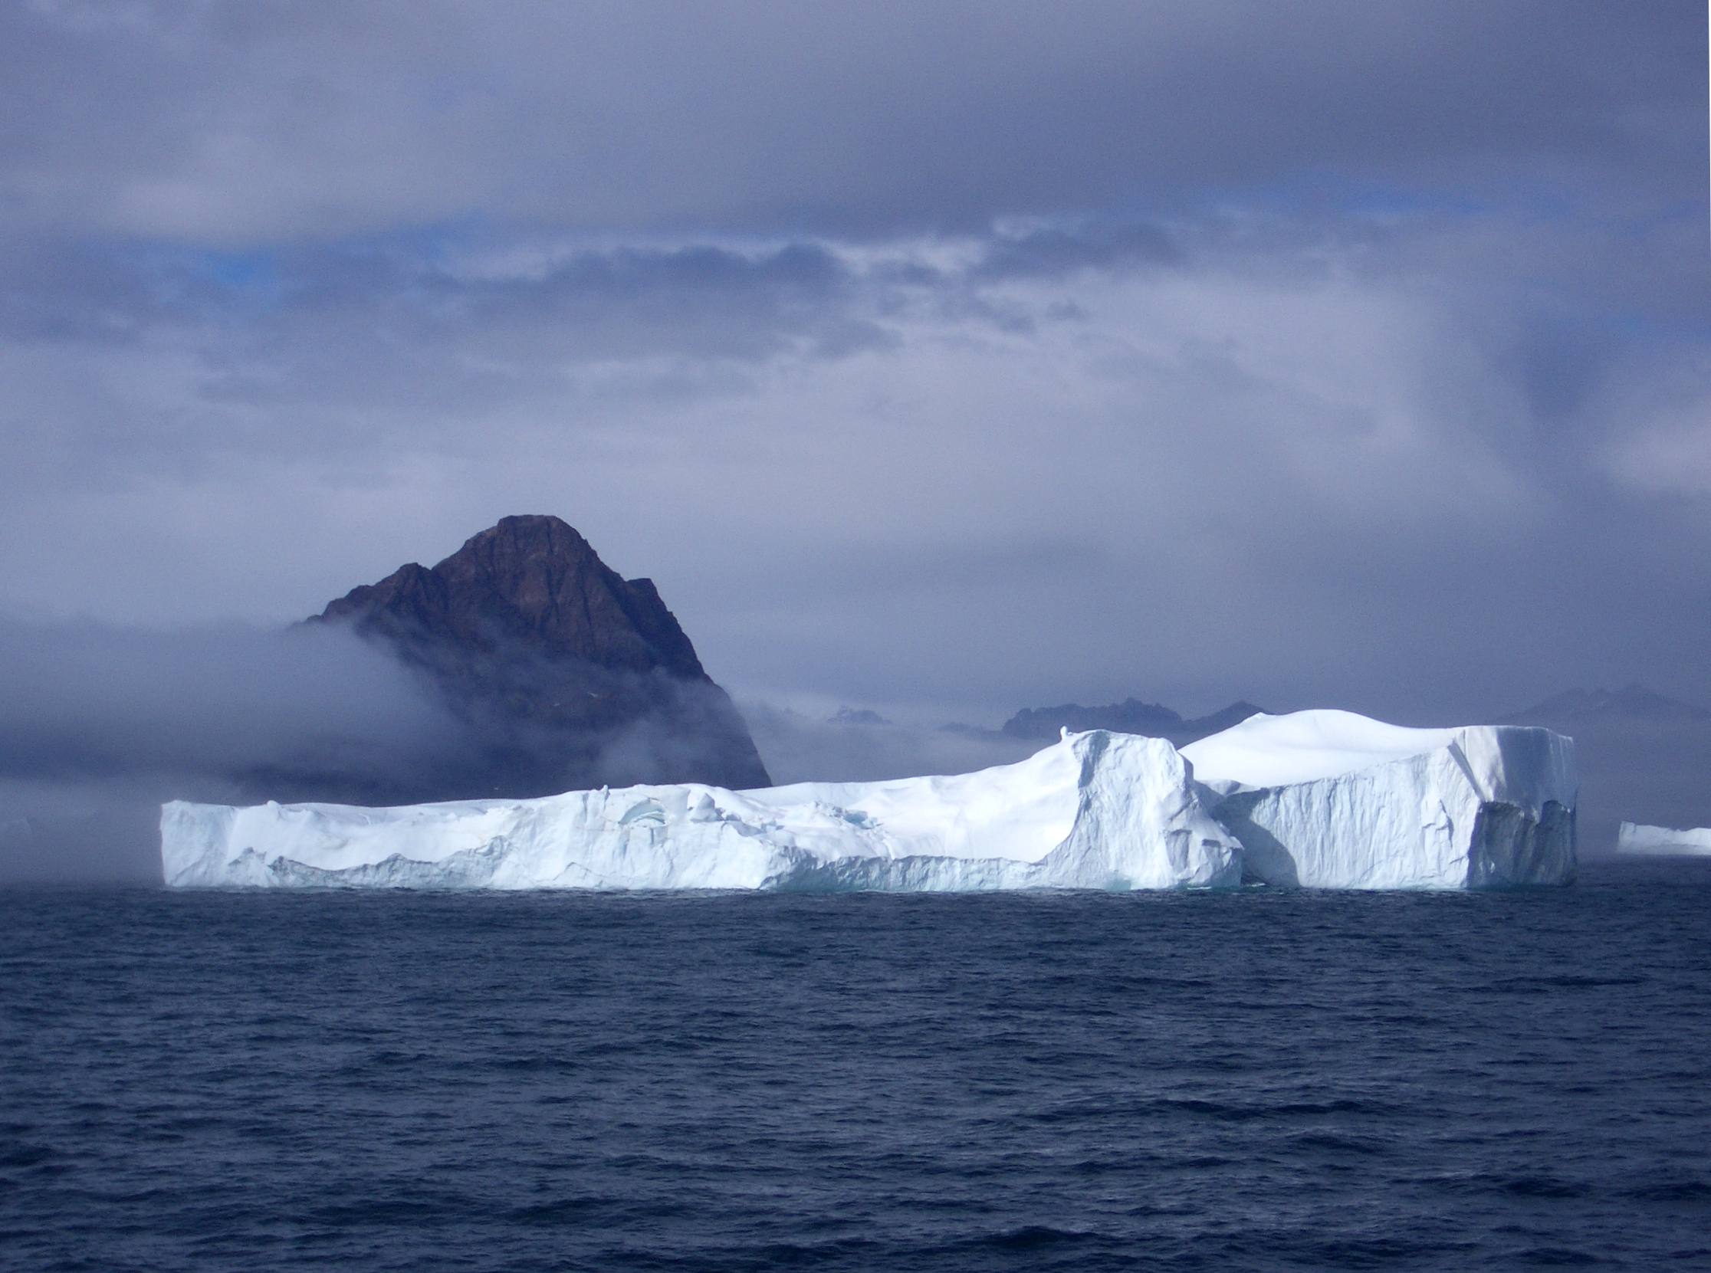
The role of icebergs in global change
Grant Bigg
Department of Geography,
University of Sheffield, UK

Slide 2
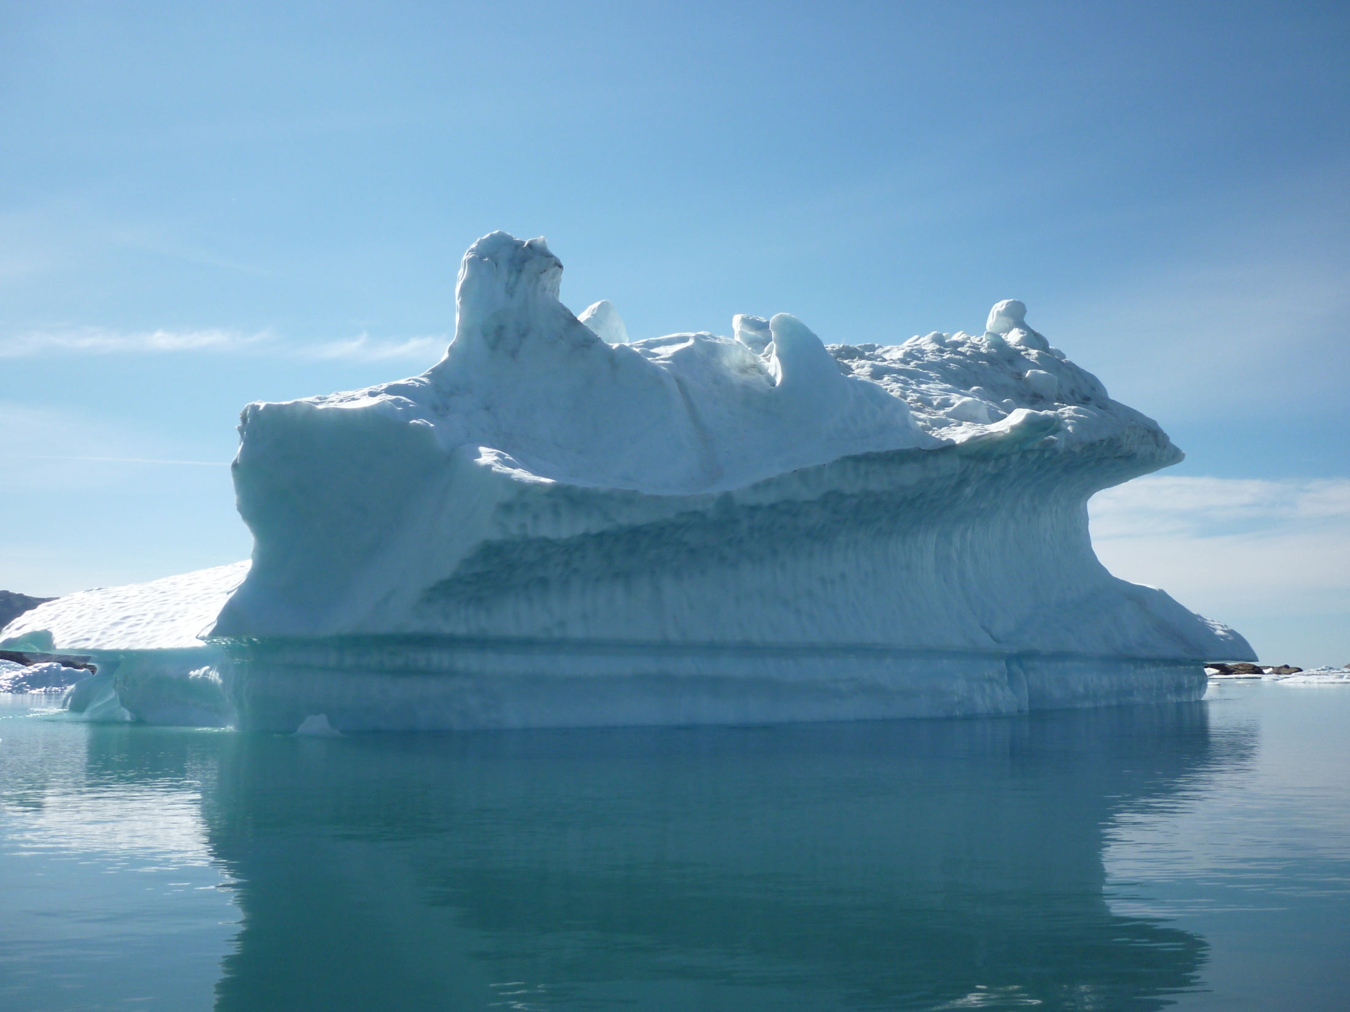
Iceberg fluxes & climate
Icebergs as a proxy
Heinrich events
Today
Biogeochemical cycles

Slide 3
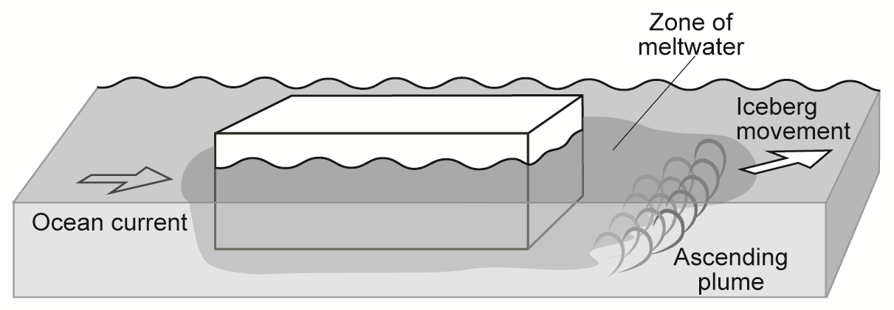
Iceberg fluxes and climate
surface reflection
cold air plume

Slide 4
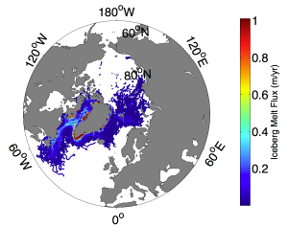
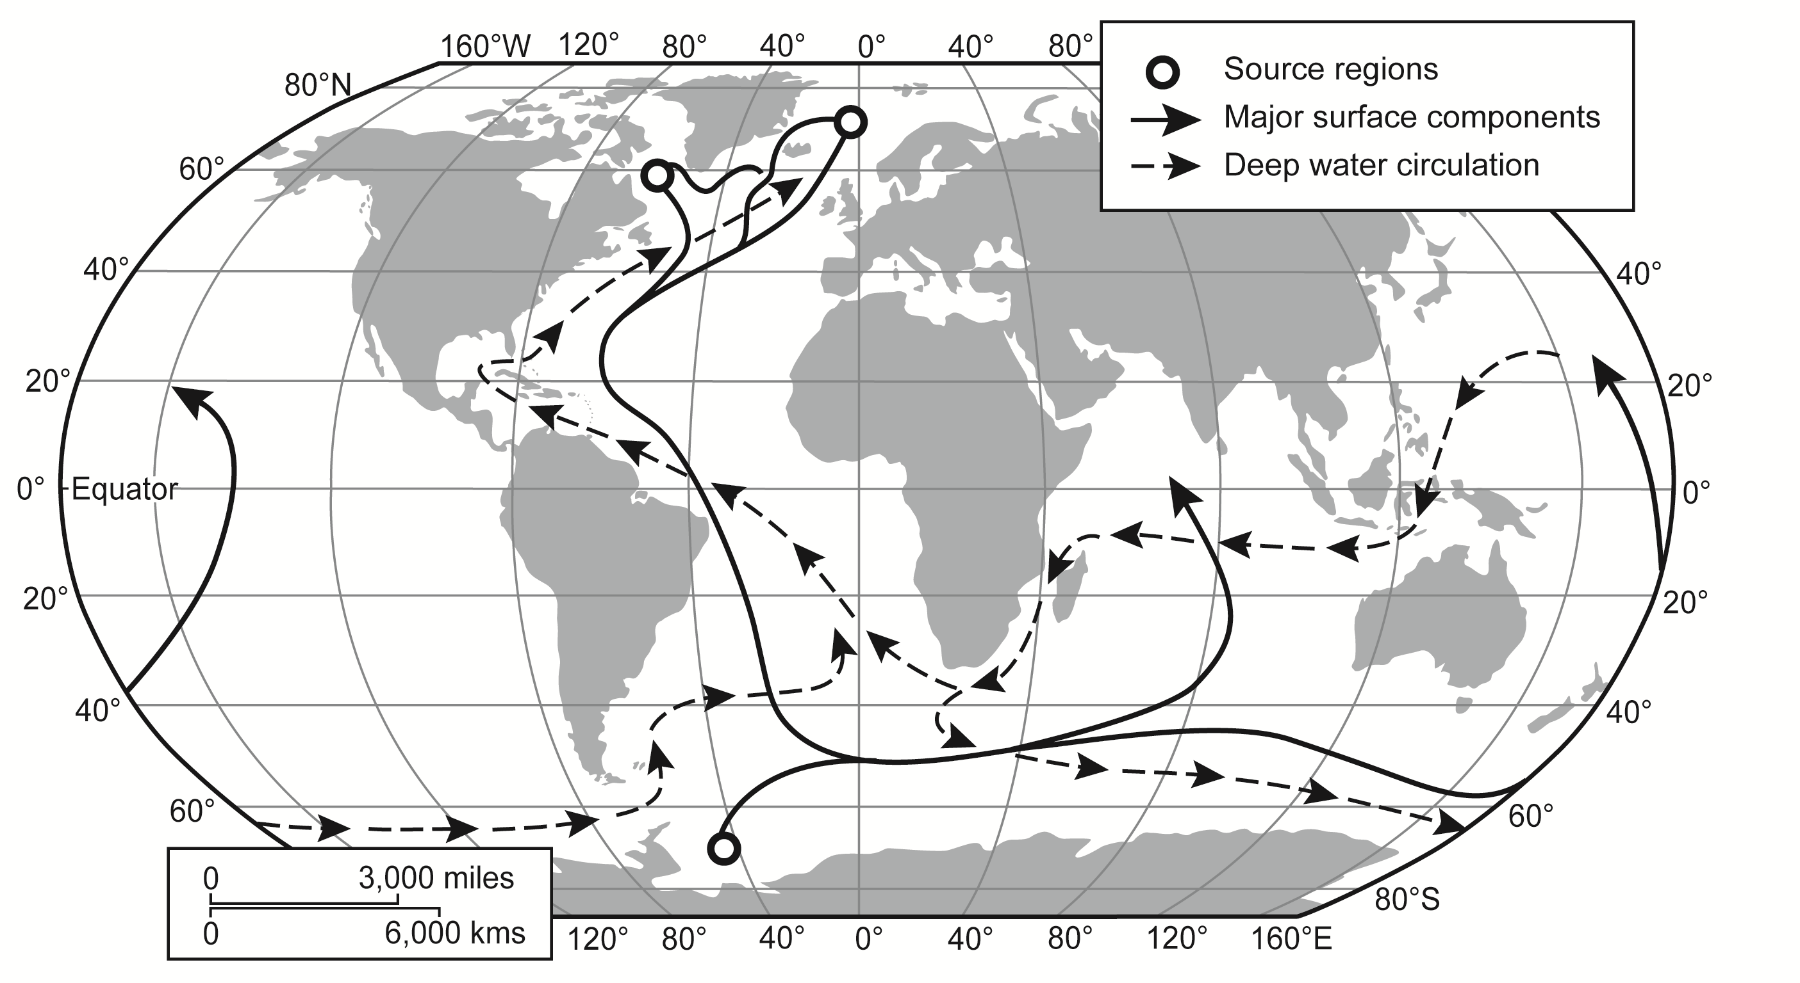
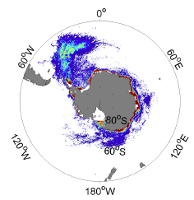
Global overturning circulation

Slide 5
Iceberg fluxes and climate
Glacial periods – Heinrich events (high volume)
surface reflection
cold air plume

Slide 6
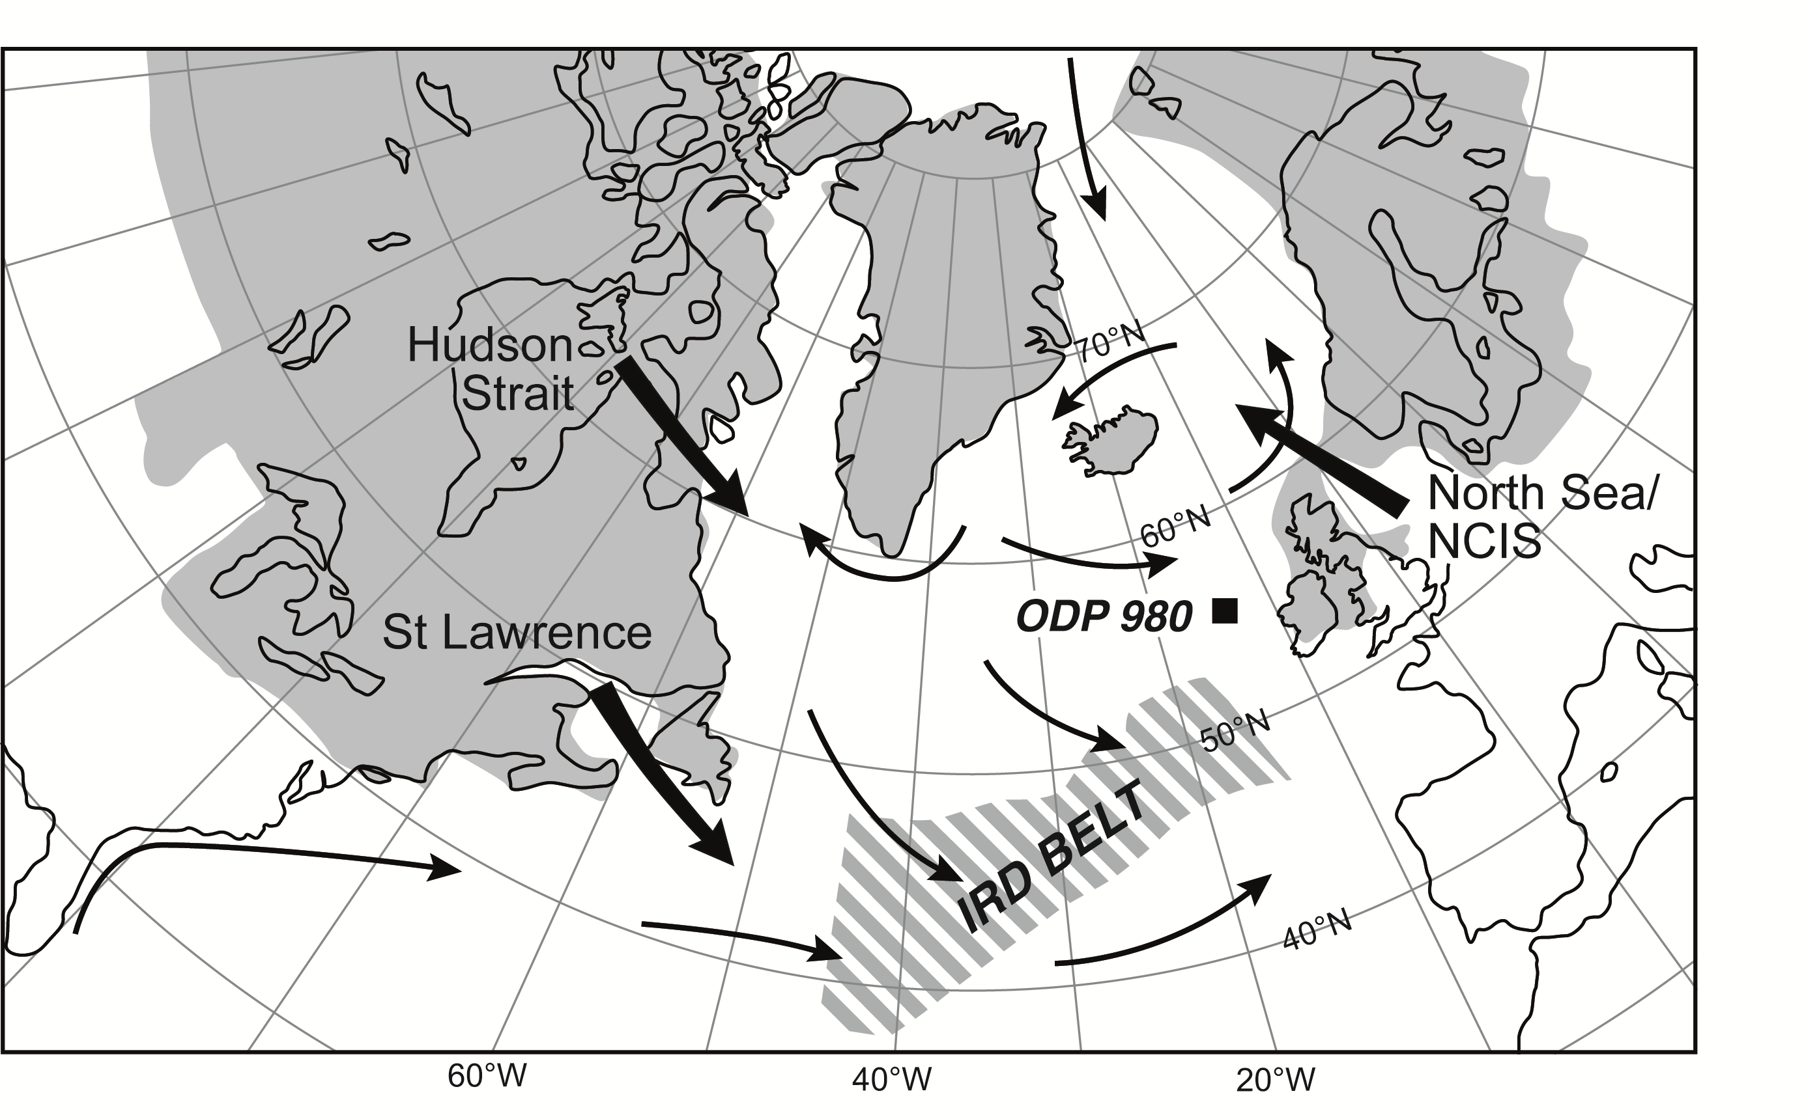
Glacial iceberg sources (North Atlantic)
Probable convection zone

Slide 7
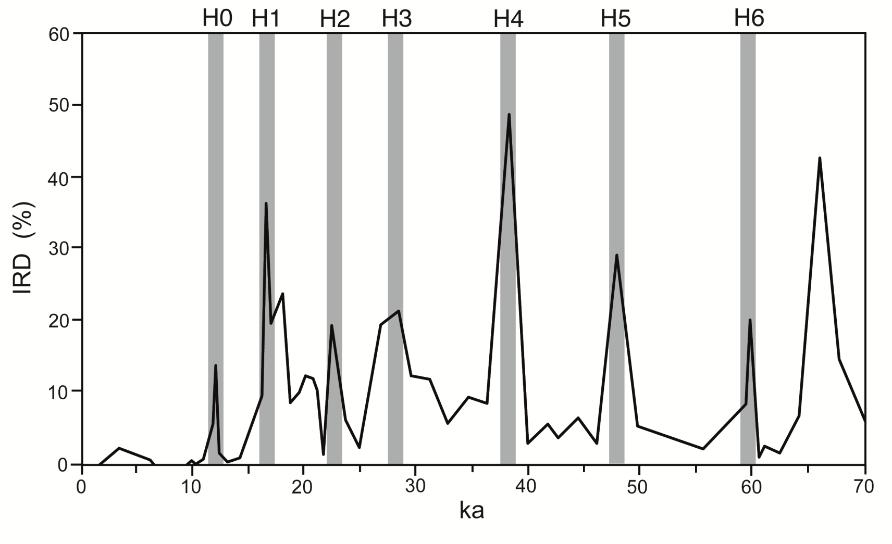
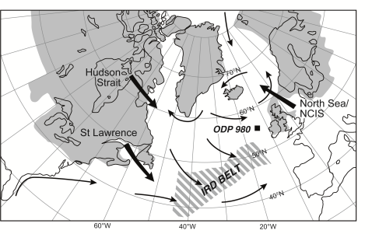
IRD record, ODP 980
Notes:
do I need something from Sidney Hemming around here?

Slide 8
Possible causes of Heinrich events
Ice sheet instability
internal oscillations (ice thickness and basal sliding)
climate feedbacks (atmospheric flow & ice sheet SMB)
(ice shelf and ocean warming)
sea level rise
Timescale: ~ 500 years

Slide 9
Heinrich events & climate change
driven by the melting of large volumes of icebergs over several hundred years
changes ocean circulation
which alters atmosphere
basin-scale climate change
where the freshwater enters the ocean is crucial for magnitude and timing of change, so need an iceberg trajectory model
Notes:
add slide of iceberg model theory

Slide 10
Iceberg model
Dynamic and thermodynamic iceberg model (Bigg et al. 1997; Levine & Bigg 2008)
Main dynamical processes included:
ocean/atmosphere/sea-ice drags, Coriolis force, pressure gradients in surrounding ocean, and wave radiation.
Main thermodynamical processes included:
basal melting, buoyant convection, wave erosion, smaller terms due to sublimation and latent heat transfer

Slide 11
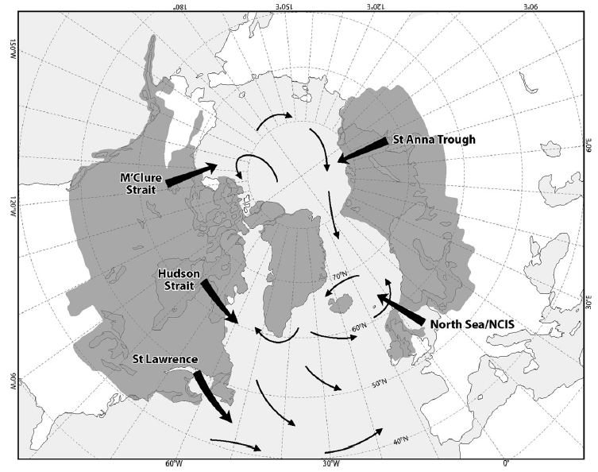
Possible source regions for Heinrich events

Slide 12
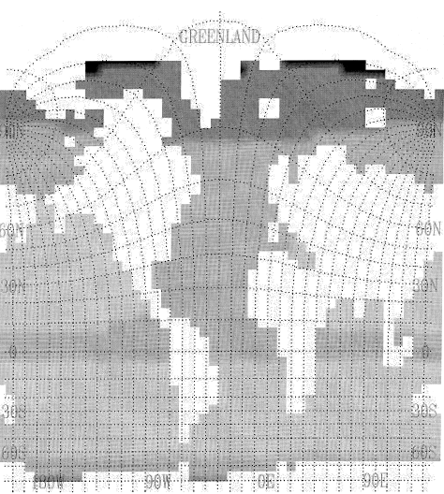
FRUGAL EMIC model
(Fine ResolUtion Greenland And Labrador sea)
Projection
Grid
Finest resolution ~ 100 km; Southern Hemisphere resolution: 8x6º
Ocean : 19 levels in vertical
Sea-ice model : thermodynamics (Semtner, 1976) and dynamics
Coupled configuration: Energy balance atmosphere (UVic)
with moisture advection, mountains, clouds, land hydrology, land-ice
Parameterized wind fields: from LGM Atmospheric GCM (Dong & Valdes, 1998)
Coupled to dynamic & thermodynamic iceberg model (Bigg et al., 1997; Levine and Bigg, 2008)

Slide 13
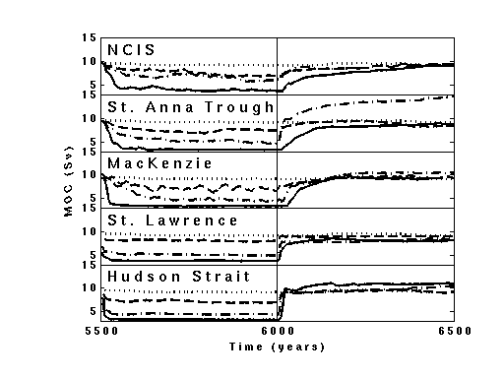
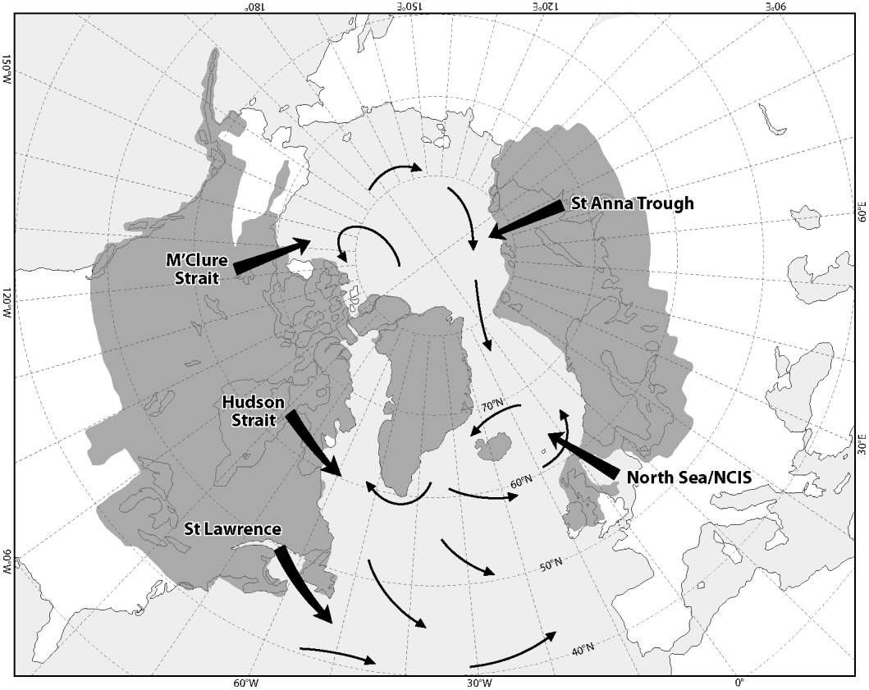
Iceberg releases & Overturning
Dotted – control
Dash – 0.1 Sv
Dot-dash 0.2 Sv
Solid – 0.4 Sv

Slide 14
Eastern North America – fast acting & fast return
Arctic & European – less fast acting & slow return

Slide 15
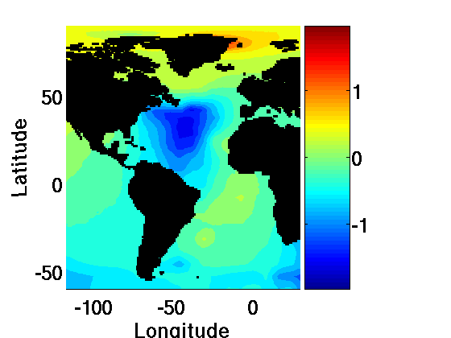
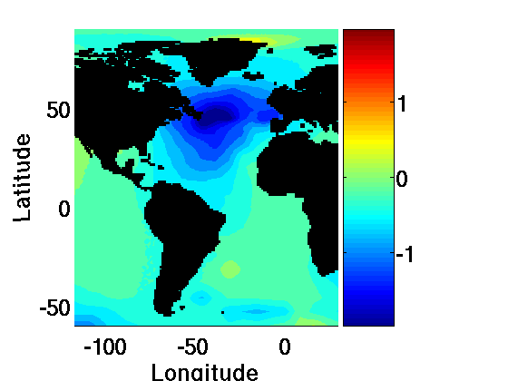
Eastern North American releases lead to air temperature decline being further to the south, but with a western Atlantic bias (both at sea and over land)
European releases lead to air temperature decline further north (but still south of Iceland), and more zonal change
North American releases may also tend to lead to northern Atlantic temperature rises
HS
NCIS

Slide 16
For a Heinrich Event of the same size and duration, coupled climate modelling shows that its climate signal’s size, rate of onset
& rate of decline depends on the source

Slide 17
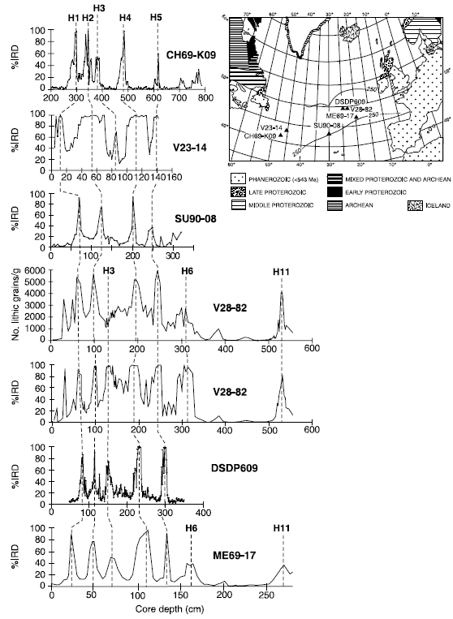
Heinrich Layers
Contrast of H1 & H3
H1: most recent major IRD signal at close of last glacial
H3: small IRD signal
mostly western Atlantic

Slide 18
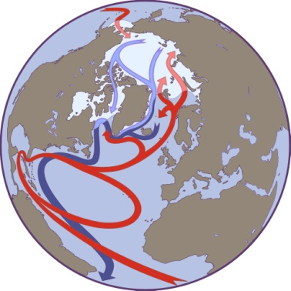
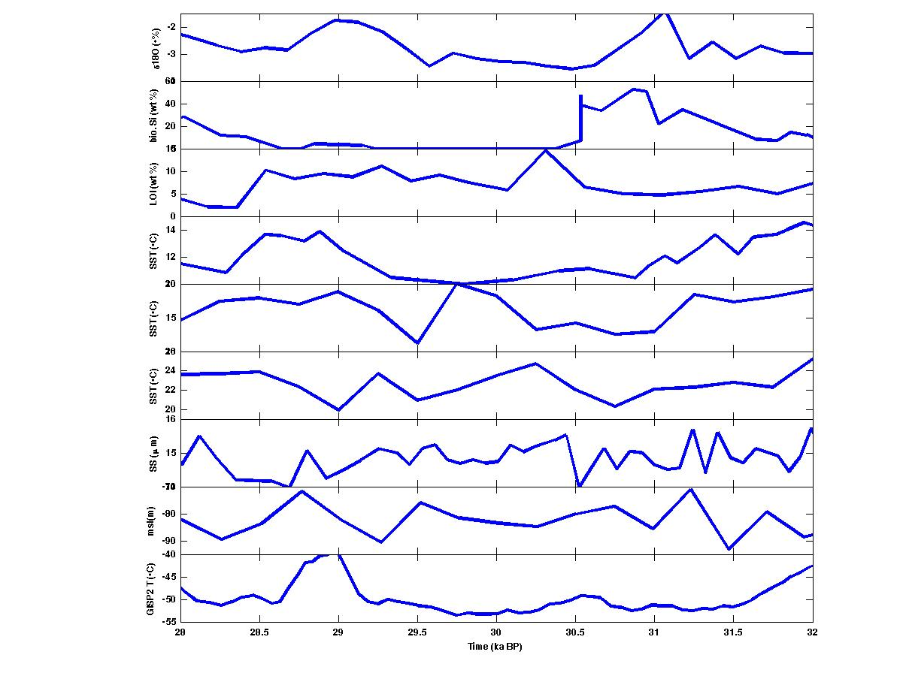
H3
A slow onset and recovery
Weak European climate
signal initially
Strong Eastern
SST signal
Eastern Atlantic IRD bias
Strong Greenland signal
Weak sea level signal
Med.
E. Atl.
W. Atl.
Origin: significant Arctic event from an ice shelf
(Fram Strait marine core: IRD peak c. 32ka BP)

Slide 19
Iceberg fluxes and climate
Today – Greenland & Antarctica (low volume)
surface reflection
cold air plume

Slide 20
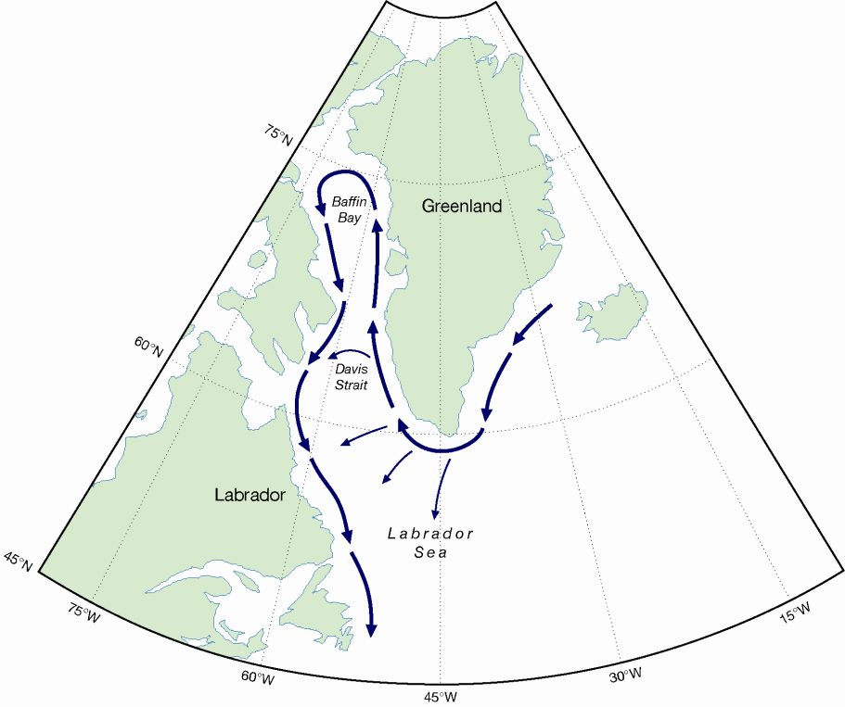
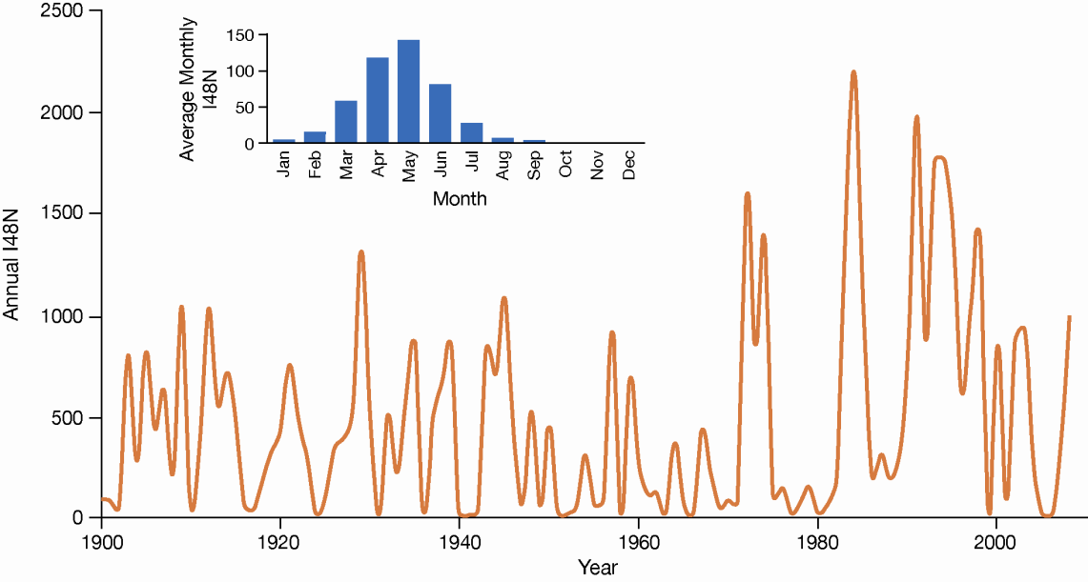
Iceberg flux from GrIS at 48°N
I48N = number of icebergs crossing 48°N
Iceberg flux at 48°N from International Ice Patrol
Routes for icebergs from GrIS to 48°N

Slide 21
Iceberg flux from GrIS at 48°N
I48N = number of icebergs crossing 48°N
Iceberg flux at 48°N from International Ice Patrol
Routes for icebergs from GrIS to 48°N
Can we reproduce the I48N timeseries?
Can we explain it?

Slide 22
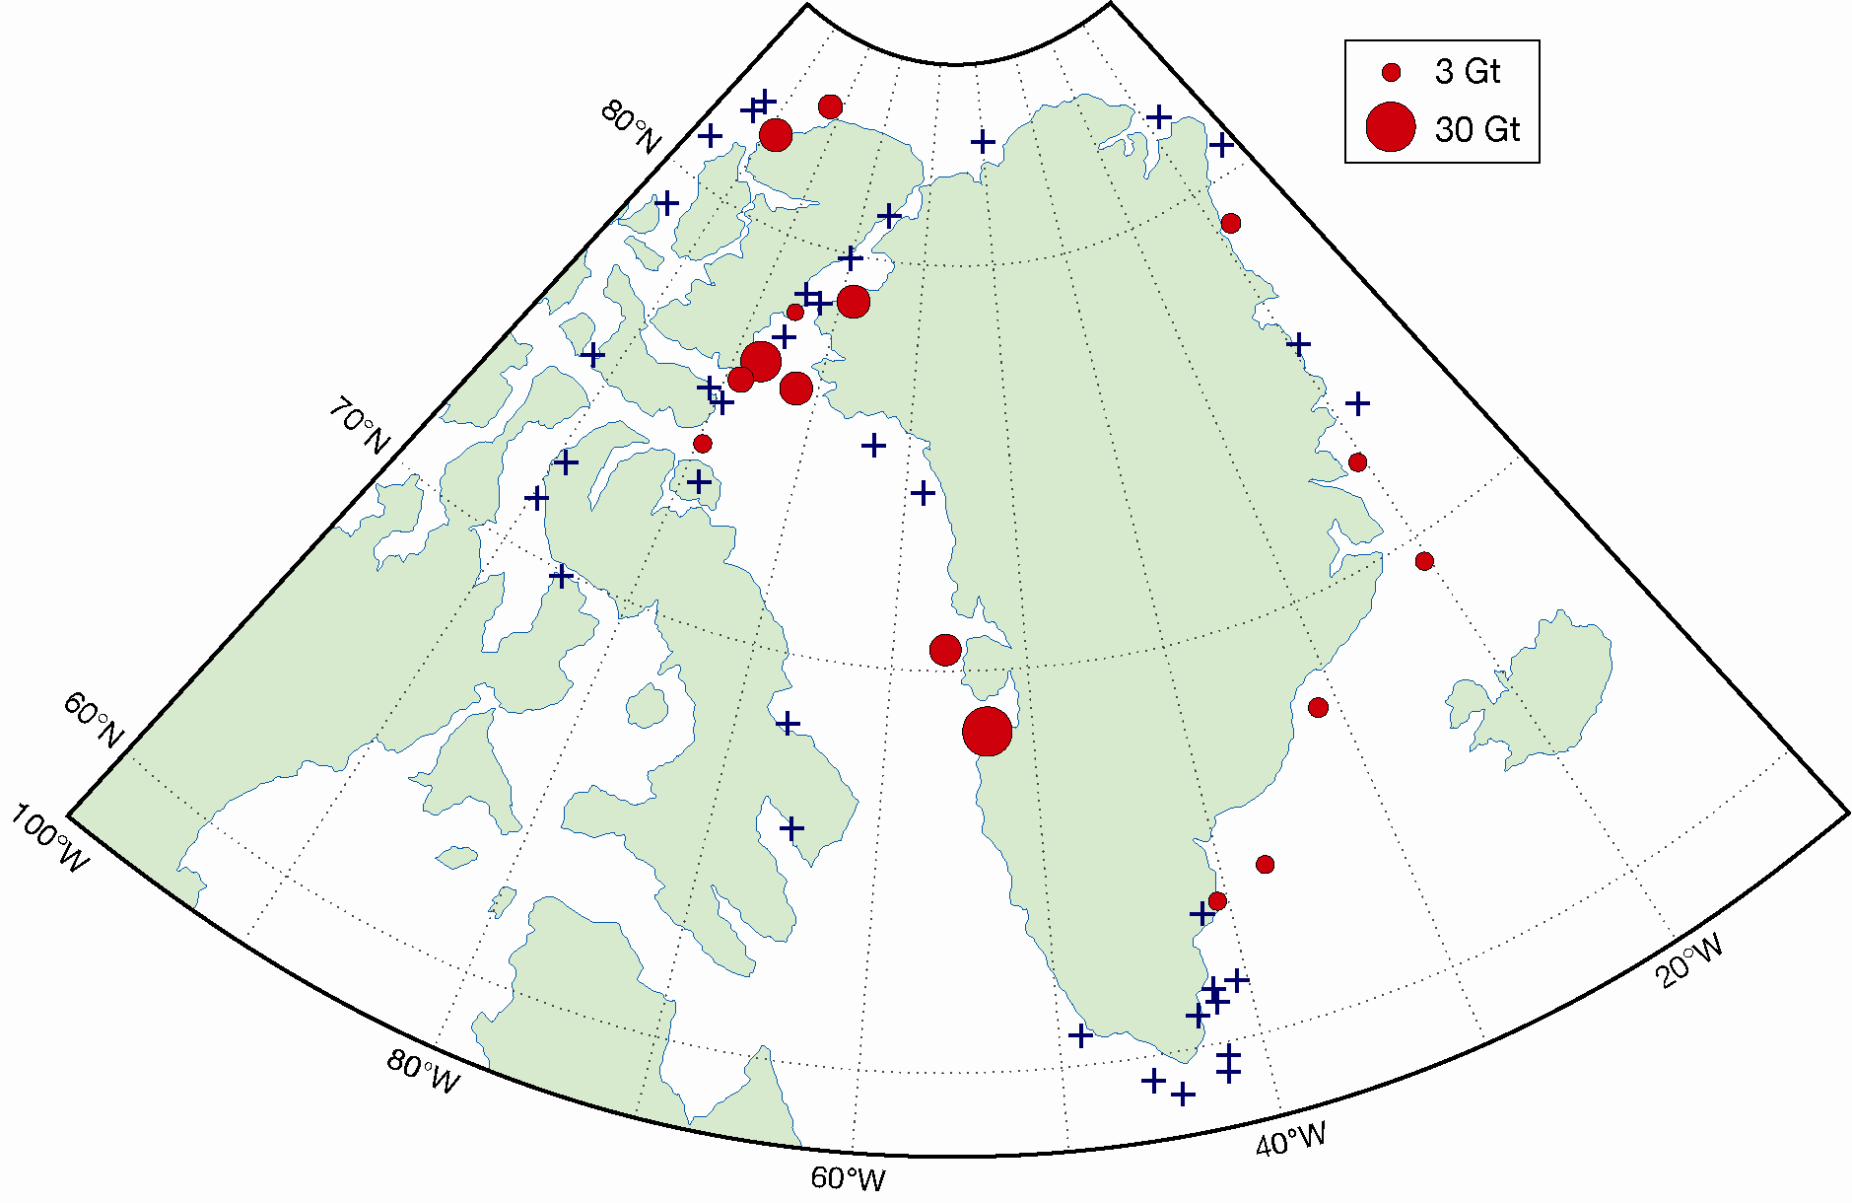
Model Icebergs
Use FRUGAL model in fine resolution, ocean-iceberg mode (min. grid ~ 20 km)
Forced by 20th Century Reanalysis (with adjusted fluxes!!)
Model icebergs are seeded at fixed points globally every 3 months
  But 75% released in one peak month
Locally varying annual flux
29 sites representing Greenland glaciers
Others from Canadian islands, Svalbard, Russian Arctic and Antarctica
10 sizes, 0.5 to 500 Mtonnes
Each berg has scale factor f such that
  For each site ∑ f(i) x mass(i) = average annual ice discharge
Iceberg calving is NOT modelled, most seed sites are well off coast

Slide 23
Constant annual GrIS discharge
Same flux of model bergs released from each seed site every year
Testing whether variation in I48N is due to the ocean forcing data alone, i.e. climatological changes over 20th century
Mean flux is similar but little correlation

Slide 24
Annual GrIS discharge is not constant
Does GrIS discharge vary as observed I48N does?
Scale the flux of model icebergs released by
  I48N(y) / I48N_{m}
  I48N(y) = observed iceberg flux at 48°N for year y
  I48Nm is mean from 1900-2008
  y depends on latitude of the seed site the model berg starts from
  <= 64°N, y is same year, most model bergs from South Greenland that reach 48N do so in same year
  > 64°N, y is next year, model bergs from further north take around a year or more

Slide 25
Variable annual GrIS discharge
Variable discharge gives a good qualitative match with observed I48N (r=0.83)
Model I48N not always as high as observed, but given the simple scaling used this looks good

Slide 26
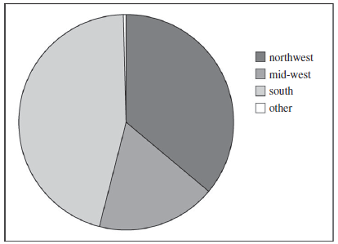
Can we explain the behaviour of the GRIS discharge?
The model has over 99% of I48N icebergs deriving from southern Greenland or Baffin Bay
See Andrews et al., 2014, Quater. Sci. Rev., 91, 204-17 for paleoceanographic validation of origin reconstruction in Denmark Strait

Slide 27
Can we explain the behaviour of the GRIS discharge?
Main processes underlying Greenland iceberg discharge:
Submarine melting (linked to ocean temperature & glacial run-off)
Ice melange in front of terminus (linked to ocean, atmospheric & ice conditions)
Crevassing & sub-glacial hydrology (surface melt)
F. Straneo et al., 2013, BAMS

Slide 28
Can we explain the behaviour of the GRIS discharge?
Main processes underlying Greenland iceberg discharge – we parameterise these using:
GRIS Surface Mass Balance (SMB)
Labrador Sea Surface Temperature (LSST)
North Atlantic Oscillation (NAO)
Use Nonlinear AutoRegressive Moving Average with eXogenous input system identification modelling (NARMAX - a tool from control systems engineering)

Slide 29
NARMAX model
N
I48N(k)=∑a_{m}f_{m}(SMB, LSST, NAO)
Where k is time (annual or monthly)
f_{m} is SMB^{v} .LSST^{w} .NAO^{x} , where v, w, x =0, …,3 and lags of 0,…,4 years are permitted
The fit between I48N and the ∑ is optimised sequentially term by term giving a model with sufficient terms to give less than a specified residual error
To allow change in the underlying physics over time we use a 30 year sliding window, allowing the model to evolve
m=1

Slide 30
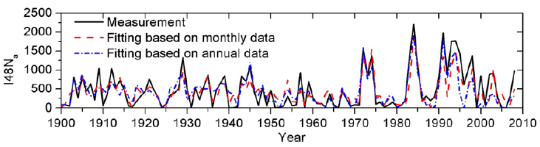
NARMAX model

Slide 31
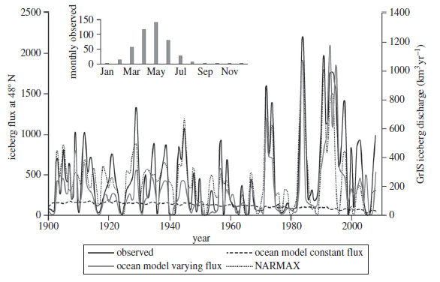
NARMAX model
Using I48N as proxy

Slide 32
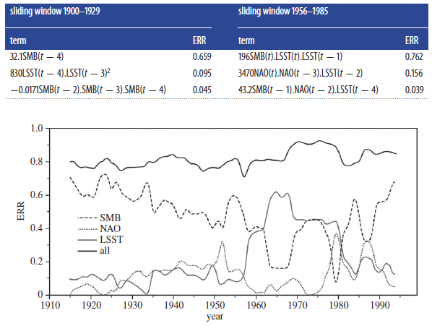
NARMAX Model
Perfect model
Evolving contribution of different factors to model(s)

Slide 33
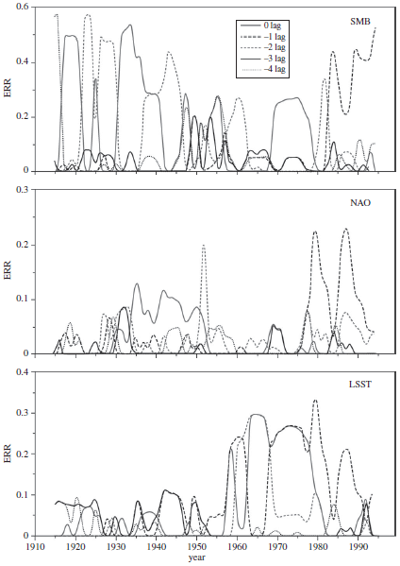
NARMAX Model
One year (8/9 months) has become dominant in recent decades
Contribution to terms of various time lags (in years)
See Zhou et al., (2016) Cold Regions Sci. & Technol., 121, 167-78 for NARMAX sensitivity and monthly analysis

Slide 34
Why has Greenland iceberg discharge changed over the last century?
All three processes are important, but act non-linearly
SMB was dominant in the first half of the 20th century, with a switch to ocean temperature being dominant in the 1960s and 70s
More recently all play a significant role
The dominant response time has switched from ~ 21/22 months to 8/9 months in recent decades
During periods of change calving more related to surface runoff and so changes to englacial, subglacial and submarine hydrology

Slide 35
Icebergs: life and the Carbon cycle

Slide 36
Icebergs: life and the Carbon cycle
Icebergs contribute to ocean primary production with previous estimates of ~ 10% of Southern Ocean production deriving from iceberg nutrient fluxes
But Southern Ocean icebergs have a bi-modal distribution and the giant iceberg mode hasn’t been assessed separately
Length of 18-280 km, but typically 30-40 km

Slide 37
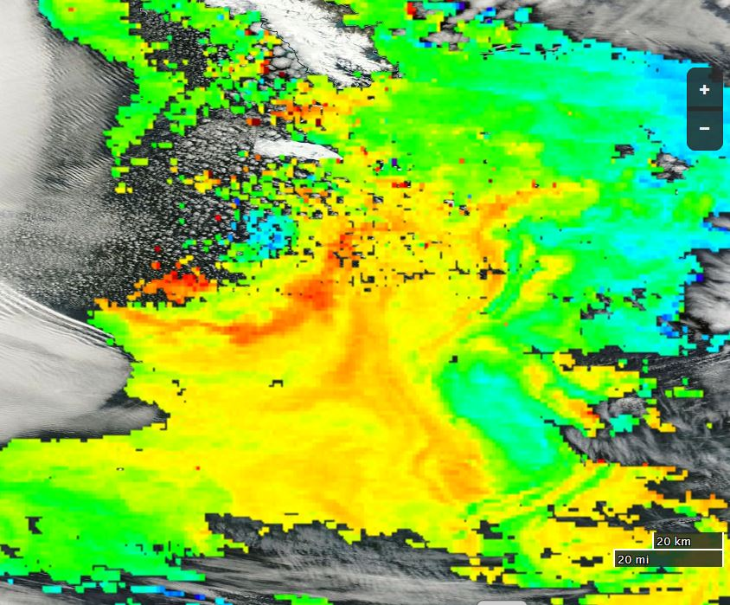

Icebergs: life and the Carbon cycle
MODIS image with Chlorophyll overlay from 23 Jan. 2015
South Georgia
B17a

Slide 38
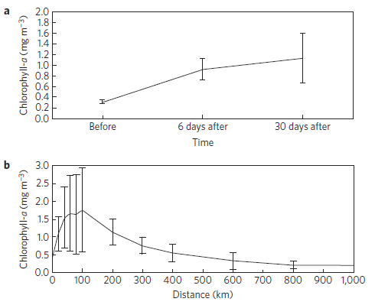
Icebergs: life and the Carbon cycle
The Chla level in the wake of a giant iceberg remains elevated for more than a month
The spread of the enhanced production can be up to 1000 km and the enhancement an order of magnitude
Duprat et al., 2016, Nature Geosci.

Slide 39
Icebergs: life and the Carbon cycle
And the plume is often both ahead and behind the iceberg
From the one available measurement of carbon export beneath a giant iceberg, relative to the undisturbed background, up to 0.012-0.04 Gt C sequestered in the deep Southern Ocean annually

Slide 40
Icebergs: life and the Carbon cycle
And the plume is often both ahead and behind the iceberg
From the one available measurement of carbon export beneath a giant iceberg, relative to the undisturbed background, up to 0.012-0.04 Gt C sequestered in the deep Southern Ocean annually
This is equivalent to up to 10-20% of the last IPCC estimate of total C sequestration in the Southern Ocean from any cause

Slide 41

The role of icebergs in global change
Iceberg meltwater fluxes change:
Ocean circulation
Sea-ice (increase)
Primary productivity (increase)
Carbon sequestration (increase)
Location & Magnitude of effect depends on:
Origin of icebergs
Size of flux
Iceberg fluxes are also a proxy for discharge:
Discussed for NW Atlantic, but also shown for comparison with IRD variation over 20th century in Denmark Strait

Slide 42

Questions?
B31 calving, Nov. 2013
CUP (2016)
With thanks to:
Postdocs Martin Wadley, Richard Levine, David Wilton, Vladimir Ivchenko and Yifan Zhu;
PhD students Rupert Gladstone, Tiago Silva, Clare Green;
Masters student Luis Duprat
and colleagues John Johnson, David Stevens, Keith Nicholls, Bob Marsh, Visakan Kadirkamanathan, Steve Billings, Edward Hanna, Hua-Liang Wei, John Andrews.

Slide 43
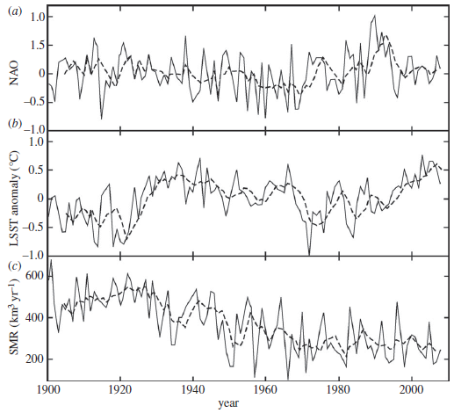
Can we explain the behaviour of the GRIS discharge?

