Slide 1
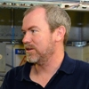
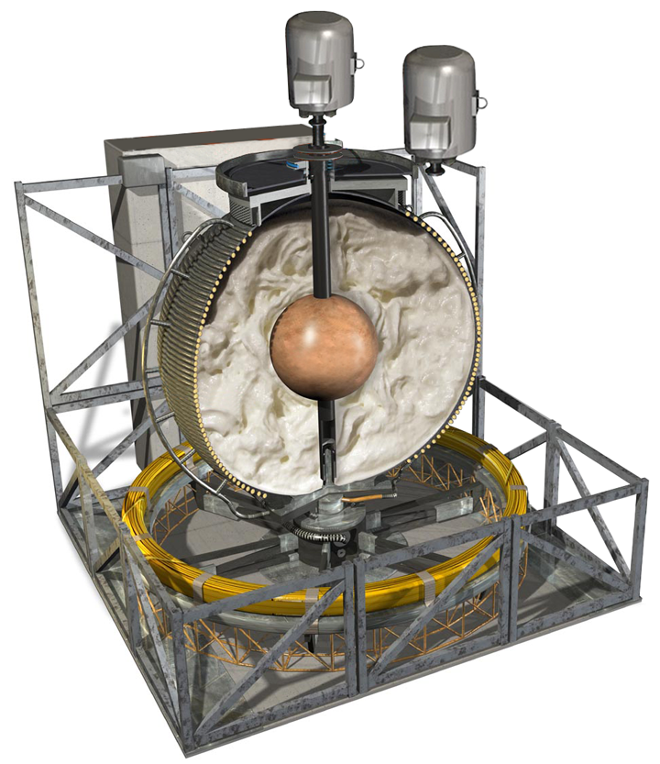
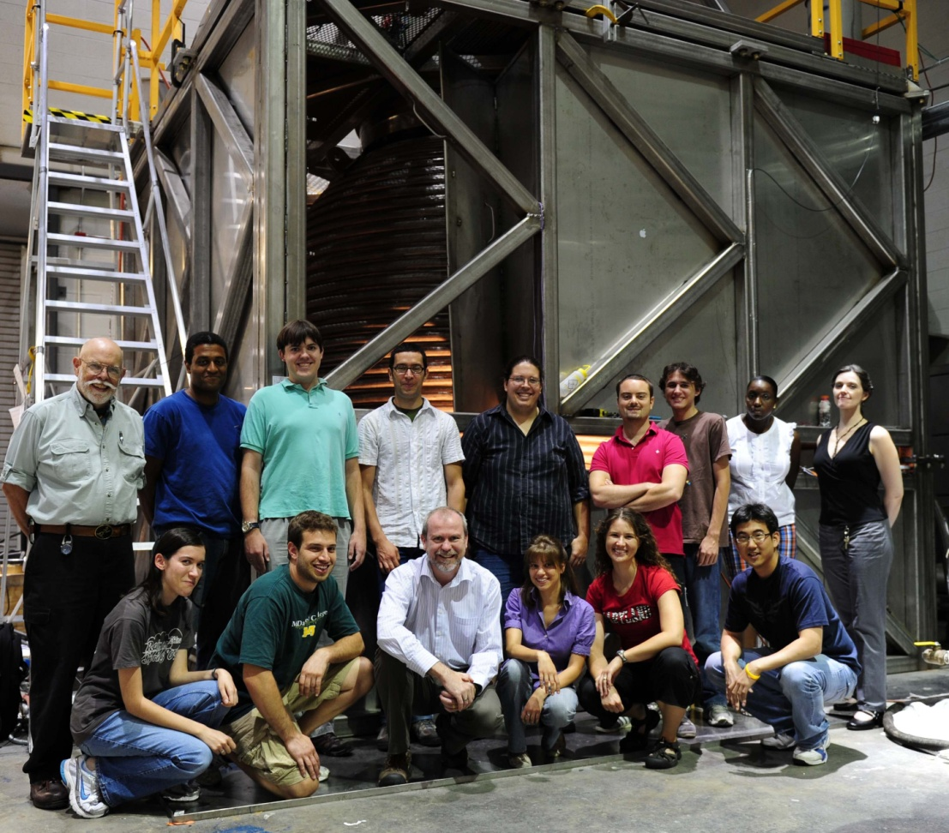
Laboratory models of the Earth’s core
Daniel P. Lathrop
University of Maryland

Slide 2
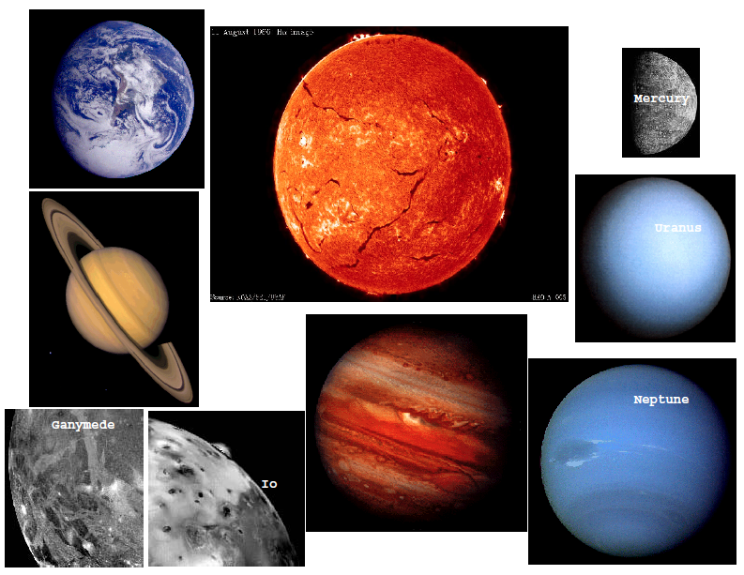
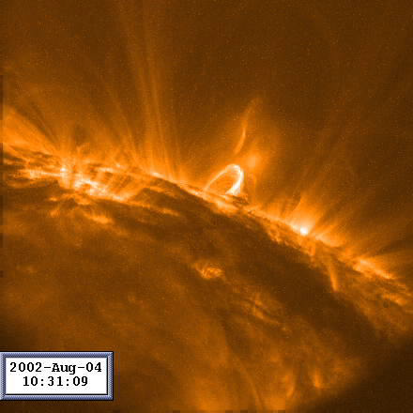

Slide 4
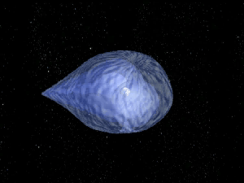

Slide 5
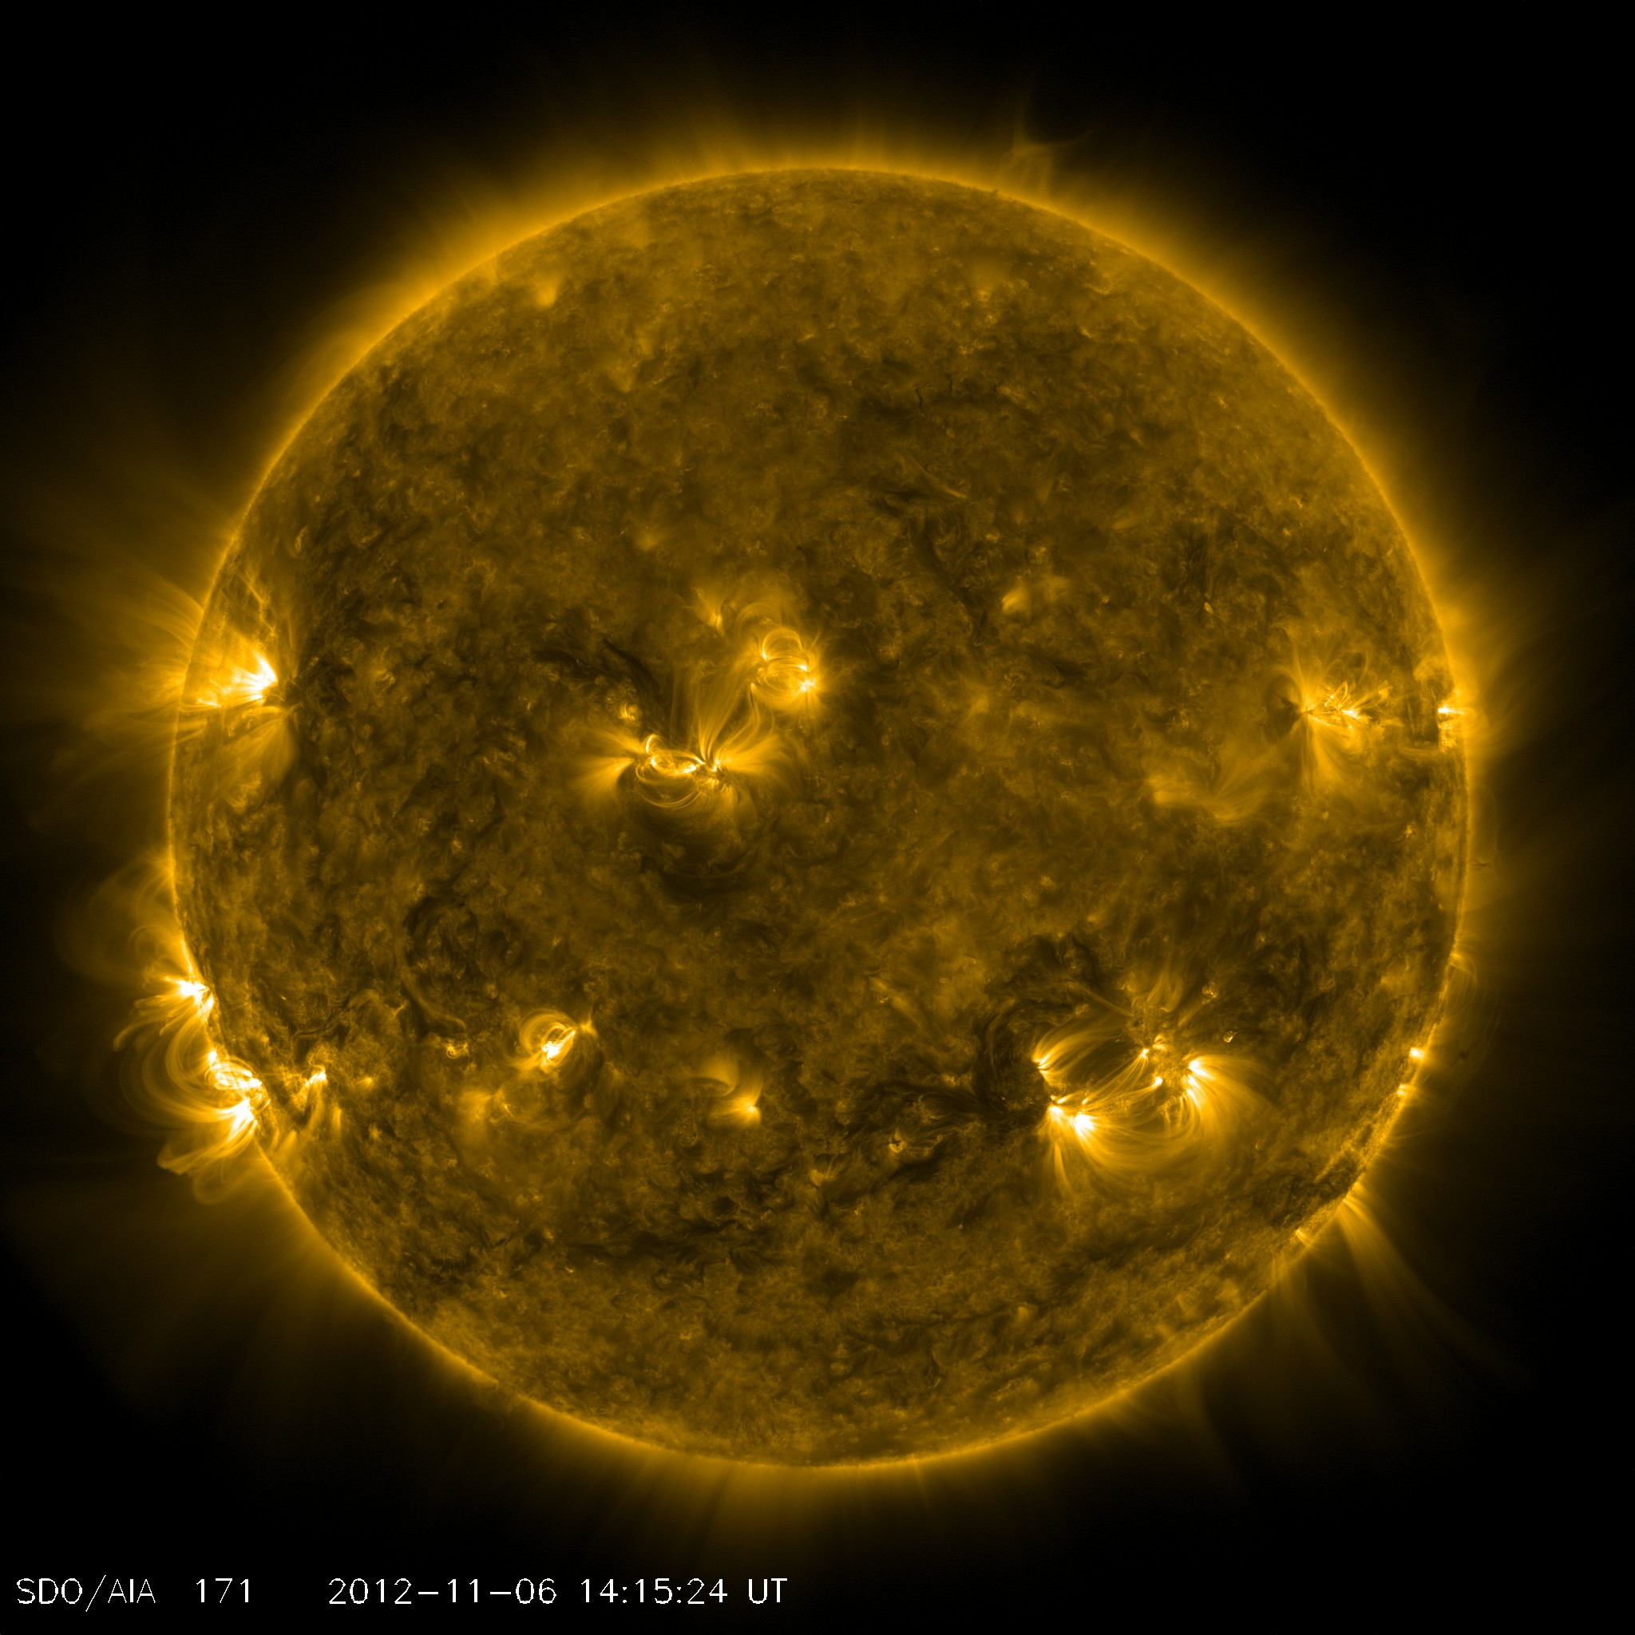

Slide 6
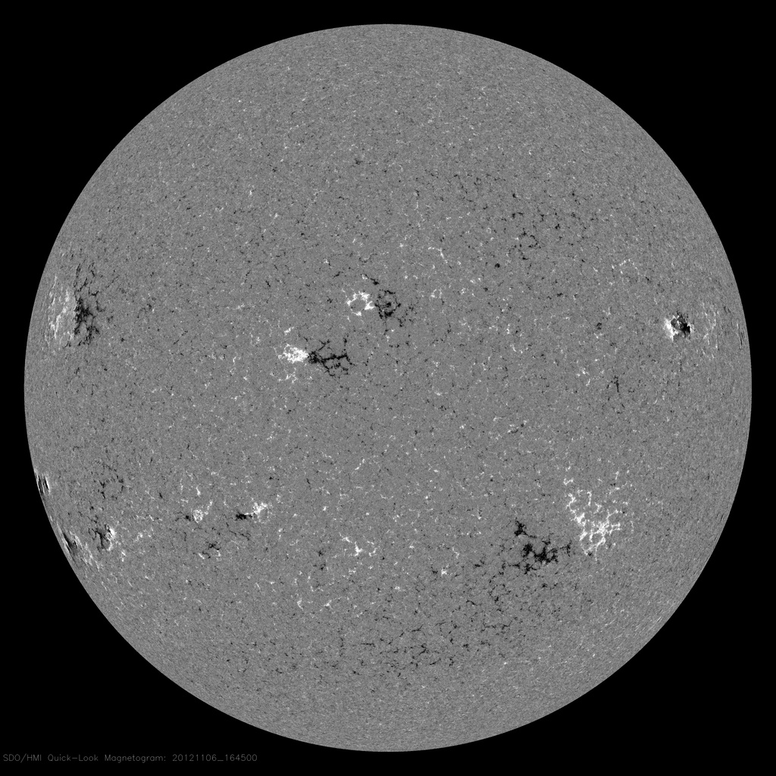

Slide 7
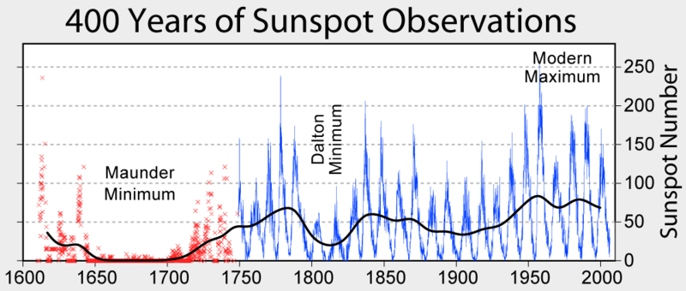
Sun undergoes 11 year cycles
http://en.wikipedia.org/wiki/Solar_cycle

Slide 8
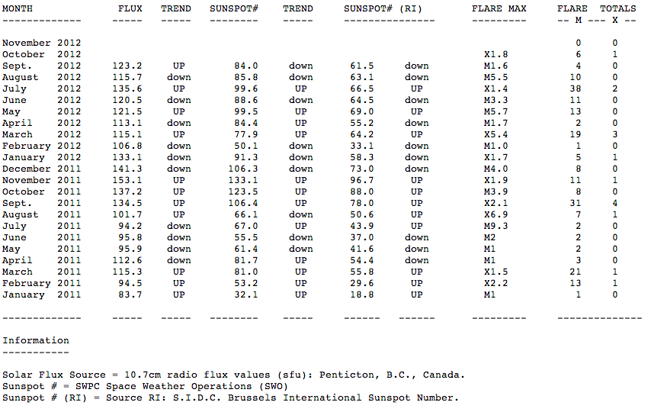
Solar cycle 24 (now)
http://solarham.com/averages.htm

Slide 9
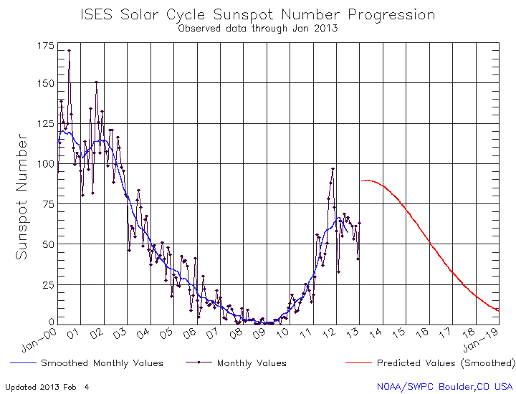
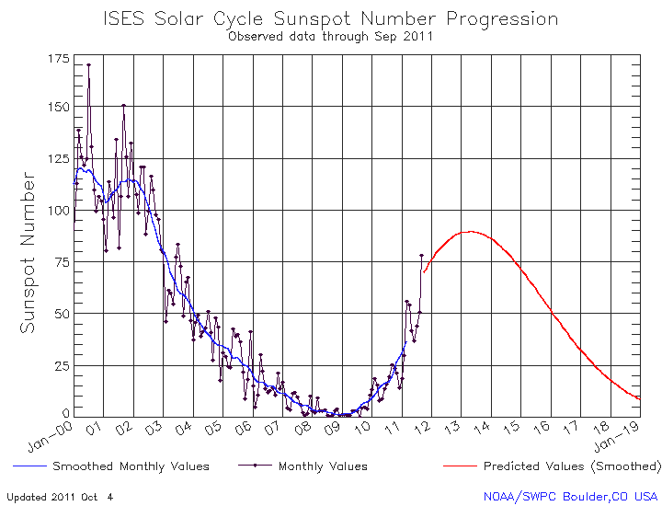

Slide 10
Carrington Event – 1859
Solar superstorm with coronal mass ejection:
the largest recorded geomagnetic storm occurred.
Aurorae were seen around the world: over the Caribbean
over the Rocky Mountains
Telegraph stations lit on fire – sparks were seen on overhead wiring

Slide 11
March 1989 geomagnetic storm
Solar storm with a X15 flare and coronal mass ejection three
days later
Caused the collapse of Hydro-Québec's electricity transmission system.
The variations in the earth's magnetic field tripped circuit breakers on
Hydro-Québec's power grid.
The James Bay network went offline in less than 90 seconds, giving Quebec
its second massive blackout that lasted 9 hours

Slide 12
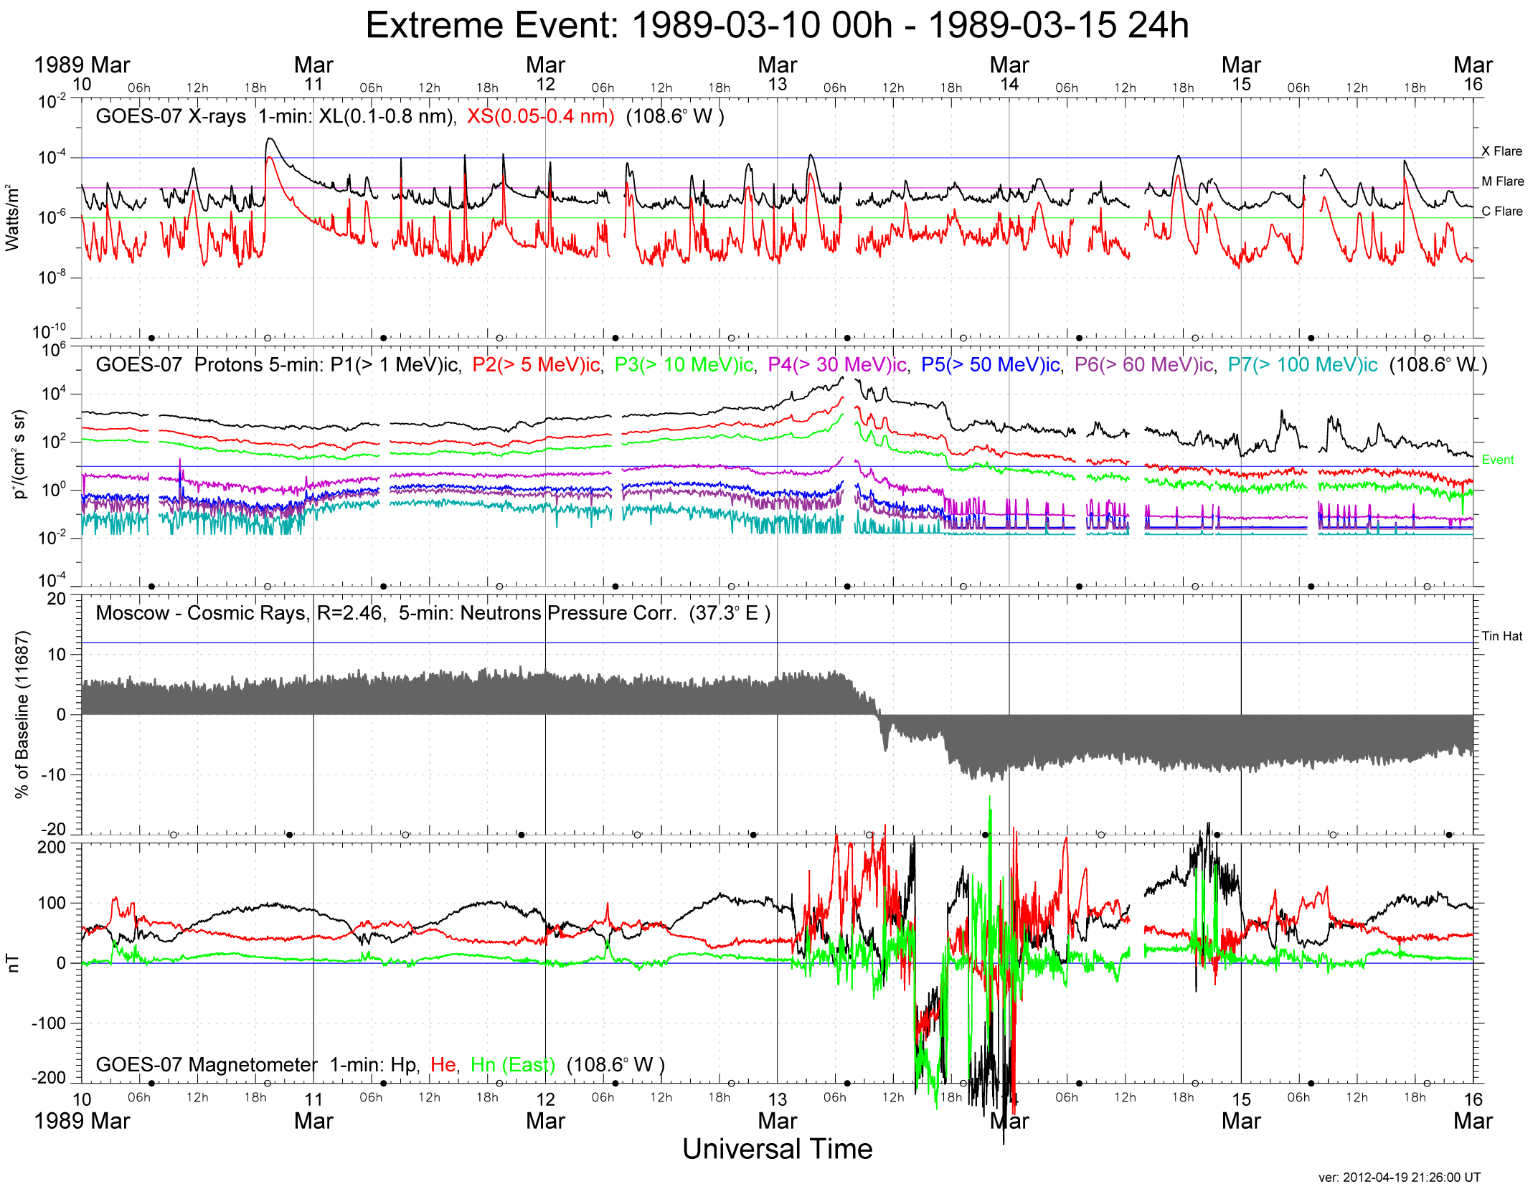
March 1989 geomagnetic storm
Solar storm with a X15 flare and coronal mass ejection three
days later
Caused the collapse of Hydro-Québec's electricity transmission system.

Slide 13
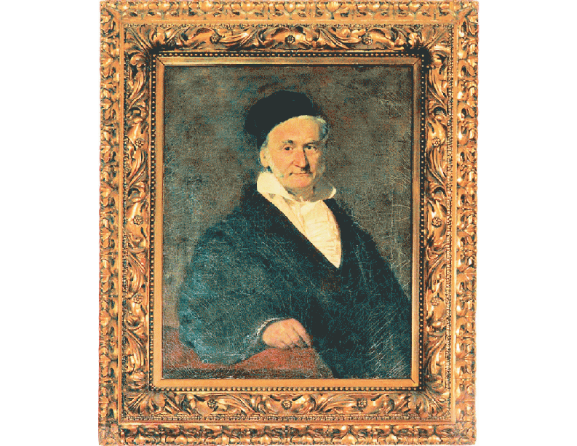

Slide 14
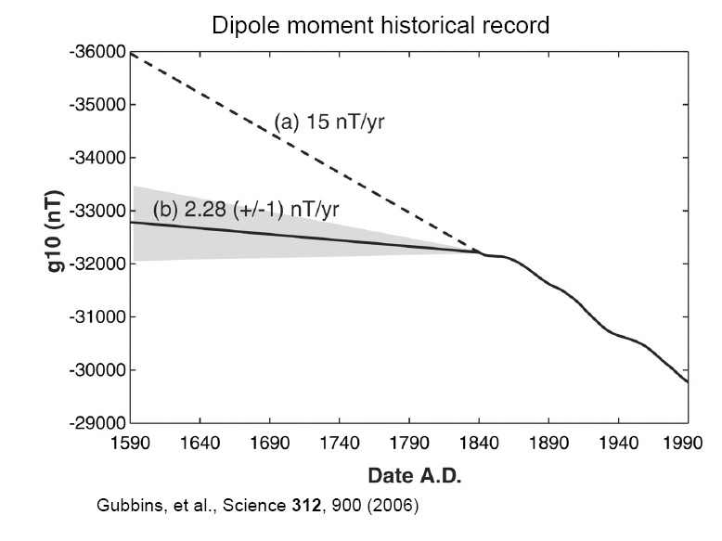

Slide 15
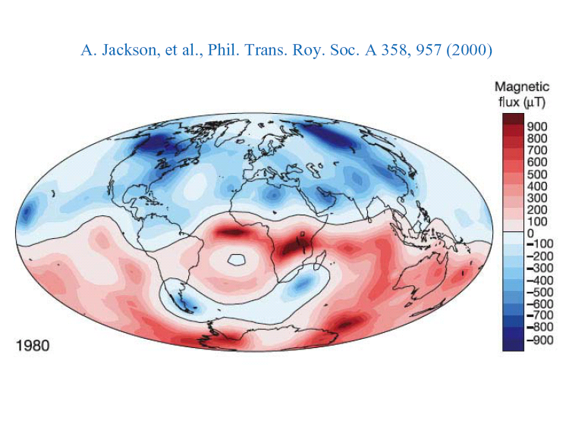

Slide 16
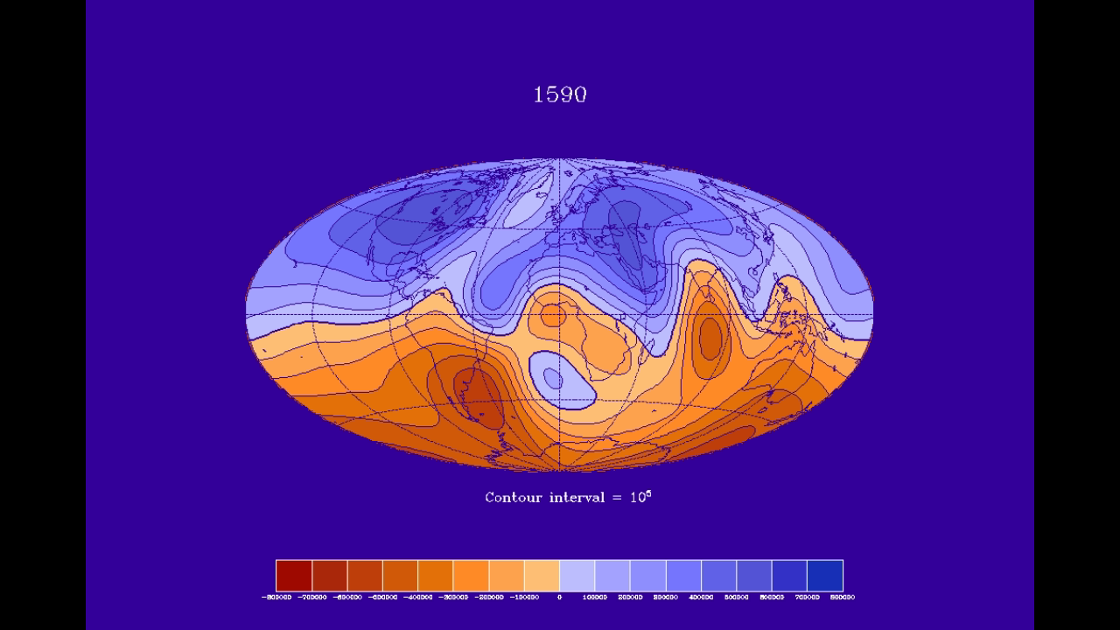

Slide 17
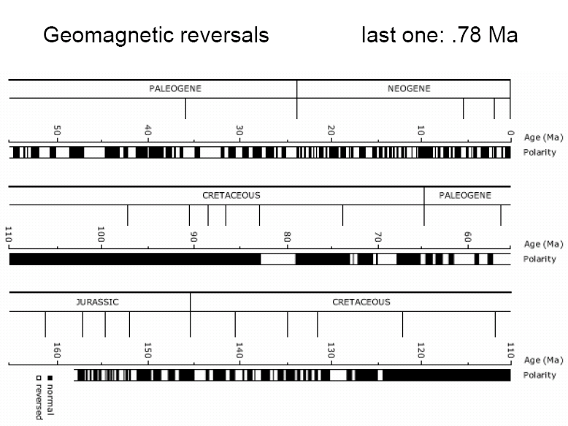

Slide 18
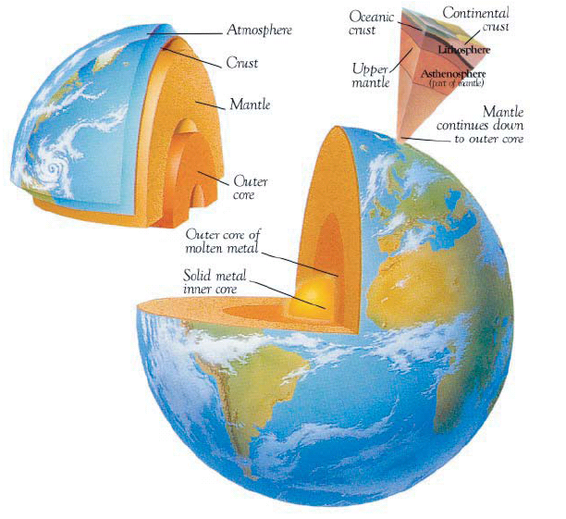

Slide 19
Simple Earth
Nonrotating; Spherical
Isothermal T = 2.725 º K
Zero axial tilt
Quiet atmosphere
Quiet crust
Quiet mantle
Quiet core
Core magnetics → B = 0

Slide 20
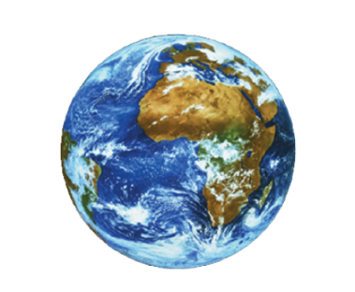
Simple Earth
Nonrotating; Spherical
Isothermal T = 2.725 º K
Zero axial tilt
Quiet atmosphere
Quiet crust
Quiet mantle
Quiet core
Core magnetics → B = 0?
Habitable Home
One Day Period; Oblate spheroid
T_{core} / T_{space} ~ 10³
23.5º, precessing
Turbulent, zonal atmosphere
Brittle quaking crust
Complex convecting mantle
Turbulent convecting core
Active self-inducing geodynamo

Slide 21
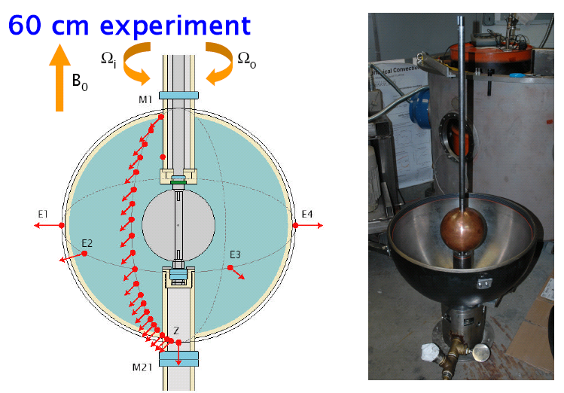

Slide 22
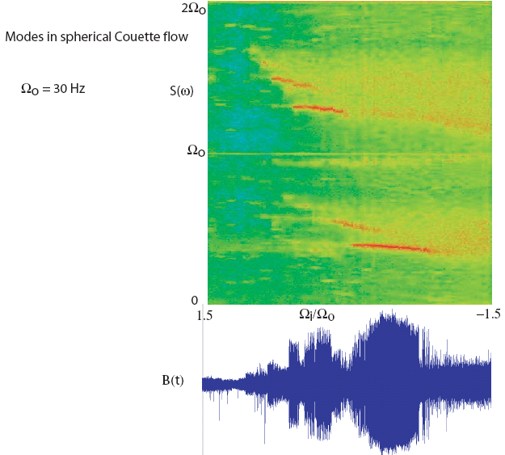

Notes:
Add pde and Q

Slide 23
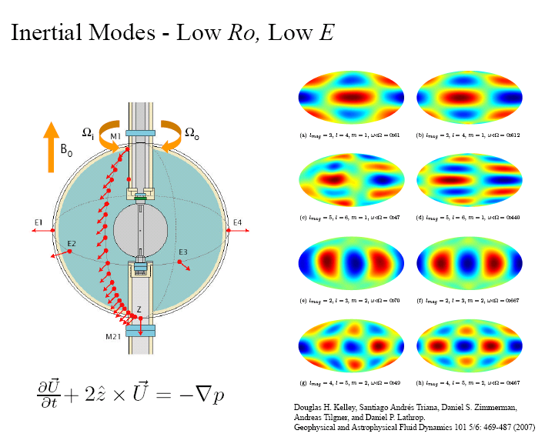


Slide 24
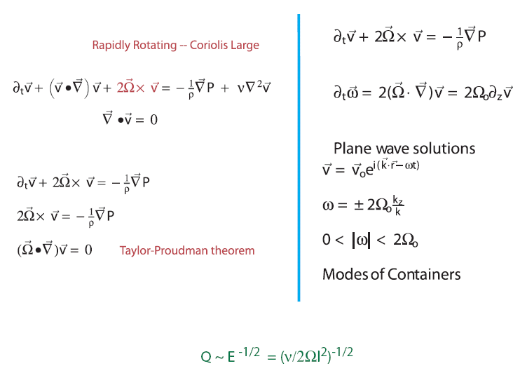

Slide 25
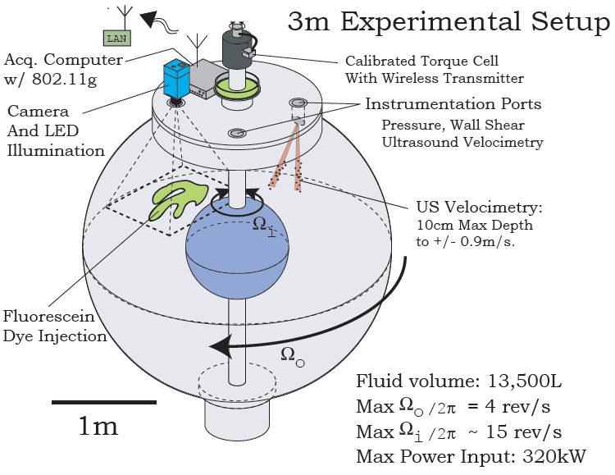

Slide 27
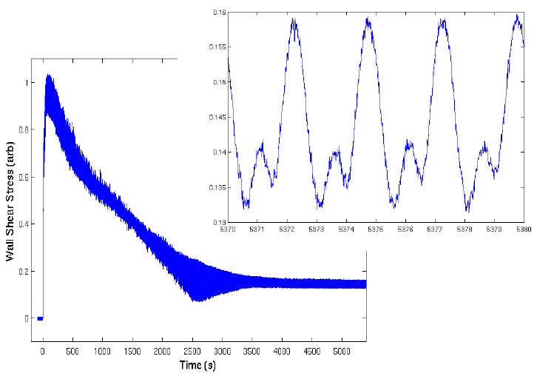
Failed approach to solid body rotation

Slide 28
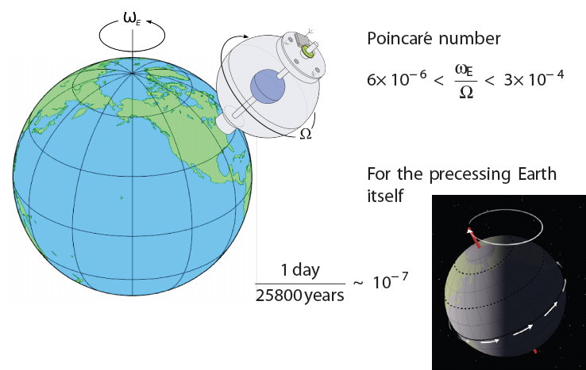
Lock inner and outer spheres together: precession driven flows!!!
Triana dissertation: complex.umd.edu

Slide 29
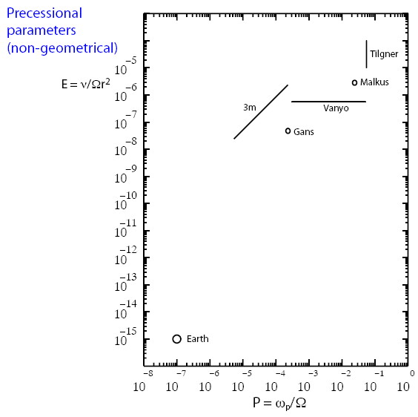

Slide 30
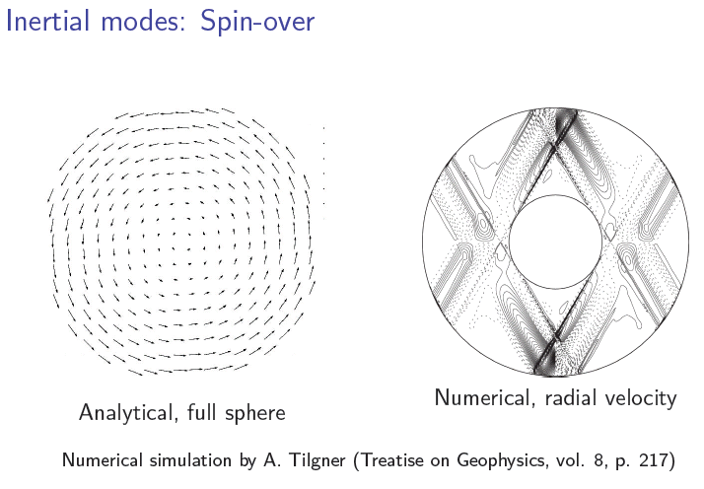

Slide 31
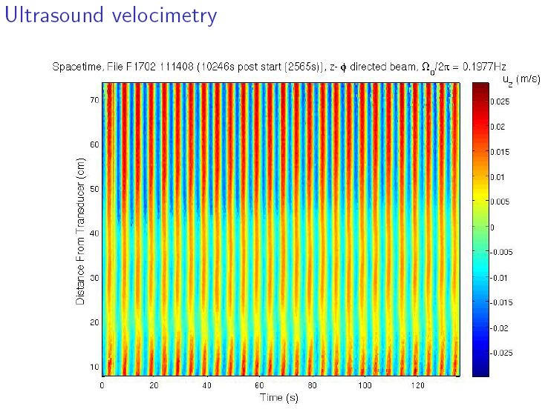

Slide 32
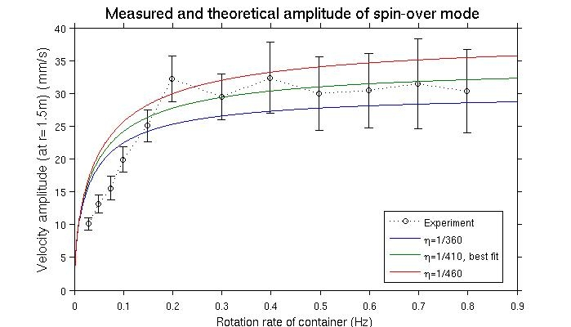
Theory from Busse JFM 33, 739 (1968) -- small ellipticity

Slide 33
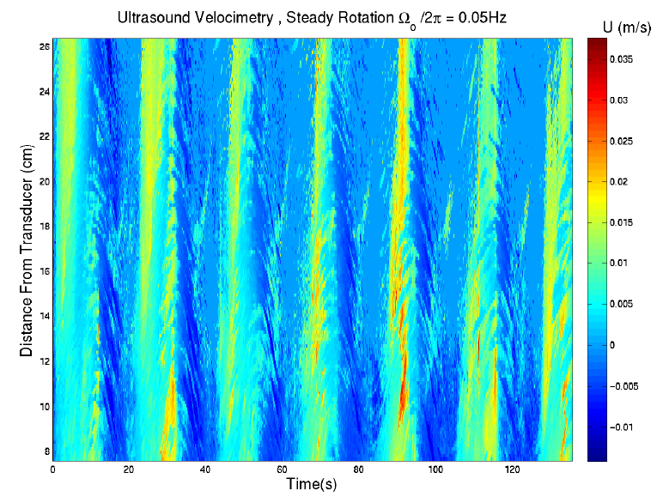

Slide 34
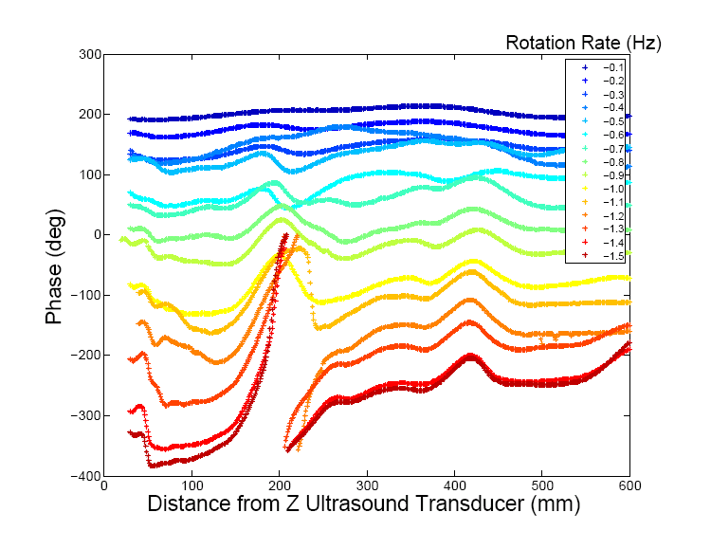

Slide 35
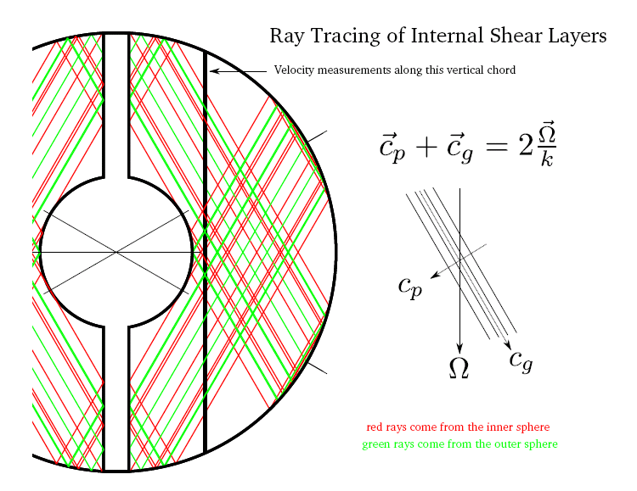

Slide 36
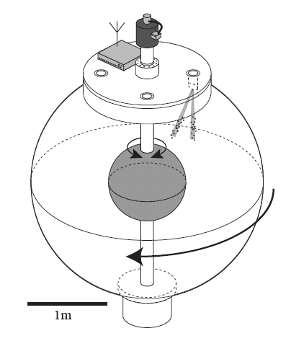

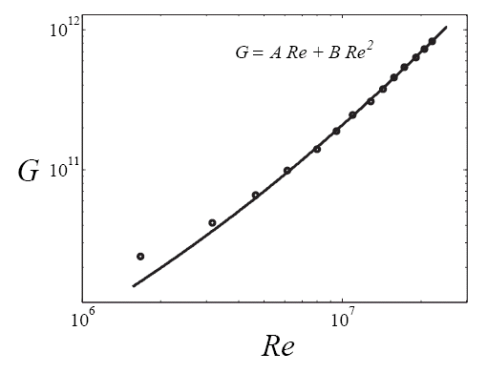
Water experiments in the 3 m system
Dimensionless torque

Slide 37
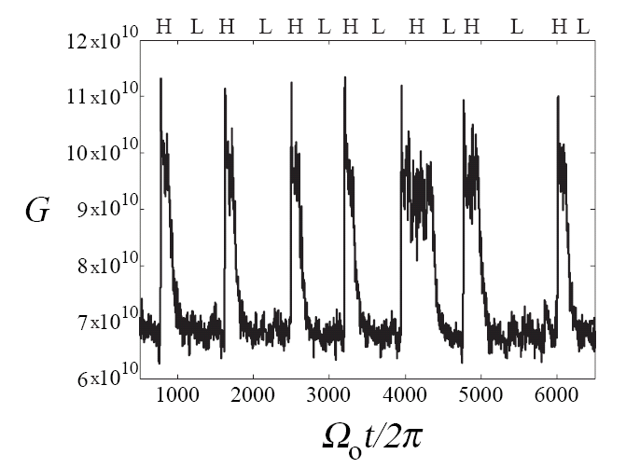
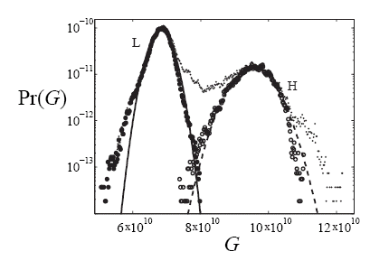
Torque
bi-stability
around Ro=2

Slide 38
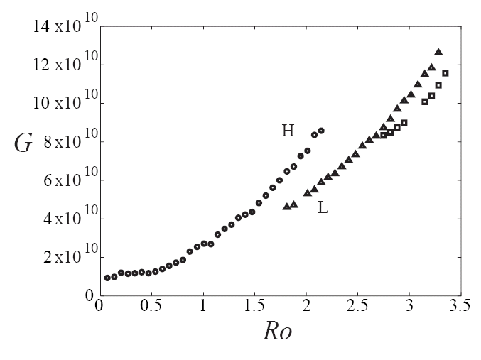
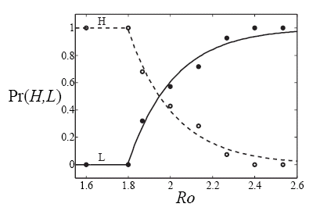
Dimensionless
torque

Slide 39
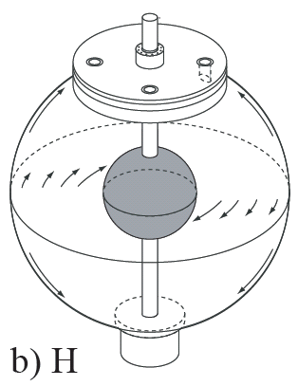
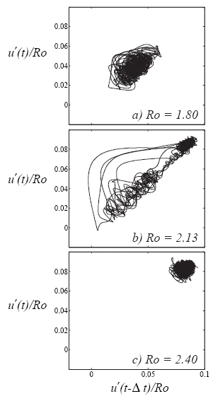
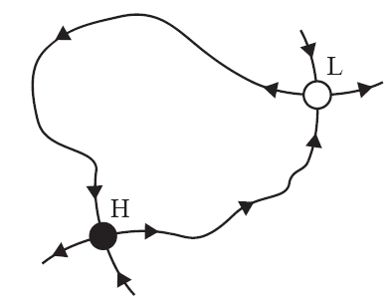
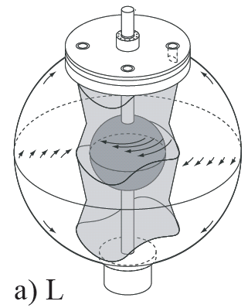
Zimmerman et al.
Physics of Fluids 2011

Slide 40
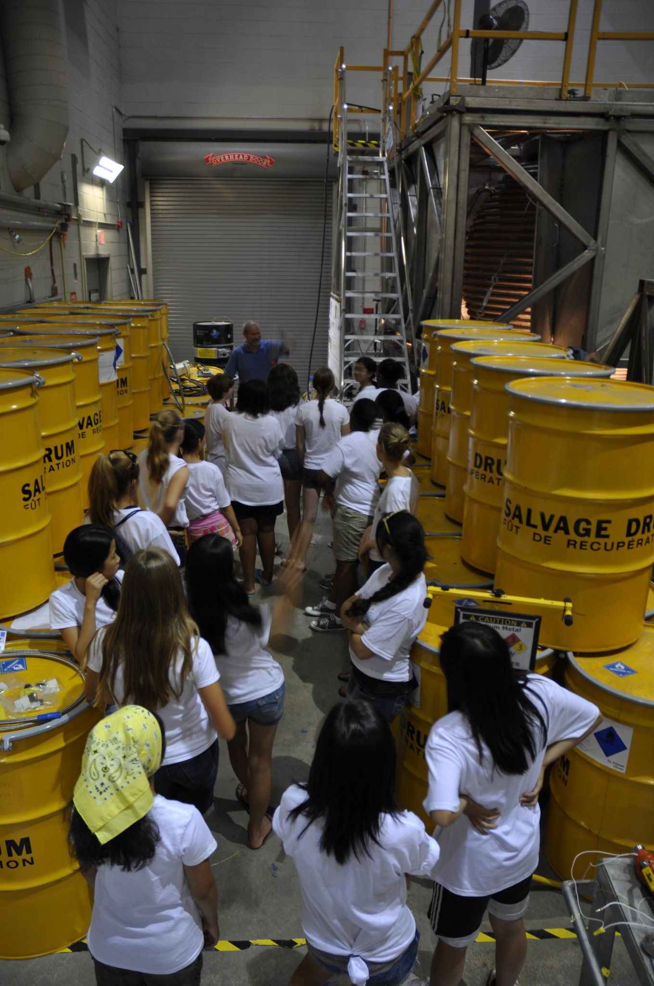
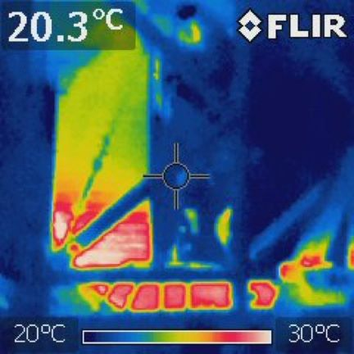

Slide 41
3m status:
Two years of water experiments: bi-stable turbulence
(Physics of Fluids) and Precession (J. Geophys. Res.)
Six months of sodium experiments -- half speed to date
– 12+ non-dynamo states (Ωo, Ωi, Bo)

Slide 42
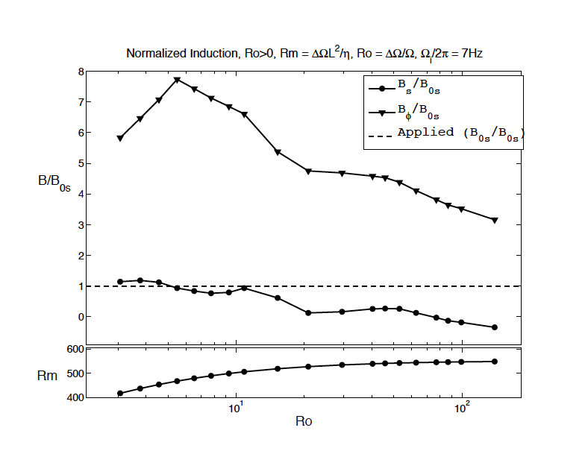

Slide 43
Next steps for 3m:
1) Rough inner sphere (requires draining)
2) Convection phase of project: cooled inner sphere
Next steps for lab:
1) Liquid sodium precession experiment Rm= 350 (Dresden is constructing cyl. experiment)
Na

