Slide 1
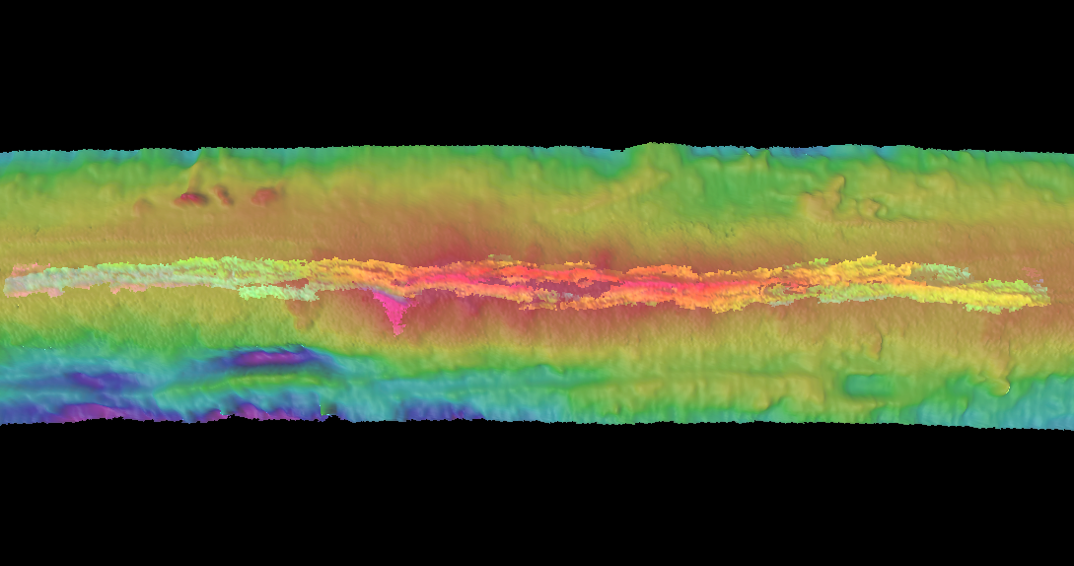
Seismic imaging of the recently erupting East Pacific Rise 9°50’N: insights into the architecture of mid-ocean ridge magmatic systems and eruption dynamics
Suzanne Carbotte¹, Milena Marjanovic¹, Shuoshuo Han¹, Pablo Canales², Helene Carton¹, John Mutter¹, Mladen Nedimovic¹, Omid Aghei³, Min Xu², Bridgit Boulahanis¹, ¹LDEO, ²WHOI, Dalhousie³.

Slide 2
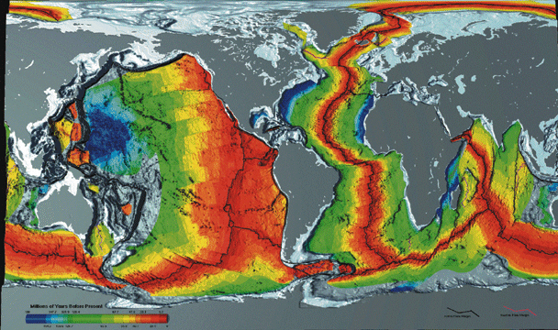
Mid Ocean Ridge and ocean floor age

Slide 3
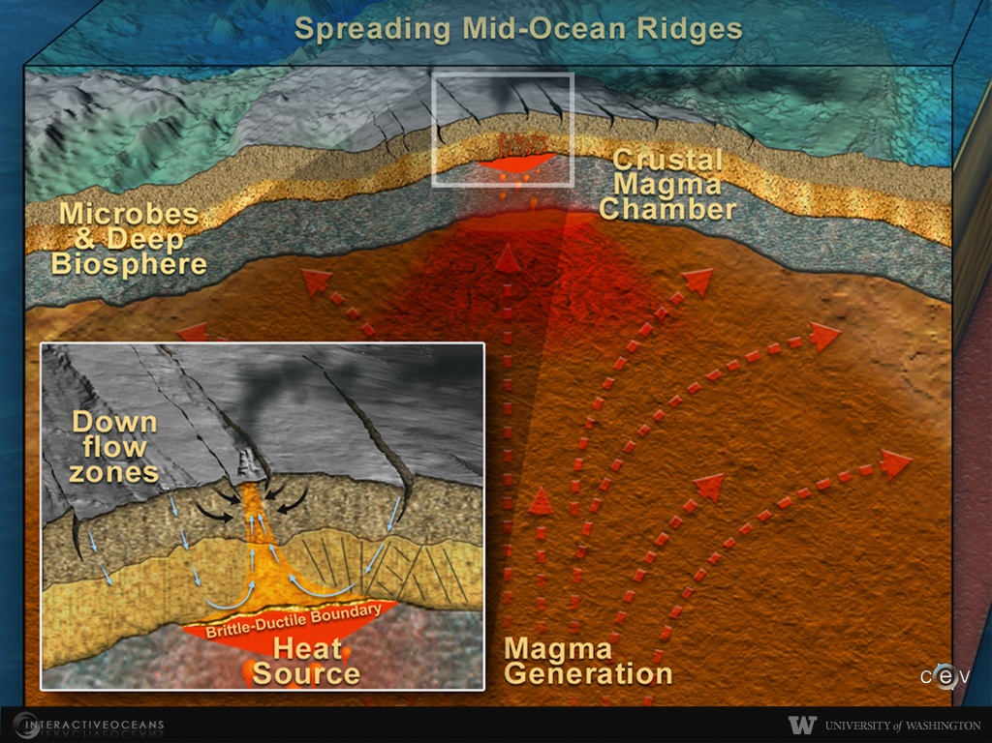
Center for Environmental Visualization, University of Washington

Slide 4
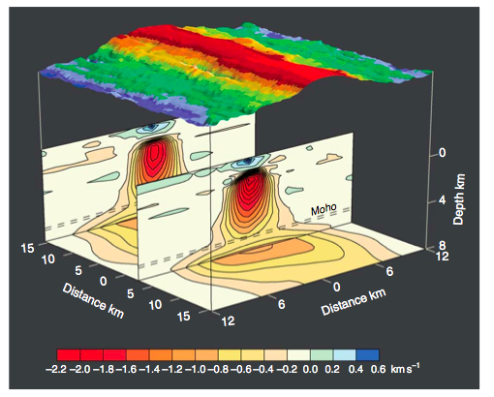
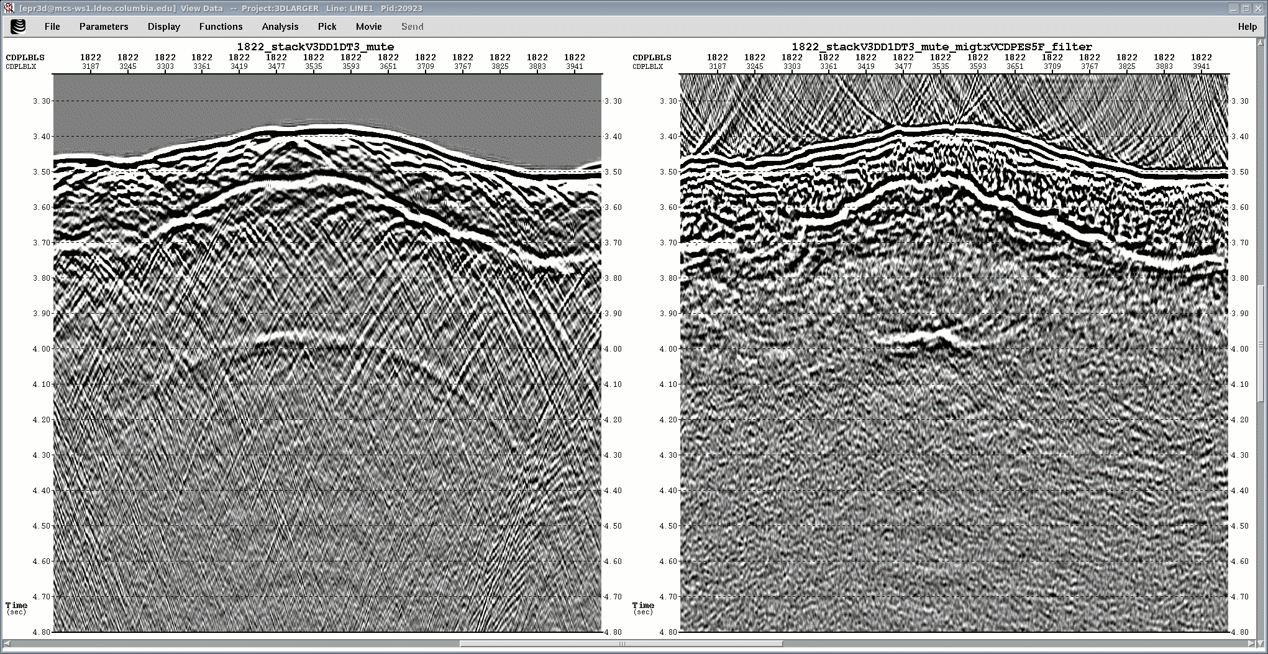
Crustal magma chambers at fast spreading EPR
Seafloor
Dunn et al., 2000
Axial Magma Lens (AML)
AML
1 km

Slide 5
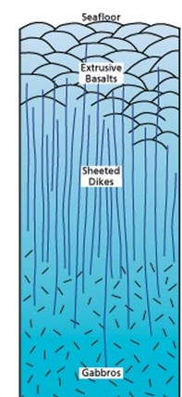
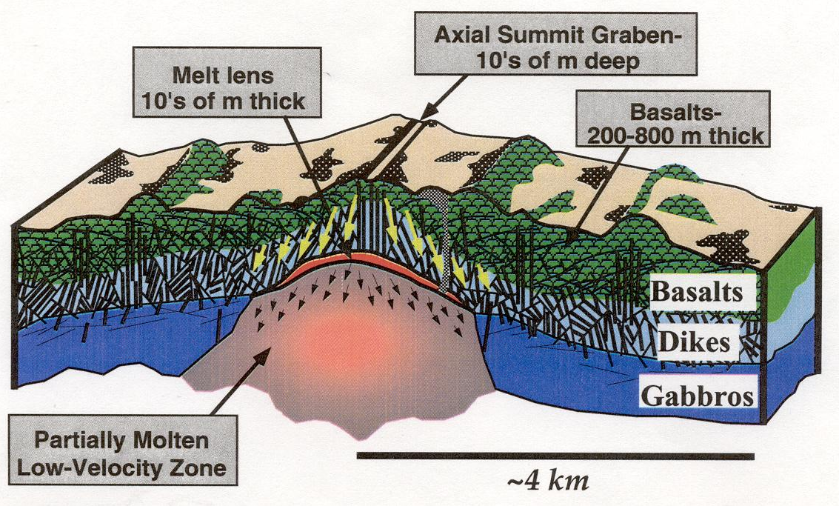
Formation of the Upper Crust: Seismic Studies
Karson et al., 2002

Slide 6
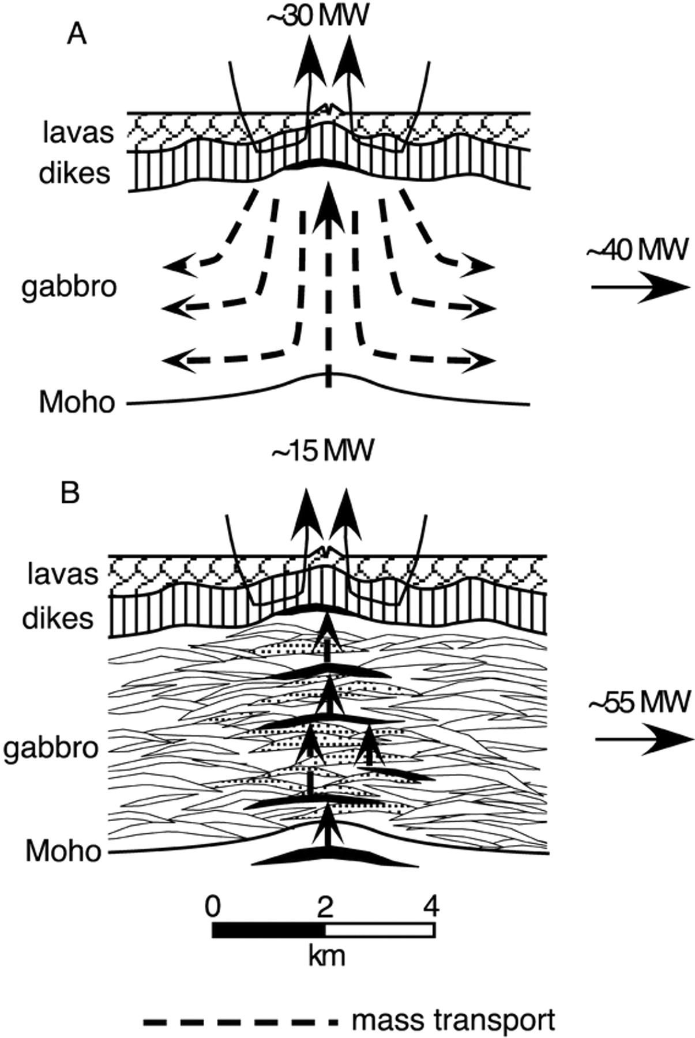
Formation of the lower crust
Gabbro glacier
Sheeted sills
Phipps Morgan and Chen 1993; Henstock et al., 1993
Kelemen et al., 1995
Seismic Observations
Ophiolite Observations

Slide 7
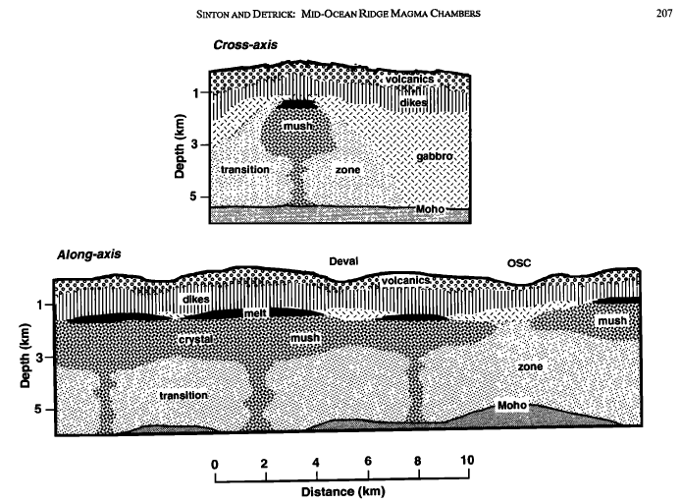
MOR magmatic system from seismic structure
Fast Spreading
AML elongate melt body in upper crust
Upper crust formed from the AML
Melt below the AML distributed in a crystal mush zone
Mantle melt reservoir at base of crust
Magmatic system quasi-steady state at fast spreading MOR
Sinton and Detrick, 1992

Slide 8
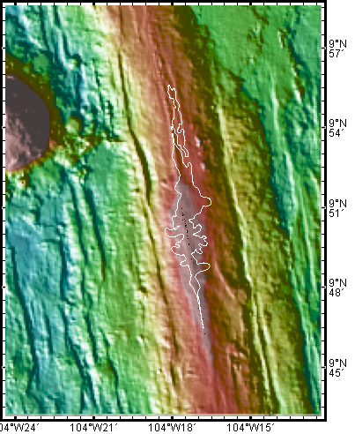
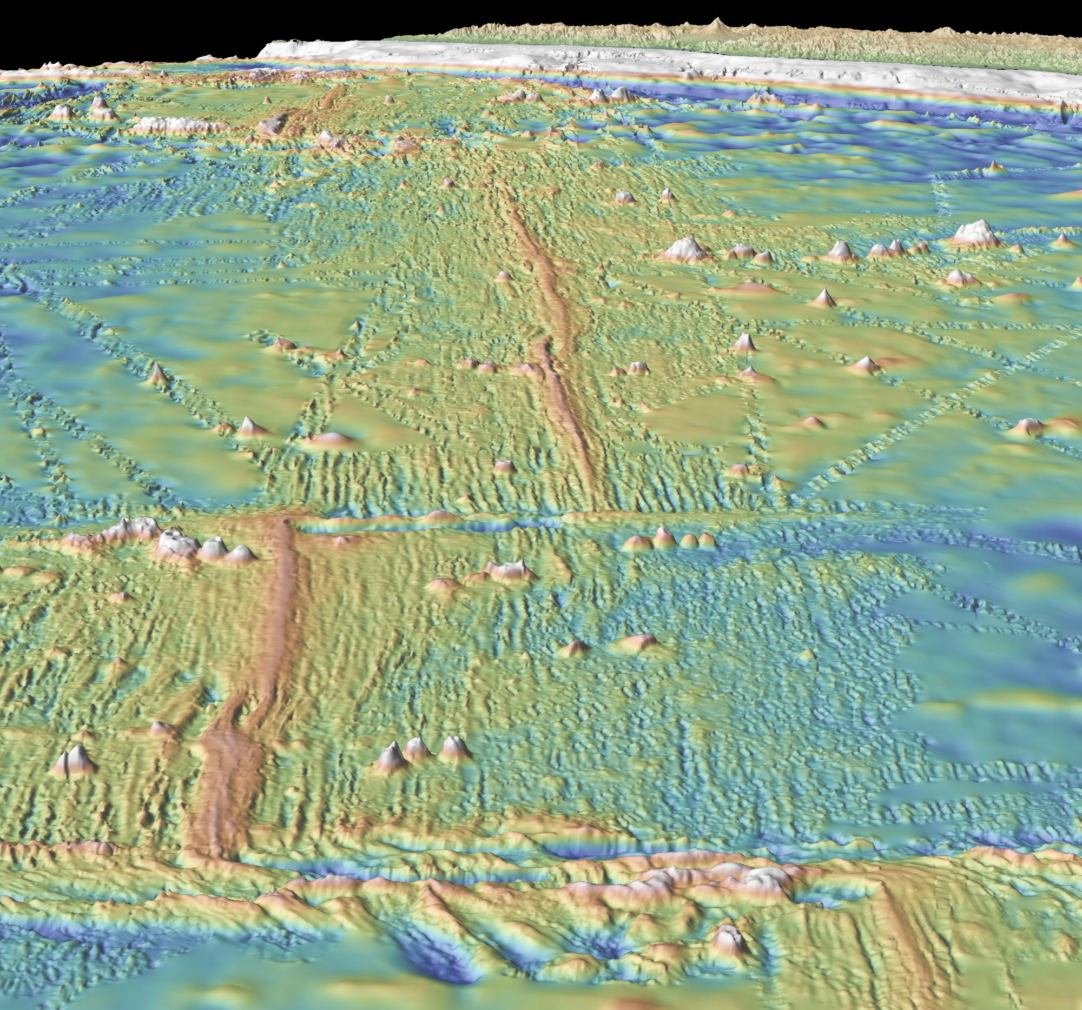
East Pacific Rise 9°50’N – R2K site
1991
2005/06
2 of 12 detected MOR eruptions

Slide 9
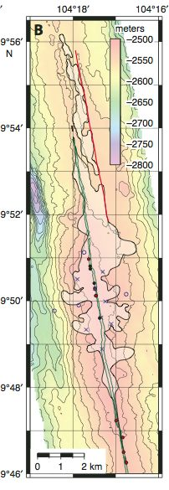
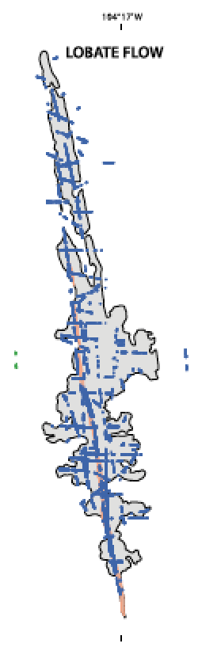
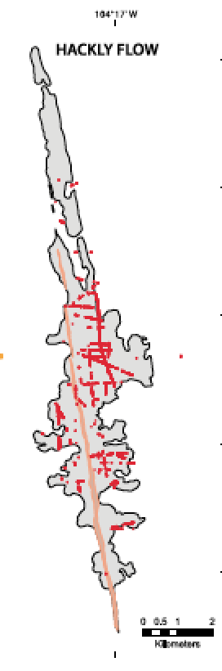
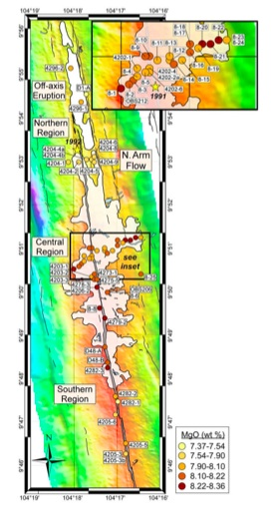
Flow Mapping
Flow Morphology
Lava Chemistry
Soule et al., 2007
Fundis et al. 2010
Goss et al., 2010

Slide 10
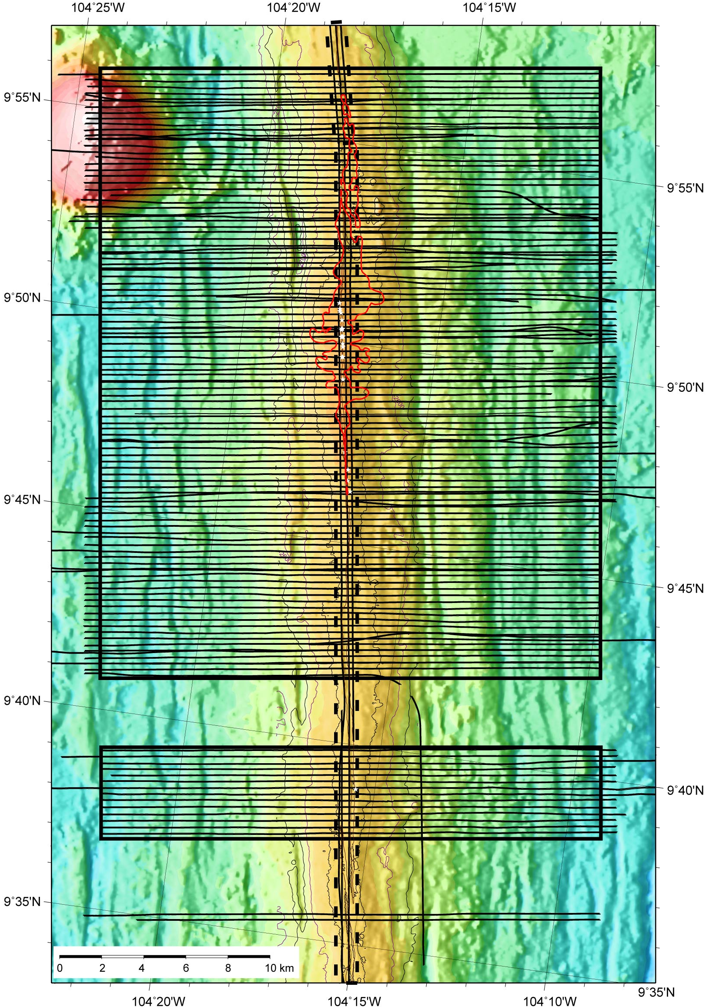
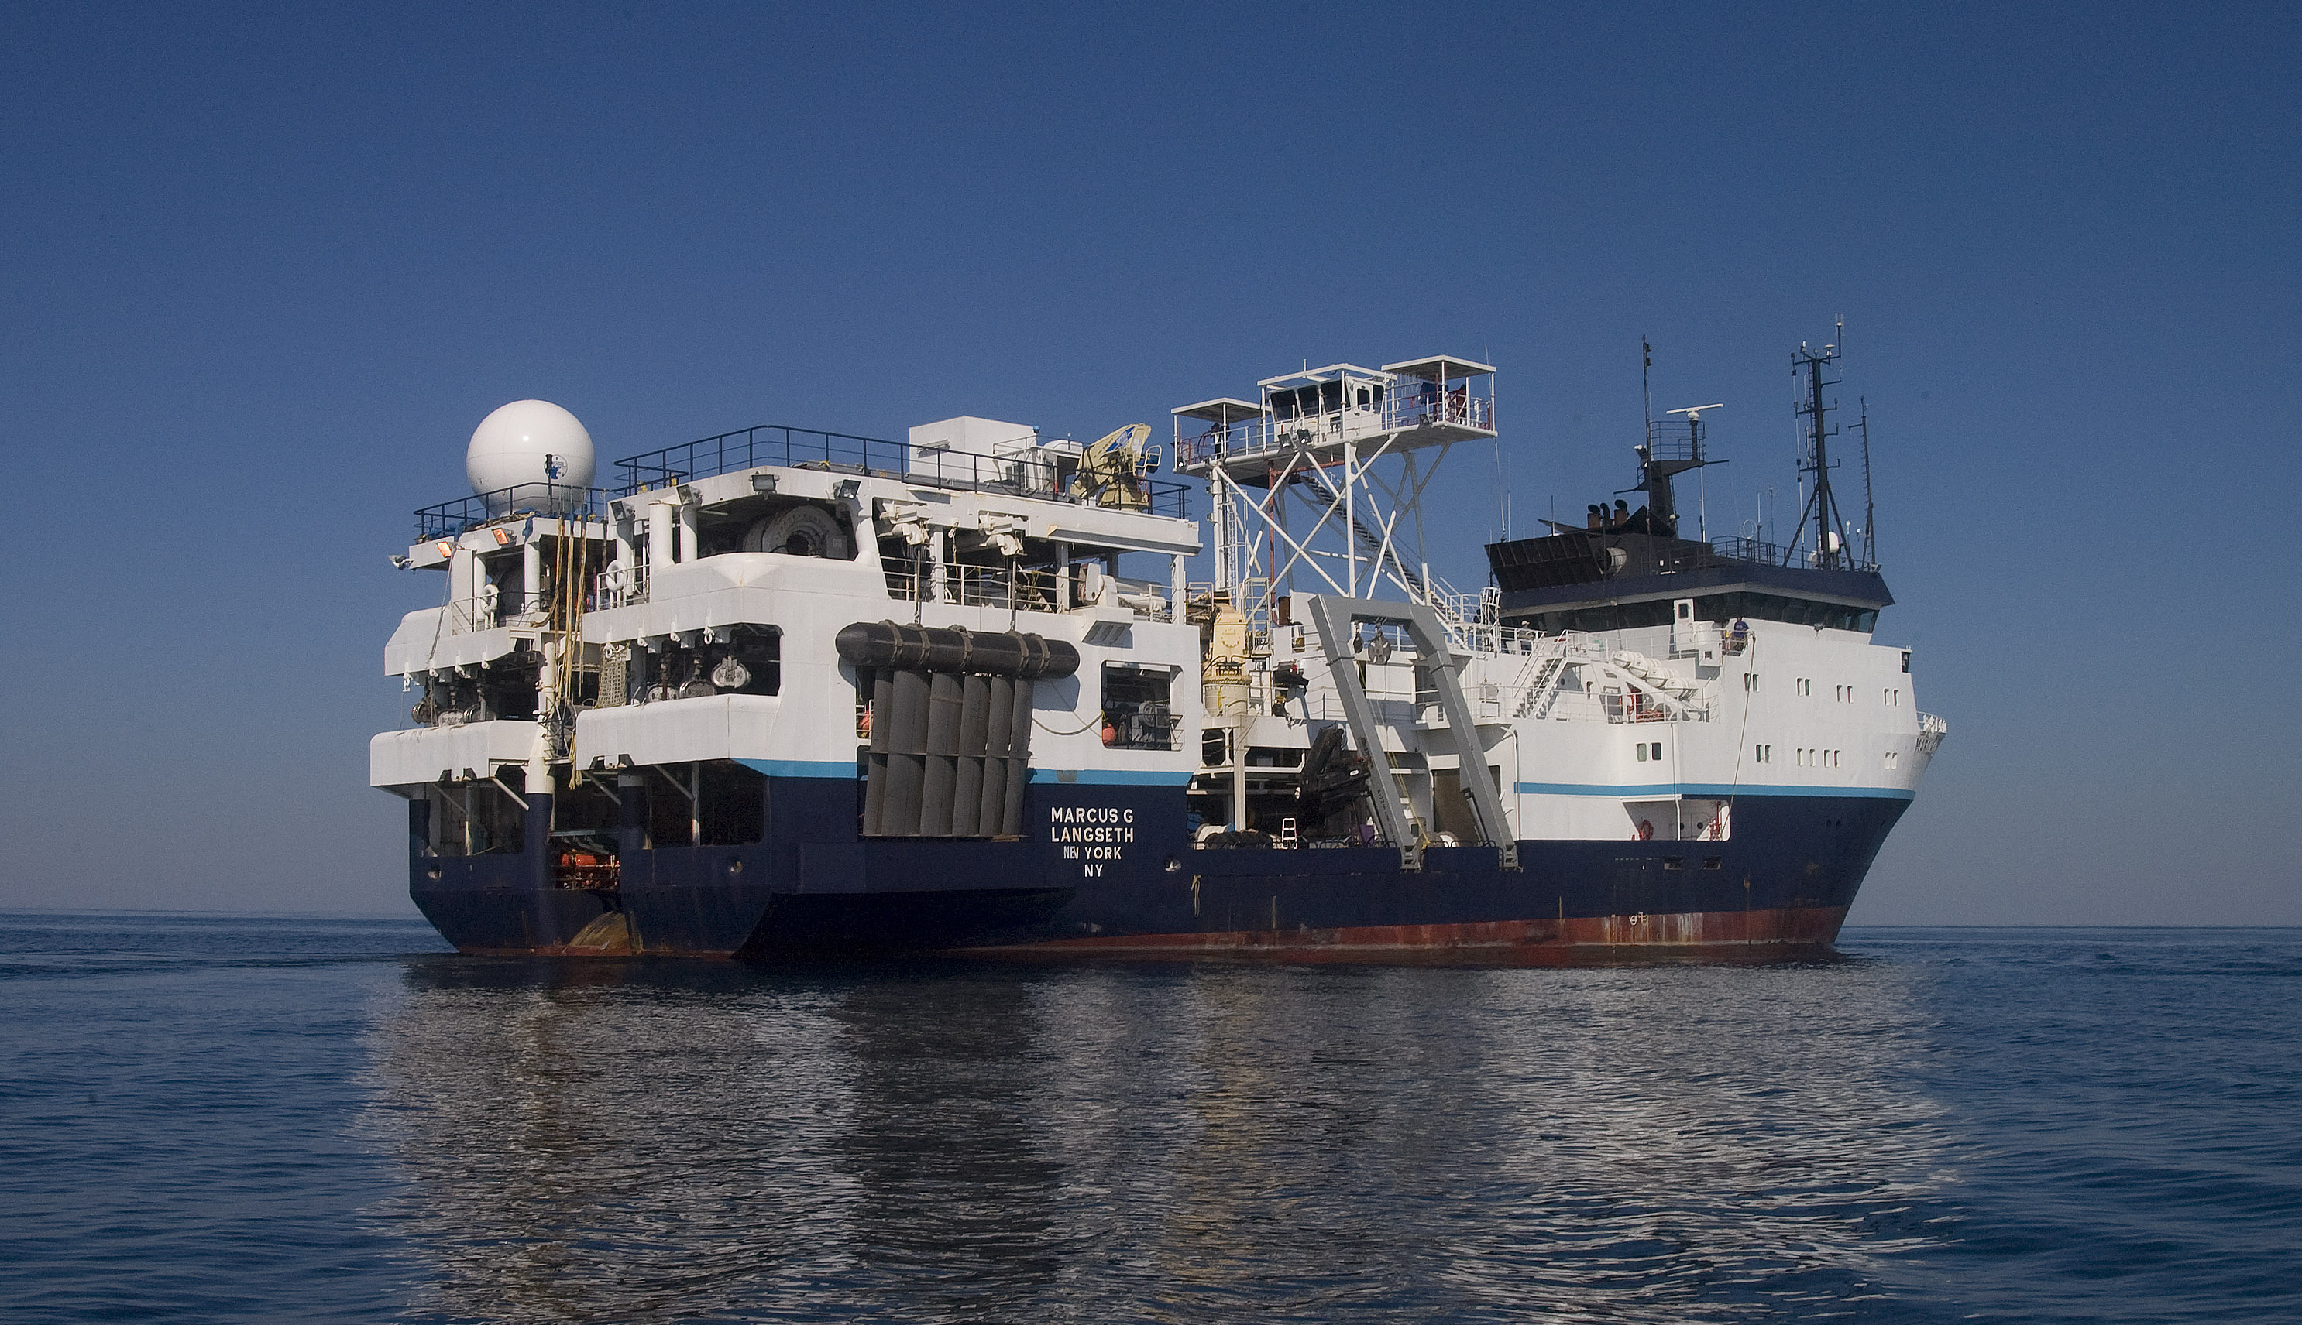
2008 3D Multi-channel seismic study
2005-06 eruption
Image magma reservoir beneath eruption zone at same resolution and scales as seafloor structures
Baseline image for future 4D study

Slide 11
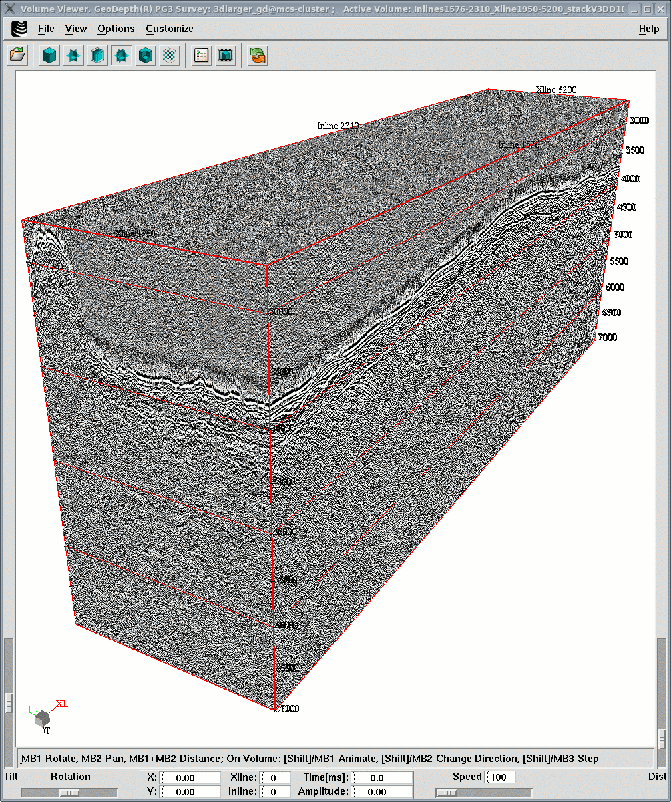
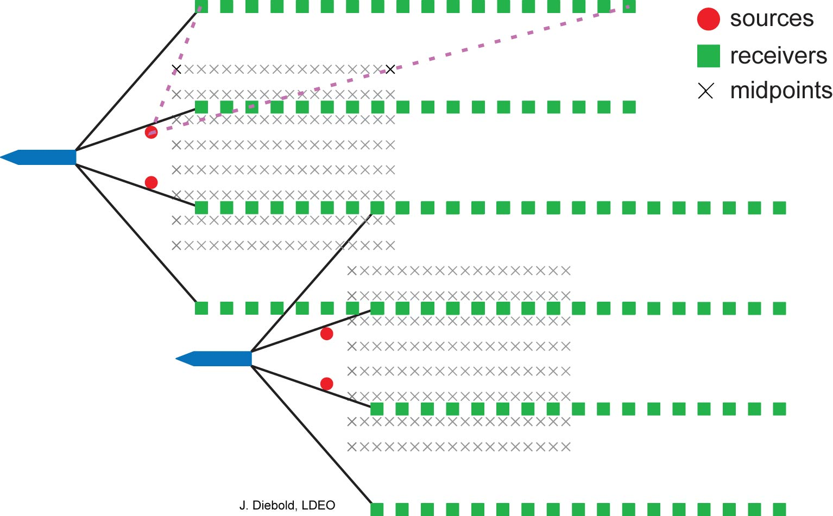
CMP Bins
37.5m
37.5 m
111 sail lines
1 sail line = 8 CMP lines

Slide 12
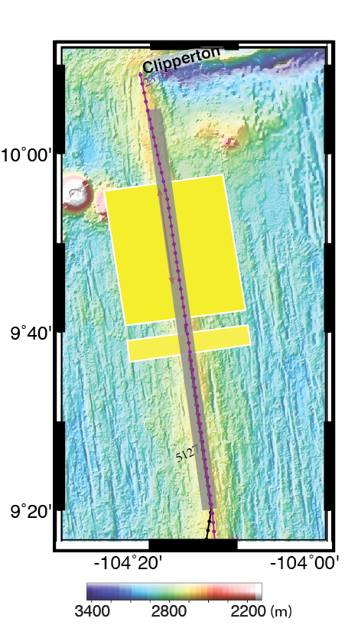
Along axis and cross axis 3D volumes

Slide 13
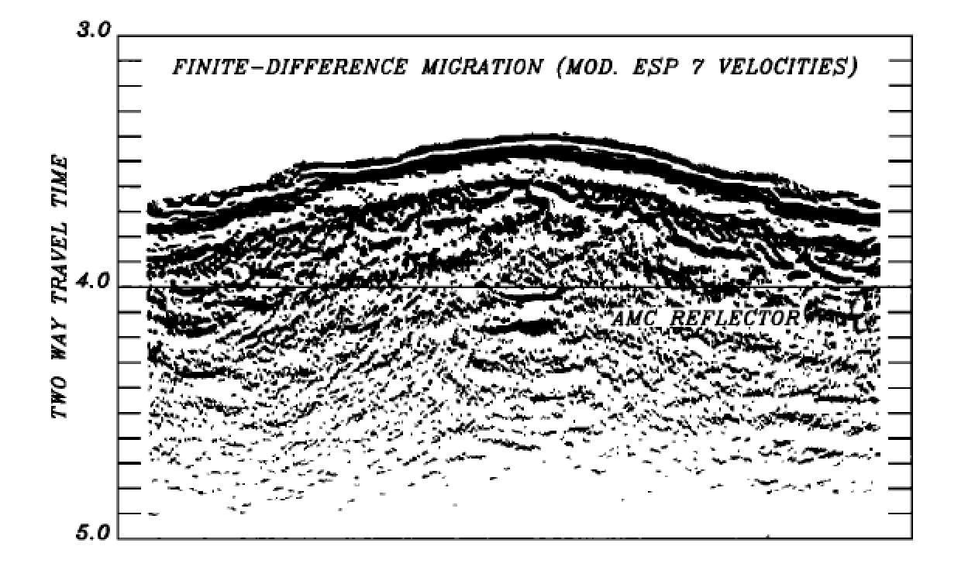
High resolution: long streamer, high data density, 3D processing
1986
1986
AML
2008

Slide 14
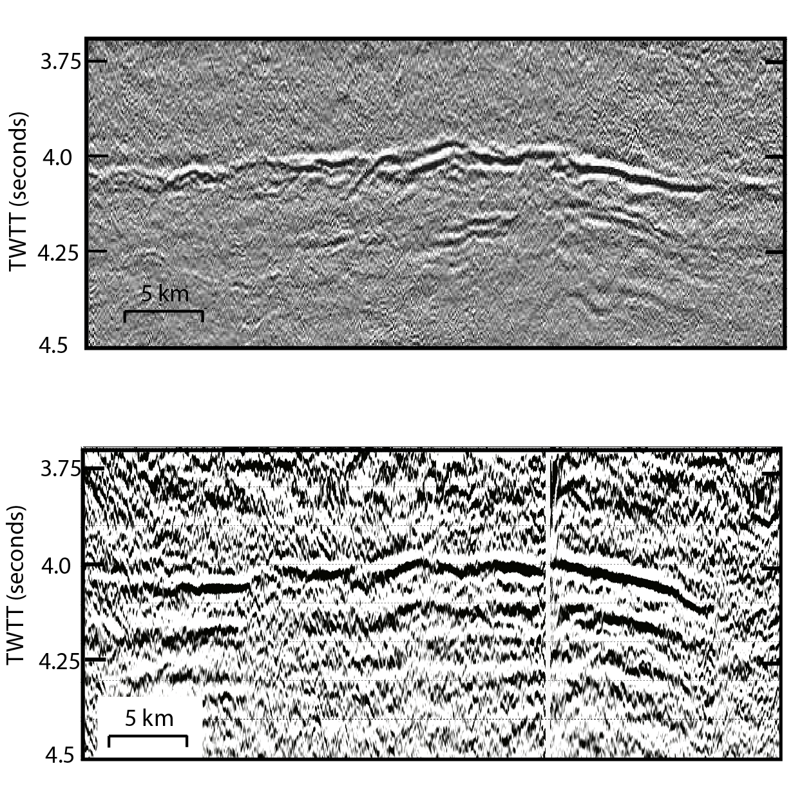
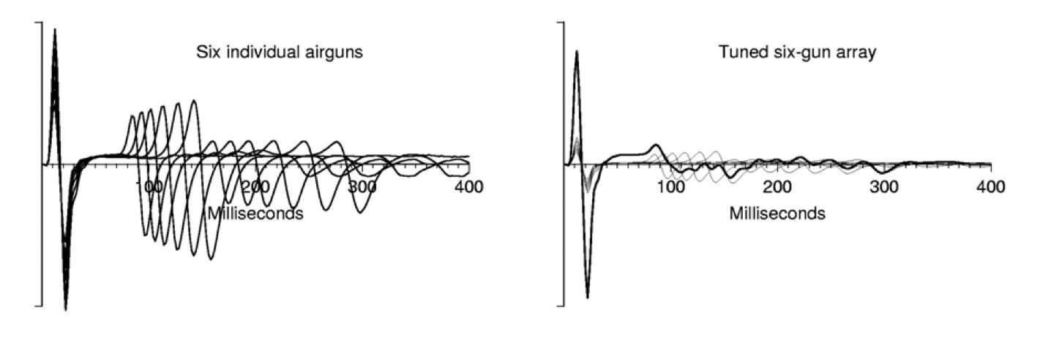
As well as broadband tuned source
Langseth-2008
AML
1985
Deeper Magma lenses
Conrad-1986
AML
Untuned Source
Source Ringing

Slide 15
Outline
1. AML is a finely segmented melt reservoir – multiple sills contributed to recent eruption
2. Melts sills imaged beneath the AML – mid-lower crust sills &contribution to eruption
3. Sub-AML characteristics and origin of fine-scale segmentation
4. Spatial variations in crustal thickness and implications regarding glacial loading

Slide 16
Outline
1. AML is a finely segmented melt reservoir – multiple sills contributed to recent eruption
2. Melts sills imaged beneath the AML and recent eruption
3. Sub-AML characteristics and origin of fine-scale segmentation
4. Spatial variations in crustal thickness and implications regarding glacial loading
Discovery of off-axis crustal magma bodies – crustal accretion not as narrowly focused as previously assumed
AML melt content is highly variable- main eruption site drained

Slide 17
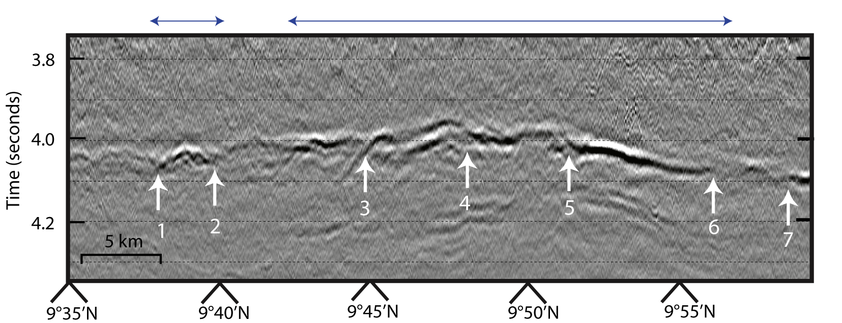
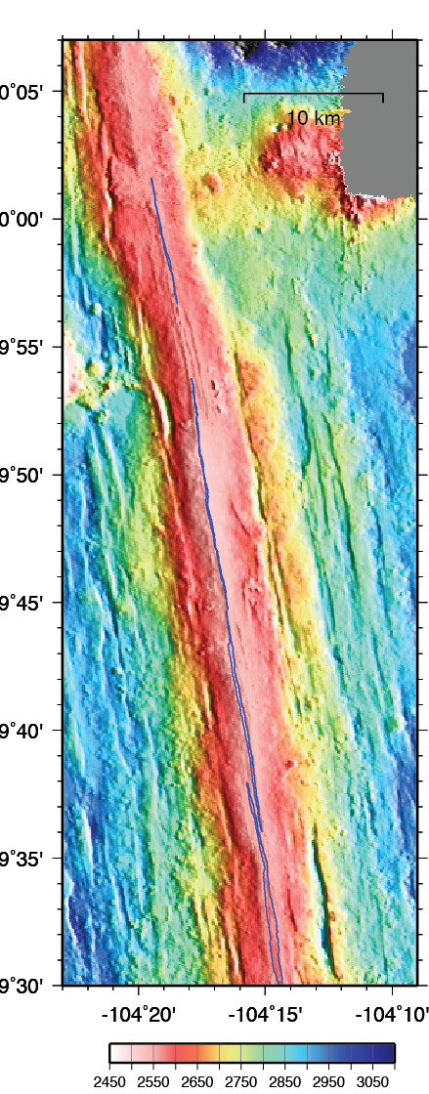
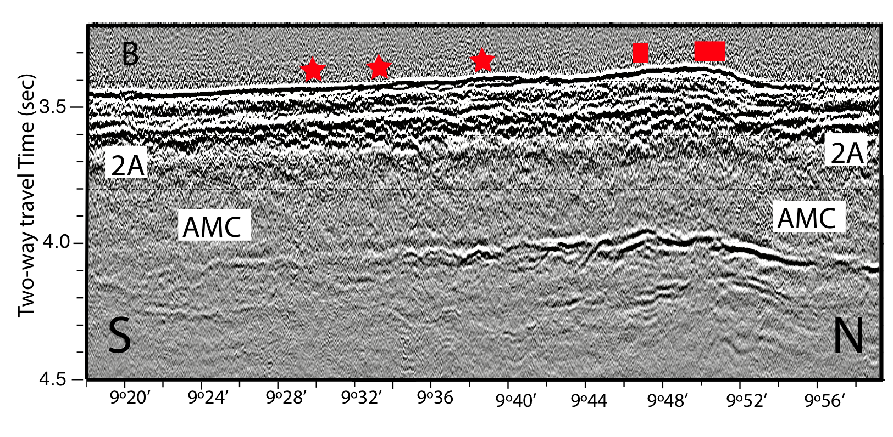
1. Segmented magma lens
3D volume
discontinuities
Notes:
17

Slide 18
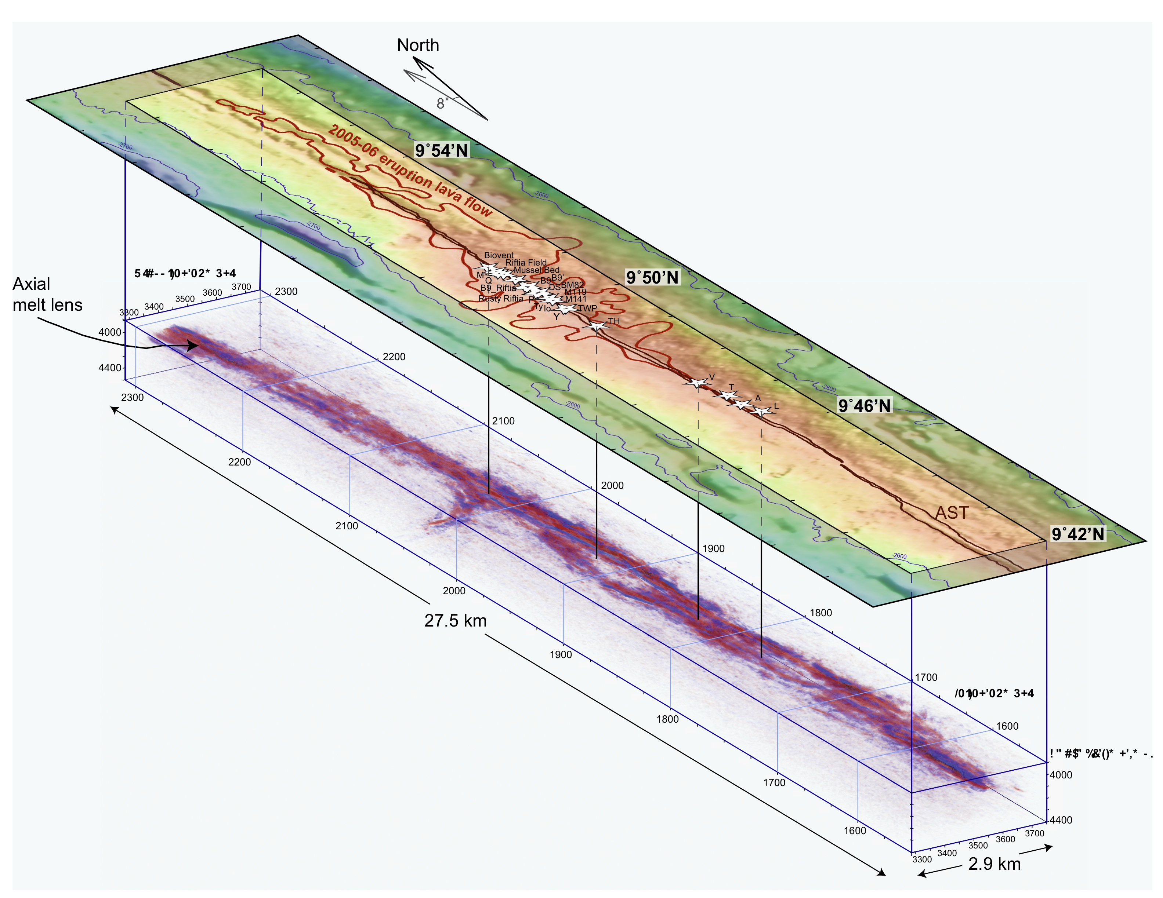
AML Discontinuity
AML Discontinuity Zone
AML Discontinuity Zone
Carton et al, (2010)

Slide 19
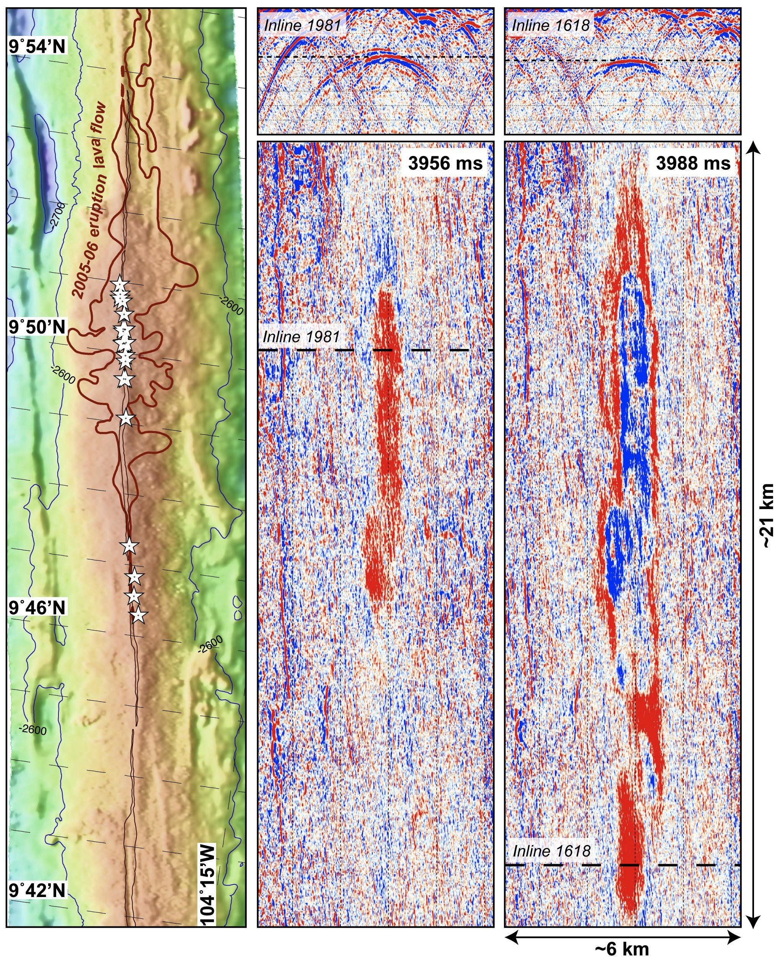
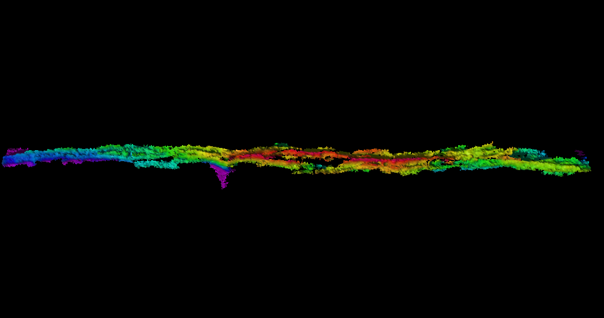

Slide 20
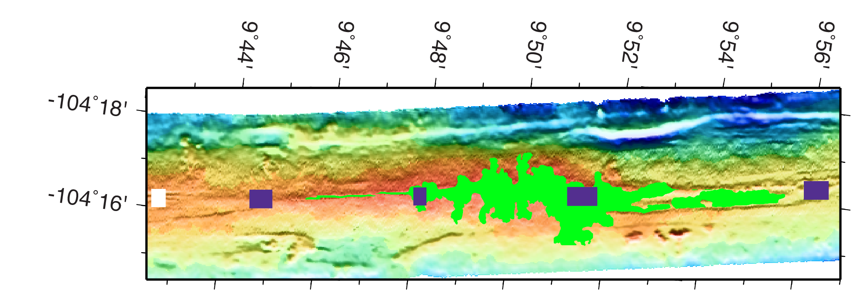
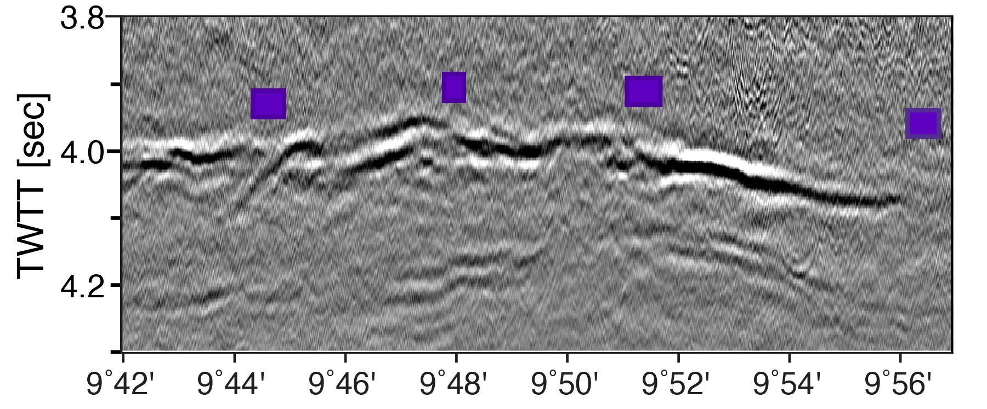
Soule et al., 2007
South
Central
North
3 Magma Sills Underlie Eruption Zone
South
Central
North
Carbotte et al., 2013

Slide 21
2005/06 Eruption
Spatial variations in eruption flow morphology
Primary eruption site ~ 9°50’-51’N
Soule et al 2007
Fundis et al. 2010

Slide 22
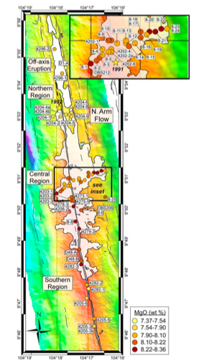
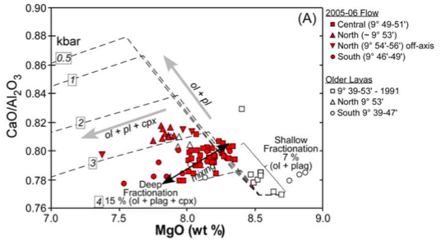
Lava Chemistry
Goss et al., 2010
North, central and southern group lavas identified.
Central lavas most primitive
North lavas – distinct parental melt

Slide 23
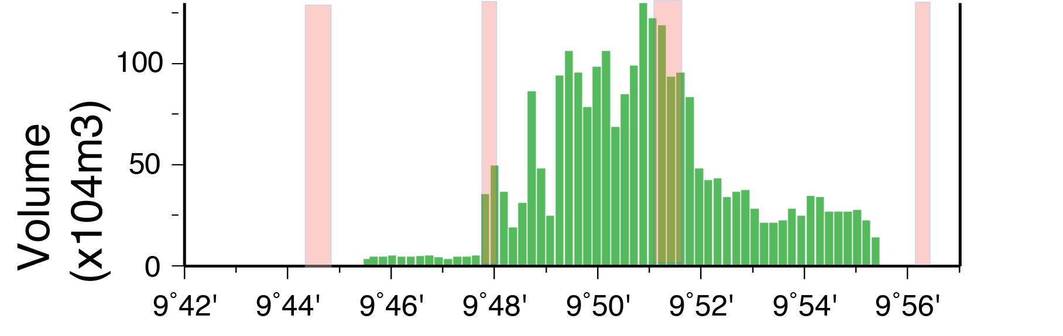
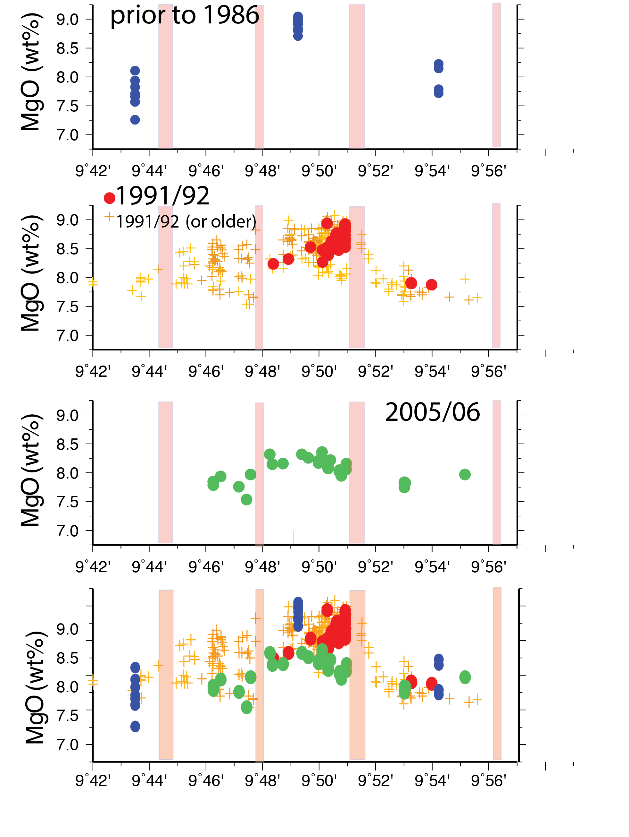
South
Central
North
Transitions in flow morphology, and chemistry coincident with magma lens segmentation
South
Central
North

Slide 24
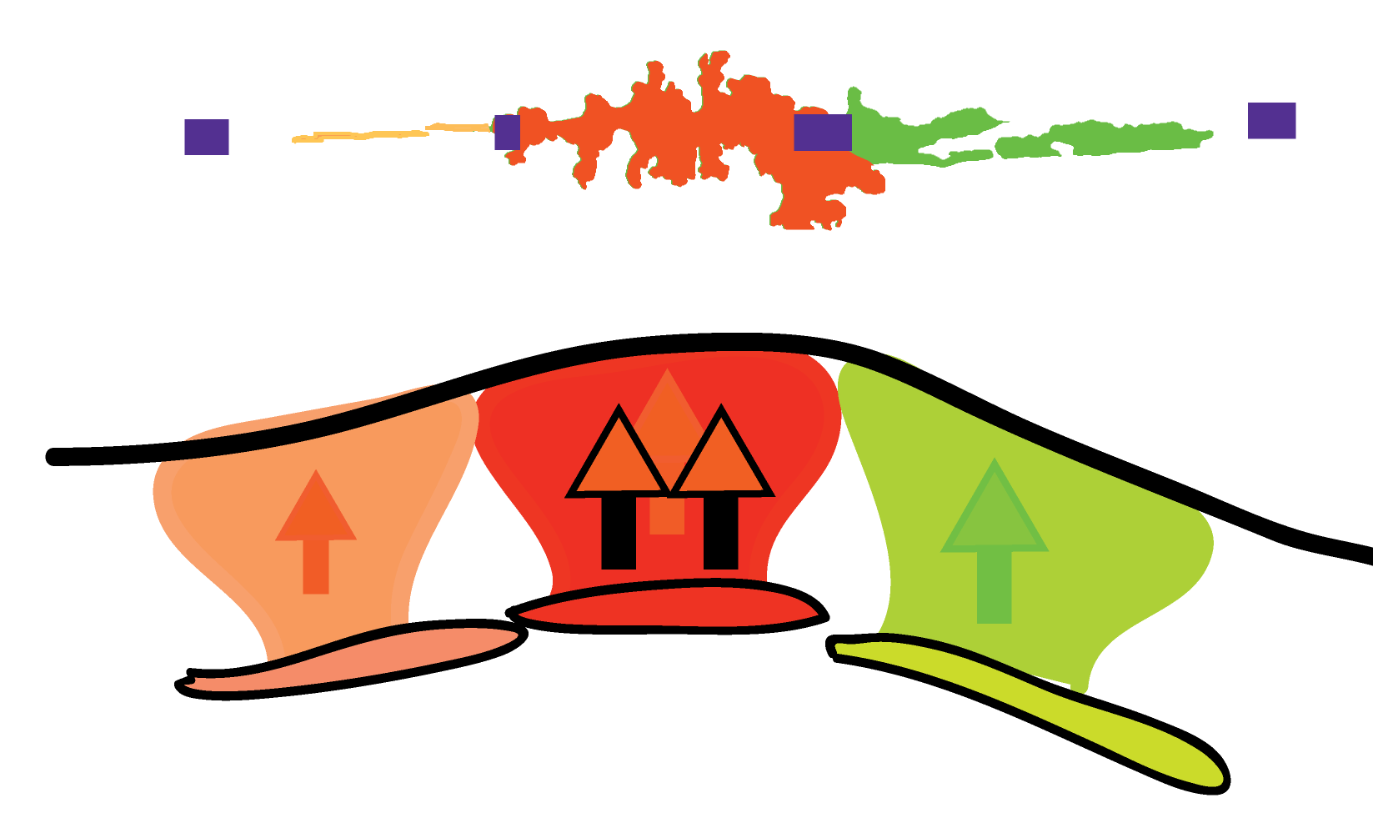
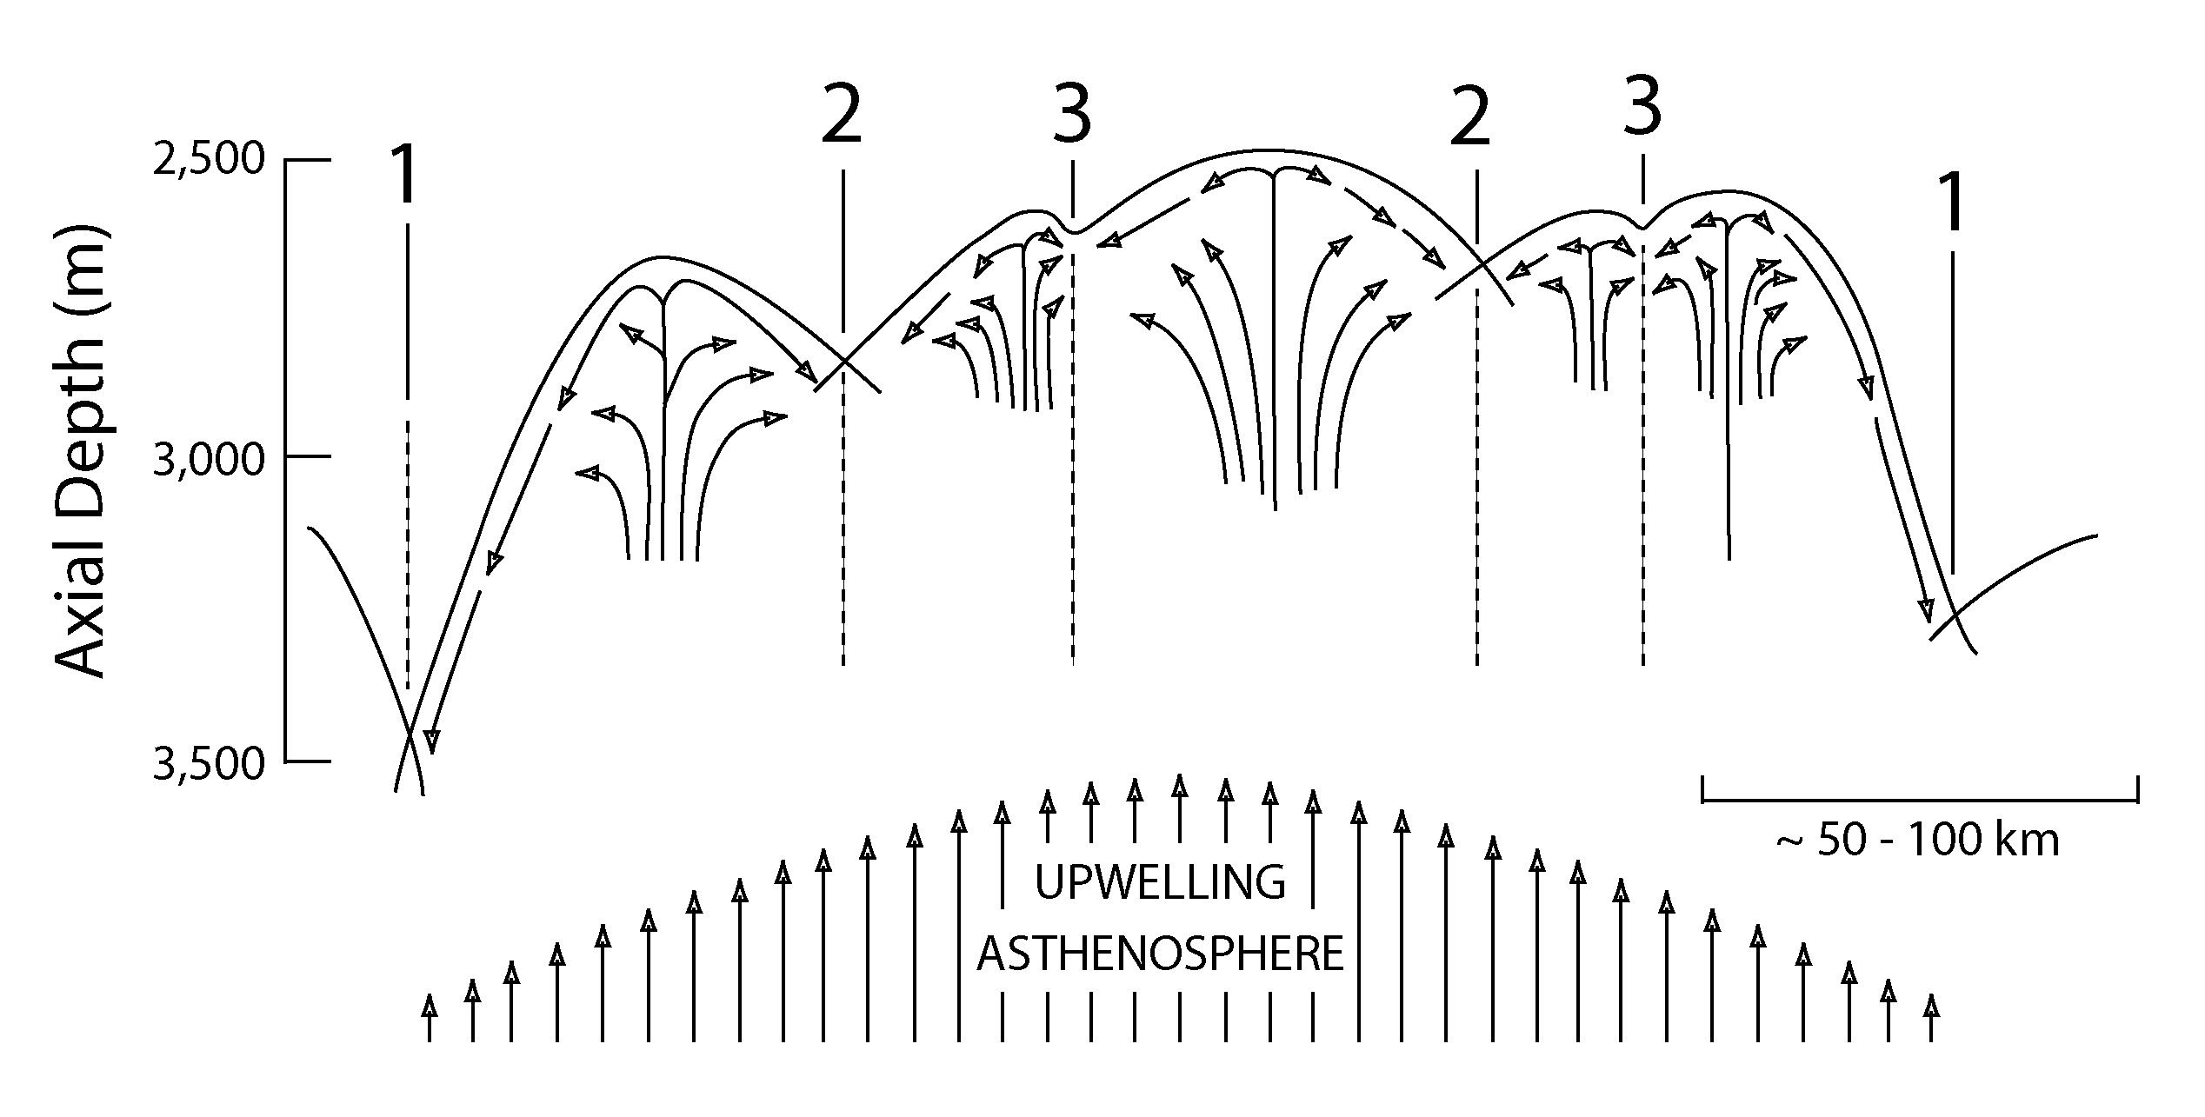
Diversity in erupted lavas reflects segmentation of magma source reservoir
Vertical not Lateral Magma Transport During Dike intrusion
Macdonald et al., 1988

Slide 25
Geochemical segmentation persists through eruptions
  Sills/lenses are chemically isolated
  Eruptions did not reconfigure lens segmentation
Goss et al., 2010; Perfit et al., 2012

Slide 26
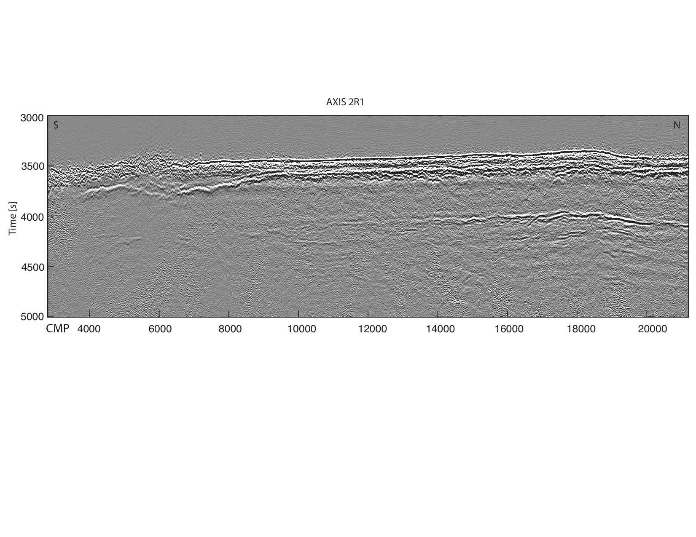
2. Melt sills beneath the AML
AML
?
?
SAML
Marjanovic et al (2014)
Internal multiples within 2A, 2B
P to S conversions from AML
Side scattered energy from seafloor or internal structures

Slide 27
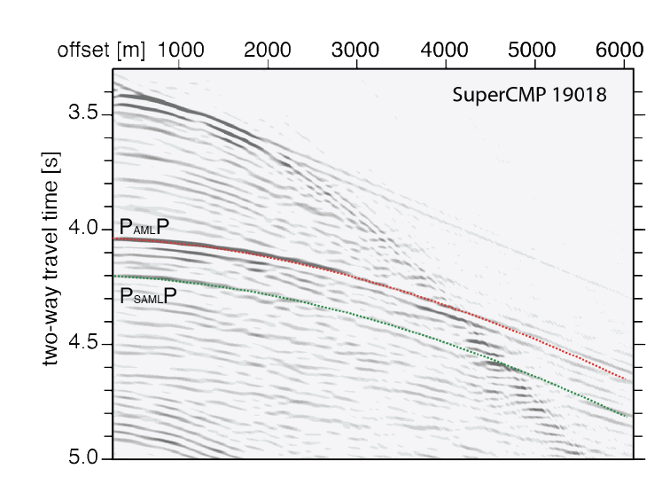
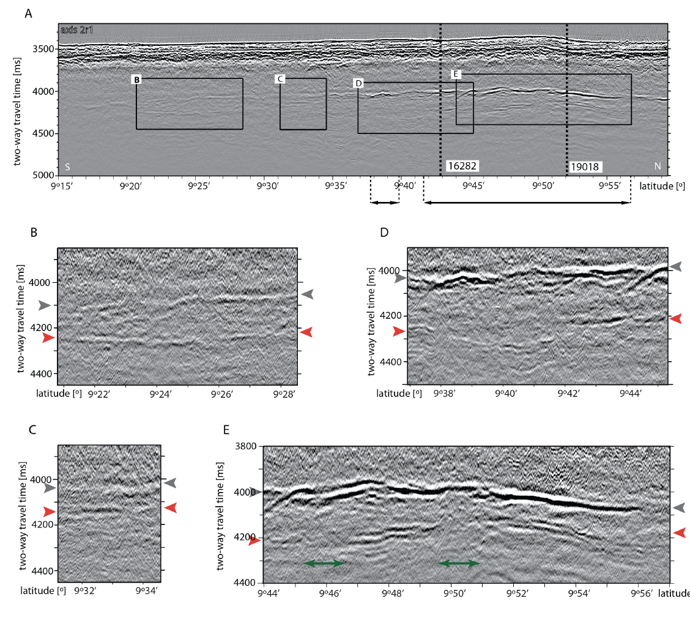
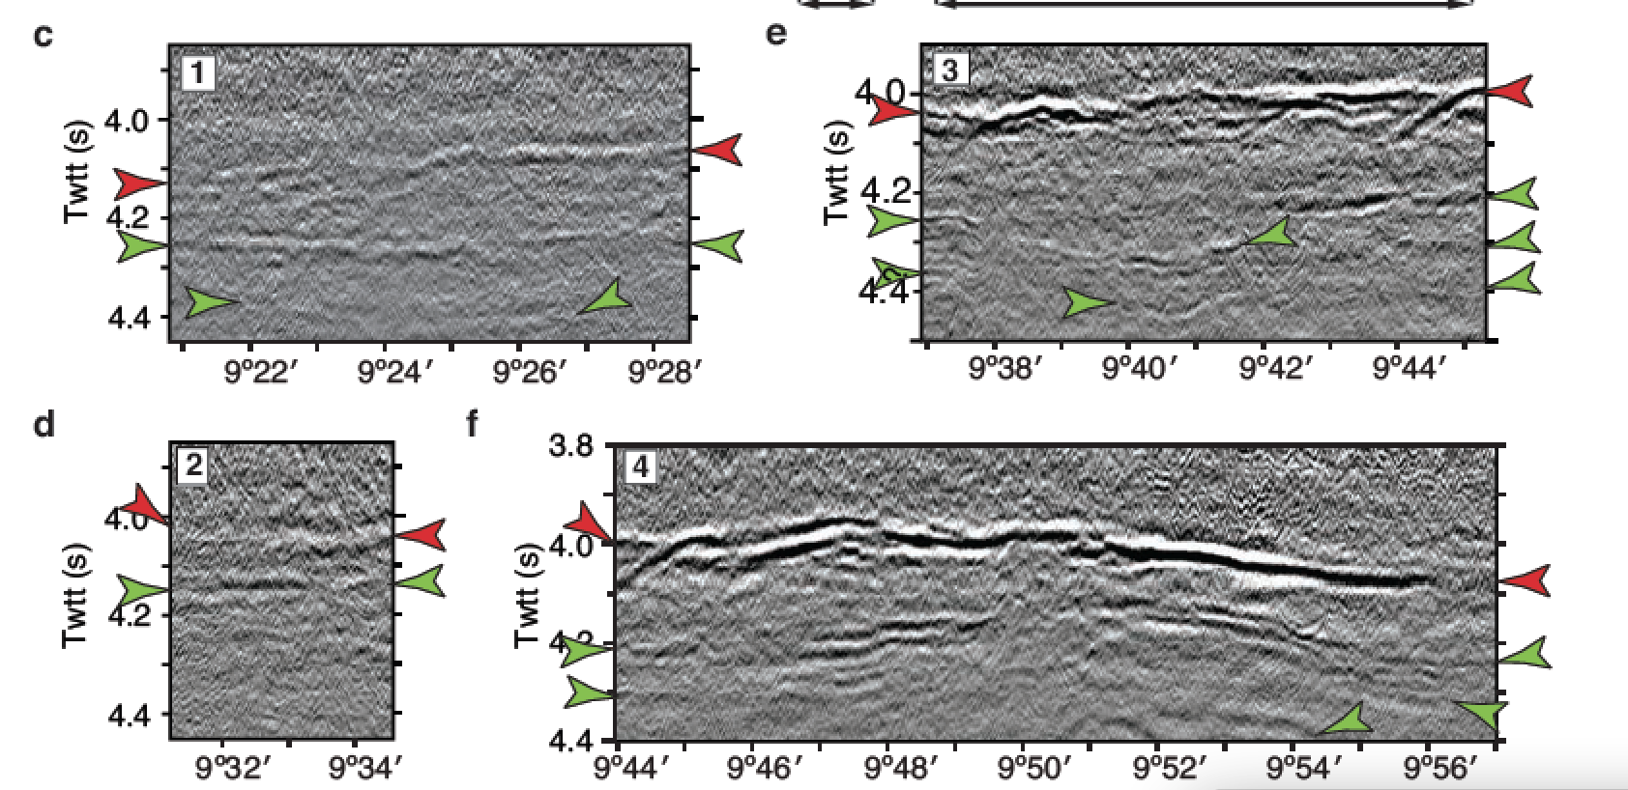
AML
SAML
AML
SAML

Slide 28
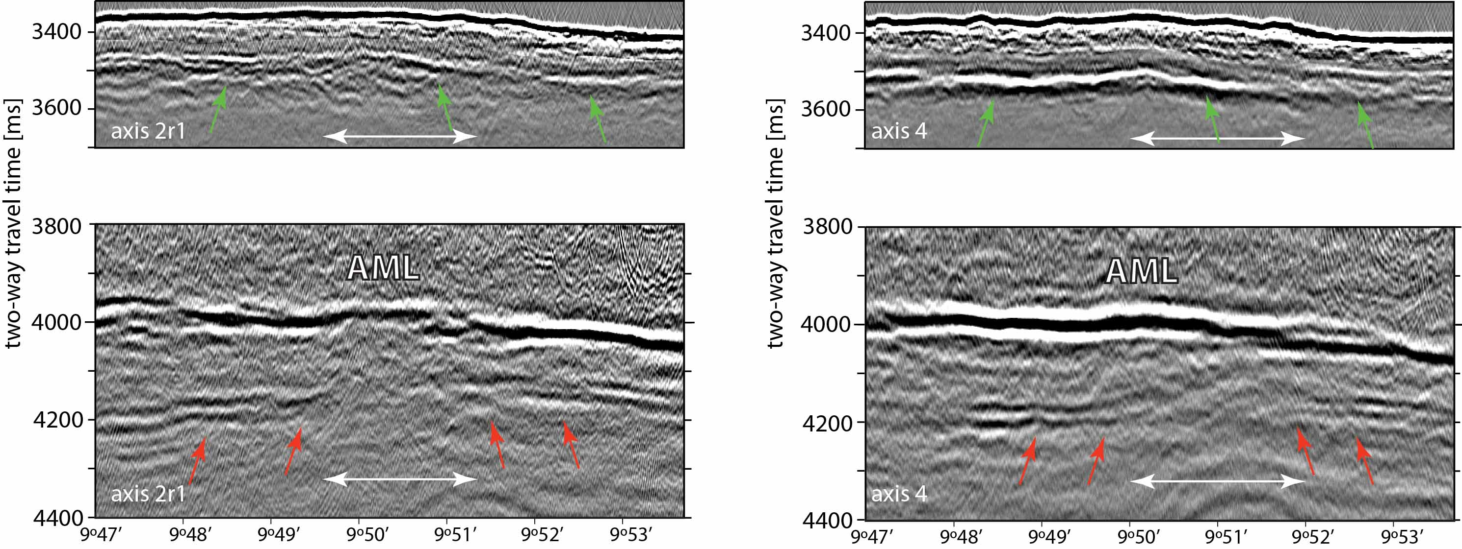
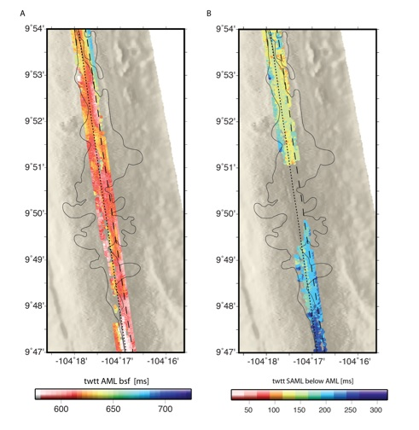
Along-axis swath 3D data
axis2r1
Twtt (msec)
axis4
Twtt (msec)
axis4
axis2r1
SAML
Marjanovic et al (2014)

Slide 29
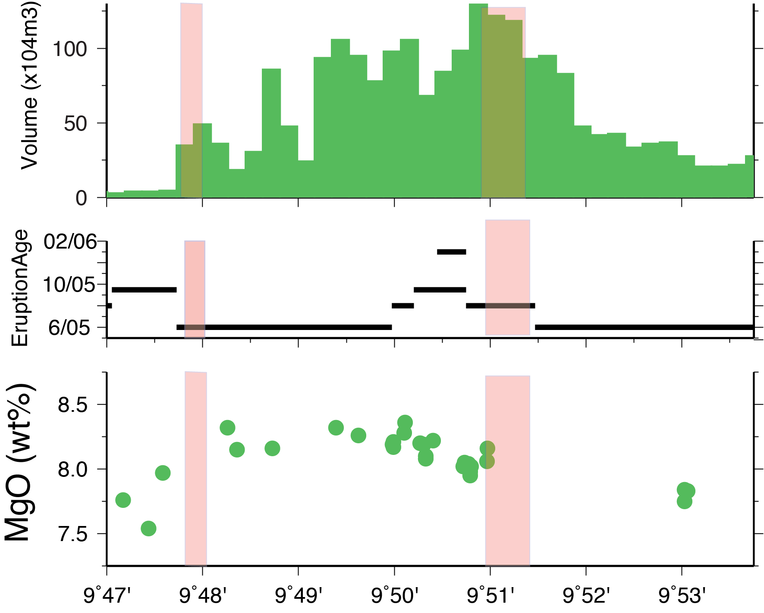
Flow
Volume
X10$ m3
2005/06
SAML drained during 2005/06 eruption?
MgO (WT%)
TWTT (msec)
Central
North

Slide 30
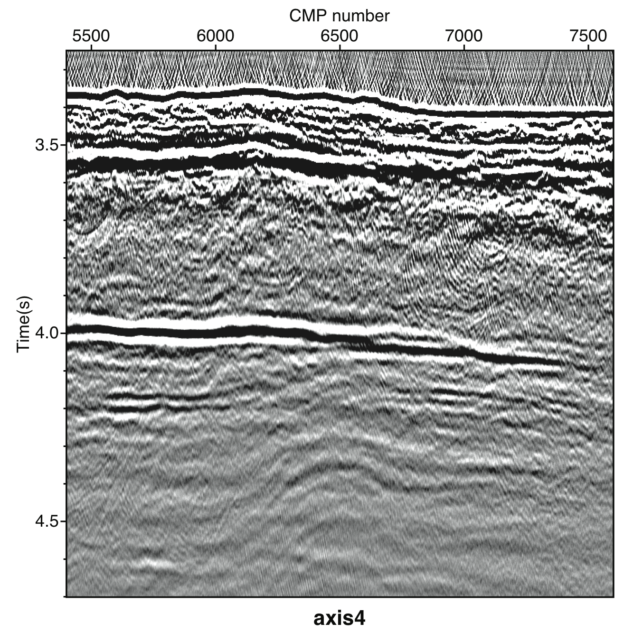
Velocity pull-up due to higher velocities (lower melt %) in crust above.
SAML
axis4

Slide 31
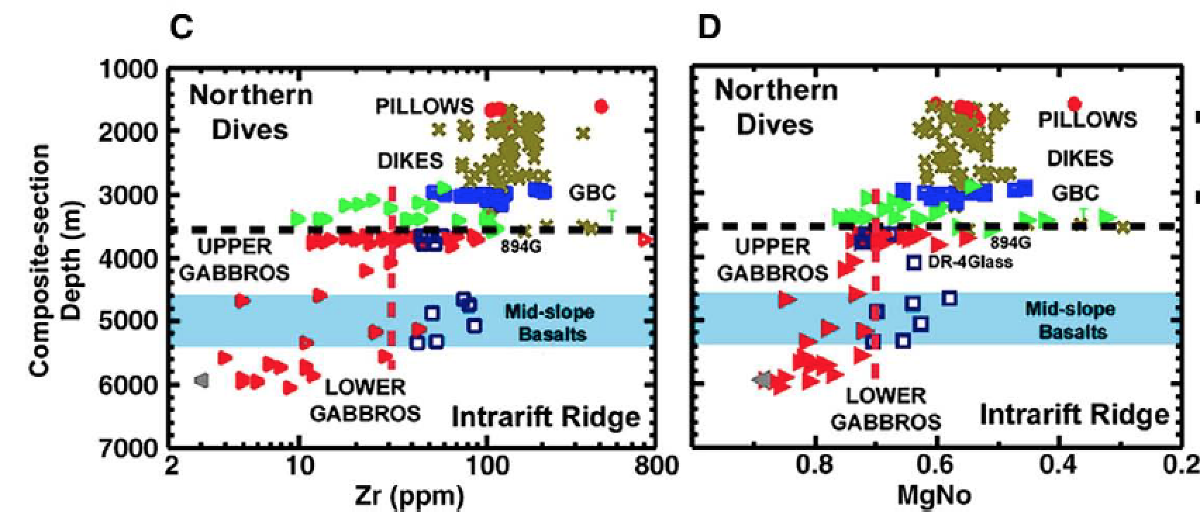
Geochemical/petrologic observations
AML
Natland and Dick, 2009
AML level gabbros are too differentiated to be primary source reservoir for dikes and lavas

Slide 32
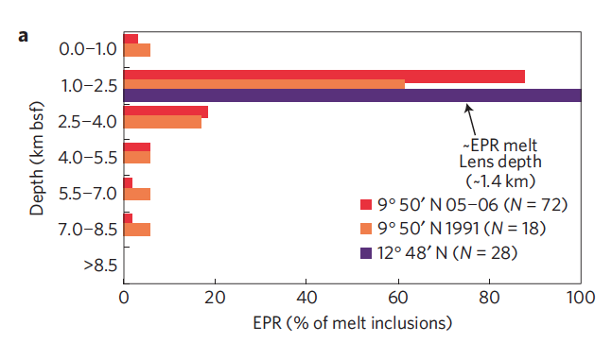
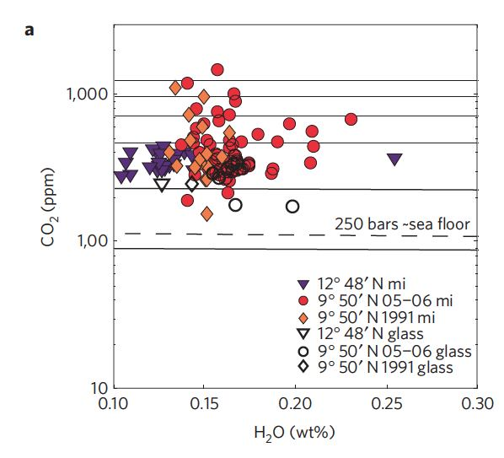
Crystallization pressures from olivine melt inclusions
Wanless and Shaw (2012)
For 2005/06 eruption - 25% of crystallization occurs deeper than the AML

Slide 33
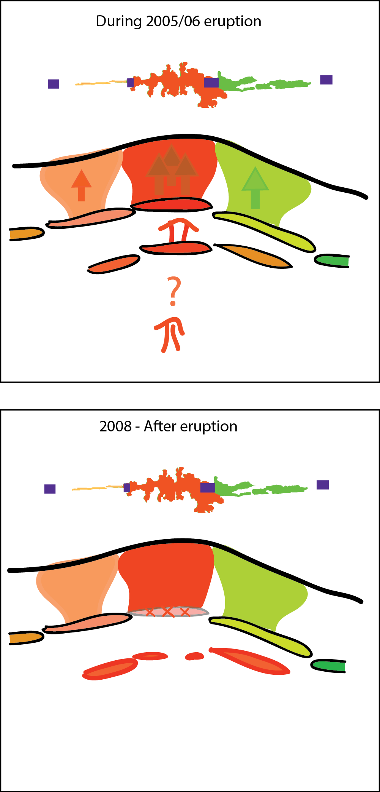
  Melts from multiple levels in the crust contributed to the eruption
  Sub-lens under central eruption zone partially drained during eruption
  Magma pulse from sub lens to central lens contributed to triggering eruption?

Slide 34
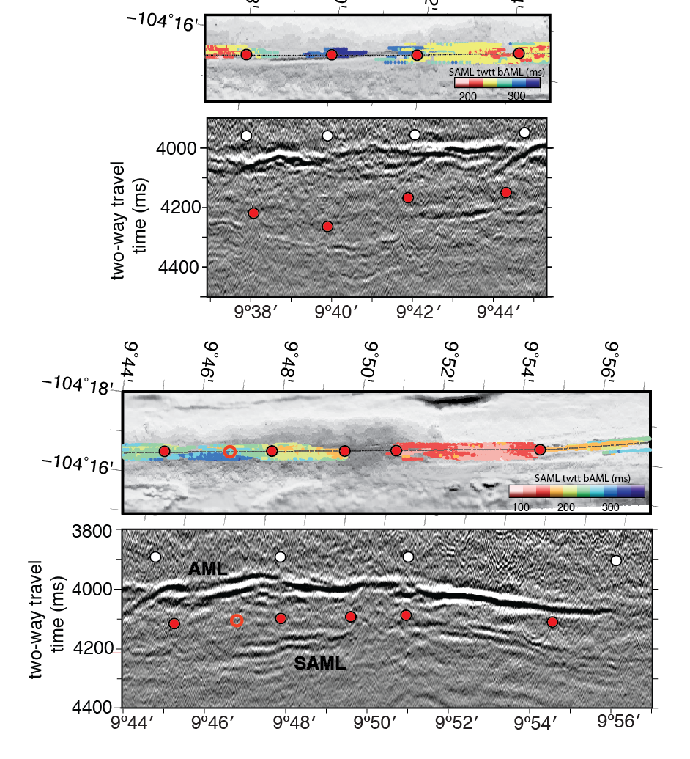
3. SAML Structure
SAML are finely segmented
Defined by breaks in reflector continuity and/or steps in twtt (25-125 ms)
Most places SAML and AML segmentation is coincident

Slide 35


Along-axis swath 3D
Axial profile
AML
SAML

Slide 36


AML vs SAML Depth
AML/SAML Segment length
Peak ~ 6 km

Slide 37

upflow
downflow
Models predicts differential cooling between recharge and discharge zones
Could generate topography on AML roof
Spatial scale controlled by length scale of hydrothermal cells
Melt reservoir
Fontaine et al, 2011

Slide 38

InterRidge DB vents
  No correlation between melt lens depths and high T venting
  SAML depths do not covary with AML depth

Slide 39


Toomey et al., 2007
Segmented sub-crustal melt distribution
SAML analogous to compaction waves in viscous mush?
Rabinowicz et al., 2001

Slide 40




4. Temporal variability in MOR magmatism linked to glacial cycles?

Slide 41


Crowley et al., 2015: Variations in sealevel give rise to temporal variations in mantle melting that contribute to abyssal hill topography?
Olive et al., 2015: Abyssal hill topography governed by faulting linked to axial thermal structure?

Slide 42

Fault Model
Glacial Loading
Goff, 1991; 2015
Olive et al, 2015

Slide 43



High spatial data density and 3D migration provides
near complete imaging of Moho for crust to ~300 ka
Crustal thickness
Oghaei et al., 2014, 2015
Barth and Mutter, 1996

Slide 44

Bathymetry
Boulahanis et al. in prep

Slide 45

Crustal Thickness
Boulahanis et al. in prep

Slide 46

Goff analysis does not detect the 100 ka (~ 5 km spacing) topography

Slide 47
Eruption Scenario
Three magma lenses fed the eruption.
  Vertical magma transport during dike intrusion
  Diversity in flow morphology and chemistry of erupted lavas governed by magma reservoir segmentation.
Sub-lens under central eruption zone drained during eruption
  Consistent with inferences from geochemical studies of deeper sourced magmas

Slide 48


Architecture
Melt sills beneath AML contribute to upper crust
Mush Zone --- Sill Complex
~5 km long AML and SAML segments arise from localized melt transport/ injection sites in lower crust
Sinton and Detrick, 1992
Annen et al 2006

Slide 49

Lens segmetnation provides framework for
Understanding spatial variations in eruption

