Slide 1
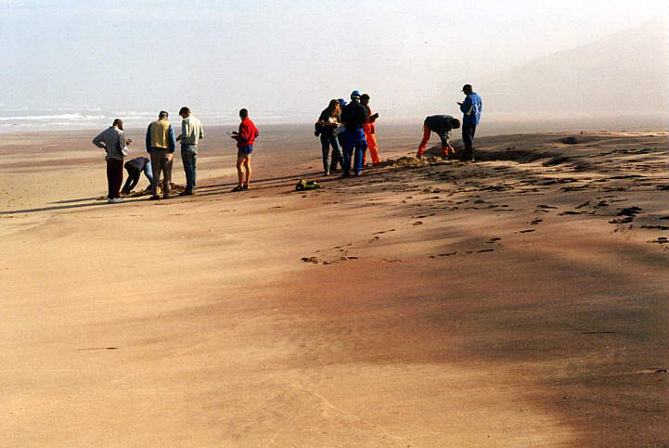
Landscape Evolution and Sediment Fluxes to the Ocean
Rudy Slingerland
Department of Geosciences
The Pennsylvania State University

Slide 2
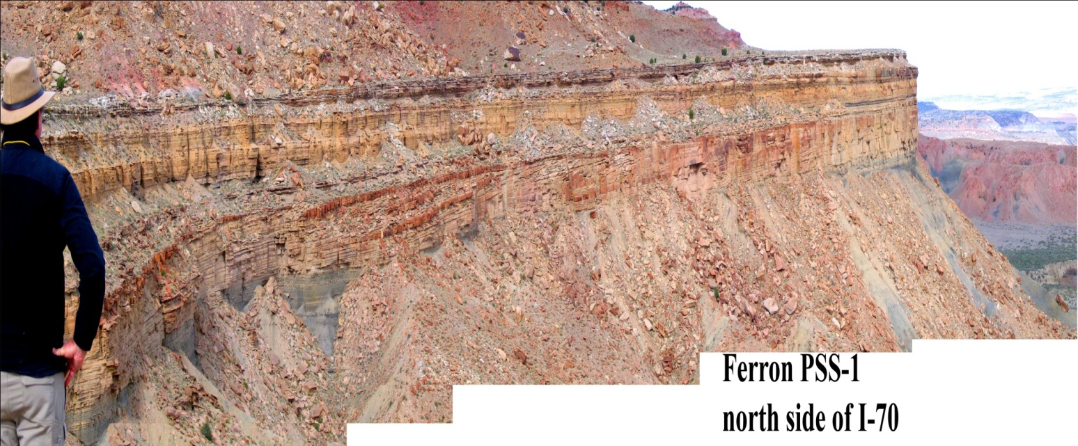
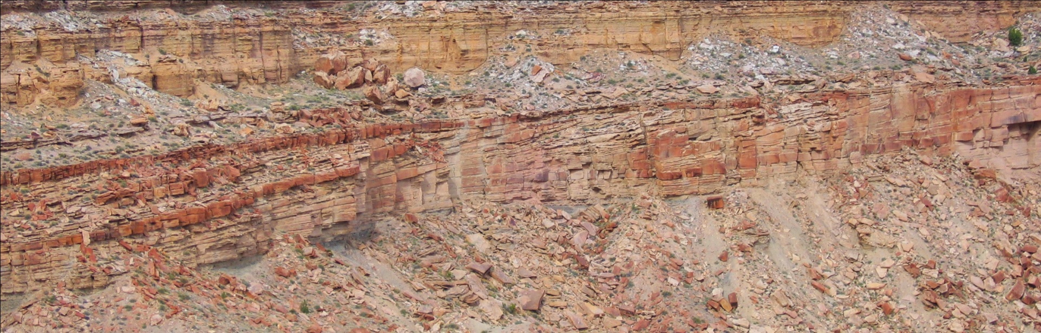
An Example:
The Turonian “Last Chance Delta”, Ferron, UT
Relevant literature: Gardner (1995); Moiola et al. (2004); Bhattacharya & Tye (2004)
Notes:
Let’s make the problem even more concrete by picking one realization of sediment transfer to a coast---the Turonian “Last Chance Delta” of the Ferron SS in Utah. 90 million years ago.

Slide 3
An Example: Turonian “Last Chance Delta” of Utah
Seven parasequences deposited over 1.7 million years
Edwards et al. (2005)
Are these seven parasequences a result of fluctuations
in sediment flux and type?
Notes:
The geometry of the source terrain has been estimated from paleo-channel dimensions/bedforms, and grain sizes as ~50,000 km²; maximum trunk river paleo-discharge was on the order of 50 x 10⁹ m³/year.

Slide 4
Two General Questions
What magnitude/frequency sediment signal reaches the coast?
How does the answer depend upon the characteristics of the landscape & the fluvial system?
Notes:
Signal here means change in flux or type of sediment

Slide 5
Orogenic Wedge and Foreland Basin
Modified from: Stolar et. al. 2006
The mass flux (F_{A}) creating the crustal thickening is knowable, and if at steady-state, gives us F_{E};
Notes:
For concreteness I’ll focus on convergent orogens and their associated thrust belts and foreland basins although what I say can be applied to other source-sink pairs---rift basins, and so forth. I choose this system because it seems to me the most constrained:
The mass flux (F_{A}) creating the crustal thickening is knowable and if at steady-state, gives us F_{E};

Slide 6
Orogenic Wedge and Foreland Basin
Modified from: Stolar et. al. 2006
The geometry of the source terrain---elevation, relief, width, etc.---is computable (assuming we believe the doubly-vergent wedge model), as is the rate of creation of accommodation space in the basin.
Notes:
Furthermore, the geometry of the source terrain---elevation, relief, width, etc.---is computable (assuming we believe the doubly-vergent wedge model) --- as is the rate of creation of accommodation space in the basin.

Slide 7
Orogenic Wedge and Foreland Basin
Modified from: Stolar et. al. 2006
Therefore sediment fluxes and types, systems tract geometries, water depths, etc. are tightly linked to the source terrain
We should be able to apply scaling theory and modeling to unravel sediment fluxes and types as a function of geodynamic boundary conditions, climatic forcing, and autogenic processes.
Notes:
Therefore sediment fluxes and types, systems tract geometries, water depths, etc.---are linked to the source terrain and general systems theory should apply.
We should be able to apply some scaling theory and modeling to unravel foreland basin stratigraphy as a function of geodynamic boundary conditions, climatic forcing, and autogenic processes.

Slide 8
Some Definitions
Characteristic Response Time: The period over which a system adjusts its state variables in response to a change in boundary condition. Two types:
  Intrinsic Response Time or Equilibrium Time: Time needed to return to equilibrium after a change in boundary conditions
  e-folding Time: Characteristic time scale of an exponential process. It is the time it takes for the difference between a perturbed value of a state variable and its equilibrium value (call this difference Δf) to have decreased by Δf/e
For diffusive systems an Equilibrium Time Scale is given by: L²/κ or by UL/κ
where: L is a length scale of the system, κ is the diffusivity of the mass
flux process, and U is a rock uplift rate
Notes:
Some definitions:
Characteristic Response Time: The period over which a system adjusts its state variables in response to a change in boundary condition.
Intrinsic Response Time or Equilibrium Time: Time needed to return to equilibrium after a change in boundary conditions.
e-folding Time: Characteristic time scale of an exponential process. It is the time it takes for the difference between a perturbed value of a state variable and its equilibrium value (call this difference ) to have decreased by /e.
The characteristic time T_{R} required for the evolution of a system described by diffusion eqn. to the quasi-steady, graded channel with overall length L is given by T_{R} = L²/K, and K = Bq/R. (B is sediment mobility parameter and R is relative density) (Humphrey and Heller 1995)
Characteristic Reaction Time of a Floodplain: LwH/Q_{f} where L is channel length, w is floodplain width, H is maximum relief between upstream and downstream ends of the plain, and Q_{f} is the sediment yield (Castelltort and Van Den Driessche 2003)
What I mean when I say a high-frequency signal:
Period of oscillation (yrs) Frequency
<10⁴ high
10⁵ -- 10⁶ medium
>10⁶ low

Slide 9
Some Definitions
Buffer (e-folding) Distance of a Diffusion Process: Distance over which amplitude A, of a periodic disturbance with period λ decreases by 1/e :
What I mean when I say a high-frequency signal:
  Period of Oscillation (yrs) Frequency
  <10⁴ high
  10⁵ -- 10⁶ medium
  >10⁶ low

Slide 10
Response Time of a Doubly Vergent Orogen
Relevant Literature: Kooi and Beaumont 1996; Hooke 2003; Stolar, Willett et al. 2006; Whipple and Meade 2006; Whipple 2009
Notes:
The relevant literature here includes (Kooi and Beaumont 1996; Hooke 2003; Stolar, Willett et al. 2006; Whipple and Meade 2006; Whipple 2009)
The key idea here is that these two-sided, frictional orogenic wedges reach a steady-state (at least in theory) in which the mass flux into the wedge, F_{A}, is balanced by a mass flux off the top, F_{E}. If the material is assumed to possess a Coulomb plastic rheology, then each side has a critical taper that sets the angles a_{p,r}, and the relief, R, and widths W_{r} + W_{p}, all of which grow self-similarly until the system reaches steady-state.
To describe that growth use conservation of mass of the wedge: The rate of change of mass of the wedge equals the mass flux in from convergence minus the mass flux out due to erosion, or if bulk density doesn’t change:
And E is an average erosion rate.

Slide 11
Response Time of a Doubly Vergent Orogen
C is a proportionality constant representing “erosional efficiency”
How sensible is this rule for erosion rate?
  Assuming a symmetric wedge and let a = b = 1, then: E = CR
  where R is the relief
Notes:
There are many different opinions on how to define E, but following Whipple and Meade who use Flint’s Law describing equilibrium river profiles and some other assumptions, the average erosion rates on the pro and retro sides of the wedge at steady-state are equal to:
C is a proportionality constant representing “erosional efficiency” and therefore is a function of climate and rock properties. How sensible is this rule for erosion rate?

Slide 12
Response Time of a Doubly Vergent Orogen
This form can be compared to the latest compilation of global sediment flux data by Syvitski and Milliman (2007), their BQART model:
  where B = IL(1 - X )Z and I is a glacial erosion factor, L is a lithology factor, X is a reservoir trapping efficiency, and Z is a human-induced soil erosion factor
Notes:
The BQART is linear in relief which is comforting. But we also realize that much of the variance in sediment flux and therefore erosion rate sits in these terms, i.e. the erosion efficiency term, C.

Slide 13
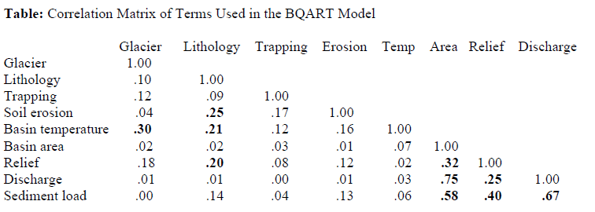
Response Time of a Doubly Vergent Orogen
So, is E = CR a sensible first guess?

Slide 14
Response Time of a Doubly Vergent Orogen
Combining the above equations and solving for the evolution of the wedge area from an initial A_{i} to a final A_{f} state yields:
The e-folding time is 1/κ = Ο(10⁶)
Notes:
Important points:
Most of the variance in k lies in C, the coefficient of erosional efficiency (a function of climate and rock type)
The characteristic time scale doesn’t depend upon the size of the orogen! (Although for asymmetric orogens there is a weak dependency upon wedge size and convergence velocity)
The rate of creation of accommodation space in the basin should follow the same functional form

Slide 15
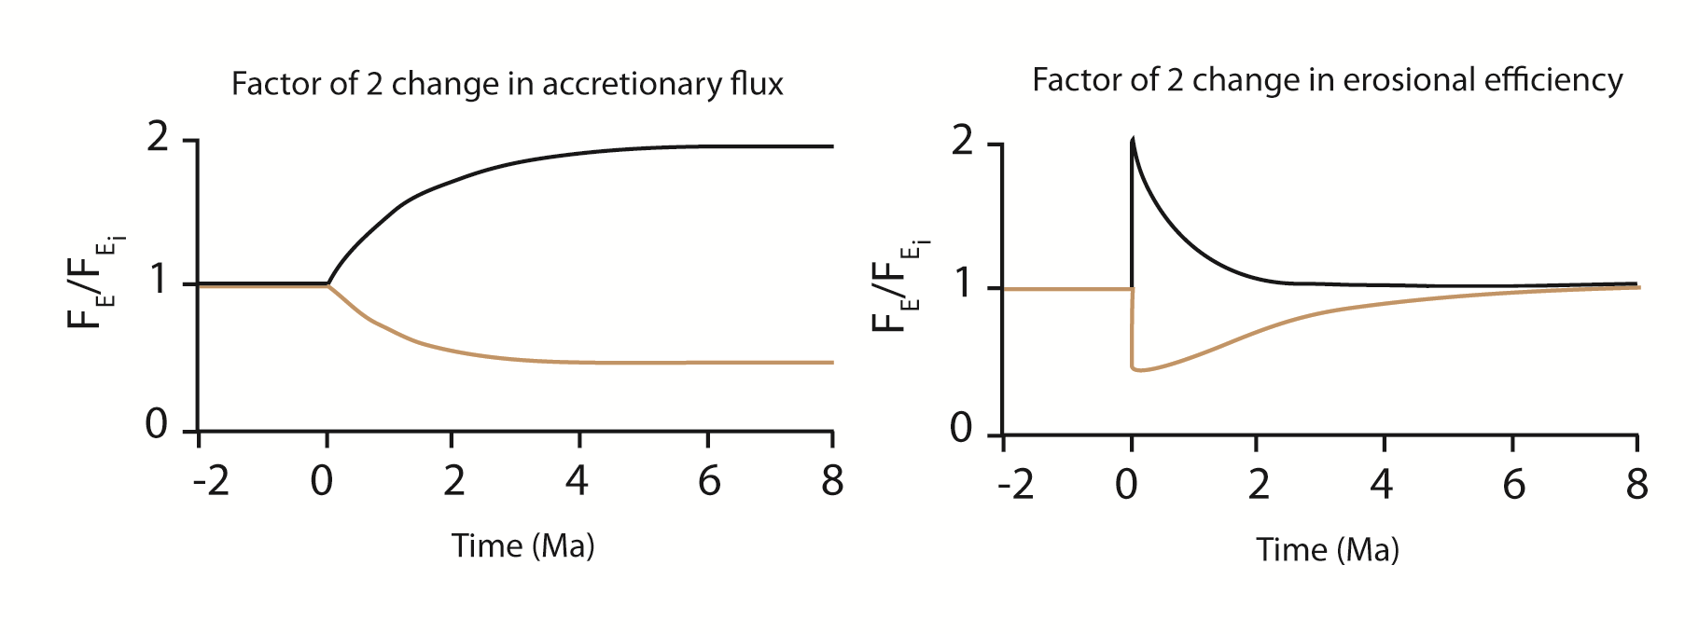
Evolution of Erosional Fluxes
e-folding time
Notes:
The evolution of erosional fluxes look like this:
(plot of total erosional flux off an asymmetric doubly-vergent orogen relative to an initial steady-state flux as a function of time)
Note that e-folding time is shorter for an increase in erosional efficiency (because orogen response time is set by FINAL value of diffusivity)

Slide 16
Summary
An orogen’s characteristic response time depends mostly on erosional efficiency
Given an instantaneous increase of accretionary flux, sediment flux to basin rises asymptotically in synch with rate of creation of accommodation;
Given an instantaneous increase in precipitation, sediment flux to basin “instantaneously” rises before returning asymptotically to the pre-perturbation level and accommodation declines

Slide 17
Summary
Given an e-folding time like Taiwan (~1.2 Ma), the signal to the coast is very low frequency!
Notes:
Ok, but these analyses don’t account for lags in the landscape response to uplift, nor variable rock types, nor drainage basin evolution. Are we missing some signal? What now seems like a long time ago (1996), Greg Tucker and I modeled the sediment flux from an evolving fold and thrust belt, specifically the Zagros Mountains of Iran. Our results bear on this question.

Slide 18
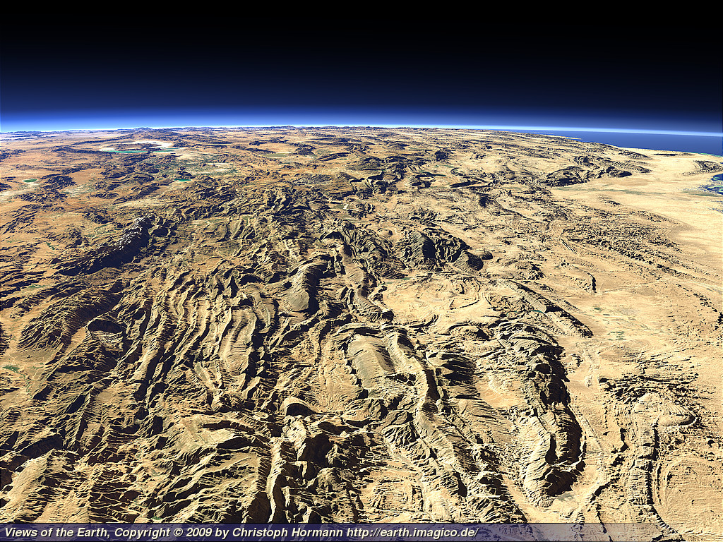
Effect of Catchment Evolution
Notes:
Here are the Zagros Mtns looking south. They are a relatively young (ca. 5 Ma) range in which deformation has propagated from the NE to SW at about 20-40 mm/yr. The strat section consists of about 2 km of salt, overlain by 2 km of shale, overlain by 7 km of carbonates, and capped by 5 km of clastics.

Slide 19
Effect of Catchment Evolution
Role of fold growth, temporary sediment ponding, and variable rock types
U(x,y,t)
Hillslopes: E_{h}
Bedrock channels:
Alluvial Channels:
Notes:
The model consisted of the standard mass conservation laws for bedrock and regolith, bedrock weathered into regolith according to , slopes diffused, and stream sediment fluxes followed a modified Bagnold formulation.

Slide 20
Effect of Catchment Evolution
Notes:
Here is a plot of sediment flux through time (normalized by incoming flux due to background uplift). The black line is the flux out of the basin, the dashed line is mass influx, and the thin solid line is the proportion of surface underlain by resistant lithology. Here are the periods of fold growth where fold one is most hinterward.
As the folds grow the sediment outflux increases, but it is delayed by about 400K due to deposition in growing synclines and the time it takes for an integrated drainage net to develop. This little blip is the result of breaching the of the Asmarai ls in the outermost fold and erosion of flysch in the soft underbelly. General breaching of the resistant limestones produces the secondary peak.
So here is a case where the interaction of variable lithologies produces a variable sedimnt outflux even though the influx is constant (ie., from 2 Ma on).

Slide 21
Effect of Catchment Evolution
Notes:
Furthermore, the normalized sediment flux is not a direct function of relief but sometimes is out of phase with it. This is because when softer rocks are exposed, accelerated erosion dissolves away relief.

Slide 22
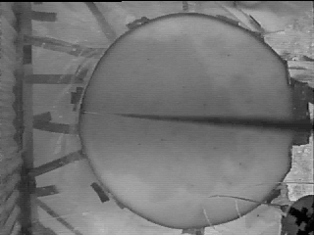
Effect of Catchment Evolution
Self-organized Criticality of Eroding Landscapes
  Relevant Literature: Hasbargen et al. 2000; Van de Wiel et al. 2010; Jerolmack et al. 2010

Slide 23
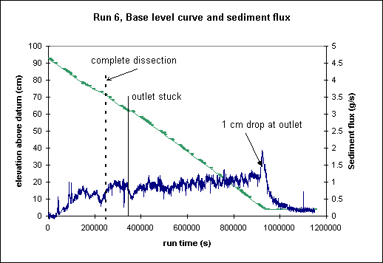
Effect of Catchment Evolution
There is an intrinsic, autogenic variation in sediment export under constant allogenic forcing that arises from “stick-slip” morphodynamics

Slide 24
Summary
Co-evolution of drainage systems and foreland folds causes complex sediment flux signal with period O(10⁵ yrs) due to drainage rearrangements, temporary ponding, and variable lithologies
Sediment fluxes can be out of phase with relief
Nonlinear “stick-slip” processes (eg. landsliding, knickpoints, avulsion, lateral stream migration) cause autogenic sediment flux noise of period T_{au} (L²/q_{o}) and magnitude M_{au} (estimated by the RMS of autogenic fluctuations?)
Notes:
Casseltort et al (2003): high-frequency stratigraphic cycles in clastic accumulations fed by large drainage systems are unlikely to reflect sediment supply cycles of tens to hundreds of thousands of years of periodicities

Slide 25
Signal Modification through the Fluvial System
Relevant literature:
    Ponce 1983; Humphrey and Heller 1995; Tucker and Slingerland 1996; Dade and Friend 1998; Métivier and Gaudemer 1999; Castelltort and Van Den Driessche 2003; Clift et al. 2006; Allen 2008; Covault et al 2009; Whittaker et al. 2010; Jerolmack et al. 2010; Van de Wiel et al. 2010
Assume a river exits a high relief terrain and passes a sediment load to a coast 100s of km away. Assume a periodic change in load occurs of period λ and amplitude A.
What magnitude/frequency sediment signal makes its way to the coast?
And how does the answer depend upon the characteristics of the fluvial system?
Notes:
Now the previous example got the sediment to the coast, but didn’t give us much insight into the relevant time and space scales of the transfer system.

Slide 26
Effect of a Diffusive System
Assume sediment flux is linear with water surface slope, and therefore the diffusion equation applies with diffusivity κ
  Defendable for bedload and self-formed streams

Slide 27
Effect of a Diffusive System
The characteristic time scale of 93 rivers ranges from 10⁴ (25%) to 10⁵ (62%) to 10⁶ (13%) yrs
e-folding distances for a 10,000 yr oscillation range from 40 km to 1000 km, with the majority averaging 500 km
But what about the mud?
  Wash load signal should propagate at speed of floodwave, and for wide, shallow rivers:
  But sediment signal also diffused by lowering and flattening of wave
  And……

Slide 28
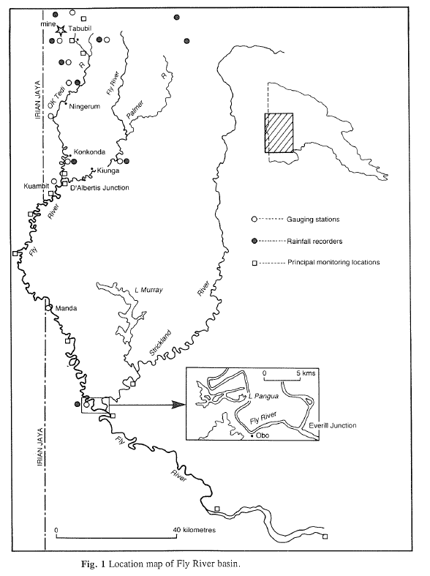
Effect of Floodplains
Ok Tedi Mine created 50% increase in fines, but 25% of the sediment load is permanently stored overbank (Aalto et al., 2008)
Markham and Day (1994)

Slide 29
Conclusions
Sediment transport systems always contain autogenic noise of period T_{au} (L²/q_{o})and magnitude M_{au} (estimated by the RMS of autogenic fluctuations)
It is impossible to deconvolve an allogenic perturbation from autogenic noise if its period is less than T_{au}…
….unless the magnitude is significantly greater than M_{au}
It follows that high-frequency stratigraphic cycles in clastic accumulations fed by large drainage systems are unlikely to reflect sediment supply cycles of tens to hundreds of thousands of years period
Thus, sequence stratigraphy is correct in focusing on changes in the rate of creation of accommodation
Notes:
Casseltort et al (2003):

