Slide 1
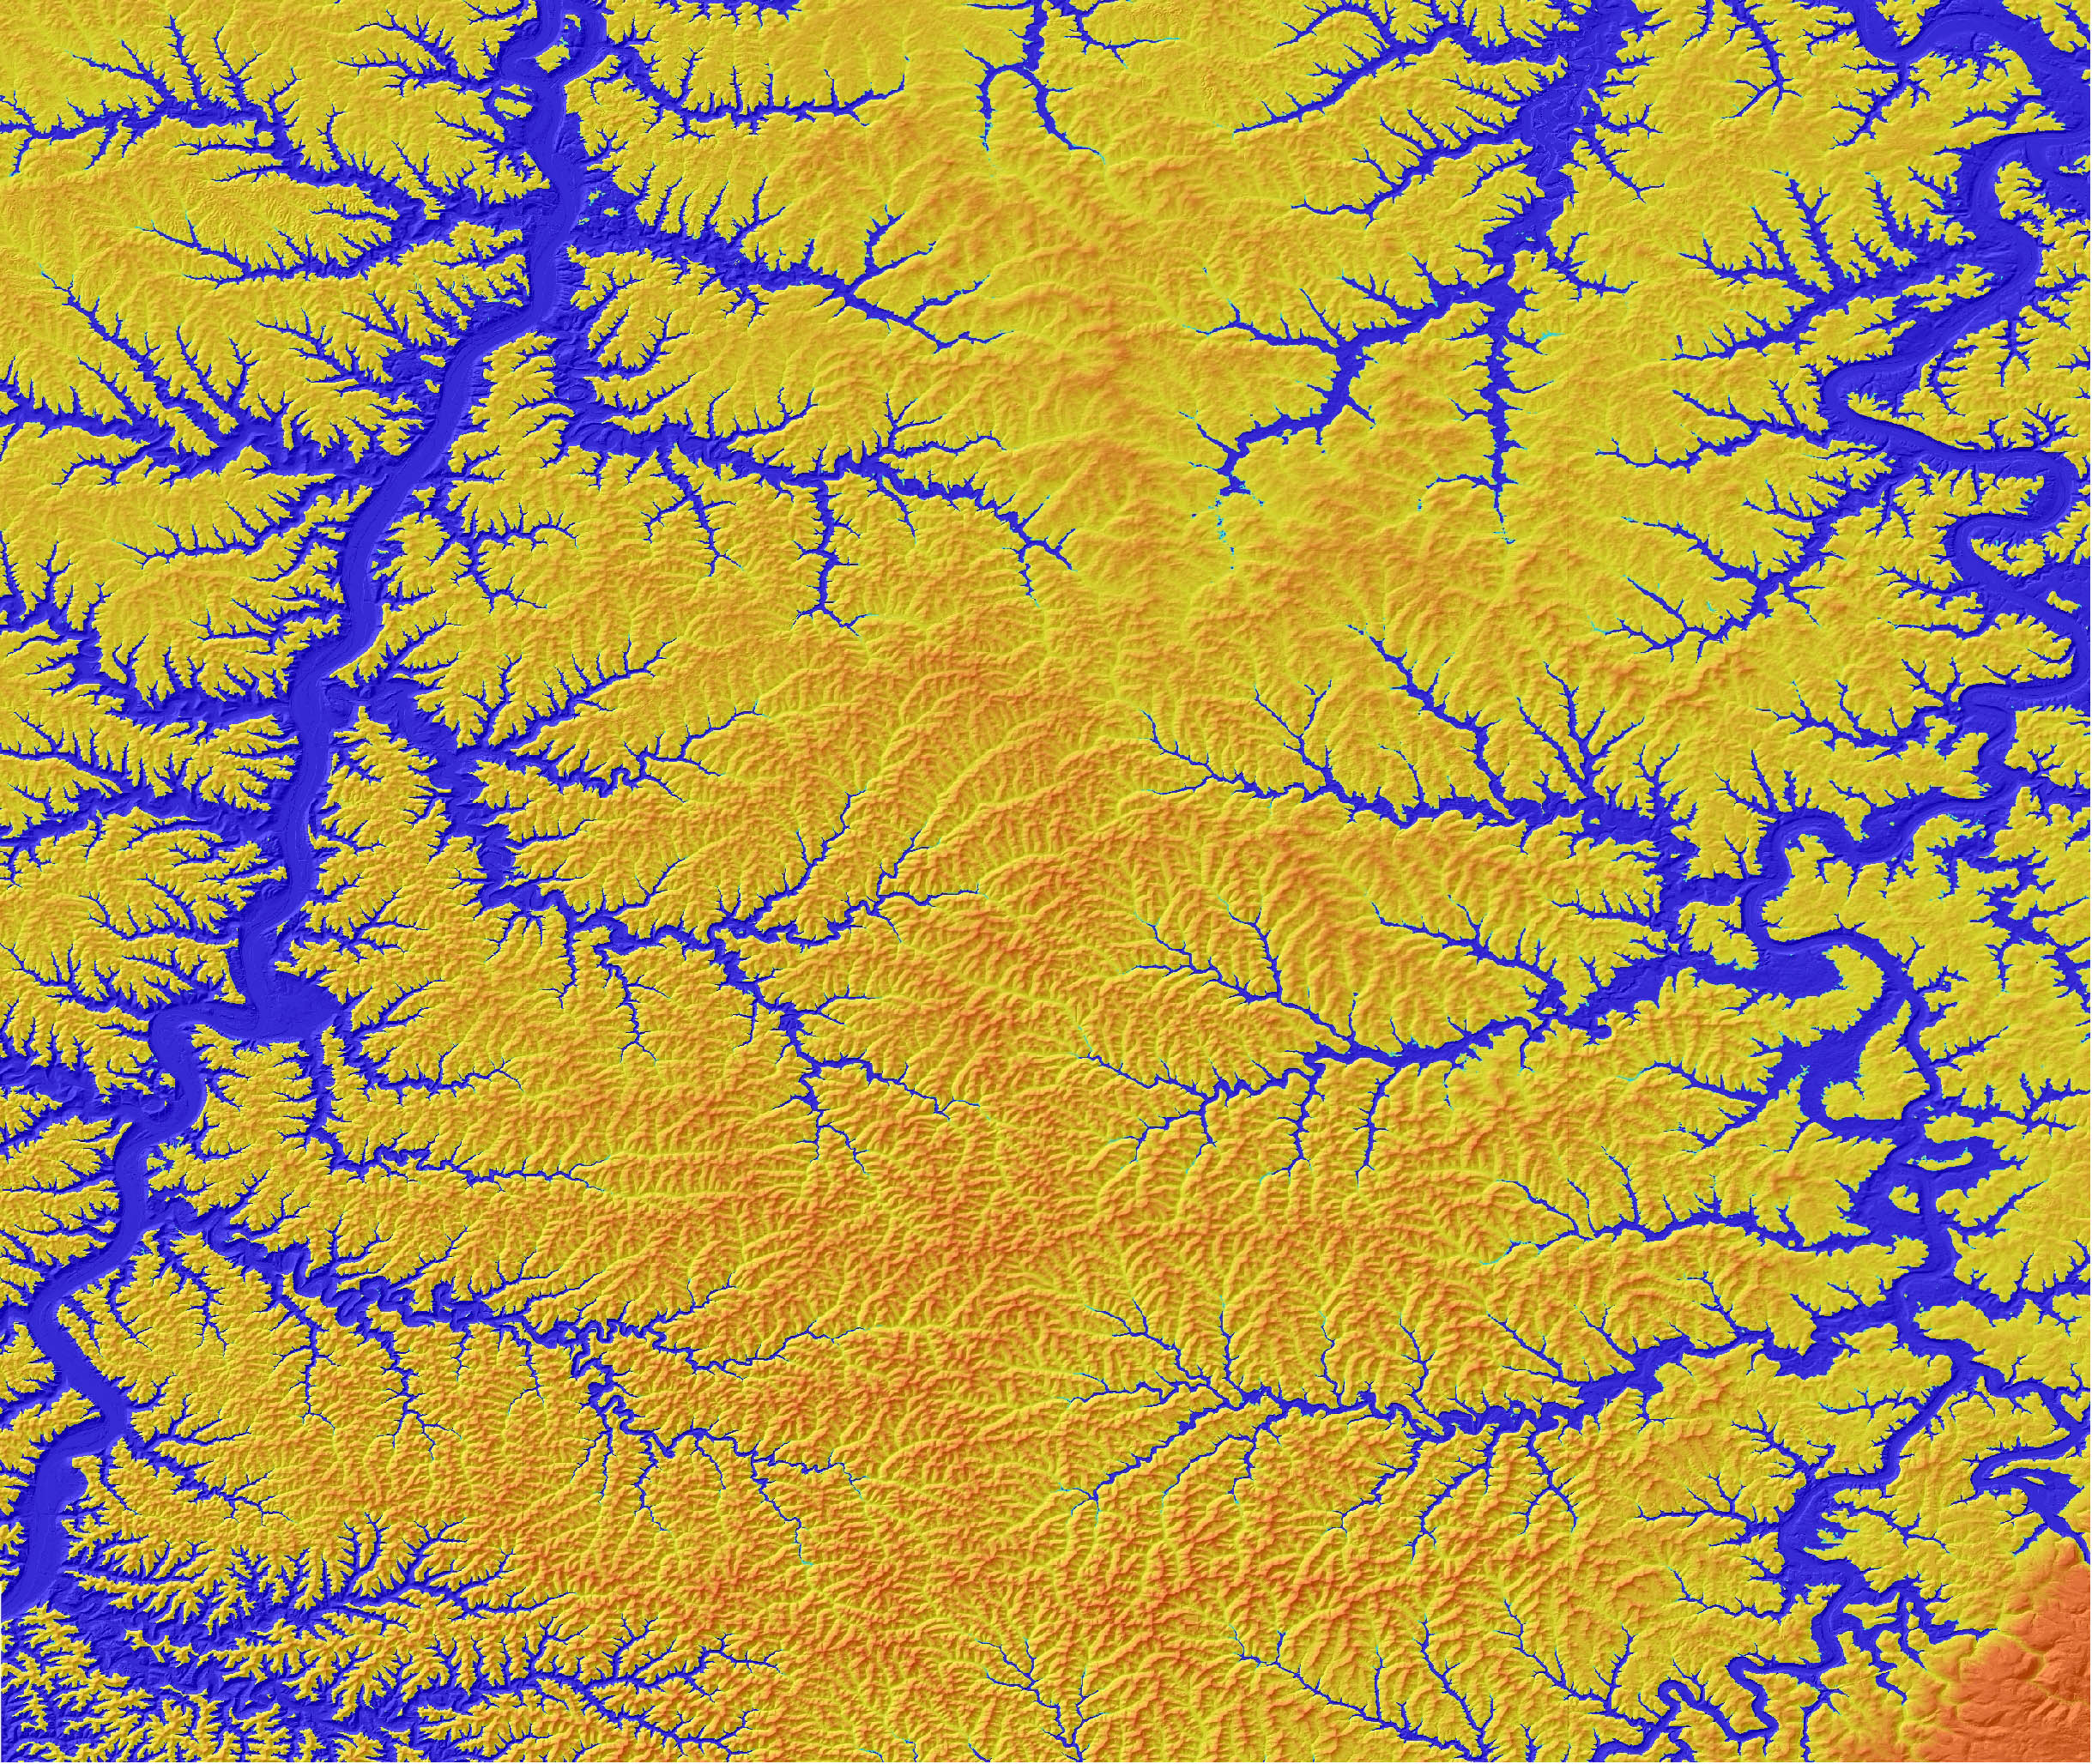
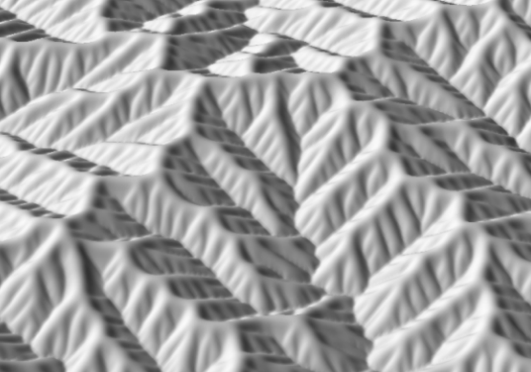
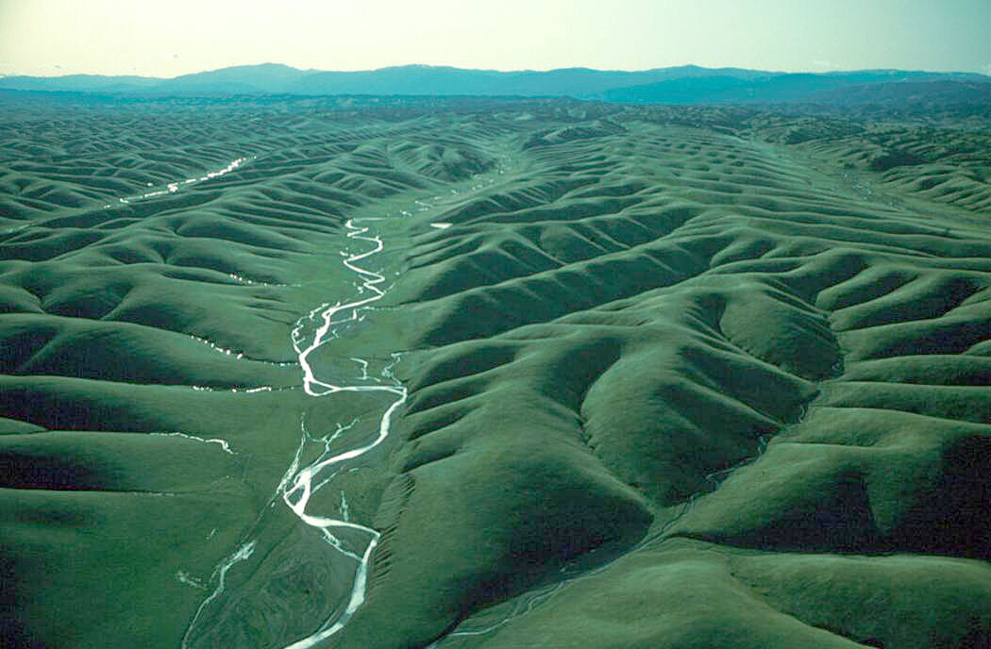
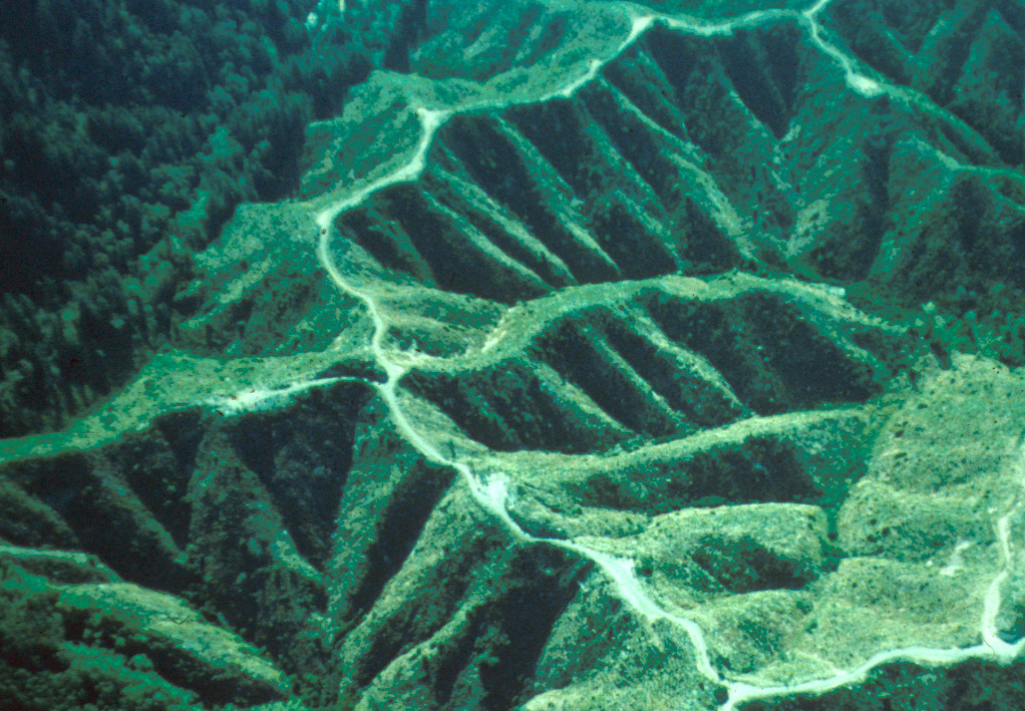
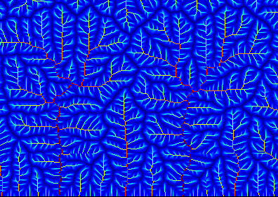
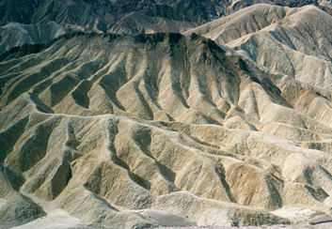
Coupling of river networks and hillslopes in landscape evolution
Taylor Perron, MIT
with K. Ferrier, P. Richardson, S. Fagherazzi, W. Dietrich, J. Kirchner

Slide 2
Erosion by river networks drives landscape evolution, but most of the land surface consists of hillslopes. How do the two interact?

Slide 3
Today: controls on the form of river networks close to the hillslope-channel transition

Slide 4
How do landscape patterns record climate, tectonics, rock type, and life?
Notes:
Landscapes are one of the first things we observe when we look at a planet. They can tell us about processes that are too slow or episodic to observe directly. We can use them to study places that are inaccessible. They are the best-resolved, most widespread part of the geologic record.
We live on them, we engineer them, and they give us our food and water. It’s worth understanding how they work.

Slide 5
What sets emergent length scales in landscapes?
200m
Gabilan Mesa, CA – 1m LiDAR from NCALM
+ airphotos from NAIP. Credit: Ionut Iordache
Notes:
The most basic characteristic of landscapes shaped by river networks is that they are dissected into ridges and valleys. And those ridges and valleys often have a characteristic size, such that they are evenly spaced.
Not rock structure.
If we can explain anything about landscapes, should be able to explain this

Slide 6
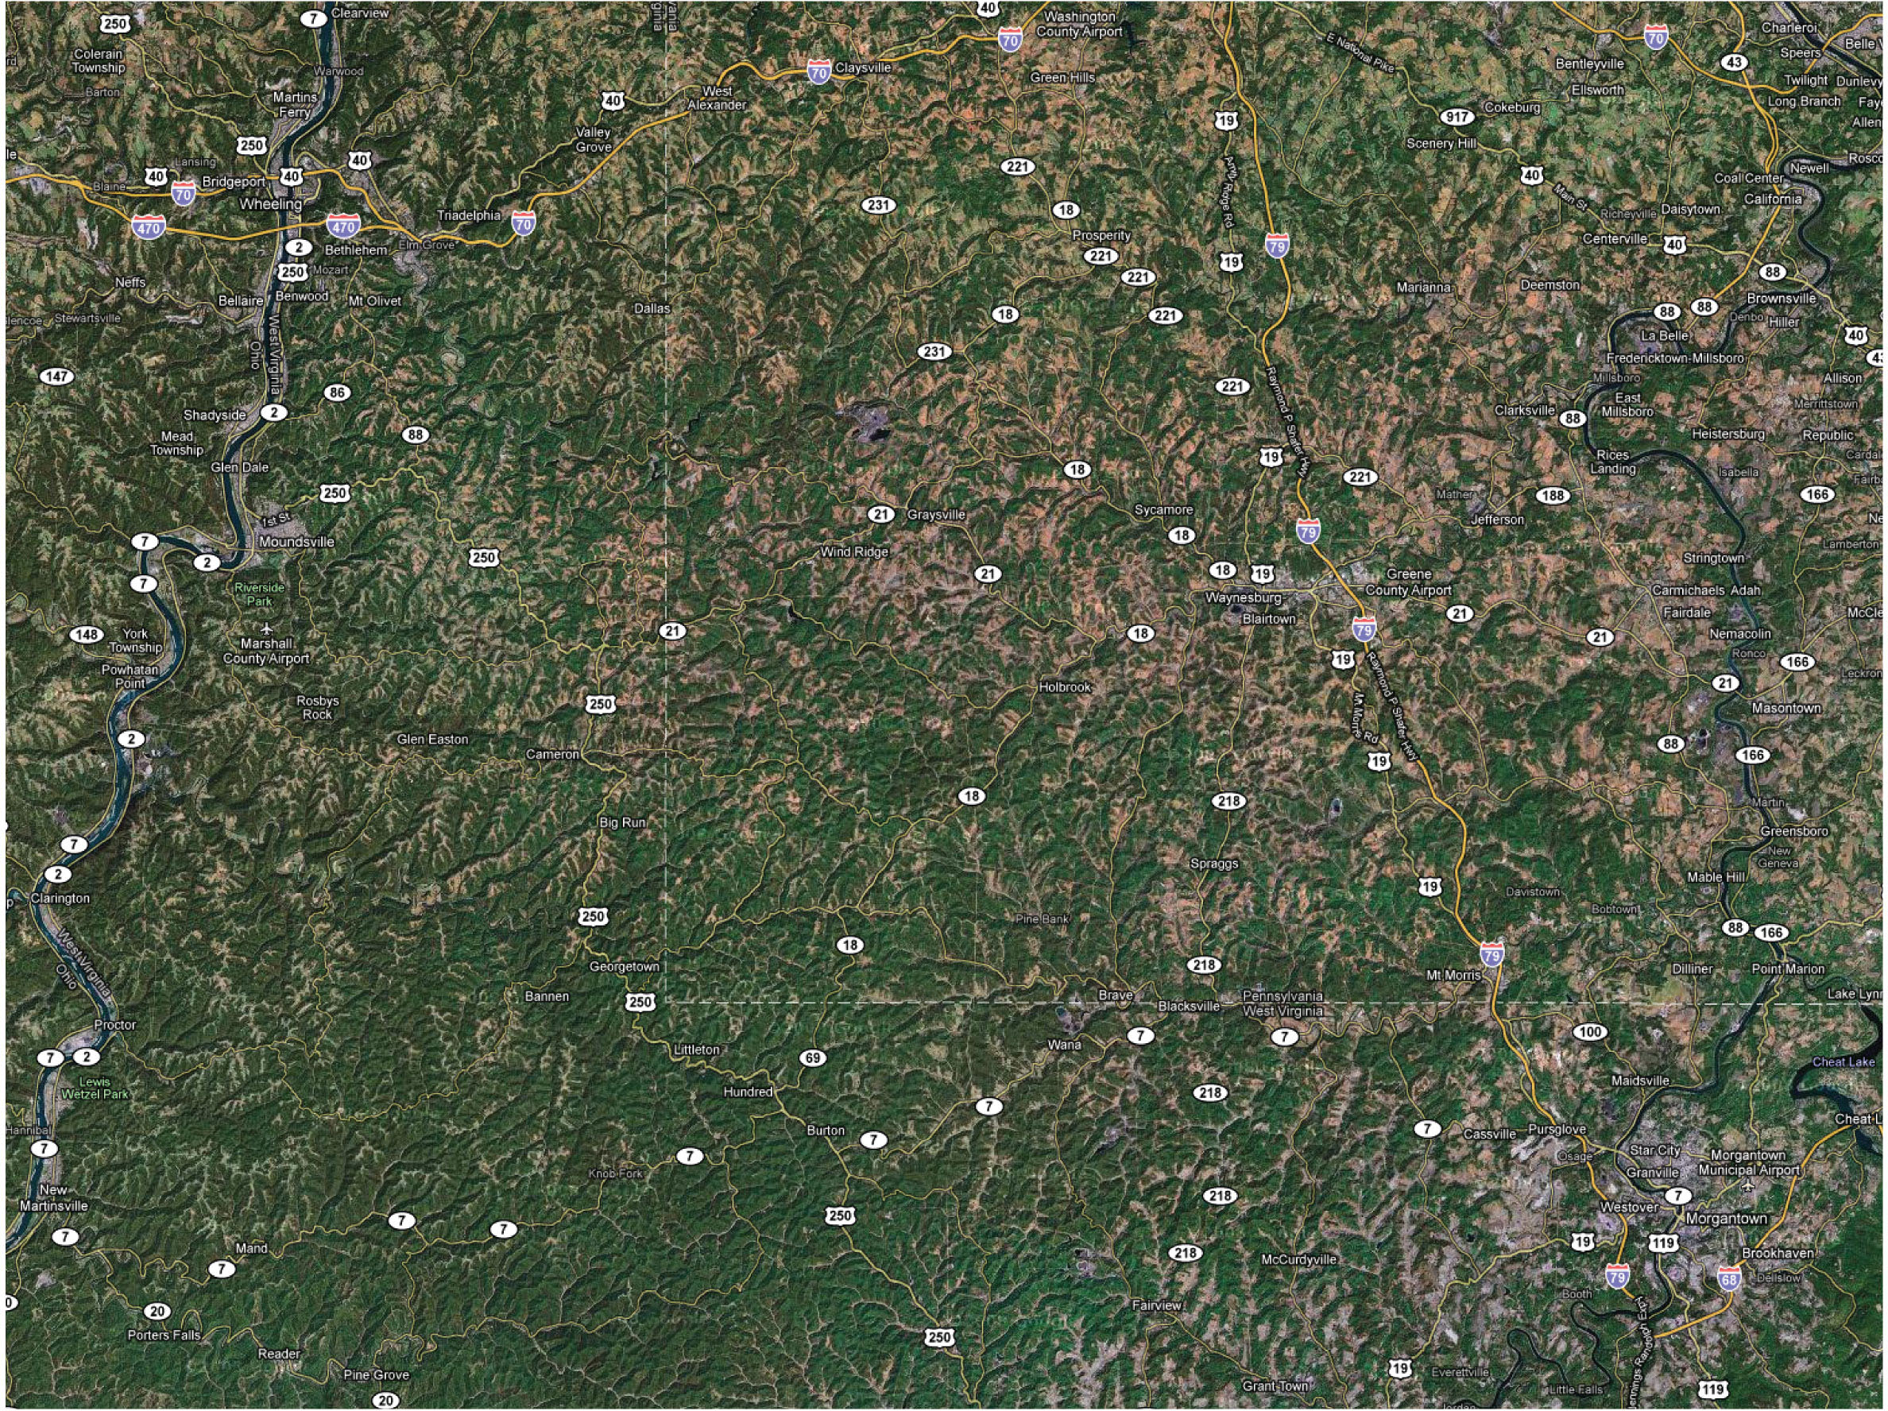
What controls the branching structure of river networks?
Allegheny Plateau, PA & WV
10 km

Slide 7
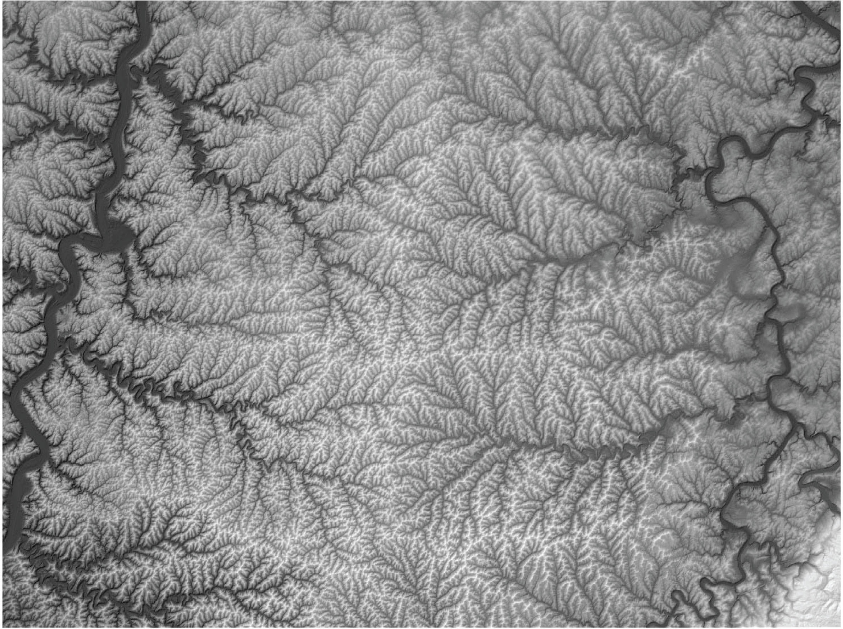
What controls the branching structure of river networks?
Allegheny Plateau, PA & WV
10 km

Slide 8
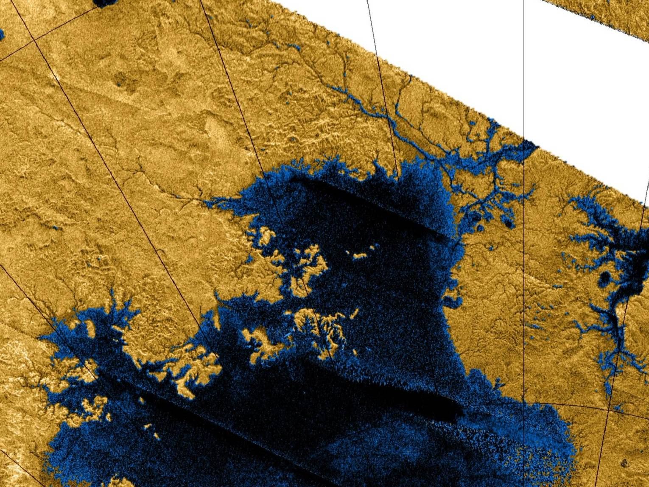
ESA/NASA/
JPL/U. Arizona
50 km
Titan

Slide 9
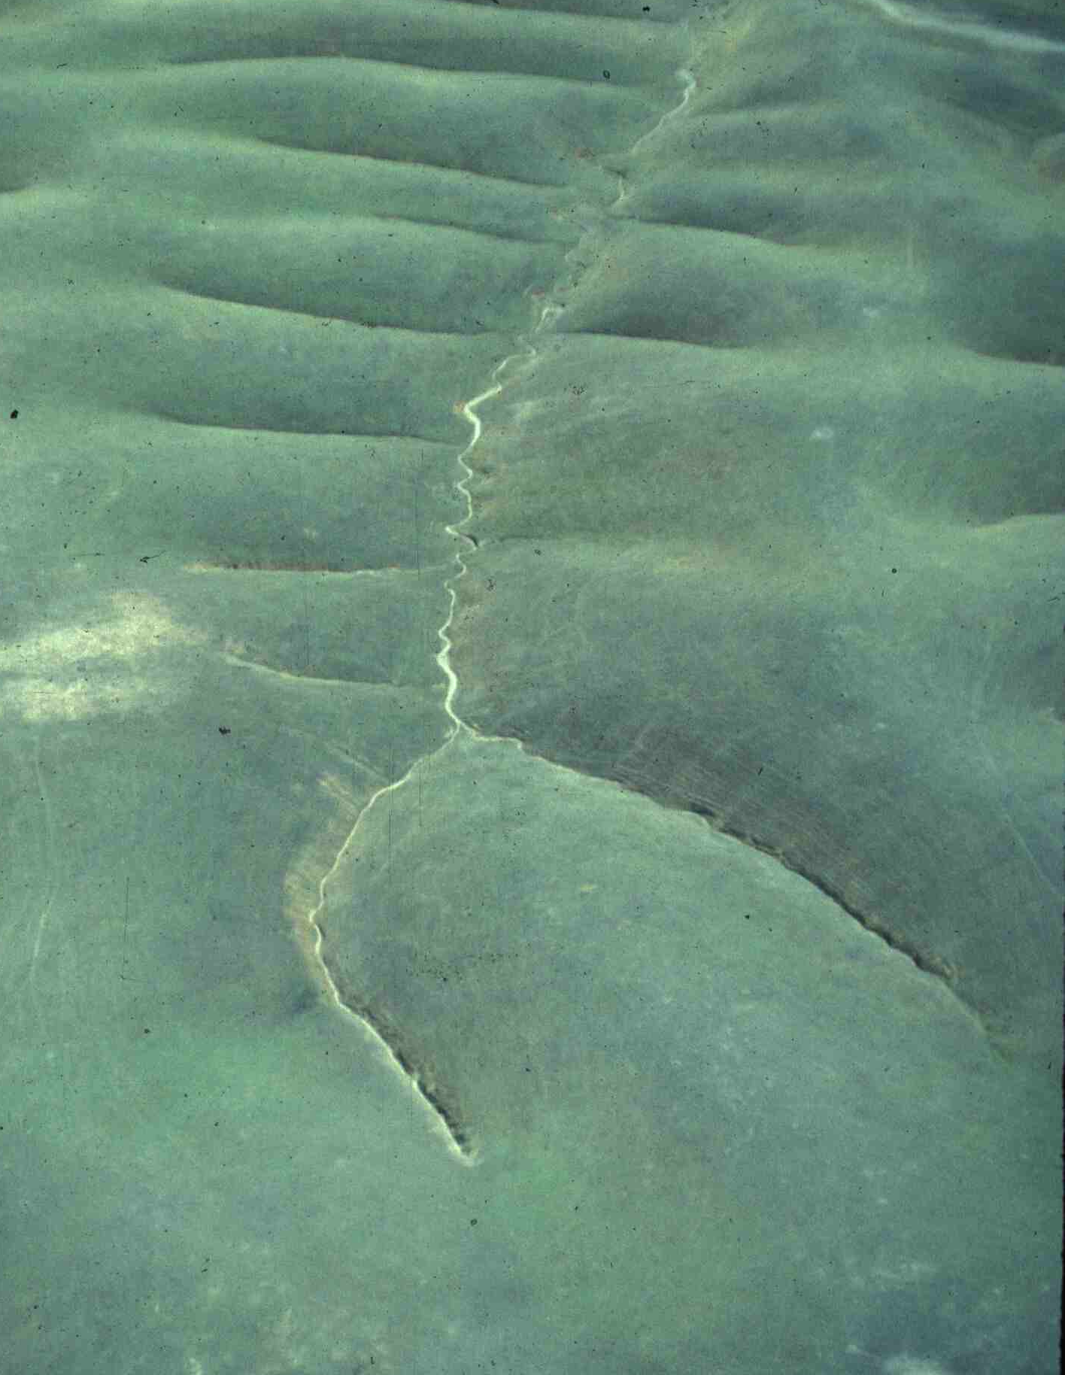
A starting point for studying river-hillslope interactions:
Why are there drainage basins?
The instability that forms drainage basins:
Valleys are perturbations in the land surface that have grown to a finite size.
50m
Dunnigan Hills, California
Notes:
How to quantify the formation of river networks?
To do this, we have to understand the instability that leads to the formation of ridges and valleys.

Slide 10
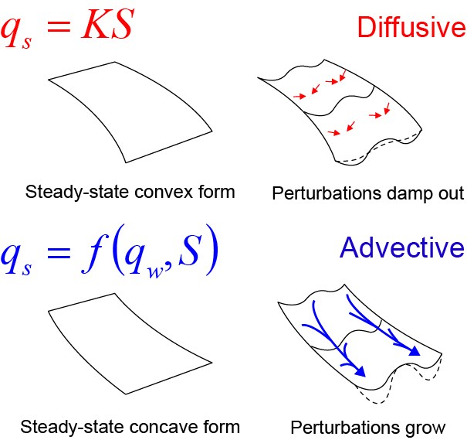
Landscapes are unstable to valley incision by flowing water
Erosion rate ∝ shear stress or rate of energy expenditure
c.f. Dietrich et al. [2003]
Notes:
So why isn’t the entire landscape dissected by valleys?
Note detachment-limited assumption.

Slide 11
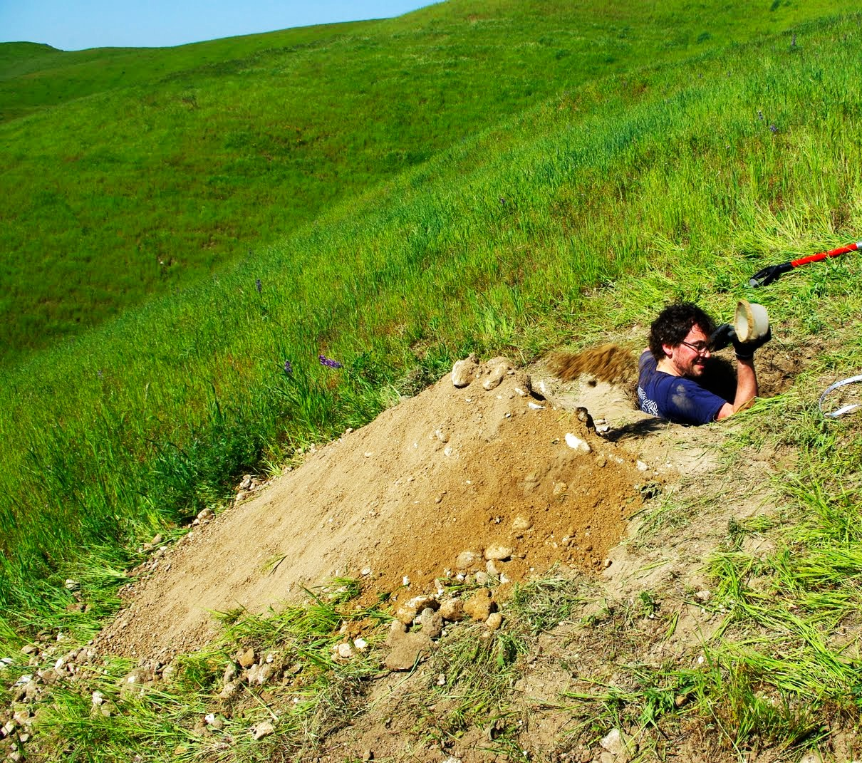
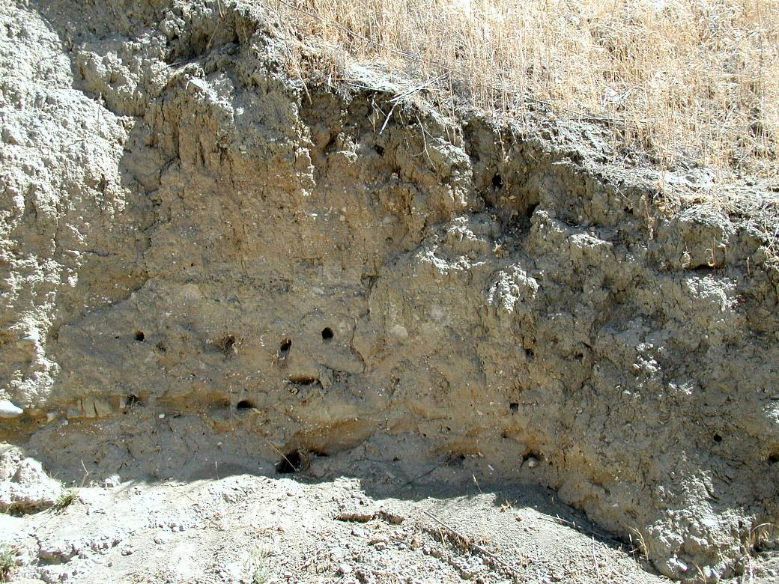
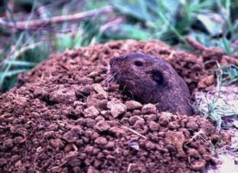
“Diffusive” processes like soil creep limit growth of valleys
topographic
gradient
Sediment flux ∝
Analogous to diffusion
  c.f. Dietrich et al. [2003]
Notes:
Not rheologic creep—it’s granular material being dilationally disturbed by biota.

Slide 12
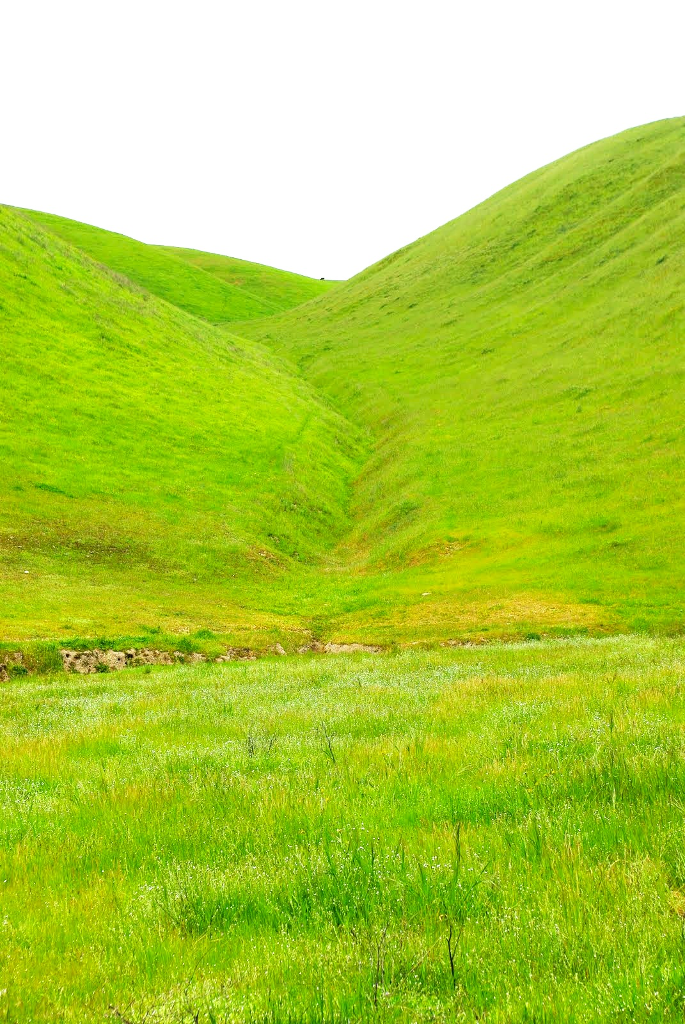
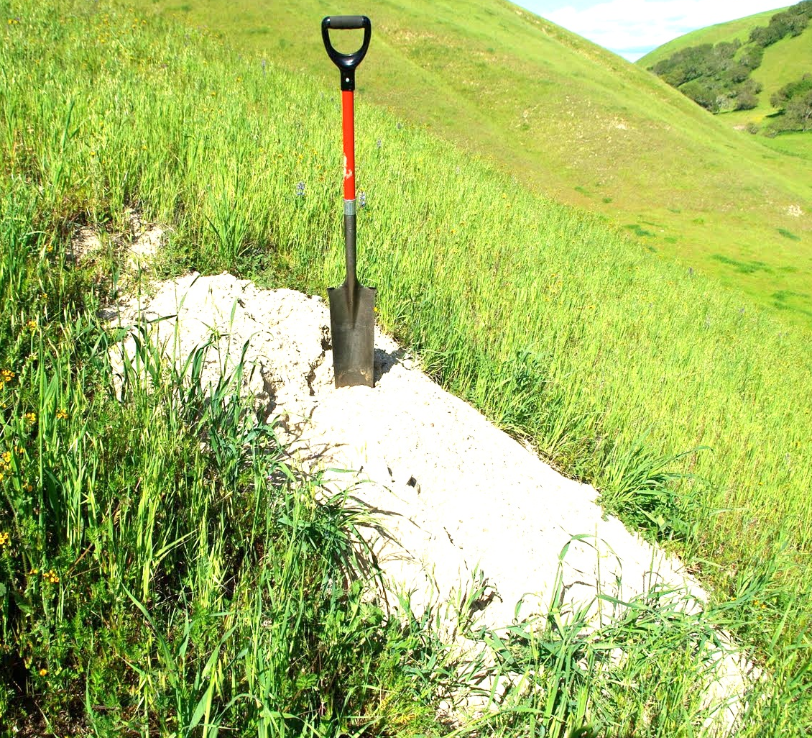
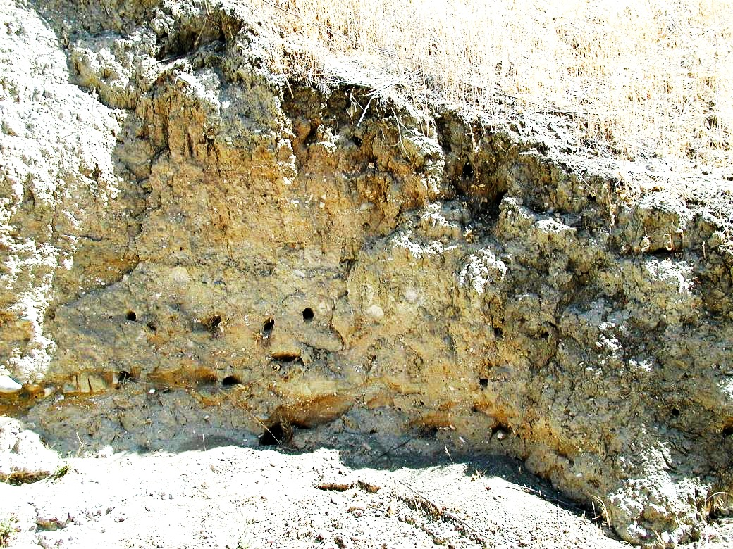
Soil creep driven by bioturbation
Episodic channel incision.
Rate = f(shear stress or energy expenditure).
Can also include an incision threshold.
Proxy for water flux.
Strong dependence on spatial scale;
feedback as topography evolves.
Uplift or boundary lowering
Notes:
Drainage basins emerge from a competition between channel incision and downslope soil transport

Slide 13
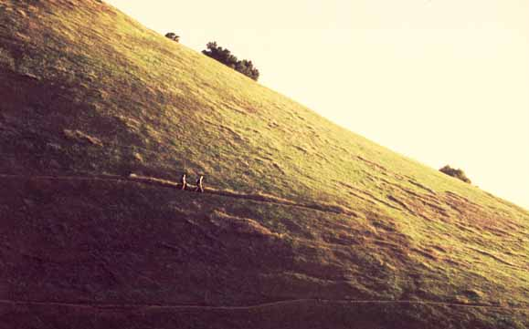
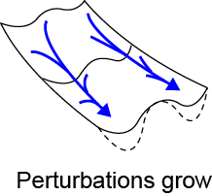
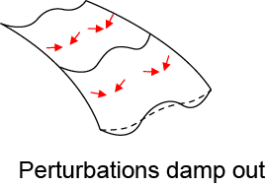
rate of change of elevation
uplift or subsidence
slope-dependent soil flux → diffusion
stream incision → nonlinear kinematic waves (advection)
Notes:
This is the simplest continuous equation that produces drainage basins.

Slide 14
Advection-diffusion systems: Péclet number
A characteristic length:
→
Heat diffusion and advection in a magma chamber.
Notes:
Note the length scale dependence

Slide 15
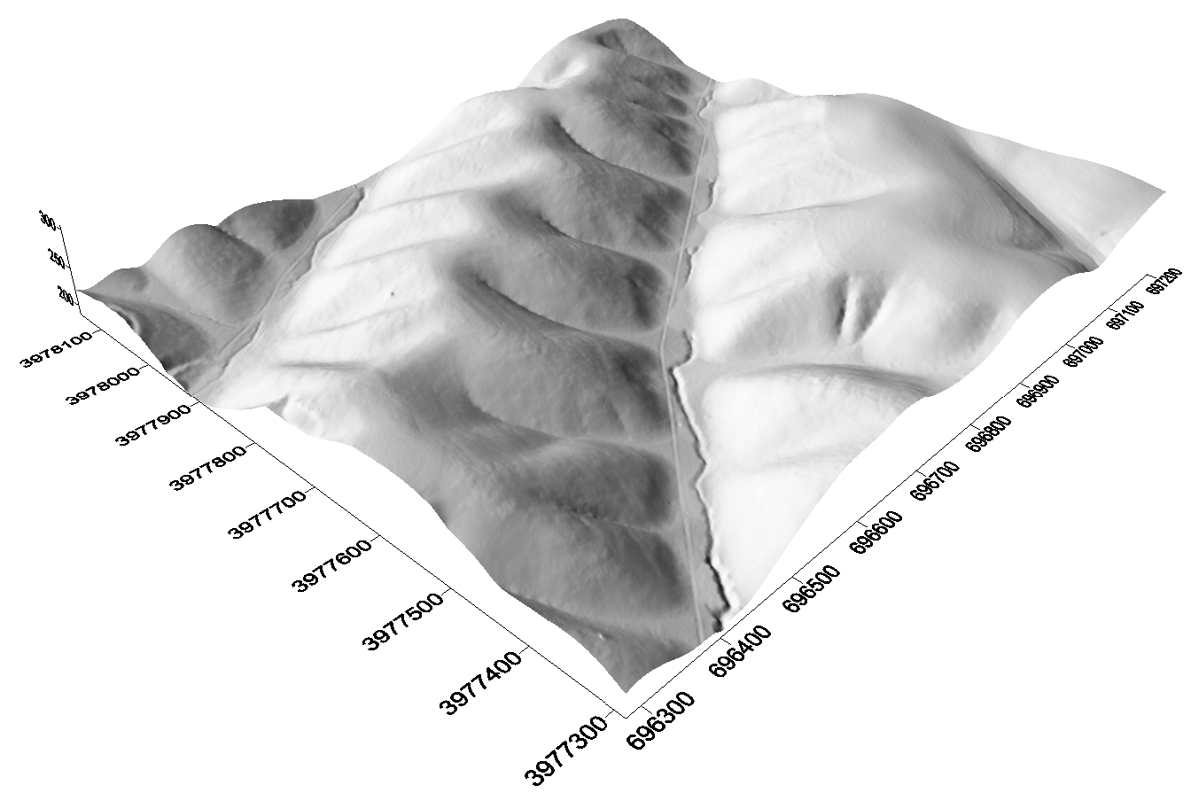
A Péclet number for landscapes:

Slide 16
A Péclet number for landscapes:
→

Slide 17
We can relate this framework to emergent length scales in landscapes
200m
Gabilan Mesa, CA – 1m LiDAR from NCALM
+ airphotos from NAIP. Credit: Ionut Iordache
Notes:
The most basic characteristic of landscapes shaped by river networks is that they are dissected into ridges and valleys. And those ridges and valleys often have a characteristic size, such that they are evenly spaced.
Not rock structure.
If we can explain anything about landscapes, should be able to explain this

Slide 18
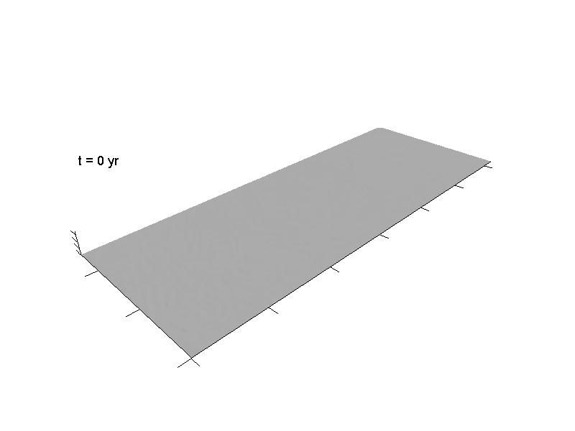
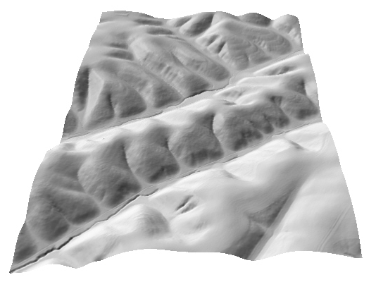
Periodic valley spacing emerges from:
Competition for drainage area
Lateral migration of valleys
Notes:
Explain model: initial conditions, boundary conditions, steady state

Slide 19
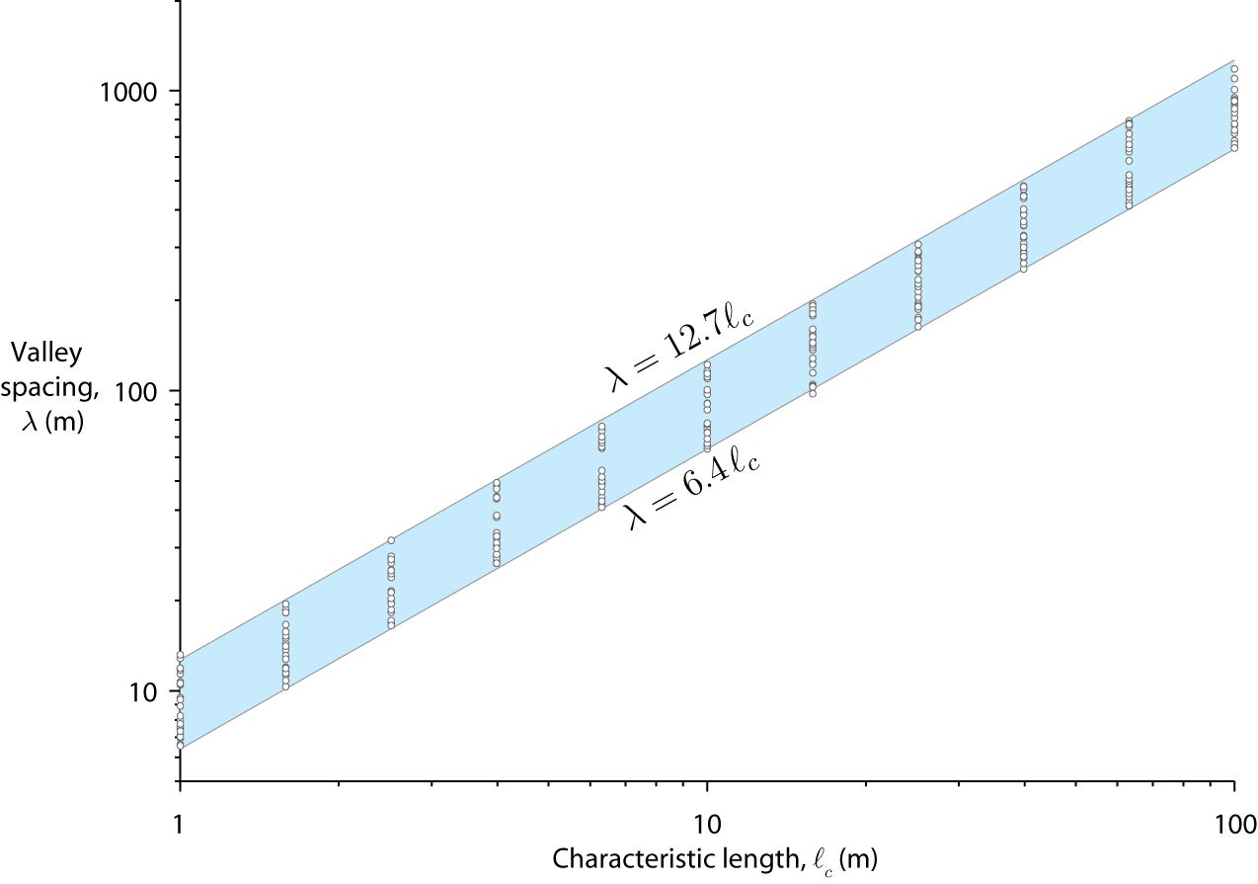
Valley spacing in numerical experiments is directly proportional to .
λ
Perron et al. [2009]

Slide 20
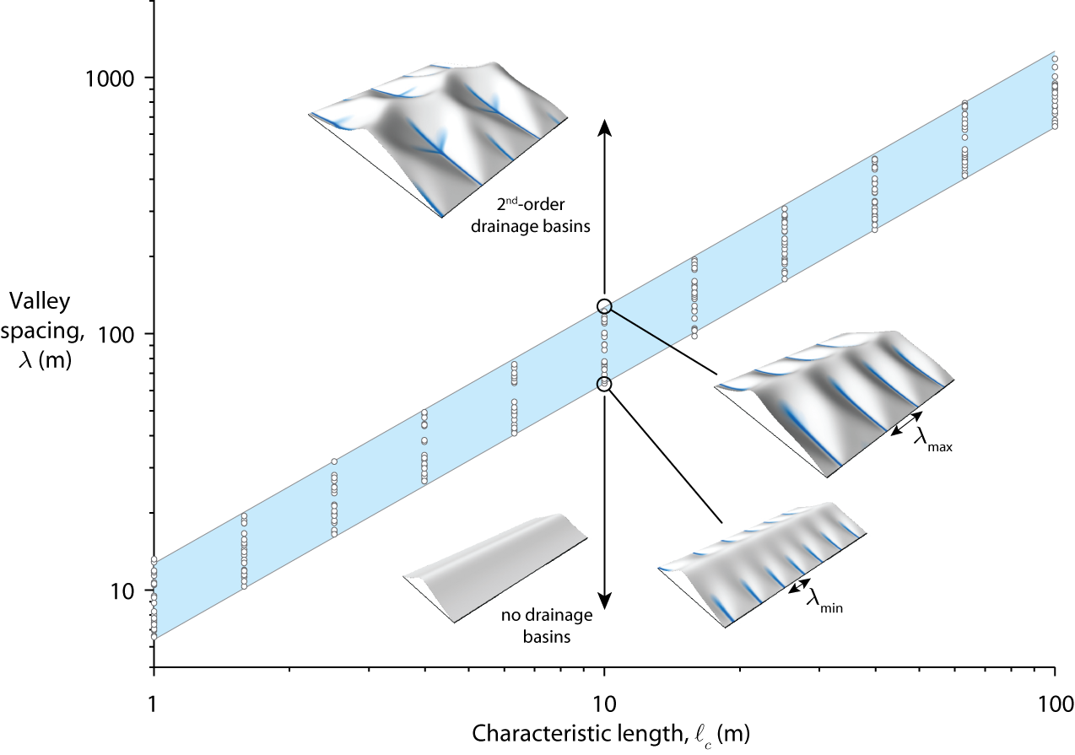
Different slope lengths lead to a 2× range in spacing of first-order valleys
Perron et al. [2009]

Slide 21
Do field sites follow this trend?
Measure with spectral analysis of LiDAR
λ
Measure from hillslope & stream profiles
Perron et al. [2009]

Slide 22
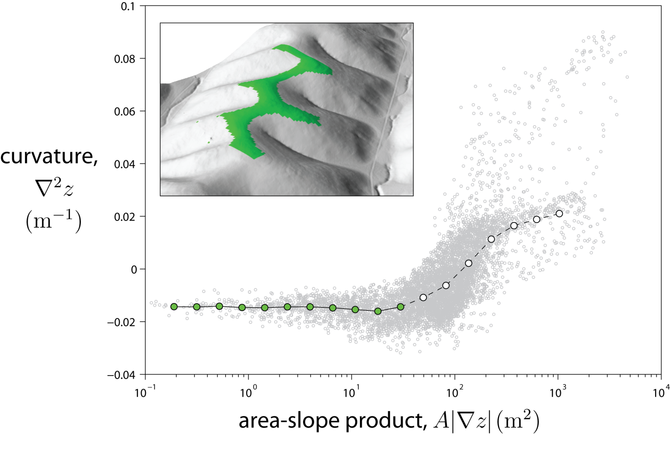
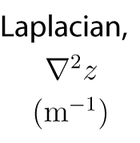
Measuring Pe with LiDAR
Assume:
Gabilan Mesa
Perron et al., 2009
Notes:
The governing equation predicts uniform curvature near ridgelines at equilibrium.
So this is a test of both the form of the equation and the equilibrium assumption.
Can’t do this without LiDAR

Slide 23
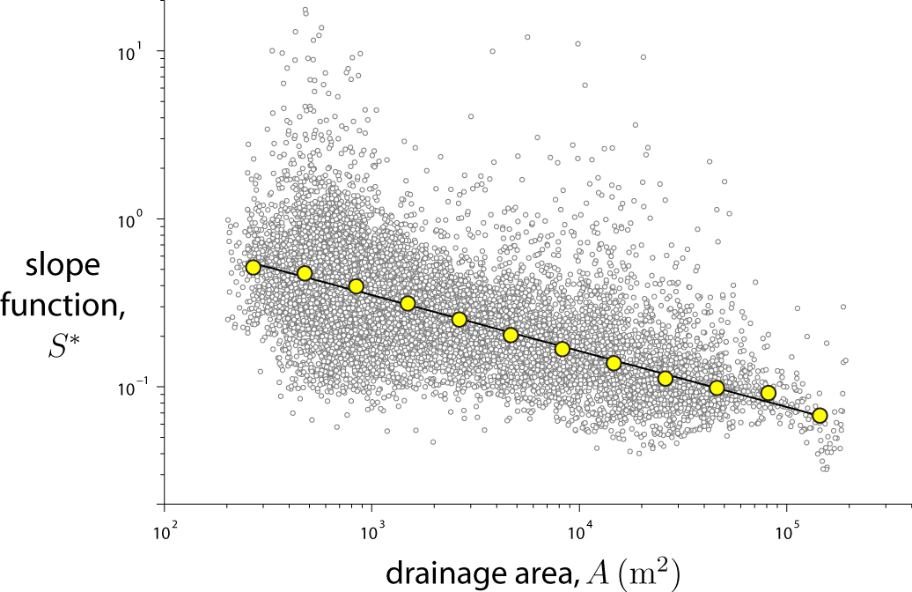
Measuring Pe with LiDAR
Perron et al., 2009
Notes:
The governing equation predicts a power-law relationship between this normalized slope and area at equilibrium.
So this is a test of both the form of the equation and the equilibrium assumption.
Note that E cancels out.

Slide 24
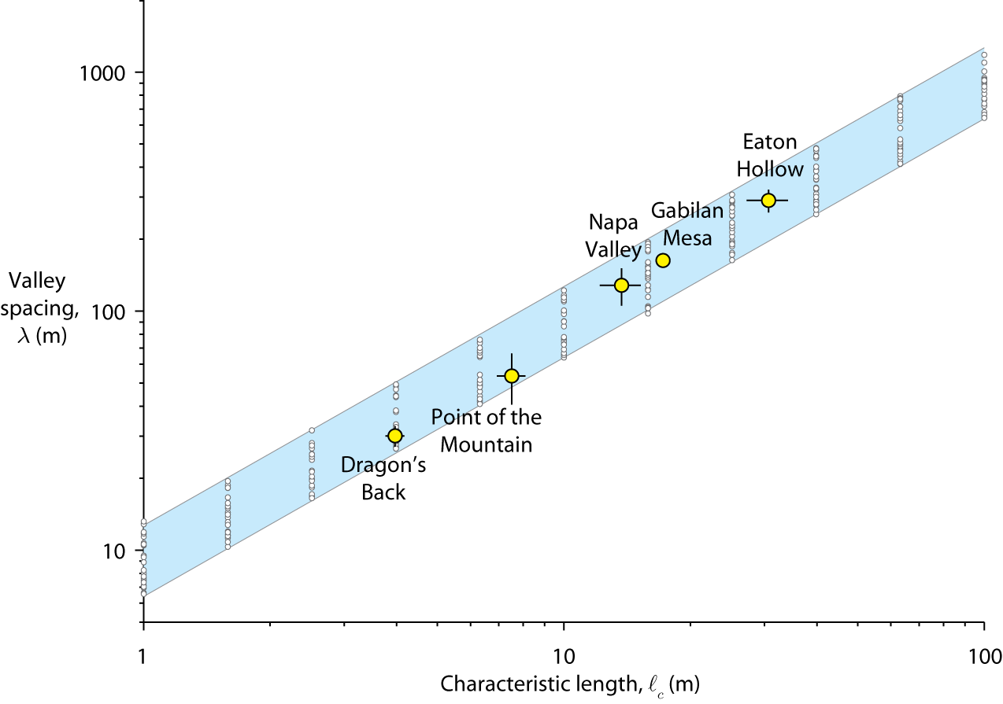
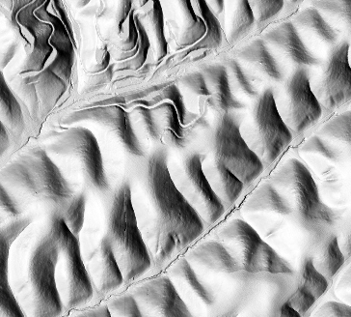
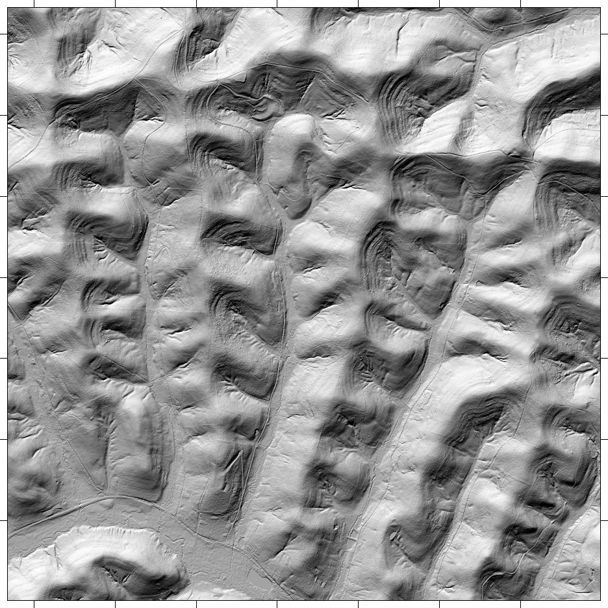
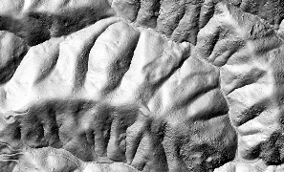
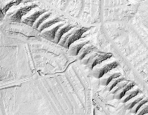
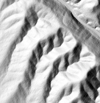
(2x scale)
Perron et al. [2009]

Slide 25
Valley spacing is a signature of rock strength, climate, and life
Increasing
Rock strength,
Rainfall
Stronger rock resists river incision
Rain promotes bioturbation
Faster soil creep
Infiltration rather than surface runoff
Weak sediments erode easily
Dry climate with less bioturbation
Slower soil creep
More runoff
(2x scale)
Perron et al. [2009]

Slide 26
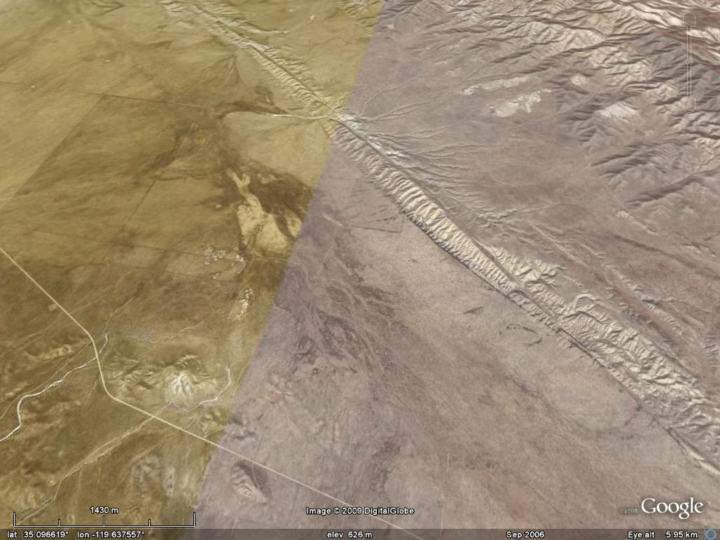
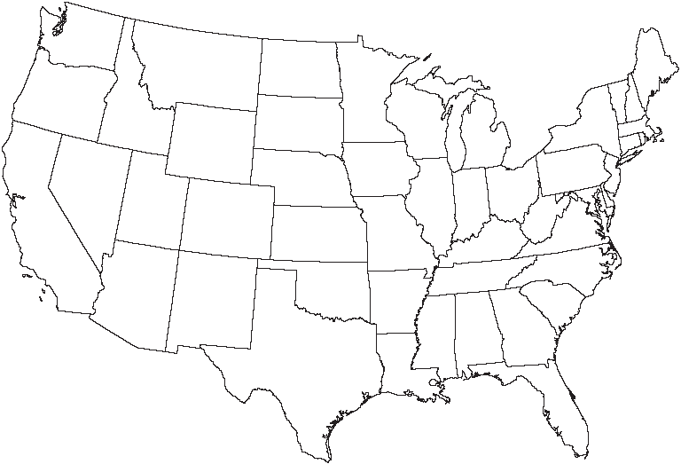
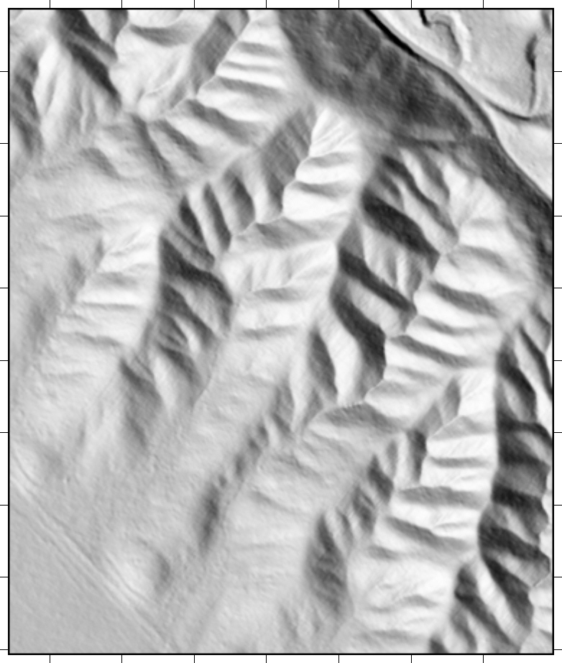
Dragon’s Back Ridge
Carrizo Plain, CA
100m
Notes:
We stay away from the areas where landsliding occurs

Slide 27
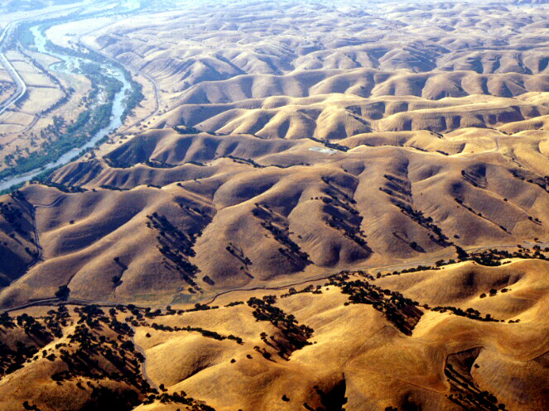
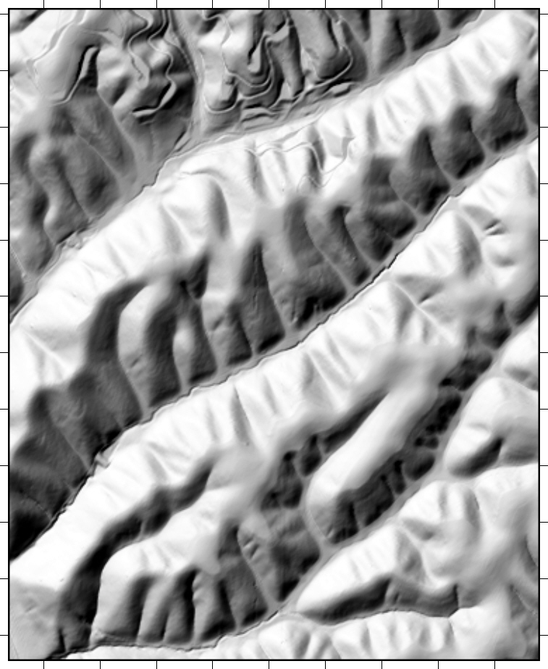
Gabilan Mesa
Salinas Valley, CA
Weakly lithified sediments
Dominant erosion processes: bioturbation creep, episodic stream incision
Notes:
80m/230kyr = 0.35 mm/yr

Slide 28
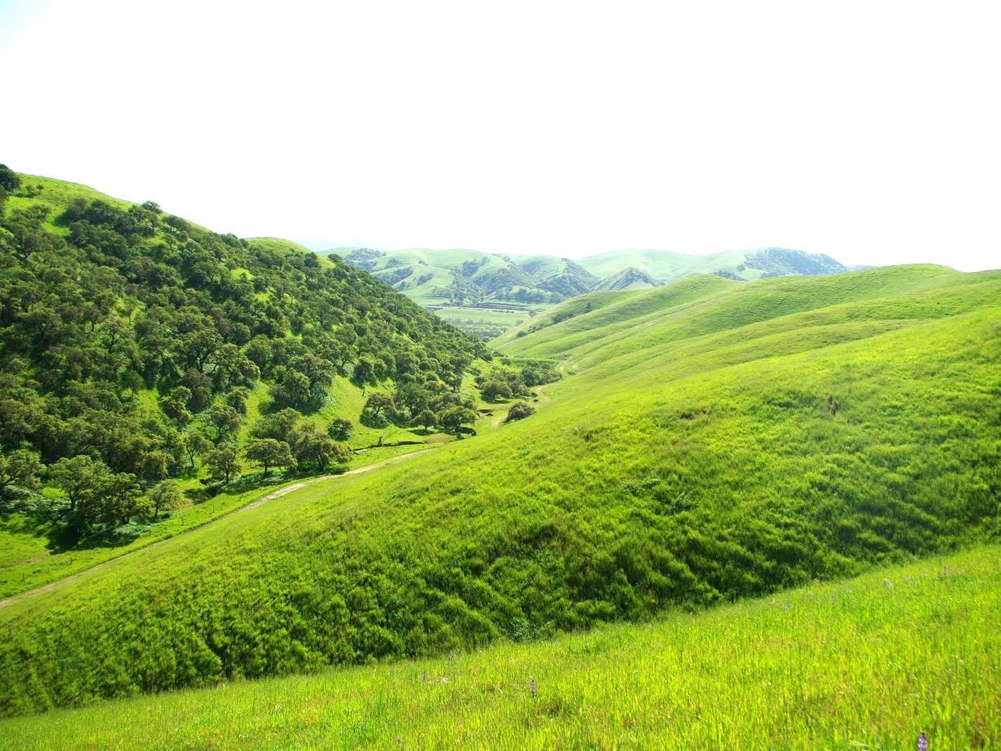
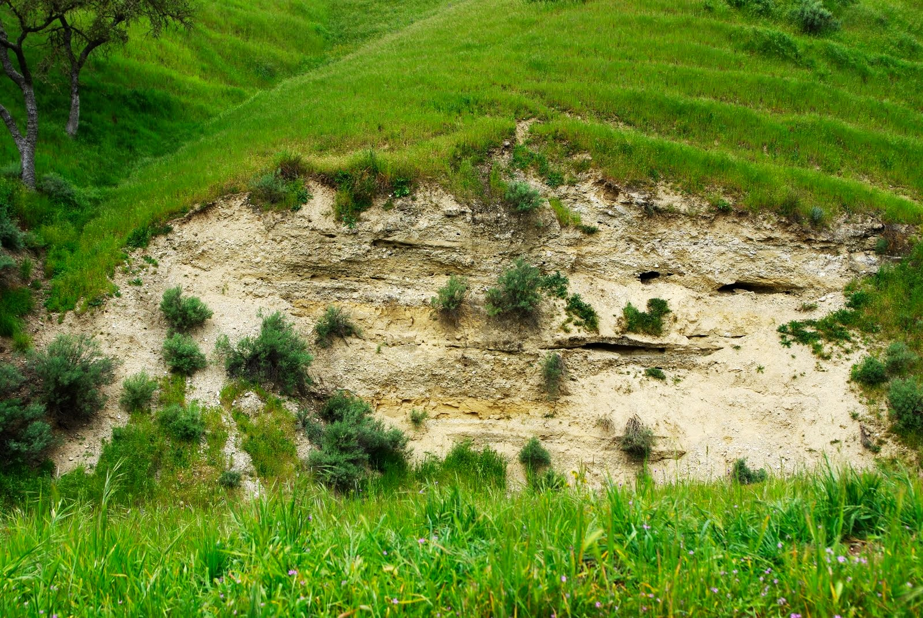

Slide 29
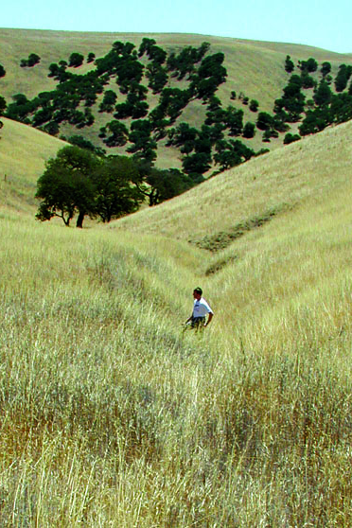

Slide 30
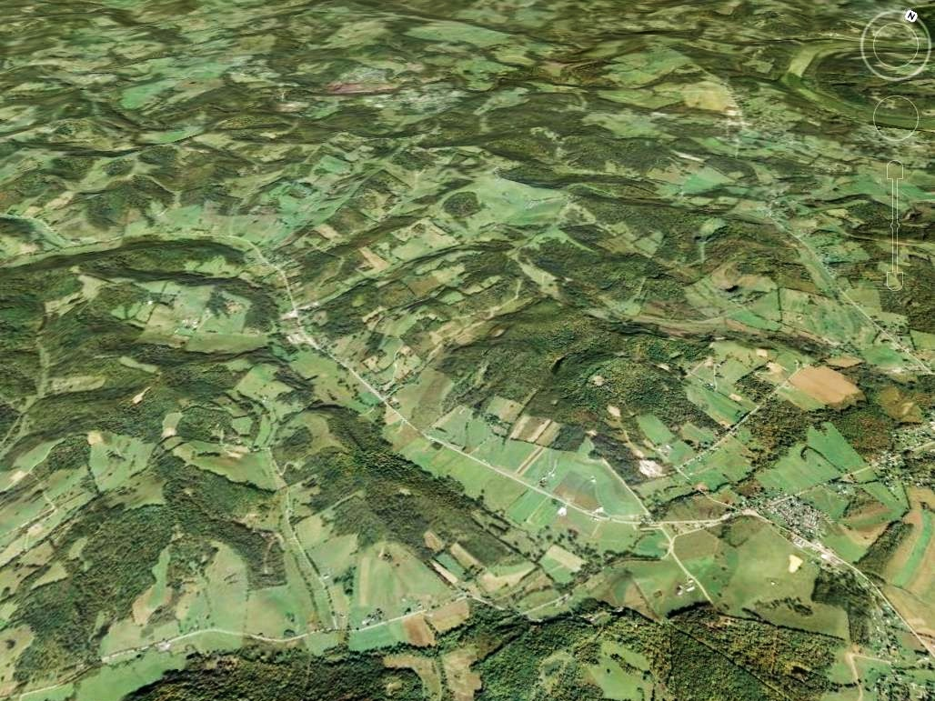
Allegheny Plateau, PA
Google
1 km

Slide 31
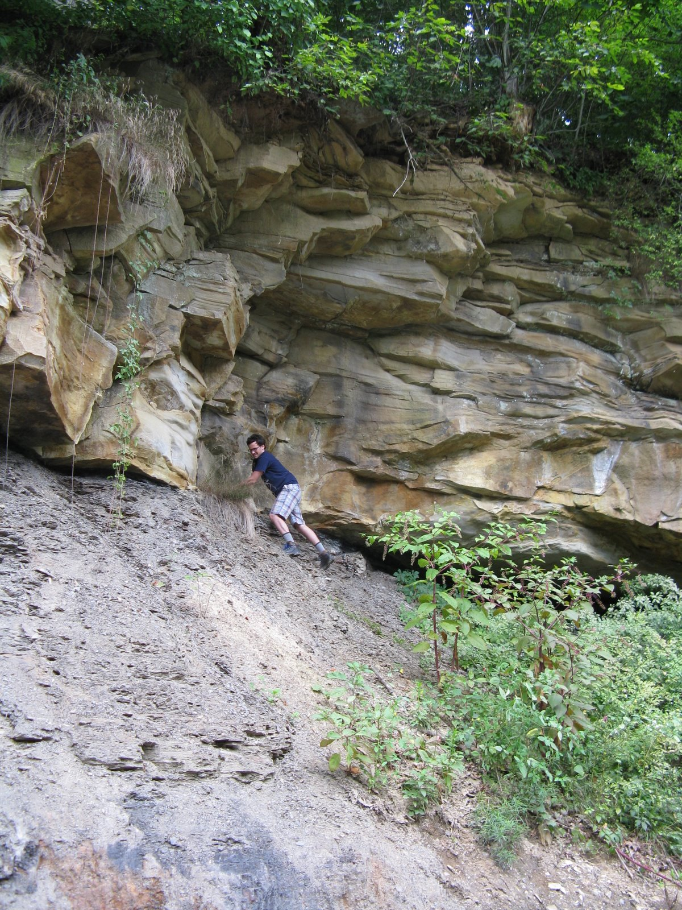
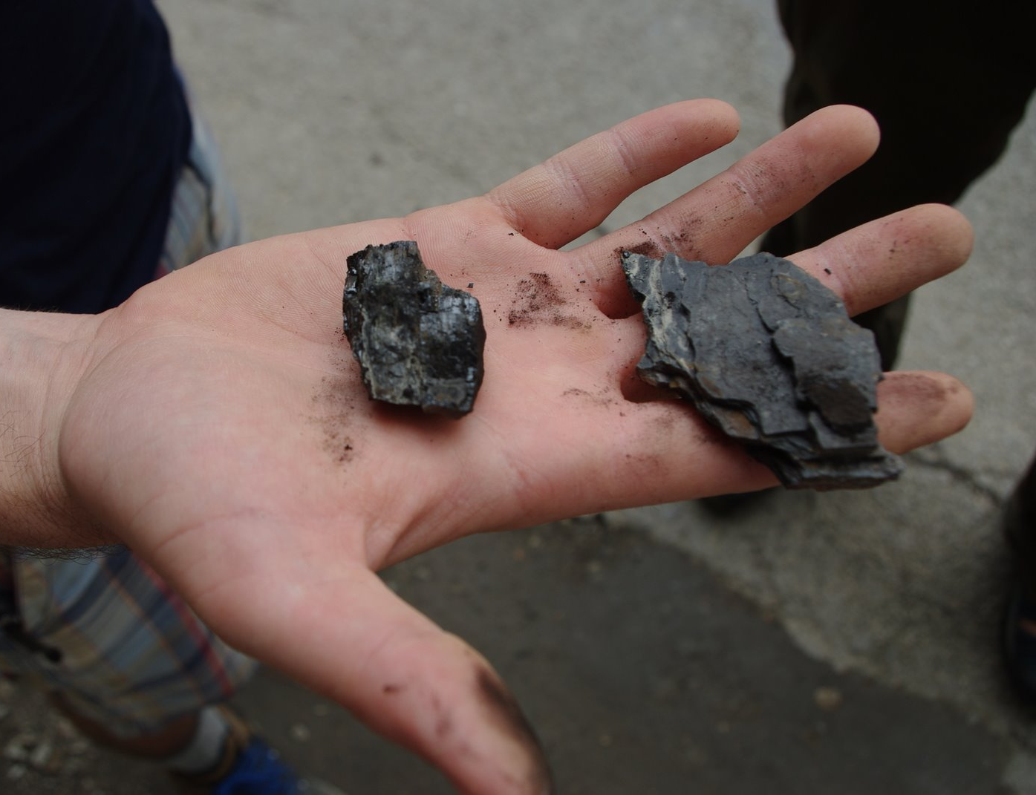
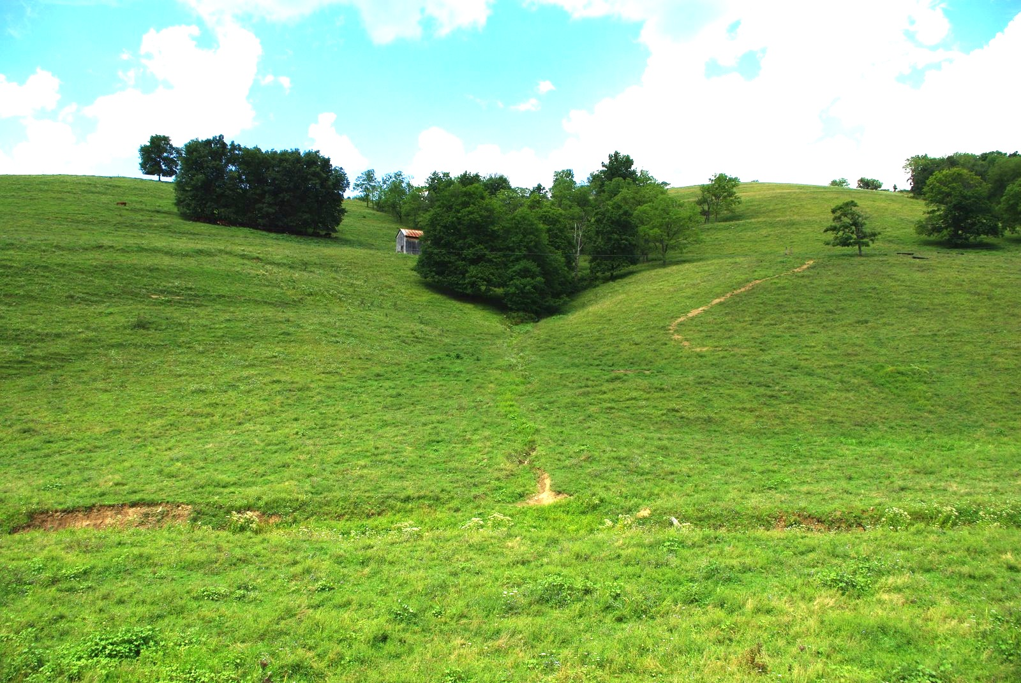
Notes:
Green Fm

Slide 32
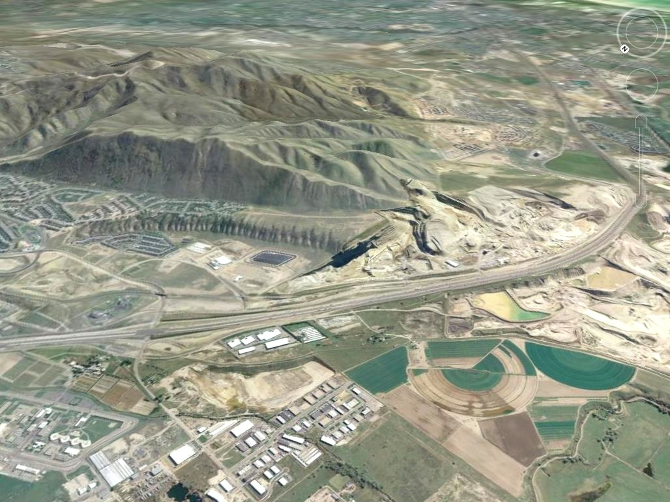
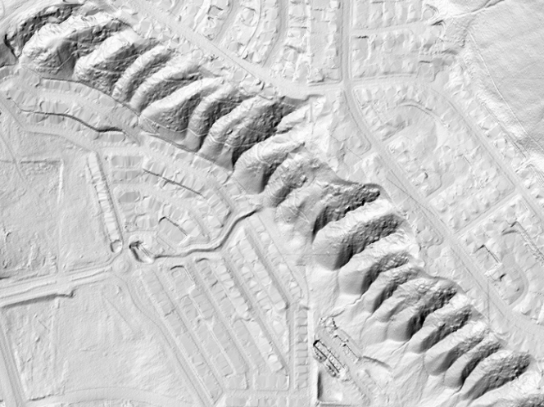
Point of the Mountain
Salt Lake Valley, UT
250m
Google

Slide 33
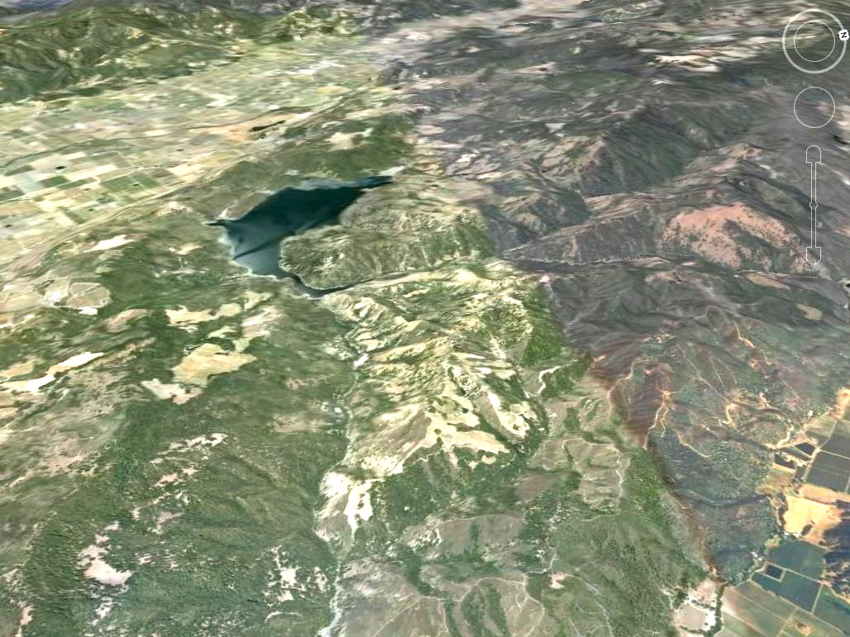

Napa Valley, CA
250m
Google

Slide 34
How do these mechanisms influence the structure of branching river networks (Pe >> 1) ?
Allegheny Plateau, PA & WV
10 km
Notes:
This is their most basic property. In some planetary cases, the branching structure is the only reason we think we’re looking at drainage networks.

Slide 35
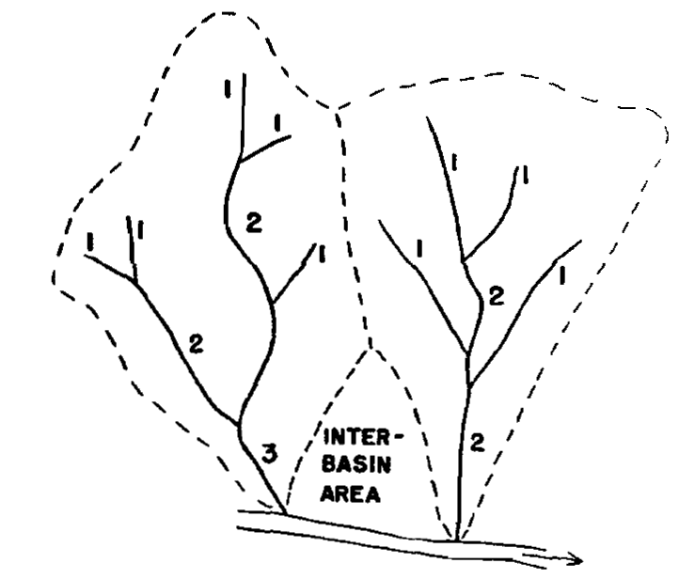

Early efforts to identify fundamental signatures suffered from a lack of uniqueness
Horton [1945] - Strahler [1952] stream ordering scheme
(in Schumm [1956])
Leopold & Langbein [1962], Shreve [1967], Kirchner [1993]:
Nearly all branching networks satisfy Horton’s laws
Notes:
There’s a long history to this question.
In fact, frameworks for quantifying the hierarchical, branching structure of river networks have become the industry standard in other fields that study networks, such as circulatory systems.
Horton, (Strahler), and Schumm posited that there were certain scaling laws that describe river networks.
But this idea took a nosedive when Kirchner showed that nearly all networks, satisfy these laws. So the idea of trying to identify universal scaling laws for river networks fell out of favor.

Slide 36


Natural networks share many characteristics with optimal channel networks that minimize local or global energy expenditure
Howard [1990]
Rodríguez-Iturbe & Rinaldo [1997]
Notes:
But R-I and Rinaldo note that our ability to explain network form with erosional mechanics lags behind.

Slide 37

Landscape evolution models produce branching networks that look realistic. Do they correctly predict properties of natural networks? What do we measure?
2 km

Slide 38




What controls the spatial scale of the transition from 1st-order to 2nd-order drainage basins?
Notes:
I suggest this is a fundamental signature that is at the root of branching networks.
Another way to think about it: what is the maximum stable size of a first-order basin?
For example: In landscapes with uniform lithology, tectonics, climate, drainage basins of different orders have well-defined modal areas.
If the same mechanism is responsible, there should be a common framework for predicting that scale.
Here I'll focus on the 1-2 transition: the first time valleys develop tributaries.
What’s different about these places that the drainage area of the branching transition differs by a factor of ~4?

Slide 39

Notes:
This is the geomorphological equivalent of turning up the rayleigh number in a rayleigh-benard convection cell. The model we've developed is one of the few capable of studying this problem (flow routing).
What controls these transitions? Let's take a closer look with a more controlled experiment.

Slide 40

As Pe increases,
1st-order basins become 2nd-order basins by:
Eating their neighbors
Growing tributaries
Notes:
Now look just at the 1o→2o transition. Branching occurs abruptly (over a narrow range of Pe)

Slide 41

1st-order basins are stable with respect to perturbations in drainage area for Pe < 250
movie 1
Notes:
Another experiment: Start with the finest-scale valleys. Turn up the knob on Pe and record a measure of valley size.
Result: the transition from 1o to 2o basins looks a lot like a pitchfork bifurcation. The solution consisting of evenly spaced valleys switches from a stable to an unstable equilibrium.

Slide 42

Basins below this threshold, when perturbed, return to their original size

Slide 43
1st-order basins are unstable with respect to perturbations in drainage area for Pe > 250
movie 1
movie 2

Slide 44

Basins above the threshold, when perturbed, eat their neighbors

Slide 45

The difference is whether a displaced divide bounces back or continues to migrate
Notes:
AS THE PREVIOUS MOVIES SUGGESTED, THEY BRANCH BECAUSE THE RIDGELINE MIGRATES UNSTABLY FOR Pe > Pe_c. And once the ridgelines have migrated and the basins have widened, their sideslopes exceed the critical Pe for the formation of first-order basins (another threshold I’m not discussing here).

Slide 46


Notes:
What sets this critical value, Pe_c, for ridge migration?

Slide 47

stable
Notes:
What sets this critical value, Pe_c, for ridge migration?

Slide 48

unstable
Notes:
What sets this critical value, Pe_c, for ridge migration?

Slide 49


Pe < Pe_{c}: stable divide
Notes:
Phase portrait for stable case: show a movie with the path followed marked on the plot

Slide 50



Pe ~ Pe_{c}: conditionally stable divide
Notes:
Phase portrait for stable case: show a movie with the path followed marked on the plot

Slide 51


Pe > Pe_{c}: unstable divide
Performing a similar analysis numerically in 2D predicts Pe_{c} ≈ 250
Notes:
Phase portrait for stable case: show a movie with the path followed marked on the plot

Slide 52



Once basins have eaten their neighbors and widened, their side slopes, now twice as long, are unstable to lateral perturbations
Amplitude exaggerated
Amplitude exaggerated

Slide 53




Slide 54
Notes:
Can these stability transitions explain the gap between modes of 1st and 2nd order basins?

Slide 55



Valley heads identified using deviation of curvature and drainage area PDFs from normal/lognormal distribution
Follows Lashermes et al. [2007], Passalacqua et al. [2010]
Curvature
Log10(area)
Notes:
Curvatures kappa are suposingly distributed randomly and we would expect a distribution close to a normal distribution.
Drainage area is varying dramatically from the very top of the hills to the outlet of the basin. The variation is of several order of magnitudes, so drainage area cannot be normally distributed. Intuitively, we had a look at the normal distribution of drainage areas, in order to shrink its range of variation and see if it was then close to normally distributed.
We observe quite nice bell-shaped distribution, with a tail at high values.
First assume that these tails represent the channelized part of the landscape

Slide 56

measured from LiDAR using method of Perron et al. [2009]
Notes:
Where to begin? Explain fundamental, emergent length scales.
For example: In landscapes with uniform lithology, tectonics, climate, drainage basins of different orders have well-defined modal areas.
If the same mechanism is responsible, there should be a common framework for predicting that scale.
Here i'll focus on the 1-2 transition: the first time valleys develop tributaries.
What’s different about these places that the drainage area of the branching transition differs by a factor of ~4?

Slide 57
Notes:
Where to begin? Explain fundamental, emergent length scales.
For example: In landscapes with uniform lithology, tectonics, climate, drainage basins of different orders have well-defined modal areas.
If the same mechanism is responsible, there should be a common framework for predicting that scale.
Here i'll focus on the 1-2 transition: the first time valleys develop tributaries.
What’s different about these places that the drainage area of the branching transition differs by a factor of ~4?

Slide 58
Notes:
Where to begin? Explain fundamental, emergent length scales.
For example: In landscapes with uniform lithology, tectonics, climate, drainage basins of different orders have well-defined modal areas.
If the same mechanism is responsible, there should be a common framework for predicting that scale.
Here i'll focus on the 1-2 transition: the first time valleys develop tributaries.
What’s different about these places that the drainage area of the branching transition differs by a factor of ~4?

Slide 59

Given the spatial scale of the 1st order – 2nd order transition,
we can gauge relative strengths of dominant erosion mechanisms, and relate them to site characteristics
MAP = 100 cm
Fast infiltration
250 Ma sed. rocks
Temperate deciduous
A₁₋₂ ≈ 4 x 10⁵ m²
MAP = 30 cm
Slow infiltration
2 Ma sed. rocks
Oak savannah
A₁₋₂ ≈ 10⁵ m²
Precip, runoff,
rock weakness
Bioturbation
Notes:
A1-2 is 4x larger in AP, so K/D is smaller. This is consistent with our expectation that runoff production is more efficient, and rock type weaker, in GM. So stream incision is more efficient there.

Slide 60

Measure from ¹⁰Be in stream sediment
Measure from LiDAR
Notes:
In this case, U is the base level lowering rate. Doesn’t have to = rock uplift rate

Slide 61
Measure from ¹⁰Be in stream sediment
Measure from LiDAR
Ultimate goal: determine how these parameterized, long-term rate coefficients depend on lithology and climate.
Notes:
In this case, U is the base level lowering rate. Doesn’t have to = rock uplift rate. Example: for AP, we just obtained measurements indicating U (actually the basin-averaged erosion rate) = 0.035 mm/yr. curvature = -0.0055 /m, so D = 0.0064 m^2/yr, comparable to values measured in other temperate landscapes. K/D = 0.00125, so K = 8e-6. We’d like to break this down even further, to study how these parameterized long-term rate coefficients depend on climate.

Slide 62

How does climate influence erosion rates?
von Blanckenburg [2005]

Slide 63
  One strategy for studying climate’s effects on erosion and landscape evolution:
  Identify natural experiments in which climate varies, but rock type and tectonics/boundary conditions are [nearly] constant

Slide 64




Microclimate-controlled topographic asymmetry
How does sunlight modulate efficiency of erosion processes?
Paul Richardson
Gabilan Mesa, CA
N
100m

Slide 65




How does a steep rainfall gradient influence the efficiency of erosion processes?
Ken Ferrier, with Sujoy Mukhopadhyay (Harvard), John Stock (USGS), The Nature Conservancy
Contours: median August precip (mm)

Slide 66

Preliminary erosion rates from cosmogenic ³He and analysis of LiDAR topography suggest more efficient hillslope erosion and river incision at higher rainfall rates
Cosmogenic ³He in detrital olivine in stream sediment

Slide 67

Hanalei River, Kauai

Slide 68



Shallow landslides are common
Shallow landslide scars mapped from Quickbird images

Slide 69




Frequency of landsliding can be estimated from landslide inventories measured at different times
2003
2005
 | 2003 - 2005 | 2005 - 2010
Number of New Landslides | 10 | 33
Landslide Generation Rate (Landslides/km²/yr) | 0.10 | 0.15
Landslide Erosion Rate (t/km²/yr) | 23 | 41
N
50 m
N
50 m
2005
2010
N
20 m
N
20 m

Slide 70



More landslides happen at steeper slopes, but not at wetter sites

Slide 71
Summary
Emergent landscape patterns are markers of climate, rock properties, and biotic processes
Branching in river networks results from an instability that occurs at a predictable scale.
With LiDAR and CRNs for select field sites, can study how efficiencies of erosion mechanisms vary with climate

