Slide 1
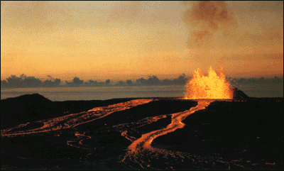
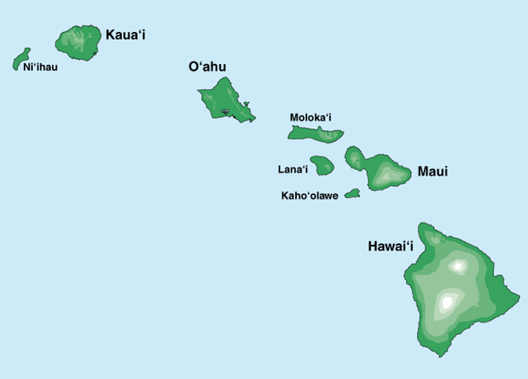
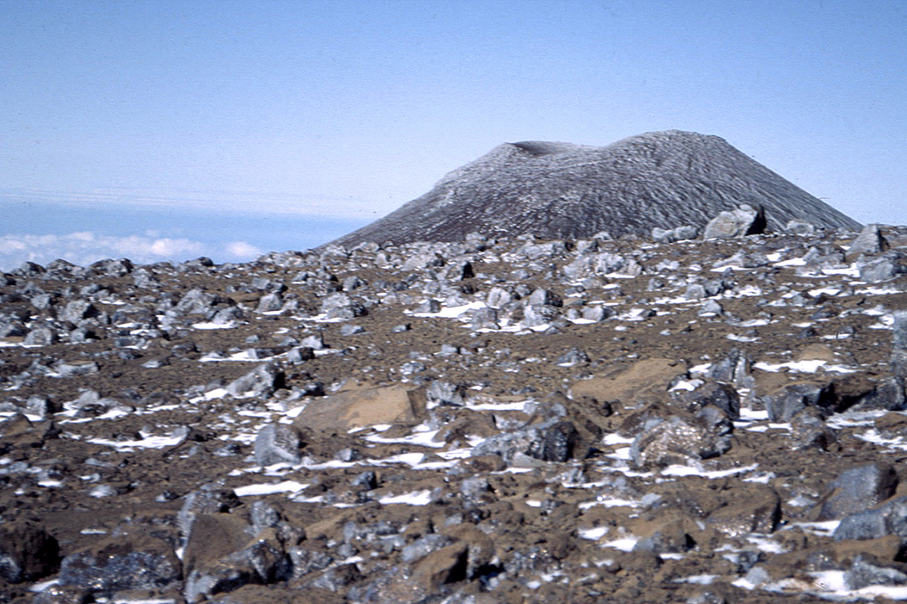
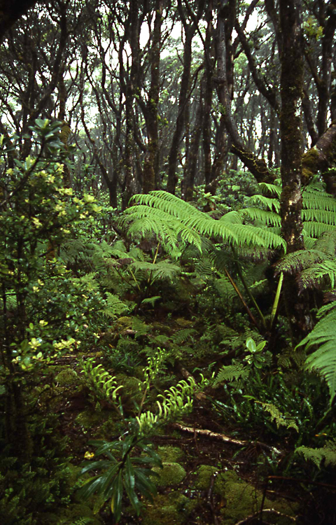
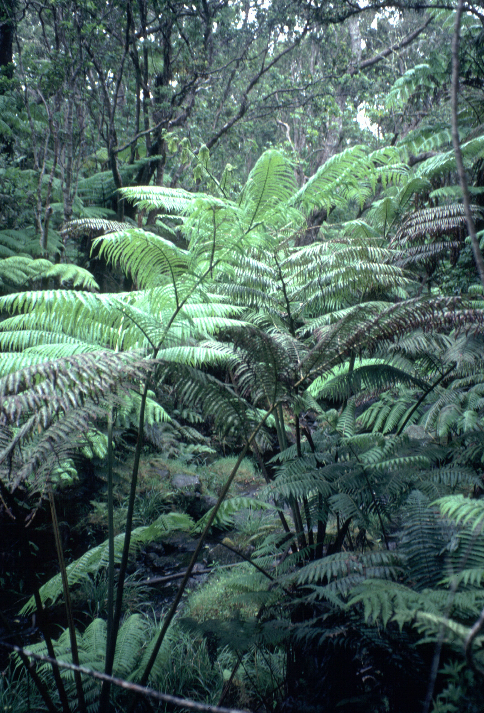
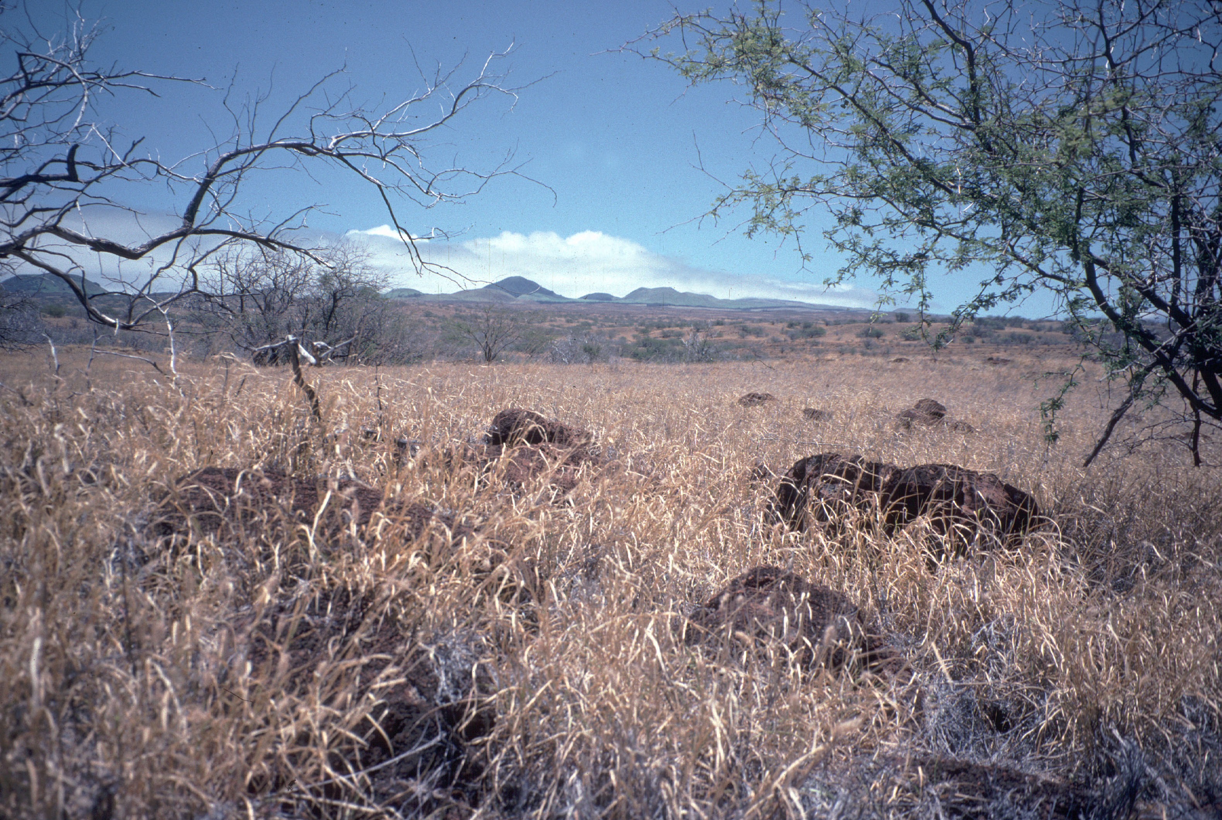
Farming the Rock:
Biogeochemical Controls on Intensive Agriculture in Polynesia
Oliver Chadwick, UCSB
Patrick Kirch
Peter Vitousek
Thegn Ladefoged

Slide 2
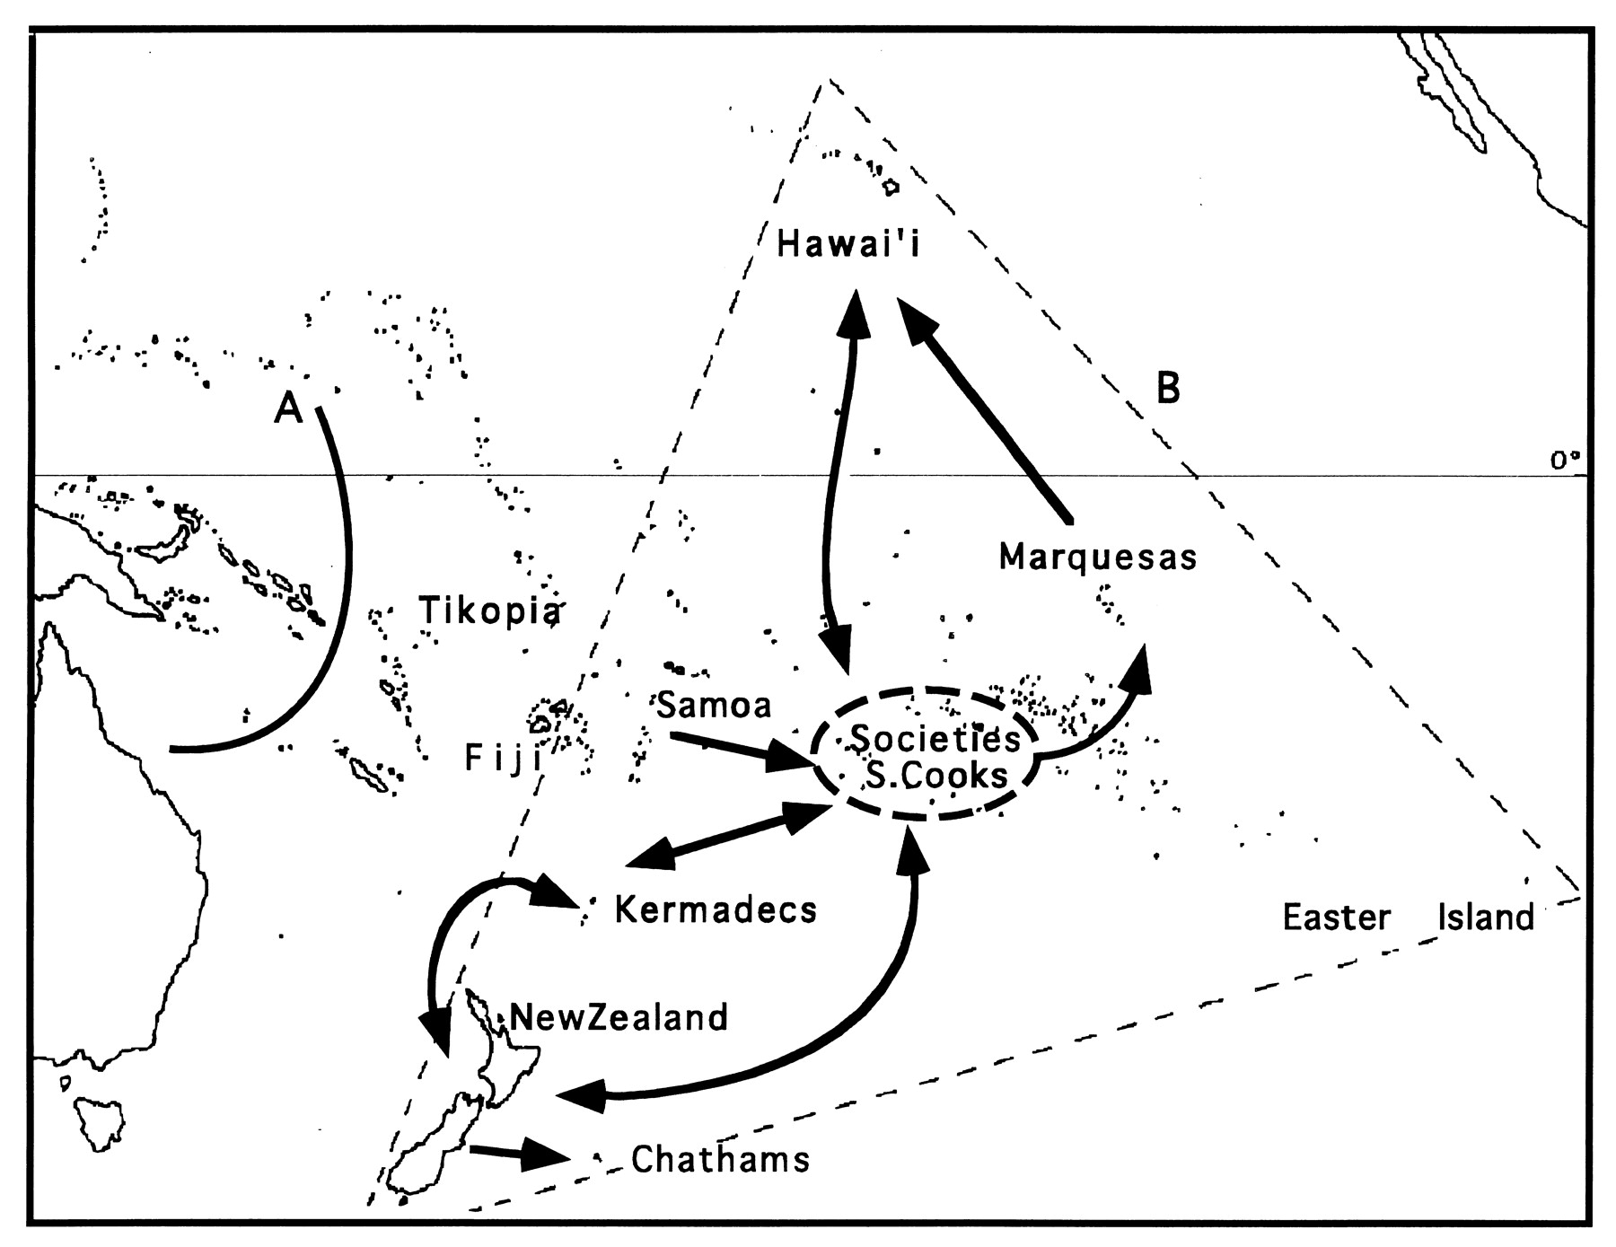
Polynesia
©1998 by National Academy of Sciences
Matisoo-Smith et al. PNAS 1998;95:15145-15150
Notes:
Map of Polynesia. Line A identifies delineation between Near and Remote Oceania and B shows the Polynesian Triangle. Bold arrows show a likely sequence of colonization and contact in prehistoric Polynesia. These sequences are based on interpretations from the mtDNA phylogenies of R. exulans. Samples included in the analyses were collected from Fiji (n = 1 from Waya), Samoa (n = 1 from Manua), the Cook Islands [n = 13 from Rarotonga (S. Cooks 12), from Aitutaki (S. Cooks 2, 3, 4, 6, and 11), from Takutea (S. Cooks 7, 9, and 10), and from Atiu (S. Cooks 1, 5, 8, and 13)], the Society Islands [n = 23 from Tahiti (Societies 6, 9, 11, 13, 18, and 21), from Raiatea (Societies 4, 5, 7, 8, 14, 15, 16, 17, 19, 20, and 22), and from Huahine (Societies 1, 2, 3, 10, 12, and 23)], the Marquesas (n = 7 from UaHuka), Hawaii [n = 5 from Hawaii (Hawaii 1–3 and 5) and from Oahu (Hawaii 4)], the Kermadecs (n = 4 from Raoul), New Zealand [n = 34 from off shore islands of the east coast of the North Island (NZ 7–10, 12–24, 28, and 34), from Kapiti Island off the west Coast of the North Island (NZ 2, 3, 11, 26, 27, and 32), from Marlborough Sounds (NZ 1, 25, 29, 30, 31, and 33), and from Stewart Island (NZ 4, 5, and 6)], and the Chatham Islands (n = 5 from Chatham Is.). The sample from Halmahera (Moluccas Islands) was used as an outgroup to root the tree.

Slide 3
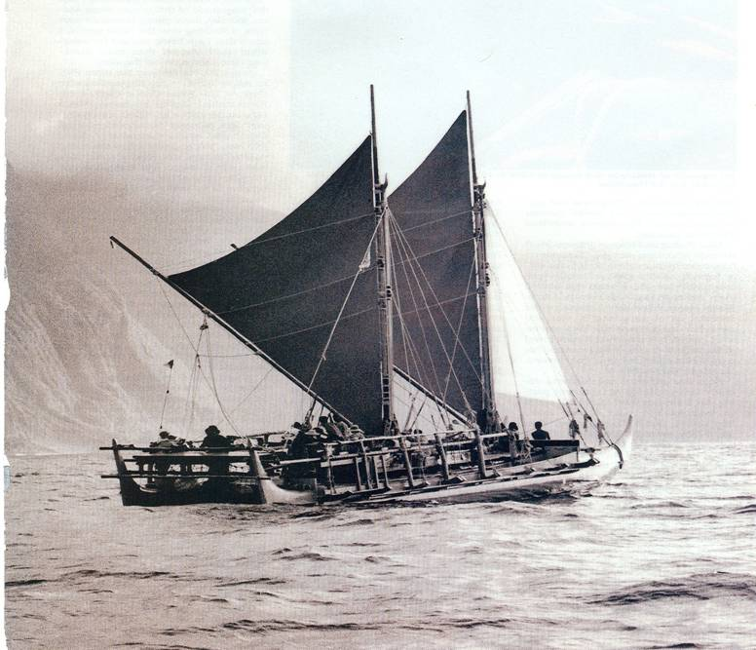
Navigators and Agriculturalists
Notes:
Arrival of Polynesians in Hawaii
Brought Kitchen Gardens
Encountered the largest variety of environments
In the Pacific

Slide 4
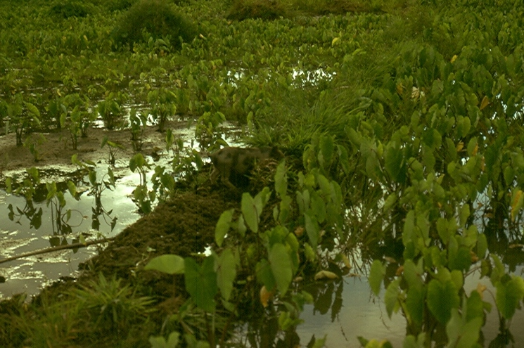
Irrigated Taro

Slide 5
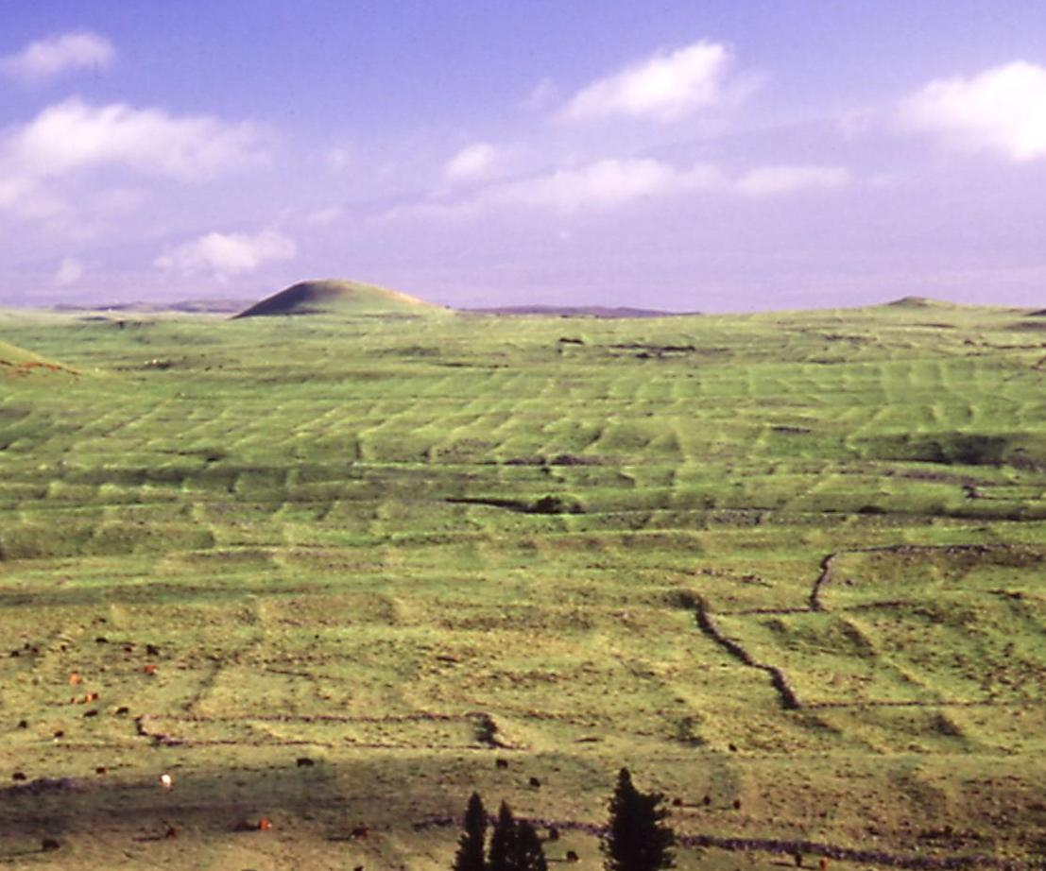
Rain-fed Sweet Potato, Taro, Sugar Cane

Slide 6
Polynesians in Hawaii
Arrival between AD1000 and AD1200
Initially lived in decentralized house-hold based villages
By the 16th century, their society had evolved to an archaic
chiefdom
All evidence suggests a complex hierarchy was thriving up to collapse due to European disease

Slide 7
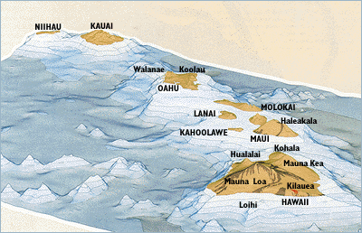
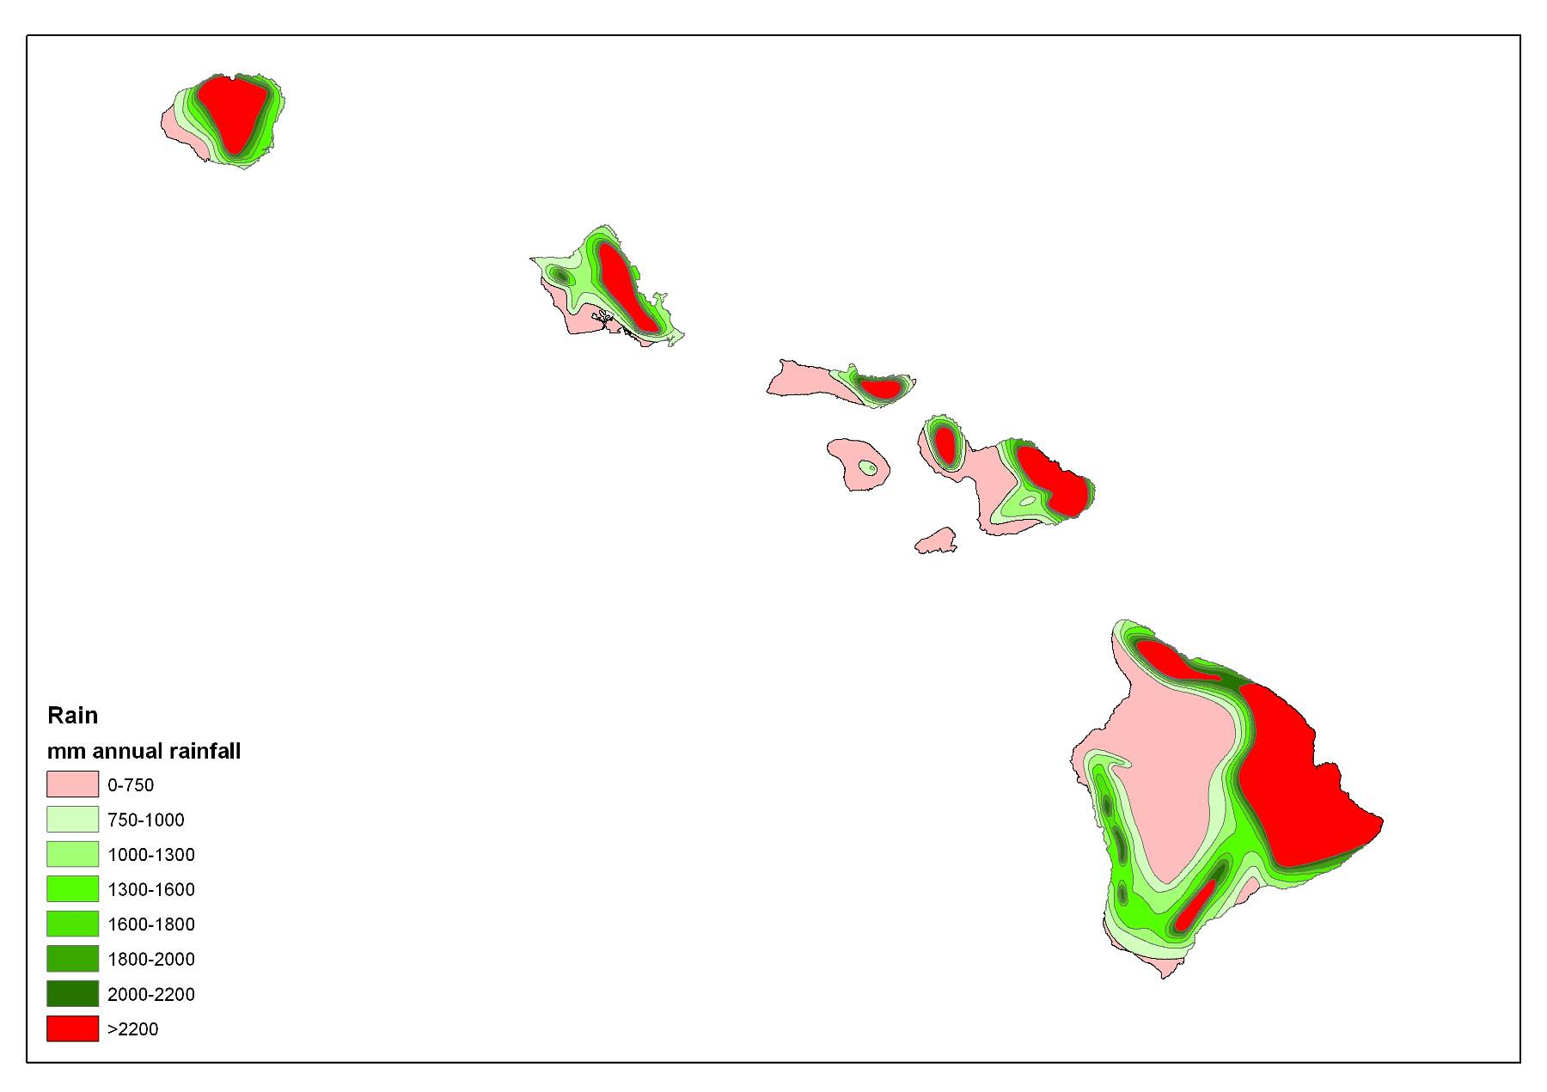
Hawaii – a niche-rich archipelago
4 my
0 – 400 ky

Slide 8
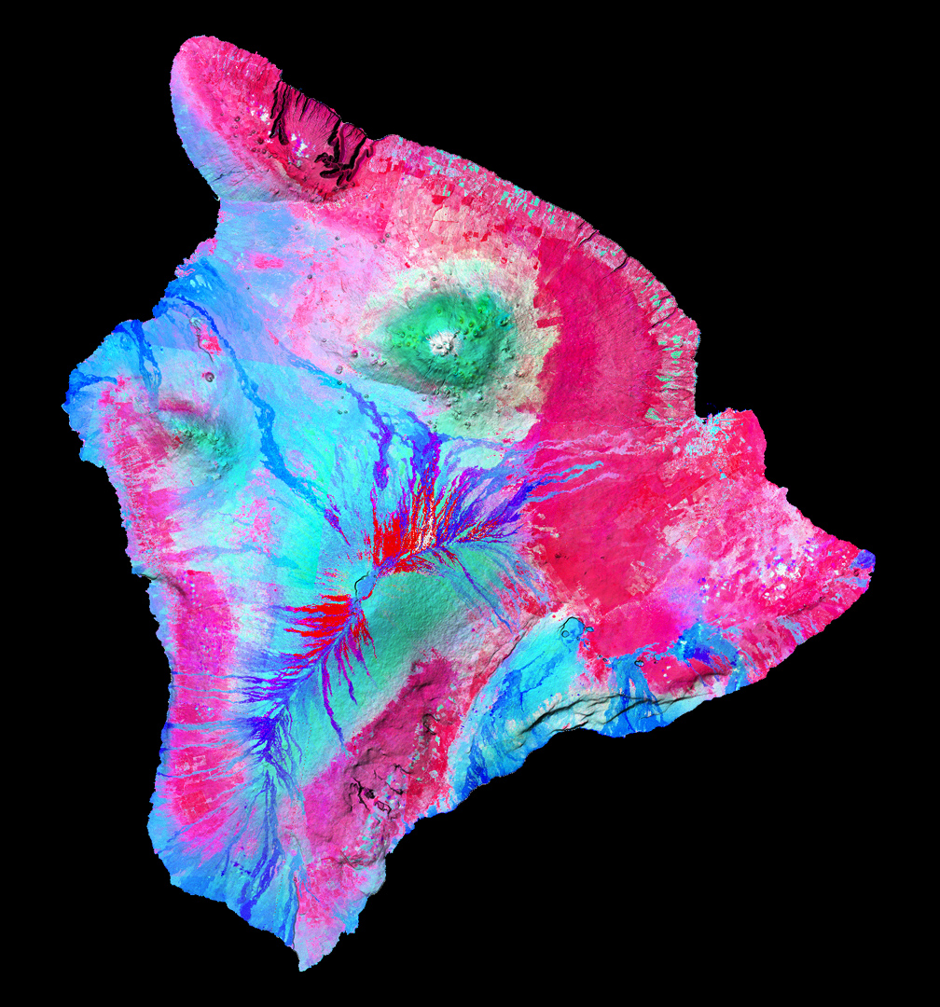
Hawaii Island
Constructional shield surfaces predominate
Mostly nutrient-rich soils
Rain-fed Agriculture

Slide 9
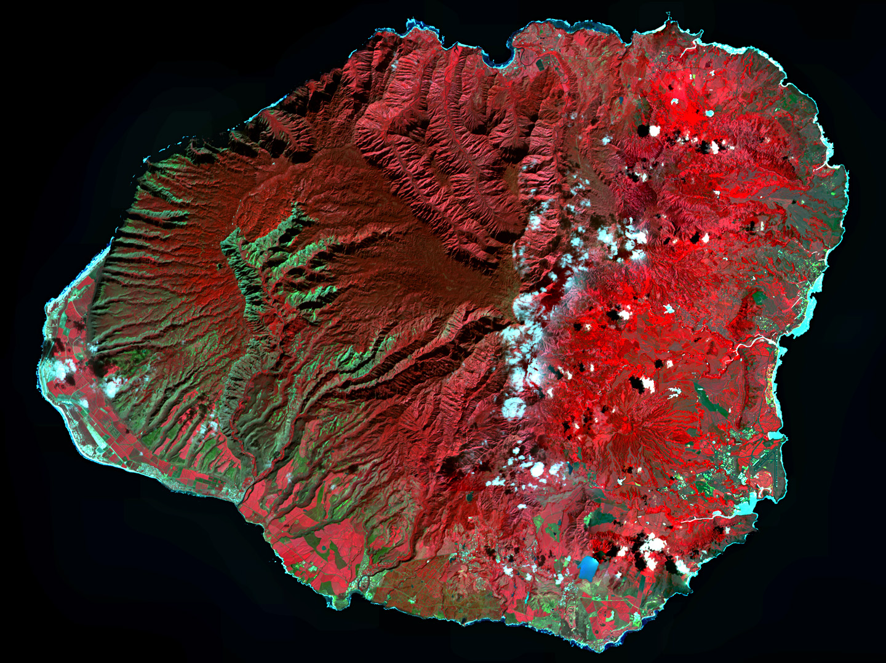
Kauai & Oahu
Strongly eroded, forming river valleys and depositional lowlands
Nutrient-depleted soils in stable uplands
Irrigated taro in lowlands

Slide 10
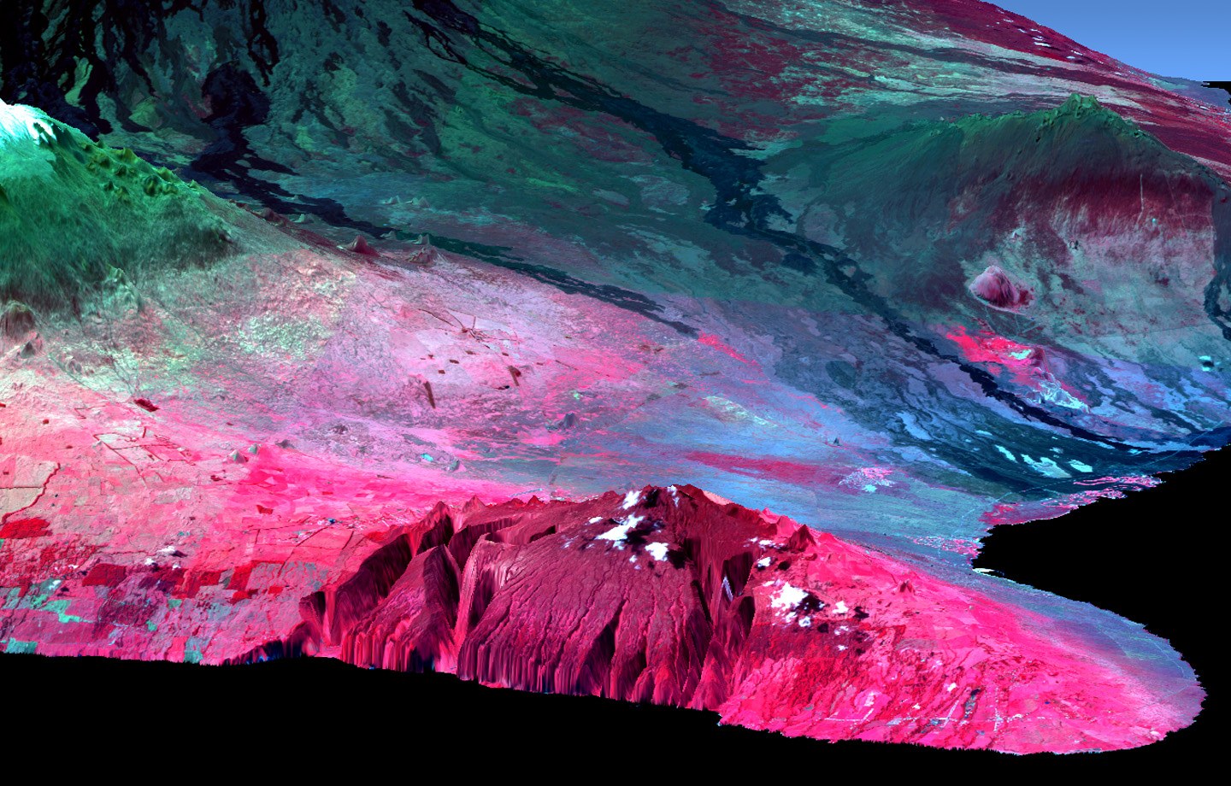
Hawaii as Natural Laboratory:
Biogeochemistry and Human Ecodynamics
Notes:
One of the useful features of Hawaii as natural
Is the fact that lava flows can be mapped through different rainfall zones.

Slide 11
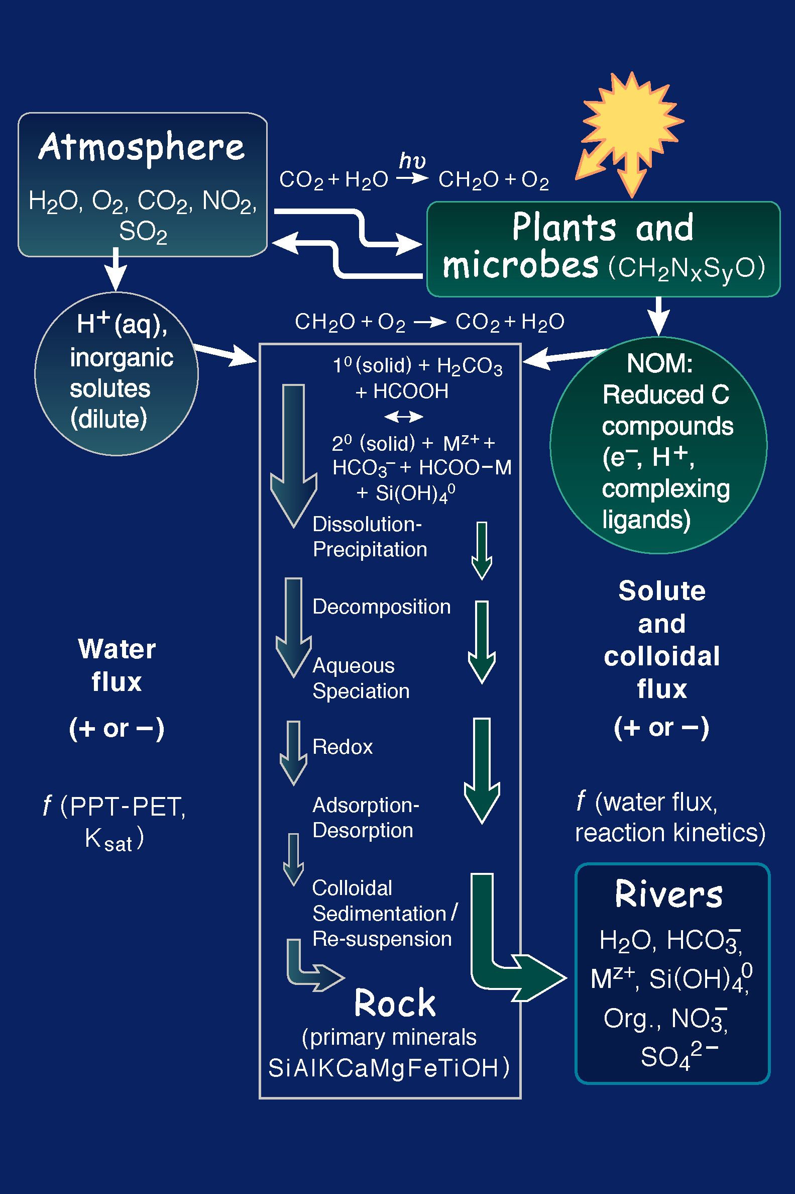
Conceptual Framework
Chadwick and Chorover, 2001

Slide 12
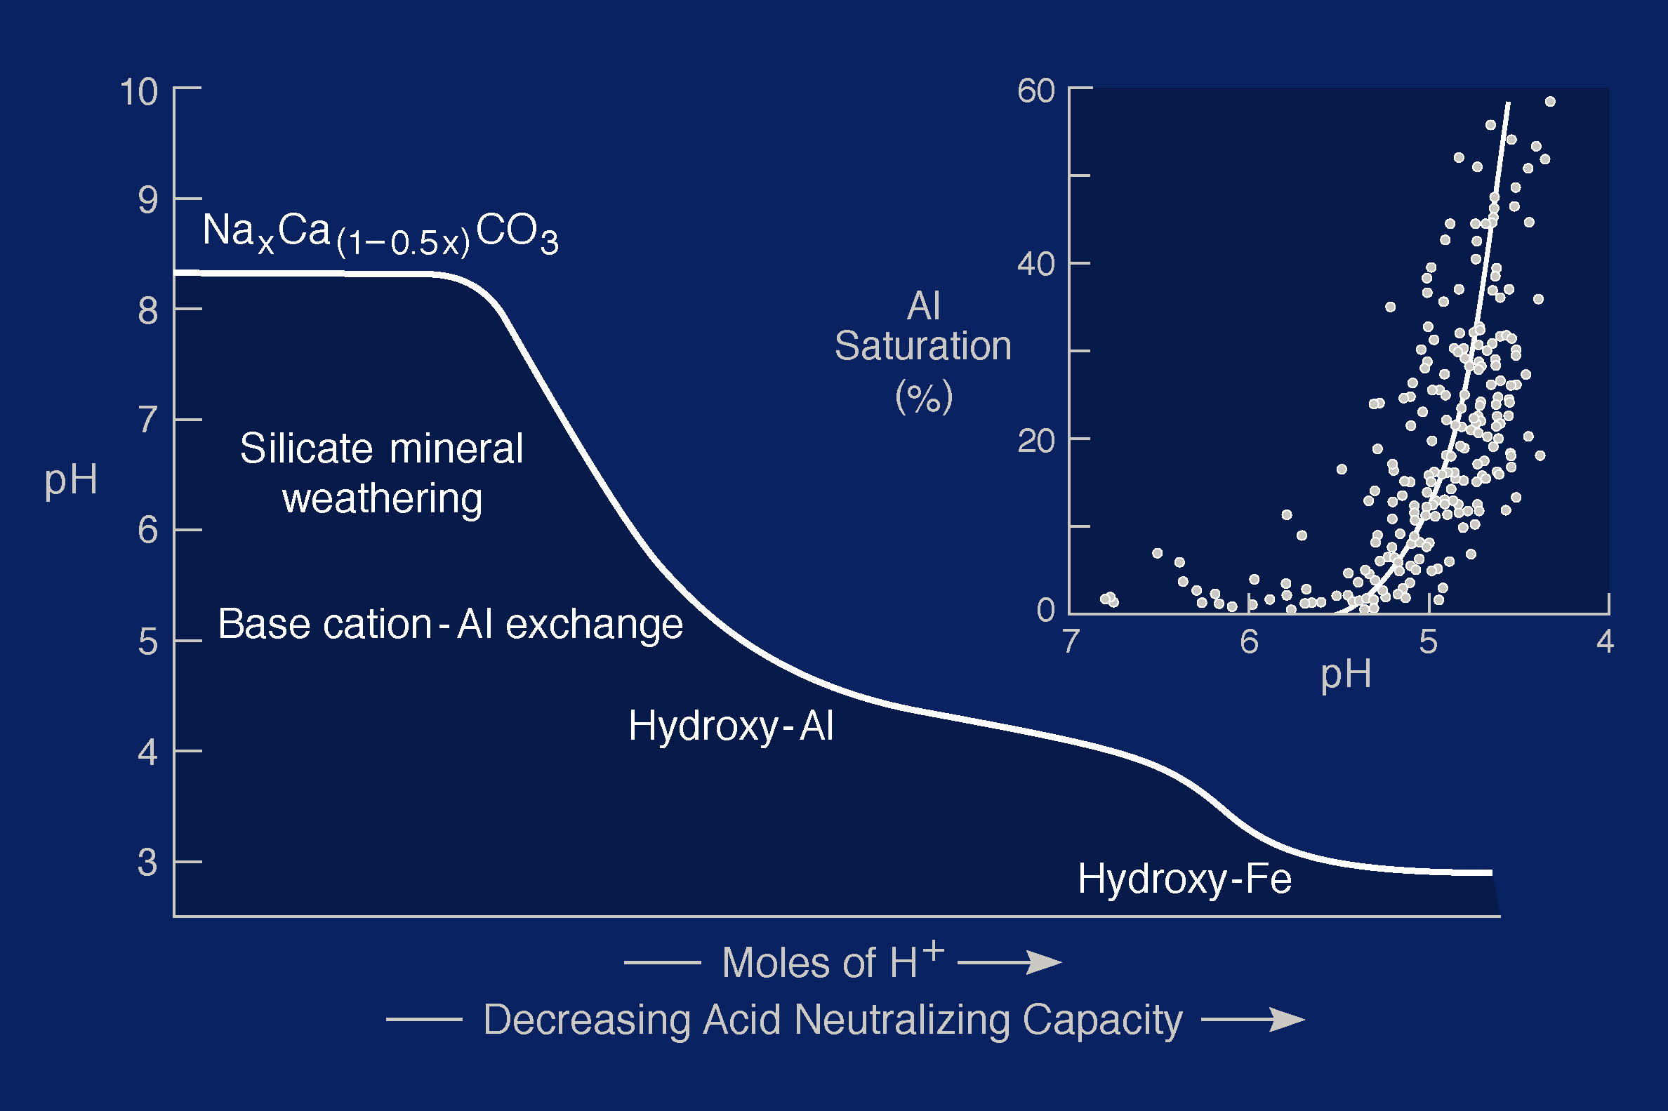
Biospheric Consumption of Rock
Chadwick and Chorover, 2001

Slide 13

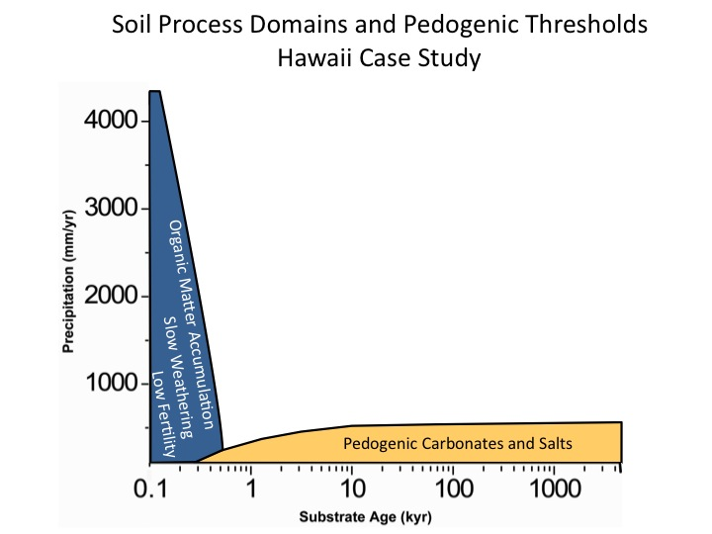

Slide 14
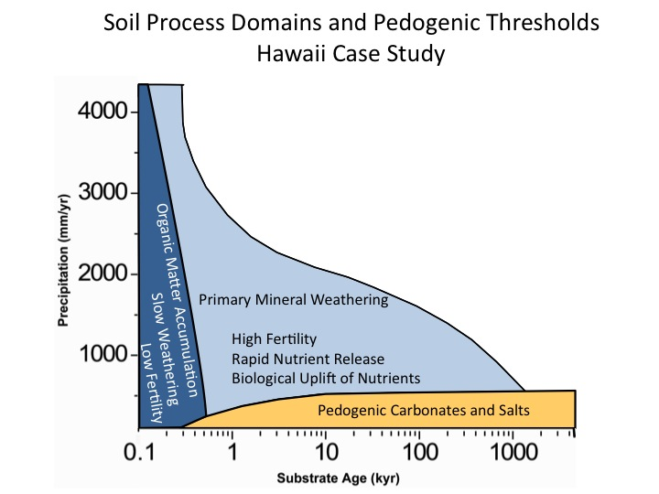

Slide 15
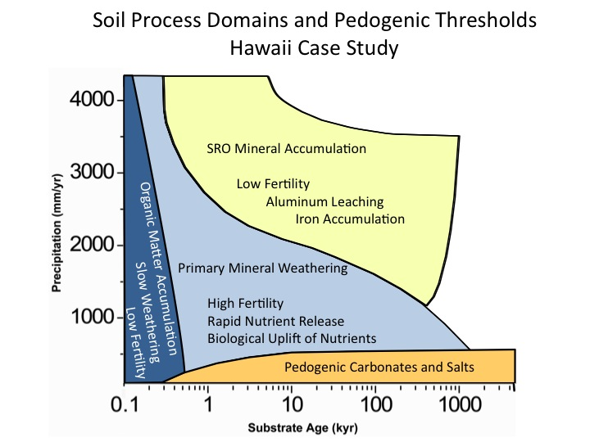

Slide 16
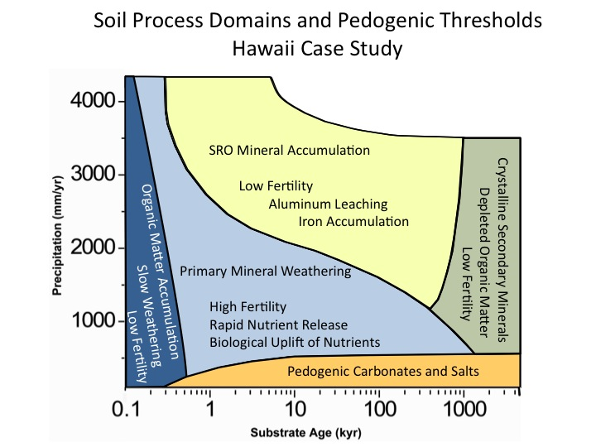

Slide 17
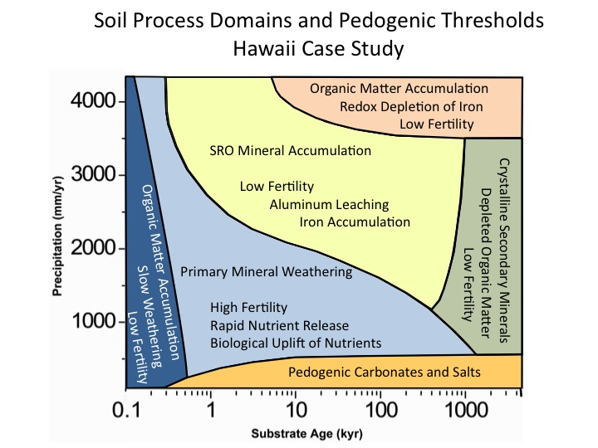

Slide 18
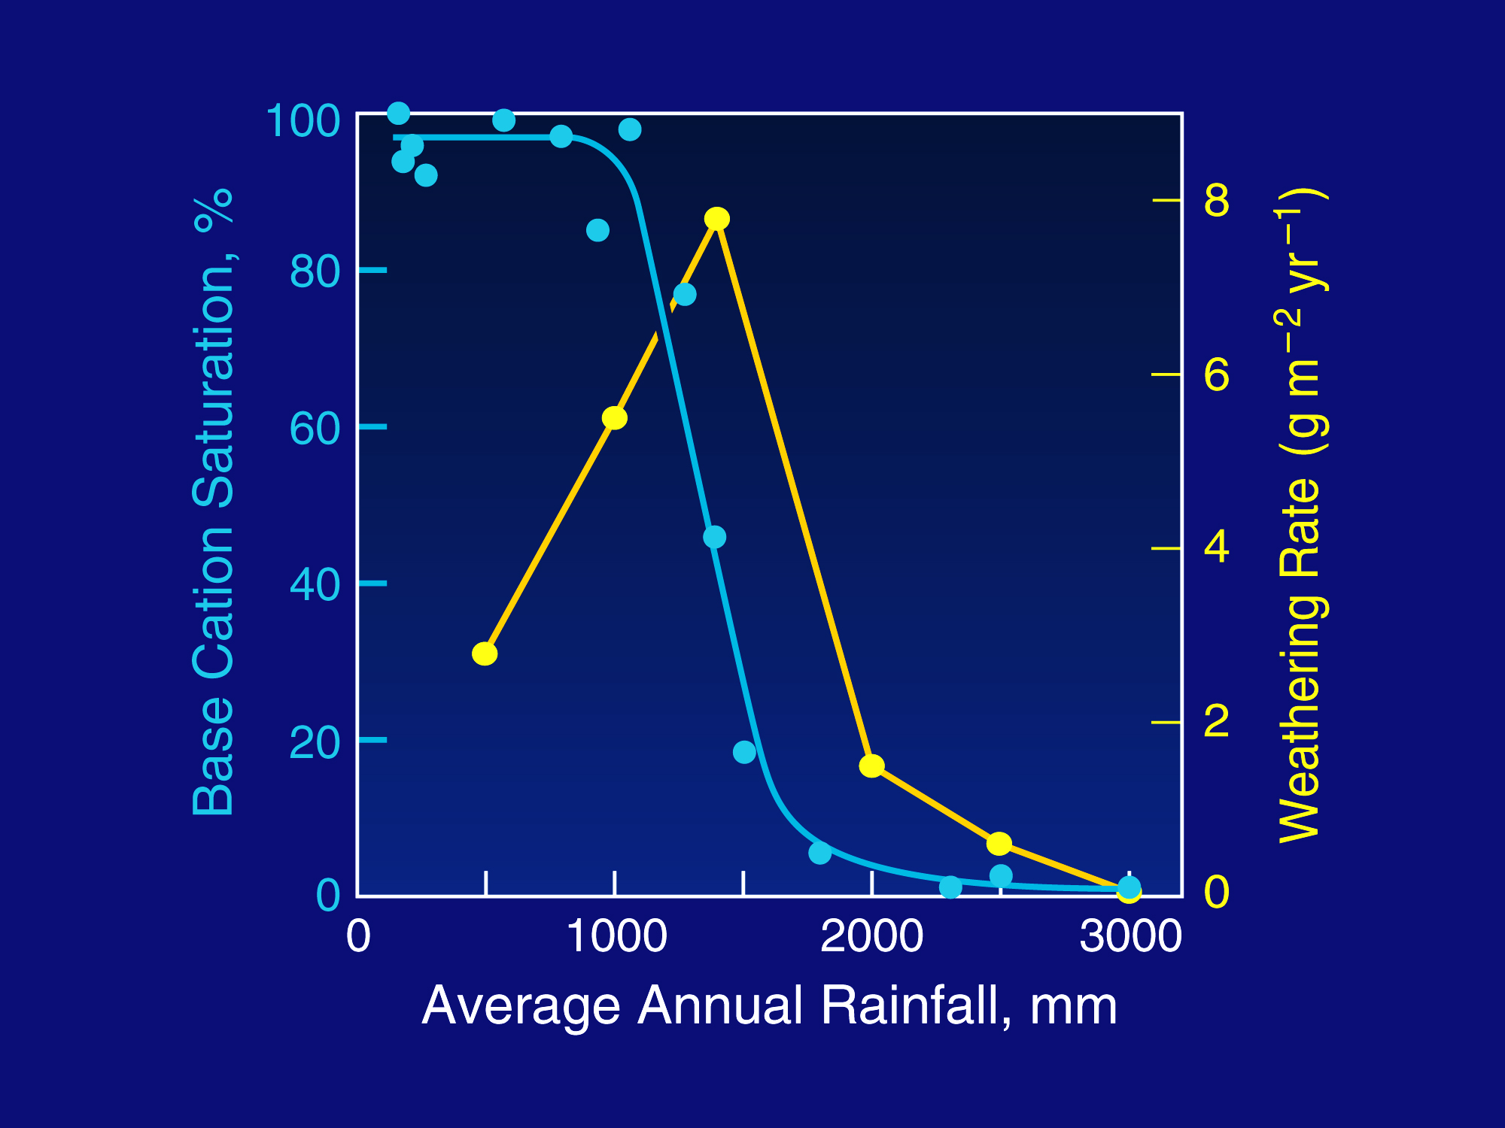
Kohala Mountain: 150 ky Lava Flow

Slide 19
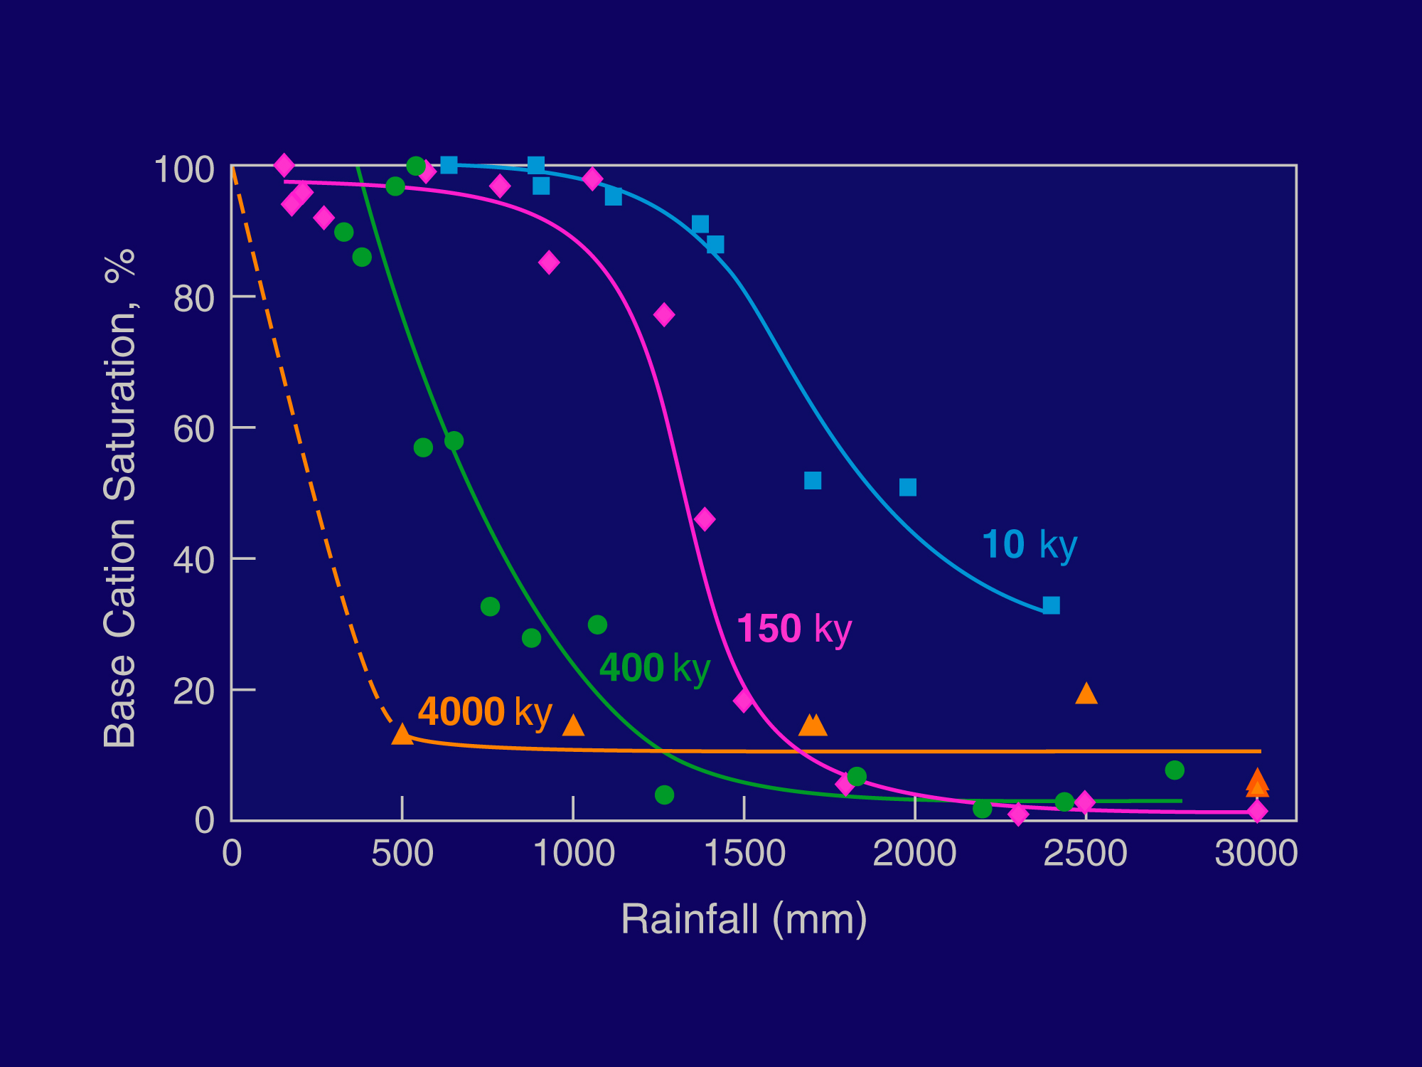
Threshold Declines with Duration of Weathering

Slide 20
Threshold Declines with Duration of Weathering

Slide 21
Threshold Declines with Duration of Weathering

Slide 22
Threshold Declines with Duration of Weathering

Slide 23
Threshold Declines with Duration of Weathering

Slide 24
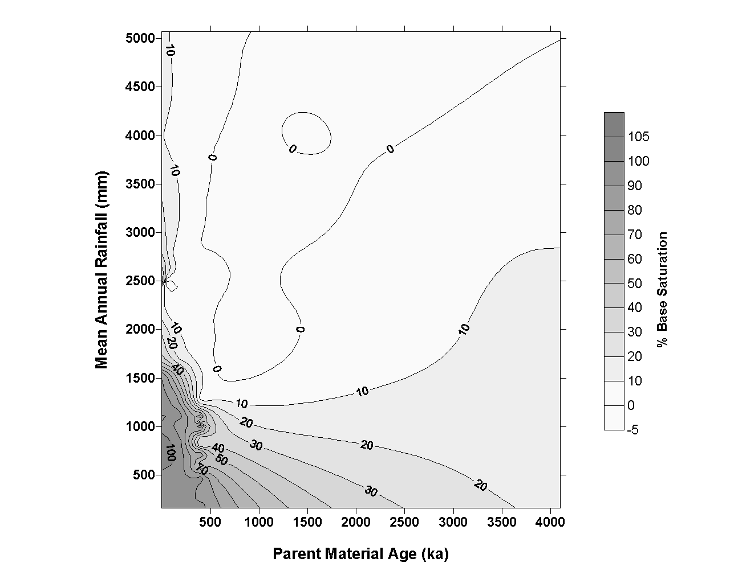

Slide 25
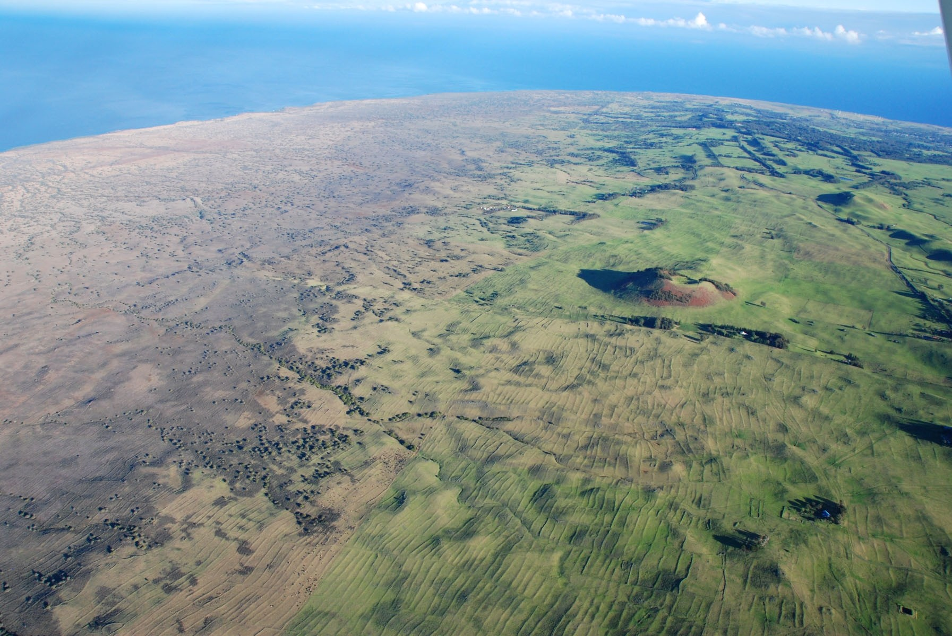
Leeward Kohala
Rain-fed fields
covered 60 km²
What role did environment play in human land use? Aridity? Nutrient depletion?

Slide 26
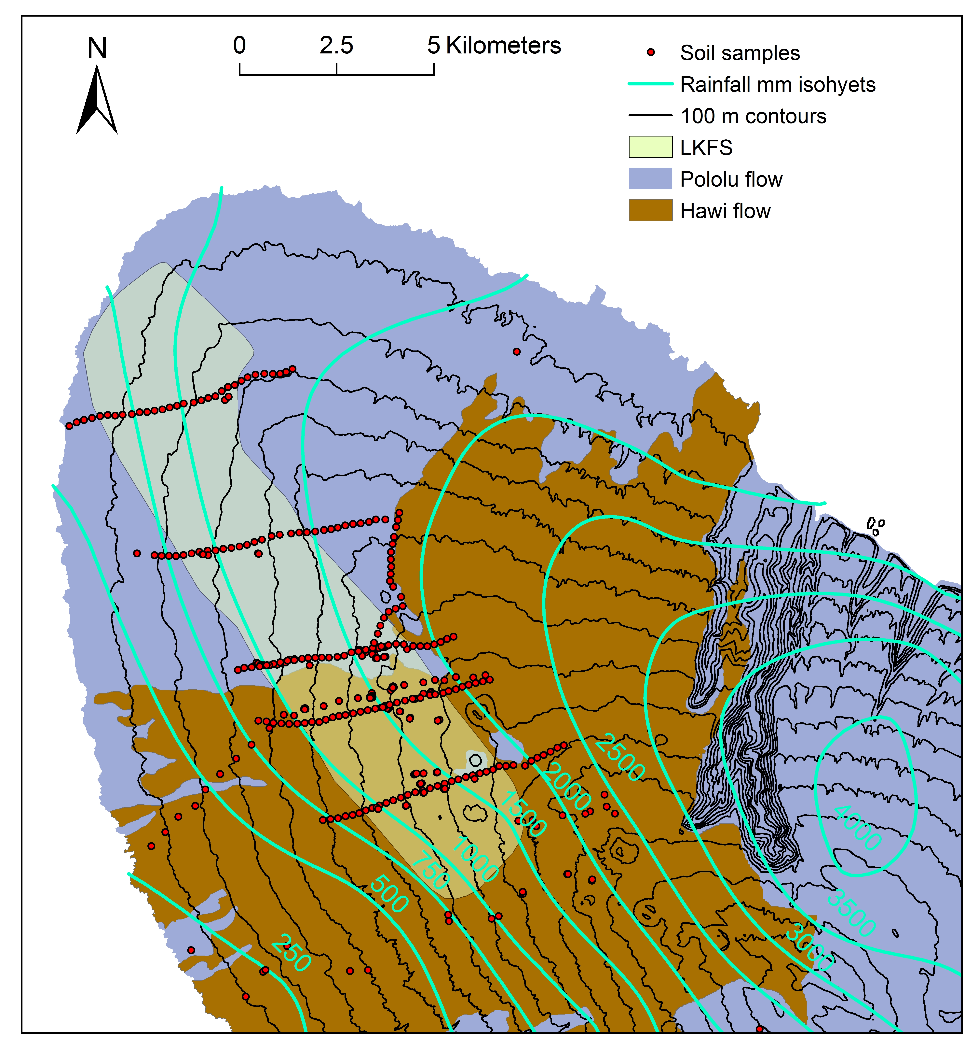
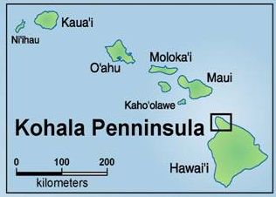
Kohala Volcano – Hawaii Island

Slide 27
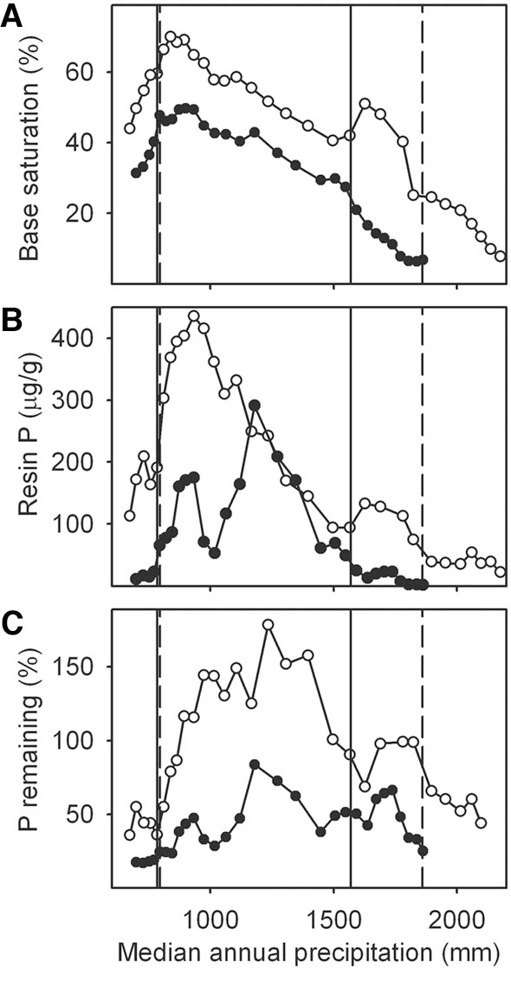
Field Boundary
150 ky Flow
≈ 750 mm
Rainfall
Field Boundary
350 ky Flow

Slide 28
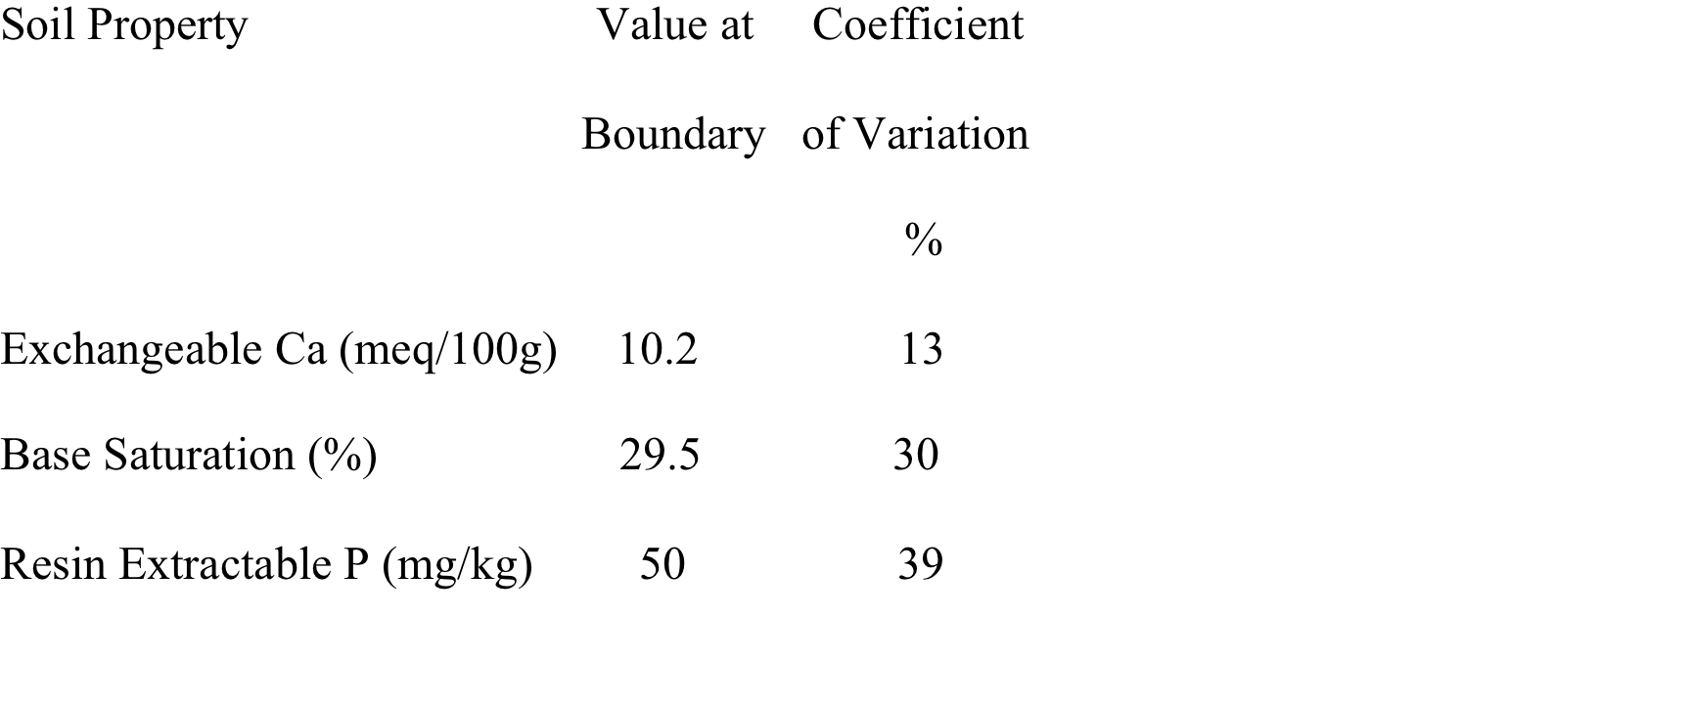
Limits to Farming the Rock

Slide 29
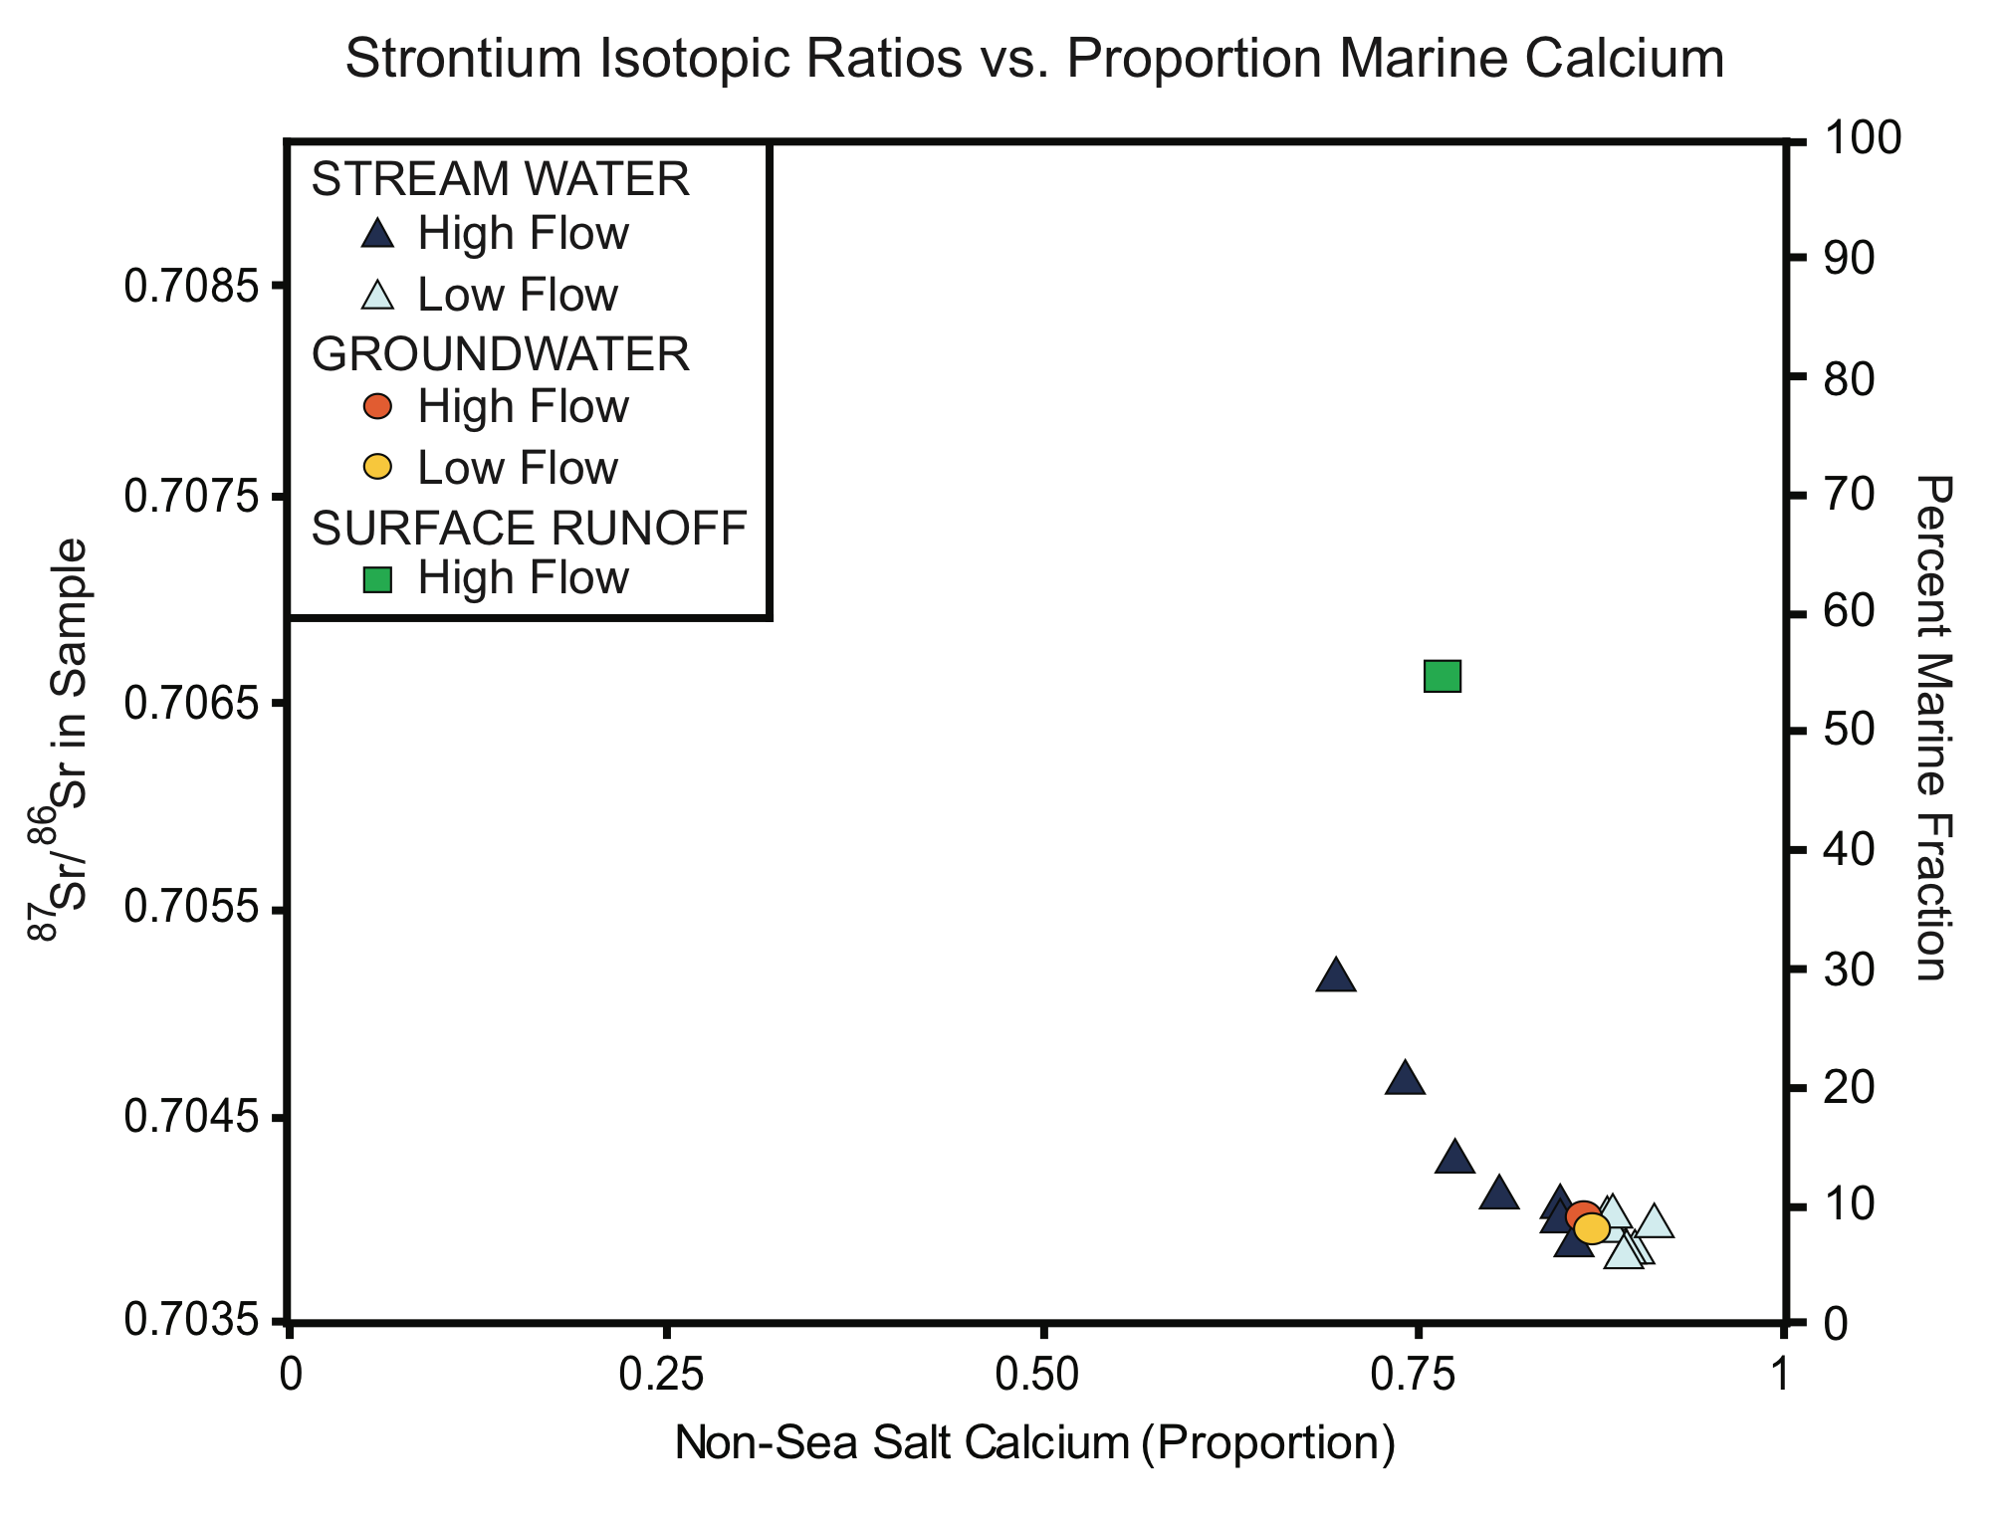
Irrigated Agriculture - Transporting the Rock
Palmer et al., 2009

Slide 30
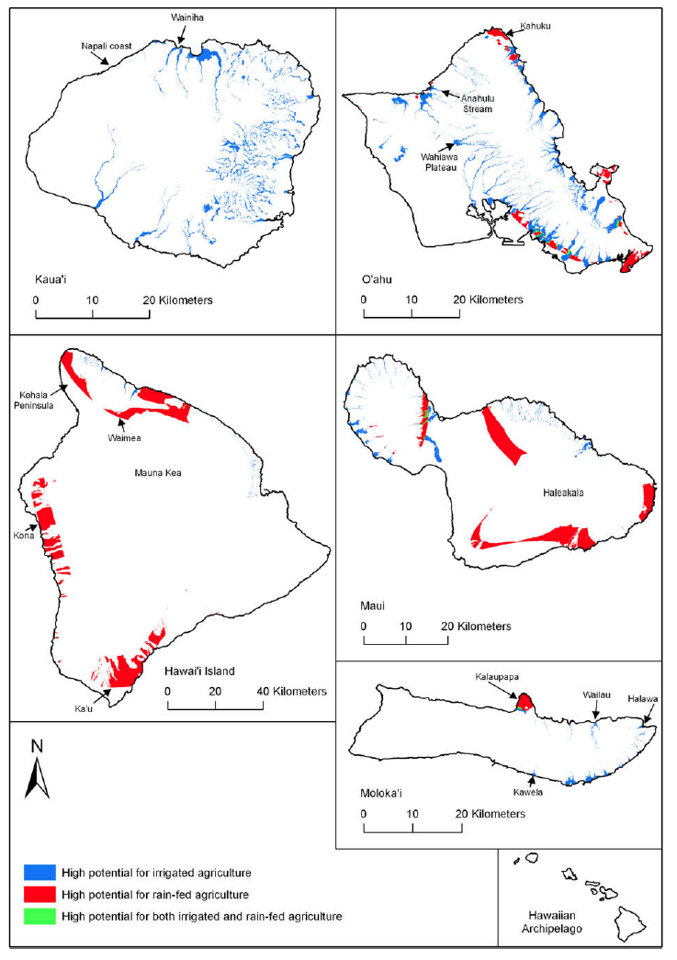
GIS Model of Areas
Suitable for Agriculture
Takes into Account:
Topography
Elevation
Lava Flow Age
Rainfall

Slide 31
Hawaiian Agricultural Productive Potential and
Labor Requirements
Island | Ag Potential | % Rainfed | Food Production | Production per
 |  |  |  | Worker
 | km² |  | mt/yr | mt/yr
Hawaii | 570 | 99 | 97000 | 0.6
Maui | 170 | 85 | 45000 | 1.0
Molokai | 20 | 45 | 8900 | 2.5
Oahu | 120 | 30 | 79000 | 3.5
Kauai | 60 | 0 | 49000 | 5.8
Ladefoged et al., 2009
Rainfed Ag could produce about 5600 kcal per worker per day
Irrigated Ag could produce 10 times that, but on limited land
Hawaii and Maui had the greatest potential to expand production

Slide 32
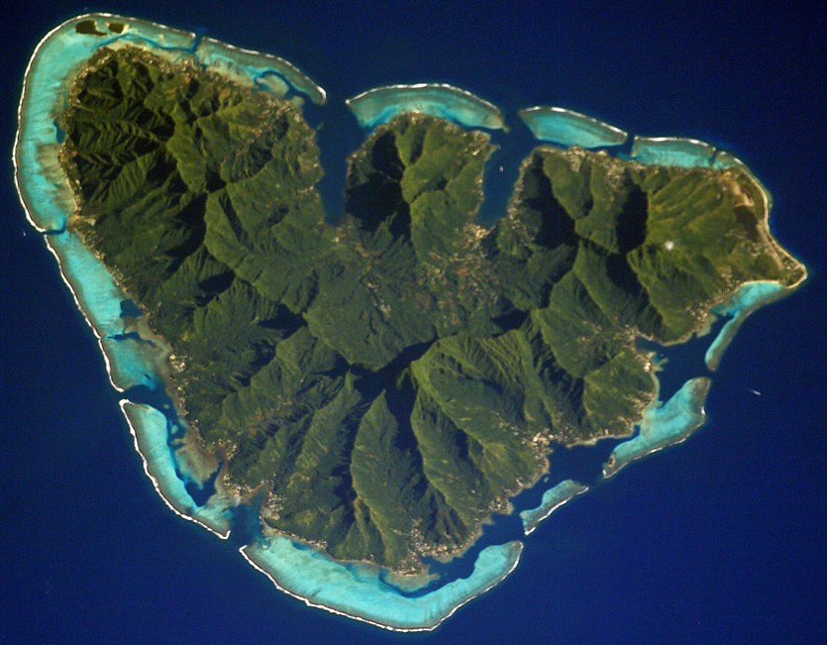
Moorea, Society Islands:
minimal dry-land potential
~135 km²

Slide 33
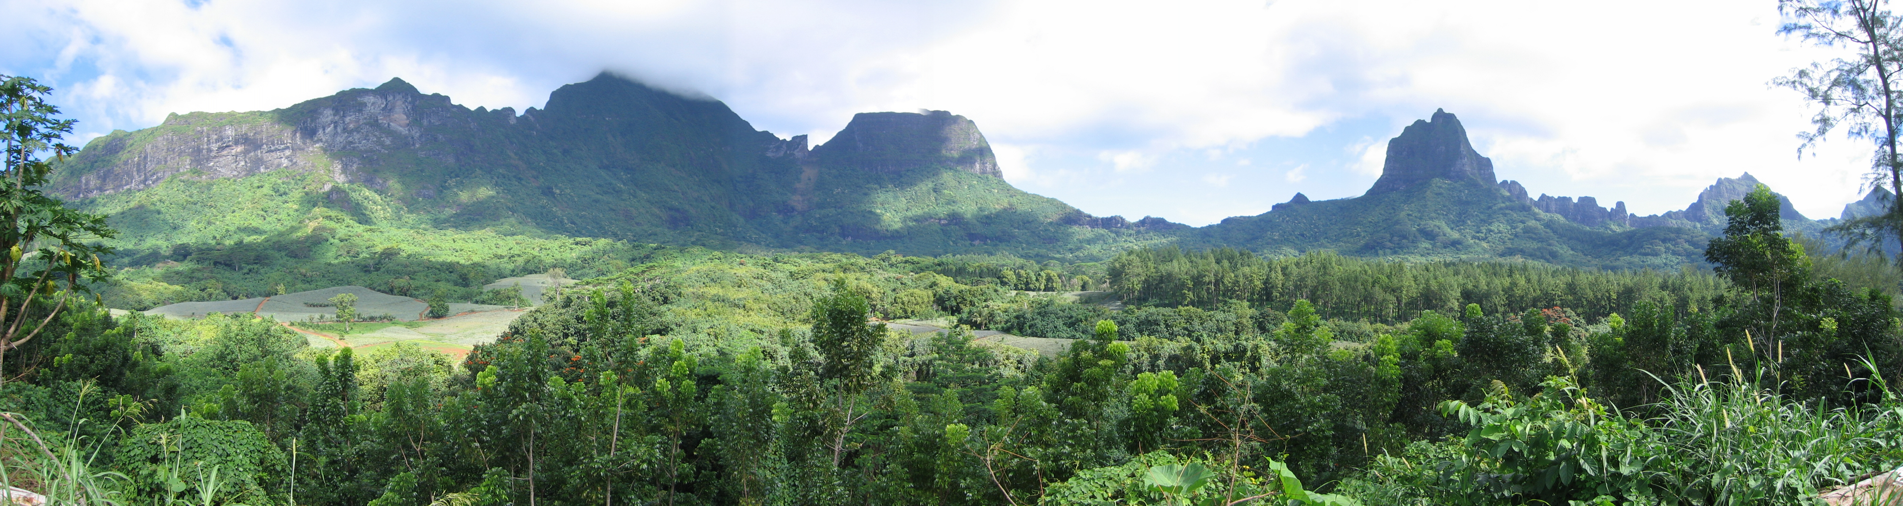
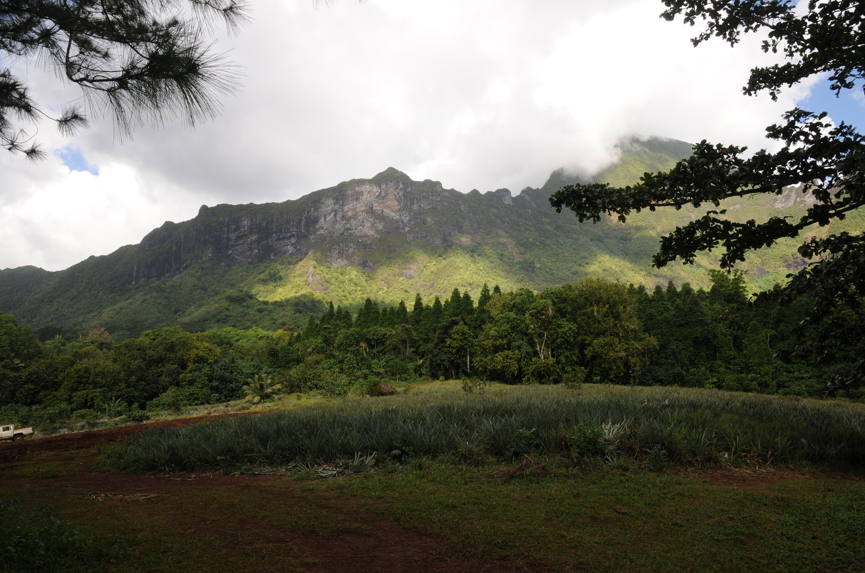

Slide 34
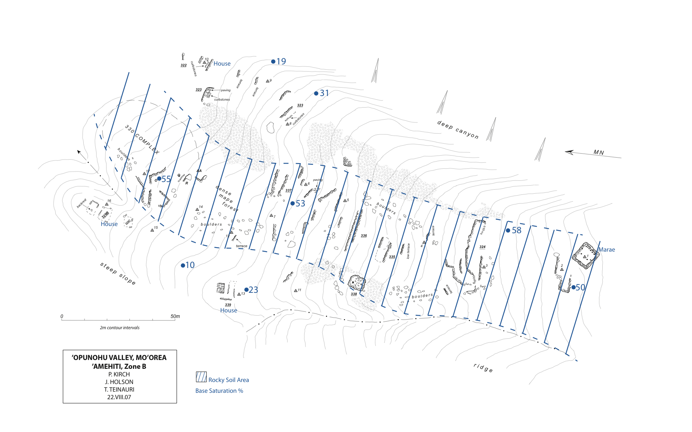

Slide 35
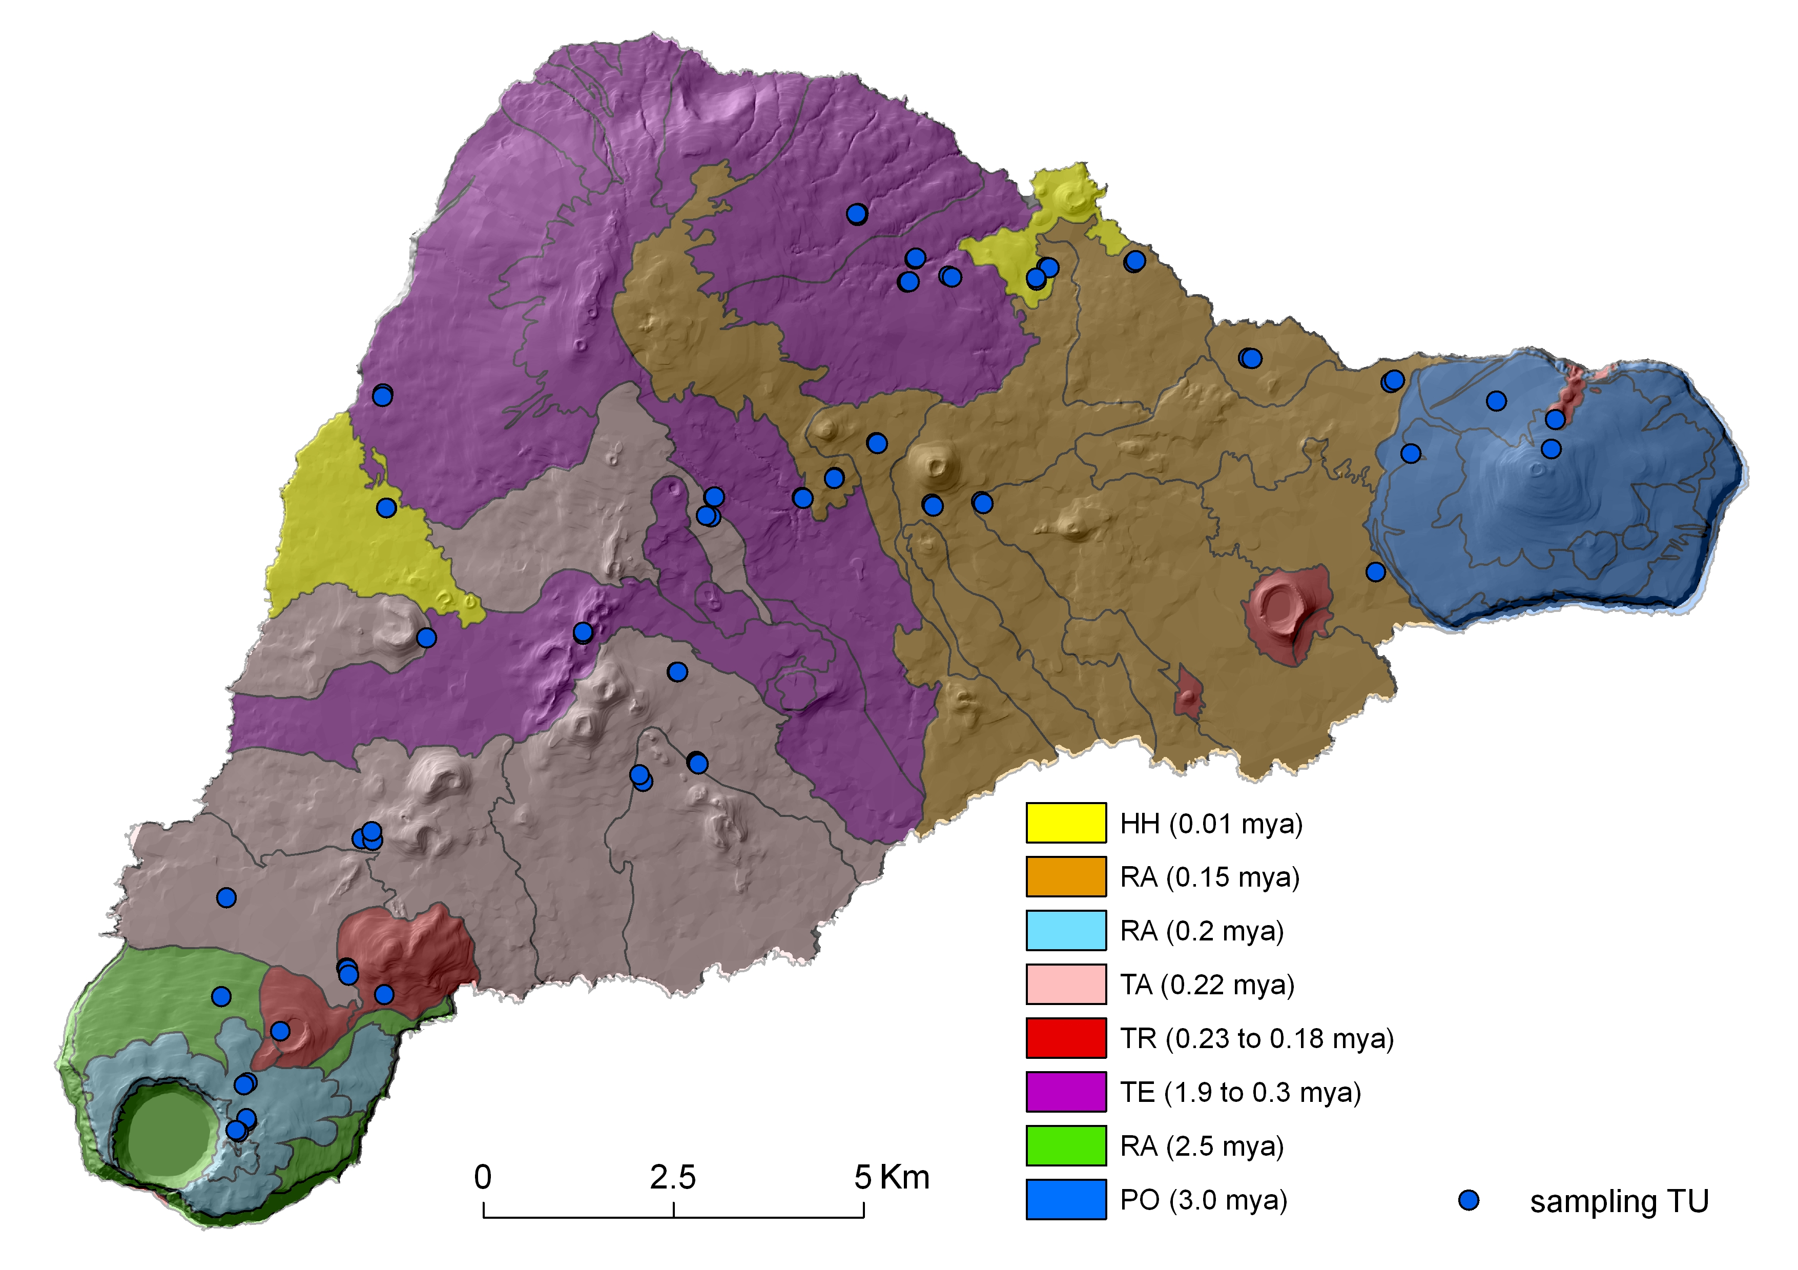
Rapa Nui
What happens if there are fewer environmental niches? Old soils? Little area for irrigated agriculture?

Slide 36
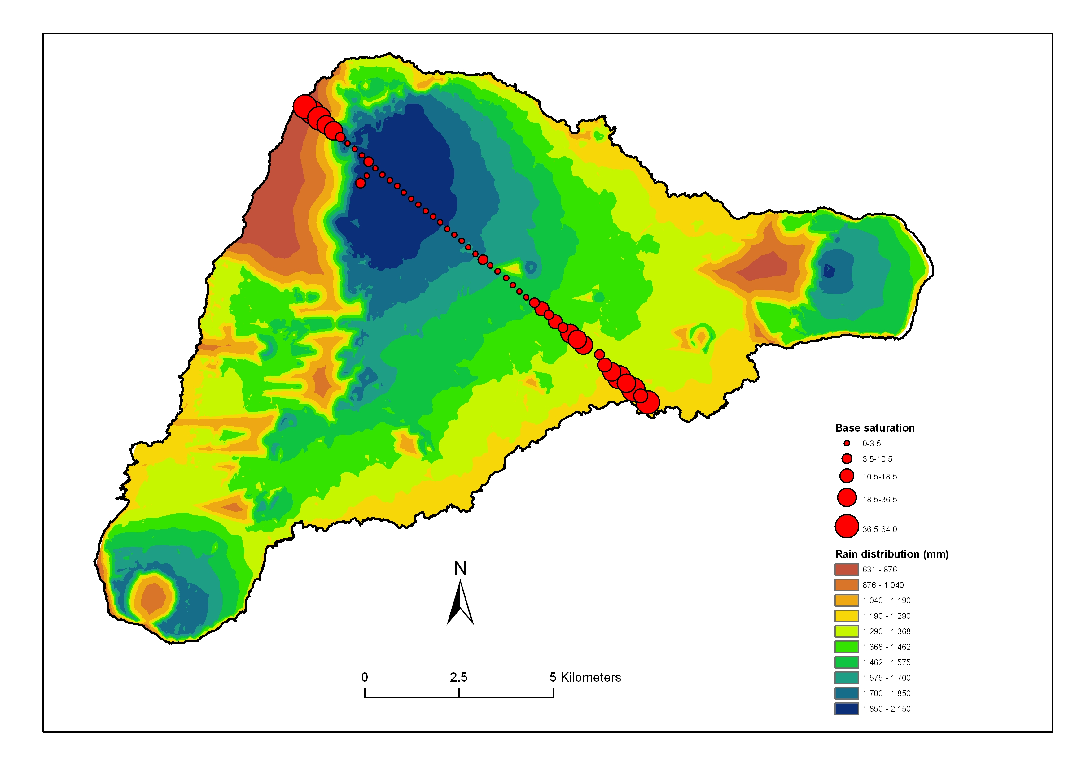
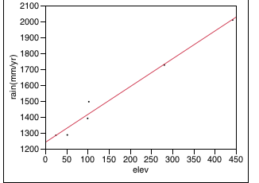
Rapa Nui
Rainfall range = 600 – 2100 mm
%BS = 1 – 65%

Slide 37
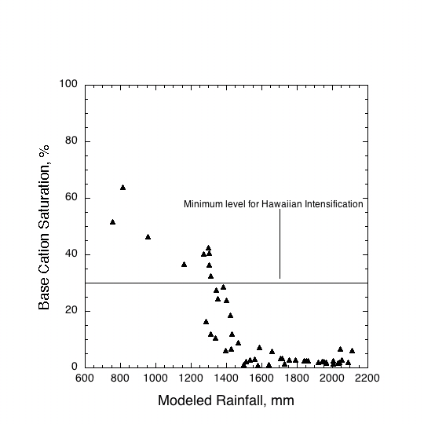
Rainfall as a Control on Rapa Nui Soil Nutrient Status

Slide 38
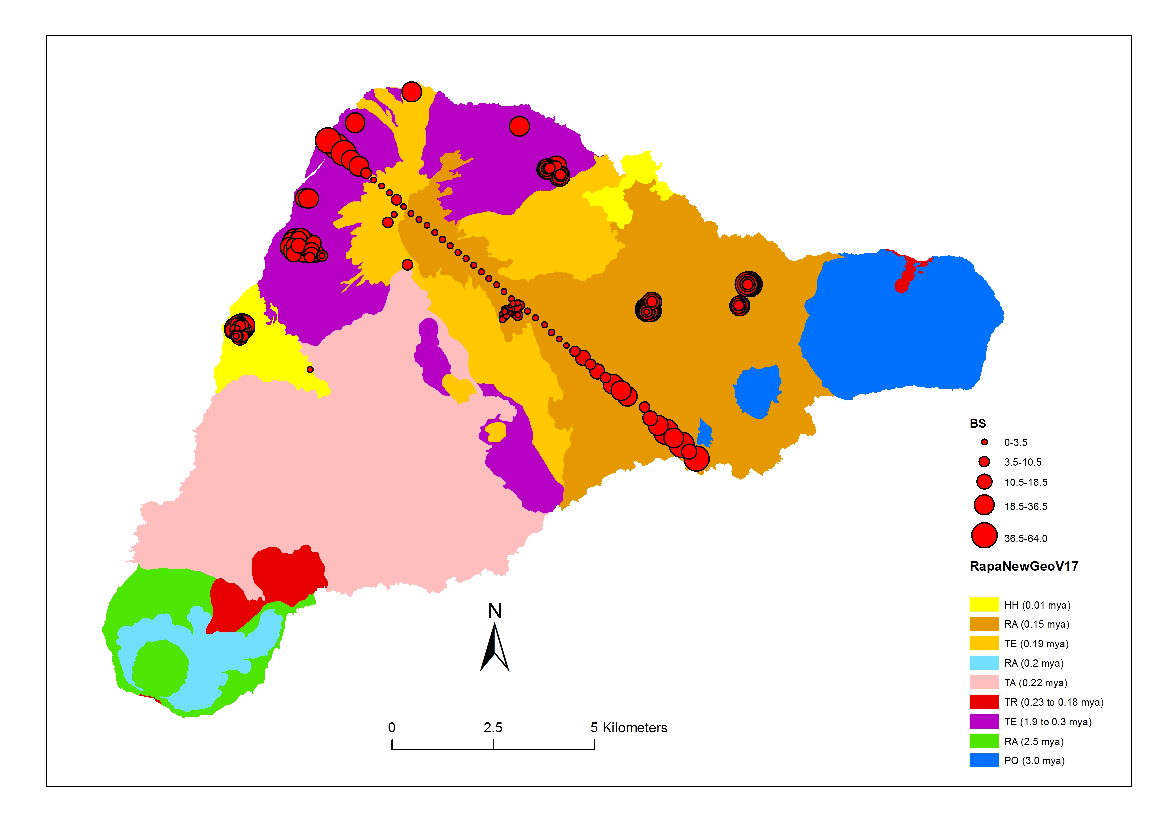
Village-based sampling for %BS

Slide 39
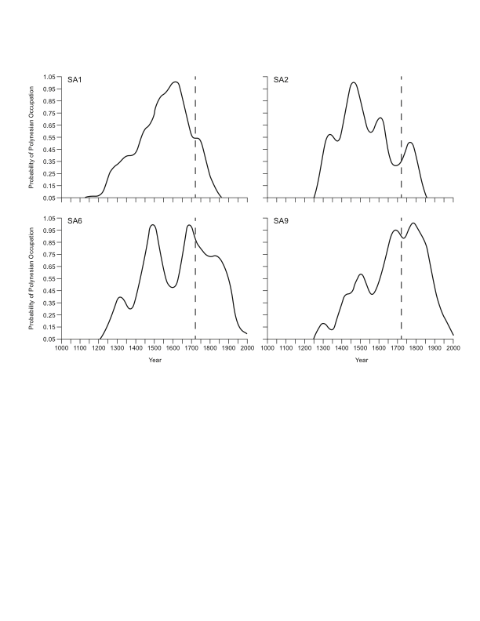
Relative Population Curves and Base Saturation for 4 locations in Rapa Nui
%BS=16 ⁺/-11
n=58
%BS=12 ⁺/-6
n=44
%BS=15 ⁺/-6
n=71
%BS=47 ⁺/-6
n=39

Slide 40
Summary
The high productive potential of irrigated agriculture in Hawaii was probably a significant factor driving unification of the islands under a supreme chief
However the ability to expand and intensify broad swaths of the uplands was critical for surplus production and directly supported the development of an archaic chiefdom
Moorea had a mix of irrigated and dryland agriculture but the latter was restricted to a few recent rock slide areas
Rapa Nui agriculture was primarily dryland and was restricted by low nutrient supply

Slide 41
Thoughts on Rapa Nui
Intensification of dryland systems as compensation for low nutrient supply – more labor per calorie
Intensification could take the form of greater rainfall capturing and channeling to open up new lands
Mining of existing nutrient resources particularly many millenia of seabird contributions could have led to population overshoot on sensitive islands such as Rapa Nui
In this case the Rapa Nui would have had to adjust to the inherent constraints associated with the weathering status of the land they inherited.

