Slide 1
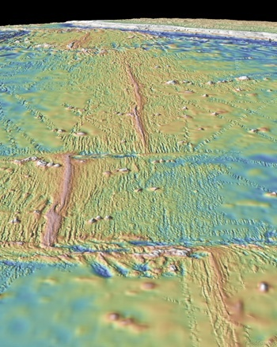
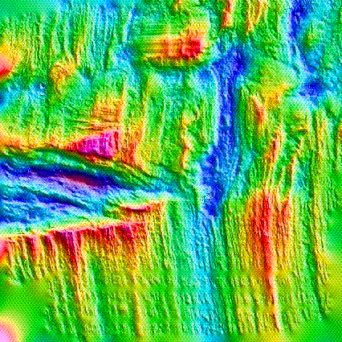
Origin and evolution of oceanic ridge-transform patterns and triple junctions:
a numerical modeling prospective
Taras Gerya
ETH-Zurich, Switzerland
Notes:
1

Slide 2
What do they have in common?
They are beautiful, enigmatic and tricky to model…
Notes:
2

Slide 3
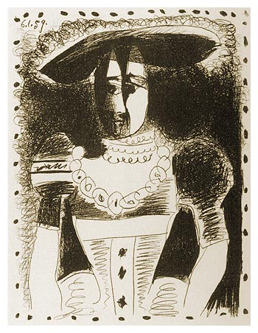
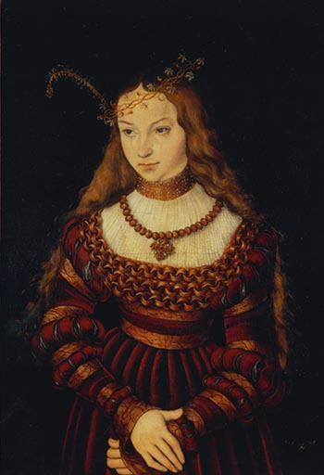
Reality is beautiful
but complex
Model is ugly
but useful
Sibylla von Cleve als Braut,
Lukas Cranach d. Ä. (1472-1553)
Noble dame, 1959
© Succession Picasso / VG Bild-Kunst, Bonn 2001

Slide 4
Oceanic transform faults:
how and why do they form?

Slide 5
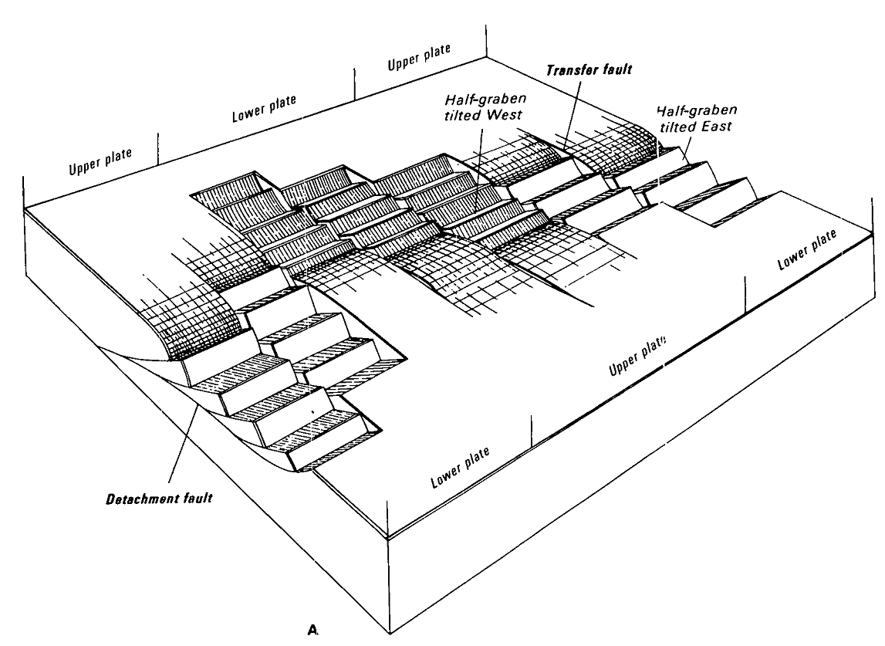
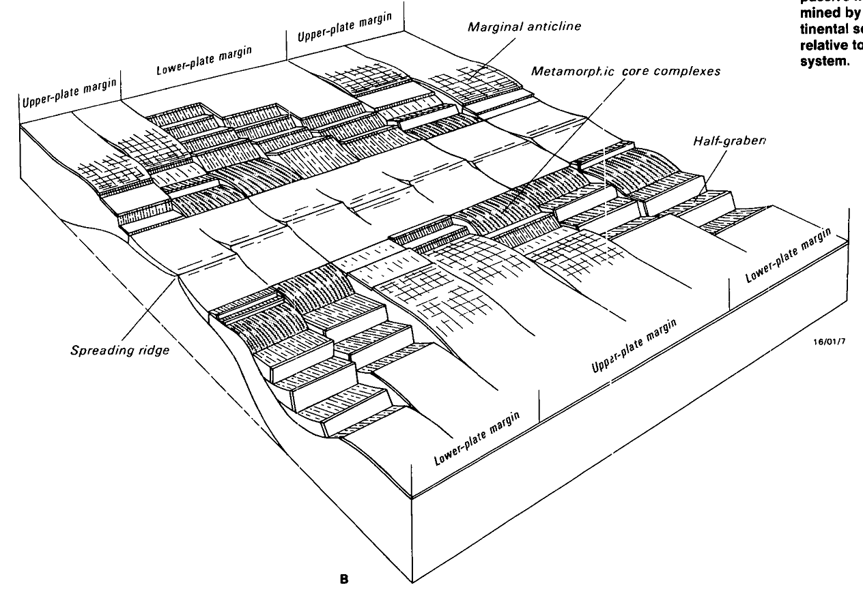
Popular view on
transforms:
inheritance
concept
Lister et al. (1986)

Slide 6
Inheritance concept
continent
preexisting
structures
continent
continent
rifting
continent
continent
ocean
spreading
ocean
continent

Slide 7
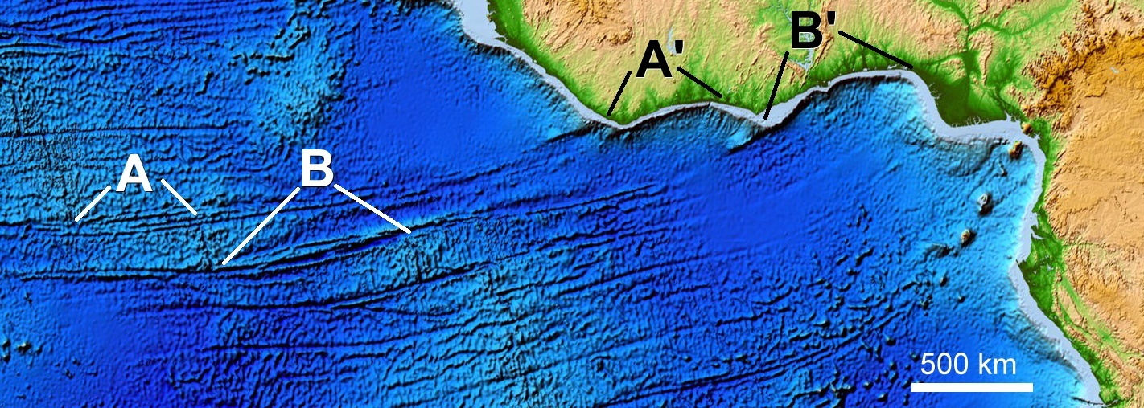
Inheritance concept
Two bents on the margin
Two transform faults

Slide 8
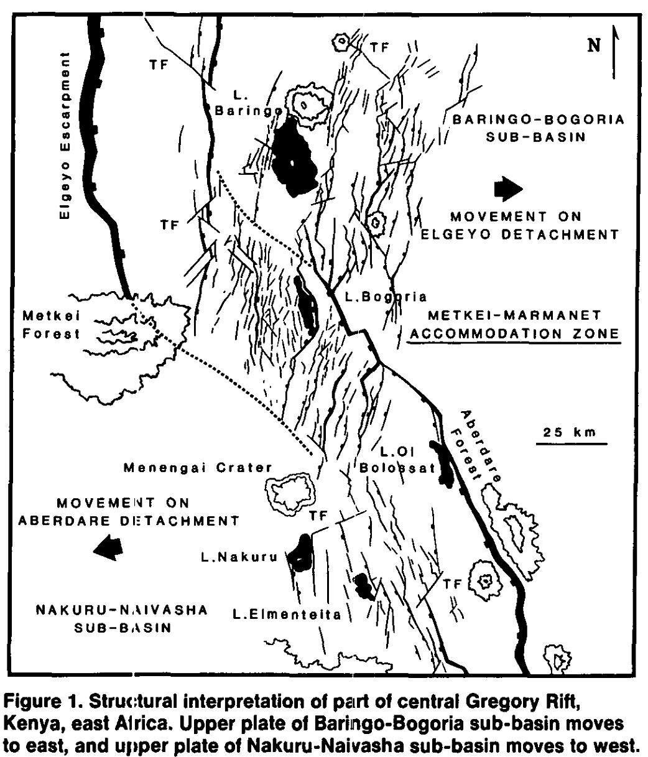
Continental rifting: no clear transform precursors
Graben A
Accommodation zone
Graben B
Bothworth (1986)

Slide 9
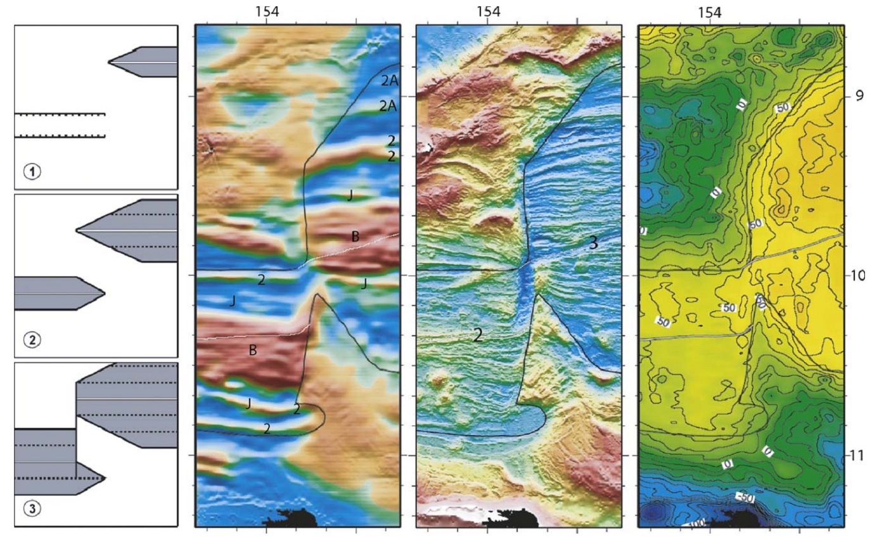
Development of rifted margins: Woodlark basin
Taylor et al. (2009)

Slide 10
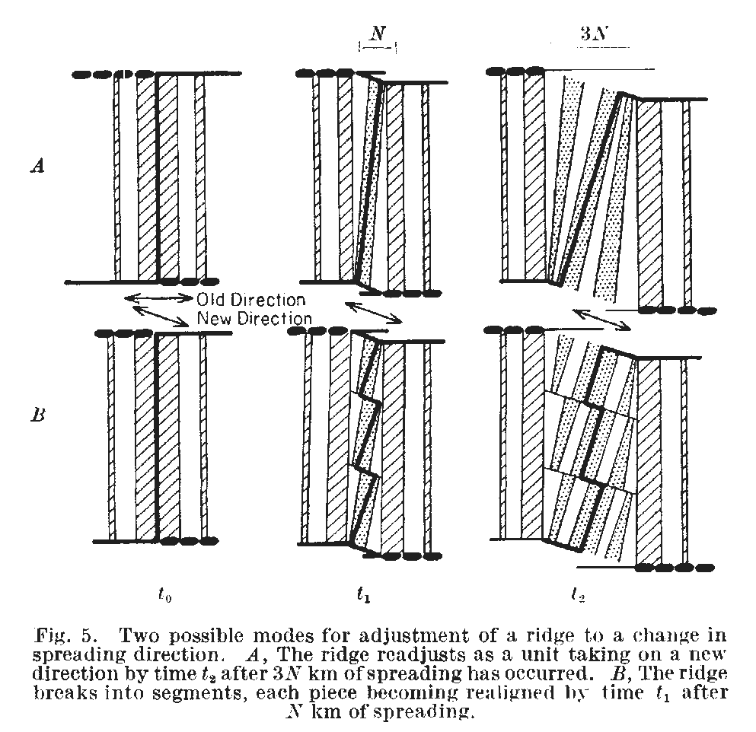
Transform faults can be emergent !
Menard (1968)

Slide 11
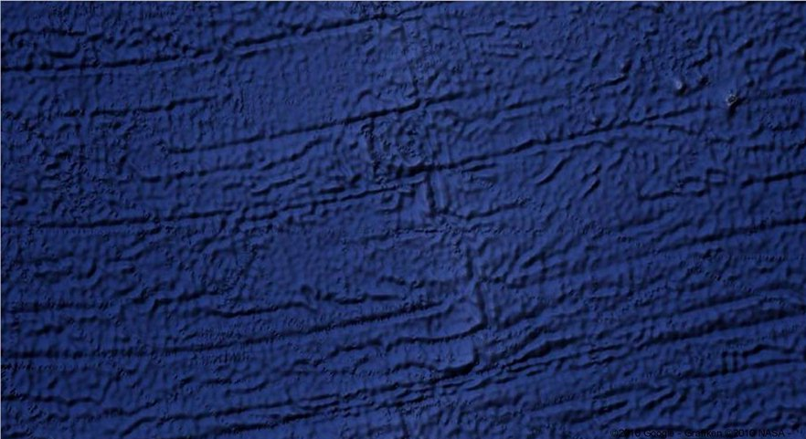
Spontaneously emerging transforms:
how is this possible?

Slide 12
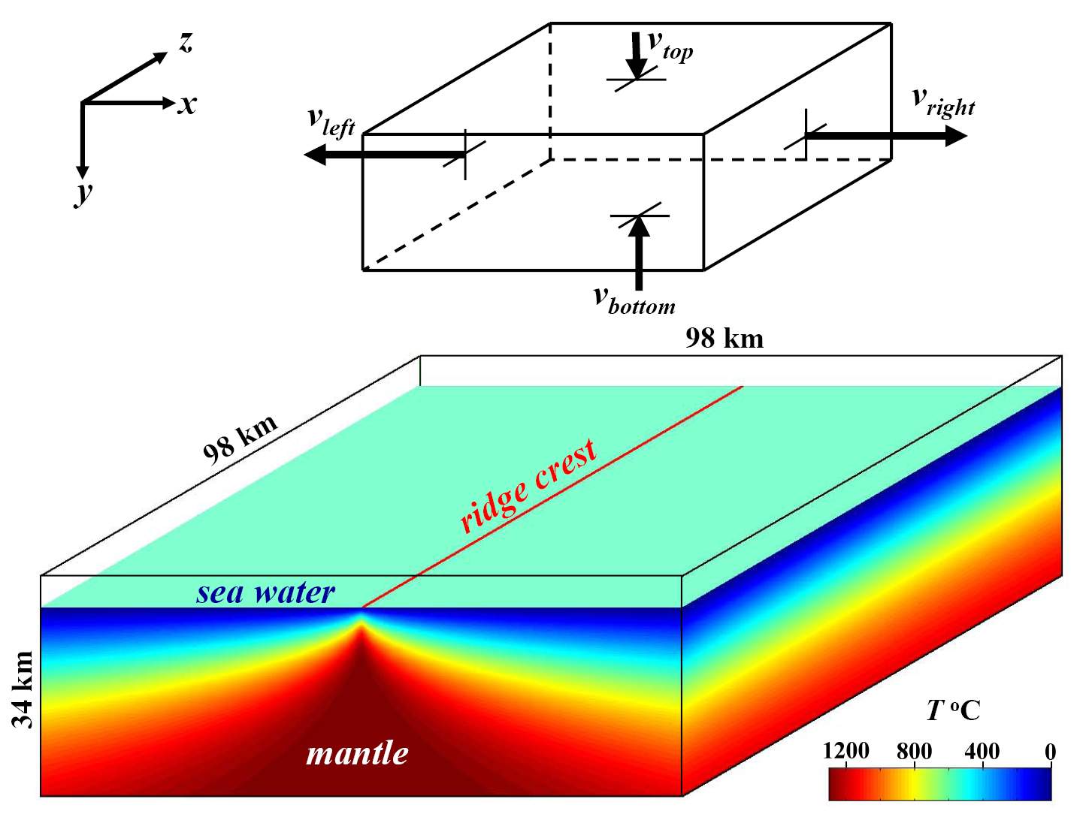
Gerya (2010)

Slide 13
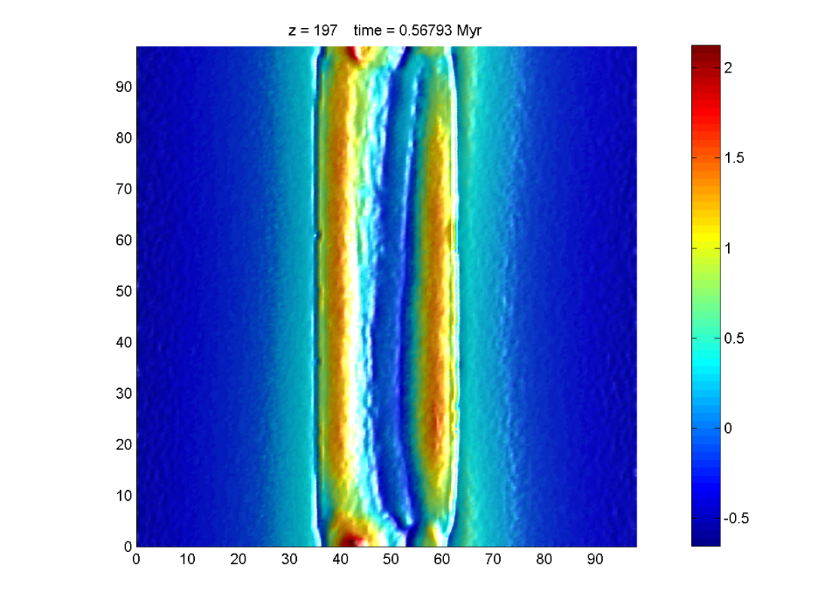
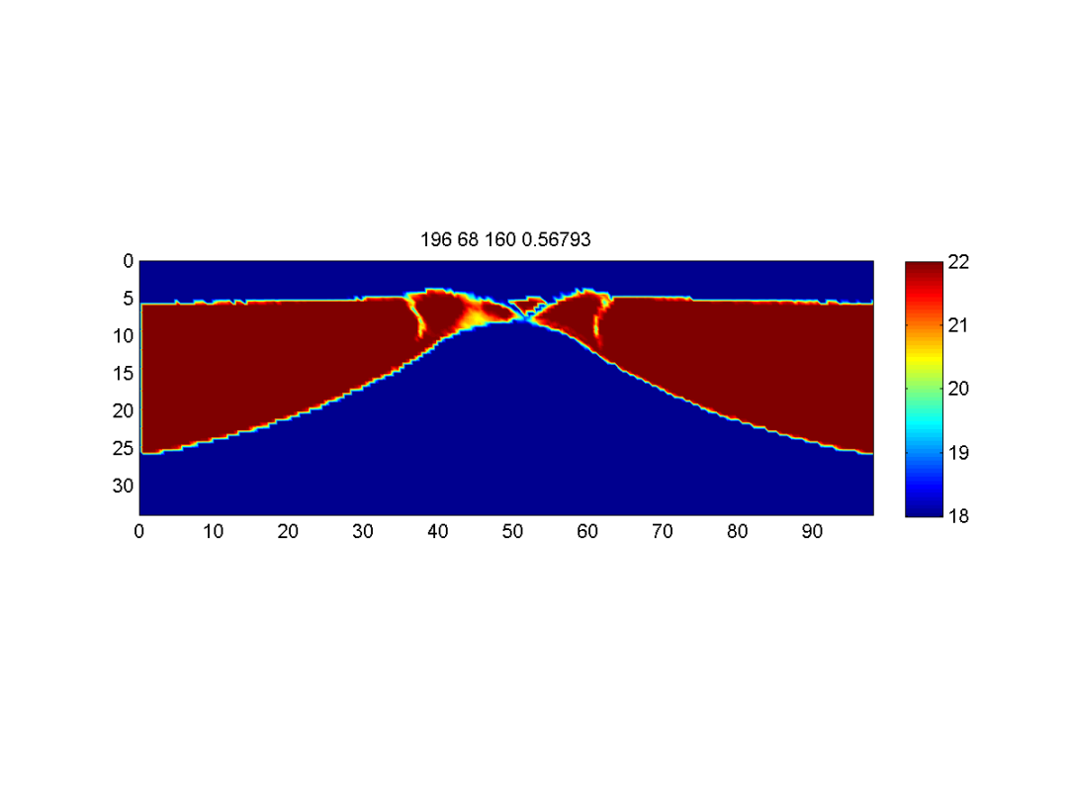
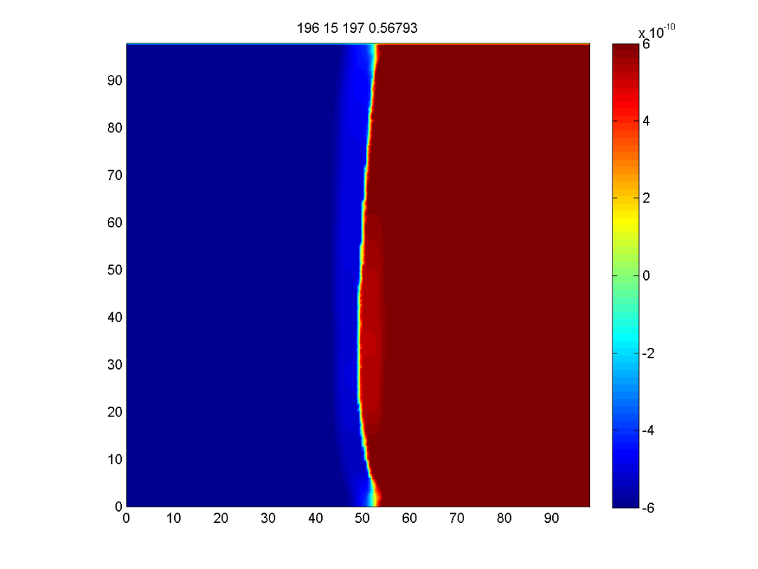

topography, km
viscosity, Pa s
A
B
v_{x}, m/s
A
B
viscosity, Pa s
C
D
C
D
Gerya (2010)

Slide 14
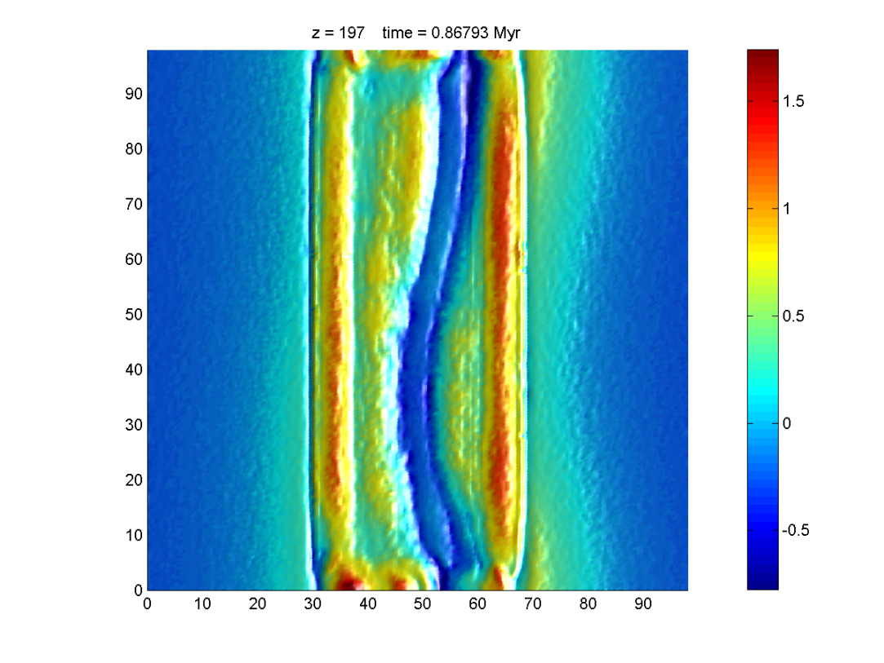
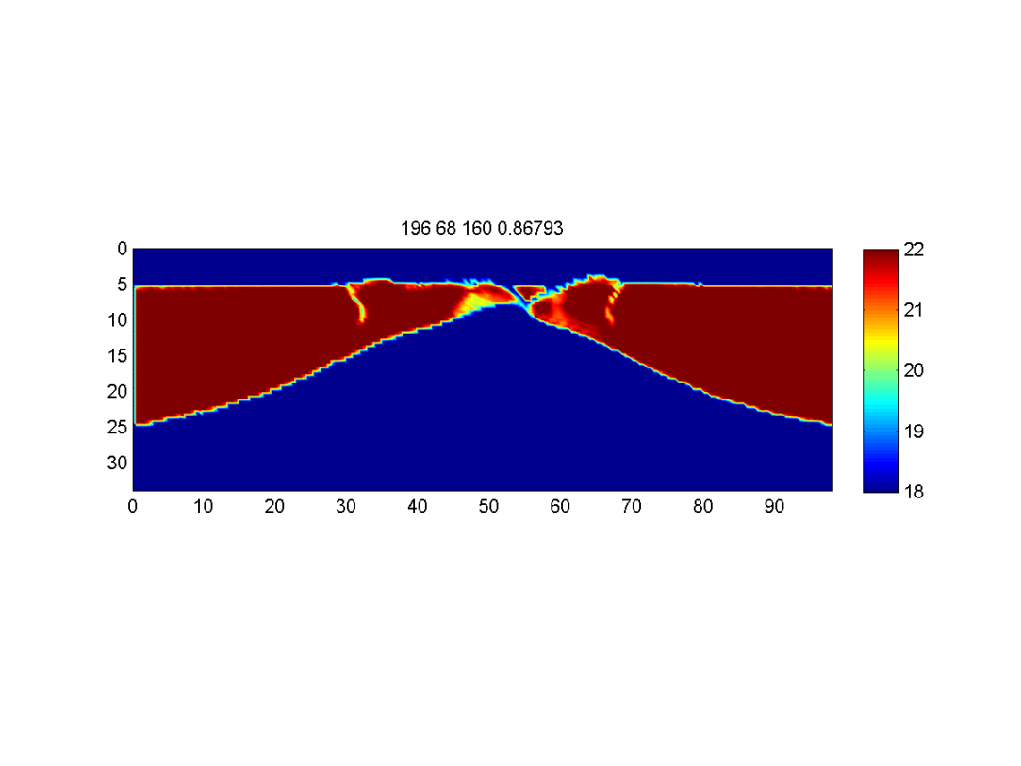
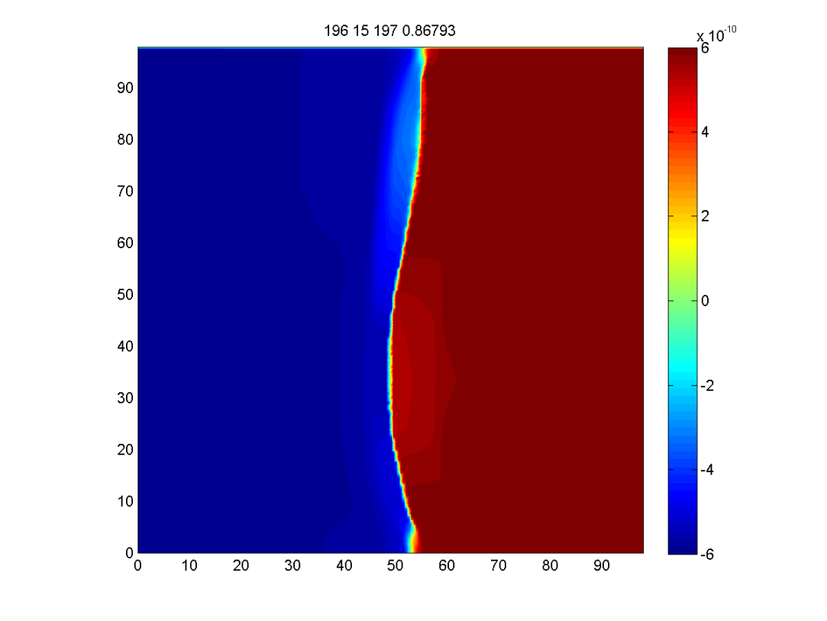
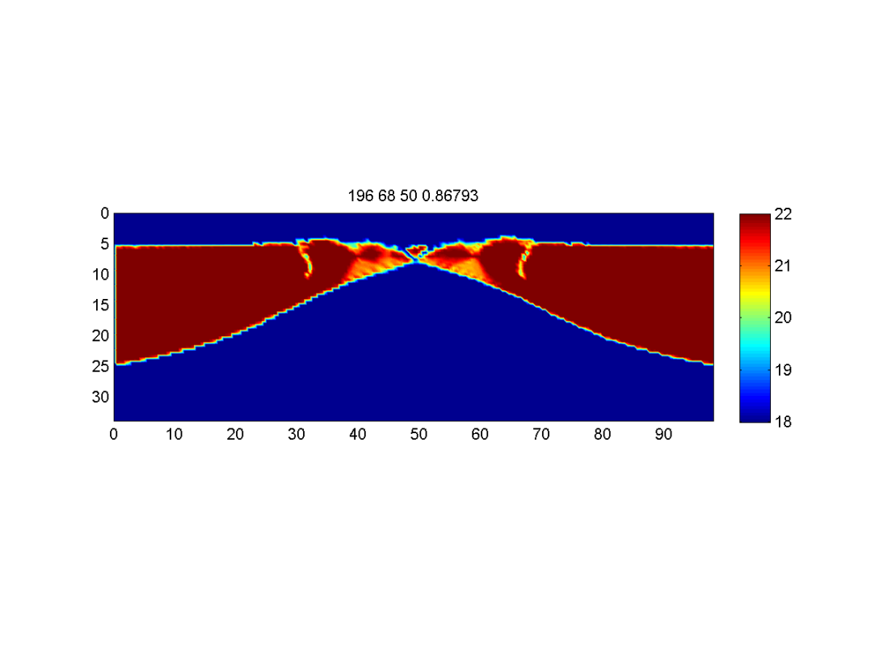
topography, km
viscosity, Pa s
A
B
v_{x}, m/s
A
B
viscosity, Pa s
C
D
C
D
Gerya (2010)

Slide 15
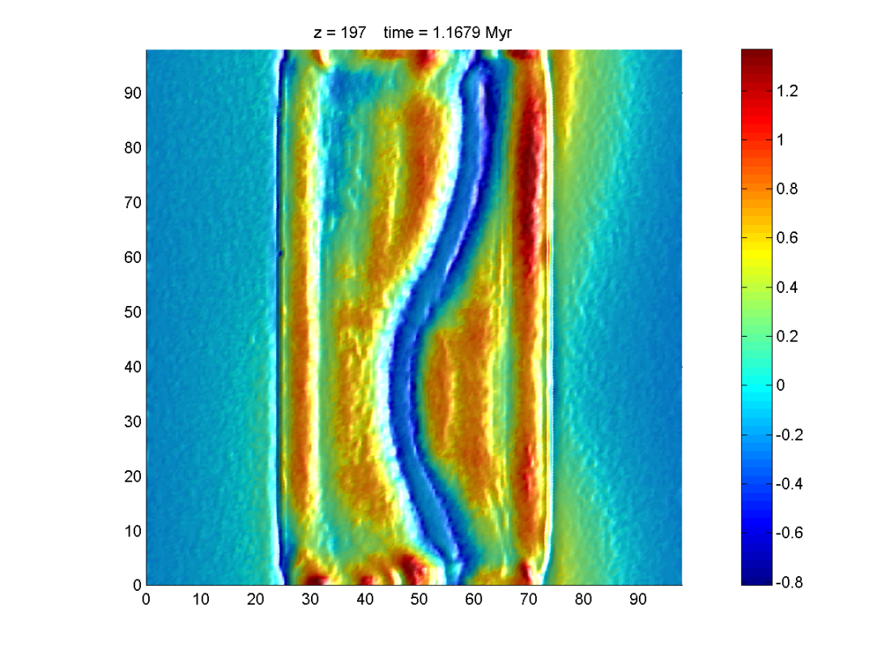
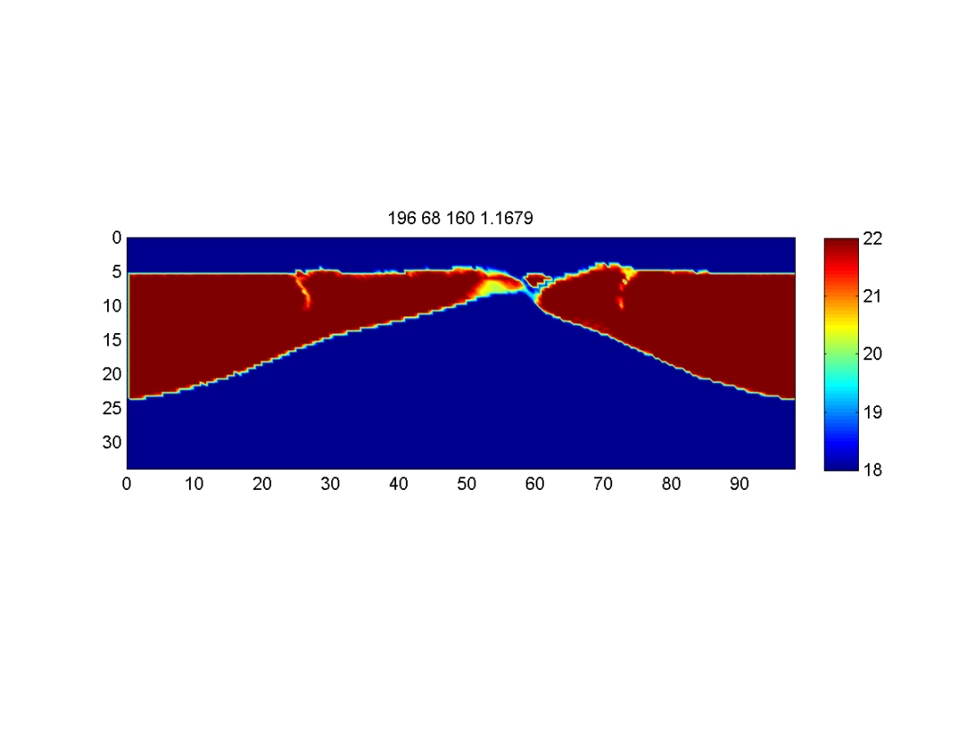
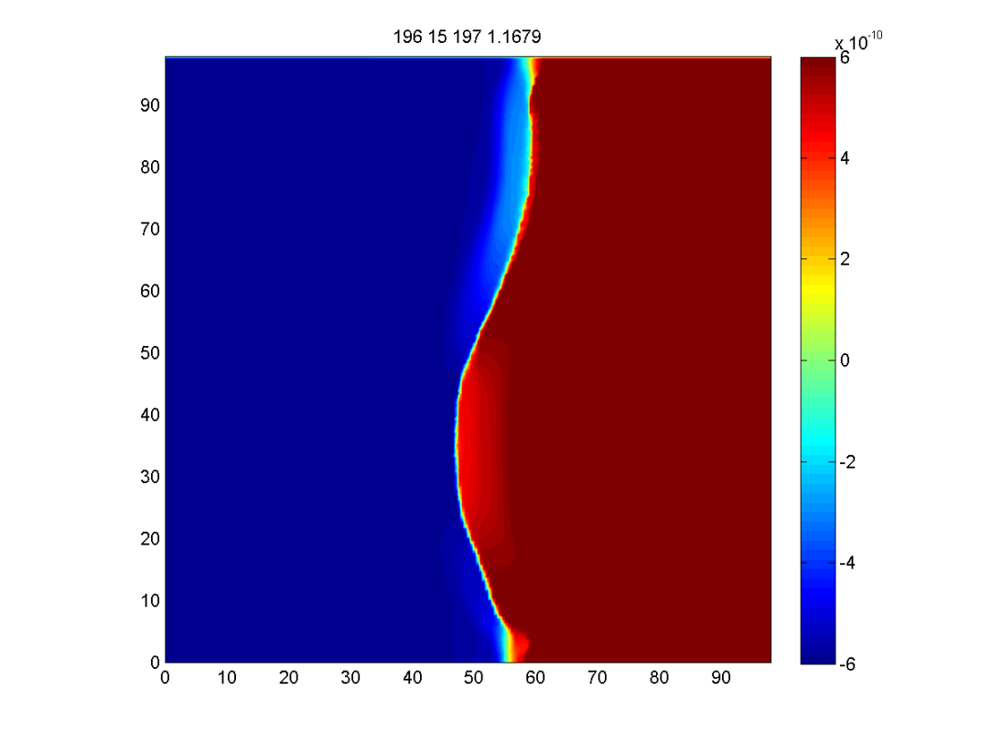

topography, km
viscosity, Pa s
A
B
v_{x}, m/s
A
B
viscosity, Pa s
C
D
C
D
Gerya (2010)

Slide 16
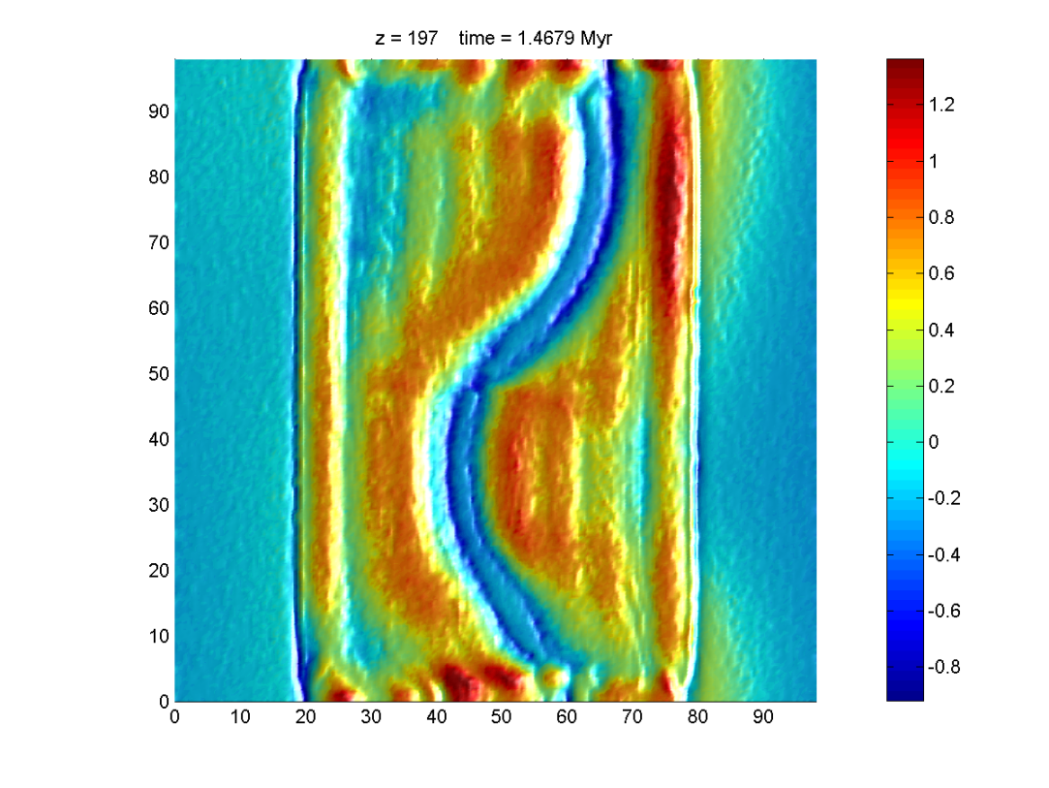
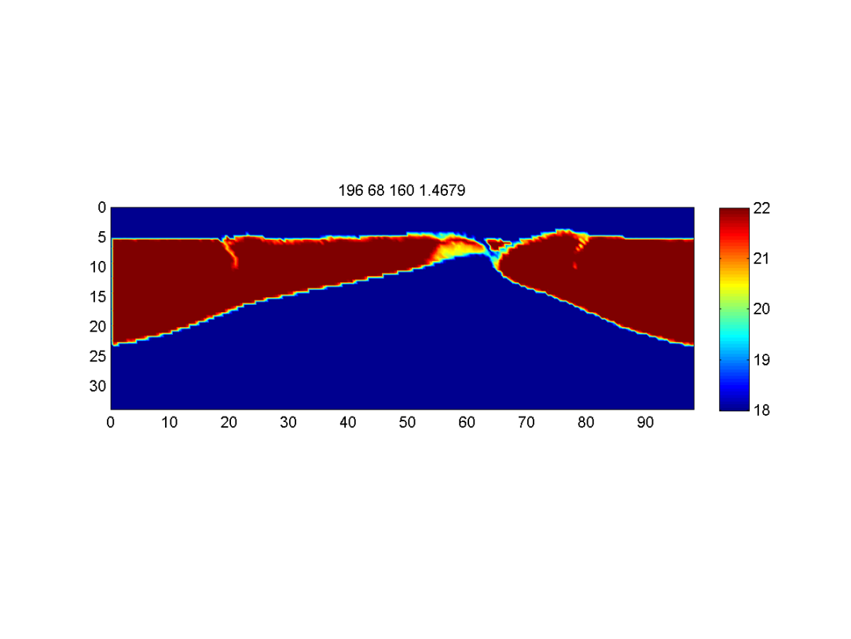
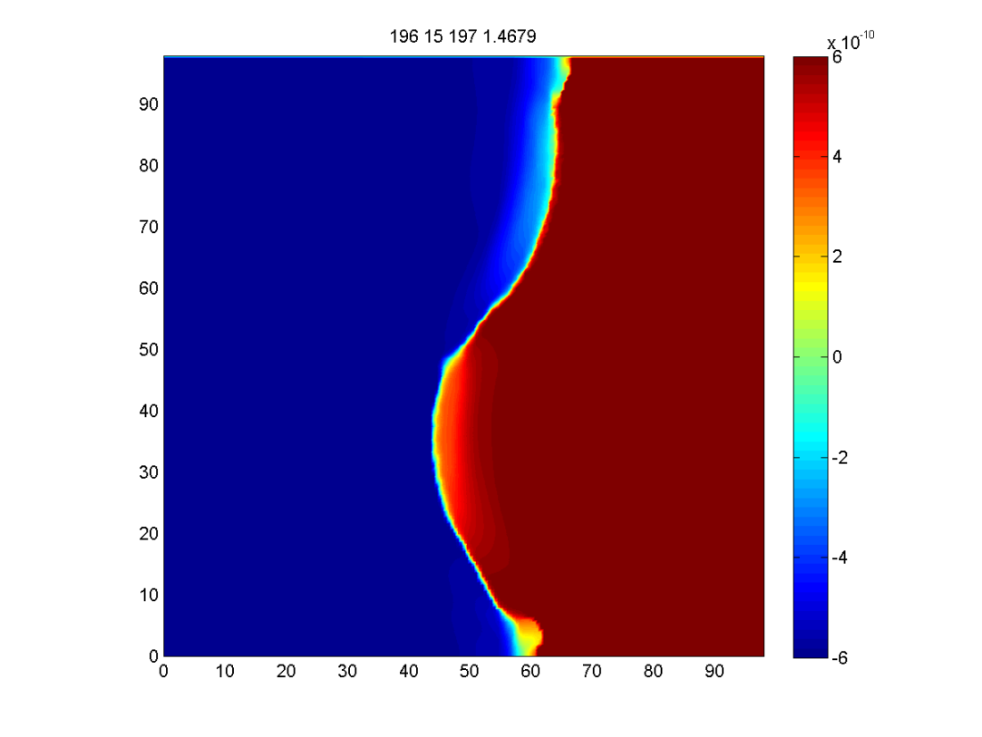

topography, km
viscosity, Pa s
A
B
v_{x}, m/s
A
B
viscosity, Pa s
C
D
C
D
Gerya (2010)

Slide 17
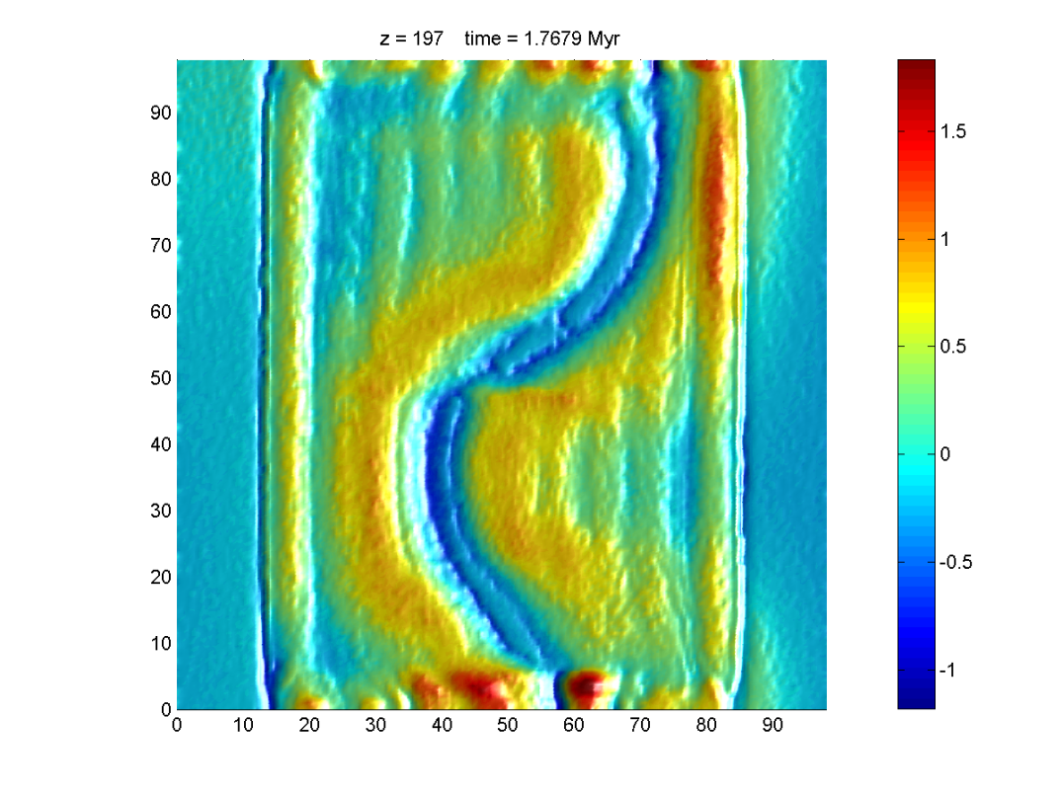
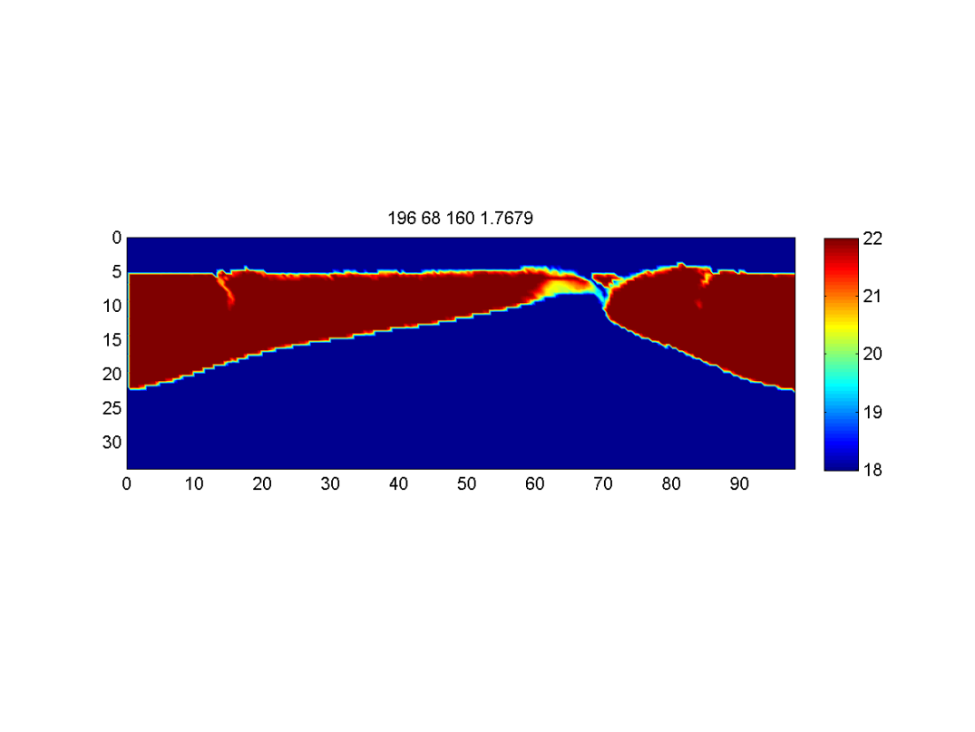
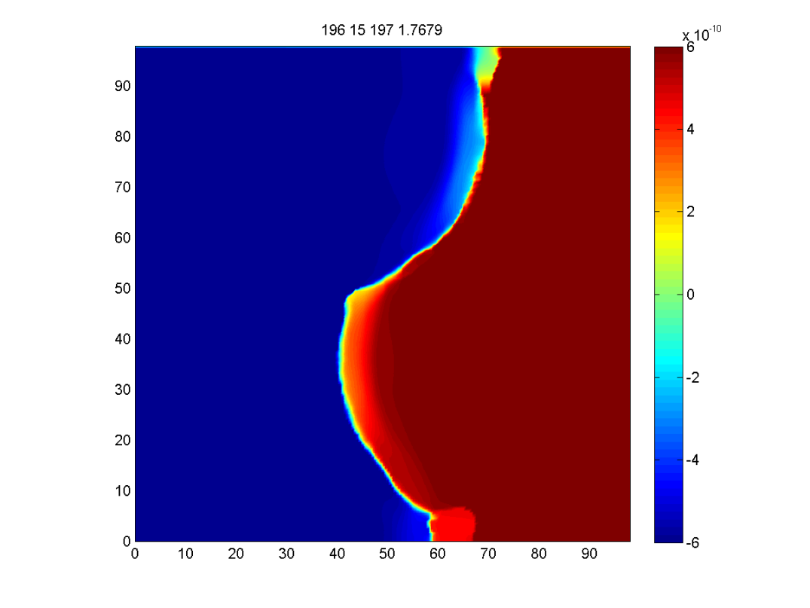
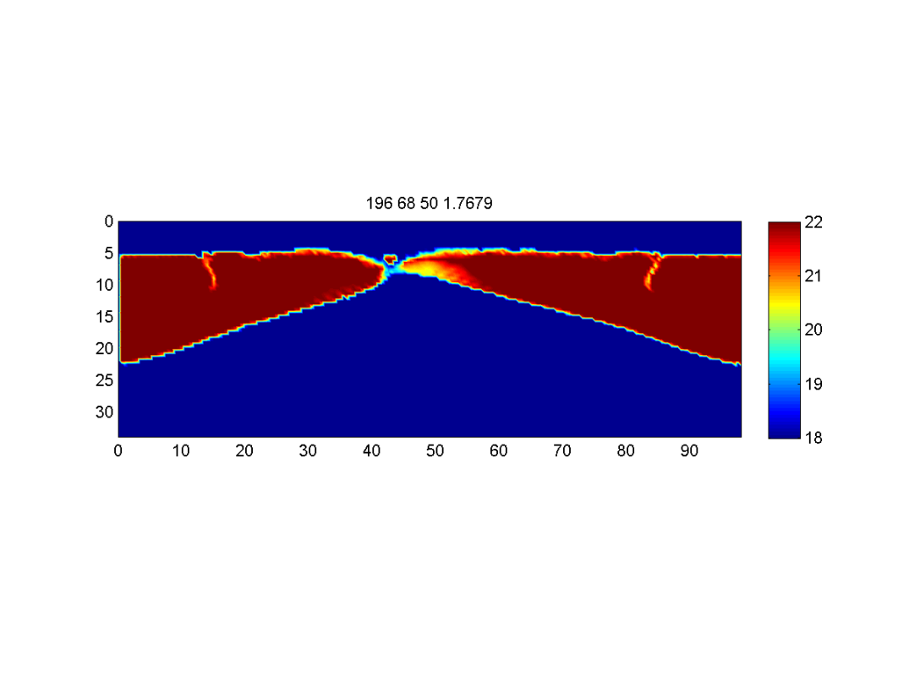
topography, km
viscosity, Pa s
A
B
v_{x}, m/s
A
B
viscosity, Pa s
C
D
C
D
Gerya (2010)

Slide 18
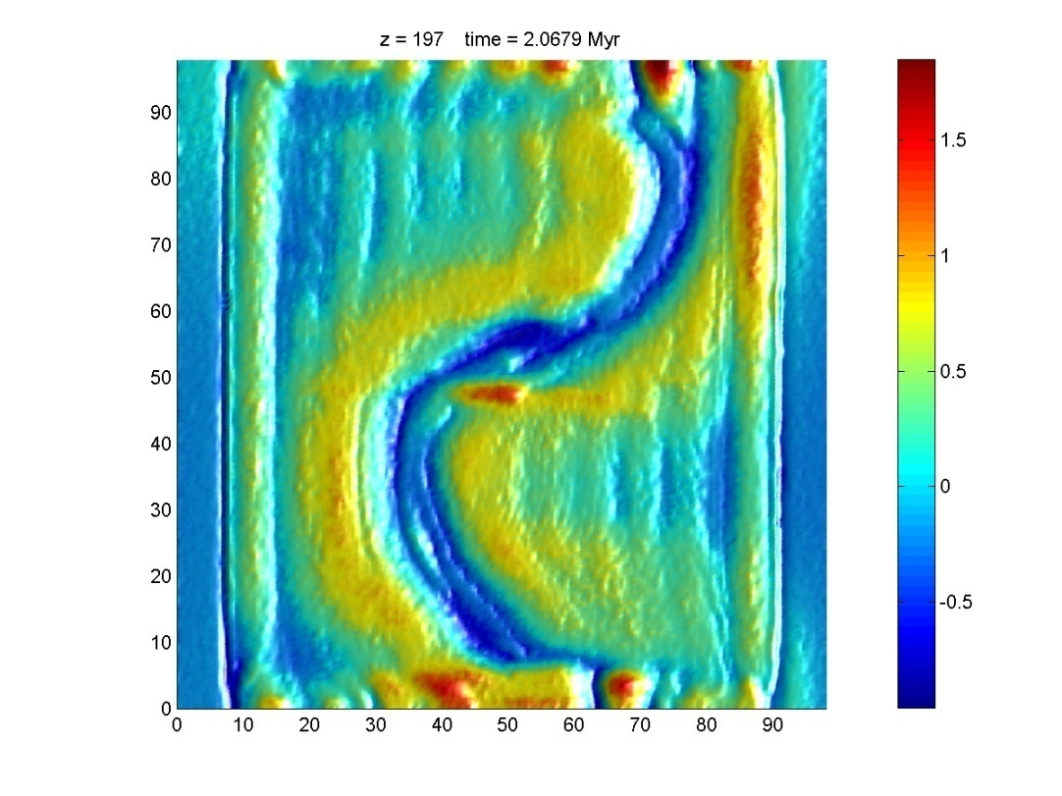
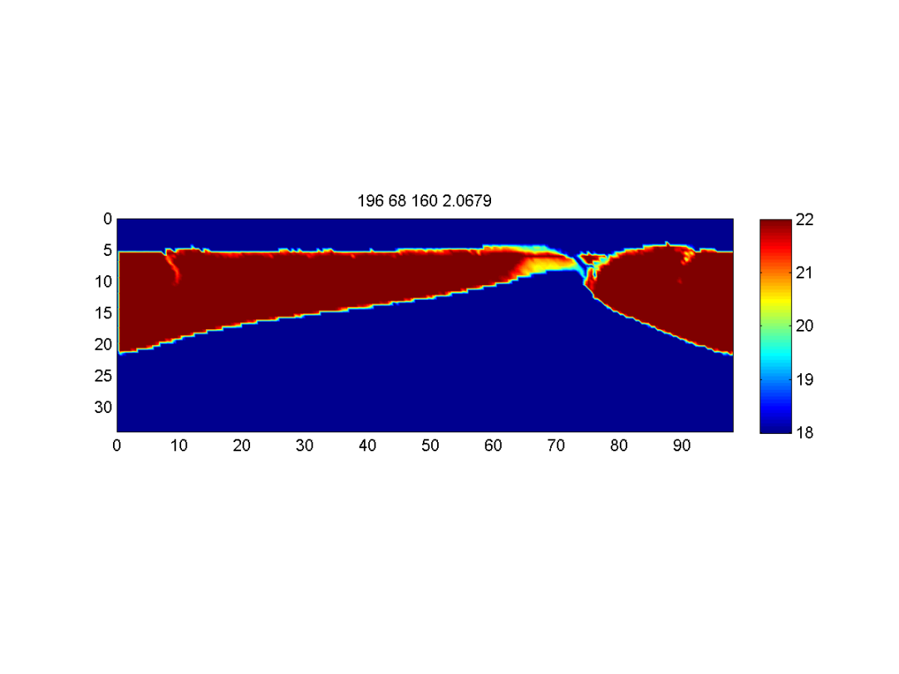
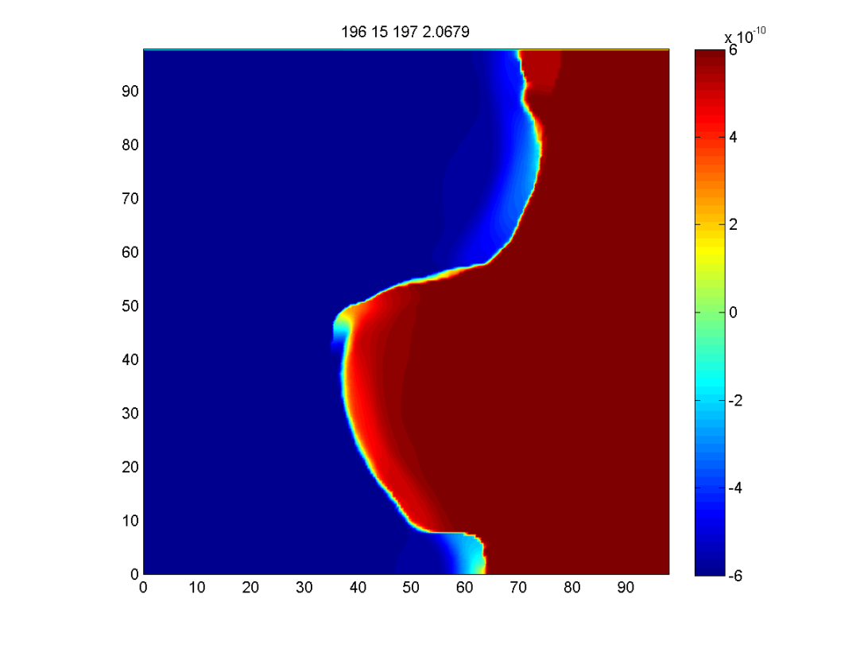
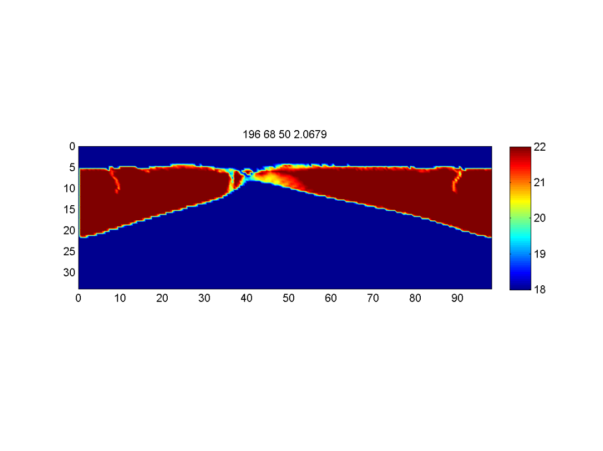
topography, km
viscosity, Pa s
A
B
v_{x}, m/s
A
B
viscosity, Pa s
C
D
C
D
Gerya (2010)

Slide 19
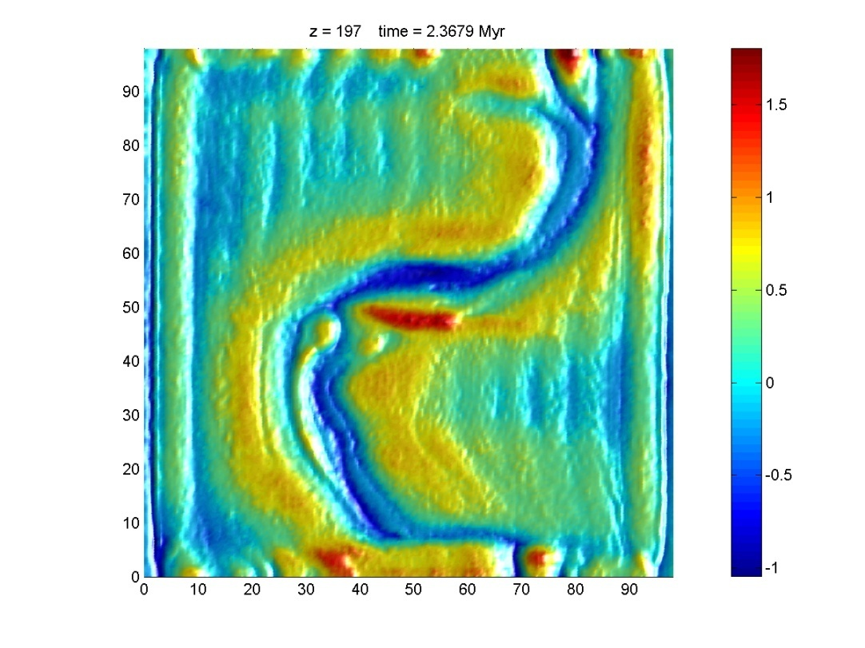
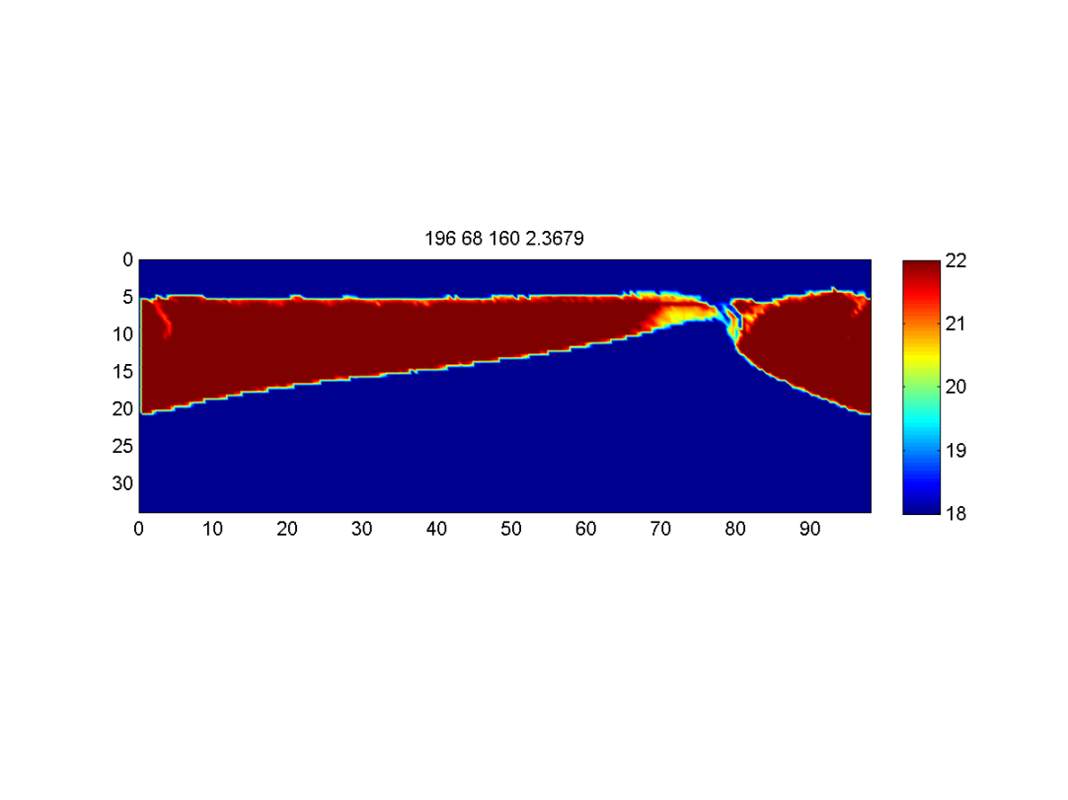
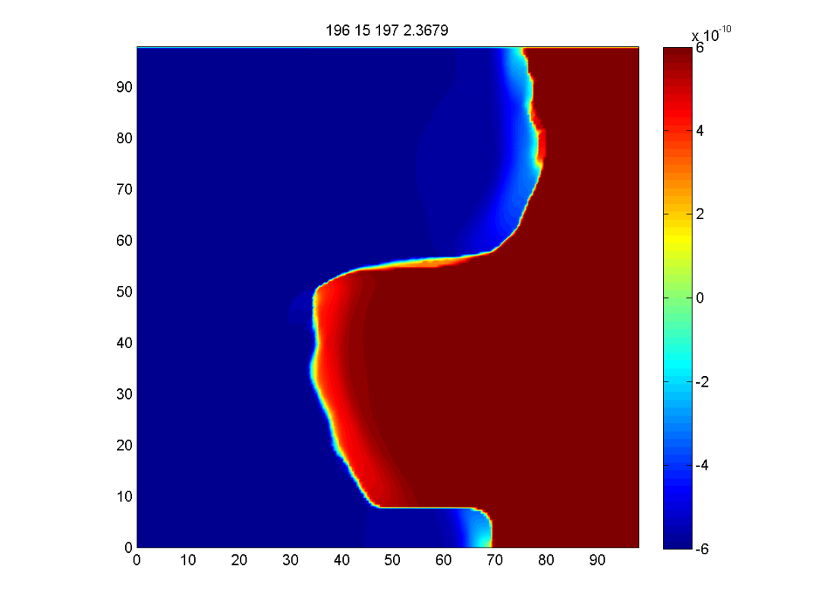
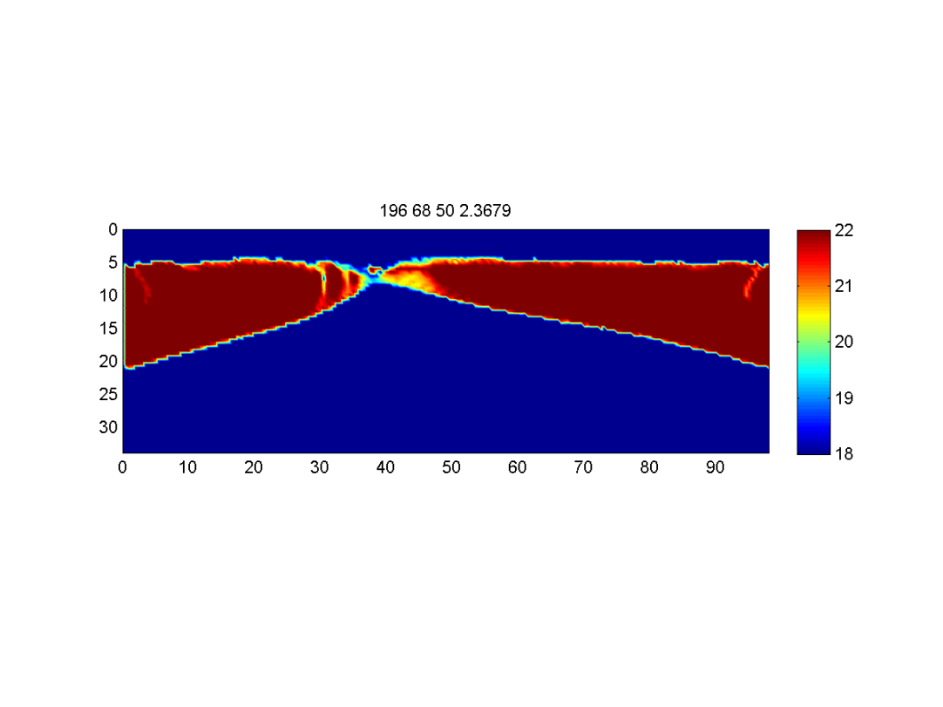
topography, km
viscosity, Pa s
A
B
v_{x}, m/s
A
B
viscosity, Pa s
C
D
C
D
Gerya (2010)

Slide 20
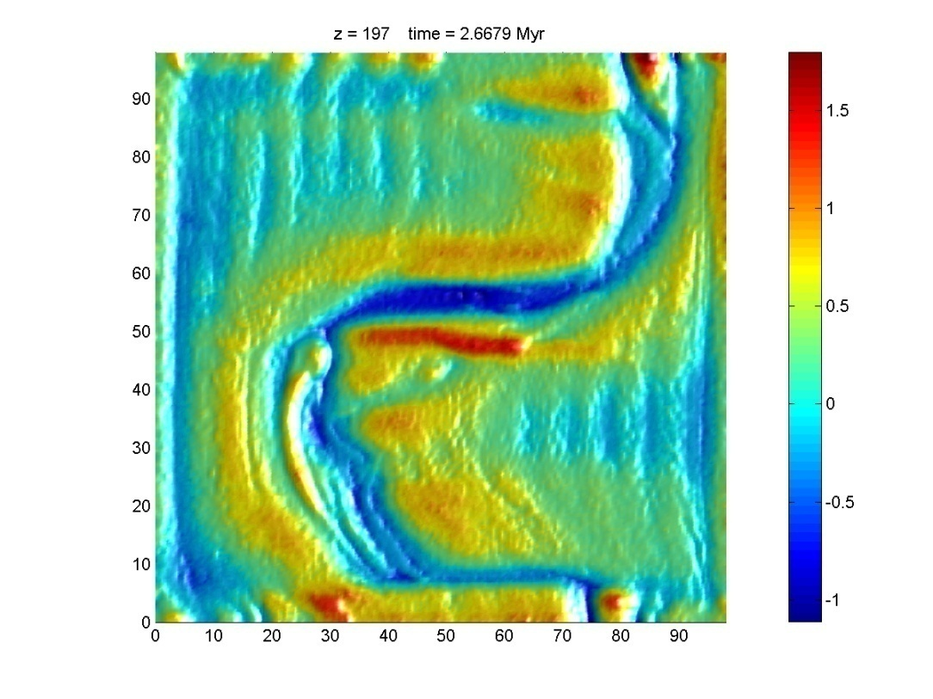
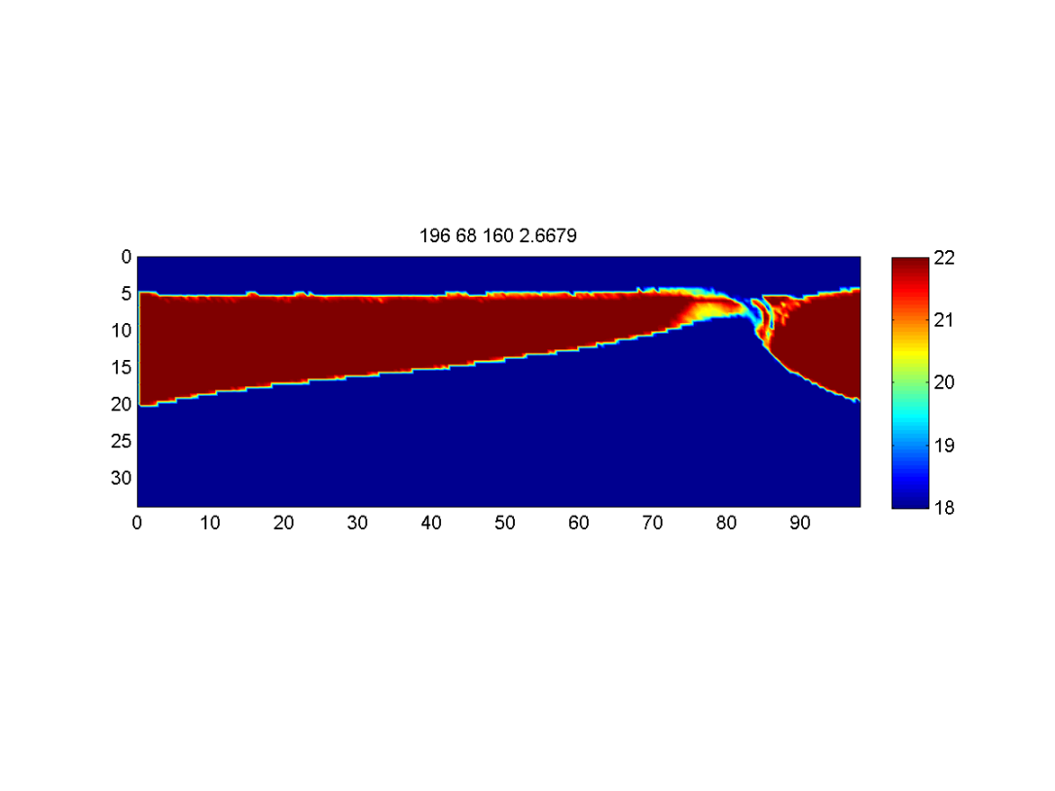
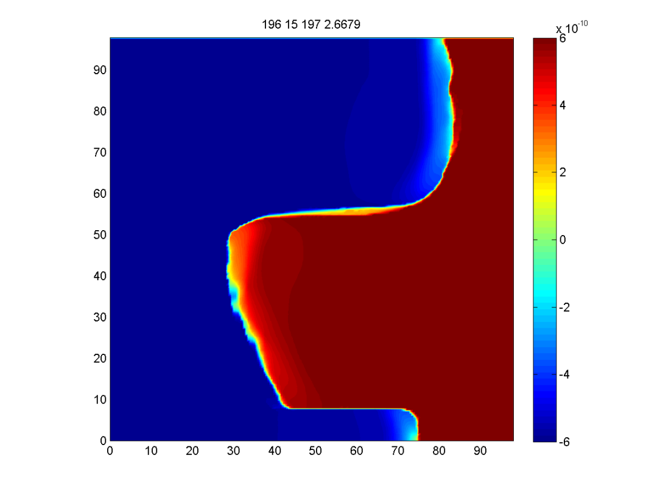
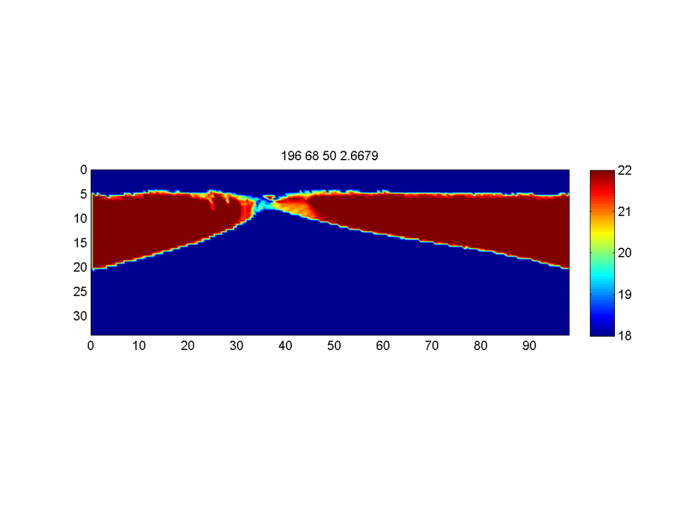
topography, km
viscosity, Pa s
A
B
v_{x}, m/s
A
B
viscosity, Pa s
C
D
C
D
Gerya (2010)

Slide 21
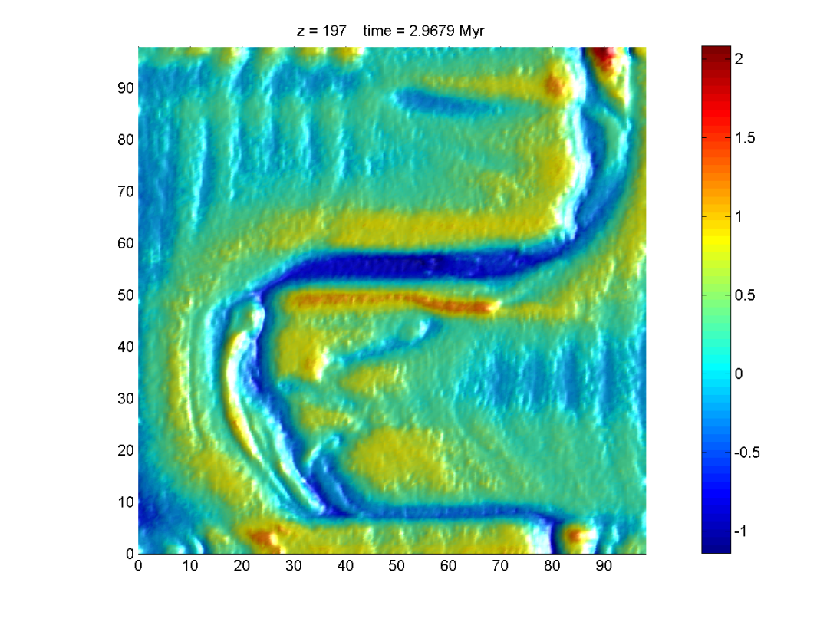
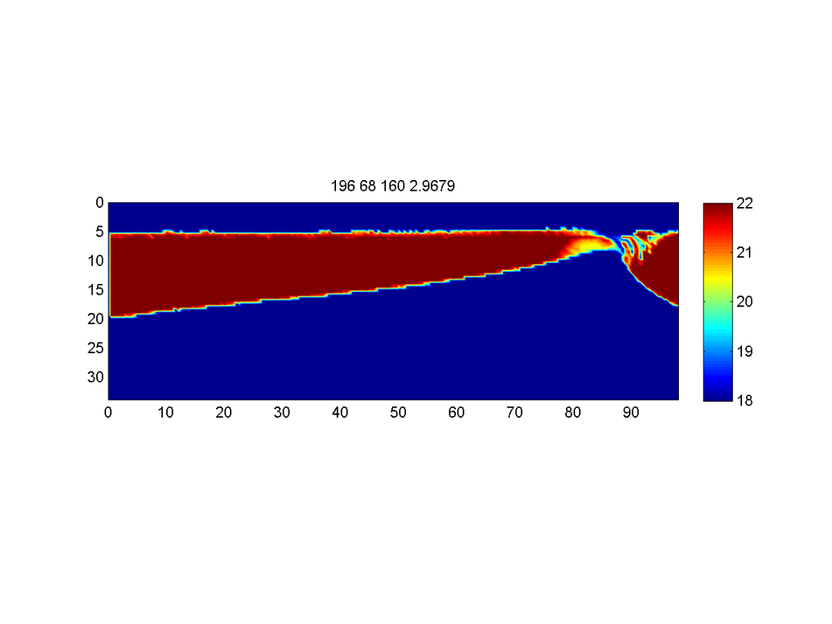
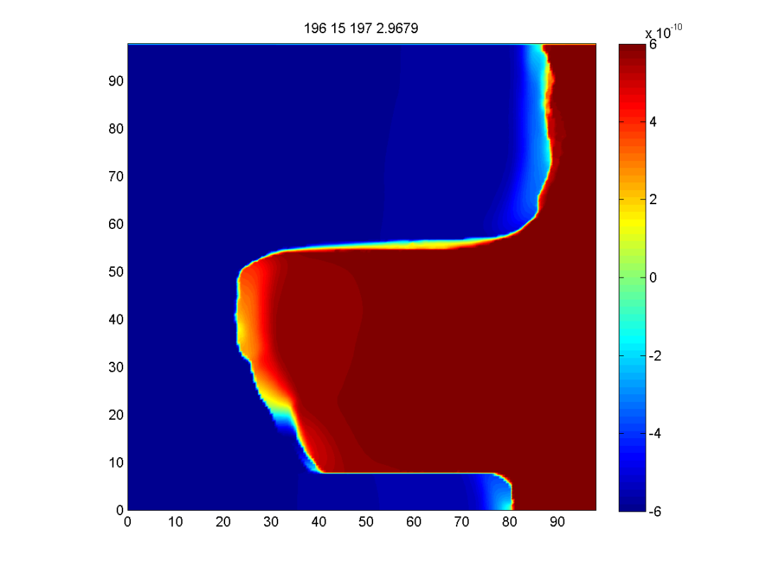
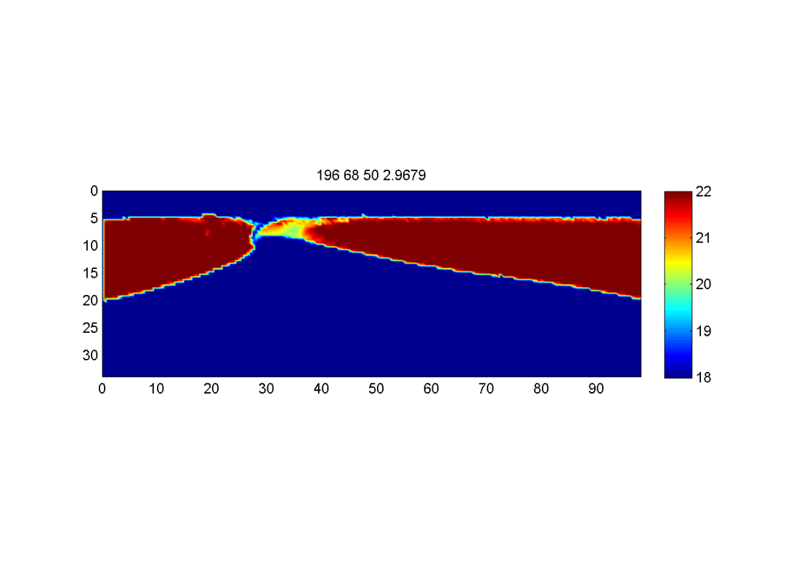
topography, km
viscosity, Pa s
A
B
v_{x}, m/s
A
B
viscosity, Pa s
C
D
C
D
Gerya (2010)

Slide 22
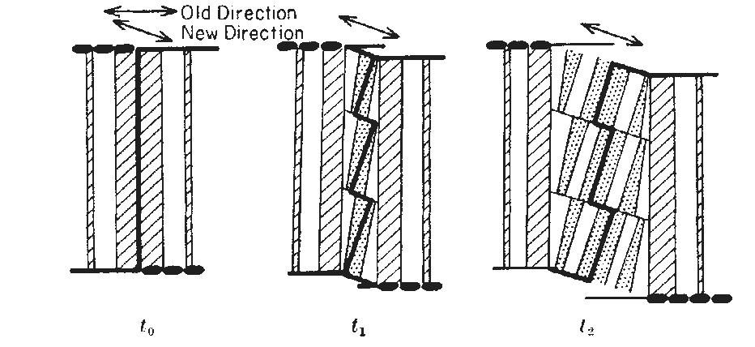
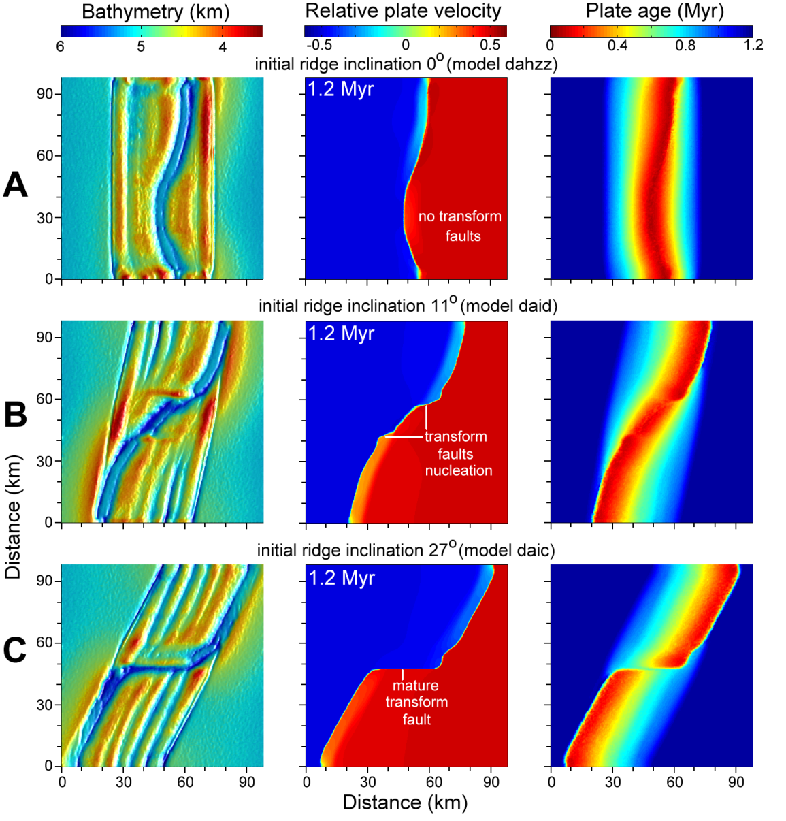
Changes in spreading direction
Menard (1968)
Gerya (2010)

Slide 23
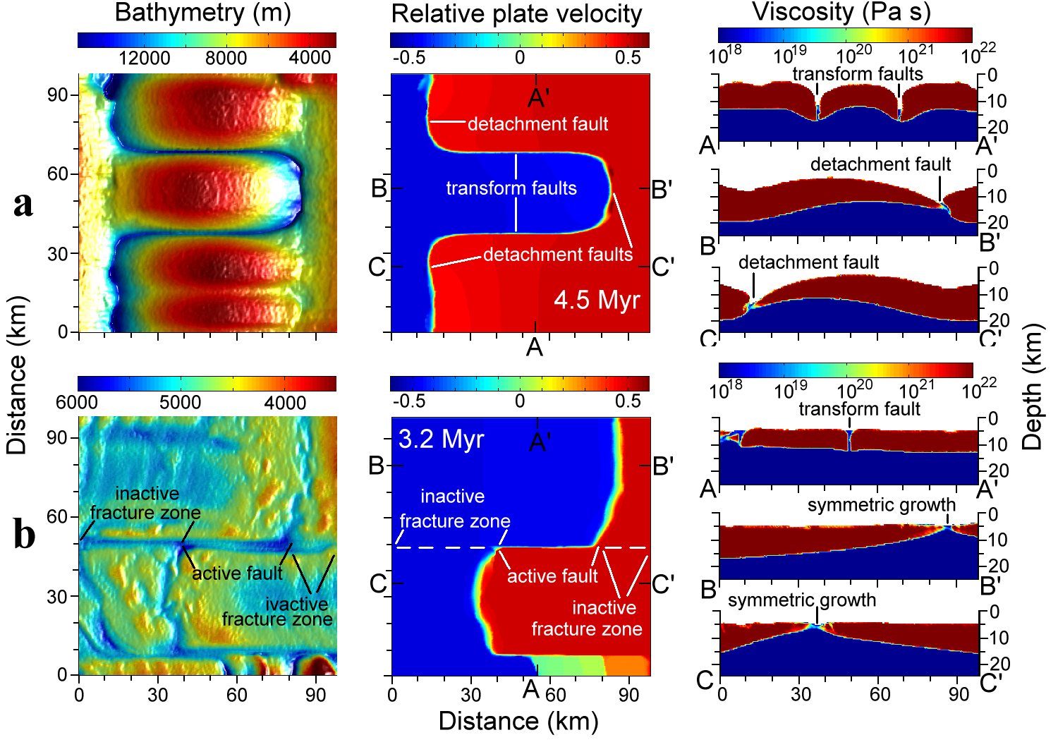
Model without gravity
Model with doubling of spreading rate
Gerya (2010)

Slide 24
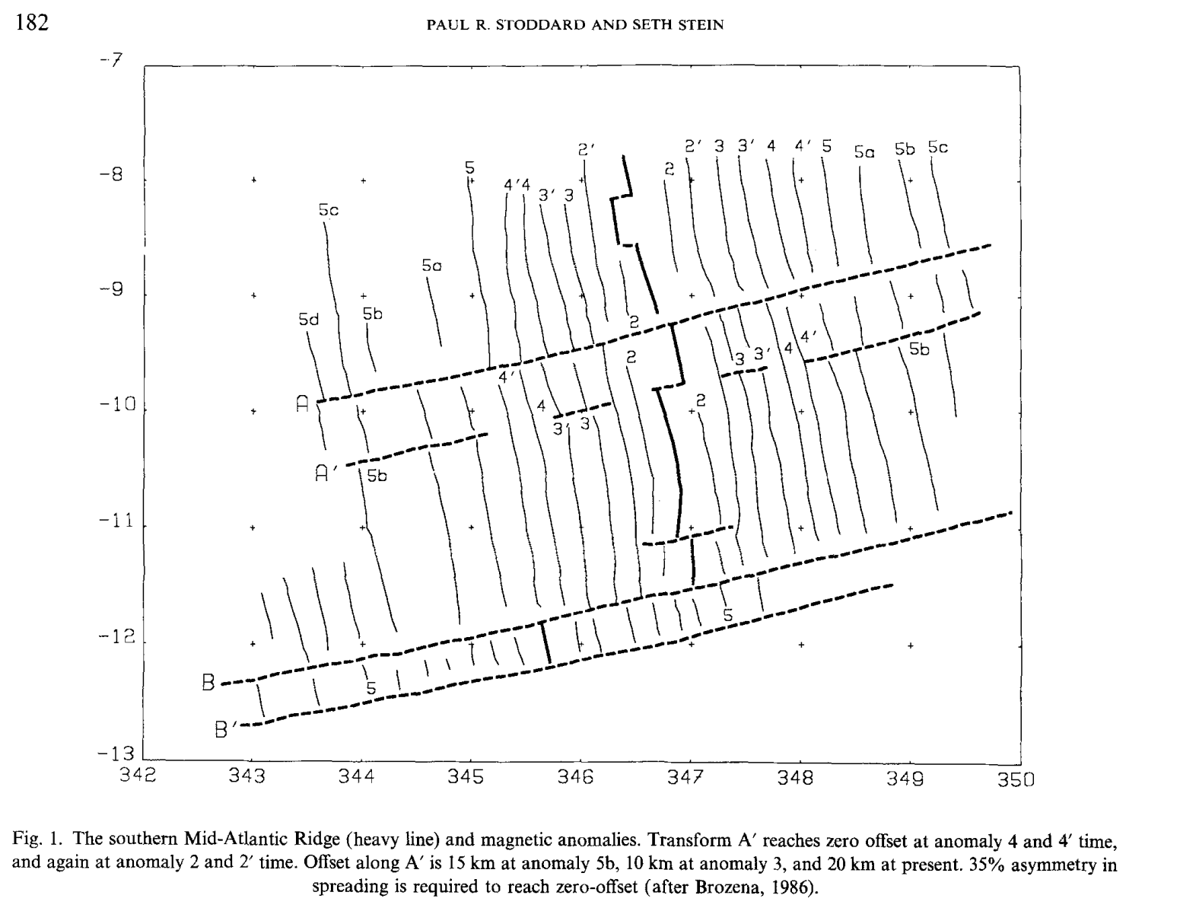
Accretion can be asymmetric => ridge offsets can change with time
Stoddard and Stein (1987)

Slide 25
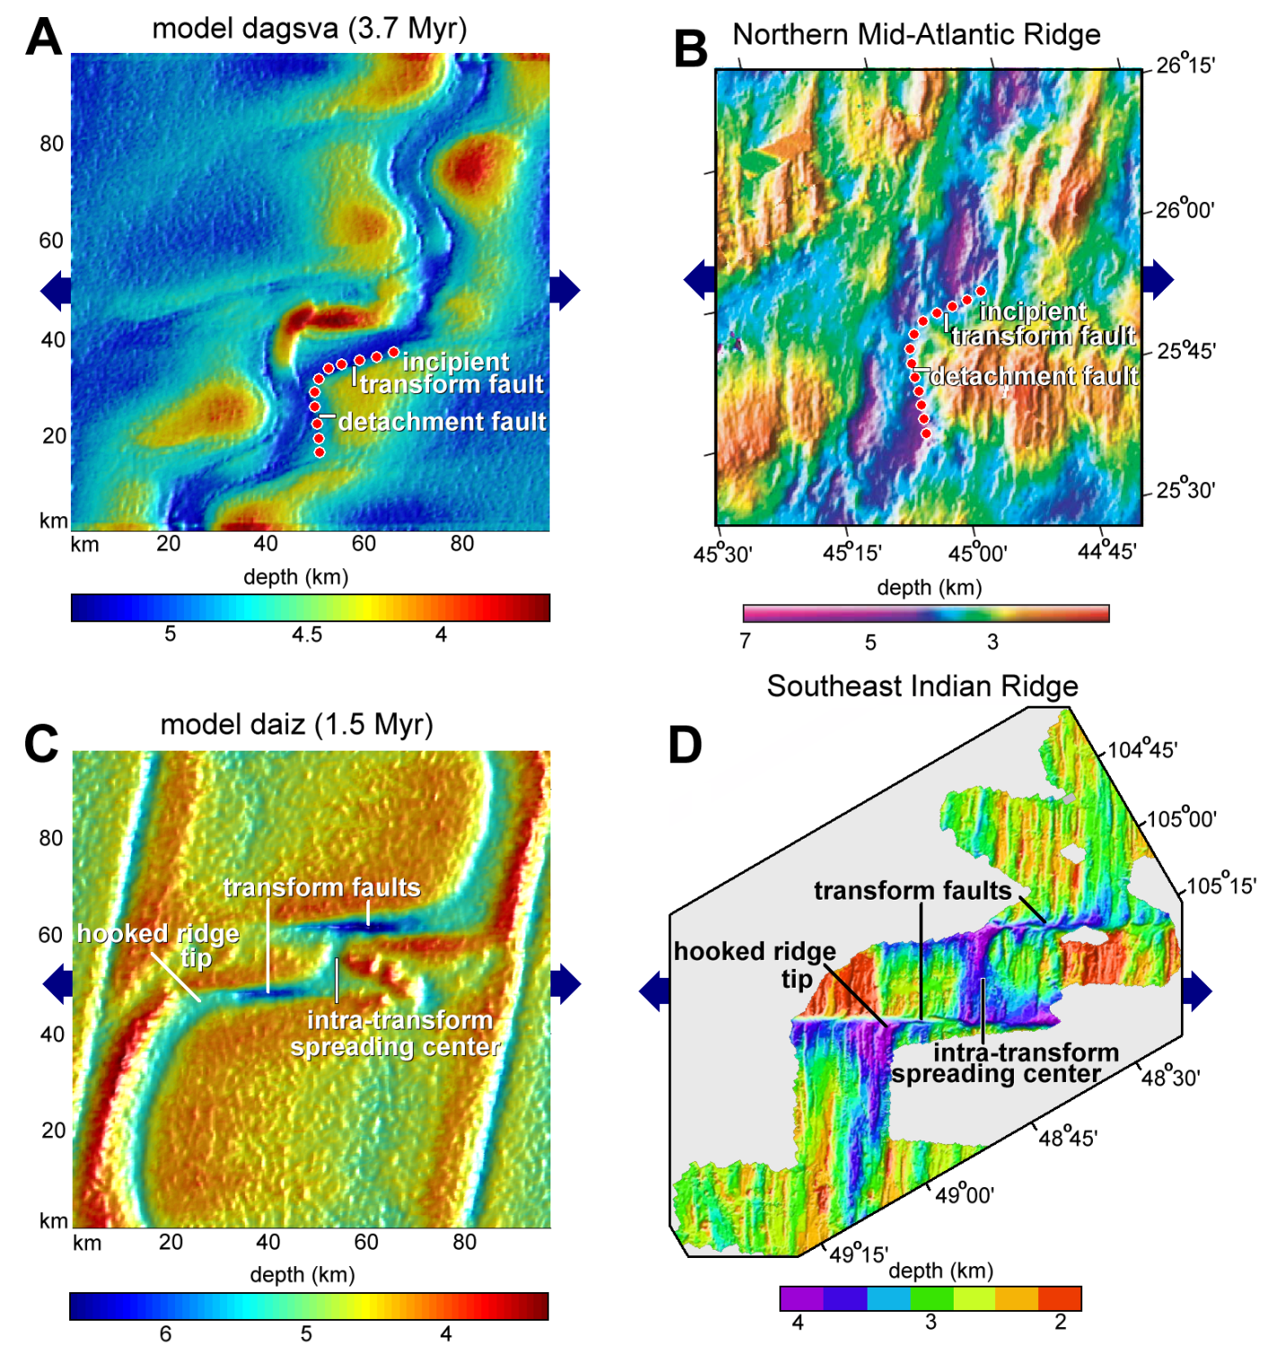
numerical vs natural ridges
Gerya (2010)

Slide 26
What about inherited transform faults ?
Two bents on the margin
Two transform faults

Slide 27


Slide 28

Concept for the numerical model

Slide 29

0.3 Myr

Slide 30

0.4 Myr

Slide 31

0.5 Myr

Slide 32

0.7 Myr

Slide 33

1.2 Myr

Slide 34

2.1 Myr

Slide 35

3.3 Myr

Slide 36

6.6 Myr

Slide 37

Gerya (2013)

Slide 38

How does orientation change ?
slow healing
rapid healing
rapid healing
slow healing
Gerya (2013)

Slide 39

Initiation of transform faults: Woodlark basin
Taylor et al. (2009)

Slide 40


Gerya (2013b)

Slide 41

Initiation of transform faults: Woodlark basin
nature
numerical model
Taylor et al. (2009)
proto-transform
Gerya (2013)

Slide 42

Initiation of oceanic spreading pattern: Woodlark bassin
modified after Taylor et al. (2009)

Slide 43

Influence of spreading rate
ultra-slow
slow
intermediate
fast
Püthe and Gerya (2013)

Slide 44

Conclusions:
fragmentation
growth
ca. 6 Myr
Ridge-transform patterns are plate-growth structures and not plate-fragmentation structures: the difference is as in between snowflakes and fragments of broken glass.

Slide 45

Nucleation and evolution of ridge-ridge-ridge triple junctions: thermomechanical model and geometrical theory
Taras Gerya & Evgenii Burov
Notes:
45

Slide 46







Slide 47

Stressed Plate+No Plume vs. Plume+Non-stressed Plate
Burov and Gerya (2014)

Slide 48

Stressed Plate + Plume
Burov and Gerya (2014)

Slide 49

Balloon = Stressed Plate
Pin = Plume

Slide 50


Modeling and understanding lithospheric processes
A Memorial Tectonophysics Volume to Evgenii Burov
will be out this year

Slide 51

Bi-directional extension

Slide 52
Bi-directional
extension
Thermal
perturbation

Slide 53
rift
rift
rift
rift
Quadruple junction

Slide 54
rift
oceanic
spreading
domain
rift
rift
rift
Spreading initiation

Slide 55
ridge
ridge
ridge
ridge
ridge
Quadruple junction splitting

Slide 56
ridge
ridge
ridge
ridge
ridge
Quadruple junction splitting

Slide 57
ridge
ridge
ridge
ridge
ridge
Triple junctions migration

Slide 58
ridge
ridge
ridge
ridge
ridge
Triple junctions migration

Slide 59
ridge
ridge
ridge
ridge
ridge
Triple junctions migration

Slide 60
ridge
ridge
ridge
ridge
ridge
Triple junctions migration

Slide 61
ridge
ridge
ridge
ridge
ridge
Triple junctions migration

Slide 62
ridge
ridge
ridge
Triple junctions migration

Slide 63





MODEL 1
MODEL 2
rifting junctions => spreading junctions
MODEL 3
MODEL 4
Gerya and Burov (submitted)

Slide 64


Transient quadruple junction
Gerya and Burov (submitted)

Slide 65


Triple junctions decrease cumulative length of dissipative plate boundaries – ridges !
quadruple junction
two triple junctions

Slide 66

Asymmetric quadruple junction in Afar?
rift
plume
rift
rift
rift
Wynn et al. (2006)

Slide 67

Origin of T-junctions

Slide 68
no extension
no extension
Simple
uni-directional
extension
Pre-existing ridge
no extension
no extension

Slide 69
no extension
Non-uniform
bi-directional
extension
Pre-existing ridge
no extension

Slide 70
no extension
distributed extension
ridge
no extension
Initial distributed extension

Slide 71
no extension
ridge
oceanic rift
ridge
no extension
T-junction initiation

Slide 72
no extension
ridge
oceanic rift
ridge
no extension
T-junction initiation

Slide 73
no extension
ridge
young ridge
ridge
no extension
T-junction development

Slide 74
no extension
fast ridge
slow ridge
fast ridge
no extension
T-junction development

Slide 75
no extension
fast ridge
slow ridge
fast ridge
no extension
T-junction development

Slide 76


T-junction => triple junction
Gerya and Burov (submitted)

Slide 77


Ideal 120º triple junction
Gerya and Burov (submitted)

Slide 78


Geometrical theory
intra-plate range
accretion
vector
v’₁= v₁-v_{t}
_ _ _
ridge
lengthening
vector
v'₁₂= (v’₁+v’₂)/2
_ _ _
Key relationship
Gerya and Burov (submitted)

Slide 79

intra-plate range
accretion
vector
ridge
lengthening
vector
Migration velocity of a triple junction
minimizes ridge lengthening rate R_{m}
weighted by square root
of the spreading rate
where n=3
SUM(ridge lengthening rate * spreading rate^{1/2} ) = min
SUM( * ^{1/2} ) = min
Gerya and Burov (submitted)

Slide 80

Ridge lengthening rate * (spreading rate)^{1/2}

Slide 81



How well does the new theory work?
3.67 Ma
9.67 Ma
Gerya and Burov (submitted)

Slide 82

How well does the new theory work?
Gerya and Burov (submitted)

Slide 83

How well does the new theory work?
Gerya and Burov (submitted)

Slide 84
Conclusions
1. Two genetically different types of quadruple and triple junctions exist:
(Rj) plate rifting junctions formed by the initial plate fragmentation and
(Sj) oceanic spreading junctions formed by the new oceanic crust accretion.
2. Geometry and migration of a triple junction minimizes ridge lengthening rate weighted by energy dissipation per unit ridge length.
Sj
Rj
Sj
intra-plate range
accretion
vector
ridge
lengthening
vector
SUM(ridge lengthening rate * spreading rate^{1/2} ) = min

